Slide 1
CS536
MORE Parsing

Slide 2
Announcements
HW 4 due
HW 5 assigned
I wrote a little piece of software that may help you to debug your ASTs
~cs536-1/public/tools/Dottify.java

Slide 3
Last Time
CYK
  Step 1: get a grammar in Chomsky Normal Form
  Step 2: Build all possible parse trees bottom-up
    Start with runs of 1 terminal
    Connect 1-terminal runs into 2-terminal runs
    Connect 1- and 2- terminal runs into 3-terminal runs
    Connect 1- and 3- or 2- and 2- terminal runs into 4 terminal runs
    …
    If we can connect the entire tree, rooted at the start symbol, we’ve found a valid parse

Slide 4
Some Interesting properties of CYK
Very old algorithm
  Already well known in early 70s
No problems with ambiguous grammars:
  Gives a solution for all possible parse tree simultaneously

Slide 5

Thinking about Language Design
Balanced considerations
  Powerful enough to be useful
  Simple enough to be parseable
Syntax need not be complex for complex behaviors
  Guy Steele’s “Growing a Language”
  https://www.youtube.com/watch?v=_ahvzDzKdB0

Slide 6
Restricting the Grammar
By restricting our grammars we can
  Detect ambiguity
  Build linear-time, O(n) parsers
LL(1) languages
  Particularly amenable to parsing
  Parseable by Predictive (top-down) parsers
    Sometimes called recursive descent

Slide 7
Top-Down Parsers
Start at the Start symbol
“predict” what productions to use
  Example: if the current token to be parsed is an id, no need to try productions that start with integer literal
  This might seem simple, but keep in mind multiple levels of productions that have to be used

Slide 8
Predictive Parser Sketch
Scanner
Parser
Col: terminal
Token Stream
Selector table
a
b
a
a
EOF
Row: nonterminal
current
“Work to do”
Stack

Slide 9
Algorithm
stack.push(eof)
stack.push(Start non-term)
t = scanner.getToken()
Repeat
if stack.top is a terminal y
match y with t
pop y from the stack
t = scanner.next_token()
if stack.top is a nonterminal X
get table[X,t]
pop X from the stack
push production’s RHS (each symbol from Right to Left)
Until one of the following:
stack is empty
stack.top is a terminal that doesn’t match t
stack.top is a non-term and parse table entry is empty
accept
reject

Slide 10
Example
S → ( S ) | { S } | ε
(
{
}
)
eof
(
)
{
}
eof
S
( S )
ε
{ S }
ε
ε
current
current
current
current
current
{
(
S
}
S
S
)
eof
“Work to do”
Stack

Slide 11
Example 2, bad input: You try
S → ( S ) | { S } | ε
(
)
{
}
eof
S
( S )
ε
{ S }
ε
ε
INPUT
(
(
}
eof

Slide 12

This Parser works great!
Given a single token we always knew exactly what production it started
(
)
{
}
eof
S
( S )
ε
{ S }
ε
ε

Slide 13
Two Outstanding Issues
How do we know if the language is LL(1)
  Easy to imagine a Grammar where a single token is not enough to select a rule
How do we build the selector table?
  It turns out that there is one answer to both:
S → ( S ) | { S } | ε | ( )
If our selector table has 1 production per cell, then grammar is LL(1)

Slide 14
Building Selector Tables
If either of the following conditions hold, the grammar is not LL(1) (note that these are not sufficient conditions):
  The grammar is left-recursive
  The grammar is not left-factored

Slide 15
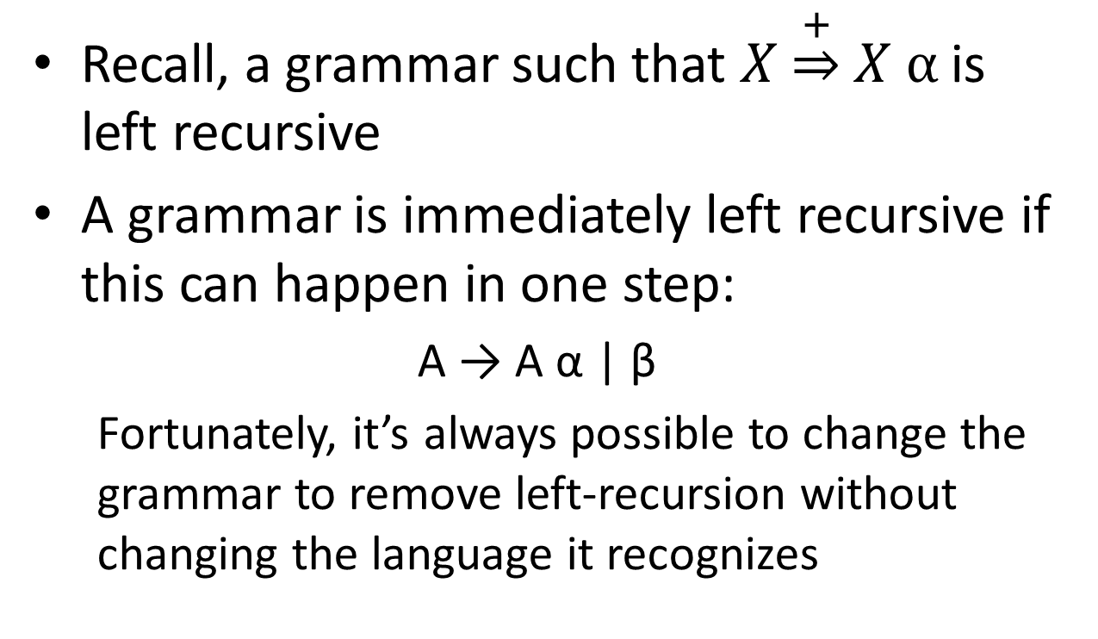
Left-Recursion
Recall, a grammar such that $X\underset{⇒}{+}X α$ is left recursive
A grammar is immediately left recursive if this can happen in one step:
  A → A α | β
  Fortunately, it’s always possible to change the grammar to remove left-recursion without changing the language it recognizes

Slide 16
Removing Left-Recursion
(for a single immediately left-recursive rule)
A → A α | β
A → β A’
A’→ α A’
| ε
Where β does
not begin with A

Slide 17
Example
A → β A’
A’→ α A’
| ε
A → A α | β
Exp → Factor Exp’
Exp’ → - Factor Exp’
| ε
Factor → intlit | ( Exp )
Exp → Exp – Factor
| Factor
Factor → intlit | ( Exp )

Slide 18
Let’s check in on the Parse Tree…
Exp → Exp – Factor
| Factor
Factor → intlit | ( Exp )
Exp → Factor Exp’
Exp’ → - Factor Exp’
| ε
Factor → intlit | ( Exp )
E
E
E
-
F
F
E
2
F
E
E
-
F
4
-
F
3
3
-
F
E
2
4
ε

Slide 19
… We’ll fix that later

Slide 20
General Rule for Removing Immediate Left-Recursion
A → α₁ | α₂ | … | α_{n} | A β₁ | A β₂ | … A β_{m}
A → α₁ A’ | α₂ A’ | … | α_{n} A’
A’ → β₁ A’ | β₂ A’ | … | β_{m} A’ | ε

Slide 21
Left Factored Grammars
If a nonterminal has two productions whose RHS has a common prefix it is not left factored and not LL(1)
Exp → ( Exp ) | ( )
Not left factored

Slide 22
Left Factoring
Given productions of the form
A → α β₁ | α β₂
  A → α A’
  A’ → β₁ | β₂

Slide 23
Combined Example
Exp → ( Exp ) | Exp Exp | ( )
Remove
Immediate left-recursion
Exp → ( Exp ) Exp' | ( ) Exp'
Exp' → Exp Exp' | ε
Left-factoring
Exp -> ( Exp''
Exp'' -> Exp ) Exp' | ) Exp'
Exp' -> exp exp' | ε

Slide 24
Where are we at?
We’ve set ourselves up for success in building the selection table
  Two things that prevent a grammar from being LL(1) were identified and avoided
    Not Left-Factored grammars
    Left-recursive grammars
  Next time
    Build two data structures that combine to yield a selector table:
      FIRST set
      FOLLOW set

Slide 25
Time Permitting: HW 4

