Slide 1
CS536
Building a Predictive Parser

Slide 2

Reminder: Use the Readings
Lots of nice pictures
Lots of examples for you to test yourself
Lectures track fairly close to the reading

Slide 3

Announcements: Reading Bug
Mea Culpa
  Bug in the website reading: now fixed
  Please report bugs directly to me

Slide 4
Clarification: Vocab Terms
token
  Output of the scanner. Has a type and one or more fields representing the text that was tokenized
symbol
  Either a terminal or a nonterminal
production rule (aka “production”)
  Way to grow a parse tree
SDT Rule (aka “rule”)
  Action associated with finishing a production rule

Slide 5

Last Time: Intro LL(1) Predictive Parser
“predict” the parse tree top-down
Parser structure
  1 token of lookahead
  A stack tracking parse tree frontier
  Selector/parse table
Necessary conditions
  Left-factored
  Free of left-recursion

Slide 6
Today: Building the Parse Table
Review Grammar transformations
  Why they are necessary
  How they work
Build the selector table
  FIRST(X): Set of terminals that can begin at a subtree rooted at X
  FOLLOW(X): Set of terminals that can appear after X

Slide 7
Review LL(1) Grammar Transformations
Necessary (but not sufficient conditions) for LL(1) Parsing:
  Left factored
    No rules with common prefix
    Why? We’d need to look past the prefix to pick rule
  Free of left recursion
    No nonterminal loops for a production
    Why? Need to look past list to know when to cap it

Slide 8
Why Left Recursion is a Problem
(Blackbox View)
CFG snippet:
XList ⟶ XList x | x
Current parse tree:
XList
Current token:
x
How should we grow the tree top-down?
XList
(OR)
XList
x
XList
x
Correct if there are no more xs
Correct if there are more xs
We don’t know which without more lookahead

Slide 9
Why Left Recursion is a Problem
(Whitebox View)
CFG snippet:
XList ⟶ XList x | x
Current parse tree:
XList
x
eof
Current token:
x
Parse table:
XList
XList x
ε
XList
x
XList
XList
x
x
(Stack overflow)
XList
x
eof
Stack
Current

Slide 10
Left Recursion Elimination: Review
Replace
A ⟶ A α | β
Head of the list
With
A ⟶ β A’
A’ ⟶ α A’ | ε
  Where β does not start with A and may not be present
  Preserve order (a list of α starting with β) but use right recursion

Slide 11
Left Recursion Elimination: Ex1
A ⟶ β A’
A’ ⟶ α A’ | ε
A ⟶ A α | β
β
E ⟶ id E’
E’ ⟶ cross id E’ | ε
E ⟶ E cross id | id
α
β
α

Slide 12
Left Recursion Elimination: Ex2
A ⟶ β A’
A’ ⟶ α A’ | ε
A ⟶ A α | β
E ⟶ TE’
E’ ⟶ + TE’ | ε
E ⟶ E + T | T
T ⟶ T * F | F
F ⟶ ( E ) | id
T ⟶ FT’
T’ ⟶ *FT’ | ε
F ⟶ ( E ) | id

Slide 13
Left Recursion Elimination: Ex3
A ⟶ β A’
A’ ⟶ α A’ | ε
A ⟶ A α | β
SList ⟶ SList D | ε
D ⟶ Type id semi
Type ⟶ bool | int
SList ⟶ ε SList’
SList’ ⟶ D Slist’ | ε
D ⟶ Type id semi
Type ⟶ bool | int
SList ⟶ D Slist | ε
D ⟶ Type id semi
Type ⟶ bool | int

Slide 14
Left Factoring: Review
  Removing common prefix from grammar
Replace
A ⟶ α β₁ | … | α β_{m} | y₁ | … | y_{n}
With
A ⟶ α A’ | y₁ | … | y_{n}
A’ ⟶ β₁ | … | β_{m}
  Where β_{i} and y_{i} are sequence of symbols with no common prefix
  y_{i} May not be present, one of the β may be ε
  Squash all “problem” rules starting with α together into one rule α A’
  Now A’ represents the suffix of the “problem” rules

Slide 15
Left Factoring: Example 1
A ⟶ α A’ | y₁ | … | y_{n}
A’ ⟶ β₁ | … | β_{m}
A ⟶ α β₁ | … | α β_{m} | y₁ | … | y_{n}
α
β₁
α
β₂
α
β₃
γ₁
X ⟶ < a > | < b > | < c > | d
α
γ₁
X ⟶ < X’ | d
X’ ⟶ a > | b > | c >
β ₁
β ₂
β ₃

Slide 16
Left Factoring: Example 2
A ⟶ α A’ | y₁ | … | y_{n}
A’ ⟶ β₁ | … | β_{m}
A ⟶ α β₁ | … | α β_{m} | y₁ | … | y_{n}
β₁
β₂
Stmt⟶ id assign E | id ( EList ) | return
E ⟶ intlit | id
Elist ⟶ E | E comma EList
Stmt ⟶ id Stmt’ | return
Stmt’ ⟶ assign E | ( EList )
E ⟶ intlit | id
Elist ⟶ E | E comma EList

Slide 17
Left Factoring: Example 3
A ⟶ α A’ | y₁ | … | y_{n}
A’ ⟶ β₁ | … | β_{m}
A ⟶ α β₁ | … | α β_{m} | y₁ | … | y_{n}
α
Β₁ = ε
α
β₂
S ⟶ if E then S | if E then S else S | semi
E ⟶ boollit
S ⟶ if E then S S’ | semi
S’ ⟶ else S | ε
E ⟶ boollit

Slide 18
Left Factoring: Not Always Immediate
A ⟶ α A’ | y₁ | … | y_{n}
A’ ⟶ β₁ | … | β_{m}
A ⟶ α β₁ | … | α β_{m} | y₁ | … | y_{n}
This snippet yearns for left-factoring
S ⟶ A | C | return
A ⟶ id assign E
C ⟶ id ( EList )
but we cannot! At least without inlining
S ⟶ id assign E | id ( Elist ) | return

Slide 19

Let’s be more constructive
So far, we’ve only talked about what precludes us from building a predictive parser
It’s time to actually build the parse table

Slide 20
Building the Parse Table
What do we actually need to ensure arbitrary production A ⟶ α is the correct one to apply?
(assume α is an arbitrary symbol string)
What terminals could possibly start α (we call this the FIRST set)
What terminal could possibly come after A (we call this the FOLLOW set)

Slide 21
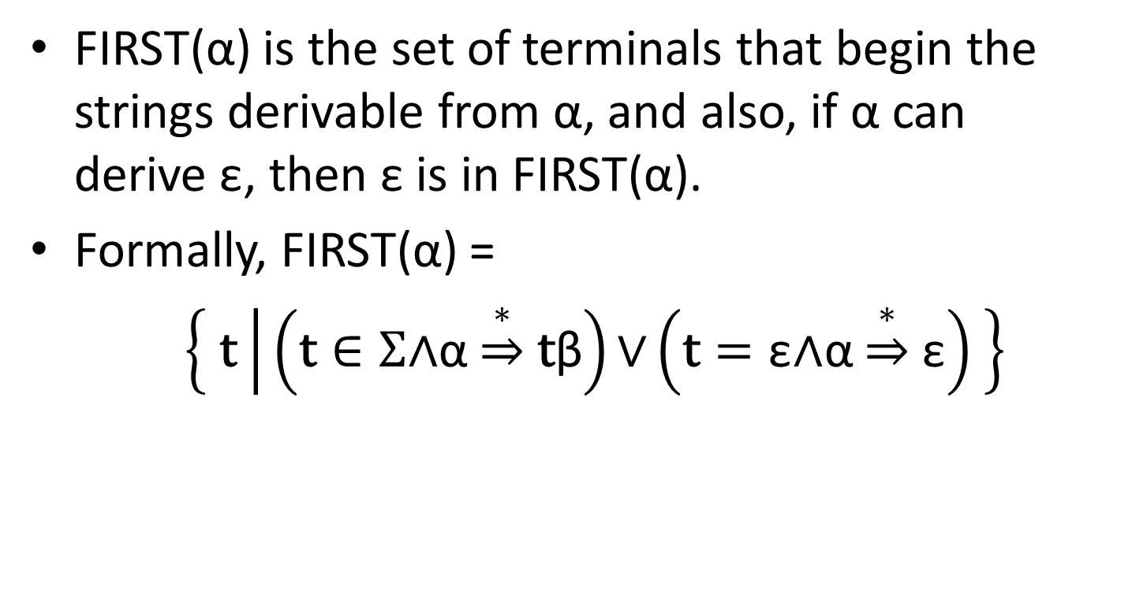
FIRST Sets
FIRST(α) is the set of terminals that begin the strings derivable from α, and also, if α can derive ε, then ε is in FIRST(α).
Formally, FIRST(α) =
$\left\{ \text{t} | \left(\text{t}∈Σ\text{∧}\text{α}\underset{⇒}{∗}\text{t}\text{β}\right)\text{∨}\left(\text{t}=\text{ε}\text{∧}\text{α}\underset{⇒}{∗}\text{ε}\right) \right\}$

Slide 22
Why is FIRST Important?
Assume the top-of-stack symbol is A and current token is a
  Production 1: A ⟶ α
  Production 2: A ⟶ β
FIRST lets us disambiguate:
  If a is in FIRST(α), it tells us that Production 1 is a viable choice
  If a is in FIRST(β), it tells us that Production 2 is a viable choice
  If a is in only FIRST(α) xor FIRST(β) , we can predict the rule we need.

Slide 23
FIRST Construction: Single Symbol
We begin by doing FIRST sets for a single, arbitrary symbol X
  If X is a terminal: FIRST(X) = { X }
  If X is ε: FIRST(ε) = { ε }
  If X is a nonterminal, for each X ⟶ Y₁ Y₂ … Y_{k}
    Put FIRST(Y₁) - {ε} into FIRST(X)
    If ε is in FIRST(Y₁) , put FIRST(Y₂) - {ε} into FIRST(X)
    If ε is also in FIRST(Y₂), put FIRST(Y₃) - {ε} into FIRST(X)
    …
    If ε is in FIRST of all Y_{i} symbols, put ε into FIRST(X)

Slide 24
FIRST(X) Example
Building FIRST(X) for nonterm X
for each X ⟶ Y₁ Y₂ … Y_{k}
  Add FIRST(Y₁) - {ε}
  If ε is in FIRST(Y_{1 to i-1}): add FIRST(Y_{i}) - {ε}
  If ε is in all RHS symbols, add ε
FIRST(Factor)
= { intlit, lparens }
Exp | ⟶ | Term Exp'
Exp' | ⟶ | minus Term Exp' | ε
Term | ⟶ | Factor Term'
Term' | ⟶ | divide Factor Term' | ε
Factor | ⟶ | intlit | lparens Exp rparens
FIRST(Term’)
= { divide, ε }
FIRST(Term)
= { intlit, lparens }
FIRST(Exp’)
= { minus, ε}
FIRST(Exp)
= { intlit, lparens}

Slide 25
FIRST(α)
We now extend FIRST to strings of symbols α
  We want to define FIRST for all RHS
Looks very similar to the procedure for single symbols
Let α =Y₁ Y₂ … Y_{k}
  Put FIRST(Y₁) - {ε} in FIRST(α)
  If ε is in FIRST(Y₁): add FIRST(Y₂) – {ε} to FIRST(α)
  If ε is in FIRST(Y₂): add FIRST(Y₃) – {ε} to FIRST(α)
  …
  If ε is in FIRST of all Y_{i} symbols, put ε into FIRST(α)

Slide 26
Building FIRST(α) from FIRST(X)
Building FIRST(X) for nonterm X
for each X ⟶ Y₁ Y₂ … Y_{k}
  Add FIRST(Y₁) - {ε}
  If ε is in FIRST(Y_{1 to i-1}): add FIRST(Y_{i}) - {ε}
  If ε is in all RHS symbols, add ε
Building FIRST(α)
Let α = Y₁ Y₂ … Y_{k}
  Add FIRST(Y₁) - {ε}
  If ε is in FIRST(Y_{1 to i-1}): add FIRST(Y_{i}) – {ε}
  If ε is in all RHS symbols, add ε

Slide 27
FIRST(α) Example
Building FIRST(α)
Let α = Y₁ Y₂ … Y_{k}
  Add FIRST(Y₁) - {ε}
  If ε is in FIRST(Y_{1 to i-1}): add FIRST(Y_{i}) – {ε}
  If ε is in all RHS symbols, add ε
E → TX
X → +TX | ε
T → FY
Y → *FY | ε
F → (E) | id
FIRST(E) = {(, id}
FIRST(T) = {(, id}
FIRST(F) = {(, id}
FIRST(X) = {+, ε}
FIRST(Y) = {*, ε}
FIRST(TX) = {(, id}
FIRST(+TX) = { + }
FIRST(FY) = { (, id }
FIRST (*FY) = { * }
FIRST( ( E ) ) = { ( }
FIRST( id ) = { id }

Slide 28

FIRST Sets aren’t enough for Parse Tables
If a rule can derive ε, we need to know what comes next
  Obviously, some productions won’t work

Slide 29
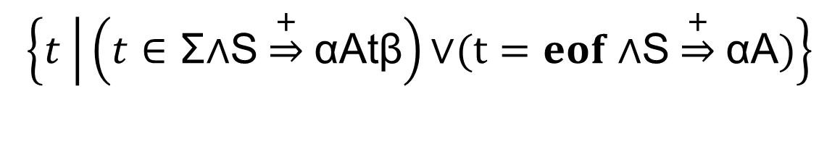
FOLLOW Sets
For nonterminal A, FOLLOW(A) is the set of terminals that can appear immediately to the right of A
Formally, FOLLOW(A) =
$$\left\{t | \left(t∈\text{Σ}\text{∧}\text{S}\underset{⇒}{+}\text{αA}\text{t}\text{β}\right)\text{∨}(t=eof \text{∧}\text{S}\underset{⇒}{+}\text{αA})\right\}$$

Slide 30
FOLLOW Sets: Pictorially
For nonterminal A, FOLLOW(A) is the set of terminals that can appear immediately to the right of A
X
S
A
B
X
Y
???
+
-
A
B
-
???
ε

Slide 31
FOLLOW Sets: Construction
To build FOLLOW(A)
  If A is the start nonterminal, add eof
  For rules X ⟶ α A β
    Add FIRST(β) – {ε}
    If ε is in FIRST(β) or β is empty, add FOLLOW(X)
Continue building FOLLOW sets until saturation
S
X
Y
Where α, β may be empty
A
B
-
???
ε
X
A
B
???
+
-

Slide 32
FOLLOW Sets Example
FOLLOW(A) for X ⟶ α A β
If A is the start, add eof
Add FIRST(β) – {ε}
Add FOLLOW(X) if ε in FIRST(β) or β is empty
S | ⟶ | B c | D B
B | ⟶ | a b | c S
D | ⟶ | d | ε
FIRST (S)
=
{ a, c, d }
FOLLOW (S)
=
{ eof }
FIRST (B)
=
{ a, c }
FOLLOW (B)
=
{ c, eof }
FIRST (D)
=
{ d, ε }
FOLLOW (D)
=
{ a, c }
FIRST (B c)
=
{ a, c }
FOLLOW (S)
=
{ eof, c }
FIRST (D B)
=
{ d, a, c }
FOLLOW (B)
=
{ c, eof }
FIRST (a b)
=
{ a }
FOLLOW (D)
=
{ a, c }
FIRST (c S)
=
{ c }
FOLLOW (S)
=
{ eof, c }
FOLLOW (B)
=
{ c, eof }
FOLLOW (D)
=
{ a, c }

Slide 33
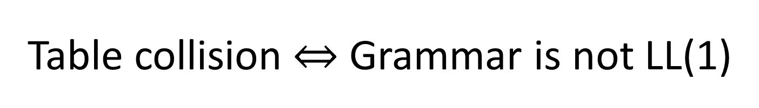
Building the Parse Table
for each production X ⟶ α {
for each terminal t in FIRST(α){
put α in Table[X][t]
}
if ε is in FIRST(α){
for each terminal t in FOLLOW(X){
put α in Table[X][t]
}
}
}
Table collision Grammar is not LL(1)

Slide 34

Putting it all together
Build FIRST sets for each nonterminal
Build FIRST sets for each production’s RHS
Build FOLLOW sets for each nonterminal
Use FIRST and FOLLOW to fill parse table for each production

Slide 35

Tips n’ Tricks
FIRST sets
  Only contain alphabet terminals and ε
  Defined for arbitrary RHS and nonterminals
  Constructed by starting at the beginning of a production
FOLLOW sets
  Only contain alphabet terminals and eof
  Defined for nonterminals only
  Constructed by jumping into production

Slide 36

Time for some Examples

Slide 37
FIRST(α) for α = Y₁ Y₂ … Y_{k}
Add FIRST(Y₁) - {ε}
If ε is in FIRST(Y_{1 to i-1}): add FIRST(Y_{i}) – {ε}
If ε is in all RHS symbols, add ε
FOLLOW(A) for X ⟶ α A β
If A is the start, add eof
Add FIRST(β) – {ε}
Add FOLLOW(X) if ε in FIRST(β) or β empty
Table[X][t]
CFG
for each production X ⟶ α
for each terminal t in FIRST(α)
put α in Table[X][t]
if ε is in FIRST(α){
for each terminal t in FOLLOW(X){
put α in Table[X][t]
S | ⟶ | B c | D B
B | ⟶ | a b | c S
D | ⟶ | d | ε
Not LL(1)
a
b
c
d
eof
FIRST (S)
=
{ a, c, d }
FOLLOW (S)
=
{ eof }
S
B c
B c
D B
FIRST (B)
=
{ a, c }
FOLLOW (B)
=
{ c, eof }
D B
D B
FIRST (D)
=
{ d, ε }
FOLLOW (D)
=
{ a, c }
FIRST (B c)
=
{ a, c }
B
a b
c S
FOLLOW (S)
=
{ eof, c }
FIRST (D B)
=
{ d, a, c }
FOLLOW (B)
=
{ c, eof }
ε
D
ε
FIRST (a b)
=
{ a }
FOLLOW (D)
=
{ a, c }
FIRST (c S)
=
{ c }

