Slide 1
CS 536
Code Generation for Control Flow Constructs

Slide 2
Announcements

Slide 3
P5: Current Status
The project should be working fine for everybody
There hasn’t been any show-stopper bug reported
and yet…

Slide 4
P5: A Litany of Annoyances
Wackiness: doesn’t effect the project, but weird
Alex Kersten: If your name analysis fails, typechecking still happens
Brady Fulcer: unparse called twice
Multi-OS / Eclipse: problems with home computer setup
Mohammad Alain: 536_deps expects ant.jar to be installed
(anon): Lexer does not accept files written on Windows
Specification
Sydney Johnson: equality undefined for strings
Oracle
Matt Rennebohm: The oracle counts cin >> a + b as a syntax error

Slide 5
P5 Mitigation Strategy
It’s sort of sad that your late days hit you right in the holiday
Uber Late day
Late day 1: 11/30
Late day 2: 12/1
Late day 3: 12/2
I strongly, strongly urge you to finish before the break

Slide 6

Honored to be Honored
Nominated as an outstanding instructor
Thanks so much!
No idea who did this
Anonymous Fist Bump
PLACE FIST HERE

Slide 7

MIPS Screencasts are Totally Up
Not my finest work
Send corrections
There’s already one misstatement that I’ve noticed
JR as “Jump-Return”
Should be Jump Register

Slide 8
Roadmap
Last time:
Got the basics of MIPS
CodeGen for most AST node types
This time:
Do the rest of the AST nodes
Introduce control flow graphs
Scanner
Scanner
Tokens
Parser
Parser
Parse Tree
AST
Semantic Anlaysis
Annotated AST
Symbol Table
MC Codegen

Slide 9

Outline
Source code
while ( a < 2){ a--;
}
Finish up data manipulation
Control Flow graphs
A good way to picture code
Representing control constructs
Assembly code
A jump or
something?

Slide 10
A Quick Warm-Up: MIPS for id = 1 + 2;
li $t0 1
sw $t0 0($sp)
subu $sp $sp 4
li $t0 2
sw $t0 0($sp)
subu $sp $sp 4
lw $t1 4($sp)
addu $sp $sp 4
lw $t0 4($sp)
addu $sp $sp 4
add $t0 $t0 $t1
sw $t0 0($sp)
subu $sp $sp 4
la $t0 -8($fp)
sw $t0 0($sp)
subu $sp $sp 4
lw $t1 4($sp)
addu $sp $sp 4
lw $t0 4($sp)
addu $sp $sp 4
sw $t0 0($t1)
push 1
General-Purpose Algorithm
Compute RHS expr on stack
Compute LHS location on stack
Pop LHS into $t1
Pop RHS into $t0
Store value $t0 at address $t1
push 2
pop opR
pop opL
Do 1+2
sp
push RHS
id2
(space for id)
push LHS
ctrl link (caller $fp)
ret address (caller $ra)
fp
param 1
pop LHS
param 2
pop RHS
caller’s AR
Do assign

Slide 11
Same Example if id was Global
li $t0 1
sw $t0 0($sp)
subu $sp $sp 4
li $t0 2
sw $t0 0($sp)
subu $sp $sp 4
lw $t1 4($sp)
addu $sp $sp 4
lw $t0 4($sp)
addu $sp $sp 4
add $t0 $t0 $t1
sw $t0 0($sp)
subu $sp $sp 4
la $t0 -8($fp)
sw $t0 0($sp)
subu $sp $sp 4
lw $t1 4($sp)
addu $sp $sp 4
lw $t0 4($sp)
addu $sp $sp 4
sw $t0 0($t1)
push 1
General-Purpose Algorithm
Compute RHS expr on stack
Compute LHS location on stack
Pop LHS into $t1
Pop RHS into $t0
Store value $t1 at address $t0
push 2
pop opR
pop opL
Do 1+2
push RHS
sp
id
push LHS
ctrl link (caller $fp)
ret address (caller $ra)
fp
param 1
pop LHS
param 2
pop RHS
caller’s AR
Do assign

Slide 12
Do We Need LHS computation ?
Admittedly, this is a bit much when the LHS is a variable
We end up doing a single load to find the address, then a store, then a load
We know a lot of the computation at compile time

Slide 13
Static v Dynamic Computation
Static
Perform the computation at compile-time
Dynamic
Perform the computation at runtime
As applied to memory addresses…
Global variable location
Local variable
Field offset

Slide 14
More Complex LHS addresses
Chain of dereferences
java: a.b.c.d
Array cell address
arr[1]
arr[c]
arr[1][c]
arr[c][1]

Slide 15
Dereference Computation
struct LinkedList{
int num;
struct LinkedList& next;
}
list.next.next.num = list.next.num
0x1002F000
num: 3
next: 0x0
list.next.next
0x10040000
num: 2
next: 0x1002F000
multi-step code to load this address
multi-step code to load this value
list.next
list
Get base addr of list
Get offset to next field
Load value in next field
Get offset to next field
Load value in next field
Get offset to num field
Load that address
(+ 4) next
next: 0x10040000

Slide 16
Dot Access
Fortunately, we know the offset from the base of a struct to a certain field statically
The compiler can do the math for the slot address
struct Demo inst;
struct Demo inst2;
inst.b.c = inst2.b.c + 1;
compute at
compile time
compute at
compile time

Slide 17
Dot Access Example
sp
void v(){
inst is based at -8($fp )
inst.val
struct Inner{ bool hi;
int there;
int c;
};
field b.c is -8 off of the base
inst.inner.c
inst.inner.there
struct Demo{ struct Inner b;
int val;
};
inst.inner.hi
ctrl link (caller $fp)
struct Demo inst;
inst.b.c = inst.b.c;
ret address (caller $ra)
fp
}
($fp-8)-8
caller’s AR
LHS
subu $t0 $fp 16
sw $t0 0($sp)
subu $sp $sp 4
RHS
lw $t0 -16($fp)
sw $t0 0($sp)
subu $sp $sp 4

Slide 18
Control Flow Constructs
Function Calls
Loops
Ifs

Slide 19
Function Call
Two tasks:
Put argument values on the stack (pass-by-value semantics)
Jump to the callee preamble label
Bonus 3rd task: save live registers
(We don’t have any in a stack machine)
Semi-bonus 4th task: retrieve result value

Slide 20
Function Call Example
int f(int arg1, int arg2){ return 2;
}
int main(){
int a; a = f(a,4);
}
li $t0 4 # push arg 2
sw $t0 0($sp) #
subu $sp $sp 4 #
lw $t0 -8($fp) # push arg 1
sw $t0 0($sp) #
subu $sp $sp 4 #
jal f # goto f
addu $sp $sp 8 # tear down params
sw $v0 -8($fp) # retrieve result

Slide 21

We Need a New Tool
Control Flow Graph
Important representation for program optimization
Helpful way to visualize source code

Slide 22
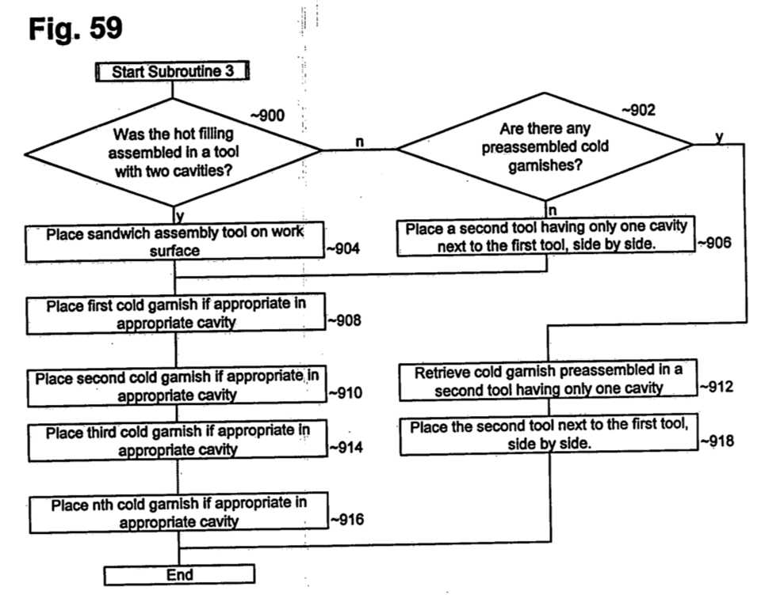
Control Flow Graphs: the Other CFG
Think of a CFG like a flowchart
Each block is a set of instructions
Execute the block, decide on next block

Slide 23
Basic Blocks
Nodes in the CFG
Largest run of instructions that will always be executed in sequence
Line1: li $t0 4
Line2: li $t1 3
Line3: add $t0 $t0 $t1
Line4: sw $t0 val
Line5: j Line2
Line1: li $t0 4
Line2: li $t1 3
Line3: add $t0 $t0 $t1
Line4: sw $t0 val
Line6: sw $t0 0($sp)
Line7: subu $sp $sp 4
Line5: j Line2
Line6: sw $t0 0($sp)
Line7: subu $sp $sp 4

Slide 24
Conditional Blocks
Branch instructions cause a node to have multiple out-edges
Entry: li $t0 3
lw $t1 0($sp)
beq $t0 $t1 Exit
fallthrough
True: sw $t2 val
nop
jump
Entry: li $t0 3
lw $t1 0($sp)
beq $t0 $t1 Exit
True: sw $t2 val
nop
Exit: li $v0 10
syscall
fallthrough
Exit: li $v0 10
syscall

Slide 25
Generating If-then Stmts
First, get label for the exit
Generate the head of the if
Make jumps to the (not-yet placed!) exit label
Generate the true branch
Write the body of the true node
Place the exit label

Slide 26
If-then Stmts
…
if (val == 1){ val = 2;
}
…
lw $t0 val # evaluate condition LHS
sw $t0 0($sp) # push onto stack
subu $sp $sp 4 #
li $t0 1 # evaluate condition RHS
sw $t0 0($sp) # push onto stack
subu $sp $sp 4 #
lw $t1 4($sp) # pop RHS into $t1
addu $sp $sp 4 #
lw $t0 4($sp) # pop LHS into $t0
addu $sp $sp 4 #
bne $t0 $t1 L_0 # skip if condition false
li $t0 2 # Loop true branch
sw $t0 val
nop # end true branch
L_0: # branch successor
…

Slide 27
Conditional Blocks
Entry: li $t0 3
lw $t1 0($sp)
beq $t0 $t1 Exit
True: sw $t2 val
j Exit
False: sw $t2 val2
nop
Exit: li $v0 10
syscall
Entry: li $t0 3
lw $t1 0($sp)
beq $t0 $t1 False
fallthrough
jump
True: sw $t2 val
j Exit
False: sw $t2 val
nop
jump
fallthrough
Exit: li $v0 10
syscall

Slide 28
Generating If-then-Else Stmts
First, get name for the false and exit labels
Generate the head of the if
Make jumps to the (not-yet placed!) true and false labels
Generate the true branch
Write the body of the true node
Jump to the (not-yet placed!) exit label
Generate the false branch
Place the false label
Write the body of the false node
Place the exit label

Slide 29
If-then-Else Stmts
…
if (val == 1){ val = 2;
} else { val = 3;
}
…
lw $t0 val # evaluate condition LHS
sw $t0 0($sp) # push onto stack
subu $sp $sp 4 #
li $t0 1 # evaluate condition RHS
sw $t0 0($sp) # push onto stack
subu $sp $sp 4 #
lw $t1 4($sp) # pop RHS into $t1
addu $sp $sp 4 #
lw $t0 4($sp) # pop LHS into $t0
addu $sp $sp 4 #
bne $t0 $t1 L_1 # branch if condition false
li $t0 2 # Loop true branch
sw $t0 val
j L_0 # end true branch
L_1: # false branch
…
L_0: # branch successor

Slide 30
While Loops CFG
Entry: li $t0 3
lw $t1 -8($fp)
slt $t2 $t0 $t1
bne $t2 $0 Exit
fallthrough
Unconditional
jump
Body: lw $t0 -8($fp)
li $t1 1
sub $t0 $t0 $t1
j Entry
Jump on false
Exit: li $v0 10
syscall

Slide 31
Generating While Loops
Very similar to if-then stmts
Generate a bunch of labels
Label for the head of the loop
Label for the successor of the loop
At the end of the loop body
Unconditionally jump back to the head

Slide 32
While Loop
while (val == 1){ val = 2;
}
L_0:
lw $t0 val # evaluate condition LHS
sw $t0 0($sp) # push onto stack
subu $sp $sp 4 #
li $t0 1 # evaluate condition RHS
sw $t0 0($sp) # push onto stack
subu $sp $sp 4 #
lw $t1 4($sp) # pop RHS into $t1
addu $sp $sp 4 #
lw $t0 4($sp) # pop LHS into $t0
addu $sp $sp 4 #
bne $t0 $t1 L_1 # branch loop end
li $t0 2 # Loop body
sw $t0 val
j L_0 # jump to loop head
L_1: # Loop successor
…

Slide 33
A Note on Conditionals
We lack instructions for branching on most relations
No “branch if reg1 > reg2”
Instead we use the slt “set less than”
slt $t2 $t1 $t0
$t2 is 1 when $t1 < $t0
$t2 otherwise set to 0

Slide 34
P6 Helper Functions
Generate (opcode, …args…)
Generate(“add”, “T0”, “T0”, “T1”)
writes out add $t0, $t0, $t1
Versions for fewer args as well
Generate indexed (opcode, “Reg1”, “Reg2”, offset)
GenPush(reg) / GenPop(reg)
NextLabel() – Gets you a unique label
GenLabel(L) –Places a label

Slide 35
Questions?
Looking forward
More uses of the CFG
Program analysis
Optimization

Slide 36

Enjoy Your Break!

