Slide 1
CS 536
Optimization

Slide 2
Announcements

Slide 3
Projects
Given the short time span, handling structs will be extra credit (for a maximum of 105% on the assignment)
P6 Oracle is underway

Slide 4
Homework
Homework 9 is due Thursday
Homework 10 is assigned Thursday, due next Thursday

Slide 5
Final Exam
List of topics posted
At a slightly different time than class
Will be offering a review session during exam week
Doodle Poll:
http://doodle.com/kmnfkufyxn4gqeqm

Slide 6
VCS Screencast
Will do this tonight
Oh, hey the UPL is doing this too:
http://www.cs.wisc.edu/events/1738

Slide 7

Anything else?
As the class winds down, I don’t think there’s anything else that I promised to do

Slide 8
Roadmap
Last time:
CodeGen for the remainder of AST nodes
Introduced the control-flow graph
This time:
Optimization Overview
Discuss a couple of optimizations
Review CFGs
Course evaluations
8

Slide 9
Optimization Overview
9

Slide 10

Optimization Goals
What are we trying to accomplish?
Traditionally, speed
Lower power
Smaller footprint
Bug resilience?
The fewer instructions the better

Slide 11
Optimization Guarantee
Informally: Don’t change the program’s output
We may relax this to “Don’t change the program’s output on good input”
This can actually be really hard to do

Slide 12
Optimization Difficulties
There’s no perfect way to check equivalence of two arbitrary programs
If there was we could use it to solve the halting problem
We’ll attempt to perform behavior-preserving transformations

Slide 13
Program Analysis
A perspective on optimization
Recognize some behavior in a program
Replace it with a “better” version
Constantly plagued by the halting problem
We can only use approximate algorithms to recognize behavior

Slide 14
Program Behavior
Two terms in program analysis / behavior detection:
Soundness: All results that are output are valid
Completeness: All results that are valid are output
These terms are necessarily mutually exclusive
If an algorithm was sound and complete, it would either:
Solve the halting program
Detect a trivial property

Slide 15
S/C Venn Diagram
Behavior detected by a
complete algorithm
True program behavior
Behavior detected by a sound algorithm

Slide 16

Back to Optimization
We want our optimizations to be sound transformations
In other words, they are always valid, but will miss some behaviors

Slide 17

You may be thinking…
I’m sad because this makes optimization seem pretty limited
Cheer up! Our optimization may be able to detect many practical instances of the behavior

Slide 18

Now you may be thinking…
I’m happy because I’m guaranteed that my optimization won’t do any harm
Settle down! Our optimization still needs to be efficient.

Slide 19

Or maybe you are thinking…
I don’t know how to feel about any of this without understanding how often it comes up
The halting problem is non-constructive, but we run into infeasible circumstances all of the time

Slide 20
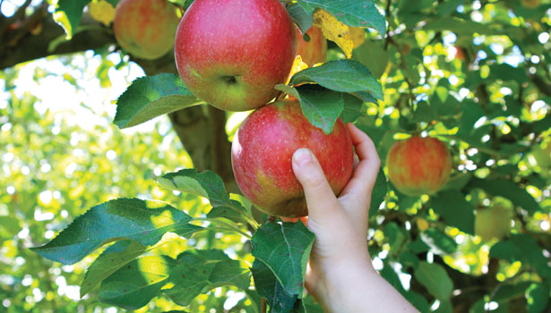
What Can We Do?
We can pick some low-hanging fruit

Slide 21
Example
Optimizations
21

Slide 22

Peephole Optimization
A naïve code generator tends to output some silly code
Err on the side of correctness over efficiency
Pattern-match the most obvious problems

Slide 23
CFG for Program Analysis
Consider the following sequence of instructions:
We’d like to remove this sequence…
Is it sound to do so?
Maybe not!
push
sw $t0 0($sp)
subu $sp $sp 4
lw $t0 4($sp)
addu $sp $sp 4
pop

Slide 24
Review: the CFG
Program as a flowchart
Nodes are “Basic Blocks”
Edges are control transfers
Fallthrough
Jump
Maybe function calls

Slide 25
CFG for Optimization
We can limit our peephole optimizations to intra-block analysis
This ensures, by definition, that no jumps will intrude on the sequence
We will assume for the rest of our peephole optimizations that instruction sequences are in one block

Slide 26

Peephole Examples
Called “peephole” optimization because we are conceptually sliding a small window over the code, looking for small patterns

Slide 27
Outline
Four different optimizations
Peephole optimization
Loop-Invariant Code Motion
For-loop strength reduction
Copy propagation
Performed after
machine code
generation
Performed before
machine code
generation

Slide 28
Peephole Optimization 1
Remove no-op sequences
Push followed by pop
Add/sub 0
Mul/div 1
push
sw $t0 0($sp)
subu $sp $sp 4
lw $t0 4($sp)
addu $sp $sp 4
pop
addu $t1 $t1 0
mul $t2 $t2 1

Slide 29
Peephole Optimization 2
Simplify sequences
Ex. Store then load
Strength reduction
Useless
instruction
sw $t0 -8($fp)
lw $t0 -8($fp)
mul $t1 $t1 2
shift-left $t1
add $t2 $t2 1
inc $t2

Slide 30
Peephole Optimization 3
Jump to next instruction
Remove this
instruction
j Lab1
Lab1 …

Slide 31

LICM
Loop Invariant Code Motion
Don’t duplicate effort in a loop
Goal
Pull code out of the loop
“Loop hoisting”
Important due to “hot spots”
Most execution time due to small regions of deeply-nested loops

Slide 32
LICM: Example
for (i=0; i<100; i++) {
for (j=0; j<100; j++) {
for (k=0; k<100; k++) {
A[i][j][k] = i*j*k
}
}
}
Sub-expression
invariant with respect to
Innermost loop
for (i=0; i<100; i++) {
for (j=0; j<100; j++) {
temp = i * j
for (k=0; k<100; k++) {
A[i][j][k] = temp *k
}
}
}

Slide 33
LICM: When Should we Do it?
In the previous example, showed LICM on source code
At IR level, more candidate operations
ASM might be too low-level
Need a guarantee that the loop is natural
No jumps into the loop
tmp0 = FP + offsetA
for (i=0; i<100; i++){
tmp1 = tmp0 - i*40000
for (j=0; j<100; j++){
tmp2 = ind2
tmp3 = i*j
for (k=0; k<100; k++){
T0 = tmp3 * k
T1 = tmp2 - k*4
store T0, 0(T1)
}
}
}

Slide 34
LICM: How Should we Do it?
Two factors, which really generalize to optimization:
Safety
Is the transformation semantics-preserving?
Make sure the operation is truly loop-invariant
Make sure ordering of events is preserved
Profitability
Is there any advantage to moving the instruction?
May end up doing instructions that are never executed
May end up performing more intermediate computation than necessary

Slide 35
Other Loop Optimizations
Loop unrolling
For a loop with a small, constant number of iterations, we may actually save time by just placing every copy of the loop body in sequence (no jumps)
May also consider doing multiple iterations within the body
Loop fusion
Merge two sequential, independent loops into a single loop body (fewer jumps)

Slide 36
Jump Optimizations
Disclaimer: Require some extra conditions
Jump around jump
Jump to jump
beq $t0,$t1,Lab1
j Lab2
Lab1: …
…
Lab2: …
bne $t0,$t1,Lab2
Lab1: …
…
Lab2: …
j Lab1
…
Lab1: j Lab2
…
Lab2: …
j Lab2
…
Lab1: j Lab2
…
Lab2: …

Slide 37
Intraprocedural Analysis
The past two optimizations had some caveats
There may be a jump into your eliminated code
We’d like to introduce a control-flow concept beyond basic blocks:
Guarantee that block1 must be executed in order to get to block2
This goes by a pretty boring name
Just kidding, it’s called
beq $t0 $t1 Lab1
j Lab2
Lab1: …
…
Lab2: …

Slide 38
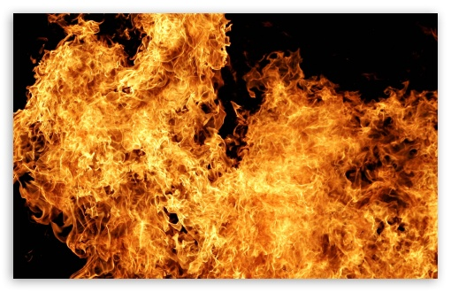
Domination

Slide 39
Dominators & PostDominators
Control Flow Graph
We say that block A dominates block B if A must be executed before B is executed
We say that block A postdominates block B if A must be executed after B
Block 1
Block 2
Block 3
Block 4

Slide 40
Next Time
Wrap up optimization

Slide 41
Teacher Evals
Need a volunteer to
Collect evals
Take evals back to the 5th floor of CS

