Slide 1
CS 536
Optimization Frameworks

Slide 2
Announcements

Slide 3
Homework
Homework 9 is due now
Homework 10 due next Thursday

Slide 4
Final Exam Review
I’ll send an email tomorrow about the date of the review
Unfortunately, nothing works for everybody
Probably only going to do 1 review session
I’ll buy pizza again
If you have preferences send them via email

Slide 5
Roadmap
Last time:
Optimization overview
Soundness and completeness
Simple optimizations
Peephole
LICM
This time:
More Optimization
Analysis frameworks
5

Slide 6
Outline
Review Dominators
Introduce some more advanced concepts
SSA
Dataflow propagation
Wrap-up
6

Slide 7
Dominator Review
7

Slide 8
Dominator Terms
Domination (A dominates B):
to reach block B, you must have gone through block A
Strict Domination (A strictly dominates B)
A dominates B and A is not B
Immediate Domination (A immediately dominates B)
A immediately dominates B if A dominates B and has no intervening dominators
8

Slide 9
Dominator Example
A
B
C
D
E
9

Slide 10
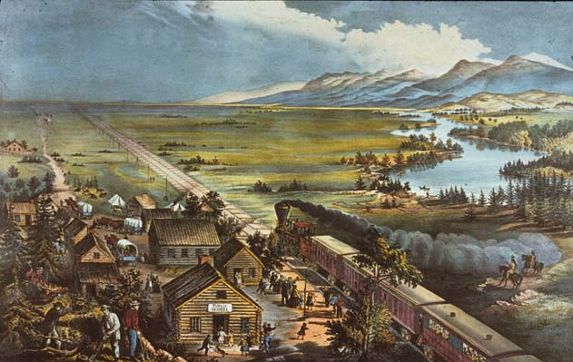
Dominance Frontier
Definition: For a block X, the set of nodes Y such that X dominates an immediate predecessor of Y but does not strictly dominate Y
10

Slide 11
Static Single Assignment
11

Slide 12
SSA: Key Idea
We’d like to build an intermediate representation of the program in which each variable gets a value in at most 1 program point:
x = 1
x = 2
y = 3
x = 1
z = 2
y = 3
x = y
z = y
w = z
i = 0;
while( i < 10){
k = i + 1;
}
12

Slide 13
Conversion
We’ll make new variables to carry over the effect of the original program
x = 1
x = x
y = x
x₁ = 1
x₂ = x₁
y₁ = x₂
13

Slide 14
Benefits
There are some obvious advantages to this format for program analysis
Easy to see the live range of a variable at a program point (i.e. the definitions that could reach that point)
Places with the variable on the LHS
Easy to see when a variable is dead (i.e. unused)
Never used on the RHS of an statement
14

Slide 15
Optimizations that SSA Helps
Dead Code Elimination
int a = 9;
int b = 2;
if ( g < 12){
a = 1;
} else { if (b < 4){
a = 2; } else {
a = 3; }
}
b = a;
return 2;
15

Slide 16
Optimizations that SSA Helps
Constant propagation / constant folding
6
int a = 30;
int b = 9 - (a / 5);
int c;
c = b * 4;
if (c > 10) {
c = c - 10;
}
return c * (60 / a);
int a = 30;
int b = 3;
int c;
c = 12;
if (true) {
c = 2;
}
return 4;
int a = 30;
int b = 3;
int c;
c = b * 4;
if (c > 10) {
c = c - 10;
}
return c * 2;
int a = 30;
int b = 3;
int c;
c = 12;
if (c > 10) {
c = c - 10;
}
return c * 2;
int a = 30;
int b = 3;
int c;
c = 12;
if (true) {
c = 2;
}
return c * 2;
true
12
2
2
4
return 4;
16

Slide 17
What about Conditionals?
x = 5
x = x – 1
x < 3
x₁ = 5
x₂ = x₁ – 1
x₂ < 3
y = x * 2
w = y
y = x - 3
y₁ = x₂ * 2
w₁ = y₁
y₂ = x₂ - 3
w = x - y
z = x + y
w₂ = y - x
z = x + y
Which y to use?
17

Slide 18
Phi Functions
We’ll introduce a special symbol Φ that represents a join like this
Takes arguments of all variables to join
Returns the “correct” one
Do we need a Φ for x?
Nope!
x₁ = 5
x₂ = x₁ – 1
x₂ < 3
y₁ = x₂ * 2
w₁ = y₁
y₂ = x₂ - 3
y₃ = Φ(y₁,y₂)
w₂ = y - x
z = x + y
y₃
18

Slide 19
Computing Phi Functions
Intuitively, we want to figure out cases where there are multiple assignments that can reach a node
To be safe, we can place Φ functions for each assignment at every node in the dominance frontier
x₁ = 5
x₂ = x₁ – 1
x₂ < 3
y₁ = x₂ * 2
w₁ = y₁
y₂ = x₂ - 3
y₃ = Φ(y₁,y₂)
w₂ = y - x
z = x + y
y₃
19

Slide 20
Pruned Phi Functions
This causes a bunch of useless Φ functions
Cases where the result is never used
Pruned SSA is a version where statically removable Φ nodes are never used
20

Slide 21
Dataflow Frameworks
21

Slide 22
Dataflow Framework Idea
Many analyses can be formulated as how data is transformed over the control flow graph
Propagate static information from:
the beginning of a single basic block
the end of a single basic block
The join points of multiple basic blocks
22

Slide 23
Dataflow Framework Idea
Meet Lattice
Transfer function
How data is propagated from one end of a basic block to the other
Meet operation
Means of combining lattice between blocks
23

Slide 24
Dataflow Analysis Direction
Forward analysis
Start at the beginning of a function’s CFG, work along the control edges
Backwards analysis
Start at the end of a function’s CFG, work against the control edges
Continuously propagate values until there is no change
24

Slide 25
Dataflow Example 1
Available Expression analysis
Whether an expression that has been previously computed may be reused
Forward dataflow problem: from expression to points of re-use
Meet Lattice:
Meet operation:
AND of all predecessors
At the beginning of each block, everything is True
* This causes some problems for loops
True
False
25

Slide 26
Dataflow Example 2
Very Busy Expression analysis
An expression is very busy at a point p if it is guaranteed that it will be computed at some time in the future
Backwards dataflow problem: from computation to use
Meet Lattice:
Meet operation: AND
True
False
26

Slide 27
The END… or is it?
Covered a broad range of topics
Some formal concepts
Some practical concepts
What we skipped
Linking and loading
Interpreters
Register allocation
Performance analysis / Proofs

Slide 28
Where to go from here
Tools
ANTLR: LL(k) Lexer generator
LLVM: compiler framework
JLex (ok JFLex) and CUP are used in actual analysis tools
If you’re interested in this stuff
701 is the graduate compilers course
Consider a career in PL (Programming Languages)

Slide 29
Is this stuff actually useful?
Yes, in the sense that it is foundational
Now you know how your programs are more-or-less compiled
Perhaps, in the sense that it’s directly applicable
You could probably build a simple language right now
Probably, in the sense that it teaches you a way of reasoning about code

Slide 30
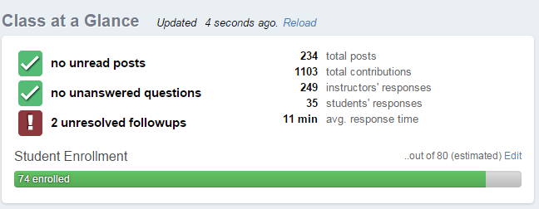
Goodbye Forever!
Thanks to everybody
Special thanks to people who posted on Piazza
Extra special thanks to people who offered suggestions and corrections

Slide 31
Credits
People
Susan Horwitz, Beck Hasti, Charles Fischer, Tom Reps – UW-Madison
Saumya Debray – University of Arizona
Books
Advanced Compiler Design and Implementation, S. Munchnick
Compilers: Principles, Techniques and Tools, A. Aho et al
Intro to Theory of Computation, M. Sipser
Types and Programming Languages, B. Pierce

