Slide 1
Announcements
Project 2 Assigned
  JLex for C Flat
  Find a partner if you want
Reminder: Homework 2
  Due 9/23 (Tuesday)

Slide 2
Roadmap
Last time
  JLex for generating Lexers
This time
  CFGs, the underlying abstraction for Parsers

Slide 3
RegExs Are Great!
Perfect for tokenizing a language
They do have some limitations
  Limited class of language that cannot specify all programming constructs we need
  No notion of structure
Let’s explore both of these issues

Slide 4
Limitations of RegExs
Cannot handle “matching”
  Eg: language of balanced parentheses
  L = { (^{x})^{x} where x > 1}
  cannot be matched
  Intuition:
  An FSM can only handle a finite depth of
  parentheses that we can handle
  let’s see a diagram…

Slide 5
Limitations of RegExs: Balanced Parens
Assume F is an FSM that recognized L. Let N be the number of states in F’.
Feed N+1 left parens into N
By the pidgeonhole principle, we must have revisited some state s on two input characters i and j.
By the definition of F, there must be a path from s to a final state. But this means that it accepts some suffix of closed parens at input i and j, but both cannot be correct
(
(
(
(
…

Slide 6
Limitations of RegEx: Structure
Our Enhanced-RegEx scanner can emit a stream of tokens:
  X = Y + Z
  … but this doesn’t really enforce any order of operations
ID
ASSIGN
ID
PLUS
ID

Slide 7

We need more power than RegExs can provide

Slide 8
The Chomsky Hierarchy
LANGUAGE CLASS:
power
efficiency
Recursively enumerable
Context-Sensitive
Context-Free
Regular

Slide 9
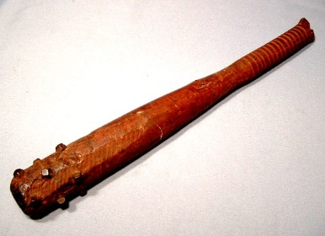
The Chomsky Hierarchy
LANGUAGE CLASS:
power
efficiency
Recursively enumerable
Context-Sensitive
Context-Free
Regular
FSM

Slide 10
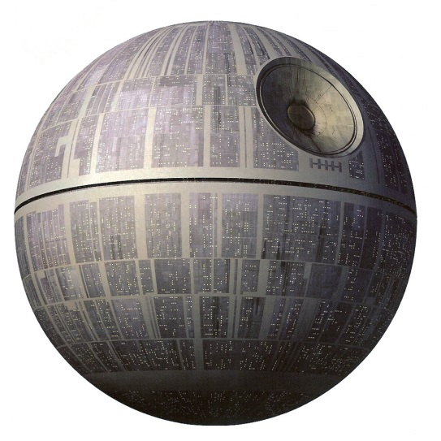
The Chomsky Hierarchy
Turing machine
LANGUAGE CLASS:
power
efficiency
Recursively enumerable
Context-Sensitive
Context-Free
Regular
FSM

Slide 11
The Chomsky Hierarchy
Turing machine
LANGUAGE CLASS:
power
efficiency
Recursively enumerable
Context-Sensitive
Context-Free
Happy medium?
Regular
FSM

Slide 12

Context Free Grammars (CFGs)
A set of (recursive) rewriting rules to generate patterns of strings
Can envision a “parse tree” that keeps structure
Don Knuth

Slide 13

CFG: Intuition
S → ( S )
A rule that says that you
can rewrite S to be an S surrounded by
a single set of parens
Before applying rule
After applying rule
S
S
CFGs recognize the language of
tree where all the leaves are terminals
(
S
)

Slide 14
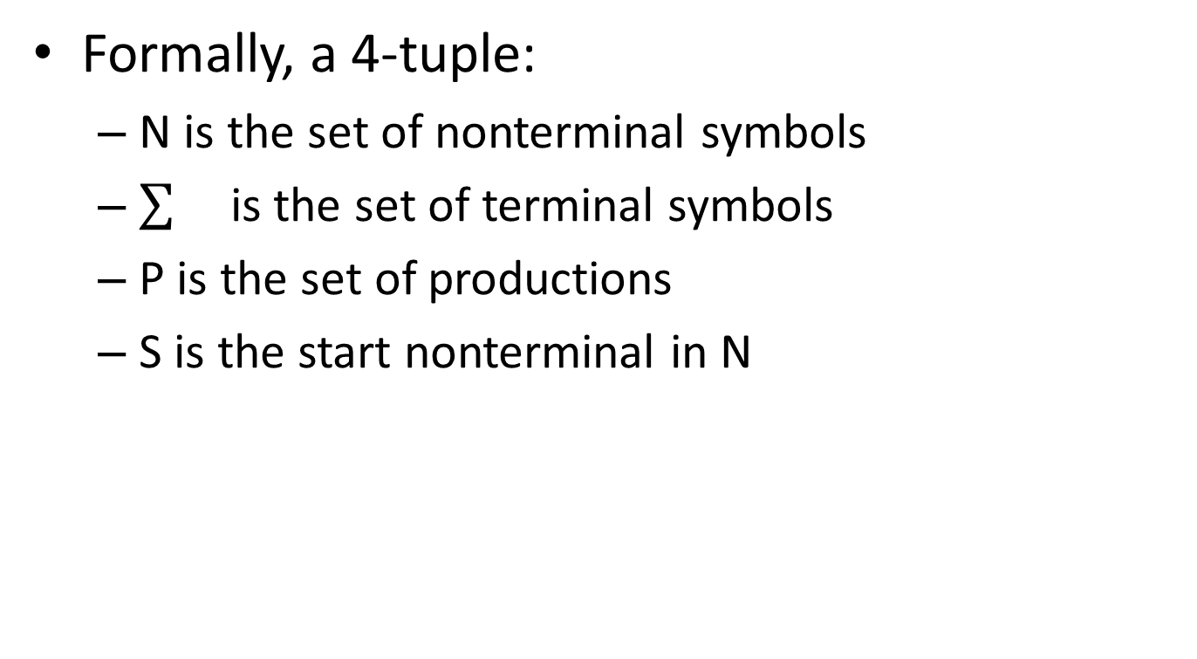
Context Free Grammars (CFGs)
Formally, a 4-tuple:
  N is the set of nonterminal symbols
  is the set of terminal symbols
  P is the set of productions
  S is the start nonterminal in N

Slide 15
Context Free Grammars (CFGs)
Placeholder / interior nodes
in the parse tree
Formally, a 4-tuple:
  N is the set of nonterminal symbols
  is the set of terminal symbols
  P is the set of productions
  S is the start nonterminal in N

Slide 16
Context Free Grammars (CFGs)
Placeholder / interior nodes
in the parse tree
Formally, a 4-tuple:
  N is the set of nonterminal symbols
  is the set of terminal symbols
  P is the set of productions
  S is the start nonterminal in N
Tokens from
scanner

Slide 17
Context Free Grammars (CFGs)
Placeholder / interior nodes
in the parse tree
Formally, a 4-tuple:
  N is the set of nonterminal symbols
  is the set of terminal symbols
  P is the set of productions
  S is the start nonterminal in N
Tokens from
scanner
Rules for deriving strings

Slide 18
Context Free Grammars (CFGs)
Placeholder / interior nodes
in the parse tree
Formally, a 4-tuple:
  N is the set of nonterminal symbols
  is the set of terminal symbols
  P is the set of productions
  S is the start nonterminal in N
Tokens from
scanner
Rules for deriving strings
If not otherwise specified, use the
non-terminal that appears on the LHS
of the first production is the start

Slide 19
Production Syntax
LHS → RHS
Expression: Sequence of
terminals and nonterminals
Single nonterminal symbol

Slide 20
Production Shorthand
Nonterm → expression
Nonterm→ ε
equivalently:
Nonterm → expression
| ε
equivalently:
Nonterm → expression | ε
Sequence of terms and nonterms

Slide 21
Derivations
To derive a string:
  Start by setting “Current Sequence” to the start symbol
  Repeat:
    Find a Nonterminal X in the Current Sequence
    Find a production of the form X→α
    “Apply” the production: create a new “current sequence” in which α replaces X
  Stop when there are no more nonterminals

Slide 22
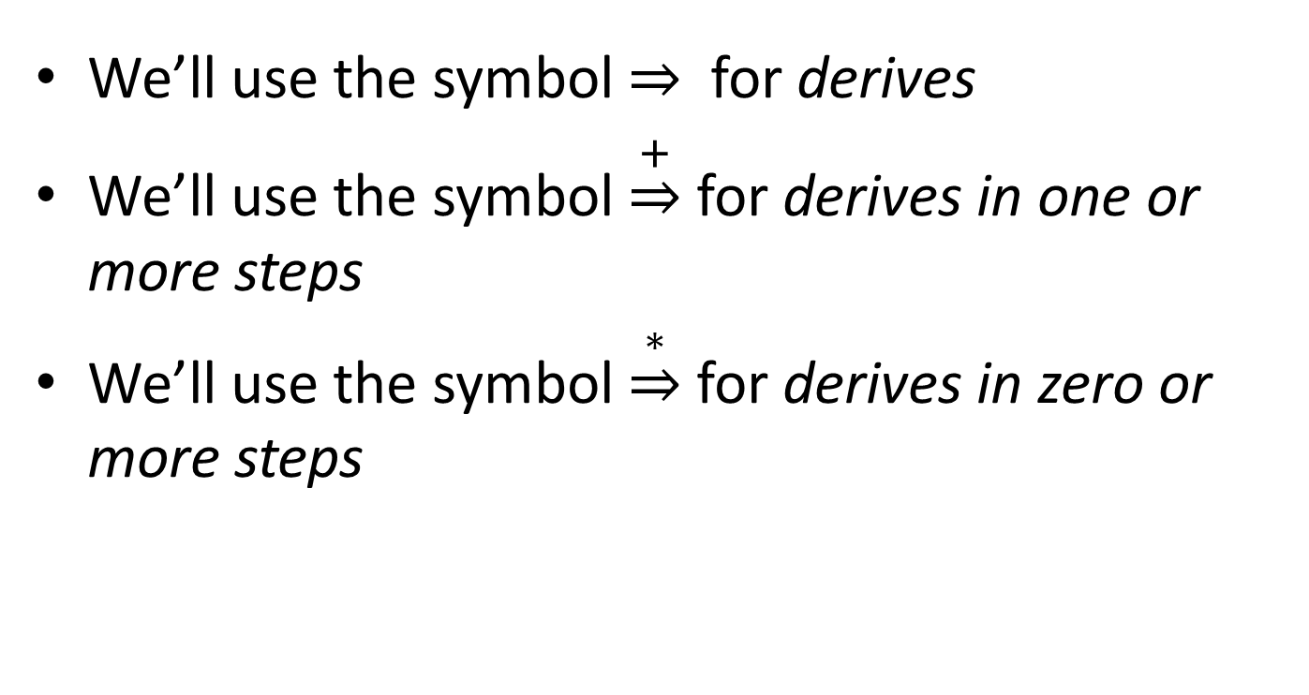
Derivation Syntax
We’ll use the symbol for derives
We’ll use the symbol $\underset{⇒}{+}$ for derives in one or more steps
We’ll use the symbol $\underset{⇒}{∗}$ for derives in zero or more steps

Slide 23
An Example Grammar

Slide 24
An Example Grammar
Terminals
begin
end
semicolon
assign
id
plus

Slide 25
An Example Grammar
For readability, bold and lowercase
Terminals
begin
end
semicolon
assign
id
plus

Slide 26
An Example Grammar
For readability, bold and lowercase
Terminals
begin
end
semicolon
assign
id
plus
Program
boundary

Slide 27
An Example Grammar
For readability, bold and lowercase
Terminals
begin
end
semicolon
assign
id
plus
Program
boundary
Represents “;”
Separates statements

Slide 28
An Example Grammar
For readability, bold and lowercase
Terminals
begin
end
semicolon
assign
id
plus
Program
boundary
Represents “;”
Separates statements
Represents “=“ statement

Slide 29
An Example Grammar
For readability, bold and lowercase
Terminals
begin
end
semicolon
assign
id
plus
Program
boundary
Represents “;”
Separates statements
Represents “=“ statement
Identifier / variable name

Slide 30
An Example Grammar
For readability, bold and lowercase
Terminals
begin
end
semicolon
assign
id
plus
Program
boundary
Represents “;”
Separates statements
Represents “=“ statement
Identifier / variable name
Represents “+“ expression

Slide 31
An Example Grammar
For readability, bold and lowercase
Terminals
begin
end
semicolon
assign
id
plus
Nonterminals
Prog
Stmts
Stmt
Expr

Slide 32
An Example Grammar
For readability, bold and lowercase
Terminals
begin
end
semicolon
assign
id
plus
For readability, Italics and UpperCamelCase
Nonterminals
Prog
Stmts
Stmt
Expr

Slide 33
An Example Grammar
For readability, bold and lowercase
Terminals
begin
end
semicolon
assign
id
plus
For readability, Italics and UpperCamelCase
Nonterminals
Prog
Stmts
Stmt
Expr
Root of the parse tree

Slide 34
An Example Grammar
For readability, bold and lowercase
Terminals
begin
end
semicolon
assign
id
plus
For readability, Italics and UpperCamelCase
Nonterminals
Prog
Stmts
Stmt
Expr
Root of the parse tree
List of statements

Slide 35
An Example Grammar
For readability, bold and lowercase
Terminals
begin
end
semicolon
assign
id
plus
For readability, Italics and UpperCamelCase
Nonterminals
Prog
Stmts
Stmt
Expr
Root of the parse tree
List of statements
A single statement

Slide 36
An Example Grammar
For readability, bold and lowercase
Terminals
begin
end
semicolon
assign
id
plus
For readability, Italics and UpperCamelCase
Nonterminals
Prog
Stmts
Stmt
Expr
Root of the parse tree
List of statements
A single statement
A mathematical expression

Slide 37
An Example Grammar
For readability, bold and lowercase
Terminals
begin
end
semicolon
assign
id
plus
Defines the syntax of legal programs
Productions
Prog → begin Stmts end
Stmts → Stmts semicolon Stmt
| Stmt
Stmt → id assign Expr
Expr → id
| Expr plus id
For readability, Italics and UpperCamelCase
Nonterminals
Prog
Stmts
Stmt
Expr

Slide 38
An Example Grammar
For readability, bold and lowercase
Terminals
begin
end
semicolon
assign
id
plus
Program
boundary
Defines the syntax of legal programs
Represents “;”
Separates statements
Productions
Prog → begin Stmts end
Stmts → Stmts semicolon Stmt
| Stmt
Stmt → id assign Expr
Expr → id
| Expr plus id
Represents “=“ statement
Identifier / variable name
Represents “+“ expression
For readability, Italics and UpperCamelCase
Nonterminals
Prog
Stmts
Stmt
Expr
Root of the parse tree
List of statements
A single statement
A mathematical expression

Slide 39
Productions
Prog → begin Stmts end
Stmts → Stmts semicolon Stmt
| Stmt
Stmt → id assign Expr
Expr → id
| Expr plus id

Slide 40
Productions
Prog → begin Stmts end
Stmts → Stmts semicolon Stmt
| Stmt
Stmt → id assign Expr
Expr → id
| Expr plus id
Derivation Sequence

Slide 41
Productions
Prog → begin Stmts end
Stmts → Stmts semicolon Stmt
| Stmt
Stmt → id assign Expr
Expr → id
| Expr plus id
Parse Tree
Derivation Sequence

Slide 42
Productions
Prog → begin Stmts end
Stmts → Stmts semicolon Stmt
| Stmt
Stmt → id assign Expr
Expr → id
| Expr plus id
Parse Tree
Derivation Sequence
Key
terminal
Nonterminal
Rule used

Slide 43
Productions
Prog → begin Stmts end
Stmts → Stmts semicolon Stmt
| Stmt
Stmt → id assign Expr
Expr → id
| Expr plus id
Parse Tree
Prog
Derivation Sequence
Prog
Key
terminal
Nonterminal
Rule used

Slide 44

Productions
Prog → begin Stmts end
Stmts → Stmts semicolon Stmt
| Stmt
Stmt → id assign Expr
Expr → id
| Expr plus id
Parse Tree
Prog
Derivation Sequence
Prog begin Stmts end
1
Key
terminal
Nonterminal
Rule used

Slide 45
Productions
Prog → begin Stmts end
Stmts → Stmts semicolon Stmt
| Stmt
Stmt → id assign Expr
Expr → id
| Expr plus id
Parse Tree
Prog
begin
Stmts
end
Derivation Sequence
Prog begin Stmts end
1
Key
terminal
Nonterminal
Rule used

Slide 46
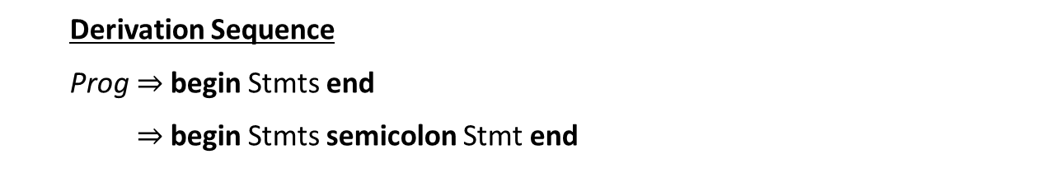
Productions
Prog → begin Stmts end
Stmts → Stmts semicolon Stmt
| Stmt
Stmt → id assign Expr
Expr → id
| Expr plus id
Parse Tree
Prog
begin
Stmts
end
Stmts
semicolon
Stmt
Derivation Sequence
Prog begin Stmts end
begin Stmts semicolon Stmt end
1
2
Key
terminal
Nonterminal
Rule used

Slide 47
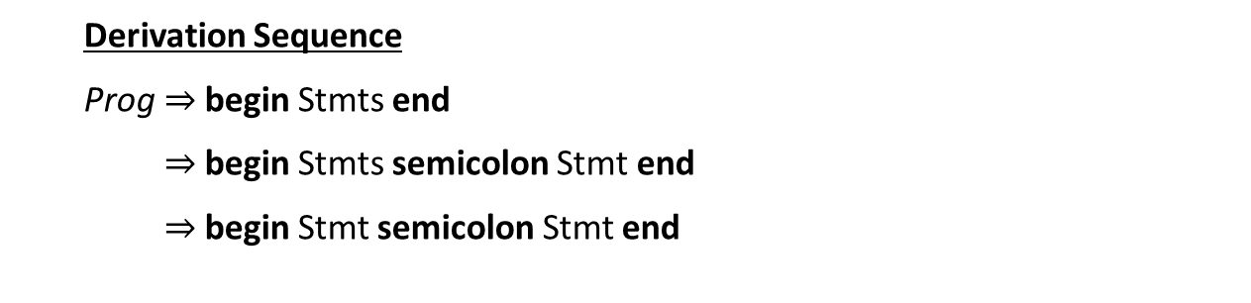
Productions
Prog → begin Stmts end
Stmts → Stmts semicolon Stmt
| Stmt
Stmt → id assign Expr
Expr → id
| Expr plus id
Parse Tree
Prog
begin
Stmts
end
Stmts
semicolon
Stmt
Stmt
Derivation Sequence
Prog begin Stmts end
begin Stmts semicolon Stmt end
begin Stmt semicolon Stmt end
1
2
Key
3
terminal
Nonterminal
Rule used

Slide 48
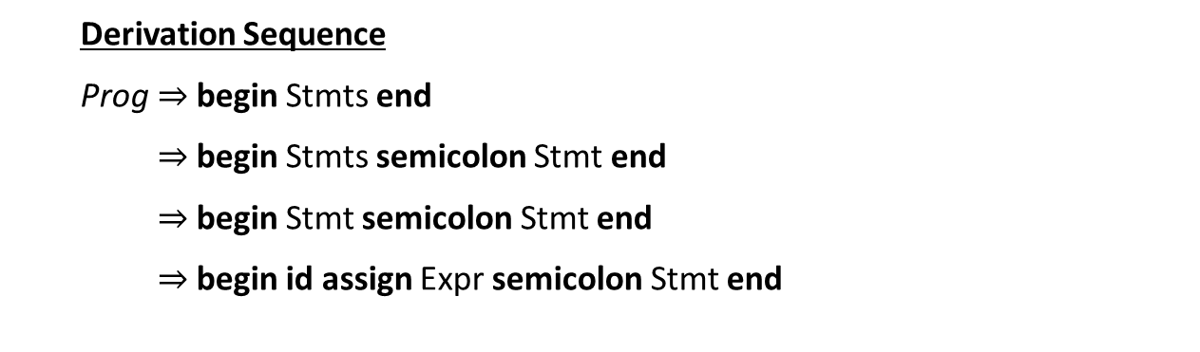
Productions
Prog → begin Stmts end
Stmts → Stmts semicolon Stmt
| Stmt
Stmt → id assign Expr
Expr → id
| Expr plus id
Parse Tree
Prog
begin
Stmts
end
Stmts
semicolon
Stmt
Stmt
Derivation Sequence
Prog begin Stmts end
begin Stmts semicolon Stmt end
begin Stmt semicolon Stmt end
begin id assign Expr semicolon Stmt end
id
assign
Expr
1
2
Key
3
4
terminal
Nonterminal
Rule used

Slide 49
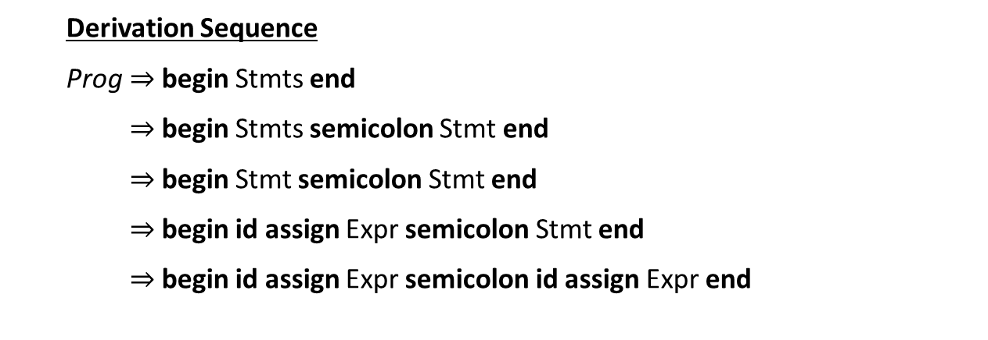
Productions
Prog → begin Stmts end
Stmts → Stmts semicolon Stmt
| Stmt
Stmt → id assign Expr
Expr → id
| Expr plus id
Parse Tree
Prog
begin
Stmts
end
Stmts
semicolon
Stmt
Stmt
id
assign
Expr
Derivation Sequence
Prog begin Stmts end
begin Stmts semicolon Stmt end
begin Stmt semicolon Stmt end
begin id assign Expr semicolon Stmt end
begin id assign Expr semicolon id assign Expr end
id
assign
Expr
1
2
Key
3
4
terminal
4
Nonterminal
Rule used

Slide 50
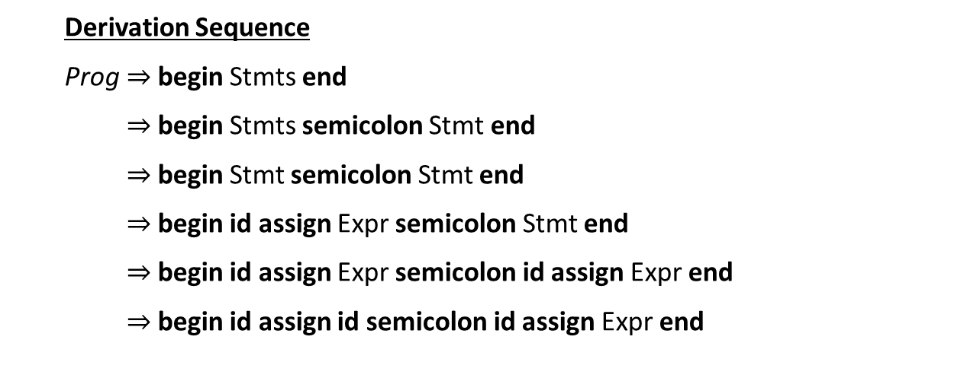
Productions
Prog → begin Stmts end
Stmts → Stmts semicolon Stmt
| Stmt
Stmt → id assign Expr
Expr → id
| Expr plus id
Parse Tree
Prog
begin
Stmts
end
Stmts
semicolon
Stmt
Stmt
id
assign
Expr
Derivation Sequence
Prog begin Stmts end
begin Stmts semicolon Stmt end
begin Stmt semicolon Stmt end
begin id assign Expr semicolon Stmt end
begin id assign Expr semicolon id assign Expr end
begin id assign id semicolon id assign Expr end
id
assign
Expr
1
2
id
Key
3
4
terminal
4
Nonterminal
5
Rule used

Slide 51
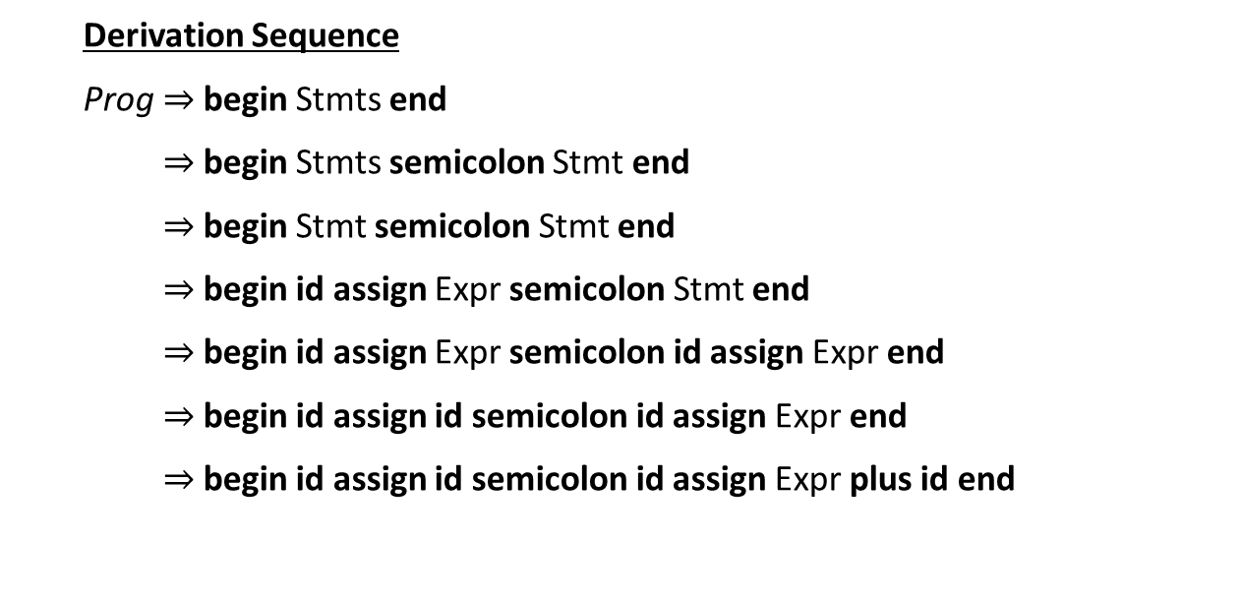
Productions
Prog → begin Stmts end
Stmts → Stmts semicolon Stmt
| Stmt
Stmt → id assign Expr
Expr → id
| Expr plus id
Parse Tree
Prog
begin
Stmts
end
Stmts
semicolon
Stmt
Stmt
id
assign
Expr
Derivation Sequence
Prog begin Stmts end
begin Stmts semicolon Stmt end
begin Stmt semicolon Stmt end
begin id assign Expr semicolon Stmt end
begin id assign Expr semicolon id assign Expr end
begin id assign id semicolon id assign Expr end
begin id assign id semicolon id assign Expr plus id end
id
assign
Expr
Expr
plus
id
1
2
id
Key
3
4
terminal
4
Nonterminal
5
Rule used
6

Slide 52
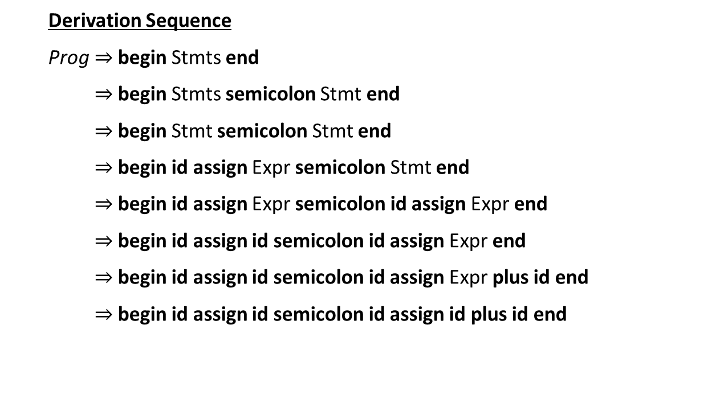
Productions
Prog → begin Stmts end
Stmts → Stmts semicolon Stmt
| Stmt
Stmt → id assign Expr
Expr → id
| Expr plus id
Parse Tree
Prog
begin
Stmts
end
Stmts
semicolon
Stmt
Stmt
id
assign
Expr
Derivation Sequence
Prog begin Stmts end
begin Stmts semicolon Stmt end
begin Stmt semicolon Stmt end
begin id assign Expr semicolon Stmt end
begin id assign Expr semicolon id assign Expr end
begin id assign id semicolon id assign Expr end
begin id assign id semicolon id assign Expr plus id end
begin id assign id semicolon id assign id plus id end
id
assign
Expr
Expr
plus
id
1
2
id
id
Key
3
4
terminal
4
Nonterminal
5
Rule used
6
5

Slide 53
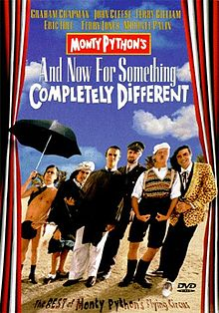
Switching Gears: Makefiles

Slide 54
Makefiles: Motivation
Typing the series of commands to generate our code can be tedious
  Multiple steps that depend on each other
  Somewhat complicated commands
  May not need to rebuild everything
Makefiles solve these issues
  Record a series of commands in a script-like DSL
  Specify dependency rules and Make generates the results

Slide 55
Makefiles: Basic Structure
<target>: <dependency list>
<command to satisfy target>
Example
Example.class: Example.java IO.class
javac Example.java
IO.class: IO.java
javac IO.java
(tab)

Slide 56
Makefiles: Basic Structure
<target>: <dependency list>
<command to satisfy target>
Example
Example.class: Example.java IO.class
javac Example.java
IO.class: IO.java
javac IO.java
(tab)

Slide 57
Makefiles: Basic Structure
<target>: <dependency list>
<command to satisfy target>
Example
Example.class: Example.java IO.class
javac Example.java
IO.class: IO.java
javac IO.java
(tab)
Example.class depends on example.java and IO.class

Slide 58
Makefiles: Basic Structure
<target>: <dependency list>
<command to satisfy target>
Example
Example.class: Example.java IO.class
javac Example.java
IO.class: IO.java
javac IO.java
(tab)
Example.class depends on example.java and IO.class
Example.class is generated by
javac Example.java

Slide 59
Makefiles: Dependencies
Example.class
Example
Example.class: Example.java IO.class
javac Example.java
IO.class: IO.java
javac IO.java
Example.java
IO.class
IO.java

Slide 60
Makefiles: Dependencies
Internal Dependency graph
Example.class
Example
Example.class: Example.java IO.class
javac Example.java
IO.class: IO.java
javac IO.java
Example.java
IO.class
IO.java

Slide 61
Makefiles: Dependencies
Internal Dependency graph
Example.class
Example
Example.class: Example.java IO.class
javac Example.java
IO.class: IO.java
javac IO.java
Example.java
IO.class
A file is rebuilt if one of it’s
dependencies changes
IO.java

Slide 62
Makefiles: Variables
You can thread common configuration values through your makefile

Slide 63
Makefiles: Variables
You can thread common configuration values through your makefile
Example
JC = /s/std/bin/javac
JFLAGS = -g

Slide 64
Makefiles: Variables
You can thread common configuration values through your makefile
Example
JC = /s/std/bin/javac
JFLAGS = -g
Build for debug

Slide 65
Makefiles: Variables
You can thread common configuration values through your makefile
Example
JC = /s/std/bin/javac
JFLAGS = -g
Example.class: Example.java IO.class
$(JC) $(JFLAGS) Example.java
IO.class: IO.java
$(JC) $(JFLAGS) IO.java
Build for debug

Slide 66

Makefiles: Phony Targets
You can run commands through make.
  Write a target with no dependencies (called phony)
  Will cause it to execute the command every time
Example
clean:
rm –f *.class
test:
java –cp . Test.class

Slide 67
Makefiles: Phony Targets
You can run commands through make.
  Write a target with no dependencies (called phony)
  Will cause it to execute the command every time
Example
clean:
rm –f *.class
test:
java –cp . Test.class

Slide 68
Makefiles: Phony Targets
You can run commands through make.
  Write a target with no dependencies (called phony)
  Will cause it to execute the command every time
Example
clean:
rm –f *.class
test:
java –cp . Test.class

Slide 69
P2 Walkthrough

