Slide 1
CS 536
CFGs for Syntax Definition

Slide 2

Announcements
Hw 2 due Thursday
Proj 2 underway
Screencast posted
Who’s seen it?
Who likes it?
Gone Thursday
New office hours posted

Slide 3
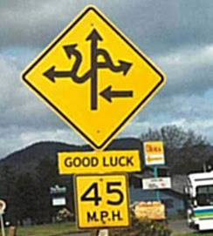
Roadmap
Last time
CFG basics
This time
CFGs for syntax design
Language membership
List grammars
Resolving ambiguity

Slide 4
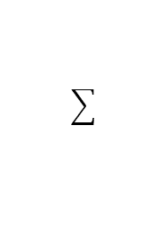
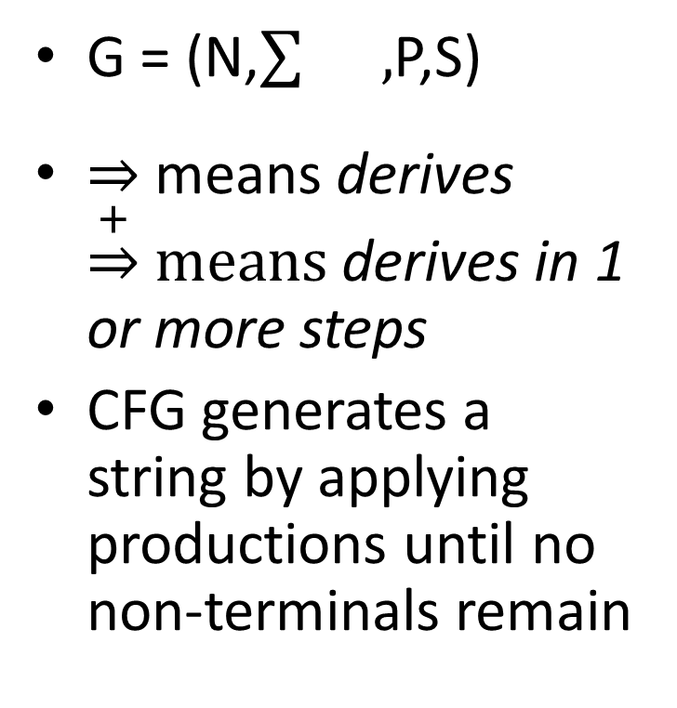
CFG Review
G = (N,$\sum{},$P,S)
means derives $\underset{⇒}{+} means$ derives in 1 or more steps
CFG generates a string by applying productions until no non-terminals remain
Example: Nested parens
N = { Q }
= { (, )}
P = Q → ( Q )
| ε
S = Q

Slide 5
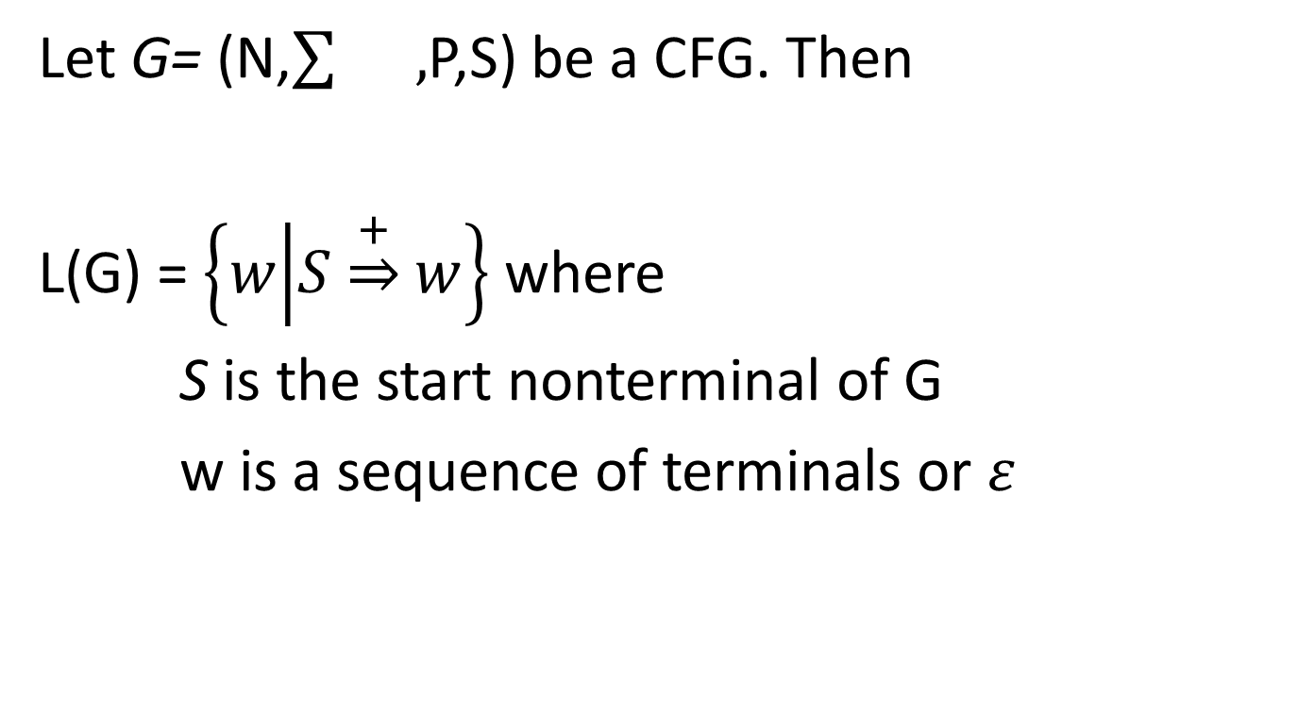
Formal CFG Language Definition
Let G= (N,$\sum{},$P,S) be a CFG. Then
L(G) = $\left\{w | S\underset{⇒}{+}w\right\}$ where
S is the start nonterminal of G
w is a sequence of terminals or $ε$

Slide 6
CFGs as Language Definition
CFG productions define the syntax of a language
We call this notation “BNF” or “enhanced BNF”
HTML Grammar using BNF
http://bioinfo2.ugr.es/OReillyReferenceLibrary/web/html/appa_02.html
Prog → begin Stmts end
Stmts → Stmts semicolon Stmt
| Stmt
Stmt → id assign Expr
Expr → id
| Expr plus id

Slide 7
List Grammars
Useful to repeat a structure arbitrarily often
Stmts → Stmts semicolon Stmt | Stmt
Stmts
Stmts
;
Stmt
List skews left
Stmts
;
Stmt
Stmts
Stmts
;
Stmt
Stmts
Stmts
;
Stmt
…

Slide 8
List Grammars
Useful to repeat a structure arbitrarily often
Stmts → Stmt semicolon Stmts | Stmt
Stmts
Stmts
;
Stmt
List skews right
Stmts
;
Stmt
Stmts
Stmts
;
Stmt
Stmts
Stmts
;
Stmt

Slide 9
List Grammars
What if we allowed both “skews”?
Stmts → Stmts semicolon Stmts | Stmt
Stmts
Stmts
;
Stmts
Stmts
;
Stmts
Stmts
;
Stmts
Stmt
Stmts
;
Stmts

Slide 10
Derivation Order
Leftmost Derivation: always expand the leftmost nonterminal
Rightmost Derivation: always expand the rightmost nonterminal
Prog
Prog → begin Stmts end
Stmts → Stmts semicolon Stmt
| Stmt
Stmt → id assign Expr
Expr → id
| Expr plus id
begin
Stmts
end
Stmts
semicolon
Stmt
Leftmost expands
this nonterminal
Rightmost expands
this nonterminal

Slide 11
Ambiguity
Even with a fixed derivation order, it is possible to derive the same string in multiple ways
For Grammar G and string w
G is ambiguous if
>1 leftmost derivation of w
>1 rightmost derivation of w
> 1 parse tree for w

Slide 12
Example: Ambiguous Grammars
Expr → intlit
| Expr minus Expr
| Expr times Expr
| lparen Expr rparen
Derive the string 4 - 7 * 3
(assume tokenization)
Parse Tree 1
Parse Tree 2
Expr
Expr
Expr
minus
Expr
Expr
times
Expr
intlit
Expr
times
Expr
Expr
minus
Expr
intlit
4
3
intlit
intlit
intlit
intlit
7
3
4
7

Slide 13
Why is Ambiguity Bad?
Eventually, we’ll be using CFGs as the basis for our parser
Parsing is much easier when there is no ambiguity in the grammar
The parse tree may mismatch user understanding!
Operator precedence
4 - 7 * 3
Expr
Expr
Expr
minus
Expr
Expr
times
Expr
intlit
Expr
times
Expr
Expr
minus
Expr
intlit
4
3
intlit
intlit
intlit
intlit
7
3
4
7

Slide 14
Resolving Grammar Ambiguity: Precedence
Intuitive problem
“Context-freeness”
Nonterminals are the same for both operators
To fix precedence
1 nonterminal per precedence level
Parse lowest level first
Expr → intlit
| Expr minus Expr
| Expr times Expr
| lparen Expr rparen

Slide 15
Resolving Grammar Ambiguity: Precedence
lowest precedence level first
1 nonterm per precedence level
Expr → intlit
| Expr minus Expr
| Expr times Expr
| lparen Expr rparen
Derive the string 4 - 7 * 3
Expr
Expr
minus
Expr
Expr → Expr minus Expr
| Term
Term → Term times Term
| Factor
Factor → intlit
| lparen Expr rparen
Term
Term
Factor
Term
times
Term
intlit
Factor
Factor
4
intlit
intlit
7
3

Slide 16
Resolving Grammar Ambiguity: Precedence
Fixed Grammar
Expr → expr minus expr
| Term
Term → Term times Term
| Factor
Factor → intlit
| lparen Expr rparen
Derive the string 4 - 7 * 3
Let’s try to re-build the wrong parse tree
Expr
Term
Expr
Term
times
Term
Factor
Expr
minus
Expr
We’ll never be able to derive minus
without parens
intlit
3
Term
Term
Term
times
Term
Factor
Factor
Factor
intlit
4
intlit
7
intlit
3

Slide 17
Did we fix all ambiguity?
Fixed Grammar
Expr → Expr minus Expr
| Term
Term → Term times Term
| Factor
Factor → intlit
| lparen Expr rparen
Derive the string 4 - 7 - 3
Expr
Expr
minus
Expr
Term
Expr
minus
Expr
Factor
Term
Term
NO!
intlit
Factor
Factor
intlit
intlit
These subtrees could have
been swapped!

Slide 18
Where we are so far
Precedence
We want correct behavior on 4 – 7 * 9
A new nonterminal for each precedence level
Associativity
We want correct behavior on 4 – 7 – 9
Minus should be left associative: a – b – c = (a – b) – c
Problem: the recursion in a rule like
Expr → Expr minus Expr

Slide 19
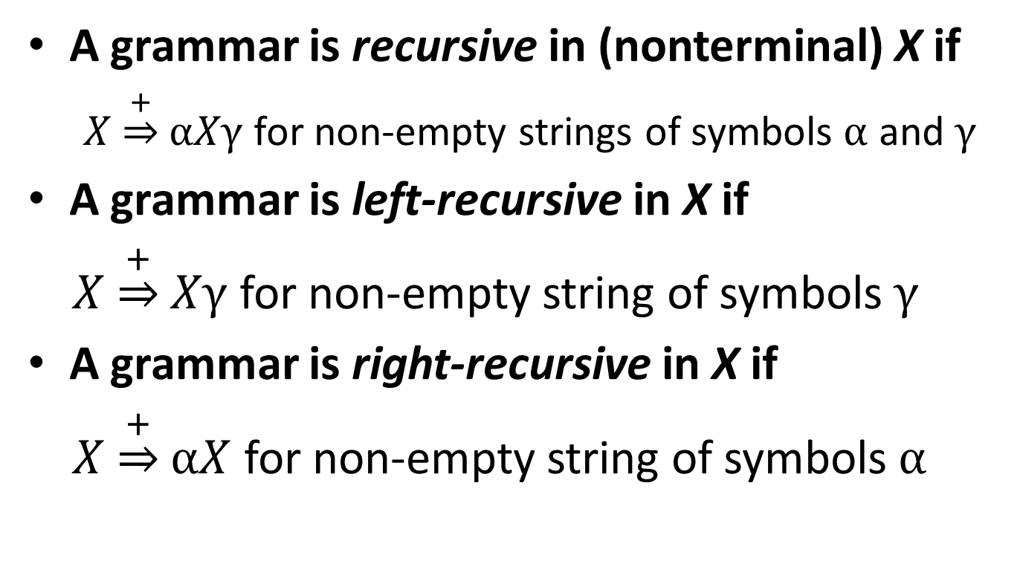
Definition: Recursion in Grammars
A grammar is recursive in (nonterminal) X if
$X\underset{⇒}{+}αXγ$ for non-empty strings of symbols $α$ and $γ$
A grammar is left-recursive in X if
$X\underset{⇒}{+}Xγ$ for non-empty string of symbols $γ$
A grammar is right-recursive in X if
$X\underset{⇒}{+}αX$ for non-empty string of symbols $α$

Slide 20
Resolving Grammar Ambiguity: Associativity
We’ll recognize left-associative operators with left-associative productions
We’ll recognize right-associative operators with right-associative productions
Term
Example: 4 – 7 – 9
Expr → Expr minus Expr
| Term
Term → Term times Term
| Factor
Factor → intlit | lparen Expr rparen
E
E
-
T
Factor
T
F
E
-
T
F
intlit
F
intlit
9
7
intlit
4

Slide 21
Resolving Grammar Ambiguity: Associativity
Expr → Expr minus Term
| Term
Term → Term times Factor
| Factor
Factor → intlit | lparen Expr rparen
Example: 4 – 7 – 9
Let’s try to re-build the wrong parse tree again
E
E
-
T
T
We’ll never be able to derive minus
without parens
F
intlit
4

