Slide 1
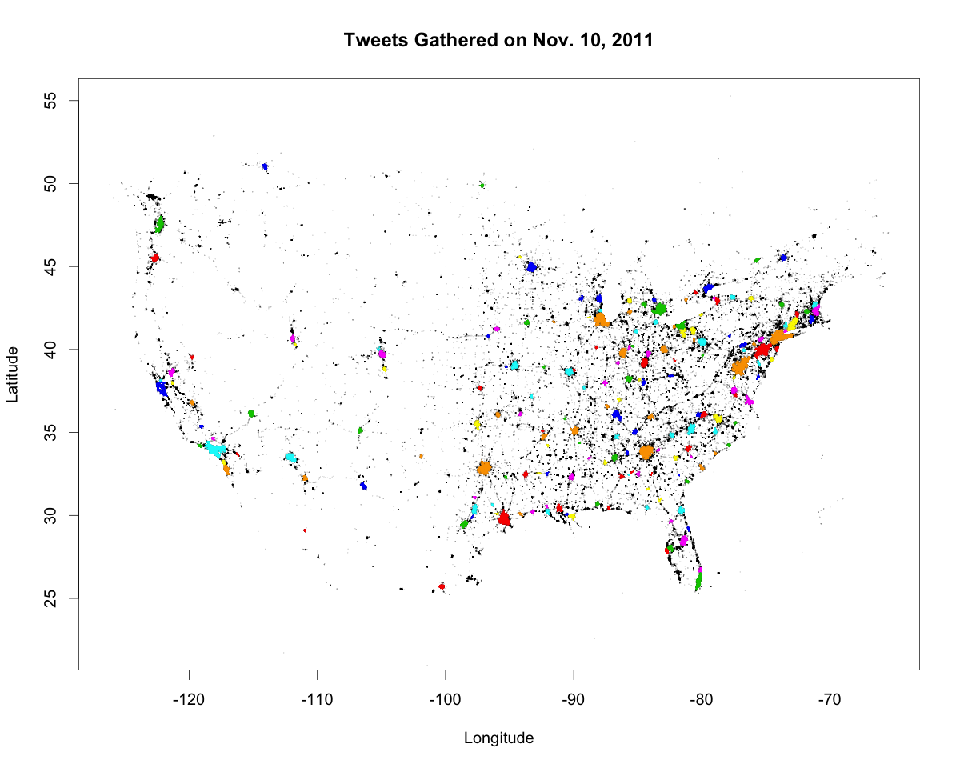
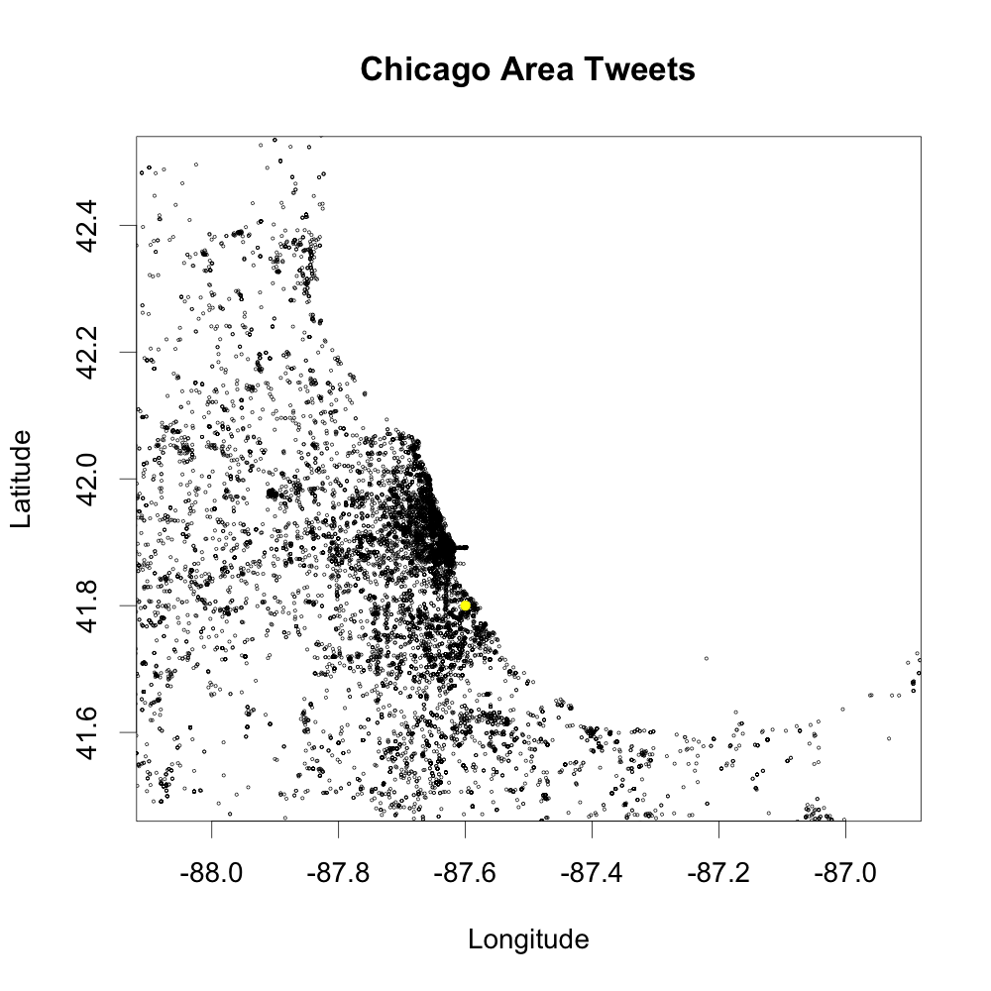
Mr. Scan
Density-Based Clustering for Extreme Scale Systems
DBSCAN
Mr. Scan Execution
Aims to separate clusters from noise
3. Merge Overlapping Clusters (CP)
4. Color the Clusters (FE)
DBSCAN example: Chicago, IL
ε = .1° lat/long
MinPts = 400
1. Detect possible
cluster overlap with
grid
2. Check for
representative
point overlap
3. Calculate the diff of
the non-core points
4. Calc distance from
representative points
Merge if at least
ONE’s distance from
< ε
Color each cluster
Send coloring to BE for cluster output
ε
ε
Orange Non-Core
ε
If D < ε merge
Blue Non-Core
FE
Found 4177 > MinPts points in ε-neighborhood. Center point is a core point.
D
2. Pick Representative Points (BE)
Representative points are a small finite set of points that represent all core points in a ε x ε box
Used to detect cluster overlap
A core point that would cause a merge has to fall within ε of a representative point
Shadow
Region
Packet Contains
Slow
Average: O(nlog(n))
Worst case: O(n²)
CP
Cluster non-core points (size bounded by MinPts)
Representative points for each ε x ε box in cluster
CP
Finds arbitrarily shaped clusters
# of clusters not needed
Shadow
Region
Geo-located tweets from Twitter gathered on Nov. 10, 2011
Representative points are the set of points which represent the furthest extension into each shadow region (Max of 2 per shadow region)
DBSCAN Scaling
DBSCAN’s serial performance limits feasible calculations to tens of millions of points
Need parallelism to cluster datasets with billions of points
1. Run DBSCAN (BE)
BE
BE
BE
BE
Points in ε-neighborhood are added to a cluster
Run DBSCAN to classify points into clusters on local partition
A region query is performed on each newly-added point to determine which ones are core or non-core
0. Prep Input Data
To Backends
Expand core points until no new core points are found
Divide data into ε x ε boxes
Form roughly equal partitions from boxes
Outline each partition with “shadow area”
Target # points per BE:
FS
800K – GPU DBSCAN
50K – CPU DBSCAN

