Slide 1
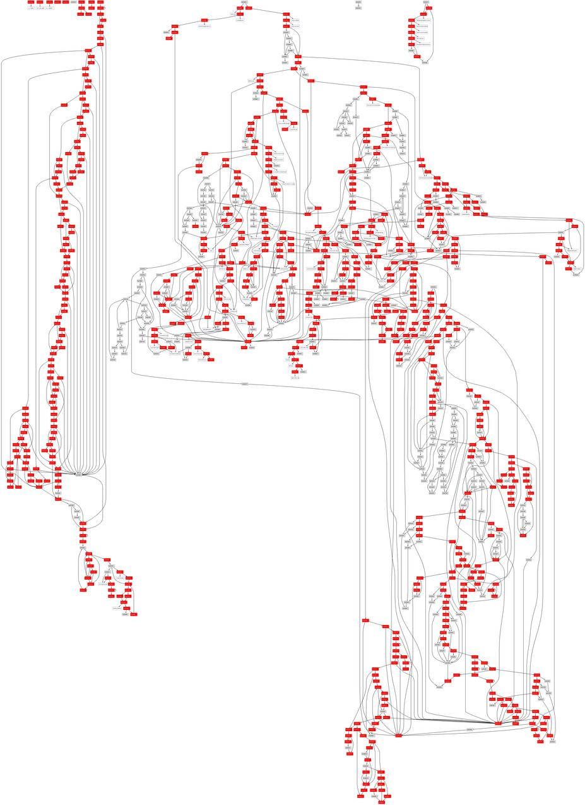
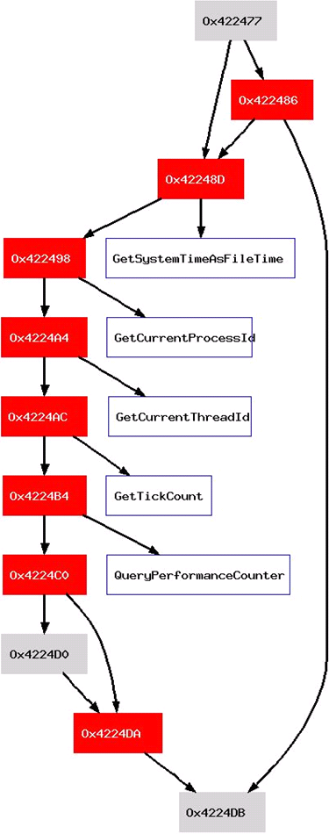
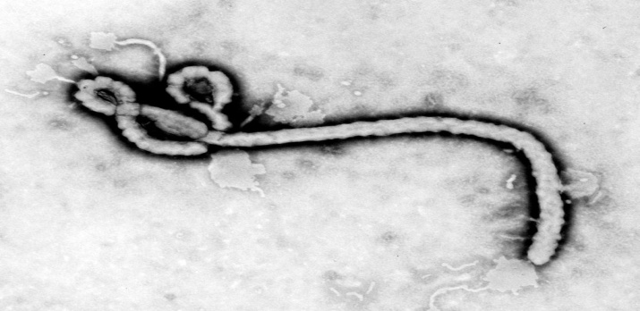
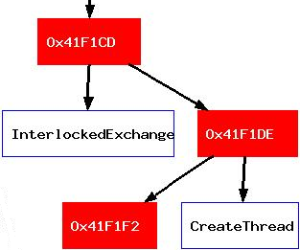
Before Execution
SD-Dyninst
Static-Dynamic Malware Analysis
The Malware Binary
Dyninst Analysis of Binary
Analyzing Conficker
Conficker generates its malicious code at runtime; we use Dyninst to analyze its static and dynamic code.
Why is analyzing malware hard?
Control Flow Graph
Static parsing
Dyninst initially generates a CFG for all visible code
Packed code: the binary’s malicious code is not generated until runtime
Self-modifying code: overwrites can change the code’s behavior
Obfuscated code: what code is statically visible is hard to analyze
These techniques are pervasive! 90% of malware is analysis-resistant
lea eax, 0x4a0000
lea ebx, 0x401000
load ecx, ptr[eax]
xor ecx, 0xffffff
store ptr[ecx],ebx
jnz .x
Code coverage of basic blocks
add eax, 4
add ebx, 4
cmp eax, 0x4a1f88
jnz .loop
Obfuscated control transfer analysis
We monitor two types of control transfer instructions:
We efficiently obtain code coverage information for Conficker A by instrumenting all of its basic blocks and removing instrumentation that has executed.
During Execution
Unpacking loop
An unpacking loop decompresses or decrypts the hidden code at runtime
File
call ptr[edi]
obfuscated library calls are resolved dynamically
.loop
lea eax, 0x4a0000
lea ebx, 0x401000
load ecx, ptr [r1]
xor ecx, 0xffffff
store ptr[ecx], r2
...
jnz .x
call ptr[edi]
.x
add eax, 4
add ebx, 4
cmp eax, 0x4a1f88
jnz .loop
jmp 0x401000
?
jmp 0x401000
Indirect transfers since we can’t statically determine where they go
Code that will be overwritten
The code that is statically present may be modified before or after it executes
Address 0x401000:
there’s nothing
here at startup!
Static transfers into empty or uninitialized regions
Hidden code bytes
Hidden code is compressed or encrypted and looks like random data
7a 77 0e 20 e9 3d e0 09 e8 68 c0 45 be 79 5e 80 89 08 27 c0 73 1c 88 48 6a d8 6a d0 56 4b fe 92 57 af 40 0c b6 f2 64 32 f5 07 b6 66 21 0c 85 a5 94 2b 20 fd 5b 95 e7 c2 16 90 14 8a 14 26 60 d9 83 a1 37 1b 2f b9 51 84 02 1c 22 8e 63 01 de a2 87 ad f3 07 51 d2 d2 02 b0 18 b5 f1 b1 fb bb 1f 67 83 c0 30 42 3d f0 2d
Memory image
At runtime the unpacking loop unpacks hidden code into the address space
But where? We want to find the code before it executes
Control Flow Graph
Instrumentation
We find new code by instrumenting control transfers to determine whether the target address is in a new code region
Conficker creates a communications thread
Address Space
jump to unpacked code
.loop
lea eax, 0x4a0000
lea ebx, 0x401000
load ecx, ptr [r1]
xor ecx, 0xffffff
store ptr[ecx], r2
...
jnz .x
call ptr[edi]
.x
add eax, 4
add ebx, 4
cmp eax, 0x4a1f88
jnz .loop
jmp 0x401000
lea eax, 0x4a0000
lea ebx, 0x401000
load ecx, ptr[eax]
xor ecx, 0xffffff
store ptr[ecx],ebx
jnz .x
pre-unpack code
add eax, 4
add ebx, 4
cmp eax, 0x4a1f88
jnz .loop
instrument-ation
Legend
 | executed basic block
 | un-executed basic block
 | control flow edge
Modified code
The program’s static code has been replaced by modified code
call ptr[edi]
Modified code
We track code writes by write-protecting code pages and capturing the resulting exceptions
7a 77 0e 20 e9 3d e0 09 e8 68 c0 45 be 79 5e 80 89 08 27 c0 73 1c 88 48 6a d8 6a d0 56 4b fe 92 57 af 40 0c b6 f2 64 32 f5 07 b6 66 21 0c 85 a5 94 2b 20 fd 5b 95 e7 c2 16 90 14 8a 14 26 60 d9 83 a1 37 1b 2f b9 51 84 02 1c 22 8e 63 01 de a2 87 ad f3 07 51 d2 d2 02 b0 18 b5 f1 b1 fb bb 1f 67 83 c0 30 42 3d f0 2d
instrument-ation
?
jmp 0x401000
Stack traces at points of interest
Unpacked code
The code must be unpacked before it can be executed, though it could be unpacked a piece at a time
At some point a control transfer instruction passes execution to an unpacked code region
Runtime parsing
Dyninst parses unpacked code regions just before they execute
Candidate control transfers to other unpacked regions are instrumented
We monitored communications code by instrumenting functions in the Windows socket library (e.g., bind, send, select) to walk the call stack.
Conficker’s communications thread at select
Frame pc=0x7c901231 func: DbgBreakPoint at 7x901230 [Win DLL]
Frame pc=0x10003c83 func: DYNbreakPoint at 0x100003c70 [instrument.]
Frame pc=0x100016f7 func: DYNstopThread at 0x100001670 [instrument.]
Frame pc=0x71ab2dc0 func: select at 0x71ab2dc0 [Win DLL]
Frame pc=0x401f34 func: nosym1f058 at 0x41f058 [Conficker]
?
Notes:
Bring out the confluence of static & dynamic techniques, make sure it’s clear that our dynamic analysis is triggering static techniques at runtime.

