Slide 1
Software Based Fault tolerance in Computer Vision
Chen-Han Ho
CS 766 Final Project

Slide 2
Reliability and Energy
As technology scales, device reliability decreases
Transistor’s energy efficiency does not scale very well
Provide reliable hardware with recovery scheme becomes expensive:
Checkpointing
Modular redundancy
Conservative design constraints

Slide 3
Computer Vision
Many different applications:
Image processing, sampling, filtering, HDR
Image transformation
Feature detection and extraction
Segmentation
Including solving matrix equations, optimization problems, heuristics..
Reliability and energy efficiency are important, especially in mobile space

Slide 4



Slide 5
Software-based approaches
Using software to relief the burden in hardware
Software checkpointing
Application robustification through stochastic optimization
Idempotent processing

Slide 6
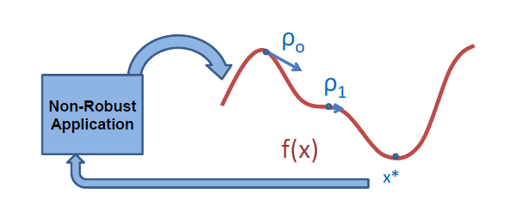
Stochastic Optimization
Re-casting applications to optimization problem
Iterative algorithm
Minimum is the output of the non-robust application
[A Numerical Optimization-based Methodology for Application Robustification, Sloan et al.]

Slide 7
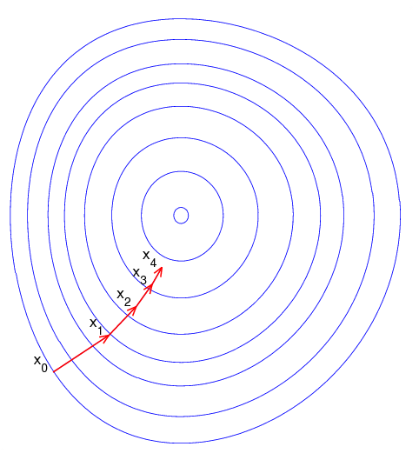
Optimization Engine
Gradient descent
Search strategy:
Conjugate gradient

Slide 8
Some Facts
10X-1000X more instructions executed
Only tolerant faults in data processing phase
Some applications can achieve ~100% accuracy, some < 50% success and require further enhancement
Energy saving?

Slide 9
Energy implications

Slide 10
Idempotent Processing
Using idempotence
- Whenever a fault happens, execution can be restart from the beginning of current idempotent region and same correct result will be produced
Compiler support
ISA interface, hardware failure detection
Simpler hardware, tolerant faults with implicit checkpoints and re-execution

Slide 11
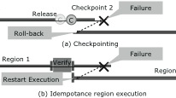
Idempotent Execution

Slide 12
Evaluation
Idempotent compiler
Pin: instrumentation
Application: VLFeat
Agglomerative Information Bottleneck (AIB)
Maximally Stable Extremal Regions (MSER)
Scale Invariant Feature Transform (SIFT)
Vector comparison (VEC)
Image convolution (CONV)

Slide 13
Results: Performance

Slide 14
Results: Energy

Slide 15
Conclusion
Stochastic optimization:
Varied accuracy
Trade accuracy for energy
Hardware support unidentified
Idempotent processing
100% correct results
Energy <> region size and re-execution time
Fault detection and region verify

Slide 16
Questions?

Slide 17
Region Size
aib | mser | sift | vec | conv
249.998 | 12.0736 | 27.0296 | 1056.19 | 94.5301

