Slide 1
How to be a good advisor/advisee?
Anish Das Sarma
Google Research

Slide 2
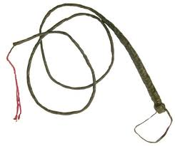
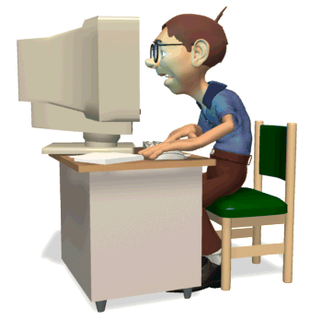
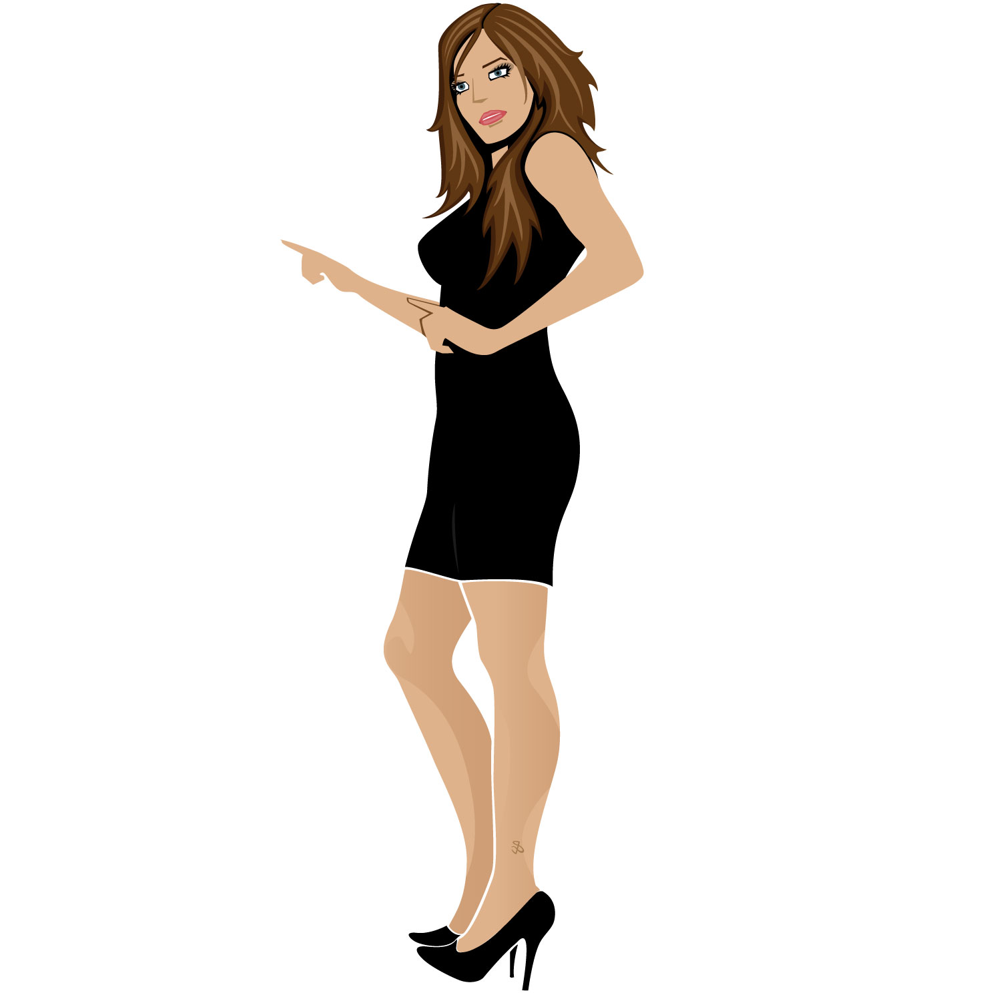
What is an advisor/advisee relationship?
Advisee does most work
Advisor provides guidance

Slide 3
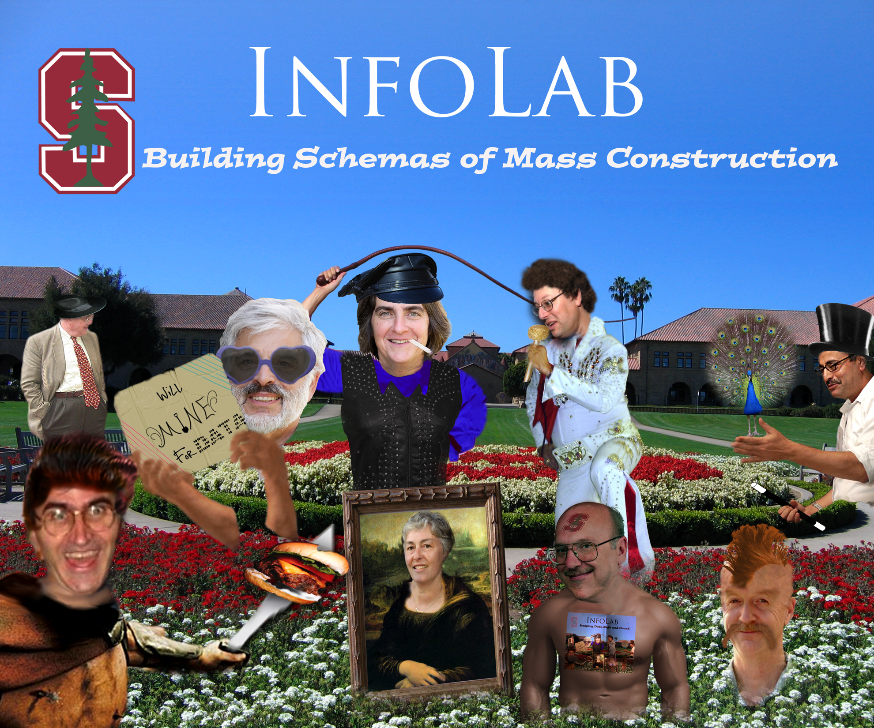

Slide 4
Advisor-Advisee Match
Match in terms of broad areas of interest
Work style:
hands on versus hands off
theory vs. practice
Compatible personalities

Slide 5
My two cents for advisees

Slide 6
Lesson #1: Seek feedback actively!
The more feedback you seek, the more you learn
Discuss your career goals
Ask questions:
What areas can I improve in?
How do I identify good research problems?
Which company should I intern at?
Don’t believe them if answer is not

Slide 7
Lesson #2: Communicate openly
Tell them what you would like changed:
I would like to meet you more often (or less often… or never)
I would like to work on a theory problem for a change
I want you to ensure my papers get accepted to Sigmod
(Email me if you get a solution to this!)
If you are really unhappy, it’s never too late to change your advisor

Slide 8
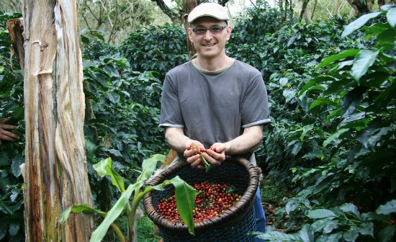
Lesson #3: Know what your advisor likes!
I got a job at Google by pretending to like coffee
Don’t worry about impressing:
Enjoy what you do
Work hard
Seek constant feedback

Slide 9
My two cents for advisors and advisees

Slide 10
Lesson #4: Give honest opinion
Balance both parties’ interests
Constructive feedback:
Praise good work
Discuss areas for development
Set realistic goals

Slide 11
Lesson #5: You can learn from everyone!
I’ve been blessed with many exceptional collaborators
seniors, peers, and juniors
academicians, industrialists
theoretical and systems people
Working with different kinds of people gives a broader perspective on research

Slide 12
Lesson #6: Don’t get yourself oversubscribed!
(lots of really smart people) &&
(working on really cool problems)
=> (hard not to want to work with them)
Enter a collaboration only if you have time to do justice

Slide 13
Summary
Seek feedback from advisors/collaborators
Communicate openly
Know what your advisor likes ☺
Give honest opinion
You can learn from every collaborator
Make sure you have time before entering a collaboration

Slide 14
Thanks!
Anish Das Sarma
anish.dassarma@gmail.com

