Slide 1
Big Picture: Dataflow Analysis
Program
Abstraction engine
System of Dataflow Equations
Equation solver
Solution (= dataflow facts)
Notes:
In terms of a typical system for program analysis, which has the pipeline shown on this slide, the algorithm plays the role of the equation solver. It takes as input the equation system that abstracts the actions of the program, and produces as output the solution to the equation system. That solution is then used to identify possible program flaws, or to establish the correctness of the program’s behavior.
<CLICK>
In essence, what we did was to combine two known techniques to create an improved equation solver.

Slide 2

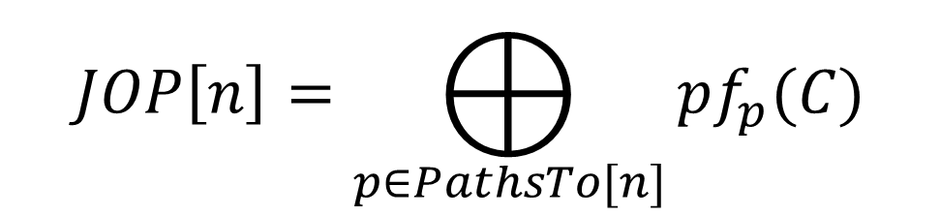

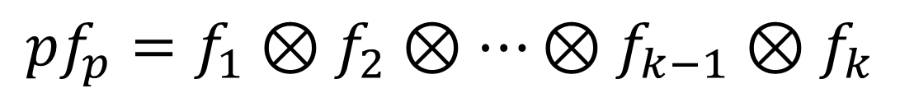


Path Semantics for
Intraprocedural Analysis
C
$$f_{1}$$
$$f_{2}$$
$$f_{k−1}$$
$$f_{k}$$
start
n
$$pf_{p}=f_{1}⊗f_{2}⊗…⊗f_{k−1}⊗f_{k}$$
$$JOP\left[n\right]=⨁_{p∈PathsTo[n]}{pf_{p}(C)}$$

Slide 3
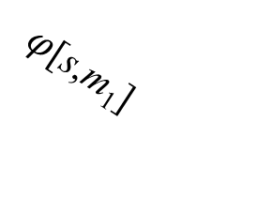




From Path Semantics to Equational Semantics
Path
semantics:
$$JOP\left[n\right]=⨁_{p∈PathsTo[n]}{pf_{p}(C)}$$
Equational
semantics:
s
x
s
x
$φ$[s,m₁]
m₁
$φ$[e,n]
$φ$[s,s] = Id
$φ$[s,m_{k}]
. . .
f[m₁,n]
⊕
m_{k}
n
f[m_{k},n]

Slide 4


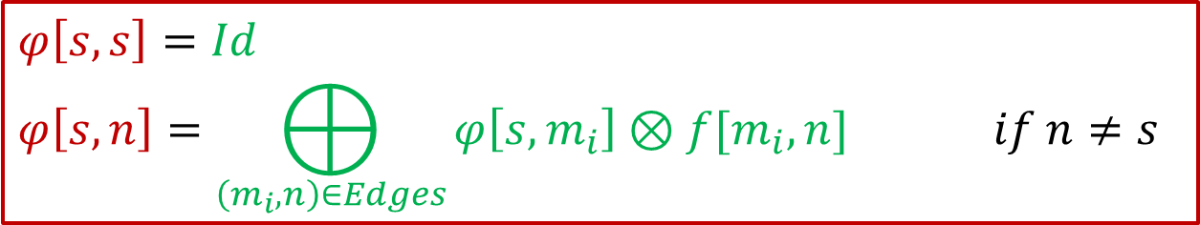


Equational Semantics
$$φ\left[s,s\right]=Id$$
$$φ\left[s,n\right]=⨁_{\left(m_{i},n\right)∈Edges}{φ\left[s,m_{i}\right]⊗f[m_{i},n] } if n≠s$$
s
x
s
x
$φ$[s,m₁]
m₁
$φ$[e,n]
$φ$[s,s] = Id
$φ$[s,m_{k}]
. . .
f[m₁,n]
⊕
m_{k}
n
f[m_{k},n]

Slide 5
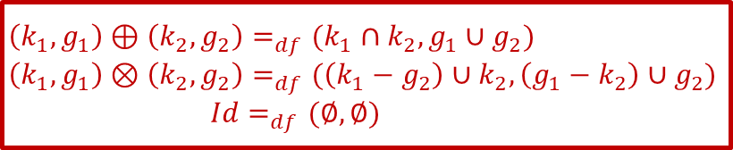


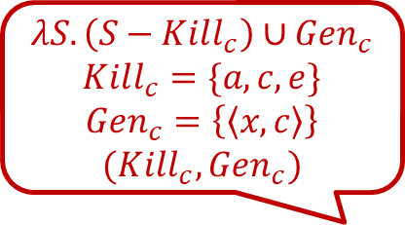













Gen-Kill Problems: Reaching Defs
start
$$Id$$
$$Id$$
a: x = 3
$$∅$$
$$Id$$
$$λS.\left(S −\{\left\langle x,a\right\rangle ,\left\langle x,c\right\rangle ,\left\langle x,e\right\rangle \}\right)∪\{\left\langle x,a\right\rangle \}$$
$$\left(k_{1},g_{1}\right)⊕\left(k_{2},g_{2}\right)=_{df}(k_{1}∩k_{2}, g_{1}∪g_{2})$$
$$\left(k_{1},g_{1}\right)⊗\left(k_{2},g_{2}\right)=_{df}(\left(k_{1}−g_{2}\right)∪k_{2},\left(g_{1}−k_{2}\right)∪g_{2})$$
$$Id=_{df}(∅,∅)$$
$$λS.\left(S −\{\left\langle x,a\right\rangle ,\left\langle x,c\right\rangle ,\left\langle x,e\right\rangle \}\right)∪\{\left\langle x,a\right\rangle \}$$
b: . . .
{⟨x:a⟩}
⋮
$$λS.\left(S−Kill_{c}\right)∪Gen_{c}$$
$$Kill_{c}=\{a,c,e\}$$
$$Gen_{c}=\left\{\left\langle x,c\right\rangle \right\}$$
$$(Kill_{c},Gen_{c})$$
⋮
$$∅$$
e: x = 7
$$Id$$
c: x = 5
{⟨x:a⟩}
$$λS.\left(S −\{\left\langle x,a\right\rangle ,\left\langle x,c\right\rangle ,\left\langle x,e\right\rangle \}\right)∪\{\left\langle x,e\right\rangle \}$$
$$λS.\left(S −\{\left\langle x,a\right\rangle ,\left\langle x,c\right\rangle ,\left\langle x,e\right\rangle \}\right)∪\{\left\langle x,c\right\rangle \}$$
{⟨x:e⟩}
f: . . .
$$λS.\left(S −\{\left\langle x,a\right\rangle ,\left\langle x,c\right\rangle ,\left\langle x,e\right\rangle \}\right)∪\{\left\langle x,e\right\rangle \}$$
$$λS.\left(S −\{\left\langle x,a\right\rangle ,\left\langle x,c\right\rangle ,\left\langle x,e\right\rangle \}\right)∪\{\left\langle x,c\right\rangle \}$$
d: . . .
{⟨x:c⟩}
⋮
⋮
$$φ[start,exit]$$
$$⊕$$
$$λS.\left(S −\{\left\langle x,a\right\rangle ,\left\langle x,c\right\rangle ,\left\langle x,e\right\rangle \}\right)∪\{\left\langle x,c\right\rangle \}$$
y = x
{⟨x:c⟩, ⟨x:e⟩}
$$λS.\left(S −\{\left\langle x,a\right\rangle ,\left\langle x,c\right\rangle ,\left\langle x,e\right\rangle \}\right)∪\{\left\langle x,c\right\rangle ,⟨x,e⟩\}$$

Slide 6
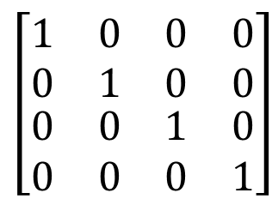






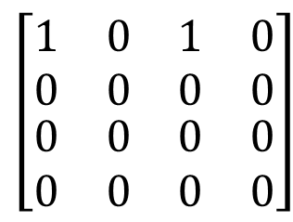
Representing Dataflow Functions
$$Λ$$
a
b
c
Identity Function
$$\left[\begin{matrix}\begin{matrix}1 & 0 \\ 0 & 1\end{matrix} & \begin{matrix}0 & 0 \\ 0 & 0\end{matrix} \\ \begin{matrix}0 & 0 \\ 0 & 0\end{matrix} & \begin{matrix}1 & 0 \\ 0 & 1\end{matrix}\end{matrix}\right]$$
$$f= λS.S$$
$$f\left(\left\{a,b\right\}\right)=\{a,b\}$$
Constant Function
$$Λ$$
a
b
c
$$\left[\begin{matrix}\begin{matrix}1 & 0 \\ 0 & 0\end{matrix} & \begin{matrix}1 & 0 \\ 0 & 0\end{matrix} \\ \begin{matrix}0 & 0 \\ 0 & 0\end{matrix} & \begin{matrix}0 & 0 \\ 0 & 0\end{matrix}\end{matrix}\right]$$
$$f= λS.\{b\}$$
$$f\left(\left\{a,b\right\}\right)=\{b\}$$

Slide 7
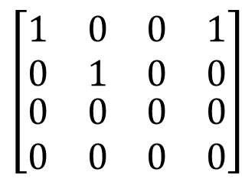




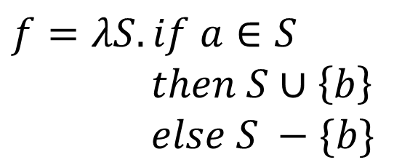

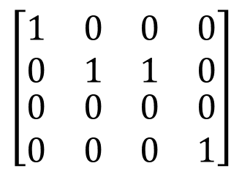
Representing Dataflow Functions
$$Λ$$
a
b
c
“Gen/Kill” Function
$$\left[\begin{matrix}\begin{matrix}1 & 0 \\ 0 & 1\end{matrix} & \begin{matrix}0 & 1 \\ 0 & 0\end{matrix} \\ \begin{matrix}0 & 0 \\ 0 & 0\end{matrix} & \begin{matrix}0 & 0 \\ 0 & 0\end{matrix}\end{matrix}\right]$$
$$f=λS.\left(S−\left\{b\right\}\right)∪\{c\}$$
$$f\left(\left\{a,b\right\}\right)=\{a,c\}$$
Non-“Gen/Kill” Function
$$Λ$$
a
b
c
$$f=λS.if a∈S$$
$$then S∪\left\{b\right\}$$
$$else S −\{b\}$$
$$\left[\begin{matrix}\begin{matrix}1 & 0 \\ 0 & 1\end{matrix} & \begin{matrix}0 & 0 \\ 1 & 0\end{matrix} \\ \begin{matrix}0 & 0 \\ 0 & 0\end{matrix} & \begin{matrix}0 & 0 \\ 0 & 1\end{matrix}\end{matrix}\right]$$
$$f\left(\left\{a,b\right\}\right)=\{a,b\}$$

Slide 8

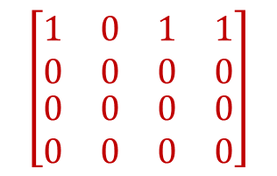



Gen-Kill Problems: Reaching Defs
start
$$Id$$
$$Id$$
a: x = 3
$$Id$$
$$λS.\left(S −\{\left\langle x,a\right\rangle ,\left\langle x,c\right\rangle ,\left\langle x,e\right\rangle \}\right)∪\{\left\langle x,a\right\rangle \}$$
b: . . .
⋮
⋮
e: x = 7
$$Id$$
$$λS.\left(S −\{\left\langle x,a\right\rangle ,\left\langle x,c\right\rangle ,\left\langle x,e\right\rangle \}\right)∪\{\left\langle x,a\right\rangle \}$$
c: x = 5
f: . . .
$$λS.\left(S −\{\left\langle x,a\right\rangle ,\left\langle x,c\right\rangle ,\left\langle x,e\right\rangle \}\right)∪\{\left\langle x,e\right\rangle \}$$
$$λS.\left(S −\{\left\langle x,a\right\rangle ,\left\langle x,c\right\rangle ,\left\langle x,e\right\rangle \}\right)∪\{\left\langle x,c\right\rangle \}$$
d: . . .
$$Λ \left\langle x,a\right\rangle \left\langle x,c\right\rangle ⟨x,e⟩$$
⋮
$Λ$
$\left\langle x,a\right\rangle$
$\left\langle x,c\right\rangle$
$⟨x,e⟩$
$$\left[\begin{matrix}\begin{matrix}1 & 0 \\ 0 & 0\end{matrix} & \begin{matrix}1 & 1 \\ 0 & 0\end{matrix} \\ \begin{matrix}0 & 0 \\ 0 & 0\end{matrix} & \begin{matrix}0 & 0 \\ 0 & 0\end{matrix}\end{matrix}\right]$$
⋮
$$λS.\left(S −\{\left\langle x,a\right\rangle ,\left\langle x,c\right\rangle ,\left\langle x,e\right\rangle \}\right)∪\{\left\langle x,c\right\rangle ,⟨x,e⟩\}$$
y = x

Slide 9















Possibly Uninitialized Variables (PUV)
“May Contain Junk”
$$∅$$
Start
$$λS.\{w,x,y\}$$
$$\{w,x,y\}$$
x = 3
$$λS.S−\{x\}$$
if . . .
$$\{w,y\}$$
$$λS.S$$
$$λS.S$$
y = x
$$\{w,y\}$$
$$λS.if x∈S$$
$$then S∪\left\{y\right\}$$
$$else S −\{y\}$$
$$\{w,y\}$$
y = w
$$λS.if w∈S$$
$$then S∪\left\{y\right\}$$
$$else S −\{y\}$$
w = 8
$$\{w\}$$
$$⊕$$
$$λS.S−\{w\}$$
printf(y)
$$∅⊕\left\{w,y\right\}=\{w,y\}$$

Slide 10



Gen-Kill Problems: Reaching Defs
$$∅$$
start
$$Id$$
a: x = 3
$$∅$$
$$λS.\left(S −\{\left\langle x,a\right\rangle ,\left\langle x,c\right\rangle ,\left\langle x,e\right\rangle \}\right)∪\{\left\langle x,a\right\rangle \}$$
b: . . .
{⟨x:a⟩}
⋮
⋮
$$∅$$
e: x = 7
$$Id$$
$$λS.\left(S −\{\left\langle x,a\right\rangle ,\left\langle x,c\right\rangle ,\left\langle x,e\right\rangle \}\right)∪\{\left\langle x,a\right\rangle \}$$
c: x = 5
{⟨x:a⟩}
{⟨x:e⟩}
f: . . .
$$λS.\left(S −\{\left\langle x,a\right\rangle ,\left\langle x,c\right\rangle ,\left\langle x,e\right\rangle \}\right)∪\{\left\langle x,e\right\rangle \}$$
$$λS.\left(S −\{\left\langle x,a\right\rangle ,\left\langle x,c\right\rangle ,\left\langle xe\right\rangle \}\right)∪\{\left\langle x,c\right\rangle \}$$
d: . . .
{⟨x:c⟩}
⋮
⋮
$$λS.\left(S −\{\left\langle x,a\right\rangle ,\left\langle x,c\right\rangle ,\left\langle x,e\right\rangle \}\right)∪\{\left\langle x,c\right\rangle ,⟨x,e⟩\}$$
y = x
{⟨x:c⟩, ⟨x:e⟩}

