Slide 1
m₁
m₂
.
.
.
m_{k}
ESSSD[s, m₁]
l(m₁, n)
ESSSD[s, m₂]
l(m₂, n)
n
s
ESSSD[s, m_{k}]
l(m_{k}, n)
Notes:
Figure 1

Slide 2
1: start
λσ.(???)
2: a=1
λσ.σ[a←1]
3: b=1
λσ.σ[b←1]
4: a<3
F
6: c=a+b
λσ.σ[c ← σ(a)+σ(b)]
7: exit
λσ.σ(a)>=3?σ:⊥
λσ.σ[a ← σ(a)+σ(b)]
T
λσ.σ(a)<3?σ:⊥
5: a=a+b
Notes:
Figure 2

Slide 3
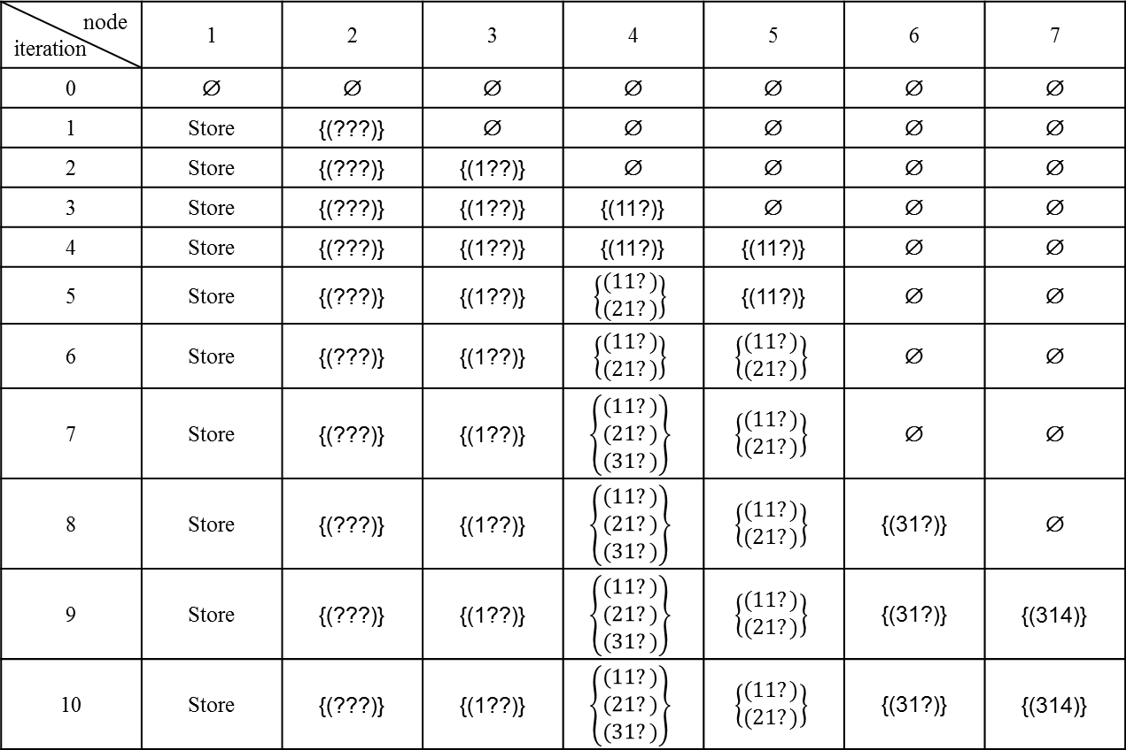
node iteration | 1 | 2 | 3 | 4 | 5 | 6 | 7
0 | ∅ | ∅ | ∅ | ∅ | ∅ | ∅ | ∅
1 | Store | {(???)} | ∅ | ∅ | ∅ | ∅ | ∅
2 | Store | {(???)} | {(1??)} | ∅ | ∅ | ∅ | ∅
3 | Store | {(???)} | {(1??)} | {(11?)} | ∅ | ∅ | ∅
4 | Store | {(???)} | {(1??)} | {(11?)} | {(11?)} | ∅ | ∅
5 | Store | {(???)} | {(1??)} | $$\left\{\begin{aligned}(11?) \\ (21?)\end{aligned}\right\}$$ | {(11?)} | ∅ | ∅
6 | Store | {(???)} | {(1??)} | $$\left\{\begin{aligned}(11?) \\ (21?)\end{aligned}\right\}$$ | $$\left\{\begin{aligned}(11?) \\ (21?)\end{aligned}\right\}$$ | ∅ | ∅
7 | Store | {(???)} | {(1??)} | $$\left\{\begin{aligned}(11?) \\ (21?) \\ (31?)\end{aligned}\right\}$$ | $$\left\{\begin{aligned}(11?) \\ (21?)\end{aligned}\right\}$$ | ∅ | ∅
8 | Store | {(???)} | {(1??)} | $$\left\{\begin{aligned}(11?) \\ (21?) \\ (31?)\end{aligned}\right\}$$ | $$\left\{\begin{aligned}(11?) \\ (21?)\end{aligned}\right\}$$ | {(31?)} | ∅
9 | Store | {(???)} | {(1??)} | $$\left\{\begin{aligned}(11?) \\ (21?) \\ (31?)\end{aligned}\right\}$$ | $$\left\{\begin{aligned}(11?) \\ (21?)\end{aligned}\right\}$$ | {(31?)} | {(314)}
10 | Store | {(???)} | {(1??)} | $$\left\{\begin{aligned}(11?) \\ (21?) \\ (31?)\end{aligned}\right\}$$ | $$\left\{\begin{aligned}(11?) \\ (21?)\end{aligned}\right\}$$ | {(31?)} | {(314)}
means that the indicated variable has a constant value at a node in the CFG. For example, variable b has the constant value 1 at node 4. (Note that we also treat ? as a constant.)
Notes:
Figure 3

Slide 4
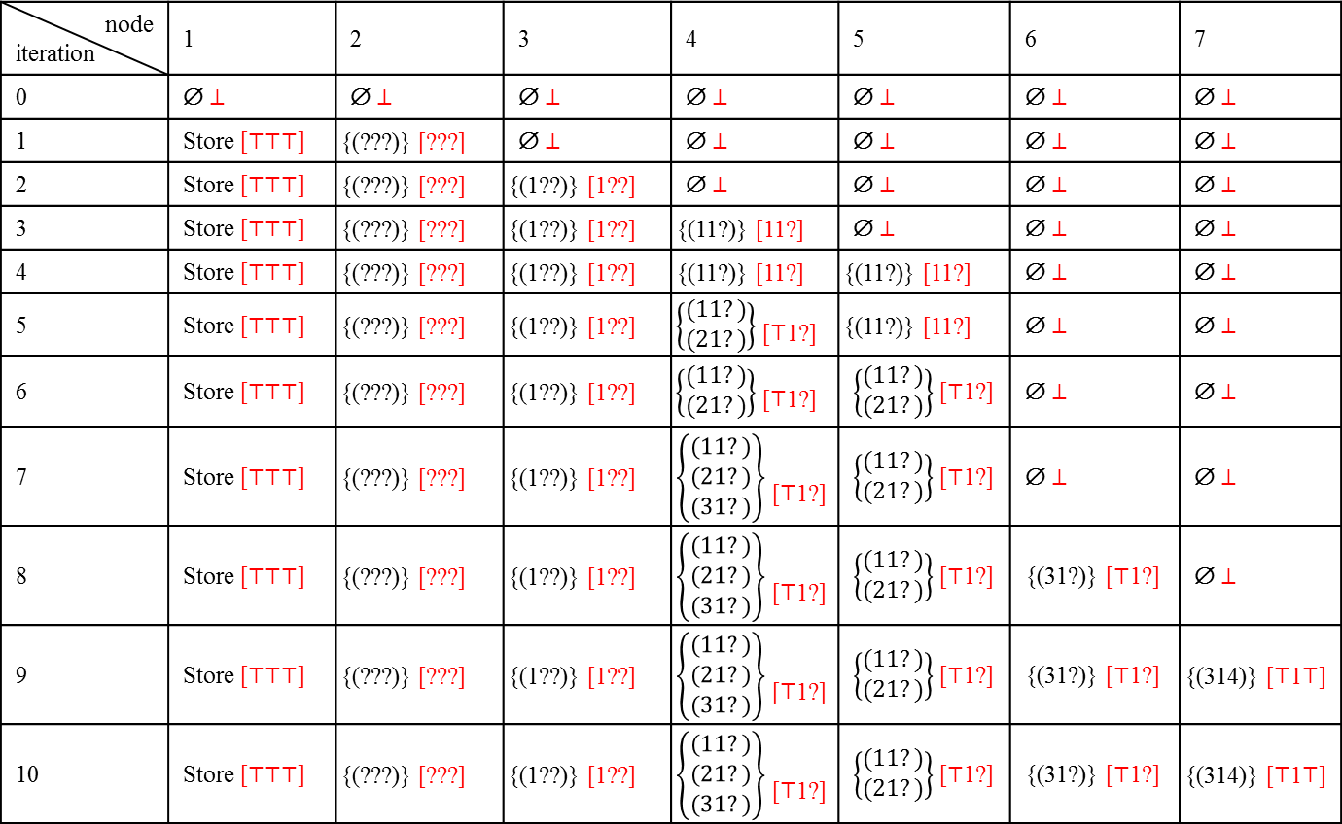
node iteration | 1 | 2 | 3 | 4 | 5 | 6 | 7
0 | ∅ ⊥ | ∅ ⊥ | ∅ ⊥ | ∅ ⊥ | ∅ ⊥ | ∅ ⊥ | ∅ ⊥
1 | Store [⊤⊤⊤] | {(???)} [???] | ∅ ⊥ | ∅ ⊥ | ∅ ⊥ | ∅ ⊥ | ∅ ⊥
2 | Store [⊤⊤⊤] | {(???)} [???] | {(1??)} [1??] | ∅ ⊥ | ∅ ⊥ | ∅ ⊥ | ∅ ⊥
3 | Store [⊤⊤⊤] | {(???)} [???] | {(1??)} [1??] | {(11?)} [11?] | ∅ ⊥ | ∅ ⊥ | ∅ ⊥
4 | Store [⊤⊤⊤] | {(???)} [???] | {(1??)} [1??] | {(11?)} [11?] | {(11?)} [11?] | ∅ ⊥ | ∅ ⊥
5 | Store [⊤⊤⊤] | {(???)} [???] | {(1??)} [1??] | $\left\{\begin{aligned}(11?) \\ (21?)\end{aligned}\right\}$ [⊤1?] | {(11?)} [11?] | ∅ ⊥ | ∅ ⊥
6 | Store [⊤⊤⊤] | {(???)} [???] | {(1??)} [1??] | $\left\{\begin{aligned}(11?) \\ (21?)\end{aligned}\right\}$ [⊤1?] | $\left\{\begin{aligned}(11?) \\ (21?)\end{aligned}\right\}$ [⊤1?] | ∅ ⊥ | ∅ ⊥
7 | Store [⊤⊤⊤] | {(???)} [???] | {(1??)} [1??] | $\left\{\begin{aligned}(11?) \\ (21?) \\ (31?)\end{aligned}\right\}$ [⊤1?] | $\left\{\begin{aligned}(11?) \\ (21?)\end{aligned}\right\}$ [⊤1?] | ∅ ⊥ | ∅ ⊥
8 | Store [⊤⊤⊤] | {(???)} [???] | {(1??)} [1??] | $\left\{\begin{aligned}(11?) \\ (21?) \\ (31?)\end{aligned}\right\}$ [⊤1?] | $\left\{\begin{aligned}(11?) \\ (21?)\end{aligned}\right\}$ [⊤1?] | {(31?)} [⊤1?] | ∅ ⊥
9 | Store [⊤⊤⊤] | {(???)} [???] | {(1??)} [1??] | $\left\{\begin{aligned}(11?) \\ (21?) \\ (31?)\end{aligned}\right\}$ [⊤1?] | $\left\{\begin{aligned}(11?) \\ (21?)\end{aligned}\right\}$ [⊤1?] | {(31?)} [⊤1?] | {(314)} [⊤1⊤]
10 | Store [⊤⊤⊤] | {(???)} [???] | {(1??)} [1??] | $\left\{\begin{aligned}(11?) \\ (21?) \\ (31?)\end{aligned}\right\}$ [⊤1?] | $\left\{\begin{aligned}(11?) \\ (21?)\end{aligned}\right\}$ [⊤1?] | {(31?)} [⊤1?] | {(314)} [⊤1⊤]
shows places where we obtain worse information than what the collecting semantics indicates. The loss of information at one point can cause other information to be lost (e.g., variable c at point 7, due to imprecise information for variable a at point 6).
Notes:
Figure 4

