Slide 1
e
x
EFAS[e,m₁]
m₁
EFAS[e,n]
EFAS[e,m_{k}]
. . .
M#(m₁,n)
⊕
m_{k}
n
M#(m_{k},n)
Notes:
EFAS-general

Slide 2
e
x
EFAS[e,e] = Id
Notes:
EFAS-initial

Slide 3
a: x = 3
⋮
c: x = 7
{⟨x:a⟩, …}
b: x = 5
{⟨x:b⟩, …}
⋮
⋮
{⟨x:b⟩, ⟨x:c⟩, …}
y = x
Notes:
EFAS-initial

Slide 4
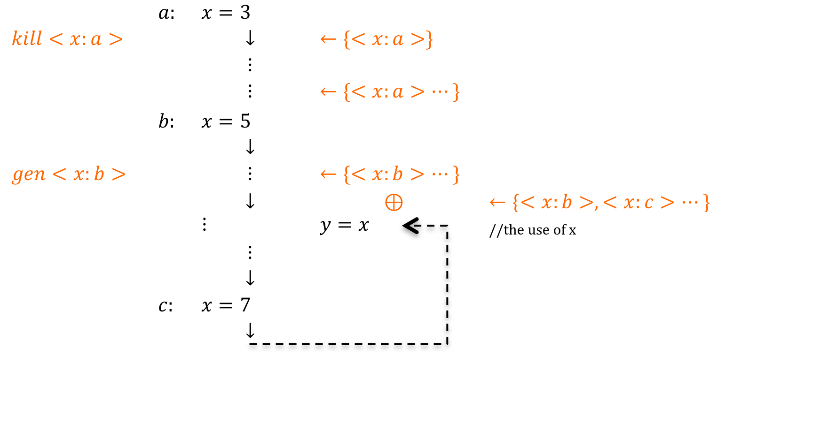
Figure: flowchart

