Slide 1
$$c_{1} c_{2} c_{3} r_{3} c_{4} r_{4} r_{2} r_{1}$$
Notes:
string-with-nesting-relationship

Slide 2
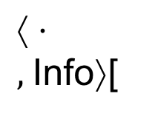
Main
P
Q
Q
$↑⋅,$Info⟩[
Stack
R
Notes:
example-stack

Slide 3
return

Slide 4
sets of states
sets of states
$$f$$
$Φ func$tion
$$Φ function$$
Notes:
abstract-composition

Slide 5
Notes:
invalid-path

Slide 6
. . .
P
Q
Stack
Q
current procedure
Notes:
stack-suffix

Slide 7
“saturated”
*
Q
Q
Notes:
abstracted-stack

Slide 8
$$\begin{matrix}\{<\boxed{\begin{matrix}\frac{M}{R}\end{matrix}}\end{matrix} ,v_{1}>, < \boxed{M} ,v_{2}>\}$$
$$C_{1}$$
$$C_{2}$$
$$\{<\begin{matrix}{∗ \atop \boxed{\begin{matrix}\frac{R}{C_{1}}\end{matrix}}}\end{matrix} ,v_{1}>, <\boxed{\begin{matrix}\frac{M}{C_{1}}\end{matrix}} ,v_{2}>\}$$
$$Q$$
Notes:
propagation-step1

Slide 9
$$\begin{matrix}\{<\boxed{\begin{matrix}\frac{M}{R}\end{matrix}}\end{matrix} ,v_{1}>, < \boxed{M} ,v_{2}>\}$$
$$C_{1}$$
$$C_{2}$$
$$\{<\begin{matrix}{∗ \atop \boxed{\begin{matrix}\frac{R}{C_{1}}\end{matrix}}}\end{matrix} ,v_{1}^{′} >, <\boxed{\begin{matrix}\frac{M}{C_{1}}\end{matrix}} ,v_{2}^{′}>\}$$
$$\{<\begin{matrix}{∗ \atop \boxed{\begin{matrix}\frac{R}{C_{1}}\end{matrix}}}\end{matrix} ,v_{1}>, <\boxed{\begin{matrix}\frac{M}{C_{1}}\end{matrix}} ,v_{2}>\}$$
$$Q$$
Notes:
propagation-step2

Slide 10
$$\begin{matrix}\{<\boxed{\begin{matrix}\frac{M}{R}\end{matrix}}\end{matrix} ,v_{1}>, < \boxed{M} ,v_{2}>\}$$
$$\begin{matrix}\{<\boxed{\begin{matrix}\frac{M}{R}\end{matrix}}\end{matrix} ,v_{3}>\}$$
$$C_{1}$$
$$C_{2}$$
$$\{<\begin{matrix}{∗ \atop \boxed{\begin{matrix}\frac{R}{C_{1}}\end{matrix}}}\end{matrix} ,v_{1}^{′} >, <\boxed{\begin{matrix}\frac{M}{C_{1}}\end{matrix}} ,v_{2}^{′}>\}$$
$$\{<\begin{matrix}{∗ \atop \boxed{\begin{matrix}\frac{R}{C_{1}}\end{matrix}}}\end{matrix} ,v_{1}>, <\boxed{\begin{matrix}\frac{M}{C_{1}}\end{matrix}} ,v_{2}>\}$$
$$Q$$
Notes:
propagation-step3

Slide 11

$$\begin{matrix}\{<\boxed{\begin{matrix}\frac{M}{R}\end{matrix}}\end{matrix} ,v_{1}>, < \boxed{M} ,v_{2}>\}$$
$$\begin{matrix}\{<\boxed{\begin{matrix}\frac{M}{R}\end{matrix}}\end{matrix} ,v_{3}>\}$$
$$C_{1}$$
$$C_{2}$$
$$Push^{\#}$$
$$\{<\begin{matrix}{∗ \atop \boxed{\begin{matrix}\frac{R}{C_{1}}\end{matrix}}}\end{matrix} ,v_{1}^{′} >, <\boxed{\begin{matrix}\frac{M}{C_{1}}\end{matrix}} ,v_{2}^{′}>,<\begin{matrix}{∗ \atop \boxed{\begin{matrix}\frac{R}{C_{2}}\end{matrix}}}\end{matrix} ,v_{3}^{′}>\}$$
$$\{<\begin{matrix}{∗ \atop \boxed{\begin{matrix}\frac{R}{C_{1}}\end{matrix}}}\end{matrix} ,v_{1}>, <\boxed{\begin{matrix}\frac{M}{C_{1}}\end{matrix}} ,v_{2}>,$$
$$<\begin{matrix}{∗ \atop \boxed{\begin{matrix}\frac{R}{C_{2}}\end{matrix}}}\end{matrix} ,v_{3}>\}$$
$$Q$$
Notes:
propagation-step4

Slide 12

$$\begin{matrix}\{<\boxed{\begin{matrix}\frac{M}{R}\end{matrix}}\end{matrix} ,v_{1}^{′} >,$$
$$< \boxed{M} ,v_{2}^{′}>\}$$
$$\begin{matrix}\{<\boxed{\begin{matrix}\frac{M}{R}\end{matrix}}\end{matrix} ,v_{3}>\}$$
$$\begin{matrix}\{<\boxed{\begin{matrix}\frac{M}{R}\end{matrix}}\end{matrix} ,v_{1}>, < \boxed{M} ,v_{2}>\}$$
$$C_{1}$$
$$C_{2}$$
$$\begin{matrix}\{<\boxed{\begin{matrix}\frac{M}{R}\end{matrix}}\end{matrix} ,v_{3}^{′}>\}$$
Merge
Merge
$$Push^{\#}$$
$$\{<\begin{matrix}{∗ \atop \boxed{\begin{matrix}\frac{R}{C_{1}}\end{matrix}}}\end{matrix} ,v_{1}^{′} >, <\boxed{\begin{matrix}\frac{M}{C_{1}}\end{matrix}} ,v_{2}^{′}>,<\begin{matrix}{∗ \atop \boxed{\begin{matrix}\frac{R}{C_{2}}\end{matrix}}}\end{matrix} ,v_{3}^{′}>\}$$
$$\{<\begin{matrix}{∗ \atop \boxed{\begin{matrix}\frac{R}{C_{1}}\end{matrix}}}\end{matrix} ,v_{1}>, <\boxed{\begin{matrix}\frac{M}{C_{1}}\end{matrix}} ,v_{2}>,$$
$$<\begin{matrix}{∗ \atop \boxed{\begin{matrix}\frac{R}{C_{2}}\end{matrix}}}\end{matrix} ,v_{3}>\}$$
$$Q$$
Notes:
propagation-step5

Slide 13
Notes:
calling-context-tree-1

Slide 14
Pop
Notes:
calling-context-tree-2

Slide 15
Push
Pop
Pop
Notes:
calling-context-tree-3

Slide 16
____ ____ ____ ____ ____ ____ . . . . . . . . . . . . ____
Execution Trace:
Notes:
parse-tree

Slide 17
____ ____ ____ ____ ____ ____ . . . ____
Execution Trace:
____ ____ ____ ____ . . .
String that is visible$\left(σ | I\right):$
Notes:
execution-trace

Slide 18
____ ____ ____ ____ ____ ____ . . . ____
____ ____ _ _ _ ____ ____ _ _ _ . . . _ _ _
Execution Trace:
$$\left(σ | I\right):$$
Notes:
overlaid-parse-tree

Slide 19
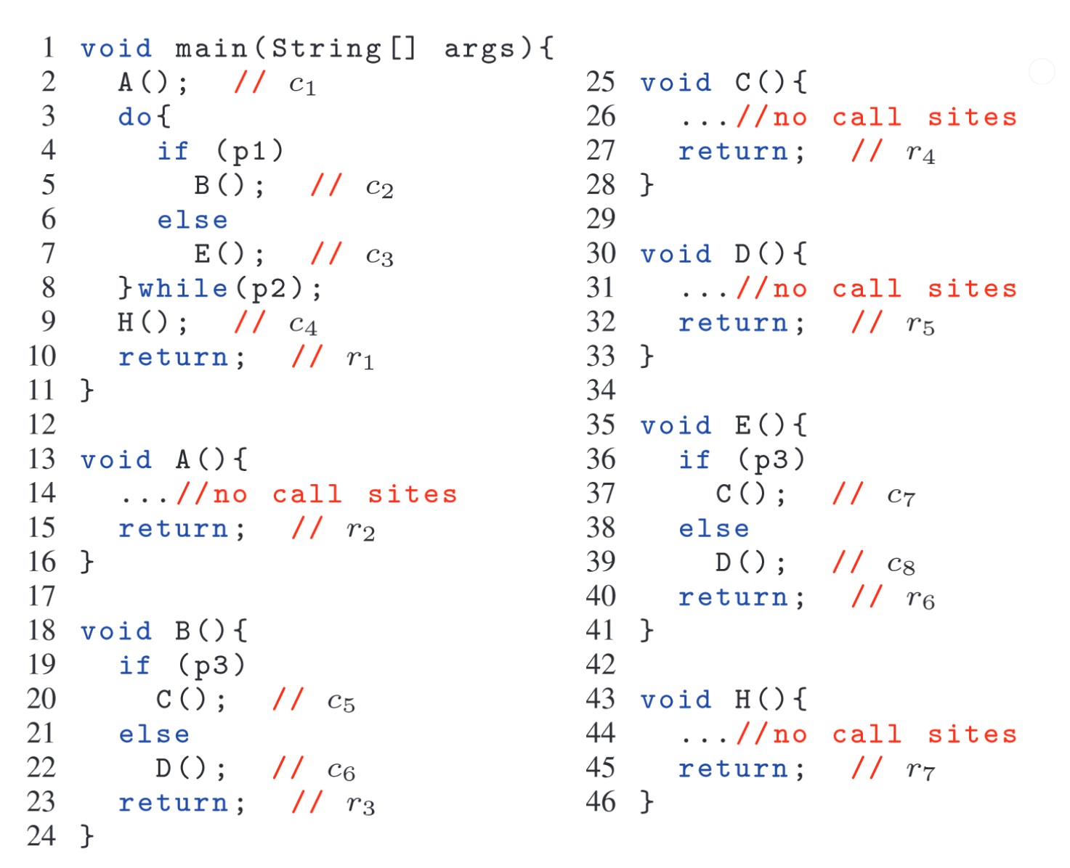
Notes:
program-example

Slide 20
$$f$$
$$3$$
$$1$$
$$Succ_{c_{i}}$$
$$c_{i}$$
$$f_{c_{i}}$$
$$2$$
$$Func_{f_{c_{i}}}$$
Notes:
LL1-production-path

Slide 21
$$3$$
$$1$$
$$1$$
$$2$$

Slide 22
$$t_{i}$$

Slide 23
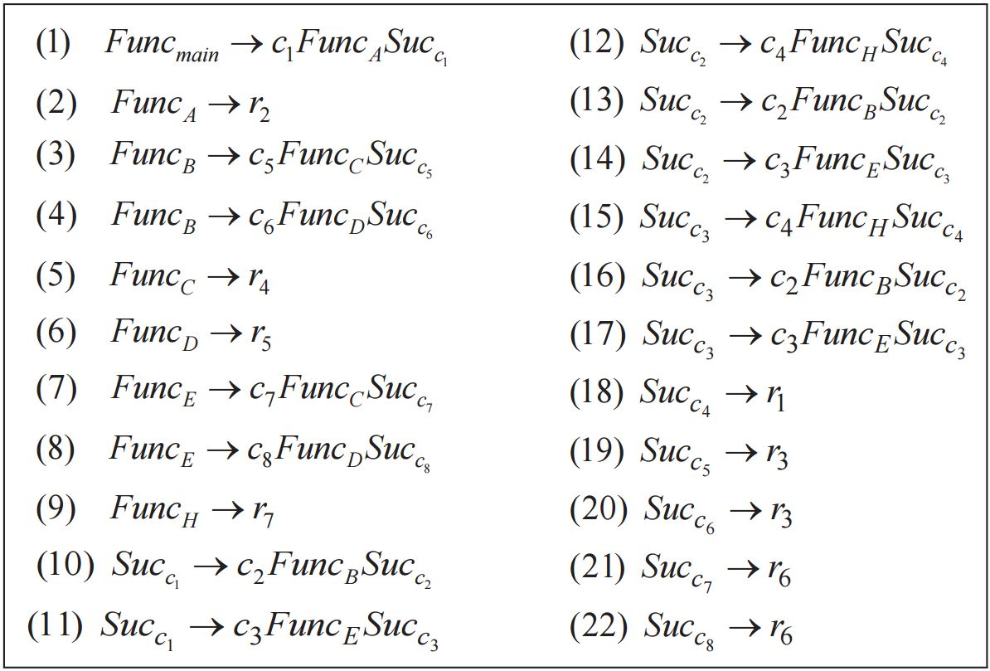
Notes:
example-grammar

