Slide 1
GPU Architectures
A CPU Perspective
Derek Hower AMD Research 5/21/2013

Slide 2
Goals
Data Parallelism: What is it, and how to exploit it?
  Workload characteristics
Execution Models / GPU Architectures
  MIMD (SPMD), SIMD, SIMT
GPU Programming Models
  Terminology translations: CPU ←→ AMD GPU ←→ Nvidia GPU
  Intro to OpenCL
Modern GPU Microarchitectures
  i.e., programmable GPU pipelines, not their fixed-function predecessors
Advanced Topics: (Time permitting)
  The Limits of GPUs: What they can and cannot do
  The Future of GPUs: Where do we go from here?

Slide 3
Data Parallel Execution on GPUs
Data Parallelism, Programming Models, SIMT

Slide 4
Graphics Workloads
Streaming computation
GPU

Slide 5
Graphics Workloads
Streaming computation on pixels
GPU

Slide 6
Graphics Workloads
Identical, Streaming computation on pixels
GPU

Slide 7

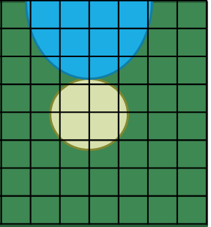
Graphics Workloads
Identical, Independent, Streaming computation on pixels
GPU

Slide 8
Architecture Spelling Bee
P-A-R-A-L-L-E-L
Spell ‘Independent’

Slide 9




Generalize: Data Parallel Workloads
Identical, Independent computation on multiple data inputs
0,7
$$color_{out}=f(color_{in})$$
7,0
1,7
$$color_{out}=f(color_{in})$$
6,0
2,7
$$color_{out}=f(color_{in})$$
5,0
3,7
$$color_{out}=f(color_{in})$$
4,0

Slide 10




Naïve Approach
Split independent work over multiple processors
CPU0
0,7
$$color_{out}=f(color_{in})$$
7,0
CPU1
1,7
$$color_{out}=f(color_{in})$$
6,0
CPU2
2,7
$$color_{out}=f(color_{in})$$
5,0
CPU3
3,7
$$color_{out}=f(color_{in})$$
4,0

Slide 11
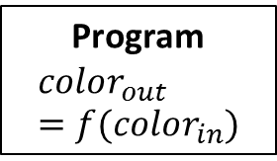
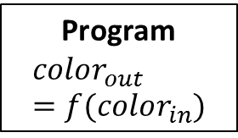
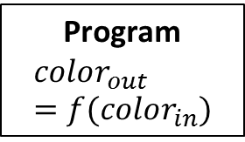
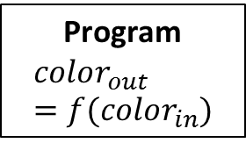
Data Parallelism: A MIMD Approach
Multiple Instruction Multiple Data
Split independent work over multiple processors
0,7
Program
$$color_{out}=f(color_{in})$$
CPU0
7,0
Fetch
Decode
Execute
Memory
Writeback
1,7
Program
$$color_{out}=f(color_{in})$$
CPU1
6,0
Fetch
Decode
Execute
Memory
Writeback
2,7
Program
$$color_{out}=f(color_{in})$$
CPU2
5,0
Fetch
Decode
Execute
Memory
Writeback
3,7
Program
$$color_{out}=f(color_{in})$$
CPU3
4,0
Fetch
Decode
Execute
Memory
Writeback

Slide 12
Data Parallelism: A MIMD Approach
Multiple Instruction Multiple Data
Split independent work over multiple processors
0,7
Program
$$color_{out}=f(color_{in})$$
CPU0
When work is identical (same program):
Single Program Multiple Data (SPMD)
(Subcategory of MIMD)
7,0
Fetch
Decode
Execute
Memory
Writeback
1,7
Program
$$color_{out}=f(color_{in})$$
CPU1
6,0
Fetch
Decode
Execute
Memory
Writeback
2,7
Program
$$color_{out}=f(color_{in})$$
CPU2
5,0
Fetch
Decode
Execute
Memory
Writeback
3,7
Program
$$color_{out}=f(color_{in})$$
CPU3
4,0
Fetch
Decode
Execute
Memory
Writeback

Slide 13
Data Parallelism: An SPMD Approach
Single Program Multiple Data
Split identical, independent work over multiple processors
0,7
Program
$$color_{out}=f(color_{in})$$
CPU0
7,0
Fetch
Decode
Execute
Memory
Writeback
1,7
Program
$$color_{out}=f(color_{in})$$
CPU1
6,0
Fetch
Decode
Execute
Memory
Writeback
2,7
Program
$$color_{out}=f(color_{in})$$
CPU2
5,0
Fetch
Decode
Execute
Memory
Writeback
3,7
Program
$$color_{out}=f(color_{in})$$
CPU3
4,0
Fetch
Decode
Execute
Memory
Writeback

Slide 14
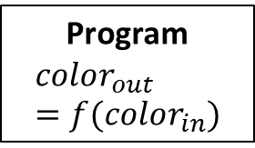
Data Parallelism: A SIMD Approach
Single Instruction Multiple Data
Split identical, independent work over multiple execution units (lanes)
More efficient: Eliminate redundant fetch/decode
0,7
1,7
CPU0
2,7
7,0
3,7
Execute
Memory
Writeback
Program
$$color_{out}=f(color_{in})$$
6,0
Execute
Memory
Writeback
Fetch
Decode
5,0
Execute
Memory
Writeback
Execute
Memory
Writeback
4,0

Slide 15
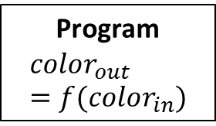
SIMD: A Closer Look
One Thread + Data Parallel Ops → Single PC, single register file
0,7
1,7
CPU0
2,7
7,0
3,7
Execute
Memory
Writeback
Program
$$color_{out}=f(color_{in})$$
6,0
Execute
Memory
Writeback
Fetch
Decode
5,0
Execute
Memory
Writeback
Execute
Memory
Writeback
4,0
Register File

Slide 16
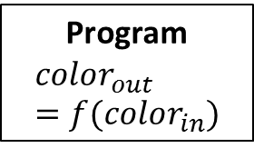
Data Parallelism: A SIMT Approach
Single Instruction Multiple Thread
Split identical, independent work over multiple lockstep threads
Multiple Threads + Scalar Ops → One PC, Multiple register files
0,7
WF0
1,7
Execute
Memory
Writeback
2,7
7,0
3,7
Execute
Memory
Writeback
Program
$$color_{out}=f(color_{in})$$
6,0
Fetch
Decode
5,0
Execute
Memory
Writeback
4,0
Execute
Memory
Writeback

Slide 17
Terminology Headache #1
It’s common to interchange
‘SIMD’ and ‘SIMT’

Slide 18
Data Parallel Execution Models
MIMD/SPMD
SIMD/Vector
SIMT
Multiple independent
threads
One thread with wide execution datapath
Multiple lockstep threads

Slide 19
Execution Model Comparison
MIMD/SPMD
SIMD/Vector
SIMT
Example Architecture | Multicore CPUs | x86 SSE/AVX | GPUs
Pros | More general: supports TLP | Can mix sequential & parallel code | Easier to program Gather/Scatter operations
Cons | Inefficient for data parallelism | Gather/Scatter can be awkward | Divergence kills performance
Notes:
Will explain pros/cons in depth later…this is a preview. End slide with: “Calling GPUs SIMT is a simplification. There is more to the story…”

Slide 20
GPUs and Memory
Recall: GPUs perform Streaming computation →
Streaming memory access
GPU
DRAM latency: 100s of GPU cycles
How do we keep the GPU busy (hide memory latency)?

Slide 21
Hiding Memory Latency
Options from the CPU world:
Caches
  Need spatial/temporal locality
OoO/Dynamic Scheduling
  Need ILP
Multicore/Multithreading/SMT
  Need independent threads
✗
✗
✓

Slide 22
Multicore Multithreaded SIMT
Many SIMT “threads” grouped together into GPU “Core”
SIMT threads in a group ≈ SMT threads in a CPU core
  Unlike CPU, groups are exposed to programmers
Multiple GPU “Cores”
GPU
GPU “Core”
GPU “Core”

Slide 23
Multicore Multithreaded SIMT
Many SIMT “threads” grouped together into GPU “Core”
SIMT threads in a group ≈ SMT threads in a CPU core
  Unlike CPU, groups are exposed to programmers
Multiple GPU “Cores”
This is a GPU Architecture (Whew!)
GPU
GPU “Core”
GPU “Core”
Notes:
What do we call these things…?

Slide 24
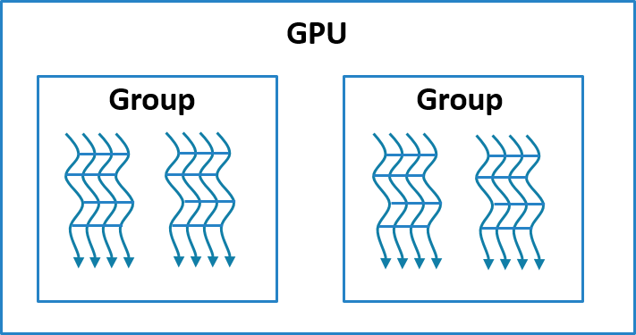
GPU Component Names
AMD/OpenCL
Derek’s CPU Analogy
Processing Element
Lane
SIMD Unit
Pipeline
GPU “Core”
Compute Unit
Core
GPU Device
Device
Notes:
“Derek” heavily influenced by Henn&Patt

Slide 25
GPU Programming Models
OpenCL

Slide 26
GPU Programming Models
CUDA – Compute Unified Device Architecture
  Developed by Nvidia -- proprietary
  First serious GPGPU language/environment
OpenCL – Open Computing Language
  From makers of OpenGL
  Wide industry support: AMD, Apple, Qualcomm, Nvidia (begrudgingly), etc.
C++ AMP – C++ Accelerated Massive Parallelism
  Microsoft
  Much higher abstraction that CUDA/OpenCL
OpenACC – Open Accelerator
  Like OpenMP for GPUs (semi-auto-parallelize serial code)
  Much higher abstraction than CUDA/OpenCL
Notes:
Will focus on OpenCL, but will compare to CUDA with terminology translation

Slide 27
GPU Programming Models
CUDA – Compute Unified Device Architecture
  Developed by Nvidia -- proprietary
  First serious GPGPU language/environment
OpenCL – Open Computing Language
  From makers of OpenGL
  Wide industry support: AMD, Apple, Qualcomm, Nvidia (begrudgingly), etc.
C++ AMP – C++ Accelerated Massive Parallelism
  Microsoft
  Much higher abstraction that CUDA/OpenCL
OpenACC – Open Accelerator
  Like OpenMP for GPUs (semi-auto-parallelize serial code)
  Much higher abstraction than CUDA/OpenCL
Notes:
Will focus on OpenCL, but will compare to CUDA with terminology translation

Slide 28
OpenCL
Early CPU languages were light abstractions of physical hardware
  E.g., C
Early GPU languages are light abstractions of physical hardware
  OpenCL + CUDA

Slide 29
OpenCL
Early CPU languages were light abstractions of physical hardware
  E.g., C
Early GPU languages are light abstractions of physical hardware
  OpenCL + CUDA
GPU Architecture
GPU
GPU “Core”
GPU “Core”

Slide 30
OpenCL
Early CPU languages were light abstractions of physical hardware
  E.g., C
Early GPU languages are light abstractions of physical hardware
  OpenCL + CUDA
GPU Architecture
OpenCL Model
GPU
NDRange
GPU “Core”
GPU “Core”
Workgroup
Workgroup
Work-item
Wavefront

Slide 31

NDRange
N-Dimensional (N = 1, 2, or 3) index space
  Partitioned into workgroups, wavefronts, and work-items
NDRange
Workgroup
Workgroup

Slide 32




Kernel
Run an NDRange on a kernel (i.e., a function)
Same kernel executes for each work-item
  Smells like MIMD/SPMD
Kernel
0,7
$$color_{out}=f(color_{in})$$
7,0
1,7
$$color_{out}=f(color_{in})$$
6,0
2,7
$$color_{out}=f(color_{in})$$
5,0
3,7
$$color_{out}=f(color_{in})$$
4,0

Slide 33
Kernel
Run an NDRange on a kernel (i.e., a function)
Same kernel executes for each work-item
  Smells like MIMD/SPMD…but beware, it’s not!
Kernel
0,7
$$color_{out}=f(color_{in})$$
7,0
1,7
$$color_{out}=f(color_{in})$$
6,0
Workgroup
2,7
$$color_{out}=f(color_{in})$$
5,0
3,7
$$color_{out}=f(color_{in})$$
4,0

Slide 34
OpenCL Code
__kernel
void flip_and_recolor(__global float3 **in_image,
__global float3 **out_image,
int img_dim_x, int img_dim_y)
{
int x = get_global_id(1); // get work-item id in dim 1
int y = get_global_id(2); // get work-item id in dim 2
out_image[img_dim_x - x][img_dim_y - y] =
recolor(in_image[x][y]);
}

Slide 35
GPU Microarchitecture
AMD Graphics Core Next

Slide 36
GPU Hardware Overview
GPU
GDDR5
GPU
L2 Cache
GPU “Core”
GPU “Core”
L1 Cache
L1 Cache
SIMT
SIMT
SIMT
SIMT
SIMT
SIMT
SIMT
SIMT
Registers
Registers
Local Memory
Local Memory

Slide 37
Compute Unit – A GPU Core
Workgroup
Compute Unit (CU) – Runs Workgroups
  Contains 4 SIMT Units
  Picks one SIMT Unit per cycle for scheduling
SIMT Unit – Runs Wavefronts
  Each SIMT Unit has 10 wavefront instruction buffer
  Takes 4 cycles to execute one wavefront
L1 Cache
SIMT
SIMT
SIMT
SIMT
10 Wavefront x 4 SIMT Units =
40 Active Wavefronts / CU
64 work-items / wavefront x 40 active wavefronts =
2560 Active Work-items / CU
Registers
Local Memory

Slide 38
Compute Unit Timing Diagram
On average: fetch & commit one wavefront / cycle
SIMT0
SIMT1
SIMT2
SIMT3
1
WF1_0
2
WF1_1
WF2_0
3
WF1_2
WF2_1
WF3_0
4
WF1_3
WF2_2
WF3_1
WF4_0
5
WF5_0
WF2_3
WF3_2
WF4_1
Time
6
WF5_1
WF6_0
WF3_3
WF4_2
7
WF5_2
WF6_1
WF7_0
WF4_3
8
WF5_3
WF6_2
WF7_1
WF8_0
9
WF9_0
WF6_3
WF7_2
WF8_1
10
WF9_1
WF10_0
WF7_3
WF8_2
11
WF9_2
WF10_1
WF11_0
WF8_3
12
WF9_3
WF10_2
WF11_1
WF12_0

Slide 39
SIMT Unit – A GPU Pipeline
Like a wide CPU pipeline – except one fetch for entire width
16-wide physical ALU
  Executes 64-wavefront over 4 cycles. Why??
64KB register state / SIMT Unit
  Compare to x86 (Bulldozer): ~1KB of physical register file state (~1/64 size)
Address Coalescing Unit
  A key to good memory performance
Registers
Registers
Registers
Registers
Registers
Registers
Registers
Registers
Registers
Registers
Registers
Registers
Registers
Registers
Registers
Registers
Address Coalescing Unit
Notes:
16x4 execution – greater instruction mix across CU + 32 bit work-item load = 64 byte coalesced load

Slide 40
Address Coalescing
Wavefront: Issue 64 memory requests
NDRange
Workgroup
Workgroup

Slide 41
Address Coalescing
Wavefront: Issue 64 memory requests
Common case:
  work-items in same wavefront touch same cache block
Coalescing:
  Merge many work-items requests into single cache block request
Important for performance:
  Reduces bandwidth to DRAM

Slide 42

GPU Memory
GPUs have caches.

Slide 43
Not Your CPU’s Cache
By the numbers: Bulldozer – FX-8170 vs. GCN – Radeon HD 7970
 | CPU (Bulldozer) | GPU (GCN)
L1 data cache capacity | 16KB | 16 KB
Active threads (work-items) sharing L1 D Cache | 1 | 2560
L1 dcache capacity / thread | 16KB | 6.4 bytes
Last level cache (LLC) capacity | 8MB | 768KB
Active threads (work-items) sharing LLC | 8 | 81,920
LLC capacity / thread | 1MB | 9.6 bytes

Slide 44
GPU Caches
Maximize throughput, not hide latency
  Not there for either spatial or temporal locality
L1 Cache: Coalesce requests to same cache block by different work-items
  i.e., streaming thread locality?
  Keep block around just long enough for each work-item to hit once
  Ultimate goal: Reduce bandwidth to DRAM
L2 Cache: DRAM staging buffer + some instruction reuse
  Ultimate goal: Tolerate spikes in DRAM bandwidth
If there is any spatial/temporal locality:
  Use local memory (scratchpad)

Slide 45
Scratchpad Memory
GPUs have scratchpads (Local Memory)
  Separate address space
  Managed by software:
    Rename address
    Manage capacity – manual fill/eviction
Allocated to a workgroup
  i.e., shared by wavefronts in workgroup
L1 Cache
SIMT
SIMT
SIMT
SIMT
Registers
Local Memory

Slide 46
Example System: Radeon HD 7970
High-end part
32 Compute Units:
  81,920 Active work-items
  32 CUs * 4 SIMT Units * 16 ALUs = 2048 Max FP ops/cycle
  264 GB/s Max memory bandwidth
925 MHz engine clock
  3.79 TFLOPS single precision (accounting trickery: FMA)
210W Max Power (Chip)
  >350W Max Power (card)
  100W idle power (card)

Slide 47
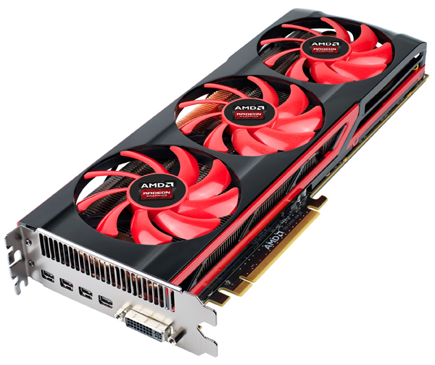
Radeon HD 7990 - Cooking
Two 7970s on one card:
375W (AMD Official) – 450W (OEM)
Notes:
Comparing GPU performance to CPU performance: Apples and Oranges

Slide 48
A Rose by Any Other Name…

Slide 49
Terminology Headaches #2-5
Nvidia/CUDA
AMD/OpenCL
Derek’s CPU Analogy
CUDA Processor
Processing Element
Lane
CUDA Core
SIMD Unit
Pipeline
GPU “Core”
Streaming
Multiprocessor
Compute Unit
Core
GPU Device
GPU Device
Device
Notes:
“Derek” heavily influenced by Henn&Patt

Slide 50
Terminology Headaches #6-9
CUDA/Nvidia
OpenCL/AMD
Henn&Patt
Sequence of SIMD Lane Operations
Thread
Work-item
Thread of SIMD Instructions
Warp
Wavefront
Group
Body of vectorized loop
Block
Workgroup
Vectorized loop
Grid
NDRange

Slide 51
Terminology Headache #10
GPUs have scratchpads (Local Memory)
  Separate address space
  Managed by software:
    Rename address
    Manage capacity – manual fill/eviction
Allocated to a workgroup
  i.e., shared by wavefronts in workgroup
L1 Cache
SIMT
SIMT
SIMT
SIMT
Registers
Local Memory
Nvidia calls ‘Local Memory’
‘Shared Memory’.
AMD sometimes calls it ‘Group Memory’.

Slide 52
Recap
Data Parallelism: Identical, Independent work over multiple data inputs
  GPU version: Add streaming access pattern
Data Parallel Execution Models: MIMD, SIMD, SIMT
GPU Execution Model: Multicore Multithreaded SIMT
OpenCL Programming Model
  NDRange over workgroup/wavefront
Modern GPU Microarchitecture: AMD Graphics Core Next (GCN)
  Compute Unit (“GPU Core”): 4 SIMT Units
  SIMT Unit (“GPU Pipeline”): 16-wide ALU pipe (16x4 execution)
  Memory: designed to stream
GPUs: Great for data parallelism. Bad for everything else.

Slide 53
Advanced Topics
GPU Limitations, Future of GPGPU

Slide 54
Choose Your Own Adventure!
SIMT Control Flow & Branch Divergence
Memory Divergence
When GPUs talk
  Wavefront communication
  GPU “coherence”
  GPU consistency
Future of GPUs: What’s next?

Slide 55
SIMT Control Flow
Consider SIMT conditional branch:
  One PC
  Multiple data (i.e., multiple conditions)
?
if (x <= 0)
y = 0;
else
y = x;

Slide 56
SIMT Control Flow
Work-items in wavefront run in lockstep
  Don’t all have to commit
Branching through predication
Active lane: commit result
Inactive lane: throw away result
All lanes active at start: 1111
if (x <= 0)
y = 0;
else
y = x;
Branch → set execution mask: 1000
Else → invert execution mask: 0111
Converge → Reset execution mask: 1111

Slide 57
SIMT Control Flow
Work-items in wavefront run in lockstep
  Don’t all have to commit
Branching through predication
Active lane: commit result
Inactive lane: throw away result
Branch divergence
All lanes active at start: 1111
if (x <= 0)
y = 0;
else
y = x;
Branch → set execution mask: 1000
Else → invert execution mask: 0111
Converge → Reset execution mask: 1111

Slide 58
Branch Divergence
When control flow diverges, all lanes take all paths
Divergence Kills Performance

Slide 59
Beware!
Divergence isn’t just a performance problem:
__global int lock = 0;
void mutex_lock(…)
{
…
// acquire lock
while (test&set(lock, 1) == false) {
// spin
}
return;
}
Notes:
Consider: one wavefront executes this code. One work-item will get the lock. The rest will not. The work-item that gets the lock can’t proceed because it is in lockstep with the work-items that failed to get the lock. No one makes progress.

Slide 60
Beware!
Divergence isn’t just a performance problem:
__global int lock = 0;
void mutex_lock(…)
{
…
// acquire lock
while (test&set(lock, 1) == false) {
// spin
}
return;
}
Deadlock: work-items can’t enter mutex together!

Slide 61
Memory Bandwidth
SIMT
DRAM
Lane 0
Bank 0
Lane 1
Bank 1
Lane 2
Bank 2
Lane 3
Bank 3
✓ -- Parallel Access

Slide 62
Memory Bandwidth
SIMT
DRAM
Lane 0
Bank 0
Lane 1
Bank 1
Lane 2
Bank 2
Lane 3
Bank 3
✗ -- Sequential Access

Slide 63
Memory Bandwidth
Memory divergence
SIMT
DRAM
Lane 0
Bank 0
Lane 1
Bank 1
Lane 2
Bank 2
Lane 3
Bank 3
✗ -- Sequential Access

Slide 64
Memory Divergence
One work-item stalls → entire wavefront must stall
  Cause: Bank conflicts, cache misses
Data layout & partitioning is important

Slide 65
Memory Divergence
One work-item stalls → entire wavefront must stall
  Cause: Bank conflicts, cache misses
Data layout & partitioning is important
Divergence Kills Performance

Slide 66
Communication and Synchronization
Work-items can communicate with:
  Work-items in same wavefront
    No special sync needed…they are lockstep!
  Work-items in different wavefront, same workgroup (local)
    Local barrier
  Work-items in different wavefront, different workgroup (global)
    OpenCL 1.x: Nope
    CUDA 4.x: Yes, but complicated

Slide 67
GPU Consistency Models
Very weak guarantee:
  Program order respected within single work-item
  All other bets are off
Safety net:
  Fence – “make sure all previous accesses are visible before proceeding”
  Built-in barriers are also fences
A wrench:
  GPU fences are scoped – only apply to subset of work-items in system
    E.g., local barrier
Take-away: confusion abounds

Slide 68
GPU Coherence?
Notice: GPU consistency model does not require coherence
  i.e., Single Writer, Multiple Reader
Marketing claims they are coherent…
GPU “Coherence”:
  Nvidia: disable private caches
  AMD: flush/invalidate entire cache at fences

Slide 69
GPU Architecture Research
Blending with CPU architecture:
  Dynamic scheduling / dynamic wavefront re-org
  Work-items have more locality than we think
Tighter integration with CPU on SOC:
  Fast kernel launch
    Exploit fine-grained parallel region: Remember Amdahl’s law
  Common shared memory
Reliability:
  Historically: Who notices a bad pixel?
  Future: GPU compute demands correctness
Power:
  Mobile, mobile mobile!!!

Slide 70
Computer Economics 101
GPU Compute is cool + gaining steam, but…
  Is a 0 billion dollar industry (to quote Mark Hill)
GPU design priorities:
  1. Graphics
  2. Graphics
  …
  N-1. Graphics
  N. GPU Compute
Moral of the story:
  GPU won’t become a CPU (nor should it)

