Slide 1
Parallel DB 101
David J. DeWitt
Microsoft Jim Gray Systems Lab
Madison, Wisconsin
dewitt@microsoft.com
© 2008 Microsoft Corporation. All rights reserved. This presentation is for informational purposes only.
Microsoft makes no warranties, express or implied in this presentation.

Slide 2
This talk is mission impossible
I did not enter on a motorcycle
I have no new product announcements to make
I have no slick demos to give
There is no final exam

Slide 3
Who is this guy?
Spent 32 years as a computer science professor at the University of Wisconsin
Which explains why my slides are so bad
Joined Microsoft in March 2008
Taught Peter Spiro everything he knows about database systems
Built 3 different parallel DB systems while a professor
DIRECT (1979 -1983)
Gamma (1983 -1990)
Paradise (1994 -2000) – sold to NCR/Teradata
Did first relational DBMS benchmark (1983)
Got Larry Ellison very, very mad at me

Slide 4
Jim Gray Systems Lab
Named after Jim Gray, a pioneer of the DB field, who was a Microsoft Technical Fellow when he was lost at sea in January 2007
Lab’s mission is to explore technologies to advance Microsoft’s mission to be the premier supplier of database systems software
Closely affiliated with the Univ. of Wisconsin – the top academic database research group in the world

Slide 5
What an audience!
About a factor of 100 larger then what I used to get on a Friday morning for an 8:50 A.M class

Slide 6
There will be a quiz at the end!
Seriously,
The goal of this talk is to teach you the fundamentals of how parallel database systems work
The key mechanisms are actually pretty simple
Understanding these mechanisms will help you use systems like Project Madison (DATAllegro) more effectively

Slide 7
Talk Outline
Alternative parallel DB architectures
Why “shared nothing” has emerged as the standard
Partitioned tables
The basis for scalable execution
Partitioned parallelism
Software building blocks for scalable database systems
Other technical challenges
Summary and conclusions

Slide 8
Metrics of success
Ideal parallel database system exhibits two key properties:
(1) linear speedup - twice as much hardware can execute the same workload twice as fast (i.e. with ½ the response time)
Interconnection Network
Interconnection Network
CPU
CPU
CPU
CPU
CPU
CPU
CPU
CPU
MEM
MEM
MEM
MEM
CPU
CPU
CPU
CPU
MEM
MEM
MEM
MEM
MEM
MEM
MEM
MEM
10 TB on 4 nodes and 4 disks
10 TB on 8 nodes and 8 disks

Slide 9
Metrics of success
(2) linear scaleup - twice as much hardware can execute the same workload on a database twice as large with the same response time
Interconnection Network
Interconnection Network
CPU
CPU
CPU
CPU
CPU
CPU
CPU
CPU
MEM
MEM
MEM
MEM
CPU
CPU
CPU
CPU
MEM
MEM
MEM
MEM
MEM
MEM
MEM
MEM
10 TB on 4 nodes and 4 disks
20 TB on 8 nodes and 8 disks

Slide 10
The Real Benefit of Linear Scaleup:
System can be grown incrementally:
1) If your DB grows by 10% you can maintain constant response times for your applications by adding 10% additional hardware resources
2) If you add a new application you can incrementally hardware resources to achieve the desired response times for all your applications

Slide 11
Barriers to linear speedup and scaleup
Startup
time needed to start a parallel operation
can dominate actual execution time with 100s of processors
Interference
the slowdown each new process imposes on all others when accessing shared resources
Skew
service time of a job is the service time of the slowest step of the job

Slide 12
How to architect a petabyte?
Petabyte data warehouses are here today
100s of “Nodes” and 1000s of drives
One of DATAllegro’s customers has a 400TB warehouse
What to do with a 1000, 1TB drives?
Simple taxonomy for describing the spectrum of possible designs:
(1) Shared-memory
(2) Shared-disk
(3) Shared-nothing

Slide 13
Shared-Memory
All CPUs share a common memory and all disks
Pros:
Global memory and storage makes DB software simpler
Scaling Limitations:
Memory system quickly becomes a bottleneck
False sharing of cache lines
Interference on shared resources (e.g. lock tables, buffer manager)
Very hard to scale up this design to 100s of cores
CPU
CPU
CPU
CPU
CPU
CPU
Memory

Slide 14
Shared-Disk
Nodes are commodity SMPs (1-4 CPUs, memory, local storage)
Very expensive storage
Very limited scalability (10-20 nodes)
Requires complicated distributed lock manager to coordinate access to shared data
Example, Oracle RAC
Node 1
Node 2
Node K
CPU
CPU
CPU
…
MEM
MEM
MEM
Storage Area Network
DB resides on SAN disks

Slide 15
Shared-Nothing
Commodity SMPs connected with commodity interconnect (gigabit ethernet, Infiniband)
Design scales essentially indefinitely
No shared buffer pool or lock table (as with shared memory)
No distributed lock manager (as with shared disk)
Memory and disk bandwidth scales linearly with the number of nodes
Node 1
Node 2
Node K
CPU
CPU
…
CPU
MEM
MEM
MEM
Interconnection Network

Slide 16
Shared-Nothing (cont.)
Database systems based on this architectural model pioneered by Teradata and Gamma (Univ. of Wisconsin) in early 1980s.
IBM DB2/PE – mid 1990s
Informix XPS – late 1990s
Recently: DATAllegro, Greenplum, Netezza, Vertica, Aster
Same hardware model used by all search engines (MSN Live, Yahoo, Google)
10,000 node clusters have become commonplace
Dealing with failures is a real challenge
Sometimes such hardware configurations are referred to as “clusters”, or “grids”
Oracle 10g is “grid” in name only

Slide 17
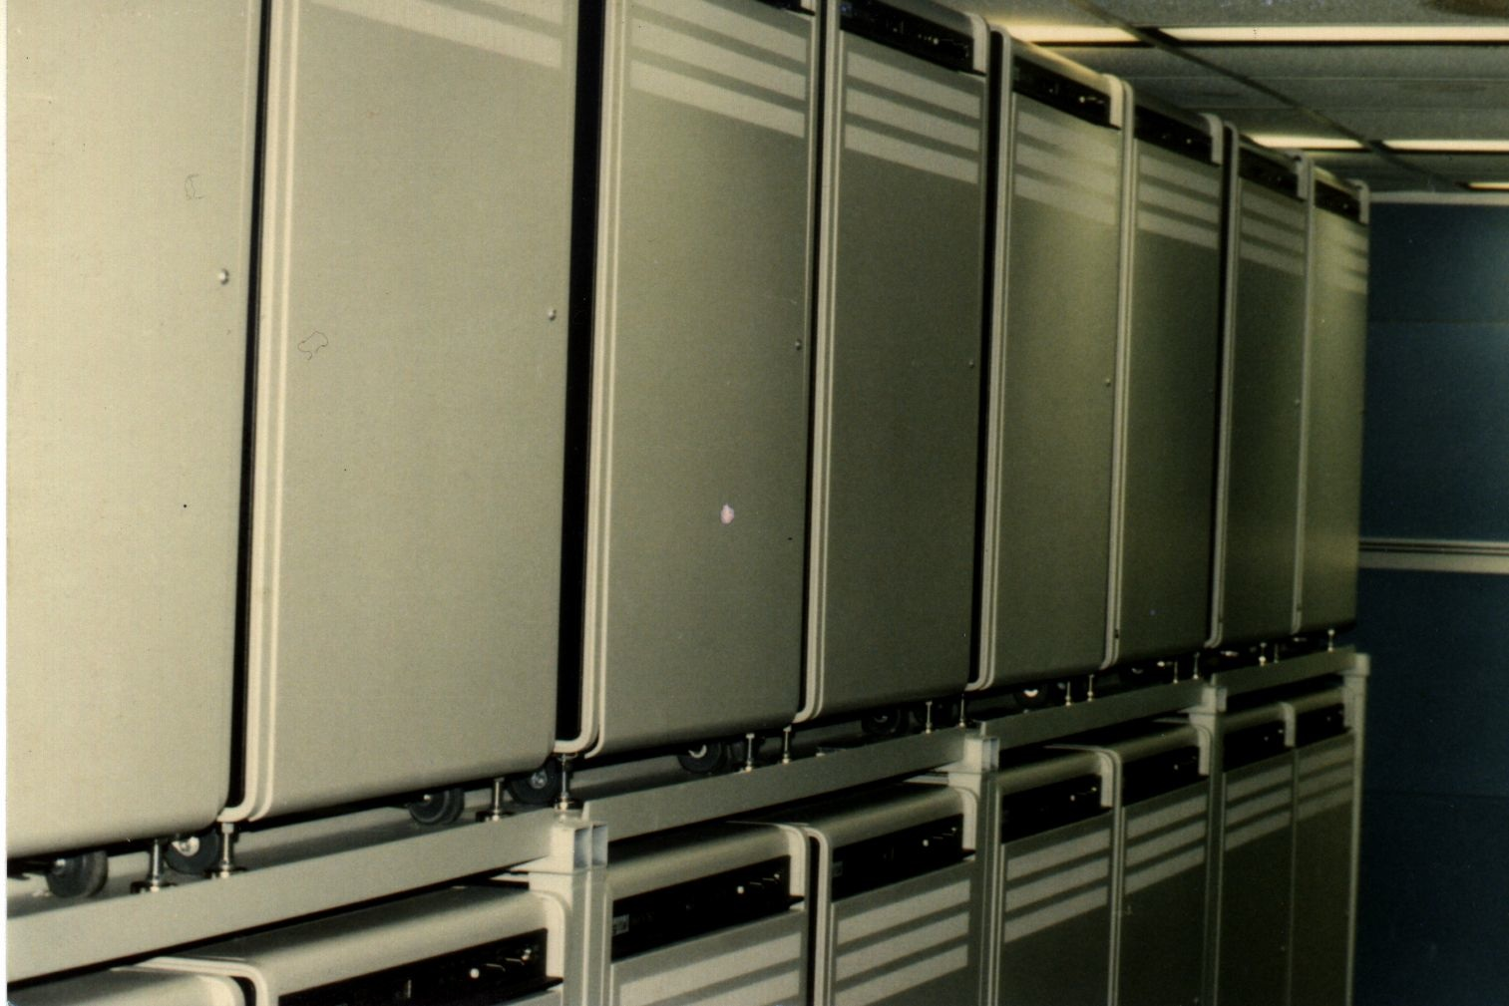
No, Google did not invent clusters
Cluster of 20 VAX 11/750s circa 1985 (Univ. Wisconsin)
Notes:
17

Slide 18
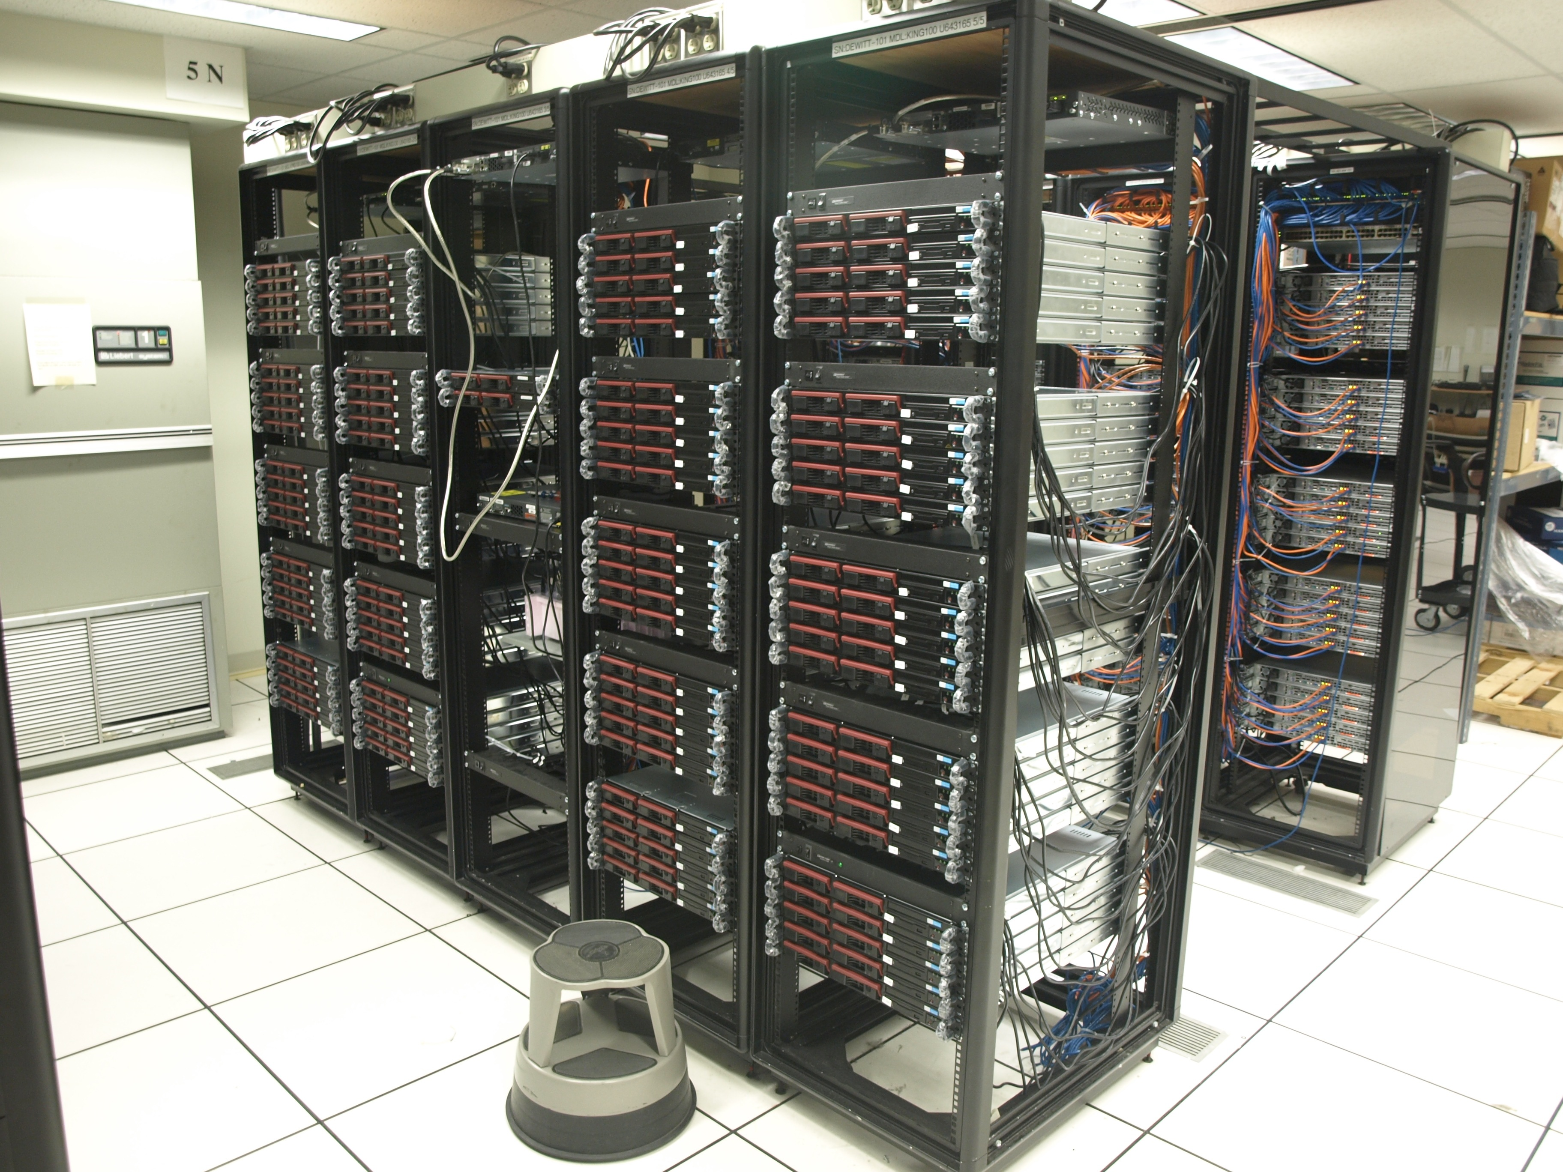
A typical cluster circa 2008
200 nodes (400 cores, 400 disks) (Univ. of Wisconsin)
Notes:
18

Slide 19
Shared-Nothing Summary
Pros
Commodity components throughout
Hardware can be incrementally scaled
Fault tolerant
No hot spots (buffer pools, lock tables)
SQL performance provides linear speedup and scaleup
Cons
Manageability – providing a single system image
Wider variety of physical DB design alternatives to consider
Software to deal with failures and data skew is more complicated

Slide 20
Talk Outline
Alternative parallel DB architectures
Why “shared nothing” has emerged as the standard
Partitioned tables
The basis for scalable execution
Partitioned parallelism
Software building blocks for scalable database systems
Other technical challenges
Summary and Conclusions

Slide 21
Horizontal partitioning
ID | Name | …
201 | cBob | …
105 | Sue | …
933 | Mary | …
ID | Name | …
201 | cBob | …
105 | Sue | …
933 | Mary | …
Key idea: Distribute rows of every table across all nodes and disks
Technique scales indefinitely
literally to 100s of nodes and 1000s of disks
Foundation for obtaining linear scaleup and speedup
Three variations:
Round-Robin Partitioning
Range Partitioning
Hash Partitioning
ID | Name | …
201 | cBob | …
105 | Sue | …
933 | Mary | …
ID | Name | …
201 | cBob | …
105 | Sue | …
933 | Mary | …
Interconnection Network
ID | Name | …
201 | cBob | …
105 | Sue | …
933 | Mary | …
ID | Name | …
201 | cBob | …
105 | Sue | …
933 | Mary | …
ID | Name | …
201 | cBob | …
105 | Sue | …
933 | Mary | …
ID | Name | …
201 | cBob | …
105 | Sue | …
933 | Mary | …

Slide 22
Round-Robin Partitioning
ID | Name | …
Node 1
Key idea: Rows assigned to disks in the order they are loaded
201 | Bob | …
220 | Sally | …
86 | Bob | …
CPU
+ Approach insures that all nodes end up with the same number of rows
- No information about where a particular row might be located given its key
MEM
Customer data set to be loaded
ID | Name | …
105 | Sue | …
ID | Name | City | Balance
201 | Bob | Madison | $3,000
105 | Sue | San Fran | $110
933 | Mary | Seattle | $40,000
150 | George | Seattle | $60
220 | Sally | Mtn View | $990
600 | Larry | Palo Alto | $1,001
750 | Anne | L.A. | $22,000
50 | Liz | NYC | $2,200
86 | Bob | Chicago | $180
630 | Bob | London | $994
19 | George | Paris | $3,105
320 | Jeff | Madison | $0
600 | Larry | …
ETL
630 | Bob | …
Interconnection Network
ID | Name | …
933 | Mary | …
750 | Anne | …
19 | George | …
CPU
MEM
ID | Name | …
Node 2
150 | George | …
50 | Liz | …
320 | Jeff | …

Slide 23
Range partitioning
The partitioning information is retained in the schema and is used during query processing as we will see later
ID | Name | …
19 | George | …
50 | Liz | …
86 | Bob | …
ID ≤ 104
Node 1
Key idea: Rows are assigned to nodes/disks based on the value of their partitioning column (e.g. ID)
After being sorted, partitioning values can be determined
For example, with 4 disks the DBMS will find ID values that will divide the input data set into four equal sized pieces
These partitioning values are then used to assign rows to nodes/disks during the load
CPU
MEM
ID | Name | …
105 | Sue | …
150 | George | …
201 | Bob | …
ID | Name | City | Balance
201 | Bob | Madison | $3,000
105 | Sue | San Fran | $110
933 | Mary | Seattle | $40,000
150 | George | Seattle | $60
220 | Sally | Mtn View | $990
600 | Larry | Palo Alto | $1,001
750 | Anne | L.A. | $22,000
50 | Liz | NYC | $2,200
86 | Bob | Chicago | $180
630 | Bob | London | $994
19 | George | Paris | $3,105
320 | Jeff | Madison | 2323
105 ≤ ID ≤ 219
ETL
Interconnection Network
Customer data set
ID | Name | City | Balance
19 | George | Paris | $3,105
50 | Liz | NYC | $2,200
86 | Bob | Chicago | $180
105 | Sue | San Fran | $110
150 | George | Seattle | $60
201 | Bob | Madison | $3,000
220 | Sally | Mtn View | $990
320 | Jeff | Madison | $0
600 | Larry | Palo Alto | $1,001
630 | Bob | London | $994
750 | Anne | L.A. | $22,000
933 | Mary | Seattle | $40,000
ID | Name | …
220 | Sally | …
320 | Jeff | …
600 | Larry | …
220 ≤ ID ≤ 629
CPU
MEM
ID | Name | …
630 | Bob | …
750 | Anne | …
933 | Mary | …
Node 2
SORT on
ID
ID ≥ 630

Slide 24
Hash partitioning
ID | Name | …
Again, the partitioning information (that the Customer table was hash partitioned on the ID column) is retained in the schema
150
George
…
220
Sally
…
Node 1
Key idea: Each row is assigned to a disk based on the value produced by applying a hash function to the value of the partitioning column (e.g. ID)
50
Liz
…
320
Jeff
…
CPU
MEM
Customer data set
ID | Name | …
201
Bob
…
HASH
On ID
105
Sue
…
ID | Name | City | Balance
201 | Bob | Madison | $3,000
105 | Sue | San Fran | $110
933 | Mary | Seattle | $40,000
150 | George | Seattle | $60
220 | Sally | Mtn View | $990
602 | Larry | Palo Alto | $1,001
752 | Anne | L.A. | $22,000
50 | Liz | NYC | $2,200
86 | Bob | Chicago | $180
633 | Bob | London | $994
19 | George | Paris | $3,105
320 | Jeff | Madison | $0
86
Bob
…
Interconnection Network
Hash_Function (201) ➔ (Node 1, Disk 2)
Hash_Function (105) ➔ (Node 1, Disk 2)
ID | Name | …
Hash_Function (933) ➔ (Node 2, Disk 2)
602
Larry
…
752
Anne
…
CPU
MEM
Note that disk 1 of node 1 ends up with 4 rows while disk 1 of node 2 ends up with only 2 rows – termed partition skew
ID | Name | …
933
Mary
…
Node 2
633
Bob
…
19
George
…

Slide 25
Talk Outline
Alternative parallel db architectures
Why “shared nothing” has emerged as the standard
Partitioned tables
The basis for scalable execution
Partitioned parallelism
Software building blocks for scalable database systems
Other technical challenges
Summary and Conclusions

Slide 26
Partitioned Parallelism
Parallel execution of relational operators
Unlike systems based on a shared-memory and shared-disk architectures, there is NO shared lock table, NO shared buffer pool, and NO distributed lock manager to limit scalability
Extensive use of pipelining of rows between relational operators
Avoid intermediate files and disk I/Os whenever possible

Slide 27
“Relational operator”. What’s that???
A primitive used by the SQL Engine to execute various SQL constructs
Example, predicate “AmtDue > $30K”
W/O an index this becomes:
Filter and scan are relational operators, rows are pipelined between the scan and filter operators
FILTER
AmtDue > $30K
SCAN
ID | Name | AmtDue
933 | Mary | $49K
633 | Bob | $19K
19 | George | $83K

Slide 28
Partitioned Parallelism
Application
Query executes using
All nodes
Sequential scan on each node
Scales to 1000s of nodes
All locking done locally
Select * from Customers
where
AmtDue > $30K
933 | Mary | $49K
19 | George | $83K
752 | Anne | $75K
86 | Bob | $90K
Parser
Catalogs
Optimizer
Execution Coordinator
86 | Bob | $90K
752 | Anne | $75K
933 | Mary | $49K
19 | George | $83K
Filter
AmtDue
> $30K
Filter
AmtDue
> $30K
Filter
AmtDue
> $30K
SQL
Server
SQL
Server
SQL
Server
Scan
Scan
Scan
Customer Table
ID | Name | AmtDue
602 | Larry | $13K
752 | Anne | $75K
322 | Jeff | $20K
ID | Name | AmtDue
933 | Mary | $49K
633 | Bob | $19K
19 | George | $83K
ID | Name | AmtDue
201 | Bob | $9K
105 | Sue | $11K
86 | Bob | $90K

Slide 29
Exploiting Partitioning Information
Application
Customers (ID, Name, AmtDue)
Hash Partition on ID
933 | Mary | $49K
Query executes using
Single node
Sequential scan
Other nodes freed to execute other queries
Parser
Select * from Customers
where ID = 933
Optimizer
Execution Coordinator
933 | Mary | $49K
Filter
ID=933
SQL
Server
SQL
Server
SQL
Server
Scan
Customer Table
ID | Name | AmtDue
602 | Larry | $13K
752 | Anne | $75K
322 | Jeff | $20K
ID | Name | AmtDue
933 | Mary | $49K
633 | Bob | $19K
19 | George | $83K
ID | Name | AmtDue
201 | Bob | $9K
105 | Sue | $11K
86 | Bob | $90K

Slide 30
The Role of Indices
Example #1:
Create table Customers (ID, Name, AmtDue) Hash partition on ID
Create clustered index on Customers (ID)

Slide 31
Index Example #1
Application
Customers (ID, Name,AmtDue)
Hash Partition on ID
Clustered index Customers (ID)
Query executes using
Single node
B-tree lookup on ID
Leads to truly scalable short transactions
933 | Mary | $49K
Parser
Select * from Customers
where ID = 933
Optimizer
Execution Coordinator
933 | Mary | $49K
Index Select ID=933
SQL
Server
SQL
Server
SQL
Server
ID
ID
ID
Customer Table
ID | Name | AmtDue
322 | Jeff | $20K
602 | Larry | $13K
752 | Anne | $75K
ID | Name | AmtDue
19 | George | $83K
633 | Bob | $19K
933 | Mary | $49K
ID | Name | AmtDue
86 | Bob | $90K
105 | Sue | $11K
201 | Bob | $9K

Slide 32
Index Example #2
Create table Customers (ID, Name, AmtDue) Hash partition on ID
Create clustered index on Customers (AmtDue)
Create non-clustered index on Customers (ID)
** Note that indexed attributes need not be the same as the attribute as the partitioning attribute

Slide 33
Index Example #2
Query executes using
All Nodes
Index lookup on AmtDue
Sequential scans avoided for both types of queries
Application
933 | Mary | $49K
Query executes using
Single node
Index lookup on ID
Customers (ID, Name, AmtDue)
Hash Partition on ID
Clustered index Customers (AmtDue) Non-clustered index Customers (ID)
933 | Mary | $49K
19 | George | $83K
752 | Anne | $75K
86 | Bob | $90K
Parser
Optimizer
Select * from Customers
where ID = 933
Execution Coordinator
Select * from Customers
where AmtDue > $30K
933 | Mary | $49K
86 | Bob | $90K
933 | Mary | $49K
19 | George | $83K
752 | Anne | $75K
Index Select
Index Select ID=933
SQL
Engine
Index Select
Index Select
AmtDue >$30K
SQL
Engine
AmtDue >$30K
SQL
Engine
AmtDue >$30K
AmtDue
ID
AmtDue
ID
AmtDue
ID
ID | Name | AmtDue
602 | Larry | $13K
322 | Jeff | $20K
752 | Anne | $75K
ID | Name | AmtDue
633 | Bob | $19K
933 | Mary | $49K
19 | George | $83K
ID | Name | AmtDue
201 | Bob | $9K
105 | Sue | $11K
86 | Bob | $90K

Slide 34
What do we know so far?
Selection operators easy to parallelize
Select * from Customers where AmtDue > $30K
Same true for simple aggregates:
Select Avg (AmtDue) from Customers
Each node independently computes a partial result
One node combines partial results
About about complex aggregates?
Select City, Avg(AmtDue) from Customers group by City
What about joins?
Select Customer.Name, Order.ShipDate where where Customer.CID = Order.CID

Slide 35
Join Example #1 – “In-Place” Join
Parser
Select Name, Item from Customers C, Orders O where C.CID = O.CID
Join on each node can be done “locally” as both tables are partitioned on CID
Constant response time for query, regardless of # of nodes
Application
Optimizer
Catalogs
Execution Coordinator
JOIN C.CID = O.CID
JOIN C.CID = O.CID
SQL Engine
SQL Engine
CID | OID | Item
Orders Table
hash partitioned
on CID
CID | OID | Item
602 | 10 | Tivo
933 | 20 | Zune
752 | 31 | Zune
633 | 21 | TV
633 | 21 | DVD
602 | 10 | Xbox
602 | 11 | iPod
19 | 51 | TV
CID | Name | AmtDue
Customers Table
hash partitioned
on CID
CID | Name | AmtDue
602 | Larry | $13K
933 | Mary | $49K
752 | Anne | $75K
633 | Bob | $19K
322 | Jeff | $20K
19 | George | $83K

Slide 36
Join Example #2 –
This join can NOT be done “locally” as Customers is hash partitioned on CID and Orders is hash partitioned on OID
Must first repartition a “copy” of Orders table by hashing on CID (after any predicates such as Orders.item = ‘Zune’ are applied)
Parser
Select Name, Item from Customers C, Orders O where C.CID = O.CID
Application
Optimizer
Catalogs
Execution Coordinator
SQL Engine
SQL Engine
CID | OID | Item
CID | OID | Item
Orders Table
hash partitioned
on OID
633 | 21 | TV
933 | 20 | Zune
602 | 11 | iPod
602 | 10 | Tivo
633 | 21 | DVD
602 | 10 | Xbox
19 | 51 | TV
752 | 31 | Zune
CID | Name | AmtDue
Customers Table
hash partitioned
on CID
CID | Name | AmtDue
602 | Larry | $13K
933 | Mary | $49K
752 | Anne | $75K
633 | Bob | $19K
322 | Jeff | $20K
19 | George | $83K

Slide 37
Table Repartitioning
Fundamental mechanism for
Joins when the input tables are not both partitioned on the joining attributes
Aggregates with group by
Conceptually 3 phases
Split phase: each node splits its portion of the table to be repartitioned (shuffled) into N fragments (N is # of nodes)
Shuffle phase: each node sends its fragments to the other nodes (it keeps one for itself)
Combine phase: each node combines the fragments it receives into a single temporary table
In practice, the 3 phases occur concurrently and pipelining is used to avoid materializing intermediate files

Slide 38
Split Phase
Split is performed by applying a hash function to the join attribute to assign each row to a partition
Essentially same process that is used to load a hash partitioned table but it is performed in parallel by all nodes
Example for N = 2 using the hash function CID modulo 2 (which produces values 0 or 1):
Orders
Temp-1
CID | OID | Item
= 0
602 | 11 | iPod
CID | OID | Item
752 | 31 | Zune
633 | 21 | TV
SCAN
CID Mod 2
602 | 11 | iPod
CID | OID | Item
633 | 21 | DVD
= 1
633 | 21 | TV
19 | 51 | TV
633 | 21 | DVD
752 | 31 | Zune
Temp-2
19 | 51 | TV

Slide 39
Split Phase – Split Orders table locally
Parser
Select Name, Item from Customers C, Orders O where C.CID = O.CID
Application
Optimizer
Catalogs
Execution Coordinator
Hash
on CID
Hash
on CID
SQL Engine
SQL Engine
SCAN
SCAN
CID | OID | Item
CID | OID | Item
Orders Table
hash partitioned on OID
633 | 21 | TV
933 | 20 | Zune
602 | 11 | iPod
602 | 10 | Tivo
633 | 21 | DVD
602 | 10 | Xbox
19 | 51 | TV
CID | OID | Item
752 | 31 | Zune
602 | 11 | iPod
CID | OID | Item
Customers Table
hash partitioned on CID
752 | 31 | Zune
CID | Name | AmtDue
CID | Name | AmtDue
933 | 20 | Zune
“Orders” Temp Table locally “split” on CID
602 | Larry | $13K
933 | Mary | $49K
CID | OID | Item
CID | OID | Item
633 | 21 | TV
752 | Anne | $75K
633 | Bob | $19K
602 | 10 | Tivo
633 | 21 | DVD
322 | Jeff | $20K
19 | George | $83K
602 | 10 | Xbox
19 | 51 | TV

Slide 40
Shuffle & Combine Phases
Parser
Select Name, Item from Customers C, Orders O where C.CID = O.CID
Application
Optimizer
Catalogs
Execution Coordinator
SQL Engine
SQL Engine
CID | OID | Item
CID | OID | Item
633 | 21 | TV
602 | 10 | Tivo
“Orders” Temp Table
Hash partitioned on CID
633 | 21 | DVD
“Orders” Temp table locally split on CID
602 | 10 | Xbox
19 | 51 | TV
933 | 20 | Zune
602 | 11 | iPod
CID | OID | Item
CID | OID | Item
752 | 31 | Zune
602 | 11 | iPod
933 | 20 | Zune
752 | 31 | Zune
CID | Name | AmtDue
Customers Table
hash partitioned on CID
CID | Name | AmtDue
602 | Larry | $13K
933 | Mary | $49K
752 | Anne | $75K
633 | Bob | $19K
322 | Jeff | $20K
19 | George | $83K

Slide 41
Perform Local Joins
Parser
Select Name, Item from Customers C, Orders O where C.CID = O.CID
Application
Optimizer
Catalogs
Execution Coordinator
SQL Engine
SQL Engine
CID | OID | Item
“Orders” Temp Table
Hash partitioned on CID
CID | OID | Item
602 | 10 | Tivo
633 | 21 | TV
602 | 10 | Xbox
633 | 21 | DVD
602 | 11 | iPod
19 | 51 | TV
752 | 31 | Zune
933 | 20 | Zune
CID | Name | AmtDue
Customers Table
hash partitioned on CID
CID | Name | AmtDue
602 | Larry | $13K
933 | Mary | $49K
752 | Anne | $75K
633 | Bob | $19K
322 | Jeff | $20K
19 | George | $83K

Slide 42
Comments
Join
Join
If neither table being joined is partitioned on the join attribute, both tables are shuffled (after applying any selection predicates)
Through the use of split and merge operators, there is no need to materialize intermediate split files
Merge
Merge
Merge
Merge
Split
Split
Split
Split
Scan
Scan
Scan
Scan
A
B
A
B
0
0
1
1
Rows flow from disk through the various operators w/o ever having to be written back to disk

Slide 43
Using Replication for Small Dimension Tables
Works very well for data warehousing
→ Joins with fact table are local
Exploited by DATAllegro
Tradeoff is that updates to replicated dimension tables must be applied on all nodes
Interconnection Network
SQL Engine
SQL Engine
SQL Engine
OID | CID | Item
10 | 1 | Tivo
31 | 2 | Zune
10 | 2 | Xbox
11 | 1 | iPod
OID | CID | Item
20 | 3 | Zune
21 | 3 | TV
21 | 1 | DVD
51 | 1 | TV
OID | CID | Item
40 | 2 | iPod
43 | 2 | Iron
9 | 3 | DVD
33 | 1 | VCR
Orders Table
hash partitioned
on OID
CID | Name
1 | U.S.
2 | France
3 | Italy
CID | Name
1 | U.S.
2 | France
3 | Italy
CID | Name
1 | U.S.
2 | France
3 | Italy
Country Table
Replicated on All Nodes

Slide 44
Talk Outline
Alternative parallel db architectures
Why “shared nothing” has emerged as the standard
Partitioned tables
The basis for scalable execution
Partitioned parallelism
Software building blocks for scalable database systems
Other technical challenges
Summary and Conclusions

Slide 45
Other Technical Challenges
Hardware failures
Avoiding skew
Query Optimization
Manageability

Slide 46
Dealing with hardware failures
RAID alone is not sufficient. Consider when a node fails
Interconnection Network
CPU
CPU
CPU
CPU
CPU
CPU
MEM
MEM
MEM
MEM
MEM
MEM
RAID
RAID
RAID
RAID
RAID
RAID
Must have redundant paths to all storage volumes

Slide 47
Skew
Partition Skew Solutions
Use a different hash function when partitioning the table
Use range partitioning rather then hash partitioning
Partition skew – occurs when fragments do not contain the same number of rows
Interconnection Network
CPU
CPU
CPU
CPU
CPU
CPU
CPU
CPU
MEM
MEM
MEM
MEM
MEM
MEM
MEM
MEM
ID | Name | …
201 | cBob | …
ID | Name | …
201 | cBob | …
105 | Sue | …
933 | Mary | …
201 | cBob | …
105 | Sue | …
933 | Mary | …
201 | cBob | …
201 | cBob | …
105 | Sue | …
933 | Mary | …
ID | Name | …
201 | cBob | …
105 | Sue | …
933 | Mary | …
ID | Name | …
201 | cBob | …
105 | Sue | …
933 | Mary | …
933 | Mary | …
201 | cBob | …
105 | Sue | …
933 | Mary | …
ID | Name | …
201 | cBob | …
105 | Sue | …
933 | Mary | …
201 | cBob | …
105 | Sue | …
201 | cBob | …
105 | Sue | …
933 | Mary | …
ID | Name | …
201 | cBob | …
105 | Sue | …
ID | Name | …
201 | cBob | …
105 | Sue | …
933 | Mary | …
201 | cBob | …
201 | cBob | …
105 | Sue | …
933 | Mary | …
ID | Name | …
201 | cBob | …
105 | Sue | …
933 | Mary | …
Since the node with the longest response time determines the response time for a query, partition skew leads to execution skew

Slide 48
Parallel Query Optimization
As you all know too well, query optimizers are “fragile”
Optimization of parallel queries for shared-nothing architectures is even harder
Estimating the amount of data to be redistributed between nodes during query execution
Increased number of physical DB design alternatives
Skew
Typical approach is to “parallelize” the best single node plan
Gray Systems Lab is working with the DATAllegro team to build a world-class parallel optimizer

Slide 49
Manageability
Huge challenge.
Goals include
Providing a single system image to the DBA
Have the ability to upgrade DB software one node at a time w/o taking the system down
Automatic management of node and disk failures

Slide 50
Conclusions
Parallelism is indeed the future of high performance SQL query processing
Shared-nothing architectures will dominate as they provide truly scalable parallelism using commodity components
The techniques of data partitioning and partitioned execution is the key to providing scalable query execution with linear scaleup and speedup
Microsoft intends to become the premier supplier of scalable database systems for data warehousing

Slide 51
Time for the Quiz
Explain how hash partitioning and range partitioning differ?
Is it possible to join two tables that are not partitioned identically on the join attribute?
What does linear scaleup mean?
What are the two key mechanisms used by a parallel database systems to achieve scalability
Google invented parallel database systems. True or false?

Slide 52
Finally
Thanks for listening
I hope you learned something useful
Feel free to send me email if you have questions (dewitt@microsoft.com)

Slide 53
Backup slides

Slide 54
Parallel DBMSs – the start was very rocky
1975-1985 – A decade of failures
Focus on exotic technologies (e.g. bubble memories, CCD memories, head per track disks)
Essentially no software building blocks to start with (e.g. networking stacks such as TCP/IP)
Misguided, overly complex designs

Slide 55
Talk Outline
Alternative parallel db architectures
Why “shared nothing” has emerged as the standard
Partitioned tables
The basis for scalable execution
Partitioned parallelism
Software building blocks for scalable database systems
Other technical challenges
Summary and Conclusions

Slide 56
Split & Merge Operators
Merge operator - merges input streams from two or more producers
Split Operator – splits a stream of rows into two or more streams by applying a function to each row in the input stream
Output streams
Input stream
Acct# mod 4 = 0
Split
Operator
Acct# mod 4 = 1
Acct# mod 4 = 2
Acct# mod 4 = 3
Producer
Merge
Operator
Producer
Consumer
Producer

Slide 57
Streaming redistribution
Select * from A,B where A.x = B.y
"Odd x & y values"
"Even x & y values"
Join
Join
Merge
Merge
Merge
Merge
Split
Split
Split
Split
Scan
Scan
Scan
Scan
A
B
A
B
0
0
1
1

Slide 58
Parallel DB vs. Map Reduce
Parallel database focused on providing the scalable execution of complex SQL Queries
Map Reduce
Computing paradigm developed first at Google for processing massive data sets on massive clusters
Borrows many key ideas from parallel database systems including the use of partitioned data sets and the the use of hashing to redistribute records with identical key values to the same node for subsequent processing
Inferior to relational data model in many ways including no declarative query language and no schema
Fault tolerance to hardware failures is superior

Slide 59
Partitioning Summary
Partitioning the rows of a table is the key to parallel database scalability:
All partitions can be scanned in parallel
e.g. 100 nodes with 8 disks/node provides an aggregated bandwidth of 60 GB/second => 3.6 TB/minute
DB can be scaled essentially indefinitely
while maintaining constant response times
The combination of indexing and partitioning alternatives provides a multitude of physical design alternatives
DBAs will be assisted by DB design wizards

Slide 60
Parallelizing Relational Operators
Only 3 simple mechanisms are needed:
Operator replication – we have seen this
Split operator for splitting streams of rows
Merge operator for merging multiple streams of rows into a single stream
Result is a parallel DBMS capable of providing linear speedup and scaleup!

