Slide 1
CS 760 Methods for Weight Update in Neural Networks
Yujia Bao
Mar 1, 2017

Slide 2
Weight Update Frameworks
input
layer
hidden
layers
output
layer
…
Image credit: Joe Bockhorst
Goal: Minimize some loss function $L$ with respect to the weights $W$.

Slide 3
Weight Update Frameworks
Batch Gradient Descent:
1. Use all examples in each iteration.
2. Exact gradient.
3. Slow.
Stochastic Gradient Descent:
1. Use one example in each iteration.
2. Local gradient might be wrong.
3. Fast.
Mini-batch gradient descent takes the best of both!

Slide 4
Mini-batch gradient descent
Procedure:
Pick a mini-batch of examples from the data
For each example:
Forward propagation to get the output;
Backward propagation to get the gradient;
Update the weights using the average gradient.
Common mini-batch size: 32, 64, 128.
Note: Forward/Backward propagation can both be done simultaneously for many examples using matrix multiplication, and this is fast on GPUs!

Slide 5
Mini-batch gradient descent
Recall the forward prop for a MLP:
$$z_{k+1}=f_{k+1}\left(W_{k}z_{k}+b_{k}\right)$$
where $f_{k+1}$ is the activation function for the ($k+1$)st layer, $W_{k}\left[i\right][j]$ is the weights from $z_{k}[j]$ to $z_{k+1}[i]$
If we have $n$ examples, we can define
$$Z_{k}=\left[\begin{matrix}z_{k}^{1} & ⋯ & z_{k}^{n}\end{matrix}\right], B_{k}=\left[\begin{matrix}b_{k} & ⋯ & b_{k}\end{matrix}\right]$$
and express the forward prop as
$$Z_{k+1}=f_{k}\left(W_{k}Z_{k}+B_{k}\right)$$

Slide 6
An example
Minimize
$L\left(w\right)=\sum_{i=1}^{40}{{\left(w−a_{i}\right)}^{2}}$
where $a_{i}=−97.5, −92.5, …, 92.5, 97.5$.
We know that the optimal is $w=0$.
Suppose our initial value of $w$ is -100. Use the basic steepest descent method with fixed learning rate = 0.2.
What’s the performances of these three frameworks?

Slide 7
An example

Slide 8
Weight Update Methods
Steepest Descent (Review)
Momentum (Review)
Nesterov Accelerated Gradient
AdaGrad [Duchi et al., 2011]
RMSprop [Tieleman & Hinton, 2012]
Adam [Kingma & Ba, 2015]
Element-wise adaptive learning rate

Slide 9
Steepest Descent
Algorithm:
Step 1. $w^{(t+1)}=w^{(t)}−η⋅{\left.\frac{∂L}{∂w}\right|}_{w^{(t)}}$
Very simple. Just one step.
Poor convergence if the function surface is more steep in one dimension than in another. Let’s see an example!

Slide 10
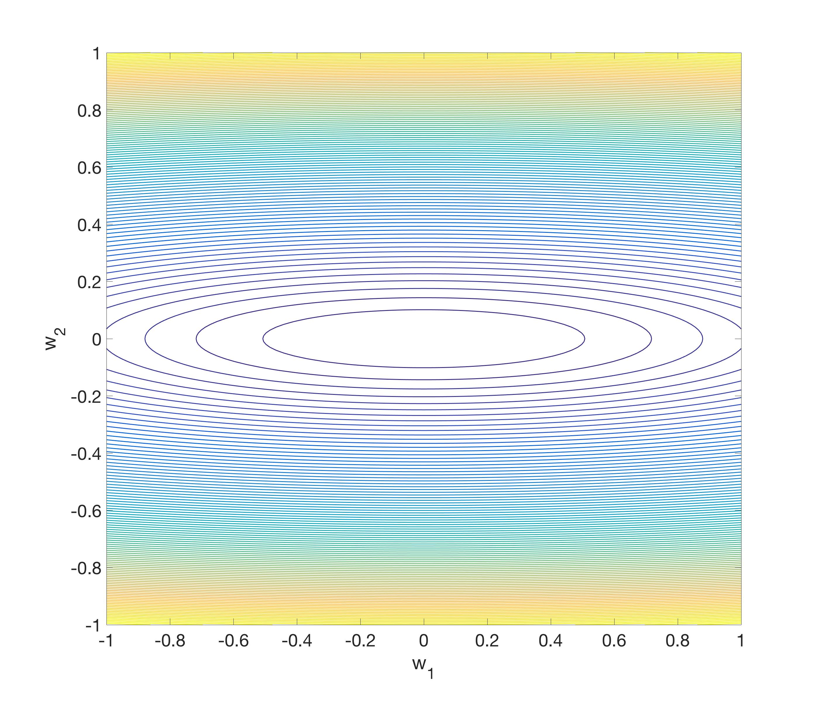
Steepest Descent
Objective:
$$L\left(w\right)=w_{1}^{2}+25w_{2}^{2}$$
Gradient:
$$∇L=\left[\begin{matrix}2w_{1} \\ 50w_{2}\end{matrix}\right]$$
Small over $w_{1}$ direction,
large over $w_{2}$ direction!
-$50w_{2}$
$$−2w_{1}$$

Slide 11
Steepest Descent
Zigzag behavior!
Move very slowly on the flat direction, oscillate on the steep direction.

Slide 12
Momentum
Algorithm:
Step 1.$v^{(t+1)}=μv^{(t)}−η⋅{\left.\frac{∂L}{∂w}\right|}_{w^{(t)}}$
Interpret $v$ as velocity, $1−μ$ as friction. $v$ stores the moving average of the gradients.
Step 2. $w^{(t+1)}=w^{(t)}+v^{(t+1)}$
A ball rolling down from the surface of the loss function.
Initialize $v^{(0)}$ to zero.
Common settings for $μ$ ranges between 0.5 to 0.99.

Slide 13
Momentum
Accelerate convergence on the direction that the gradient keeps the same sign over the past few iterations.
If $μ$ is large, momentum will overshoot the target, but the overall convergence is still faster than steepest descent in practice.
As $μ$ goes smaller, momentum behaves more similar to steepest descent.

Slide 14
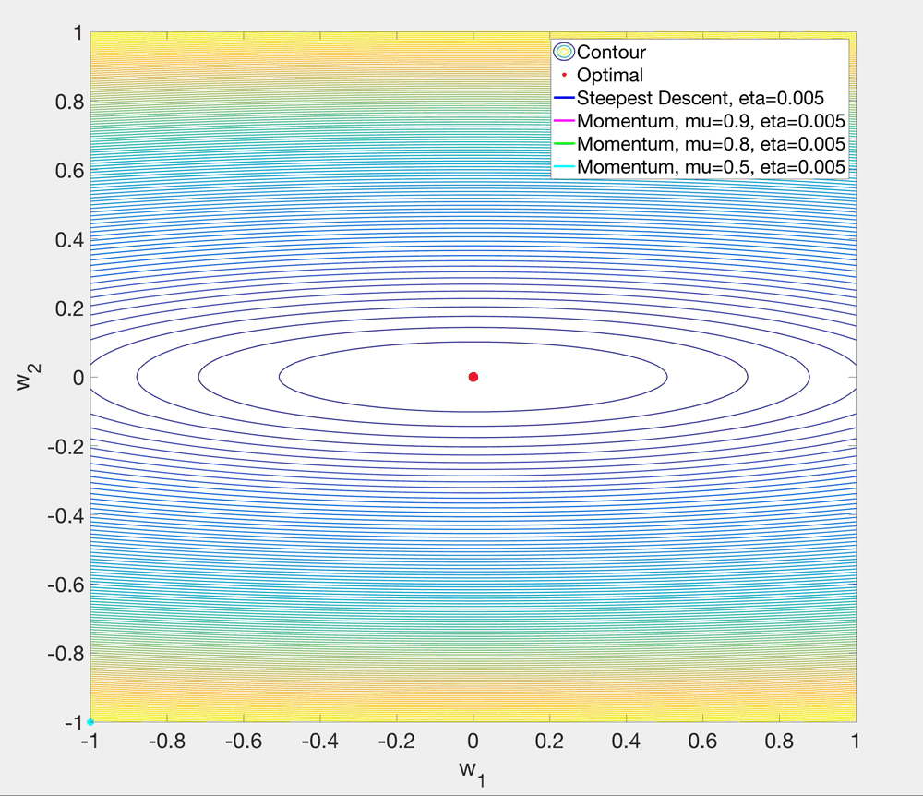

Slide 15
Nesterov Accelerated Gradient
Momentum
Nesterov Accelerated Gradient
$$w^{(t+1)}$$
Negative gradient
direction: $−η⋅{\left.\frac{∂L}{∂w}\right|}_{w^{(t)}+μv^{(t)}}$
Speed
direction:$μv^{(t)}$
Speed
direction:$μv^{(t)}$
$$w^{(t+1)}$$
Actual update
Actual update
$$w^{(t)}$$
$$w^{(t)}$$
Negative gradient
direction: $−η⋅{\left.\frac{∂L}{∂w}\right|}_{w^{(t)}}$

Slide 16
An example
Suppose $w^{(t)}$ is already optimal, but $v^{(t)}≠0$.
Momentum
Nesterov Accelerated Gradient
$$w^{(t+1)}$$
Negative gradient
direction: $−η⋅{\left.\frac{∂L}{∂w}\right|}_{w^{(t)}+μv^{(t)}}$
Speed
direction:$μv^{(t)}$
Speed
direction:$μv^{(t)}$
Actual update
$$w^{(t+1)}$$
Actual update
$$w^{(t)}$$
$$w^{(t)}$$
Negative gradient
direction: $0$
Look ahead! The actual update is more reliable than Momentum.

Slide 17
Nesterov Accelerated Gradient
Algorithm:
Step 1.$v^{(t+1)}=μv^{(t)}−η⋅{\left.\frac{∂L}{∂w}\right|}_{w^{(t)}+μv^{(t)}}$
Step 2.$w^{(t+1)}=w^{(t)}+v^{(t+1)}$
Nesterov Accelerated Gradient has better performance than momentum [Ilya et al., 2013].

Slide 18
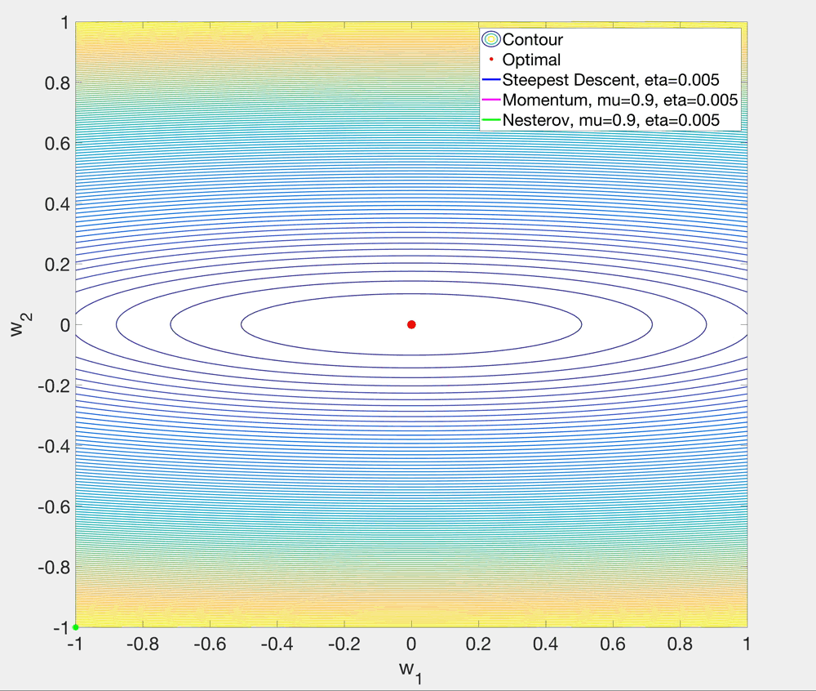

Slide 19
Element-wise adaptive learning rate

Slide 20
AdaGrad (Adaptive Gradient)
Algorithm:
Step 1. $G^{(t+1)}=G^{(t)}+{\left({\left.\frac{∂L}{∂w}\right|}_{w^{(t)}}\right)}^{2}$
$G$ is the sum of the square gradient.
Step 2.$w^{(t+1)}=w^{(t)}−\frac{η}{\sqrt{G^{(t+1)}}+{10}^{−7}}⋅{\left.\frac{∂L}{∂w}\right|}_{w^{(t)}}$
Scale the learning rate by $1/\sqrt{G}$ and follow the negative gradient direction.
Common settings for $η$ is 0.01.
Different learning rate for each $w$ (each $w$ has its own $G$).
Increase the learning rate on the flat direction.
Decrease the learning rate on the steep direction.

Slide 21
AdaGrad (Adaptive Gradient)
Consider the previous example:
$$L\left(w\right)=w_{1}^{2}+25w_{2}^{2}$$
Gradient:
$$∇L=\left[\begin{matrix}2w_{1} \\ 50w_{2}\end{matrix}\right]$$
Initial $w^{(0)}$ is $\left(−1,−1\right)$.
$$w^{(1)}=\left[\begin{matrix}−1 \\ −1\end{matrix}\right]−\left[\begin{matrix}\frac{η}{\sqrt{{\left(−2\right)}^{2}}+{10}^{−7}}⋅(−2) \\ \frac{η}{\sqrt{{\left(−50\right)}^{2}}+{10}^{−7}}⋅(−50)\end{matrix}\right]≈\left[\begin{matrix}−1 \\ −1\end{matrix}\right]+\left[\begin{matrix}η \\ η\end{matrix}\right]$$
Will follow the diagonal direction!

Slide 23
AdaGrad (Adaptive Gradient)
Algorithm:
Step 1. $G^{(t+1)}=G^{(t)}+{\left({\left.\frac{∂L}{∂w}\right|}_{w^{(t)}}\right)}^{2}$
Step 2. $w^{(t+1)}=w^{(t)}−\frac{η}{\sqrt{G^{(t+1)}}+{10}^{−7}}⋅{\left.\frac{∂L}{∂w}\right|}_{w^{(t)}}$
Why that slow?
Learning rate goes down monotonically as $t$ increases.
Stop learning!!!

Slide 24
RMSProp (Root Mean Square Propagation)
Algorithm:
Step 1. $G^{(t+1)}=γG^{(t)}+\left(1−γ\right)⋅{\left({\left.\frac{∂L}{∂w}\right|}_{w^{(t)}}\right)}^{2}$
$G$ is a moving exponential average of the square gradient.
Step 2. $w^{(t+1)}=w^{(t)}−\frac{η}{\sqrt{G^{(t+1)}}+{10}^{−7}}⋅{\left.\frac{∂L}{∂w}\right|}_{w^{(t)}}$
Scale the learning rate by $1/\sqrt{G}$ and follow the negative gradient direction.
Default settings: $γ=0.9, η=0.001$.

Slide 26
Another example (saddle point)
Now consider minimizing
$$L\left(w\right)=w_{1}^{3}+w_{2}^{2}$$
The problem is unbounded and $(0,0)$ is a saddle point.
At $\left(−0.01,−1\right)$, we have $∇L=\left[\begin{matrix}0.0003 \\ −2\end{matrix}\right]$.
How will these methods behave if we start at this point?

Slide 27
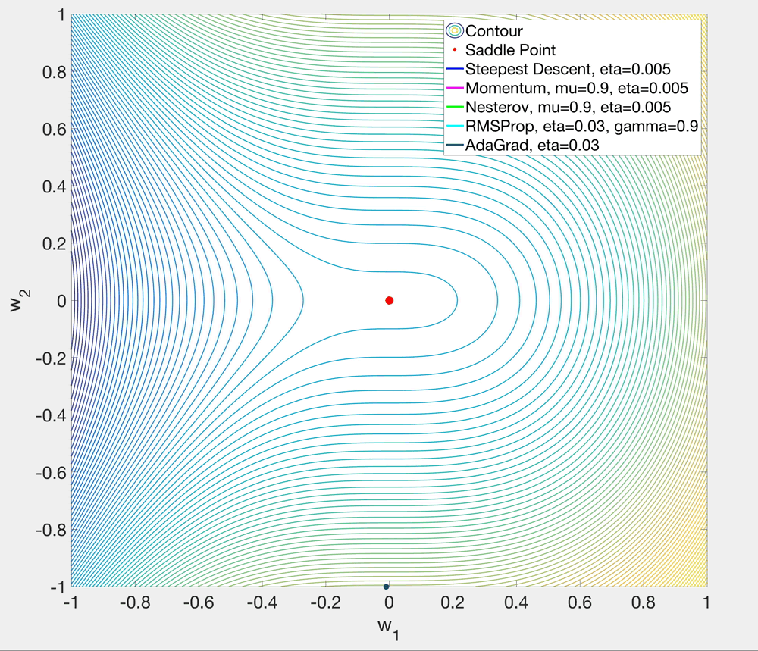

Slide 28
Adam (Adaptive Moment Estimation)
Algorithm [Simplified Version]:
Step 1. $m^{(t+1)}=β_{1}m^{(t)}+\left(1−β_{1}\right)⋅{\left.\frac{∂L}{∂w}\right|}_{w^{(t)}}$
$m$ is the exponential moving average of the gradients (similar as the speed in the momentum method);
Step 2. $v^{(t+1)}=β_{2}v^{(t)}+(1−β_{2})$ $⋅{\left({\left.\frac{∂L}{∂w}\right|}_{w^{(t)}}\right)}^{2}$
$v$ is the exponential moving average of the square gradients.
Step 3. $w^{(t+1)}=w^{(t)}−\frac{η}{\sqrt{v^{\left(t+1\right)}}+{10}^{−8}}⋅m^{(t+1)}$
Default settings: $β_{1}=0.9, β_{2}=0.999, η=0.001$.

Slide 29
Adam (Adaptive Moment Estimation)
Algorithm [Complete Version]:
Step 1.$m^{(t+1)}=β_{1}m^{(t)}+\left(1−β_{1}\right)⋅{\left.\frac{∂L}{∂w}\right|}_{w^{(t)}}$
Step 2. $v^{(t+1)}=β_{2}v^{(t)}+(1−β_{2})$ $⋅{\left({\left.\frac{∂L}{∂w}\right|}_{w^{(t)}}\right)}^{2}$
Step 3. ${\hat{m}}^{(t+1)}=\frac{1}{1−β_{1}^{t}}⋅m^{(t+1)}$
Step 4. ${\hat{v}}^{(t+1)}=\frac{1}{1−β_{2}^{t}}⋅v^{(t+1)}$
Step 5. $w^{(t+1)}=w^{(t)}−\frac{η}{\sqrt{{\hat{v}}^{(t+1)}}+{10}^{−8}}⋅{\hat{m}}^{(t+1)}$
Bias Correction (since we set $m^{(0)},v^{(0)}$ to 0)

Slide 32
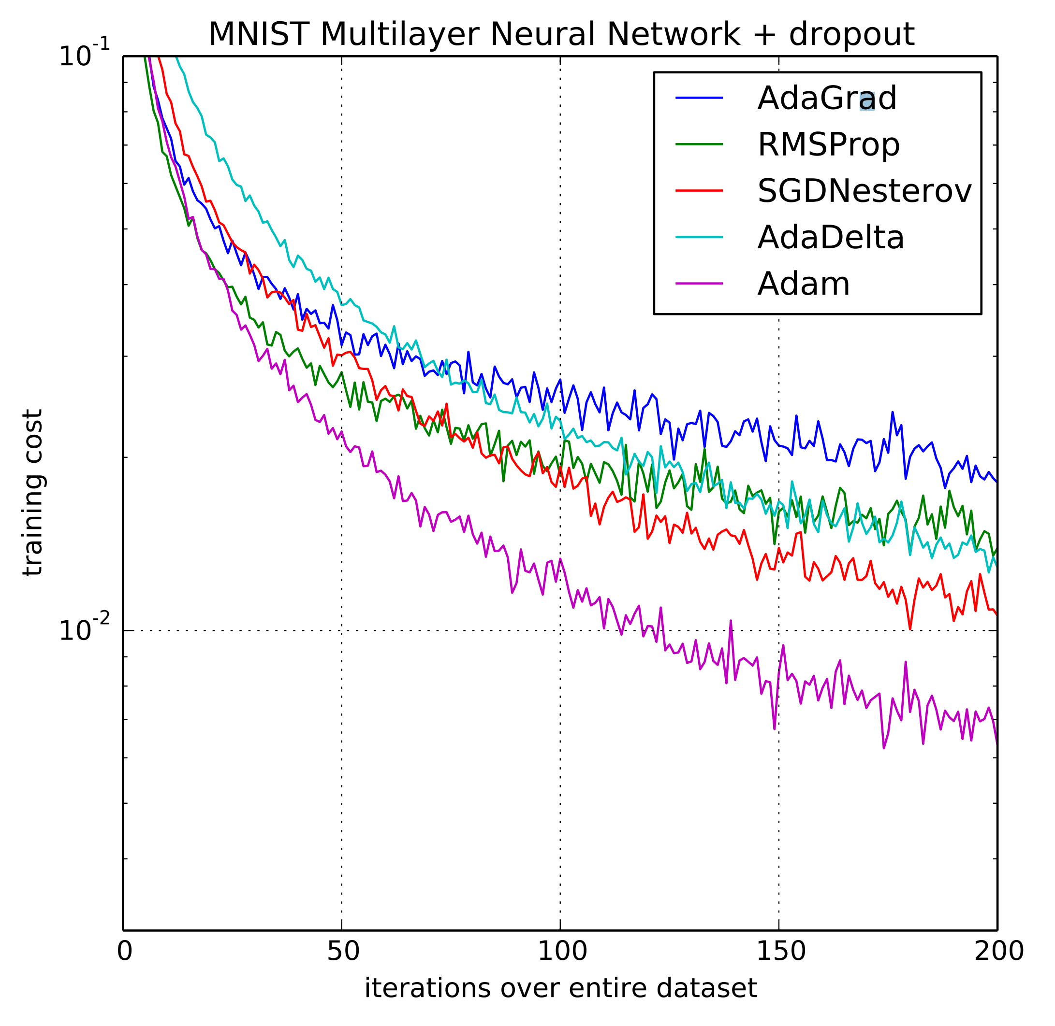
Adam (Adaptive Moment Estimation)
Image credit: Kingma & Ba, 2015
Network configurations:
Input layer: 28x28
2 hidden layers (1000 ReLUs each)
Output: 10 SoftMax
Cross-entropy loss.
In practice, Adam is the default choice to use. [Fei-Fei Li, Andrej Karpathy, Justin Johnson]

Slide 33
Thanks!

