Slide 1

Generalized Event Cameras
Varun Sundar^{1*}, Matthew Dutson^{1*}, Andrei Ardelean², Claudio Bruschini², Edoardo Charbon², Mohit Gupta¹.
¹
²
* denotes equal contribution

Slide 2
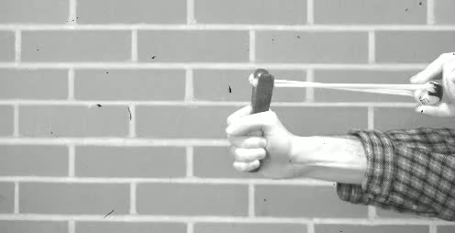
Imaging with Conventional Cameras
Conventional camera
30 FPS
Notes:
(animate) Imagine trying to capture a ping-pong ball launched by a slingshot.
(animate) A conventional, 30 FPS camera is unfortunately too slow for this purpose, and the ping-pong ball is a blur.

Slide 3
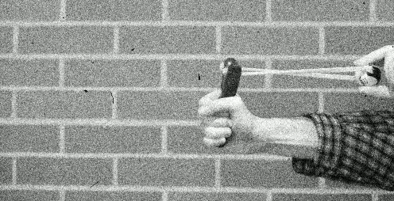
Imaging with High-Speed Cameras
High-speed camera
3025 FPS
15125 Mbps for a 1 MPixel array
SwissSPAD2 5-bit sum images
Notes:
(animate) We could resort to high-speed cameras, which captures the dynamics of the slingshot.
However, there are two problems here: one, the high-speed images are quite noisy, and two, we have to readout a lot of data, around 15 Gbps for a 1-megapixel sensor.
This large data rate can easily saturate current data transfer protocols such as USB 3.0.

Slide 4
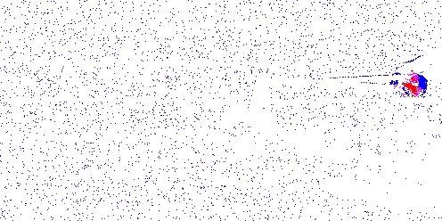
Event Cameras enable Resource-efficient Vision
Event-based camera
290 Mbps for 1 MPixel
Notes:
(animate) Event cameras---inspired by biological visual systems--were designed to address these fundamental challenges---with the goal of capturing fast dynamics while maintaining a low sensor readout.
Event cameras achieve this by selectively transmitting data, rather than dense transmission.

Slide 5
Selective Transmission
When, |Brightness deviations| $≥$ $τ$
Brightness
$$τ$$
Time
Blue denotes +ve changes, red denotes –ve changes
Notes:
(animate) Each pixel of an event camera transmits information only when the perceived brightness increases or decreases by a fixed threshold.
(animate) The transmitted information encodes the polarity of change. This produces a temporal series of blue and red spikes, corresponding to positive and negative changes respectively.

Slide 6
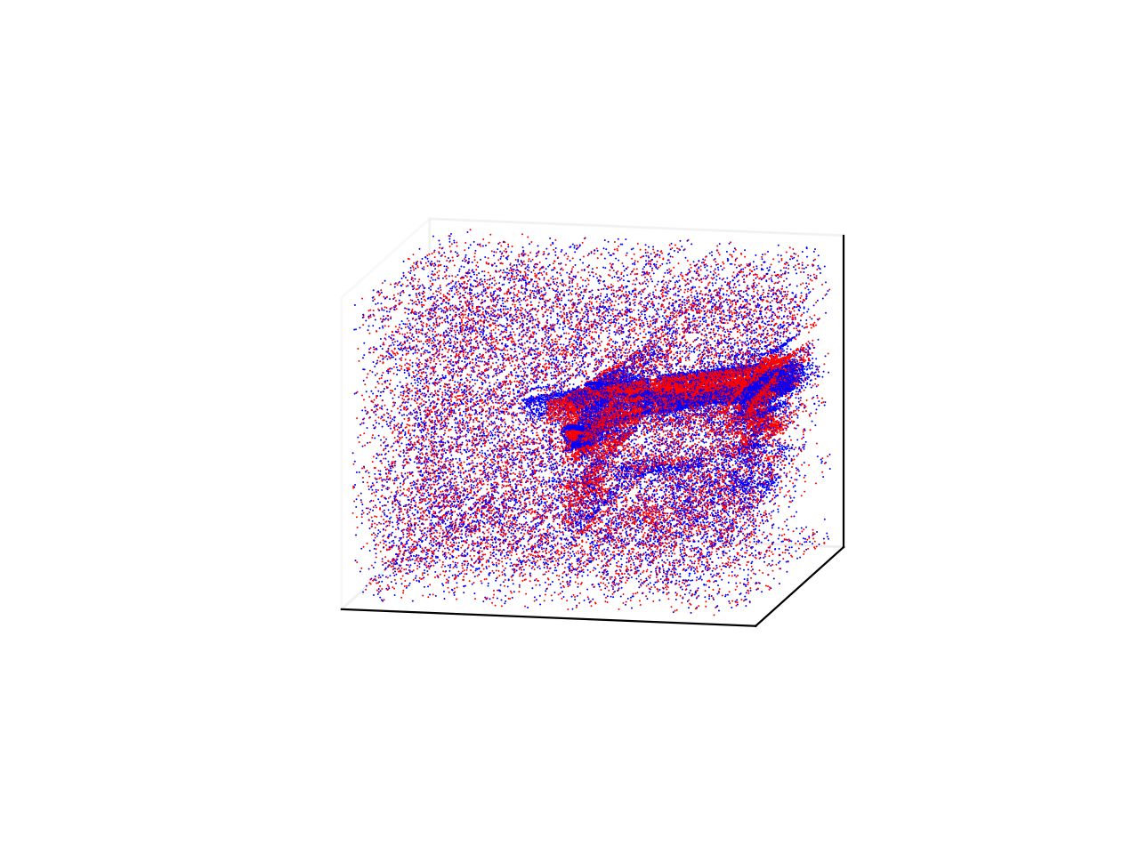
Spatiotemporal Change Plot
Sparse spatiotemporal stream of change polarities
Notes:
(animate) Here is another visualization of the event camera’s outputs, as a spatiotemporal grid of change polarities.

Slide 7
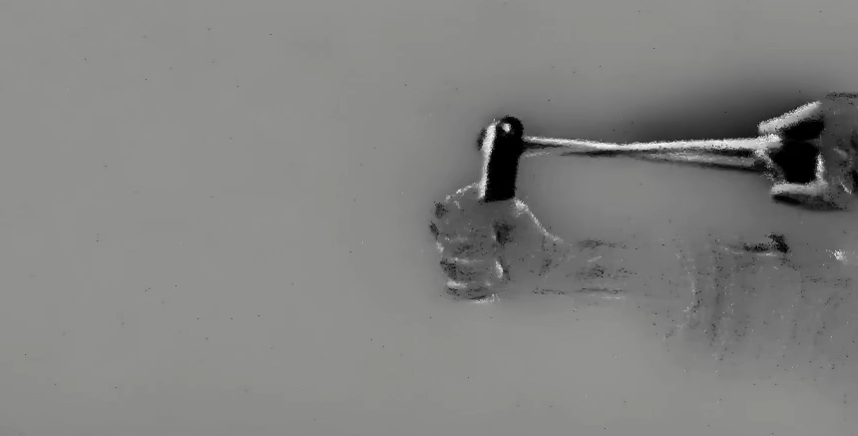
Lack of Sufficient Intensity Information
Prophesee EVK4 using E2VID+
E2VID+, Stoffregen et al. (ECCV 2020).
Notes:
Unfortunately, the sparse spatiotemporal data captured by an event camera does not retain sufficient information to reconstruct high-quality scene intensities.
(animate) For example, here are the outputs of a recent intensity-from-events technique. Details of the scene are hard to discern in dynamic regions, while being completely lost in static regions.

Slide 8
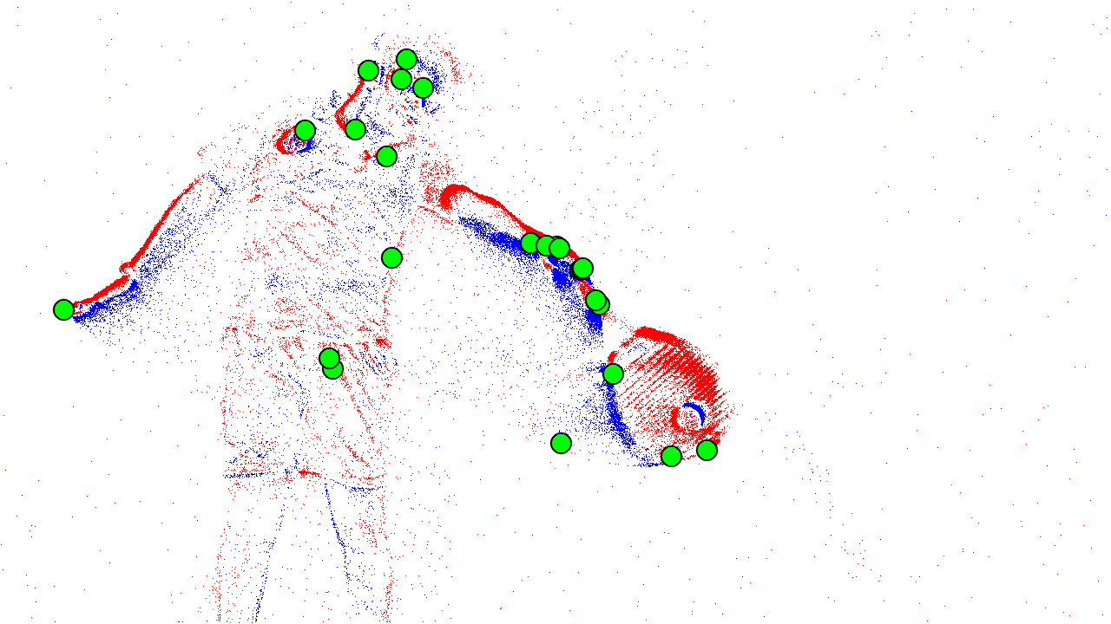
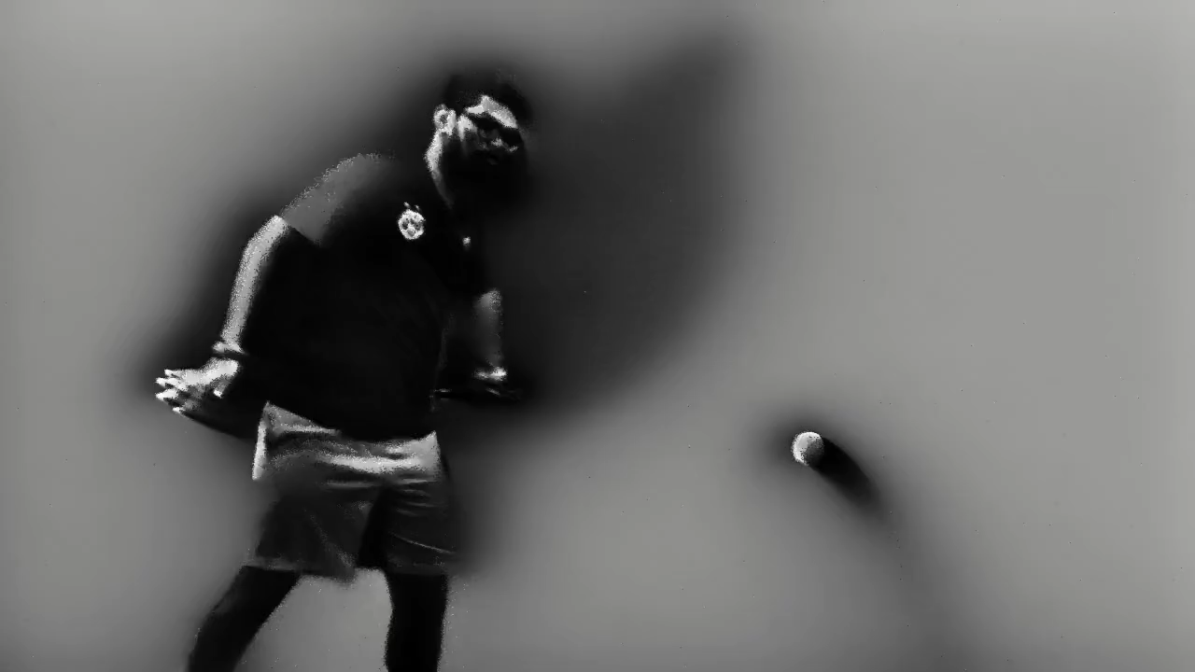
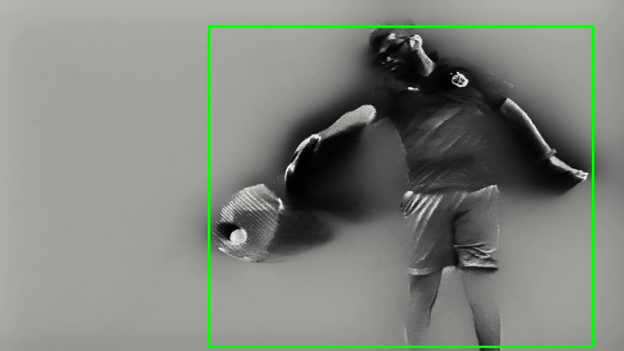
Impact on Downstream Inference
Corner detection works
Arc*
person 85%
Forehand contact point in tennis
Prophesee EVK4
Ball, racket not detected
DETR on E2VID outputs
Arc*, Alzugaray et al. (IRAL 2018).
DETR, Carion et al. (ECCV 2020).
Notes:
The lossy nature of event camera outputs also limits their downstream performance.
(animate) For instance, consider this tennis scene captured using a commercial event camera.
(animate) While it is possible to run certain tasks on events, such as corner detection…
(animate) for other tasks, such as object detection, events do not provide sufficient contextual information. As a result, we fail to detect the tennis racket and the ball in this scene.

Slide 9
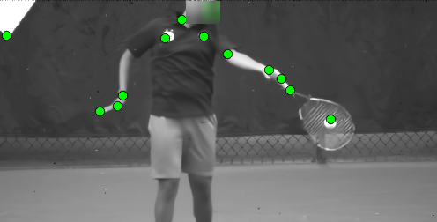
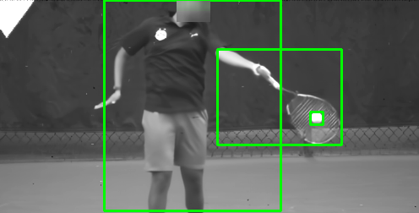
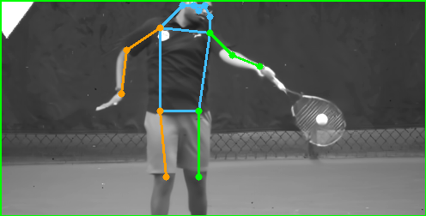
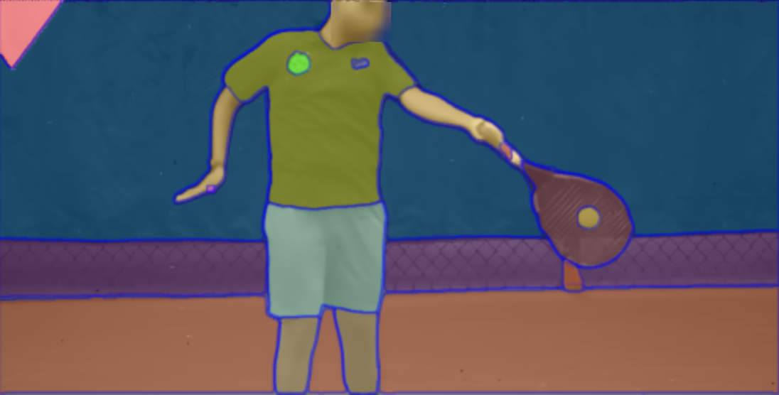
What We would Like to Achieve
ball >99%
person 97%
racket >99%
Corner detection
Object detection
Pose estimation
Semantic segmentation
Faces have been blurred for anonymity reasons.
Notes:
Our goal is to design a new class of event cameras that can be used in a plug-and-play manner with a gamut of computer vision algorithms, even in very challenging scenarios involving high-speed motion and low light.
(animate) For example, in addition to detecting corners; (animate) we would like to detect the person, racket, and ball in this scene; (animate) estimate human poses reliably; (animate) and segment all portions of the scene---including static regions.

Slide 10
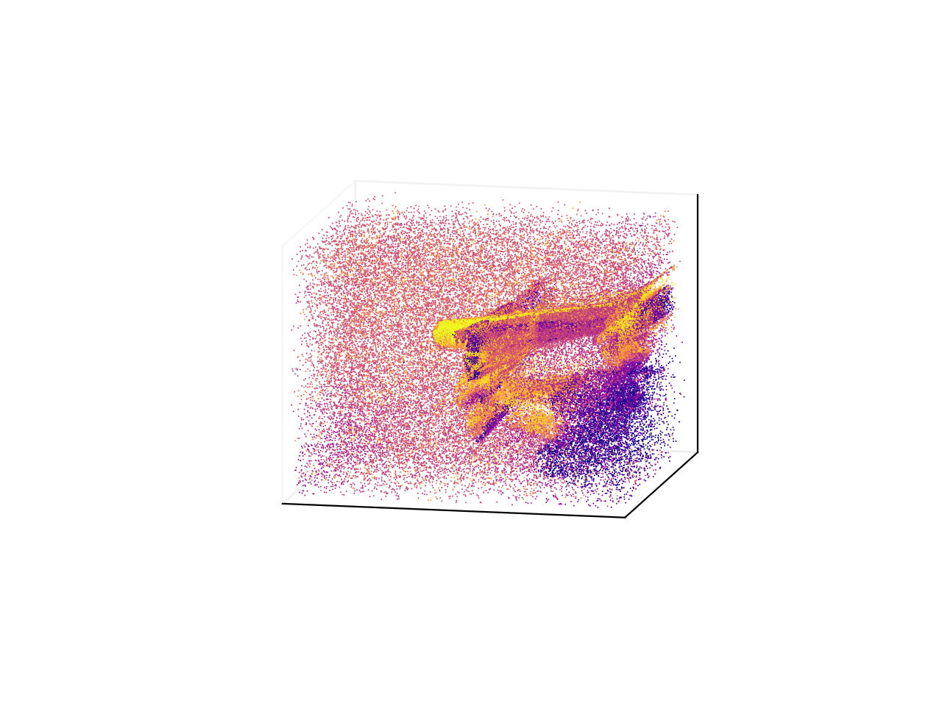
Generalized Event Streams
Sparse spatiotemporal stream of flux descriptor values ( )
Notes:
To achieve this, we conceptualize a novel space of generalized event cameras in terms of when events are generated and what flux information is captured.
(animate) Our generalized event cameras also produce a sparse spatiotemporal stream – but the key difference is that this stream inherently preserves scene intensity.

Slide 11
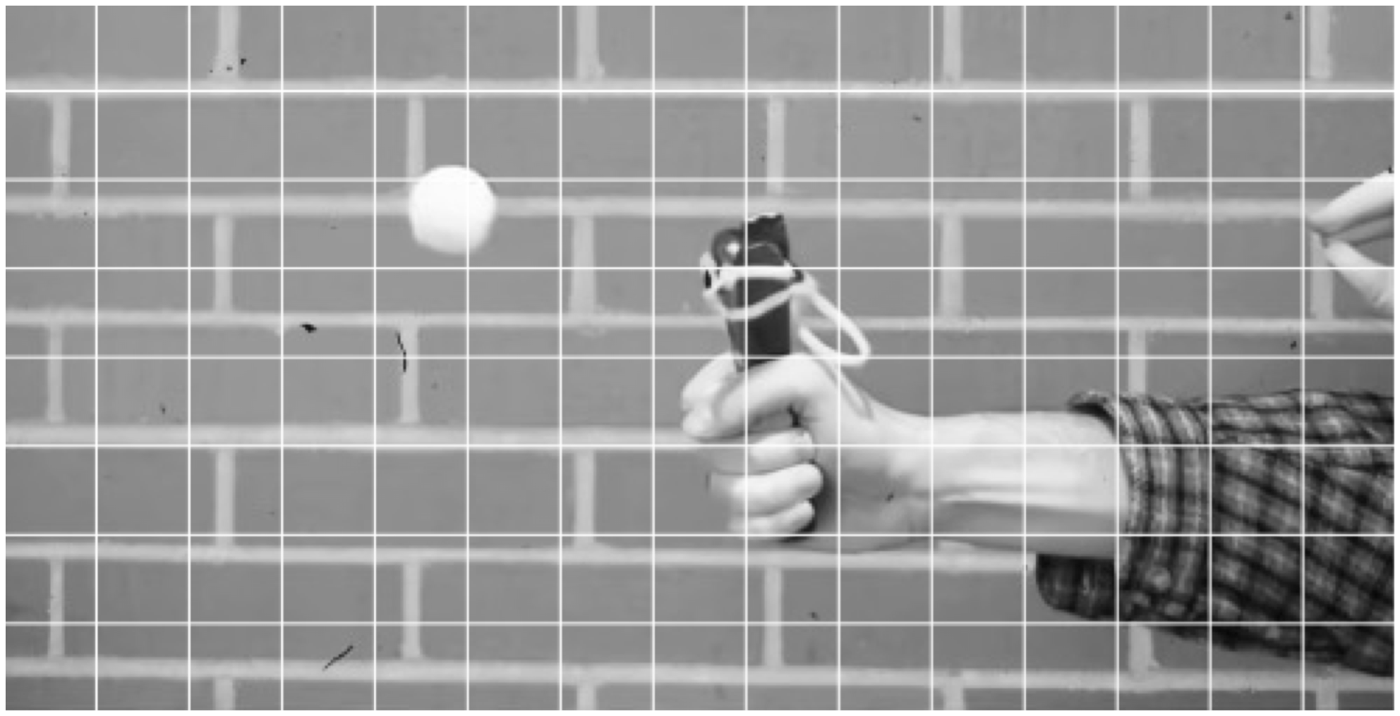
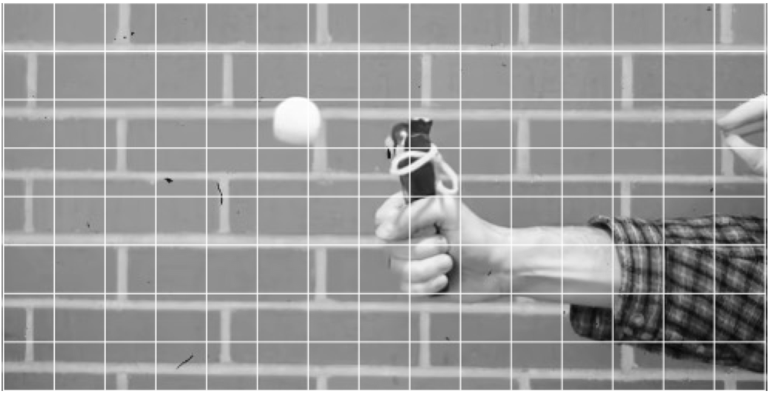
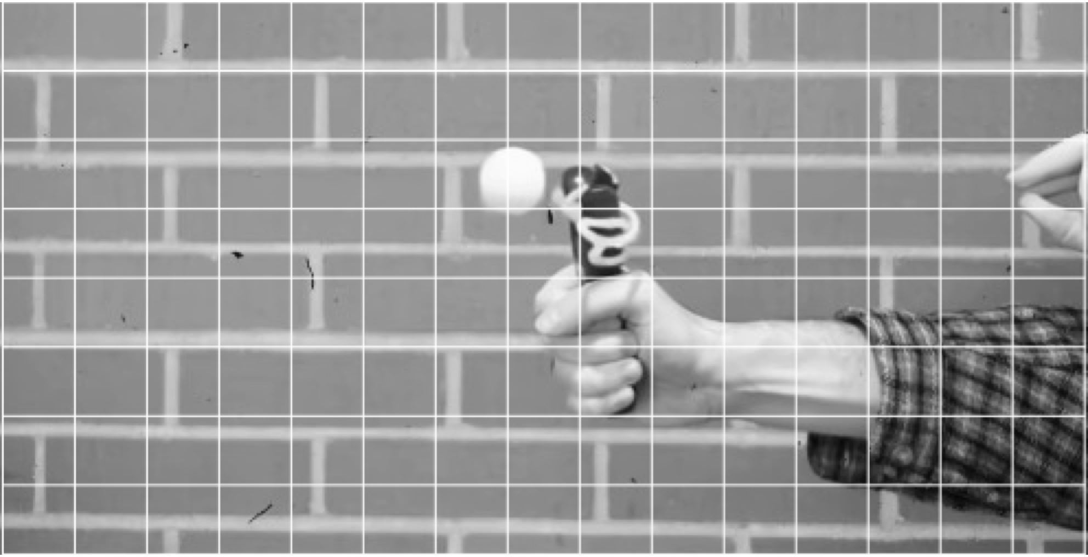
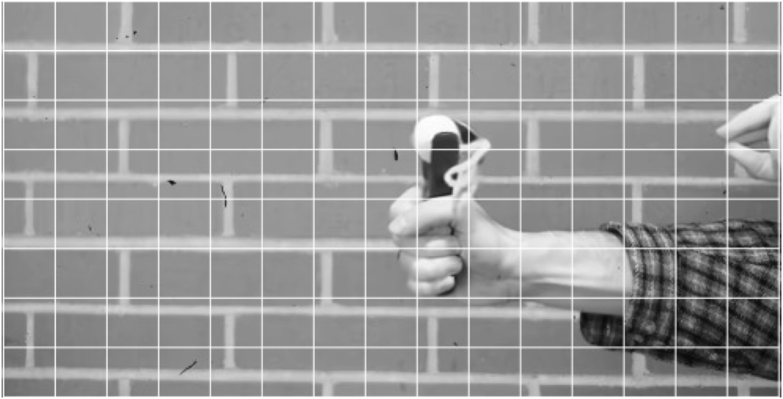
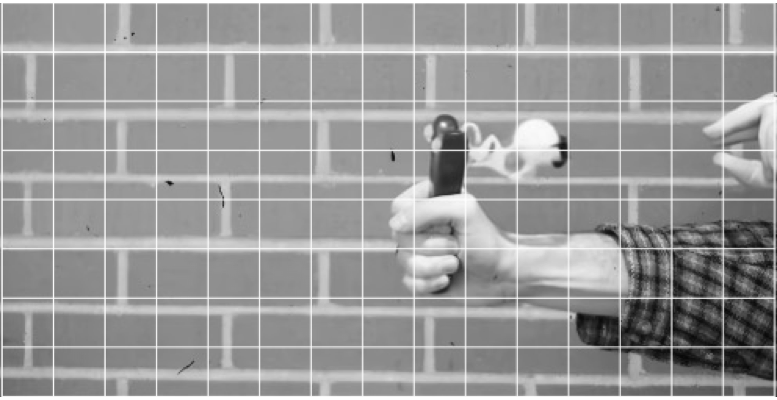
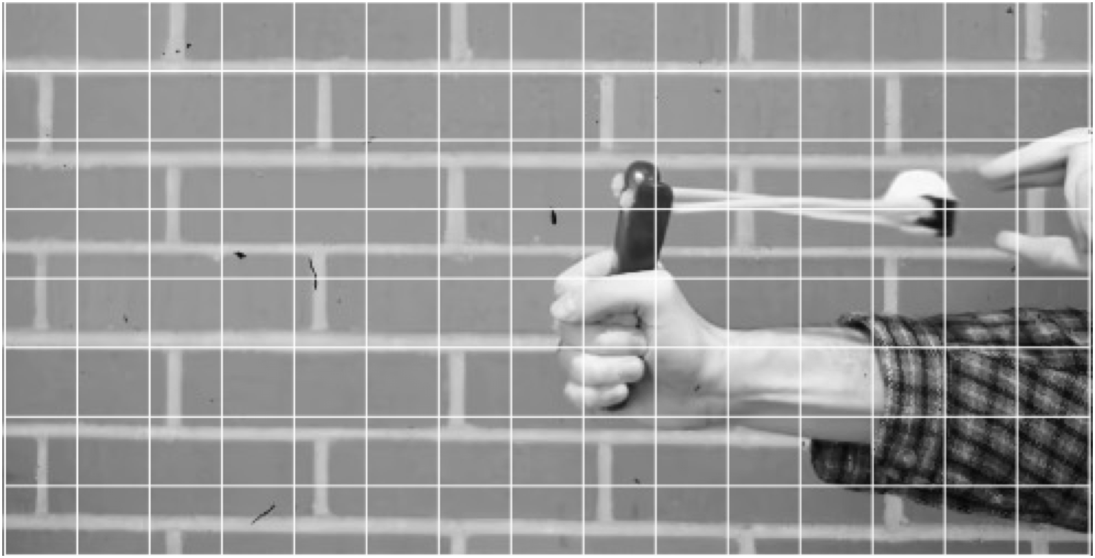
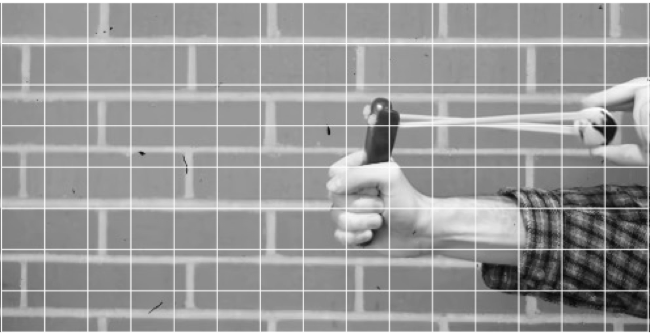
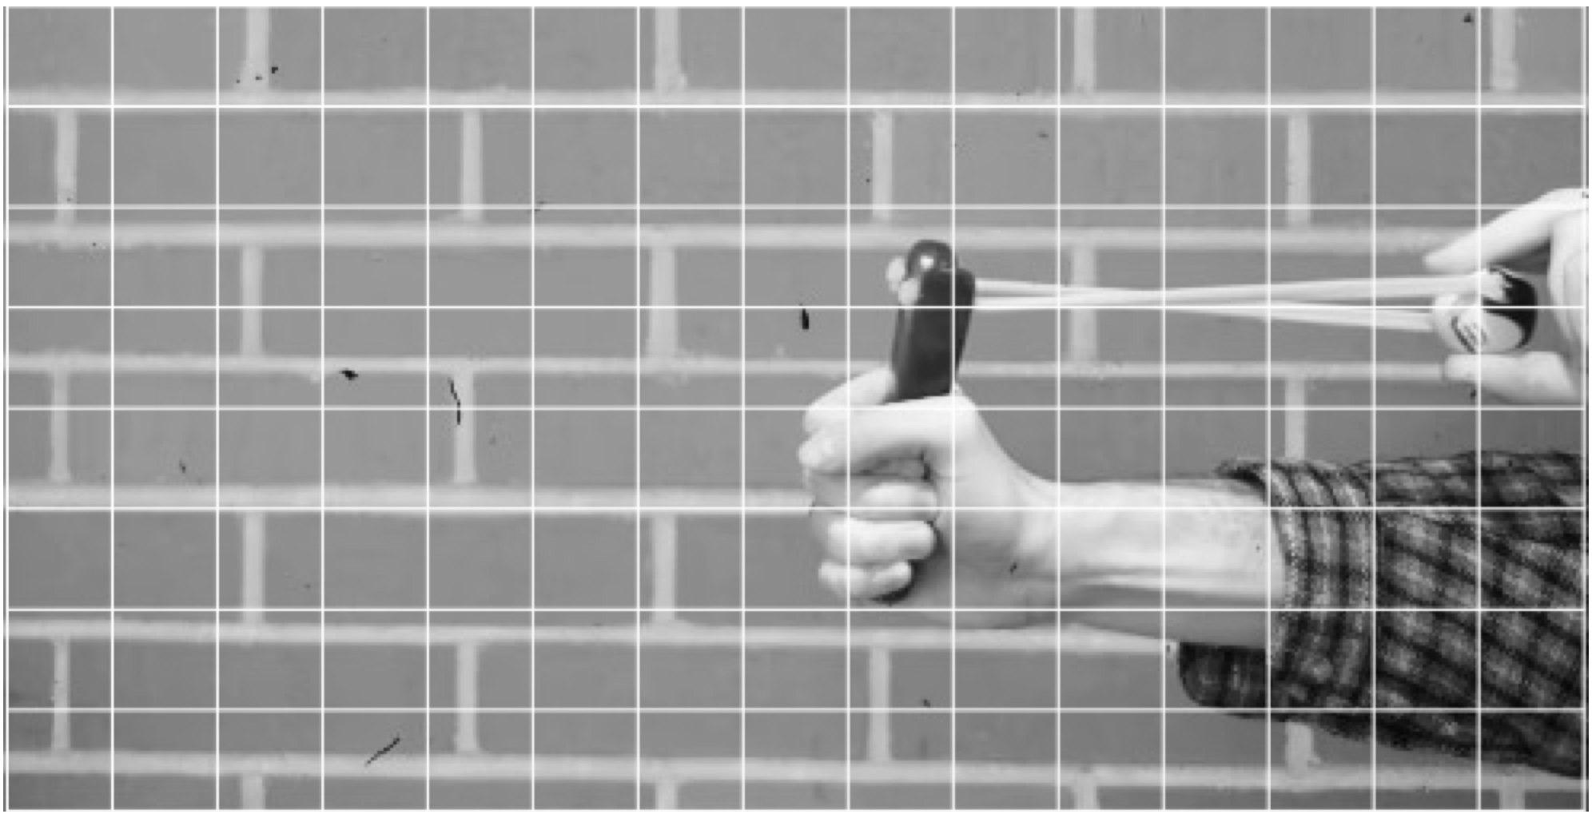

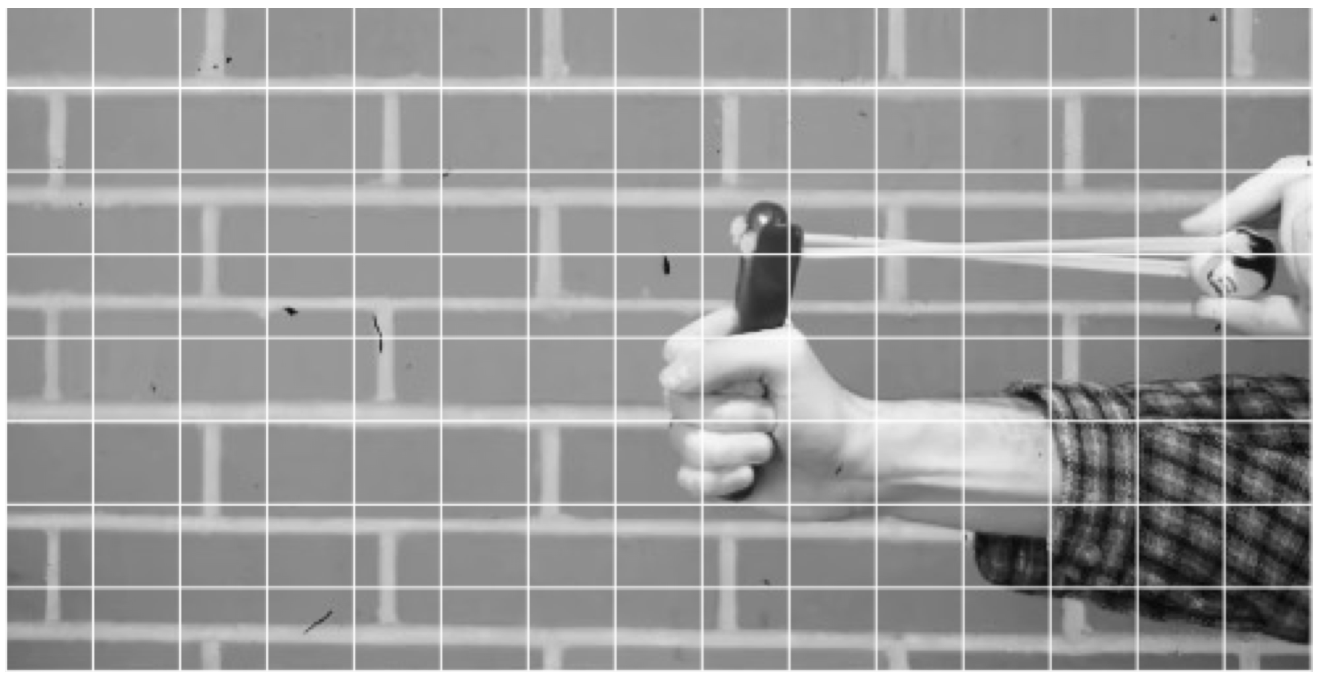








Rich Flux Descriptors
What flux information to capture
Motion
adaptive
Spatial patches
Coded exposures
Notes:
(animate) We make use of rich flux descriptors that go beyond what existing event cameras capture.
(animate) Our flux descriptors can be motion adaptive, (animate) span spatial extents, (animate) or even utilize unconventional modalities such as coded exposures.

Slide 12
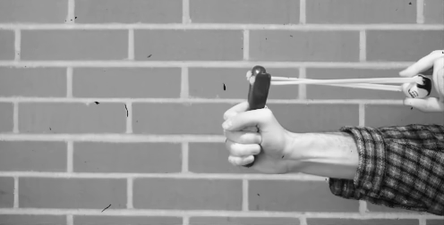
Intensity-Preserving Event Streams
Our reconstructions
3000 FPS
495 Mbps for 1 MPixel
Notes:
Generalized event cameras facilitate high-fidelity intensity imaging while retaining a low sensor readout.
(animate) This makes it possible to image the slingshot at 3000 FPS, but with a readout of 495 Mbps for a 1 Mpixel array, which for context, is an order of magnitude lower than a high-speed camera and would fit comfortably within the bandwidth of USB 3.0.

Slide 13
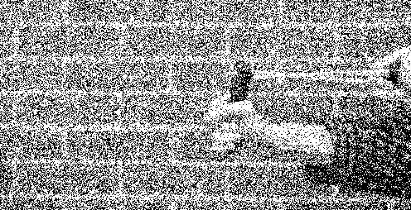
Implementing Generalized Events
Single-photon response
Binary frames acquired @ 96.8 kHz
Notes:
The crucial detail in generalized events is how we implement them, since their enabling techniques may not be easy to implement in analog.
For this reason, we turn to an emerging sensing technology, single-photon sensors, (animate) that can provide digital access to photon detections as a sequence of extremely high-speed binary frames.

Slide 14
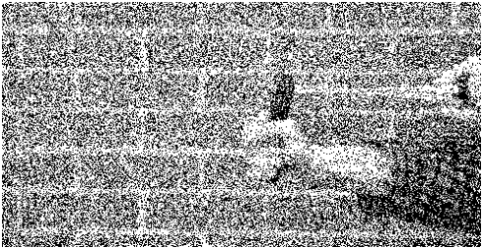
Single-Photon Generalized Event Cameras
Proposed algorithms
Lightweight and efficient
Single-photon response
Generalized events
Notes:
(animate) We design lightweight and efficient algorithms that transform photon detections into generalized event streams.

Slide 15
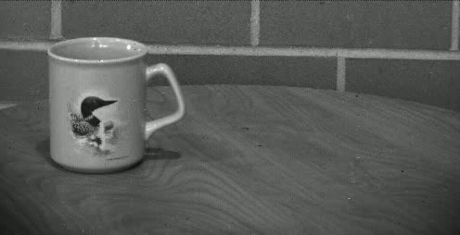
Imaging Non-rigid Deformations
Frame-based camera at 30 FPS
360 Mbps for 1 MPixel
Notes:
We now demonstrate the capabilities of generalized event cameras.
(animate) We image a stress ball that is hurled at a coffee cup, aiming to capture its non-rigid deformations.
A 30 FPS capture conveys the extent and speed of motion in this scene.

Slide 16
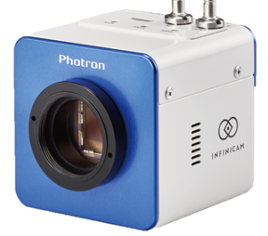
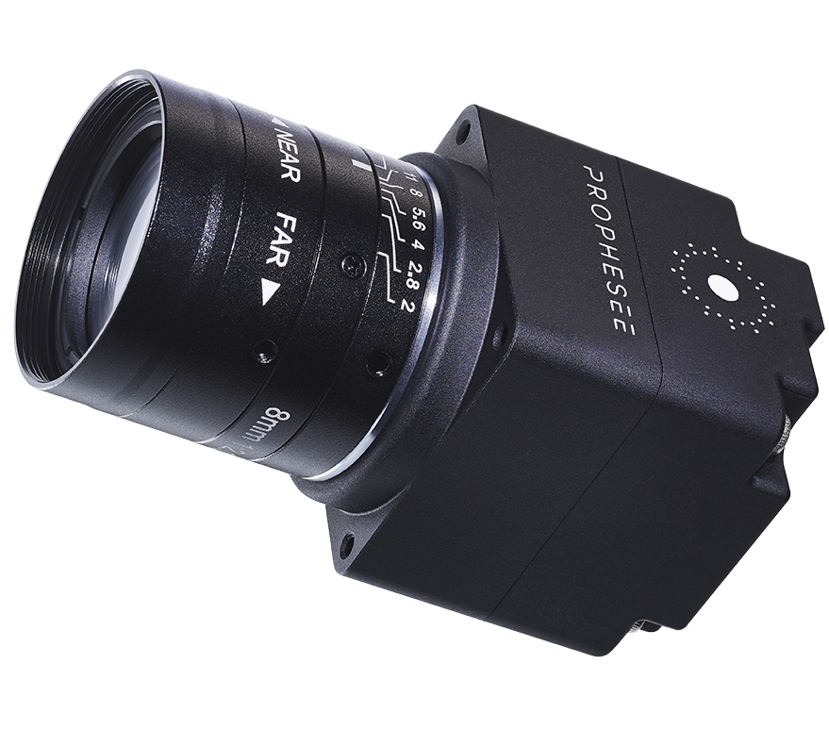
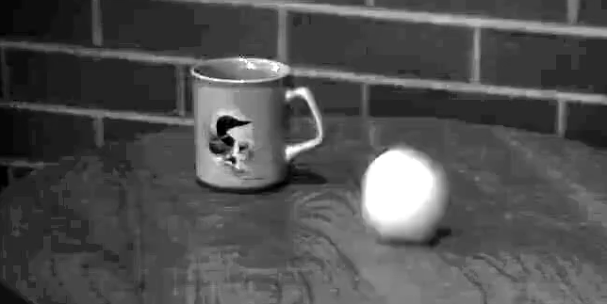

Existing Imaging Solutions
Photron Infinicam at 500 FPS
E2VID+ on Prophesee EVK4
Quantization artifacts
Noisy
Lacks scene information
3590 Mbps for 1 MPixel
236 Mbps for 1 MPixel
Notes:
(animate) A high-speed camera can capture the deformation dynamics at 500 FPS. However, each captured frame is SNR-limited in indoor conditions, and features prominent noise and compression artifacts arising from the camera’s ISP.
(animate) Meanwhile, reconstructions from an event camera lack scene information and do not capture the coffee mug placed on the table.

Slide 17
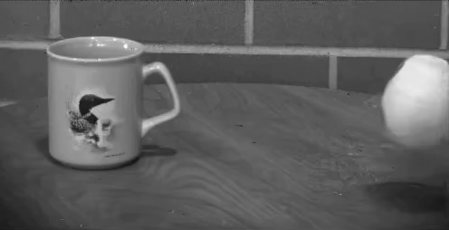
High-speed Videography with Generalized Events
Generalized events
3000 FPS
360 Mbps for 1 MPixel
Notes:
(animate) In comparison, our generalized events provide high-quality reconstructions at 3000 FPS that successfully capture the extensive deformations of the stress ball. The readout cost of our events are quite low at 360 Mbps for a 1MPixel array.

Slide 18
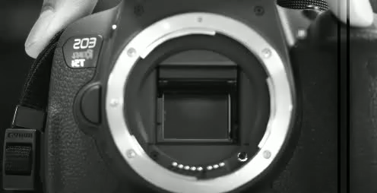
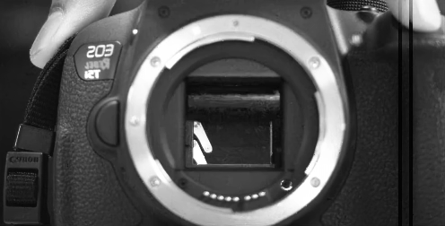
More High-speed Videography
Conventional camera
30 FPS
360 Mbps for 1 MPixel
Generalized events
3025 FPS
757 Mbps for 1 MPixel

Slide 19
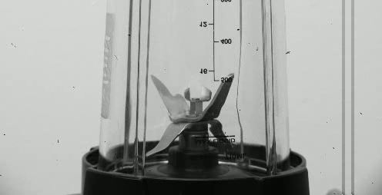
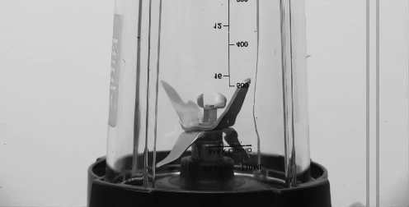
Conventional camera
30 FPS
360 Mbps for 1 MPixel
Generalized events
3025 FPS
907 Mbps for 1 MPixel

Slide 20
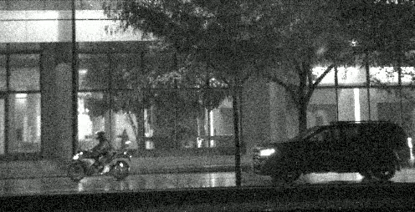
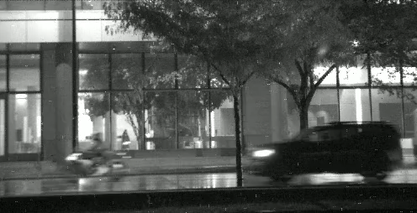
Nighttime Frame-based Imaging
Short exposure: too noisy
Long exposure: too blurred
Notes:
Next, we consider an urban nighttime traffic scene.
For frame-based cameras, low-light scenes force a choice between (animate) short exposures that preserve motion information but are too noisy, (animate) and long exposures that mitigate noise, but suffer from motion blur.

Slide 21
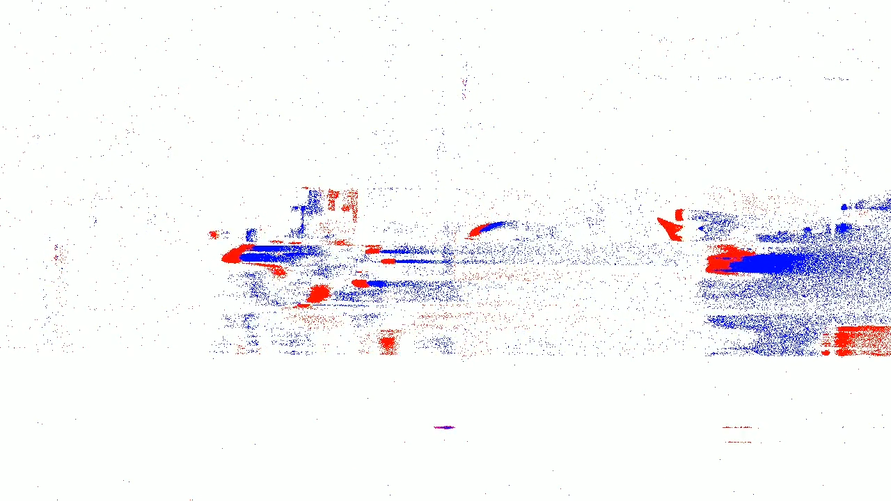
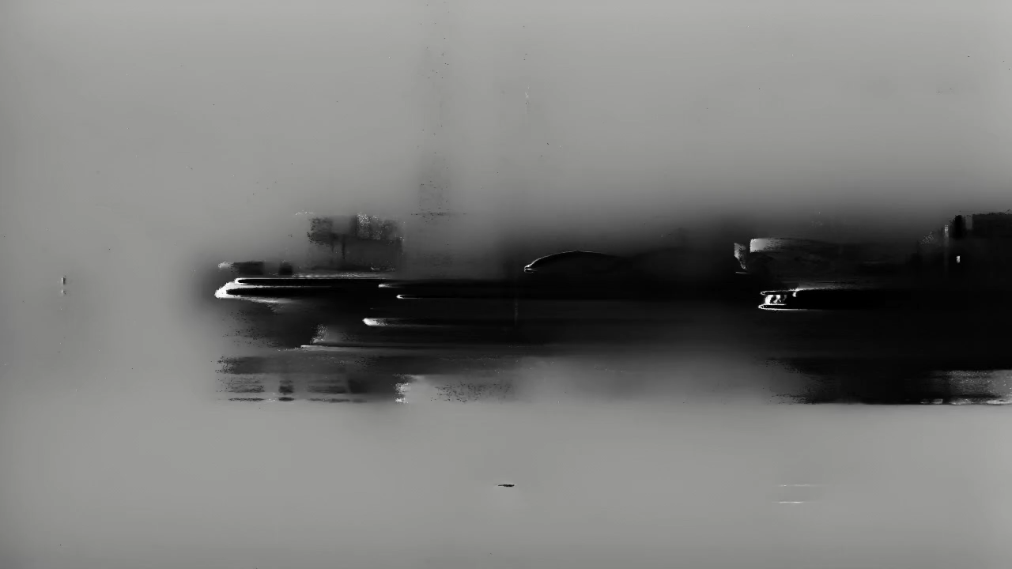
Nighttime Event Imaging
Prophesee EVK4 events
360 Mbps for 1 MPixel
E2VID+ on Prophesee
360 Mbps for 1MPixel
Notes:
Nighttime sequences are also challenging for existing event cameras, (animate) leading to significant blur in detecting events. (animate) As a result, the outputs of a technique such as E2VID are also of low quality.

Slide 22
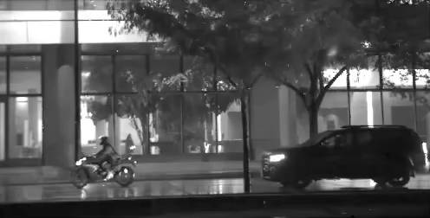
Nighttime Generalized Event Imaging
AC Flicker
Indoor LED lights
Generalized events
3000 FPS
315 Mbps for 1 MPixel
Few restoration artifacts
Notes:
Our generalized events benefit from their single-photon implementation and offer good low-light performance.
(animate) Here, we show reconstructions at 3000 FPS and with a readout of 315 Mbps per megapixel.
(animate) In addition to recovering details of the motorcyclist and car, we recover the flicker of AC lights mounted just outside the glass building.
(animate) The indoor LED lights, in comparison, do not vary as conspicuously.
(animate) Finally, we observe a few artifacts from our restoration techniques, which were trained solely on synthetic data.

Slide 23
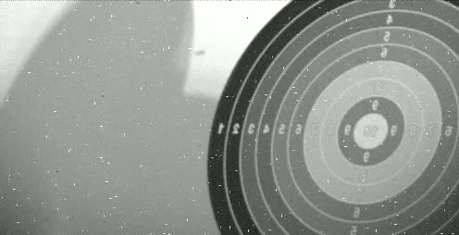
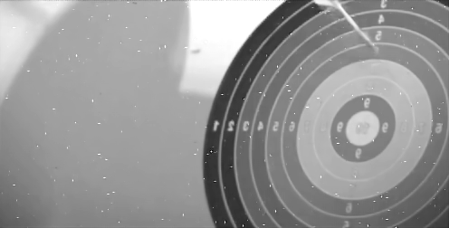
Throwing Darts in the Dark
At 5 lux, contrast stretched visualization
Conventional camera
30 FPS
360 Mbps for 1 MPixel
Generalized events
2300 FPS
514 Mbps for 1 MPixel

Slide 24
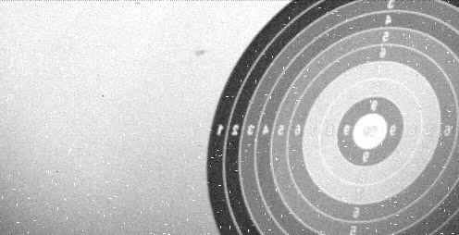
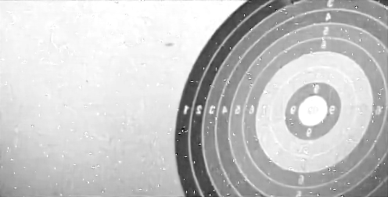
Throwing Darts in the Dark
At 2 lux
Conventional camera
30 FPS
360 Mbps for 1 MPixel
Generalized events
2300 FPS
1510 Mbps for 1 MPixel

Slide 25
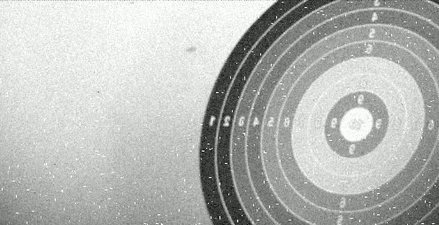
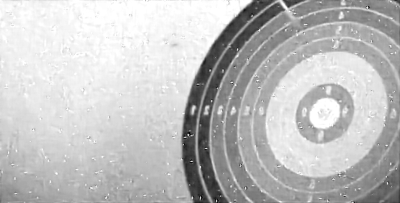
Throwing Darts in the Dark
At 1 lux
Conventional camera
30 FPS
360 Mbps for 1 MPixel
Generalized events
2300 FPS
1730 Mbps for 1 MPixel

Slide 26
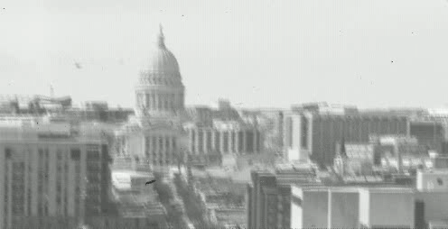
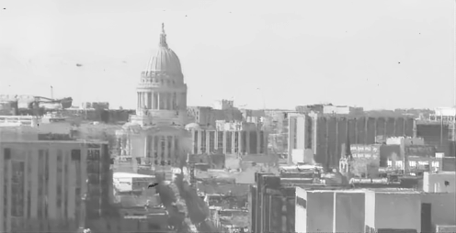
Scenes with Camera Motion
Exaggerated 2x
Conventional camera
30 FPS
360 Mbps for 1 MPixel
Generalized events
3025 FPS
724 Mbps for 1 MPixel

Slide 27
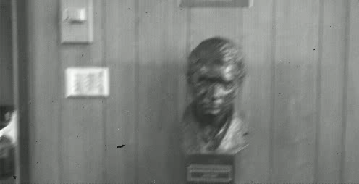
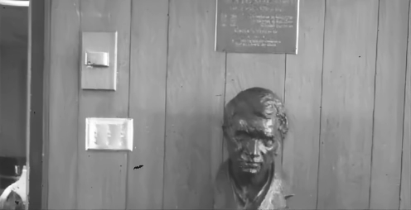
Scenes with Camera Motion
Exaggerated 2x
Conventional camera
30 FPS
360 Mbps for 1 MPixel
Generalized events
3025 FPS
498 Mbps for 1 MPixel

Slide 28
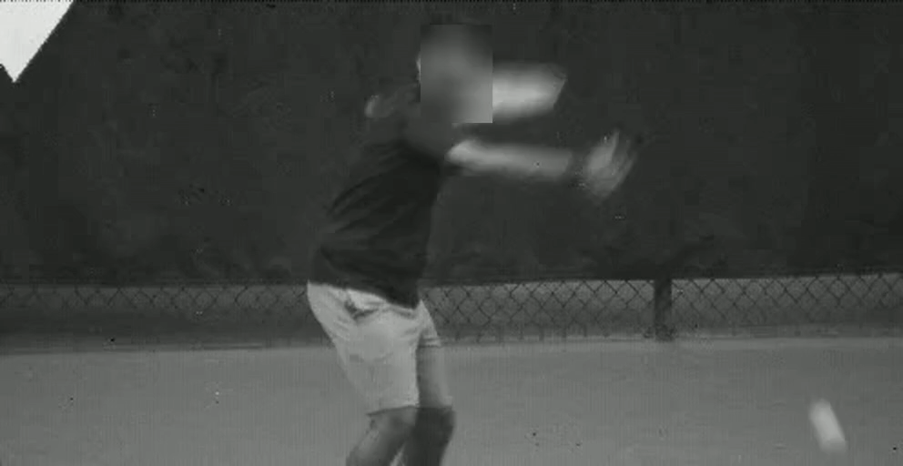

Plug-and-Play Event Vision
Conventional camera
30 FPS
360 Mbps for 1 MPixel
Generalized events
3000 FPS
520 Mbps for 1 MPixel
Faces have been blurred for anonymity reasons.
Notes:
As a direct implication of preserving intensity information, we can run a variety of downstream algorithms in a plug-and-play manner.
(animate) We show this on a tennis forehand sequence, (animate) with a 30 FPS capture that depicts the racket speed, (animate) and our reconstructions which capture the racket swing in extreme slow motion.

Slide 29
Plug-and-Play Event Vision
ball >99%
person 97%
racket >99%
Corner detection
Harris corner detection
Object detection
DETR
Faces have been blurred for anonymity reasons.
Harris et al. (1988).
DETR, Carion et al. (ECCV 2020).
Notes:
(animate) We run a corner detector and (animate) an object detector. The latter succeeds in detecting the person, racket and tennis ball.

Slide 30
Plug-and-Play Event Vision
Pose estimation
HRNet
Semantic segmentation
Segment Anything
Faces have been blurred for anonymity reasons.
HRNet, Sun et al. (CVPR 2019).
Segment Anything, Kirillov et al. (ICCV 2023).
Notes:
(animate) We can also reliably estimate the player’s pose, (animate) and provide fine-grained segmentation of both static and dynamic regions of the scene.

Slide 31


Deluge of Single-Photon Data
Proposed algorithms
Data bottleneck (5 Gbps)
Downstream inference
Photon-detections
(100 Gbps)
Notes:
A key consideration in realizing generalized event cameras is the readout of single-photon data.
(animate) Single-photon sensors produce an exorbitant amount of data, as high as 100 Gbps for a 1MPixel array, (animate) which easily overwhelm existing data peripherals.
(animate) To realize the benefits provided by generalized events, it is critical to perform relevant computations close to the sensor, thereby preventing photon detection readout.

Slide 32
On-Chip Compatibility
Generalized events reduce readout costs by around 2 orders of magnitude.
UltraPhase, Ardelean et al. (2023), “Computational Imaging SPAD Cameras.”
Notes:
(animate) We show that our proposed computations are lightweight and efficient enough to be carried out near sensor, using a recent single-photon compute platform called UltraPhase.
(animate) Across several instances of our generalized event cameras, which we mark in yellow, we demonstrate that on-chip implementations can reduce sensor readout (animate) and power costs by over two orders of magnitude.

Slide 33


Summary: Extreme Bandwidth-Efficient Vision
Lightweight and efficient algorithms
Single-photon sensors
Generalized events
High-fidelity imaging
Low-sensor readout
Plug-and-play event vision
3000 FPS
495 Mbps for 1MPixel
CoTracker
CoTracker, Karaev et al. (arXiv 2023).
Notes:
(animate) In summary, we design a novel class of generalized event streams that contain rich scene intensity information, by harnessing the outputs of single-photon sensors.
(animate) Our generalized event cameras provide the exciting capability of high-fidelity imaging (animate) with an efficient readout, (animate) which directly facilitates plug-and-play event vision without the need for any algorithmic re-engineering or retraining.

Slide 34
Existing Imaging Solutions
Quantization artifacts
Noisy
Lacks scene information
High-speed camera at 500 FPS
3590 Mbps for 1 MPixel
E2VID+ on Prophesee EVK4
236 Mbps for 1 MPixel

Slide 35
Rich Flux Descriptors
What information to transmit
Motion
adaptive
Spatial patches
Coded exposures

Slide 36
Comparison to Existing Event Cameras
var ctx = document.getElementById("canvas").getContext("2d"); // #g1 ctx.save(); ctx.transform(3.779530, 0.000000, 0.000000, 3.779530, -3.968090, -14.865400); // #g21 ctx.save(); ctx.transform(1.000000, 0.000000, 0.000000, 1.000000, -0.859468, -0.052497); // #path7 ctx.beginPath(); ctx.strokeStyle = 'rgb(0, 0, 0)'; ctx.lineWidth = 0.264583; ctx.moveTo(2.041650, 4.117930); ctx.lineTo(28.977269, 4.117930); ctx.lineTo(28.977269, 20.602529); ctx.lineTo(2.041650, 20.602529); ctx.closePath(); ctx.stroke(); ctx.restore(); ctx.restore();

Slide 37
…plus What Information to Encode
Characterized by an “Integrator”
Low-pass filtered brightness

Slide 39
Throwing Darts at 5 lux

Slide 40
Axes of Generalized Event Cameras
When to transmit
Integrator value
Time
Enhanced spatiotemporal contexts
Noise-aware thresholding

Slide 42
Event Camera: Change Detection plus…
When to transmit

Slide 43

Plug-and-Play Event Vision
Frame-based camera at 30 FPS
360 bps/sec

