Slide 1
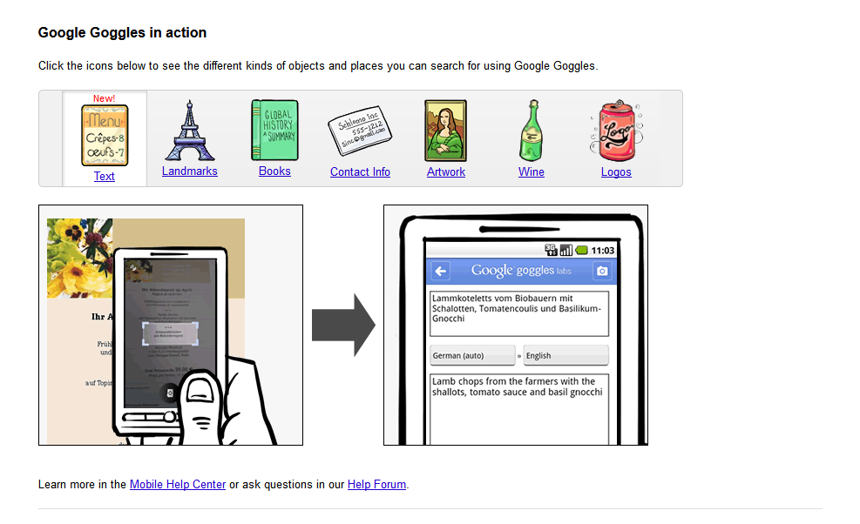
Image Search for Object Recognition and 3D Scene Reconstruction
Google Goggles

Slide 2

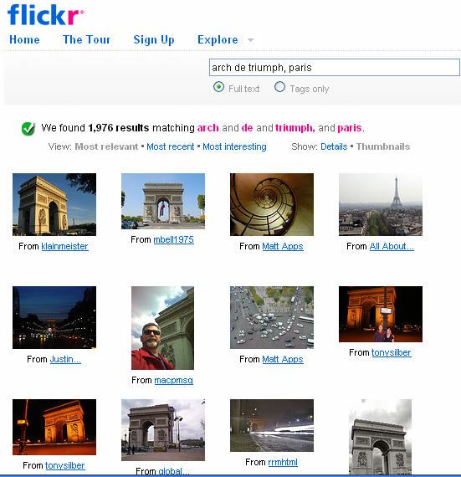

Landmark Recognition

Slide 3
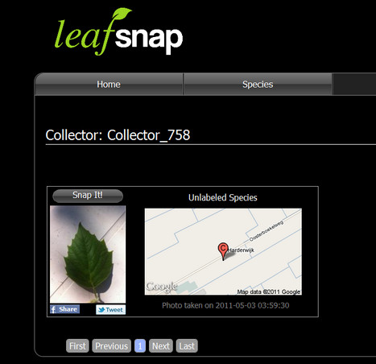
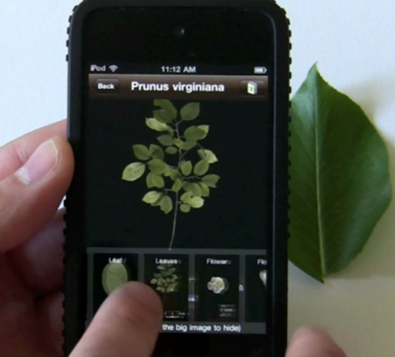
Leafsnap
Leaf recognition

Slide 4
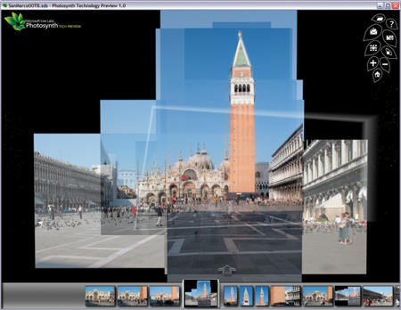
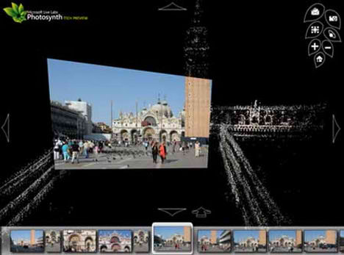
Microsoft Photosynth for 3D Reconstructdion

Slide 5
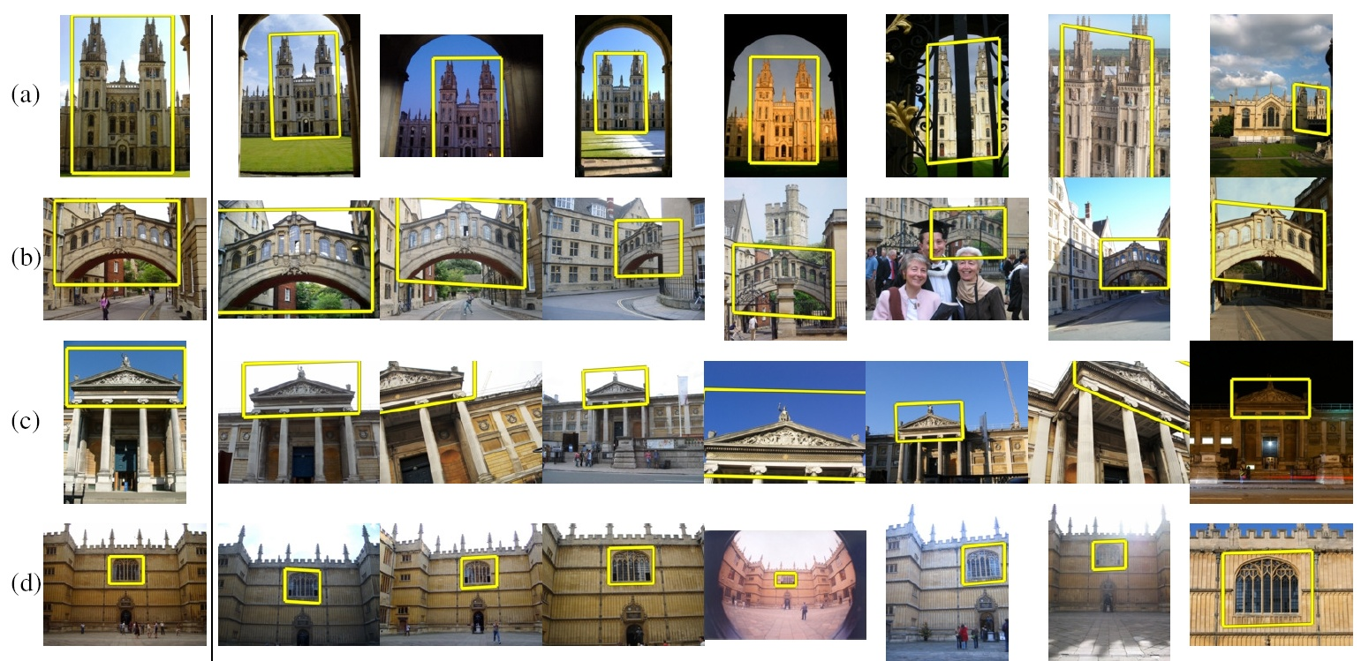
Challenge
How to quickly find images in a large database that match a given image region?

Slide 6

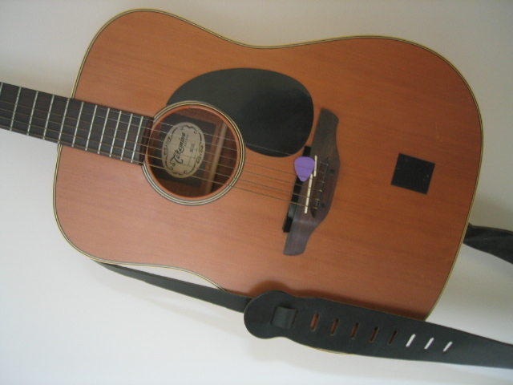


Image Representation and Matching
Database
Query
Compute feature points (aka keypoints) for every image in the database and the query

Slide 7
Image Matching
See how many feature points are close to feature points in each other image
Lots of Matches
Few or No Matches

Slide 8
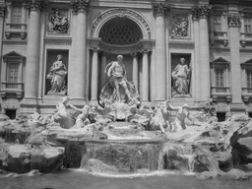
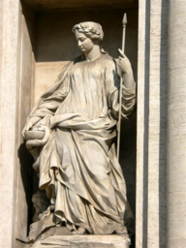
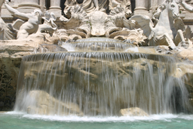
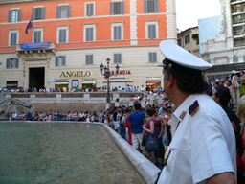
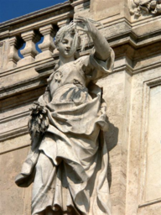
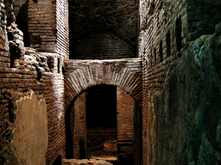
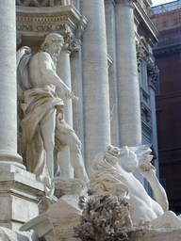
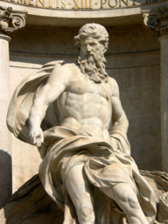
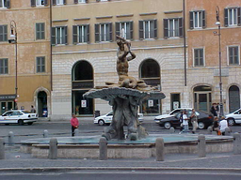
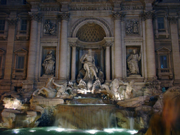
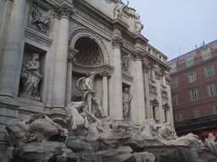
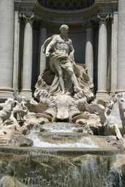
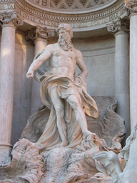
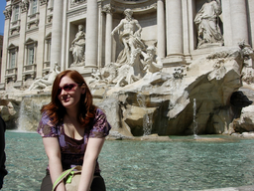
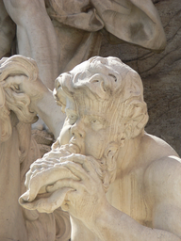
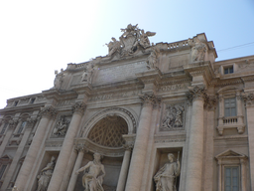
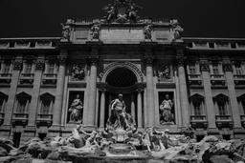
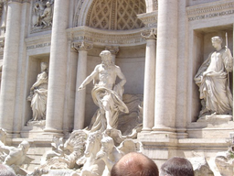
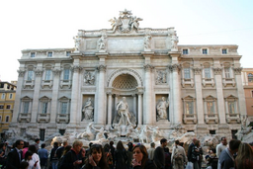
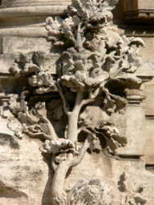
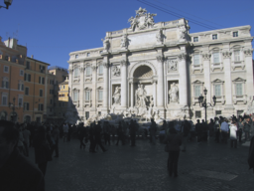
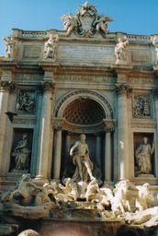
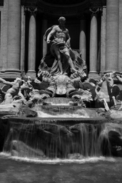
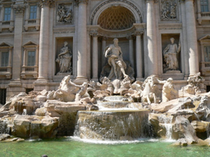
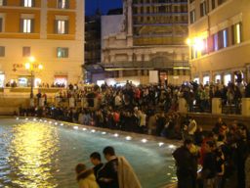
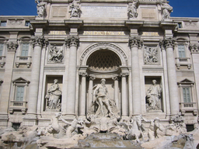
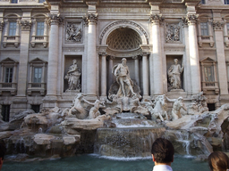
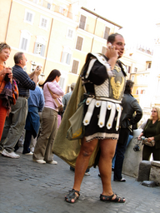
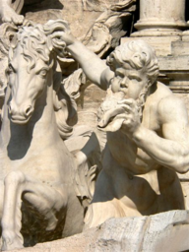
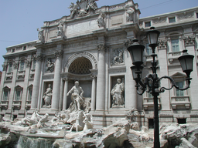
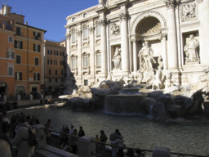
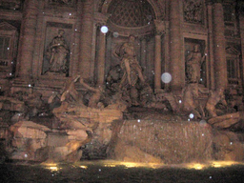
Feature Detection
Detect feature points

Slide 9
Feature Detection
Detect feature points

Slide 10
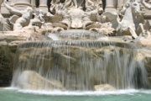





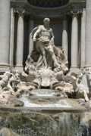



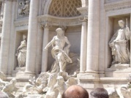



Feature Detection
Detect features

Slide 11




Wide-Baseline Feature Matching
Match features between each pair of images
Notes:
Next, we match features across each pair of photos using approximate nearest neighbor matching.

Slide 12
Pairwise Feature Matching
Match features between each pair of images
  Use a “descriptor” (i.e., a feature vector) for each feature point
  For each feature point in image I, find 2 closest points in each other image, J, and accept if d1/d2 < 0.6

Slide 13

Pairwise Feature Matching
Refine matching using RANSAC to estimate “fundamental matrices” between pairs of images
Fundamental matrix:
F is a 3x3 matrix with
rank 2 such that for:
corresponding points
in stereo pair

Slide 14

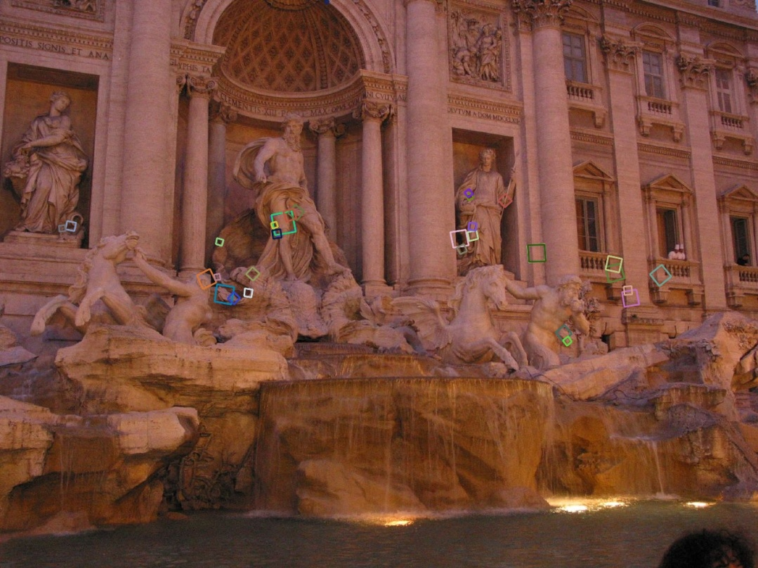
The Power of SIFT

Slide 15
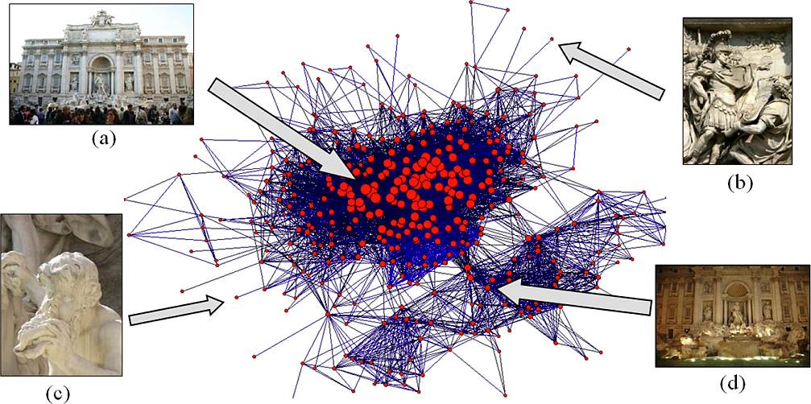
Construct Image Connectivity Graph
Each image is a node; an edge is present if there are enough matching feature points between an image pair

Slide 16
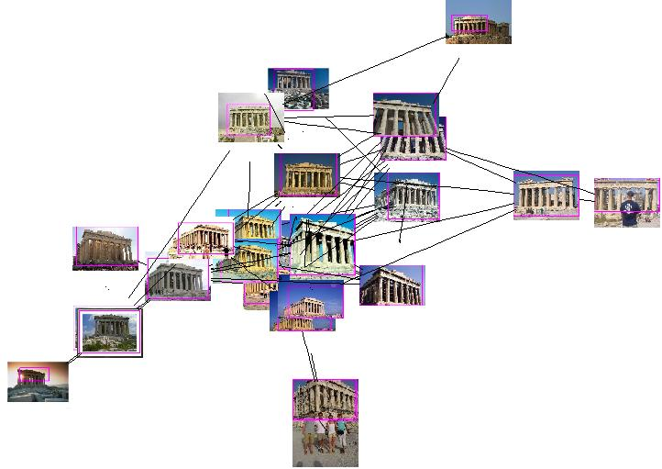
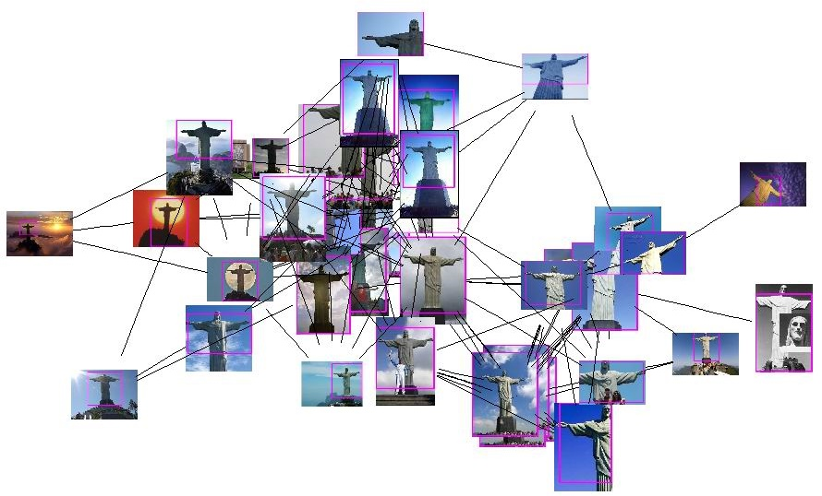
Visual Clusters
Acropolis, Athens, Greece
Corcovado, Rio de Janeiro, Brazil

Slide 17
How to find Matches Fast?
Key idea 1: “Visual Words”
Cluster the feature point descriptors

Slide 18
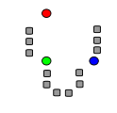
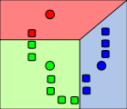
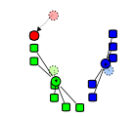
Key idea 1: “Visual Words”
K-Means Clustering algorithm
1. Randomly select K centers
2. Assign each point to nearest center
3. Compute new center (mean) for each cluster
Illustration: http://en.wikipedia.org/wiki/K-means_clustering

Slide 19

Key idea 1: “Visual Words”
K-Means Clustering algorithm
1. Randomly select K centers
2. Assign each point to nearest center
Back to 2
3. Compute new center (mean) for each cluster
Illustration: http://en.wikipedia.org/wiki/K-means_clustering

Slide 20
Kmeans: Matlab code
function C = kmeans(X, K)
% Initialize cluster centers to be randomly sampled points
[N, d] = size(X);
rp = randperm(N);
C = X(rp(1:K), :);
lastAssignment = zeros(N, 1);
while true
% Assign each point to nearest cluster center
bestAssignment = zeros(N, 1);
mindist = Inf*ones(N, 1);
for k = 1:K
for n = 1:N
dist = sum((X(n, :)-C(k, :)).^2);
if dist < mindist(n)
mindist(n) = dist;
bestAssignment(n) = k;
end
end
end
% break if assignment is unchanged
if all(bestAssignment==lastAssignment), break; end;
% Assign each cluster center to mean of points within it
for k = 1:K
C(k, :) = mean(X(bestAssignment==k, :));
end
end

Slide 21
K-means Demo
http://home.dei.polimi.it/matteucc/Clustering/tutorial_html/AppletKM.html

Slide 22
Key idea 1: “Visual Words”
Cluster the feature point descriptors
Assign each descriptor to a cluster number
  What does this buy us?
  Each descriptor was 128 dimensional floating point, now is 1 integer (easy to match!)
  Is there a catch?
    Need a lot of clusters (e.g., 1 million) if we want points in the same cluster to be very similar
    Points that really are similar might end up in different clusters

Slide 23
Key idea 1: “Visual Words”
Cluster the feature point descriptors
Assign each descriptor to a cluster number
Represent an image region with a count of these “visual words”

Slide 24
Key idea 1: “Visual Words”
Cluster the feature point descriptors
Assign each descriptor to a cluster number
Represent an image region with a count of these “visual words”
An image is a good match if it has a lot of the same visual words as the query region

Slide 25
Naïve matching is still too slow
Imagine matching 1,000,000 images, each with 1,000 feature points

Slide 26

Key Idea 2: Inverse Document File
Like a book index: keep a list of all the words (feature points) and all the pages (images) that contain them
Rank database images based on tf-idf measure
tf-idf: Term Frequency – Inverse Document Frequency
# times word appears in document
# documents
# words in document
# documents that contain the word

Slide 27
Fast visual search
“Video Google”, Sivic and Zisserman, ICCV 2003
“Scalable Recognition with a Vocabulary Tree”, Nister and Stewenius, CVPR 2006.

Slide 28



110,000,000 Images in 5.8 Seconds
Slide
Slide Credit: Nister
Notes:
Very recently, we have scaled the system even further.
The system we just demo’d searches a 50 thousand image index in the RAM of this laptop at real-time rates.
We have built and programmed a desktop system at home in which we currently have 12 hard drives. We bypass the operating system and
read and write the disk surfaces directly.
Last week this system clocked in on 110 Million images in 5.8 seconds, so roughly 20Million images per second and machine.
The images consist of around 10 days of four TV channels, so more than a month of TV.
Soon we don’t have to watch TV, because we’ll have machines doing it for us.

Slide 29



Slide
Slide Credit: Nister
Notes:
To continue the analogy, if we printed all these images on paper, and stacked them,

Slide 30

Slide
Slide Credit: Nister
Notes:
The pile would stack, as high as

Slide 31

Slide
Slide Credit: Nister
Notes:
Mount Everest.
Another way to put perspective on this is, Google image search not too long ago claimed to index 2 billion images,
although based on meta-data, while we do it based on image content.
So, with about 20 desktop systems like the one I just showed, it seems that it may be possible to build a web-scale content-based image search engine,
and we are sort of hoping that this paper will fuel the race for the first such search engine.
So, that is some motivation.
Let me now move to the contribution of the paper.
As you can guess by now, it is about scalability of recognition and retrieval.

Slide 32
Key Ideas
Visual Words
  Cluster descriptors (e.g., K-means)
Inverse document file
  Quick lookup of files given keypoints
tf-idf: Term Frequency – Inverse Document Frequency
# documents
# times word appears in document
# documents that contain the word
# words in document

Slide 33
Recognition with K-tree
Following slides by David Nister (CVPR 2006)

Slide 34

Notes:
I will now try to describe the approach with an animation.
The first, offline phase, is to train the vocabulary tree.
We use Maximally Stable Extremal Regions by Matas et al. and then we extract SIFT descriptors from the MSER regions.
Regarding the feature extraction, we are not really claiming anything other than down-in-the-trenches nose-to-the-grindstone hard work to get good implementations of the state-of-the-art, and since we are all obsessed with novelty I will not spend any time talking about the feature extraction.
We believe that the vocabulary tree approach will work well on any of your favorite descriptors.

Slide 35
Notes:
All the descriptor vectors are thrown into a common space.
This is done for many images, the goal being to acquire enough statistics on how natural images distribute points in the descriptor space.

Slide 38


Slide 39


Slide 41
Notes:
We then run k-means on the descriptor space. In this setting, k defines what we call the branch-factor of the tree, which indicates how fast the tree branches.
In this illustration, k is three. We then run k-means again, recursively on each of the resulting quantization cells.
This defines the vocabulary tree, which is essentially a hierarchical set of cluster centers and their corresponding Voronoi regions.
We typically use a branch-factor of 10 and six levels, resulting in a million leaf nodes. We lovingly call this the Mega-Voc.

Slide 51
Notes:
We now have the vocabulary tree, and the online phase can begin.
In order to add an image to the database, we perform feature extraction. Each descriptor vector is now dropped down from the root of the tree and quantized very efficiently into a path down the tree, encoded by a single integer.
Each node in the vocabulary tree has an associated inverted file index.
Indicies back to the new image are then added to the relevant inverted files.
This is a very efficient operation that is carried out whenever we want to add an image.

Slide 52



Slide 53



Slide 54



Slide 55



Slide 56

Notes:
When we then wish to query on an input image, we quantize the descriptor vectors of the input image in a similar way, and accumulate scores for the images in the database with so called term frequency inverse document frequency (tf-idf). This is effectively an entropy weighting of the information. The winner is the image in the database with the most common information with the input image.

Slide 57































Performance
Notes:
One of the reasons we managed to take the system this far is that we have worked with rigorous performance testing against a database with ground truth.
We now have a benchmark database with over 10000 images grouped in sets of four images of the same object. We query on one of the images in the group and see how many of the other images in the group make it to the top of the query.
In the paper, we have tested this up to a million images, by embedding the ground truth database into a database encompassing all the frames of 10 feature length movies.

Slide 58

More words is better
Improves
Retrieval
Improves
Speed
Branch factor
Notes:
We have used the performance testing to explore various settings for the algorithm.
The most important finding is that the number of leaf nodes in the vocabulary tree is very important.
In principle, there is a trade-off, because we wish to have discriminative quantizations, which implies many leaf-nodes, while we also wish to have repeatable quantizations, which implies few leaf nodes.
However, it seems that in a large practical range, the bigger the better when it comes to the vocabulary. This probably depends on the descriptors used, but is not entirely surprising, since we are trying to divide up a 128-dimensional space in discriminative bins.
This is a very useful finding, because it means that we are in a win-win situation:
a larger vocabulary improves retrieval performance. It turns out that it also improves the retrieval speed, because our inverted file index becomes much sparser, so we exploit the true power of inverted files better with a larger vocabulary.
We also use a hierarchical scoring scheme, which has the nice property that the performance will only level out, not actually go down.

Slide 59

Higher branch factor works better (but slower)
Notes:
We also find that performance improves with the branch factor.
This improvement is not dramatic, but it is interesting to note that very low branch factors are somewhat weak, and a branch factor of two results in partitioning the space with planes.

Slide 60
Can we be more accurate?
So far, we treat each image as containing a “bag of words”, with no spatial information
Which matches better?
e
h
a
f
e
e
z
a
f
e
h
a
f
e
e

Slide 61
Can we be more accurate?
So far, we treat each image as containing a “bag of words”, with no spatial information
Real objects have consistent geometry

Slide 62
Final key idea: geometric verification
Goal: Given a set of possible keypoint matches, figure out which ones are geometrically consistent
How can we do this?

Slide 63
Final key idea: geometric verification
RANSAC for affine transform
Repeat N times:
e
z
e
z
a
a
Randomly choose 3 matching pairs
f
f
e
e
Estimate transformation
Affine Transform
e
z
e
Predict remaining points and count “inliers”
z
a
a
f
f
e
e

Slide 64
Application: Large-Scale Retrieval
Query
Results on 5K (demo available for 100K)
[Philbin CVPR’07]

Slide 65





Application: Image Auto-Annotation
Moulin Rouge
Old Town Square (Prague)
Tour Montparnasse
Colosseum
Viktualienmarkt
Maypole
Left: Wikipedia image
Right: closest match from Flickr
[Quack CIVR’08]

Slide 66


Example Applications
Aachen Cathedral
Mobile tourist guide
Self-localization
Object/building recognition
Photo/video augmentation

Slide 67














Video Google System
Query region
Collect all words within query region
Inverted file index to find relevant frames
Compare word counts
Spatial verification
[Sivic & Zisserman, ICCV 2003]
Demo online athttp://www.robots.ox.ac.uk/~vgg/research/vgoogle/index.html
Retrieved frames

Slide 68
Summary: Uses of Feature Points
Feature points can be detected reliably in different images at the same 3D location
  DOG interest points are localized in x, y, scale
SIFT is robust to rotation and small deformation
Interest points provide correspondence
  For image stitching
  For defining coordinate frames for object insertion
  For object recognition and retrieval

Slide 69
From Pairwise Matches to Tracks
Given pairwise matches, next step is to link up matches to form “tracks”
Image 2
Each track is a connected component of the pairwise feature match graph
Each track will eventually grow up to become a 3D point
Image 1
Image 3

Slide 70
From Pairwise Matches to Tracks
Given pairwise matches, next step is to link up matches to form “tracks”
Image 2
Some tracks might be inconsistent
We remove these features from the troublesome images
Image 1
Image 3

Slide 71
Correspondence Estimation
Link up pairwise matches to form connected “tracks” of matching feature points across several images
Image 1
Image 2
Image 3
Image 4

Slide 72



The Power of Transitivity

Slide 73
Most Tracks are Short
Example image collection with 3,000 images:
  1,546,612 total tracks
  79% have length 2
  90% have length < 4
  98% have length < 11
  Longest track: 385 features

Slide 74

Track Lifetime
Lifetime of 3,192 tracks from the previous sequence

Slide 75

Track Lifetime
number of tracks
track length
Track length histogram

Slide 76


Image Connectivity Post-Track Generation
Raw image matches
Image matches after track generation

Slide 77


The Story so far…
Input images
Feature detection
Matching + track generation
Images with feature correspondence

Slide 78

The Story so far…
Next step:
  Use “structure from motion” to solve for geometry (cameras and 3D points)

Slide 79
Structure from Motion (SfM)
Unknown
camera
viewpoints
Estimate
  Scene geometry (3D coordinates for each point)
  Camera extrinsic and intrinsic parameters (3D relative position and orientation, focal length, lens radial distortion)

Slide 80
Recover Structure from Motion
p₄
p₁
p₃
minimize
p₂
f (R, T, P)
p₅
p₇
p₆
Camera 1
Camera 3
R₁,t₁
R₃,t₃
Camera 2
R₂,t₂

Slide 81

M. Pollefeys and L. Van Gool

Slide 82

A World-Wide Landmark Recognition Engine with Web Learning
Yantao Zheng, Ming Zhao, Yang Song, Hartwig Adam, Ulrich Buddemeier, Alessandro Bissacco, Fernando Brucher, Tat-Seng Chua, Hartmut Neven, Jay Yagnik
Google
or, technology behind
Notes:
82

Slide 83
Introduction
Goal: Build a landmark recognition engine at earth-scale

Slide 84




Impact of Landmark Recognition Engine
Landmark virtual tour
Image and video
content analysis
Organize personal album
Geographic
exploration
of landmarks

Slide 85



Challenge I
No list of landmarks in the world
We only have noisy data on Internet
Tourist web
articles
Tourist photos
geographical
location

Slide 86


Challenge II
How to learn landmark visual models?
Image search
engine
Photo-sharing
websites

Slide 87
Challenge III
Efficiency
  Learning from enormous data
  Recognizing from huge model

Slide 88


Discovering Landmarks in the World
Two approaches:
  Photos in photo-sharing websites
  Online tourist articles
Landmark
name
Geo-tagged

Slide 89

Learning Landmarks from
GPS-tagged Photos
20M images from
picasa.com
panoramio.com
Premise:
Landmark photos are
  geographically adjacent
  visually similar
  uploaded by diff. users
Geo-
clustering
geo cluster = landmarks?
validate by photo authors
Noisy
image pool
Visual
clustering
Graph clustering based on local features
Validate by photo authors
Analyzing
text tags
Compute frequency of n-grams of text tags

Slide 90
Landmarks from GPS-tagged Photos
~20 million GPS-tagged photos
140k geo-clusters and 14k visual clusters
2,240 landmarks from 812 cities in 104 countries
  biased distribution, mostly in Europe

Slide 91


Learning Landmarks from
Tourist Web Articles
Explore article corpus in wikitravel.com
Assume a geographical hierarchy
Landmark mining = named entity extraction
HTML is a structure tree
  Node: an HTML tag
  Value: text
Classify each tree node based on semantic clues embedded in the document structure

Slide 92

Learning Landmarks from
Tourist Web Articles
Heuristic rules
  nodes are in "To See" or "See" section
  nodes are children of “bullet list” nodes
  Nodes indicate bold font format
Extract all named entities as landmark candidates
Validate by visual models

Slide 93


Experiments: Statistics of
Learned Landmarks
China: 101 landmarks
Under-counted! Why?
 | From photos | From articles | Total
Landmark # | 2,240 | 3,246 | 5,486
City # | 812 | 626 | 1,259
Country # | 104 | 130 | 144
U.S.- High internet penetration
rate & enourmous tour site
small overlap: 174 landmarks shared

Slide 94

Learning Landmarks from
Tourist Web Articles
~7,000 landmarks from 787 cities in 145 countries
  More evenly distributed

Slide 95

Unsupervised Learning of
Landmark Images
Geo-
clusters
Landmarks
from tour
articles
……
Noisy
image pool
Premise: photos from landmark should be similar
Visual
clustering
Clustering based on local features
Validate and
clean models
Visual model validates landmarks
Photo vs. non-photo classifier to filter noisy images

Slide 96





Object Matching based on Local Features
Sim(
,
) = image match score
  Interest points:
  Laplacian-of-Gaussian (LoG) filter
Image representation
Local feature:
Gabor wavelets
match score =
Probability that match of and is false positive
Probability of at least m out of n feature match, if
Probability of a feature match by chance

Slide 97
Constructing Match Region Graph
  Node is match region/image
  2 types of edges:
match edge:
measures match confidence
Image
matching
    overlap region edge:
    measures spatial overlapping

Slide 98
Graph Clustering on Match Regions
Match region graph
Visual clusters
Agglomerative
hierarchical clustering
Distance between any two regions = shortest path connecting them
Why hierarchical agglomerative clustering?
  but not K-means, GMM, etc.
Because we don't have knowledge of # of clusters
  Each cluster should correspond to one distinct view of a landmark

Slide 99



Visual Cluster Validation and Cleaning
Validate by number of different authors or hosting web sites of the images
  reflects the popular appeal of landmarks
Filter out non-photographic images, such as maps and logos
  train Adaboost classifier
  features: color hist, Hough transform, etc.
Clean clusters by detecting large area human face

Slide 100



Efficiency Issues
Query image
Recognition engine: ~5,000 landmarks
21.4M photos
Issue 1: learning landmark image
Issue 2: recognizing landmark
Parallel computing to learn true landmark images
Efficient hierarchical clustering
Indexing local feature for matching
Query time: ~0.2 sec in a P4 computer
kd-tree indexing

Slide 101

Evaluation of Landmark Image Learning
Randomly select 1,000 visual clusters
68 (0.68%) were outliers: maps, logos, human photos
Apply photographic vs. non-photographic classifier
37 outliers: 0.68% ≥ 0.37%

Slide 102
Landmark Recognition
Detect features in query image
For each feature in query image
  Find NN features using k-d tree
NN features link to their model image
Score match regions between query and model images

Slide 103
Scoring Match Regions
Query image interest points matching points in model image determined through NN search
Match score = 1-P_{FPij} (probability match b/w regions is false positive)
  P_{FPij} is based on the number of matched points
Match threshold = total score > 5

Slide 104
Intuition
Query image should have many interest points with matches in match region = high match score
Points should have matches in multiple regions (images) - threshold

Slide 105


Evaluation of Landmark Recognition
Positive testing images:
  728 images from 124 landmarks
Negative testing images:
Caltech-256 (30,524 ) + Pascal VOC 07 (9,986 ) = 40,510 images
For positive images:
  417 images detected to be landmarks
  337/417 (80.8%) are correct
  Identification rate: 337/728 (46.3%)
For negative images:
  463 images detected to be landmarks
  False acceptance rate: 1.1%
Landmarks can
be similar!

Slide 106


False Alarms
Match is technically correct, but match region is not landmark
A problem of model generation
Match is technically false, due to visual similarity
A problem of image feature and matching mechanism
For positive images:
337/417 (80.8%) are correct
Identification rate: 337/728 (46.3%)
For negative images:
False acceptance rate: 1.1%

Slide 107
Conclusion
A world-scale landmark recognition engine
Cast it as a multi-source and multi-modal data mining task
21.4M images processed
5,486 landmarks from 1,259 cities in 144 countries were incorporated
Future work:
  Multi-lingual aspect of landmark engine

