Slide 1
Propositional Logic
Reading: Chapter 7.1, 7.3 – 7.5
[Partially based on slides from Jerry Zhu, Louis Oliphant and Andrew Moore]

Slide 2
Logic
If a problem domain can be represented formally, then a decision maker can use logical reasoning to make rational decisions
Many types of logic
  Propositional Logic (Boolean logic)
  First-Order Logic (aka first-order predicate calculus)
  Non-Monotonic Logic
  Markov Logic
A logic includes:
  syntax: what is a correctly-formed sentence?
  semantics: what is the meaning of a sentence?
  Inference procedure (reasoning, entailment): what sentence logically follows given knowledge?
Notes:
Logic and probability are two of the main tools in the formal study of reasoning. Logic offers a qualitative (structural) perspective on inference.
Logic used in CS (theory, PL, DB, AI, etc) as well as philosophy, cognitive science and math.

Slide 3
Propositional Logic
A symbol in Propositional Logic (PL) is a symbolic variable whose value must be either True or False, and which stands for a natural language statement that could be either true or false
  A = “Smith has chest pain”
  B = “Smith is depressed”
  C = “It is raining”

Slide 4
Propositional Logic Syntax
Sentence → AtomicSentence | ComplexSentence
AtomicSentence → True | False | Symbol
Symbol → P | Q | R | . . .
ComplexSentence → ← Sentence
| ( Sentence ∧ Sentence )
| ( Sentence ∨ Sentence )
| ( Sentence ⇒ Sentence )
| ( Sentence ⇔ Sentence )
BNF (Backus-Naur Form) grammar for Propositional Logic
((←P ∨ ((True ∧ R) ⇔ Q)) ⇒ S)) well formed (“wff” or “sentence”)
(←(P ∨ Q) ∧ ⇒ S) not well formed

Slide 5
Propositional Logic Syntax
((←P ∨ ((True ∧ R) ⇔ Q)) ⇒ S)

Slide 6
Propositional Logic Syntax
Precedence (from highest to lowest):
←, ∧, ∨, ⇒, ⇔
If the order is clear, you can leave off parentheses
←P ∨ True ∧ R ⇔ Q ⇒ S ok (though not recommended)
P ⇒ Q ⇒ S not ok

Slide 7
Semantics
An interpretation is a complete True / False assignment to all propositional symbols
  Example symbols: P means “It is hot”, Q means “It is humid”, R means “It is raining”
  There are 8 interpretations (TTT, ..., FFF)
The semantics (meaning) of a sentence is the set of interpretations in which the sentence evaluates to True
Example: the semantics of the sentence P ∨ Q is the set of 6 interpretations:
  P=True, Q=True, R=True or False
  P=True, Q=False, R=True or False
  P=False, Q=True, R=True or False
A model of a set of sentences is an interpretation in which all the sentences are true

Slide 8
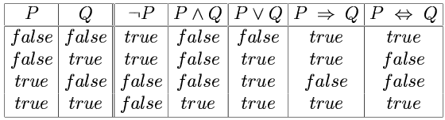
Evaluating a Sentence under an Interpretation
Calculated using the definitions of all the connectives, recursively
Pay attention to ⇒
  “5 is even implies 6 is odd” is True!
  If P is False, regardless of Q, P ⇒ Q is True
  No causality needed: “5 is odd implies the Sun is a star” is True

Slide 9
Understanding “⇒”
This is an operator. Although we call it “implies” or “implication,” do not try to understand its semantic form from the name. We could have called it “foo” instead and still defined its semantics the same way.
A ⇒ B “means” A is sufficient but not necessary to make B true
Example:
  Let A be “has a cold” and B be “drink water”
  A ⇒ B can be interpreted as “should drink water” when “has a cold.”
  However, you can drink water even when you do not have a cold. Thus A ⇒ B is still true when A is not true.

Slide 10
Example
(←P ∨ (Q ∧ R)) ⇒ Q
P | Q | R | ¬P | Q ∧ R | ¬P ∨ (Q ∧ R) | Wff
F | F | F | T | F | T | F
F | F | T | T | F | T | F
F | T | F | T | F | T | T
F | T | T | T | T | T | T
T | F | F | F | F | F | T
T | F | T | F | F | F | T
T | T | F | F | F | F | T
T | T | T | F | T | T | T
Satisfiable: a sentence that is true under some interpretation(s)
Deciding satisfiability of a sentence is NP-complete

Slide 11
Example
((P ∧ R) ⇒ Q) ∧ P ∧ R ∧ ←Q
P | Q | R | ¬Q | R ∧ ¬Q | P ∧ R ∧ ¬Q | P ∧ R | (P ∧ R) ⇒ Q | Wff
F | F | F | T | F | F | F | T | F
F | F | T | T | T | F | F | T | F
F | T | F | F | F | F | F | T | F
F | T | T | F | F | F | F | T | F
T | F | F | T | F | F | F | T | F
T | F | T | T | T | T | T | F | F
T | T | F | F | F | F | F | T | F
T | T | T | F | F | F | T | T | F
Unsatisfiable: a sentence that is false under all interpretations
Also called inconsistent or a contradiction

Slide 12
Example
(P ⇒ Q) ∨ (P ∧ ←Q)
P | Q | R | P ⇒ Q | P ∧ ¬Q | Wff
F | F | F | T | F | T
F | F | T | T | F | T
F | T | F | T | F | T
F | T | T | T | F | T
T | F | F | F | T | T
T | F | T | F | T | T
T | T | F | T | F | T
T | T | T | T | F | T
Valid: a sentence that is true under all interpretations
Also called a tautology

Slide 13
Knowledge Base (KB)
A knowledge base, KB, is a set of sentences Example KB:
  ChuckGivingLecture ⇔ (TodayIsTuesday ∨ TodayIsThursday)
  ←ChuckGivingLecture
It is equivalent to a single long sentence: the conjunction of all sentences
  (ChuckGivingLecture ⇔ (TodayIsTuesday ∨ TodayIsThursday)) ∧ ←ChuckGivingLecture
A model of a KB is an interpretation in which all sentences in KB are true

Slide 14
Entailment
Entailment is the relation of a sentence β logically following from other sentences α (e.g., KB)
α ⊨ β
α ⊨ β if and only if, in every interpretation in which α is true, β is also true; i.e., whenever α is true, so is β; all models of α and also models of β
Deduction theorem: α ⊨ β if and only if α ⇒ β is valid (always true)
Proof by contradiction (refutation, reductio ad absurdum): α ⊨ β if and only if α ∧ ←β is unsatisfiable
There are 2^{n} interpretations to check, if KB has n symbols

Slide 15
Entailment
Entailment is the relation of a sentence β logically following from other sentences α (e.g., the KB)
α ⊨ β
α ⊨ β if and only if, in every interpretation in which α is true, β is also true
All interpretations
β is true
α is true

Slide 16
Deductive Inference
Say you write a program that, according to you, proves whether a sentence β is entailed by α
The thing your program does is called deductive inference
We don’t trust your inference program (yet), so we write things your program finds as
α ⊢ β
It reads “β is derived from α by your program”
What properties should your program have?
  Soundness: the inference algorithm only derives entailed sentences. That is, if α ⊢ β then α ⊨ β
  Completeness: all entailment can be inferred. That is, if α ⊨ β then α ⊢ β

Slide 17
Soundness and Completeness
Soundness says that any wff that follows deductively from a set of axioms, KB, is valid (i.e., true in all models)
Completeness says that all valid sentences (i.e., true in all models of KB), can be proved from KB and hence are theorems

Slide 18
Method 1: Inference by Enumeration
Also called Model Checking or Truth Table Enumeration
LET: KB = A ∨ C, B ∨ ←C β = A ∨ B
QUERY: KB ⊨ β ?
A | B | C
false | false | false
false | false | true
false | true | false
false | true | true
true | false | false
true | false | true
true | true | false
true | true | true
NOTE: The computer doesn't know the meaning
of the proposition symbols
So, all logically distinct cases
must be checked to prove that
a sentence can be derived from KB
Notes:
CLICK EACH

Slide 19
Inference by Enumeration
LET: KB = A ∨ C, B ∨ ←C β = A ∨ B
QUERY: KB ⊨ β ?
A | B | C
false | false | false
false | false | true
false | true | false
false | true | true
true | false | false
true | false | true
true | true | false
true | true | true
A∨C | B∨ ←C | KB
false | true | false
true | false | false
false | true | false
true | true | true
true | true | true
true | false | false
true | true | true
true | true | true
Rows where all of sentences in KB are true are the models of KB
Notes:
CLICK EACH

Slide 20
Inference by Enumeration
LET: KB = A ∨ C, B ∨ ←C β = A ∨ B
QUERY: KB ╞ β ?
YES!
β is entailed by KB if all models of KB are models of β, i.e., all rows where KB is true, β is also true
A | B | C
false | false | false
false | false | true
false | true | false
false | true | true
true | false | false
true | false | true
true | true | false
true | true | true
A∨C | B∨ ←C | KB
false | true | false
true | false | false
false | true | false
true | true | true
true | true | true
true | false | false
true | true | true
true | true | true
A∨B
false
false
true
true
true
true
true
true
KB⇒β
true
true
true
true
true
true
true
true
In other words:
KB ⇒ β is valid
Notes:
CLICK EACH

Slide 21
Inference by Enumeration
Using inference by enumeration to build a complete truth table in order to determine if a sentence is entailed by KB is a complete inference algorithm for Propositional Logic
But very slow: takes exponential time

Slide 22
Method 2: Natural Deduction using
Sound Inference Rules
Goal: Define a more efficient algorithm than enumeration that uses a set of inference rules to incrementally deduce new sentences that are true given the initial set of sentences in KB, plus uses all logical equivalences

Slide 23
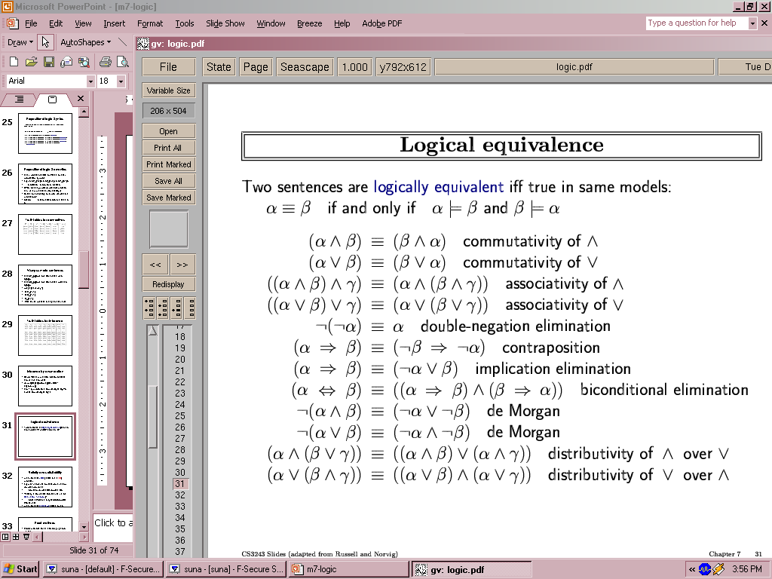
Logical Equivalences
You can use these equivalences to derive or modify sentences

Slide 24
Sound Inference Rules
Modus Ponens (Latin for “mode that affirms”)
And-Elimination
  α ⇒ β, α
  β
  α ∧ β
Note: Prove that an inference rule is sound by using a truth table, e.g.:
  α
P | Q | P | P⇒Q | P ∧ (P⇒Q) | Q | (P ∧ (P⇒Q)) ⇒ Q
T | T | T | T | T | T | T
T | F | T | F | F | F | T
F | T | F | T | F | T | T
F | F | F | T | F | F | T

Slide 25
Some Sound Inference Rules
Implication-Elimination, IE
(Modus Ponens, MP)
α⇒β, α
β
And-Elimination, AE
α₁ ∧ α₂ ∧ … ∧ α_{n}
α_{i}
And-Introduction, AI
α₁, α₂, … , α_{n}
α₁ ∧ α₂ ∧ … ∧ α_{n}
Or-Introduction, OI
α_{i}
α₁ ∨ α₂ ∨ … ∨ α_{n}
Double-Negation Elimination, DNE
← ← α
α
Notes:
CLICK ANIM

Slide 26
Inference Rules
Each inference rule formalizes the idea that
“A infers B” (A ⊢ B) in terms of
“logically follows” (A ⊨ B)
Doesn’t say anything about deducibility – just says for each interpretation that makes A true, that interpretation also makes B true

Slide 27
Question
What’s the difference between
  ≡ (logical equivalence)
  ⊨ (entails)
  ⊢ (derived from; infers)

Slide 28
Natural Deduction = Constructing a Proof
A Proof is a sequence of inference steps that leads from α (i.e., KB) to β (i.e., query)
This is a search problem!
  KB:
  (P ∧ Q) ⇒ R
  (S ∧ T) ⇒ Q
  S
  T
  P
  Θυερψ:
  R

Slide 29
Proof by Natural Deduction
S Premise (i.e., given sentence in KB)
T Premise
S ∧ T Conjunction(1, 2) (And-Introduction)
(S ∧ T) ⇒ Q Premise
Q Modus Ponens(3, 4)
P Premise
P ∧ Q Conjunction(5, 6)
(P ∧ Q) ⇒ R Premise
R Modus Ponens(7, 8)
(Last line is query sentence)

Slide 30
Monotonicity Property
Note that natural deduction relies on the monotonicity property of Propositional Logic:
Deriving a new sentence and adding it to KB does NOT affect what can be entailed from the original KB
Hence we can incrementally add new true sentences that are derived in any order
Once something is proved true, it will remain true

Slide 31
Proof by Natural Deduction
  KB:
  1. ChuckGivingLecture ⇔ (TodayIsTuesday ∨ TodayIsThursday)
  2. ← ChuckGivingLecture
  Θυερψ:
  ← TodayIsTuesday

Slide 32
Proof
  KB:
  1. ChuckGivingLecture ⇔ (TodayIsTuesday ∨ TodayIsThursday)
  2. ← ChuckGivingLecture
  3. (ChuckGivingLecture ⇒ (TodayIsTuesday ∨ TodayIsThursday)) ∧ ((TodayIsTuesday ∨ TodayIsThursday) ⇒ ChuckGivingLecture) iff/biconditional-elimination to 1
  4. (TodayIsTuesday ∨ TodayIsThursday) ⇒ ChuckGivingLecture
  and-elimination to 3
  5. ← ChuckGivingLecture ⇒ ←(TodayIsTuesday ∨ TodayIsThursday) contraposition to 4
  6. ←(TodayIsTuesday ∨ TodayIsThursday) Modus Ponens 2,5
  7. ←TodayIsTuesday ∧ ←TodayIsThursday de Morgan to 6
  8. ← TodayIsTuesday and-elimination to 7

Slide 33
Resolution Rule of Inference
Resolution Rule of Inference
Examples
called “unit resolution”

Slide 34
Resolution
Take any two “clauses” where one contains some symbol, and the other contains its complement (negative)
P ∨ Q ∨ R ←Q ∨ S ∨ T
Merge (resolve) them, by throwing away the symbol and its complement, to obtain their resolvent clause:
P ∨ R ∨ S ∨ T
If two clauses resolve and there’s no symbol left, you have derived False, aka the empty clause

Slide 35


Method 3: Resolution Refutation
Show KB ⊨ α by proving that KB ∧ ¬α is unsatsifiable, i.e., deducing False from KB ∧ ¬α
Your algorithm can use all the logical equivalences to derive new sentences, plus:
Resolution rule: a single inference rule
  Sound: only derives entailed sentences
  Complete: can derive any entailed sentence
    Resolution is refutation complete: if KB ⊨ β, then KB ∧ ← β ⊢ False
  But the sentences need to be preprocessed into a special form
  But all sentences can be converted into this form

Slide 36
Resolution Refutation Algorithm
Add negation of query to KB
Pick 2 sentences that haven’t been used before and can be used with the Resolution Rule of inference
If none, halt and answer that the query is NOT entailed by KB
Compute resolvent and add it to KB
If False in KB
  Then halt and answer that the query IS entailed by KB
  Else Goto 2

Slide 37
Conjunctive Normal Form (CNF)‏
  Replace all ⇔ using iff/biconditional elimination
    α ⇔ β ≡ (α ⇒ β) ∧ (β ⇒ α)
  Replace all ⇒ using implication elimination
    α ⇒ β ≡ ¬α ∨ β
  Move all negations inward using
    double-negation elimination
      ¬(¬α) ≡ α
    de Morgan's rule
      ¬(α ∨ β) ≡ ¬α ∧ ¬β
      ¬(α ∧ β) ≡ ¬α ∨ ¬β
  Apply distributivity of ∨ over ∧
    α ∧ (β ∨ γ) ≡ (α ∧ β) ∨ (α ∧ γ) + 1 more

Slide 38
Convert Sentence into CNF
A ⇔ (B ∨ C) starting sentence
(A ⇒ (B ∨ C)) ∧ ((B ∨ C) ⇒ A ) iff/biconditional elimination
(←A ∨ B ∨ C) ∧ (←(B ∨ C) ∨ A ) implication elimination
(←A ∨ B ∨ C) ∧ ((←B ∧ ←C) ∨ A ) move negations inward
(←A ∨ B ∨ C) ∧ (←B ∨ A) ∧ (←C ∨ A) distribute ∨ over ∧
called a “clause”

Slide 39
Resolution Refutation Steps
Given KB and β (query)
Add ← β to KB, and convert all sentences to CNF
Show this leads to False (aka “empty clause”). Proof by contradiction
Example KB:
  A ⇔ (B ∨ C)
  ←A
Example query: ←B

Slide 40
Resolution Refutation Preprocessing
Add ←β to KB, and convert to CNF:
  a1: ←A ∨ B ∨ C
  a2: ←B ∨ A
  a3: ←C ∨ A
  b: ←A
  c: B
Want to reach goal: False (empty clause)

Slide 41
Resolution Refutation Example
  a1: ←A ∨ B ∨ C
  a2: ←B ∨ A
  a3: ←C ∨ A
  b: ←A
  c: B
  Step 1: resolve a2, c: A
  Step 2: resolve above and b: empty clause / false

Slide 42
Example
Given:
  P ∨ Q
  P ⇒ R
  Q ⇒ R
Prove: R
Notes:
1. P v Q 2. ~P v R 3. ~Q v R 4. ~R 5. Q v R (RR(1,2) 6. ~P (RR(2,4)) 7. ~Q (RR(3,4)) 8. R (RR(5,7)) 9. nil (RR(4,8))

Slide 43
Example
Given:
  (P ⇒ Q) ⇒ Q
  (P ⇒ P) ⇒ R
  (R ⇒ S) ⇒ ¬(S ⇒ Q)
Prove: R

Slide 44
Example
Given:
  P
  ¬P
Prove: R

Slide 45
Efficiency of the Resolution Refutation Algorithm
Run time can be exponential in the worst case
  Often much faster
Factoring: if a new clause contains duplicates of the same symbol, delete the duplicates
P ∨ R ∨ P ∨ T ≡ P ∨ R ∨ T
If a clause contains a symbol and its complement, the clause is a tautology and is useless; it can be thrown away
  a1: (←A ∨ B ∨ C)
  a2: (←B ∨ A)
  Resolvent of a1 and a2 is: B ∨ C ∨ ←B
  Which is valid, so throw it away

Slide 46
Resolution Refutation Strategies
Resolution refutation proofs can be thought of as search:
  reversed construction of search tree (leaves to root)
  leaves are KB clauses and ← query
  resolvent is new node with arcs to parent clauses
  root is False clause
Notes:
CLICK EACH SUB

Slide 47
Resolution Refutation Strategies
Breadth-First
  level 0 clauses: KB clauses and ← query
  level k clauses: resolvents computed from 2 clauses:
    one of which must be from level k-1
    other from any earlier level
  compute all possible level 1 clauses,
  then all possible level 2 clauses, etc.
  complete but very inefficient
Notes:
CLICK EACH SUB

Slide 48
Resolution Refutation Strategies
Input Resolution
  P and Q can be resolved if at least one is from
  the set of original clauses, i.e., KB and ← query
  proof trees have a single "spine" (see Fig. 9.11)
  Modus Ponens is a form of input resolution since each step is used to generate a new fact
  complete for FOL KB with only Horn clauses
Notes:
CLICK EACH SUB

Slide 49
Resolution Refutation Strategies
Linear Resolution
  a slight generalization of input resolution
  P and Q can be resolved if:
    at least 1 is from the set of original clauses
    or P must be an ancestor of Q in the proof tree
  complete
Notes:
CLICK EACH SUB

Slide 50
Resolution Refutation Strategies
Unit Preference
  prefer to do resolutions where 1 sentence
  is a single literal, a unit clause
  goal is to produce the empty clause, so focus search by producing resolvents that are shorter
  complete but slow for medium-sized problems
Unit Resolution
  requires at least 1 clause to be a unit clause
  complete for FOL KB with Horn clauses
Notes:
CLICK EACH SUB

Slide 51
Method 4: Chaining with Horn Clauses
Resolution is more powerful than we need for many practical situations
A weaker form: Horn clauses
  A Horn clause is a disjunction of literals with at most one positive
  ←R ∨ P ∨ Q no
  ←R ∨ ← P ∨ Q yes
  KB = conjunction of Horn clauses
  What’s the big deal?
    ←R ∨ ← P ∨ Q
    ≡ ←(R ∧ P) ∨ Q
    ≡ ?

Slide 52
Horn Clauses
    ←R ∨ ←P ∨ Q
    ≡ ←(R ∧ P) ∨ Q
    ≡ (R ∧ P) ⇒ Q Every rule in KB is in this form
    P (special case, no negative literals): fact
    ←R ∨ ←P (special case, no positive literal): goal clause
The big deal:
  KB easy for humans to read
  Natural forward chaining and backward chaining algorithms; proof easy for humans to read
  Can decide entailment with Horn clauses in time linear with KB size
But …
  Can only ask atomic queries

Slide 53
Horn Clauses
Only 1 rule of inference needed:
Generalized Modus Ponens
    P, Q, (P ∧ Q) ⇒ R
    R

Slide 54
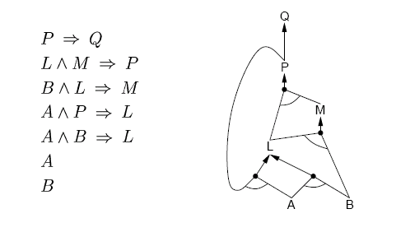
Forward Chaining
“Apply” any rule whose premises are satisfied in the KB
Add its conclusion to the KB until query is derived
KB:
query: Q
Forward chaining with Horn clause KB is complete

Slide 55
Forward Chaining
P ⇒ Q
L ∧ M ⇒ P
B ∧ L ⇒ M
A ∧ P ⇒ L
A ∧ B ⇒ L
A
B
L GMP(5,6,7)
M GMP(3,7,8)
P GMP(2,8,9)
Q GMP(1,10)

Slide 56
Forward Chaining
“Apply” any rule whose premises are satisfied in the KB
Add its conclusion to the KB until query is derived
KB:
OR
query: Q
AND-OR graph
AND

Slide 57
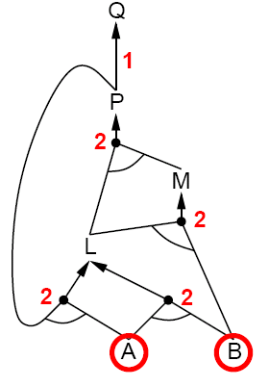
Forward Chaining
P ⇒ Q
L ∧ M ⇒ P
B ∧ L ⇒ M
A ∧ P ⇒ L
A ∧ B ⇒ L
A
B

Slide 58
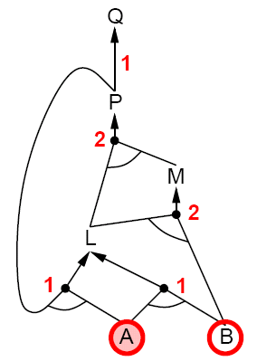
Forward Chaining
P ⇒ Q
L ∧ M ⇒ P
B ∧ L ⇒ M
A ∧ P ⇒ L
A ∧ B ⇒ L
A
B

Slide 59
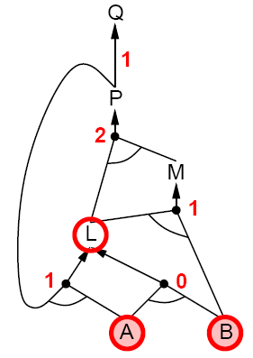
Forward Chaining
P ⇒ Q
L ∧ M ⇒ P
B ∧ L ⇒ M
A ∧ P ⇒ L
A ∧ B ⇒ L
A
B

Slide 60
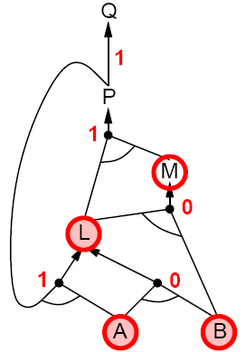
Forward Chaining
P ⇒ Q
L ∧ M ⇒ P
B ∧ L ⇒ M
A ∧ P ⇒ L
A ∧ B ⇒ L
A
B

Slide 61
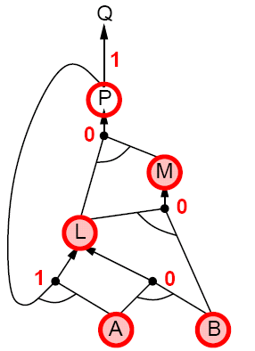
Forward Chaining
P ⇒ Q
L ∧ M ⇒ P
B ∧ L ⇒ M
A ∧ P ⇒ L
A ∧ B ⇒ L
A
B

Slide 62
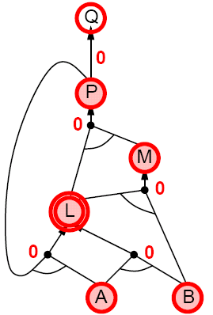
Forward Chaining
P ⇒ Q
L ∧ M ⇒ P
B ∧ L ⇒ M
A ∧ P ⇒ L
A ∧ B ⇒ L
A
B

Slide 63
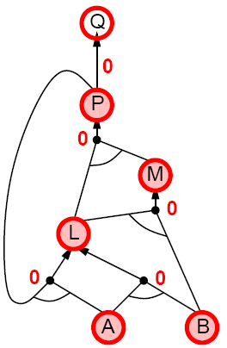
Forward Chaining
P ⇒ Q
L ∧ M ⇒ P
B ∧ L ⇒ M
A ∧ P ⇒ L
A ∧ B ⇒ L
A
B

Slide 64
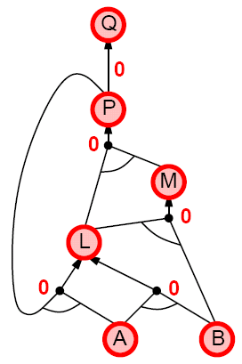
Forward Chaining
P ⇒ Q
L ∧ M ⇒ P
B ∧ L ⇒ M
A ∧ P ⇒ L
A ∧ B ⇒ L
A
B

Slide 65
Backward Chaining
Forward chaining problem: can generate a lot of irrelevant conclusions
  Search forward, start state = KB, goal test = state contains query
Backward chaining
  Work backwards from goal to premises
  Find all implications of the form
  (…) ⇒ query
  Prove all the premises of one of these implications
  Avoid loops: check if new subgoal is already on the goal stack
  Avoid repeated work: check if new subgoal
    Has already been proved true, or
    Has already failed

Slide 66
Backward Chaining
P ⇒ Q
L ∧ M ⇒ P
B ∧ L ⇒ M
A ∧ P ⇒ L
A ∧ B ⇒ L
A
B
Q Goal
P Subgoal(1,8)
L ∧ M Subgoal(2,9)
L Subgoal(10)
A ∧ B Subgoal(5,11)
A True(6)
B True(7)
L True(5,13,14)
M True(14,15)
P True(15,16)
Q True(1,17)

Slide 67
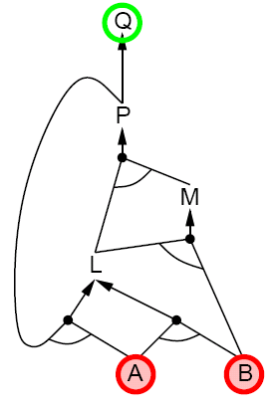
Backward Chaining
P ⇒ Q
L ∧ M ⇒ P
B ∧ L ⇒ M
A ∧ P ⇒ L
A ∧ B ⇒ L
A
B
OR
AND

Slide 68
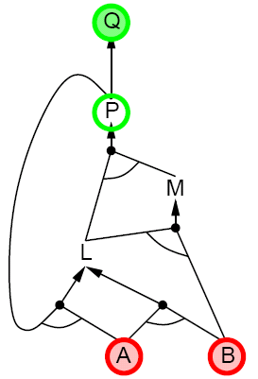
Backward Chaining
P ⇒ Q
L ∧ M ⇒ P
B ∧ L ⇒ M
A ∧ P ⇒ L
A ∧ B ⇒ L
A
B

Slide 69
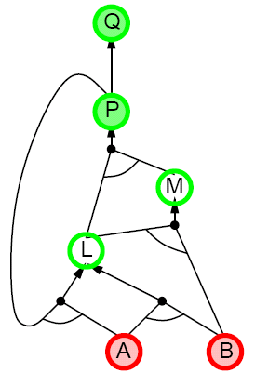
Backward Chaining
P ⇒ Q
L ∧ M ⇒ P
B ∧ L ⇒ M
A ∧ P ⇒ L
A ∧ B ⇒ L
A
B

Slide 70
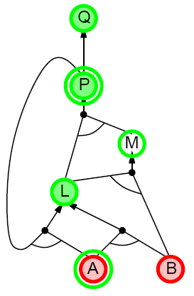
Backward Chaining
P ⇒ Q
L ∧ M ⇒ P
B ∧ L ⇒ M
A ∧ P ⇒ L
A ∧ B ⇒ L
A
B

Slide 71
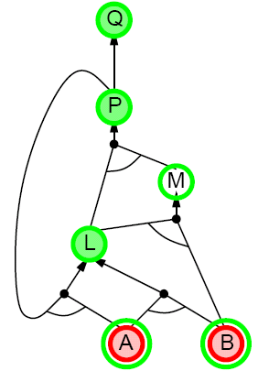
Backward Chaining
P ⇒ Q
L ∧ M ⇒ P
B ∧ L ⇒ M
A ∧ P ⇒ L
A ∧ B ⇒ L
A
B

Slide 72
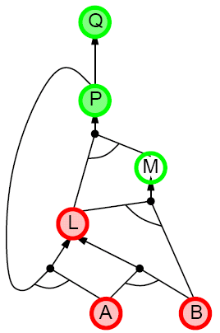
Backward Chaining
P ⇒ Q
L ∧ M ⇒ P
B ∧ L ⇒ M
A ∧ P ⇒ L
A ∧ B ⇒ L
A
B

Slide 73
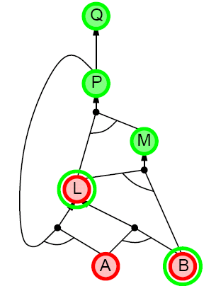
Backward Chaining
P ⇒ Q
L ∧ M ⇒ P
B ∧ L ⇒ M
A ∧ P ⇒ L
A ∧ B ⇒ L
A
B

Slide 74
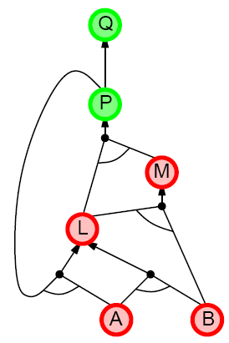
Backward Chaining
P ⇒ Q
L ∧ M ⇒ P
B ∧ L ⇒ M
A ∧ P ⇒ L
A ∧ B ⇒ L
A
B

Slide 75
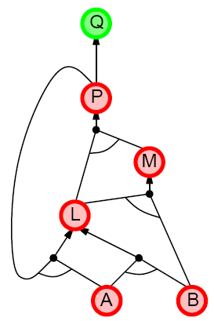
Backward Chaining
P ⇒ Q
L ∧ M ⇒ P
B ∧ L ⇒ M
A ∧ P ⇒ L
A ∧ B ⇒ L
A
B

Slide 76
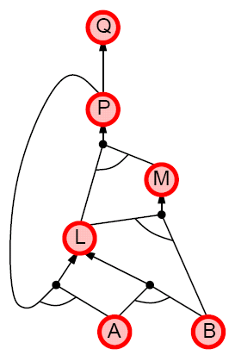
Backward Chaining
P ⇒ Q
L ∧ M ⇒ P
B ∧ L ⇒ M
A ∧ P ⇒ L
A ∧ B ⇒ L
A
B

Slide 77
Forward vs. Backward Chaining
Forward chaining is data-driven
  May perform lots of work irrelevant to the goal
Backward chaining is goal-driven
  Appropriate for problem solving
  Time complexity can be much less than linear in size of KB
Some form of bi-directional search may be even better

Slide 78
Prolog: A Logic Programming Language
A Program =
  a set of logic sentences as Horn clauses
    called the database (DB), i.e., the KB
    ordered by programmer
  executed by specifying a query to be proved
    uses backward-chaining
    uses depth-first search on the ordered facts and rules
    searches until a solution is found
Notes:
CLICK EACH SUB

Slide 79
Prolog Basic Syntax
Database:
  Fact: a positive literal
  FOL: F(x) in Prolog: F(X).
  initial capital variables universally quantified
  Rules: ≥ 1 negative and 1 positive literals
  if antecedent(s) then consequent
  FOL: A₁ ∧ A₂ ∧ … ∧ A_{n} ⇒ C in Prolog: C :- A₁, A₂, … , A_{n}.
Query:
  FOL: Q₁ ∧ Q₂ ∧ … ∧ Q_{n} in Prolog: ?- Q₁, Q₂, … , Q_{n}.
  query variables implicitly existentially quantified
Notes:
CLICK EACH SUB
show example DB

Slide 80
Some Applications of PL
Puzzles (e.g., Sudoku)
Scheduling problems
Layout problems
Boolean circuit analysis
Automated theorem provers
Legal reasoning systems

Slide 81
Weaknesses of PL
PL is not a very expressive language
Can’t express relations over a group of things, e.g., “All triangles have 3 sides”
Only deals with “facts,” e.g., “It is raining,” but does not allow variables where you can express things about them without naming them explicitly. For example, “When you paint a block with green paint, it becomes green.”
You can’t quantify things, e.g., talk about all of them, some of them, none of them, without naming them explicitly

Slide 82
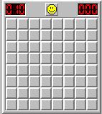
Problems with Propositional Logic
Consider the game “Minesweeper” on a 10 x 10 field with only one land mine
How do you express the knowledge, with Propositional Logic, that the squares adjacent to the land mine will display the number 1?

Slide 83
Problems with Propositional Logic
Consider the game “Minesweeper” on a 10 x 10 field with only one land mine
How do you express the knowledge, with Propositional Logic, that the squares adjacent to the land mine will display the number 1?
Intuitively with a rule like
Landmine(x,y) ⇒ Number1(Neighbors(x,y))
but Propositional Logic cannot do this

Slide 84
Problems with Propositional Logic
Propositional Logic has to say, e.g. for cell (3, 4):
  Landmine_3_4 ⇒ Number1_2_3
  Landmine_3_4 ⇒ Number1_2_4
  Landmine_3_4 ⇒ Number1_2_5
  Landmine_3_4 ⇒ Number1_3_3
  Landmine_3_4 ⇒ Number1_3_5
  Landmine_3_4 ⇒ Number1_4_3
  Landmine_3_4 ⇒ Number1_4_4
  Landmine_3_4 ⇒ Number1_4_5
  And similarly for each of Landmine_1_1, Landmine_1_2, Landmine_1_3, …, Landmine_10_10
Difficult to express large domains concisely
Don’t have objects and relations
First-Order Logic is a powerful upgrade

Slide 85
Other Logic Systems
Logics are characterized by what they commit to as "primitives"
Logic | What Exists in World | Knowledge States
Propositional | facts | true/false/unknown
First-Order | facts, objects, relations | true/false/unknown
Temporal | facts, objects, relations, times | true/false/unknown
Probability Theory | facts | degree of belief 0..1
Markov | facts, objects, relations | degree of belief 0..1
Notes:
CLICK SLIDE

Slide 86
Ontological Commitment
Logics are characterized by what they consider to be ‘primitives’
Logic
Primitives
Available Knowledge
Propositional
facts
true/false/unknown
First-Order
facts, objects, relations
true/false/unknown
Temporal
facts, objects, relations, times
true/false/unknown
Probability Theory
facts
degree of belief 0…1
Fuzzy
degree of truth
degree of belief 0…1

Slide 87
First-Order Logic (FOL)
Also known as First-Order Predicate Calculus (FOPC)
Constants: Bob, 2, Madison, …
Functions: Income, Address, Sqrt, …
Predicates: Sister, Teacher, ≤, …
Variables: x, y, a, b, c, …
Connectives: ∧ ∨ ← ⇒ ⇔
Equality: =
Quantifiers: ∀ ∃
Notes:
CLICK EACH

Slide 88
FOL Syntax: Quantifiers
Universal quantifier: ∀<variable> <sentence>
Means the sentence is true for all values of x in the domain of variable x
Main connective typically ⇒ forming if-then rules
  All humans are mammals becomes in FOL:
  ∀x Human(x) ⇒ Mammal(x)
  i.e., for all x, if x is a human then x is a mammal
  Mammals must have fur becomes in FOL:
  ∀x Mammal(x)⇒ HasFur(x)
  for all x, if x is a mammal then x has fur
Notes:
CLICK EACH SUB

Slide 89
FOL Syntax: Quantifiers
∀x (Human(x) ⇒ Mammal(x))
Equivalent to the conjunction of instantiations of x:
(Human(Jim) ⇒ Mammal(Jim)) ∧
(Human(Deb) ⇒ Mammal(Deb)) ∧
(Human(22) ⇒ Mammal(22)) ∧ …
Notes:
CLICK EACH SUB

Slide 90
FOL Syntax: Quantifiers
Existential quantifier: ∃<variable> <sentence>
Means the sentence is true
for some value of x in the domain of variable x
Main connective is typically ∧
  Some humans are old becomes in FOL:
  ∃x Human(x) ∧ Old(x)
  there exist an x such that x is a human and x is old
  Mammals may have arms. becomes in FOL:
  ∃x Mammal(x) ∧ HasArms(x)
  there exist an x such that x is a mammal and x has arms
Notes:
CLICK EACH SUB

Slide 91
Fun with Sentences
Good people always have friends.
could mean: All good people have friends.
∀x (Person(x) ∧ Good(x)) ⇒ ∃y(Friend(x,y))
Busy people sometimes have friends.
could mean: Some busy people have friends.
∃x Person(x) ∧ Busy(x) ∧ ∃y(Friend(x,y))
Bad people never have friends.
could mean: Bad people have no friends.
∀x (Person(x) ∧ Bad(x)) ⇒ ←∃y(Friend(x,y))
or equivalently: No bad people have friends.
←∃x Person(x) ∧ Bad(x) ∧ ∃y(Friend(x,y))
Notes:
CLICK EACH SUB

Slide 92
Fun with Sentences
There is exactly one shoe.
  ∃x Shoe(x) ∧ ∀ y(Shoe(y) ⇒ (x=y))
There are exactly two shoes.
  ∃x,y Shoe(x) ∧ Shoe(y) ∧ ←(x=y) ∧
  ∀z (Shoe(z) ⇒ (x=z) ∨ (y=z))
Notes:
CLICK EACH SUB

Slide 93
What You Should Know
A lot of terms
Use truth tables (inference by enumeration)
Natural deduction proofs
Conjuctive Normal Form (CNF)
Resolution Refutation algorithm and proofs
Horn clauses
Forward chaining algorithm
Backward chaining algorithm

Slide 94
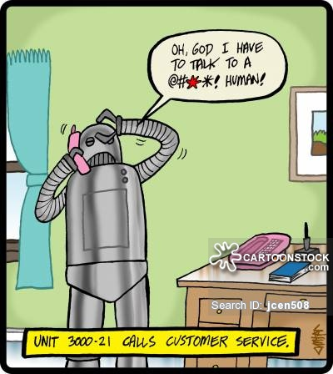
That’s All Folks!

