Slide 1
CS 536
Introduction to Programming Languages and Compilers
Charles N. Fischer
Lecture 2
©

Slide 2
Reading Assignment
Read Chapter 3 of
Crafting a Compiler.
©

Slide 3
The Structure of a Compiler
A compiler performs two major tasks:
Analysis of the source program being compiled
Synthesis of a target program
Almost all modern compilers are syntax- directed: The compilation process is driven by the syntactic structure of the source program.
A parser builds semantic structure out of tokens, the elementary symbols of programming language syntax. Recognition of syntactic structure is a major part of the analysis task.
©

Slide 4
Semantic analysis examines the meaning (semantics) of the program. Semantic analysis plays a dual role.
It finishes the analysis task by performing a variety of correctness checks (for example, enforcing type and scope rules). Semantic analysis also begins the synthesis phase.
The synthesis phase may translate source programs into some intermediate representation (IR) or it may directly generate target code.
©

Slide 5
If an IR is generated, it then serves as input to a code generator component that produces the desired machine- language program. The IR may optionally be transformed by an optimizer so that a more efficient program may be generated.
©

Slide 6
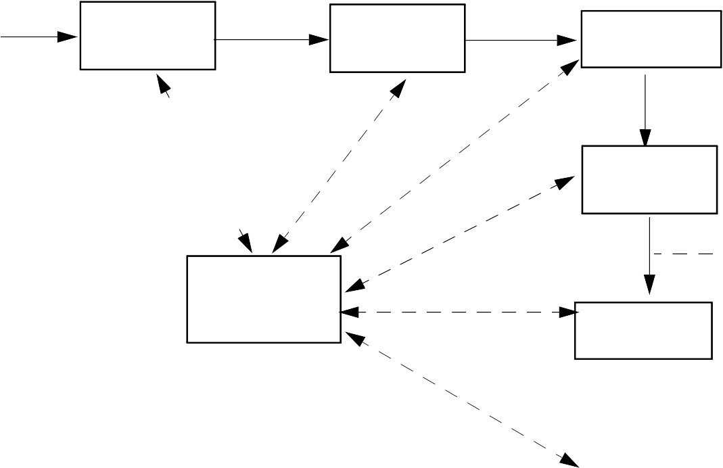
Source Program
Abstract Syntax Tree
(AST)
Scanner
Tokens
Parser
Type Checker
(Character Stream)
Decorated
AST
Translator
Intermediate Representation
Symbol Tables
(IR)
Optimizer
IR
Code Generator
Target Machine Code
The Structure of a Syntax-Directed Compiler
©
20

Slide 7
Scanner
The scanner reads the source program, character by character. It groups individual characters into tokens (identifiers, integers, reserved words, delimiters, and so on). When necessary, the actual character string comprising the token is also passed along for use by the semantic phases.
The scanner:
Puts the program into a compact and uniform format (a stream of tokens).
Eliminates unneeded information (such as comments).
Sometimes enters preliminary information into symbol tables (for
©

Slide 8
example, to register the presence of a particular label or identifier).
Optionally formats and lists the source program
Building tokens is driven by token descriptions defined using regular expression notation.
Regular expressions are a formal notation able to describe the tokens used in modern programming languages. Moreover, they can drive the automatic generation of working scanners given only a specification of the tokens.
Scanner generators (like Lex, Flex and JLex) are valuable compiler- building tools.
©

Slide 9
Parser
Given a syntax specification (as a context- free grammar, CFG), the parser reads tokens and groups them into language structures.
Parsers are typically created from a CFG using a parser generator (like Yacc, Bison or Java CUP).
The parser verifies correct syntax and may issue a syntax error message.
As syntactic structure is recognized, the parser usually builds an abstract syntax tree (AST), a concise representation of program structure, which guides semantic processing.
©

Slide 10
Type Checker (Semantic Analysis)
The type checker checks the static semantics of each AST node. It verifies that the construct is legal and meaningful (that all identifiers involved are declared, that types are correct, and so on).
If the construct is semantically correct, the type checker
“decorates” the AST node, adding
type or symbol table information to it. If a semantic error is discovered, a suitable error message is issued.
Type checking is purely dependent on the semantic rules of the source language. It is independent of the compiler’s target machine.
©

Slide 11
Translator (Program Synthesis)
If an AST node is semantically correct, it can be translated.
Translation involves capturing the run- time “meaning” of a construct.
For example, an AST for a while loop contains two subtrees, one for the loop’s control expression, and the other for the loop’s body. Nothing in the AST shows that a while loop loops! This “meaning” is captured when a while loop’s AST is translated. In the IR, the notion of testing the value of the loop control expression,
©

Slide 12
and conditionally executing the loop body becomes explicit.
The translator is dictated by the semantics of the source language. Little of the nature of the target machine need be made evident. Detailed information on the nature of the target machine (operations available, addressing, register characteristics, etc.) is reserved for the code generation phase.
In simple non- optimizing compilers (like our class project), the translator generates target code directly, without using an IR.
More elaborate compilers may first generate a high- level IR
©

Slide 13
(that is source language oriented) and then subsequently translate it into a low- level IR (that is target machine oriented). This approach allows a cleaner separation of source and target dependencies.
©

Slide 14
Optimizer
The IR code generated by the translator is analyzed and transformed into functionally equivalent but improved IR code by the optimizer.
The term optimization is misleading: we don’t always produce the best possible translation of a program, even after optimization by the best of compilers.
Why?
Some optimizations are impossible to do in all circumstances because they involve an undecidable problem. Eliminating unreachable (“dead”) code is, in general, impossible.
©

Slide 15
Other optimizations are too expensive to do in all cases. These involve NP- complete problems, believed to be inherently exponential.
Assigning registers to variables is an example of an NP- complete problem.
Optimization can be complex; it may involve numerous subphases, which may need to be applied more than once.
Optimizations may be turned off to speed translation.
Nonetheless, a well designed
optimizer can significantly speed program execution by simplifying, moving or eliminating unneeded computations.
©

Slide 16
Code Generator
IR code produced by the translator is mapped into target machine code by the code generator. This phase uses detailed information about the target machine and includes machine- specific optimizations like register allocation and code scheduling.
Code generators can be quite complex since good target code requires consideration of many special cases.
Automatic generation of code generators is possible. The basic approach is to match a low- level IR to target instruction templates, choosing
©
30

Slide 17
instructions which best match each IR instruction.
A well- known compiler using automatic code generation techniques is the GNU C compiler. GCC is a heavily optimizing compiler with machine description files for over ten popular computer architectures, and at least two language front ends (C and C+ + ).
©

Slide 18
Symbol Tables
A symbol table allows information to be associated with identifiers and shared among compiler phases. Each time an identifier is used, a symbol table provides access to the information collected about the identifier when its declaration was processed.
©

Slide 19
Example
Our source language will be CSX, a blend of C, C+ + and Java.
Our target language will be the Java JVM, using the Jasmin assembler.
A simple source line is
a = bb+abs(c-7);
this is a sequence of ASCII characters in a text file.
The scanner groups characters into tokens, the basic units of a program.
a = bb+abs(c-7);
After scanning, we have the following token sequence:
Id_{a} Asg Id_{bb} Plus
^{Id}abs
Lparen Id_{c}
Minus
IntLiteral₇
Rparen
Semi
©

Slide 20
The parser groups these tokens into language constructs (expressions, statements, declarations, etc.) represented in tree form:
Asg
Id_{a}
Plus Id_{bb}
Call
^{Id}abs
Minus
Id_{c}
IntLiteral
(What happened to the parentheses and the semicolon?)
©

Slide 21
The type checker resolves types and binds declarations within scopes:
_{Asg}int
Id_{a}
intloc
Plus^{int}
intloc
int
Id_{bb}
Call
method
Minus^{int}
^{Id}abs
Id_{c}
intloc
int
IntLiteral₇
©

Slide 22
Finally, JVM code is generated for each node in the tree (leaves first, then roots):
iload | 3 | ; | push local 3 | (bb)
iload | 2 | ; | push local 2 | (c)
ldc | 7 | ; | Push literal | 7
isub |  | ; | compute c-7
invokestatic abs(I)I
java/lang/Math/
iadd ; compute
bb+abs(c-7)
istore | 1 | ; | store | result | into
 |  |  | local | 1(a)
©

Slide 23
Symbol Tables & Scoping
Programming languages use scopes to limit the range in which an identifier is active (and visible).
Within a scope a name may be defined only once (though overloading may be allowed).
A symbol table (or dictionary) is commonly used to collect all the definitions that appear within a scope.
At the start of a scope, the symbol table is empty. At the end of a scope, all declarations within that scope are available within the symbol table.
©

Slide 24
A language definition may or may not allow forward references to an identifier.
If forward references are allowed, you may use a name that is defined later in the scope (Java does this for field and method declarations within a class).
If forward references are not allowed, an identifier is visible only after its declaration. C, C+ + and Java do this for variable declarations.
In CSX only forward references to methods are allowed.
©

Slide 25
In terms of symbol tables, forward references require two passes over a scope.
First all declarations are gathered. Next, all references are resolved using the complete set of declarations stored in the symbol table.
If forward references are disallowed, one pass through a scope suffices, processing declarations and uses of identifiers together.
©

Slide 26
Block Structured Languages
Introduced by Algol 60, includes C, C+ + , C#, CSX and Java.
Identifiers may have a non- global scope. Declarations may be local to a class, subprogram or block.
Scopes may nest, with declarations propagating to inner (contained) scopes.
The lexically nearest declaration of an identifier is bound to uses of that identifier.
©
40

Slide 27
Example (drawn from C):
int x,z; void A()
float x,y; print(x,y,z);
}
void B() {
print (x,y,z)
}
{
int float
float
int undeclared
int
©

Slide 28
Block Structure Concepts
Nested Visibility
No access to identifiers outside their scope.
Nearest Declaration Applies
Using static nesting of scopes.
Automatic Allocation and Deallocation of Locals
Lifetime of data objects is bound to the scope of the Identifiers that denote them.
©

Slide 29
Is Case Significant?
In some languages (C, C+ + , Java and many others) case is significant in identifiers. This means aa and AA are different symbols that may have entirely different definitions.
In other languages (Pascal, Ada, Scheme, CSX) case is not significant. In such languages aa and AA are two alternative spellings of the same identifier.
Data structures commonly used to implement symbol tables usually treat different cases as different symbols. This is fine when case is significant in a language.
©

Slide 30
When case is insignificant, you probably will
need to strip case before entering or looking up identifiers.
This just means that identifiers are converted to a uniform case before they are entered or looked up. Thus if we choose to use lower case uniformly, the identifiers aaa, AAA, and AaA are all converted to aaa for purposes of insertion or lookup.
BUT, inside the symbol table the identifier is stored in the form it was declared so that programmers see the form of identifier they expect in listings, error messages, etc.
©

Slide 31
How are Symbol Tables Implemented?
There are a number of data structures that can reasonably be used to implement a symbol table:
An Ordered List
Symbols are stored in a linked list, sorted by the symbol’s name. This is simple, but may be a bit too slow if many identifiers appear in a scope.
A Binary Search Tree
Lookup is much faster than in linked lists, but rebalancing may be needed. (Entering identifiers in sorted order turns a search tree into a linked list.)
Hash Tables
The most popular choice.
©

Slide 32
Implementing Block- Structured Symbol Tables
To implement a block structured symbol table we need to be able to efficiently open and close individual scopes, and limit insertion to the innermost current scope.
This can be done using one symbol table structure if we tag individual entries with a “scope number.”
It is far easier (but more wasteful of space) to allocate one symbol table for each scope. Open scopes are stacked, pushing and popping tables as scopes are opened and closed.
©

Slide 33
Be careful though—many preprogrammed stack implementations don’t allow you to “peek” at entries below the stack top. This is necessary to lookup an identifier in all open scopes.
If a suitable stack implementation (with a peek operation) isn’t available, a linked list of symbol tables will suffice.
©

Slide 34
Scanning
A scanner transforms a character stream into a token stream.
A scanner is sometimes called a
lexical analyzer or lexer.
Scanners use a formal notation (regular expressions) to specify the precise structure of tokens.
But why bother? Aren’t tokens very simple in structure?
Token structure can be more detailed and subtle than one might expect. Consider simple quoted strings in C, C+ + or Java. The body of a string can be any sequence of characters except a quote character (which must be escaped). But is this simple definition really correct?
©

Slide 35
Can a newline character appear in a string? In C it cannot, unless it is escaped with a backslash.
Are null strings (zero- length) allowed? In C, C+ + , Java and Ada they are, but Pascal forbids them.
(In Pascal a string is a packed array of characters, and zero length arrays are disallowed.)
A precise definition of tokens can ensure that lexical rules are clearly stated and properly enforced.
C, C+ + and Java allow escaped newlines in strings, Pascal forbids them entirely. Ada forbids all unprintable characters.
©
50

Slide 36
Regular Expressions
Regular expressions specify simple (possibly infinite) sets of strings. Regular expressions routinely specify the tokens used in programming languages.
Regular expressions can drive a
scanner generator.
Regular expressions are widely used in computer utilities:
• The Unix utility grep uses regular expressions to define search patterns in files.
• Unix shells allow regular expressions in file lists for a command.
©

Slide 37
Most editors provide a “context search” command that specifies desired matches using regular expressions.
•The Windows Find utility allows some regular expressions.
©

Slide 38
Regular Sets
The sets of strings defined by regular expressions are called regular sets.
When scanning, a token class will be a regular set, whose structure is defined by a regular expression.
Particular instances of a token class are sometimes called lexemes, though we will simply call a string in a token class an instance of that token. Thus we call the string abc an identifier if it matches the regular expression that defines valid identifier tokens.
Regular expressions use a finite character set, or vocabulary (denoted Σ).
©

Slide 39
This vocabulary is normally the character set used by a computer. Today, the ASCII character set, which contains a total of 128 characters, is very widely used.
Java uses the Unicode character set which includes all the ASCII characters as well as a wide variety of other characters.
An empty or null string is allowed (denoted λ, “lambda”). Lambda represents an empty buffer in which no characters have yet been matched. It also represents optional parts of tokens. An integer literal may begin with a plus or minus, or it may begin with λ if it is unsigned.
©

Slide 40
Catenation
Strings are built from characters in the character set Σ via catenation.
As characters are catenated to a string, it grows in length. The string do is built by first catenating d to λ, and then catenating o to the string d. The null string, when catenated with any string s, yields s. That is, s λ ≡ λ s ≡ s. Catenating λ to a string is like adding 0 to an integer— nothing changes.
Catenation is extended to sets of strings:
Let P and Q be sets of strings. (The symbol ∈ represents set membership.) If s₁ ∈ P and s₂ ∈ Q
then string s₁s₂ ∈ (P Q).
©

Slide 41
Alternation
Small finite sets are conveniently represented by listing their elements. Parentheses delimit expressions, and | , the alternation operator, separates alternatives.
For example, D, the set of the ten single digits, is defined as
D = (0 | 1 | 2 | 3 | 4 | 5 | 6 | 7 | 8 | 9).
The characters (, ), ' , ∗, + , and | are meta- characters (punctuation and regular expression operators).
Meta- characters must be quoted when used as ordinary characters to avoid ambiguity.
©

Slide 42
For example the expression
( '(' | ')' | ; | , )
defines four single character tokens (left parenthesis, right parenthesis, semicolon and comma). The parentheses are quoted when they represent individual tokens and are not used as delimiters in a larger regular expression.
Alternation is extended to sets of strings:
Let P and Q be sets of strings.
Then string s ∈ (P | Q) if and only if s ∈ P or s ∈ Q.
For example, if LC is the set of lower- case letters and UC is the set of upper- case letters, then (LC | UC) is the set of all letters (in either case).
©

Slide 43
Kleene Closure
A useful operation is Kleene closure
represented by a postfix ∗ operator.
Let P be a set of strings. Then P* represents all strings formed by the catenation of zero or more selections (possibly repeated) from P.
Zero selections are denoted by λ.
For example, LC* is the set of all words composed of lower- case letters, of any length (including the zero length word, λ).
Precisely stated, a string s ∈ P* if and only if s can be broken into zero or more pieces: s = s₁ s₂ ...
s_{n} so that each s_{i} ∈ P (n ≥ 0, 1 ≤ i ≤
n).
We allow n = 0, so λ is always in P.
©

Slide 44
Definition of Regular Expressions
Using catenations, alternation and Kleene closure, we can define regular expressions as follows:
∅ is a regular expression denoting the empty set (the set containing no strings). ∅ is rarely used, but is included for completeness.
λ is a regular expression denoting the set that contains only the empty string. This set is not the same as the empty set, because it contains one element.
A string s is a regular expression denoting a set containing the single string s.
©

Slide 45
If A and B are regular expressions,
then A | B, A B, and A* are also regular expressions, denoting the alternation, catenation, and Kleene closure of the corresponding regular sets.
Each regular expression denotes a set of strings (a regular set). Any finite set of strings can be represented by a regular expression of the form (s₁ | s₂ | … | s_{k} ). Thus the
reserved words of ANSI C can be defined as
(auto | break | case | …).
©
60

Slide 46
The following additional operations useful. They are not strictly necessary, because their effect can be obtained using alternation, catenation, Kleene closure:
P⁺ denotes all strings consisting of one or more strings in P catenated together:
P* = (P⁺ | λ) and P⁺ = P P*.
For example, ( 0 | 1 )⁺ is the set of all strings containing one or more bits.
If A is a set of characters, Not(A) denotes (Σ − A); that is, all characters in Σ not included in A. Since Not(A) can never be larger than Σ and Σ is finite, Not(A) must also be finite, and is therefore regular. Not(A) does not contain λ since λ is not a character (it is a zero- length string).
©

Slide 47
For example, Not(Eol) is the set of all characters excluding Eol (the end of line character, '\n' in Java or C).
It is possible to extend Not to strings, rather than just Σ. That is, if S is a set of strings, we define S to be
(Σ* − S); the set of all strings except those in S. Though S is usually infinite, it is also regular if S is.
If k is a constant, the set A^{k} represents all strings formed by catenating k (possibly different) strings from A.
That is, A^{k} = (A A A …) (k copies).
Thus ( 0 | 1 )³² is the set of all bit strings exactly 32 bits long.
©

Slide 48
Examples
Let D be the ten single digits and let L be the set of all 52 letters. Then
A Java or C+ + single- line comment that begins with // and ends with Eol can be defined as:
Comment = // Not(Eol)* Eol
A fixed decimal literal (e.g.,
12.345) can be defined as:
Lit = D⁺. D⁺
• An optionally signed integer literal can be defined as:
IntLiteral = ( '+' | − | λ ) D⁺
(Why the quotes on the plus?)
©

Slide 49
Finite Automata and Scanners
A finite automaton (FA) can be used to recognize the tokens specified by a regular expression. FAs are simple, idealized computers that recognize strings belonging to regular sets. An FA consists of:
A finite set of states
A set of transitions (or moves) from one state to another, labeled with characters in Σ
A special state called the start state
A subset of the states called the
accepting, or final, states
©

Slide 50
A comment delimited by ## markers, which allows single #’s within the comment body:
Comment2 =
## ((# | λ) Not(#) )* ##
All finite sets and many infinite sets are regular. But not all infinite sets are regular. Consider the set of balanced brackets of the form
[ [ [.] ] ].
This set is defined formally as
{ [^{m} ]^{m} | m ≥ 1 }.
This set is known not to be regular. Any regular expression that tries to define it either does not get all balanced nestings or it includes extra, unwanted strings.
©

Slide 51
These four components of a finite automaton are often represented graphically:
is a stat^{e}e^{of}
is a transition is the start state
is an accepting state
Finite automata (the plural of automaton is automata) are represented graphically using transition diagrams. We start at the start state. If the next input character matches the label on
©

Slide 52
a transition from the current state, we go to the state it points to. If no move is possible, we stop. If we finish in an accepting state, the sequence of characters read forms a valid token; otherwise, we have not seen a valid token.
In this diagram, the valid tokens are the strings described by the regular
expression (a b (c)⁺ )⁺.
a
a c
b
c
©

Slide 53
Deterministic Finite Automata
As an abbreviation, a transition may be labeled with more than one character (for example, Not(c)). The transition may be taken if the current input character matches any of the characters labeling the transition.
If an FA always has a unique transition (for a given state and character), the FA is deterministic (that is, a deterministic FA, or DFA). Deterministic finite automata are easy to program and often drive a scanner.
If there are transitions to more than one state for some character, then the FA is nondeterministic (that is, an NFA).
©

Slide 54
A DFA is conveniently represented in a computer by a transition table. A transition table, T, is a two dimensional array indexed by a DFA state and a vocabulary symbol.
Table entries are either a DFA state or an error flag (often represented as a blank table entry). If we are in state s, and read character c, then T[s,c] will be the next state we visit, or T[s,c] will contain an error marker indicating that c cannot extend the current token. For example, the regular expression
// Not(Eol)* Eol
which defines a Java or C+ + single- line comment, might be translated into
©

Slide 55
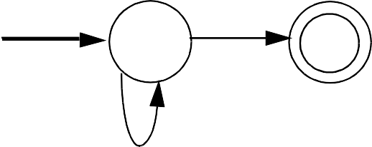
/
/
Eol
1
2
3
4
Not(Eol)
The corresponding transition table is:
State | Character
 | / | Eol | a | b
1 | 2
2 | 3
3 | 3 | 4 | 3 | 3 | 3
4
A complete transition table contains one column for each character. To save space, table compression may be used. Only non- error entries are explicitly represented in the table, using hashing, indirection or linked structures.
©
70

Slide 56
All regular expressions can be translated into DFAs that accept (as valid tokens) the strings defined by the regular expressions. This translation can be done manually by a programmer or automatically using a scanner generator.
A DFA can be coded in:
Table- driven form
Explicit control form
In the table- driven form, the transition table that defines a DFA’s actions is explicitly represented in a run- time table that is “interpreted” by a driver program.
In the direct control form, the transition table that defines a DFA’s actions appears implicitly as the control logic of the program.
©

Slide 57
For example, suppose CurrentChar is the current input character. End of file is represented by a special character value, eof. Using the DFA for the Java comments shown earlier, a table- driven scanner is:
State while
if
= StartState
(true){
(CurrentChar break
== eof)
NextState =
T[State][CurrentChar]
if(NextState == error) break
State = NextState read(CurrentChar)
}
if (State in AcceptingStates)
// Process valid token
// Signal a lexical error
else
©

Slide 58
This form of scanner is produced by a scanner generator; it is definition- independent. The scanner is a driver that can scan any token if T contains the appropriate transition table.
Here is an explicit- control scanner for the same comment definition:
if (CurrentChar == '/'){ read(CurrentChar)
if (CurrentChar == '/') repeat
read(CurrentChar) until (CurrentChar in
{eol, eof})
else //Signal lexical error else // Signal lexical error
if (CurrentChar ==
eol) token
// Process valid else //Signal
lexical
error
©

Slide 59
The token being scanned is
“hardwired” into the logic of the code. The scanner is usually easy to read and often is more efficient, but is specific to a single token definition.
©

