Slide 1
CS 536
Introduction to Programming Languages and Compilers
Charles N. Fischer
Lecture 5
©

Slide 2
Multi Character Lookahead
We may allow finite automata to look beyond the next input character.
This feature is necessary to implement a scanner for FORTRAN.
In FORTRAN, the statement
DO 10 J = 1,100
specifies a loop, with index J
ranging from 1 to 100. The statement
DO 10 J = 1.100
is an assignment to the variable DO10J. (Blanks are not significant except in strings.)
A FORTRAN scanner decides whether the O is the last character of a DO token only after reading as far as the comma (or period).
©

Slide 3
A milder form of extended lookahead problem occurs in Pascal and Ada.
The token 10.50 is a real literal, whereas 10..50 is three different tokens.
We need two- character lookahead after the 10 prefix to decide whether we are to return 10 (an integer literal) or 10.50 (a real literal).
©

Slide 4
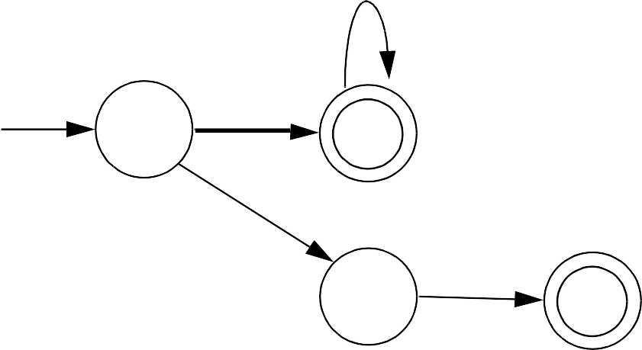
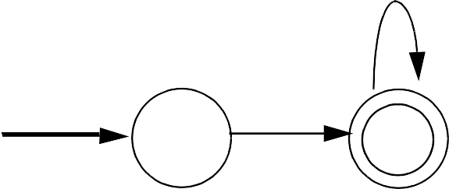
Suppose we use the following FA.
D
D
D
.
D
.
.
Given 10..100 we scan three characters and stop in a non- accepting state.
Whenever we stop reading in a non- accepting state, we back up along accepted characters until an accepting state is found.
Characters we back up over are rescanned to form later tokens. If no accepting state is reached during backup, we have a lexical error.
©

Slide 5
Performance Considerations
Because scanners do so much character- level processing, they can be a real performance bottleneck in production compilers.
Speed is not a concern in our project, but let’s see why scanning speed can be a concern in production compilers.
Let’s assume we want to compile at a rate of 5000 lines/sec. (so that most programs compile in just a few seconds).
Assuming 30 characters/line (on average), we need to scan 150,000 char/sec.
©

Slide 6
A key to efficient scanning is to group character- level operations whenever possible. It is better to do one operation on n characters rather than n operations on single characters.
In our examples we’ve read input one character as a time. A subroutine call can cost hundreds or thousands of instructions to execute—far too much to spend on a single character.
We prefer routines that do block reads, putting an entire block of characters directly into a buffer.
Specialized scanner generators can produce particularly fast scanners.
The GLA scanner generator claims that the scanners it produces run as fast as:
©

Slide 7
while(c != Eof) { c = getchar();
}
©

Slide 8
Lexical Error Recovery
A character sequence that can’t be scanned into any valid token is a lexical error.
Lexical errors are uncommon, but they still must be handled by a scanner. We won’t stop compilation because of so minor an error.
Approaches to lexical error handling include:
Delete the characters read so far and restart scanning at the next unread character.
Delete the first character read by the scanner and resume scanning at the character following it.
Both of these approaches are reasonable.
©

Slide 9
The first is easy to do. We just reset the scanner and begin scanning anew.
The second is a bit harder but also is a bit safer (less is immediately deleted). It can be implemented using scanner backup.
Usually, a lexical error is caused by the appearance of some illegal character, mostly at the beginning of a token.
(Why at the beginning?)
In these case, the two approaches are equivalent.
The effects of lexical error recovery might well create a later syntax error, handled by the parser.
©

Slide 10
...for$tnight...
Consider
The $ terminates scanning of for. Since no valid token begins with
$, it is deleted. Then tnight is
scanned as an identifier. In effect we get
...for tnight...
which will cause a syntax error. Such “false errors” are unavoidable, though a syntactic error- repair may help.
©

Slide 11
Error Tokens
Certain lexical errors require special care. In particular, runaway strings and runaway comments ought to receive special error messages.
In Java strings may not cross line boundaries, so a runaway string is detected when an end of a line is read within the string body.
Ordinary recovery rules are inappropriate for this error. In particular, deleting the first character (the double quote character) and restarting scanning is a bad decision.
It will almost certainly lead to a cascade of “false” errors as the string text is inappropriately scanned as ordinary input.
©

Slide 12
One way to handle runaway strings is to define an error token.
An error token is not a valid token; it is never returned to the parser. Rather, it is a pattern for an error condition that needs special handling. We can define an error token that represents a string terminated by an end of line rather than a double quote character.
For a valid string, in which internal double quotes and back slashes are escaped (and no other escaped characters are allowed), we can use
" ( Not( " | Eol | \ ) | \" | \\ )* "
For a runaway string we use
" ( Not( " | Eol | \ ) | \" | \\ )* Eol
(Eol is the end of line character.)
©

Slide 13
When a runaway string token is recognized, a special error message should be issued.
Further, the string may be
“repaired” into a correct string by returning an ordinary string token with the closing Eol replaced by a double quote.
This repair may or may not be “correct.” If the closing double
quote is truly missing, the repair will be good; if it is present on a succeeding line, a cascade of inappropriate lexical and syntactic errors will follow.
Still, we have told the programmer exactly what is wrong, and that is our primary goal.
©

Slide 14
In languages like C, C+ + , Java and CSX, which allow multiline comments, improperly terminated (runaway) comments present a similar problem.
A runaway comment is not detected until the scanner finds a close comment symbol (possibly belonging to some other comment) or until the end of file is reached. Clearly a special, detailed error message is required.
Let’s look at Pascal- style comments that begin with a { and end with a }. Comments that begin and end with a pair of characters, like /* and */ in Java, C and C+ + , are a bit trickier.
©

Slide 15
Correct Pascal comments are defined quite simply:
{ Not( } )* }
To handle comments terminated by Eof, this error token can be used:
{ Not( } )* Eof
We want to handle comments unexpectedly closed by a close comment belonging to another comment:
{... missing close comment
... { normal comment }...
We will issue a warning (this form of comment is lexically legal).
Any comment containing an open comment symbol in its body is most probably a missing } error.
©

Slide 16
We split our legal comment definition into two token definitions.
The definition that accepts an open comment in its body causes a warning message ("Possible unclosed comment") to be printed.
We now use:
The first definition matches correct comments that do not contain an open comment in their body.
The second definition matches correct, but suspect, comments that contain at least one open comment in their body.
{ | Not( { | } )* } | and
{ | (Not( { | } )* { | Not( { | } )* )+ }
©

Slide 17
Single line comments, found in Java, CSX and C+ + , are terminated by Eol.
They can fall prey to a more subtle error—what if the last line has no Eol at its end?
The solution?
Use this definition for single line comments:
// Not(Eol)*
The Eol is consumed as “white space.”
©

Slide 18
Regular Expressions and Finite Automata
Regular expressions are fully equivalent to finite automata.
The main job of a scanner generator like JLex is to transform a regular expression definition into an equivalent finite automaton.
It first transforms a regular expression into a nondeterministic finite automaton (NFA).
Unlike ordinary deterministic finite automata, an NFA need not make a unique (deterministic) choice of a successor state to visit. As shown below, an NFA is allowed to have a state that has two transitions (arrows) coming
©

Slide 19
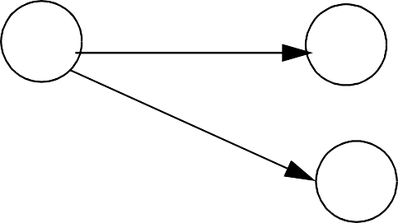
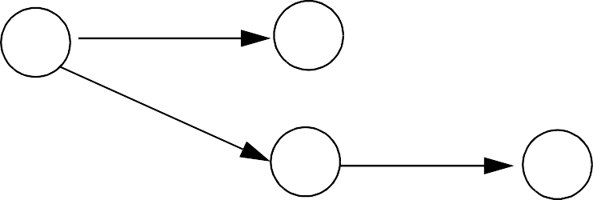
out of it, labeled by the same symbol. An NFA may also have transitions labeled with λ.
a
a
a
λ
a
Transitions are normally labeled with individual characters in Σ, and although λ is a string (the string with no characters in it), it is definitely not a character. In the above example, when the automaton is in the state at the left and the next input character is a, it may choose to use the
©

Slide 20
transition labeled a or first follow the λ transition (you can always find λ wherever you look for it) and then follow an a transition.
FAs that contain no λ transitions and that always have unique successor states for any symbol are deterministic.
©

Slide 21
Building Finite Automata From Regular Expressions
We make an FA from a regular expression in two steps:
Transform the regular expression into an NFA.
Transform the NFA into a deterministic FA.
The first step is easy.
Regular expressions are all built out of the atomic regular expressions a (where a is a character in Σ) and λ by using the three operations
A B and A | B and A*.
©

Slide 22
Other operations (like A⁺ ) are just abbreviations for combinations of these.
NFAs for a and λ are trivial:
a
λ
Suppose we have NFAs for A and B and want one for A | B. We construct the NFA shown below:
Finite Automaton
for A
A
λ
λ
λ
Finite Automaton B
for B
λ
©

Slide 23
The states labeled A and B were the accepting states of the automata for A and B; we create a new accepting state for the combined automaton.
A path through the top automaton accepts strings in A, and a path through the bottom automation accepts strings in B, so the whole automaton matches A | B.
The construction for A B is even easier. The accepting state of the combined automaton is the same state that was the accepting state of B. We must follow a path through A’s automaton, then through B’s automaton, so overall A B is matched.
We could also just merge the accepting state of A with the initial state of B. We chose not to
©

Slide 24
only because the picture would be more difficult to draw.
Finite Automaton
for A
A
λ
 |  | Finite Automaton for B
©

Slide 25
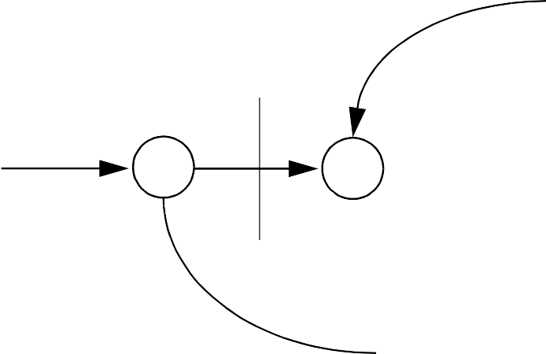
Finally, let’s look at the NFA for
A*. The start state reaches an accepting state via λ, so λ is accepted. Alternatively, we can follow a path through the FA for A one or more times, so zero or more strings that belong to A are matched.
λ
λ
Finite Automaton
for A
λ
A
λ
©

Slide 26
Creating Deterministic Automata
The transformation from an NFA N to an equivalent DFA D works by what is sometimes called the subset construction.
Each state of D corresponds to a set of states of N.
The idea is that D will be in state
{x, y, z} after reading a given input string if and only if N could be in any one of the states x, y, or z, depending on the transitions it chooses. Thus D keeps track of all the possible routes N might take and runs them simultaneously.
Because N is a finite automaton, it has only a finite number of states. The number of subsets of N’s states is also finite, which makes
©

Slide 27
tracking various sets of states feasible.
An accepting state of D will be any set containing an accepting state of N, reflecting the convention that N accepts if there is any way it could get to its accepting state by choosing the “right” transitions.
The start state of D is the set of all states that N could be in without reading any input characters— that is, the set of states reachable from the start state of N following only λ transitions. Algorithm close computes those states that can be reached following only λ transitions.
Once the start state of D is built, we begin to create successor states:
©

Slide 28
We take each state S of D, and each character c, and compute S’s successor under c.
S is identified with some set of
N’s states, {n₁, n₂,...}.
We find all the possible successor states to {n₁, n₂,...} under c,
obtaining a set {m₁, m₂,...}.
Finally, we compute
T = CLOSE({ m₁, m₂,...}).
T becomes a state in D, and a transition from S to T labeled with c is added to D.
We continue adding states and transitions to D until all possible successors to existing states are added.
Because each state corresponds to a finite subset of N’s states, the
©

Slide 29
process of adding new states to D
must eventually terminate.
Here is the algorithm for λ- closure, called close. It starts with a set of NFA states, S, and adds to S all states reachable from S using only λ transitions.
void close(NFASet S) {
λ
while
(x | in S and x →
and S | y notin S) = S U {y} | {
y
}}
Using close, we can define the construction of a DFA, D, from an NFA, N:
©

Slide 30
DFA MakeDeterministic(NFA N) {
DFA D ; NFASet
D.StartState = {
T
N.StartState }
close(D.StartState) D.States = { D.StartState }
while (states or transitions can be added to D) {
Choose any state S in D.States and any character c in Alphabet
T = {y in N.States
such that
c
x → y close(T );
for some x
in S}
if (T notin D.States) {
D.States
= D.States U {T}
D.Transitions
=
D.Transitions U
{the transition
c
S →
T}
} }
D.AcceptingStates =
{ S in D.States such that an accepting state of N in S}
}
©

Slide 31
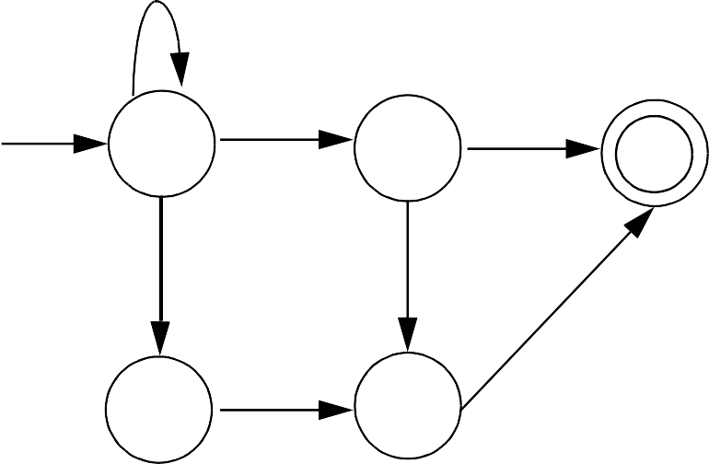
Example
To see how the subset construction operates, consider the following NFA:
b
λ
a
1
2
5
a
a
b
a | b
3
4
We start with state 1, the start state of N, and add state 2 its λ- successor.
D’s start state is {1,2}. Under a, {1,2}’s successor is
{3,4,5}.
©

Slide 32
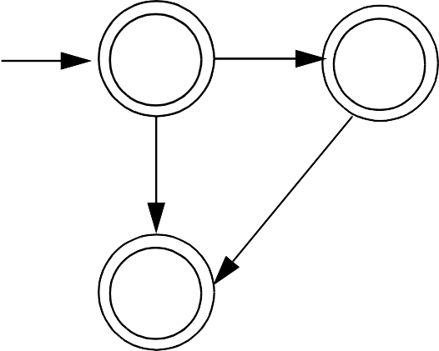
State 1 has itself as a successor under b. When state 1’s λ- successor, 2, is included, {1,2}’s successor is {1,2}. {3,4,5}’s successors under a and b are {5} and {4,5}.
{4,5}’s successor under b is {5}.
Accepting states of D are those state sets that contain N’s accepting state which is 5.
The resulting DFA is:
b
a
b
1,2
3,4,5
4,5
a
a | b
55
©

Slide 33
It is not too difficult to establish that the DFA constructed by MakeDeterministic is equivalent to the original NFA.
The idea is that each path to an accepting state in the original NFA has a corresponding path in the DFA. Similarly, all paths through the constructed DFA correspond to paths in the original NFA.
What is less obvious is the fact that the DFA that is built can sometimes be much larger than the original NFA. States of the DFA are identified with sets of NFA states.
If the NFA has n states, there are
2^{n} distinct sets of NFA states, and hence the DFA may have as many
as 2^{n} states. Certain NFAs actually
©

Slide 34
exhibit this exponential blowup in size when made deterministic.
Fortunately, the NFAs built from the kind of regular expressions used to specify programming language tokens do not exhibit this problem when they are made deterministic.
As a rule, DFAs used for scanning are simple and compact.
If creating a DFA is impractical (because of size or speed- of- generation concerns), we can scan using an NFA. Each possible path through an NFA is tracked, and reachable accepting states are identified. Scanning is slower using this approach, so it is used only when construction of a DFA is not practical.
©

Slide 35
Optimizing Finite Automata
We can improve the DFA created by MakeDeterministic.
Sometimes a DFA will have more states than necessary. For every DFA there is a unique smallest equivalent DFA (fewest states possible).
Some DFA’s contain unreachable states that cannot be reached from the start state.
Other DFA’s may contain dead states that cannot reach any accepting state.
It is clear that neither unreachable states nor dead states can participate in scanning any valid token. We therefore eliminate all such states as part of our optimization process.
©

Slide 36
We optimize a DFA by merging together states we know to be equivalent.
For example, two accepting states that have no transitions at all out of them are equivalent.
Why? Because they behave exactly the same way—they accept the string read so far, but will accept no additional characters.
If two states, s₁ and s₂, are equivalent, then all transitions to s₂ can be replaced with
transitions to s₁. In effect, the two states are merged together into one common state.
How do we decide what states to merge together?
©

Slide 37
We take a greedy approach and try the most optimistic merger of states. By definition, accepting and non- accepting states are distinct, so we initially try to create only two states: one representing the merger of all accepting states and the other representing the merger of all non- accepting states.
This merger into only two states is almost certainly too optimistic. In particular, all the constituents of a merged state must agree on the same transition for each possible character. That is, for character c all the merged states must have no successor under c or they must all go to a single (possibly merged) state.
If all constituents of a merged state do not agree on the
©

Slide 38
transition to follow for some character, the merged state is split into two or more smaller states that do agree.
As an example, assume we start with the following automaton:
1
a
2
b
c
3
4
d
b
c
5
6
7
Initially we have a merged non- accepting state {1,2,3,5,6} and a merged accepting state {4,7}.
A merger is legal if and only if all constituent states agree on the same successor state for all characters. For example, states 3 and 6 would go to an accepting state given character c; states 1, 2, 5 would not, so a split must occur.
©

Slide 39
We will add an error state s_{E} to the original DFA that is the successor
state under any illegal character. (Thus reaching s_{E} becomes
equivalent to detecting an illegal token.) s_{E} is not a real state; rather it allows us to assume every state
has a successor under every character. s_{E} is never merged with
any real state.
Algorithm Split , shown below, splits merged states whose constituents do not agree on a common successor state for all characters. When Split terminates, we know that the states that remain merged are equivalent in that they always agree on common successors.
©

Slide 40
Split(FASet StateSet) { repeat
for(each merged state S in StateSet) { Let S correspond to {s₁,...,s_{n}}
for(each char c in Alphabet){ Let t₁,...,t_{n} be the successor states to s₁,...,s_{n} under c if(t₁,...,t_{n} do not all belong to
the same merged state){
Split S into two or more new states such that s_{i} and s_{j} remain in the same merged state if and only if t_{i} and t_{j} are in the same merged state}
}
until no more splits are possible
}
©

Slide 41
Returning to our example, we initially have states {1,2,3,5,6} and
{4,7}. Invoking Split , we first observe that states 3 and 6 have a common successor under c, and states 1, 2, and 5 have no successor under c (equivalently, have the error state s_{E} as a
successor).
This forces a split, yielding {1,2,5},
{3,6} and {4,7}.
Now, for character b, states 2 and
5 would go to the merged state
{3,6}, but state 1 would not, so another split occurs.
We now have: {1}, {2,5}, {3,6} and
{4,7}.
At this point we are done, as all constituents of merged states agree on the same successor for each input symbol.
©

Slide 42
Once Split is executed, we are essentially done.
Transitions between merged states are the same as the transitions between states in the original DFA.
Thus, if there was a transition between state s_{i} and s_{j} under character c, there is now a transition under c from the
merged state containing s_{i} to the
merged state containing s_{j}. The start state is that merged state containing the original start state.
Accepting states are those merged states containing accepting states (recall that accepting and non- accepting states are never merged).
©

Slide 43
Returning to our example, the minimum state automaton we obtain is
1
a | d
b
c
2,5
3,6
4,7
©

Slide 44
Properties of Regular Expressions and Finite Automata
Some token patterns can’t be defined as regular expressions or finite automata. Consider the set of balanced brackets of the form [ [ [.] ] ]. This set is defined formally as
{ [^{m} ]^{m} | m ≥ 1 }.
This set is not regular.
No finite automaton that recognizes
exactly this set can exist.
Why? Consider the inputs [, [[, [[[, ... For two different counts (call them i
and j) [^{i} and [^{j} must reach the same state of a given FA! (Why?)
Once that happens, we know that if [^{i}]^{i}
is accepted (as it should be), the [^{j}]^{i} will also be accepted (and that should not happen).
©

Slide 45
R = V* - R is regular if R is. Why?
Build a finite automaton for R. Be careful to include transitions to an
“error state” s_{E} for illegal characters.
Now invert final and non- final states. What was previously accepted is now rejected, and what was rejected is now accepted. That is, R is accepted by the modified automaton.
Not all subsets of a regular set are themselves regular. The regular
expression [⁺ ]⁺ has a subset that isn’t regular. (What is that subset?)
©

Slide 46
Let R be a set of strings. Define R^{rev} as all strings in R, in reversed (backward) character order.
Thus if R = {abc, def}
then R^{rev} = {cba, fed}.
If R is regular, then R^{rev} is too. Why? Build a finite automaton for R.
Make sure the automaton has only one final state. Now reverse the direction of all transitions, and interchange the start and final states. What does the modified automation accept?
©

Slide 47
R₁ ∩ R₂ is also regular. We can show this two different ways:
If R₁ and R₂ are both regular, then
Build two finite automata, one for R1 and one for R2. Pair together states of the two automata to match R1 and R2 simultaneously. The paired- state automaton accepts only if both R1 and R2 would, so
R1 ∩ R2 is matched.
We can use the fact that R1 ∩ R2
is = R₁ ∪ R₂ We already know
union and complementation are regular.
©

