Slide 1
Single Image
Vignetting Correction
Patrick Flynn

Slide 2
Outline
Motivation and Background
Previous Work
Current Method
My Implementation
Results
Looking Ahead

Slide 3
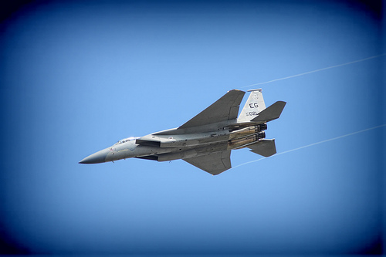
Background
Vignetting is an effect where the image intensity drops off away from the center.

Slide 4
Background (Cont.)
Causes of vignetting:
  Mechanical: Lens hoods, filters
  Optical: Due to lens itself
  Natural: Less light reflected at sharp angles
Sometimes added for artistic effects
This project focuses on trying to reverse this effect.

Slide 5
Previous Work
Use calibration images for a camera
Use overlapping scene images to fit a function
Segment the image into regions and use texture info to rebuild image
Fit some vignetting model

Slide 6
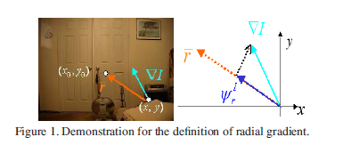
The method I used…
Presented by Zheng et al at ‘08 CVPR Conf.
Idea: Since vignetting is a function of the radius, use radial information.
Uses the radial gradient:

Slide 7
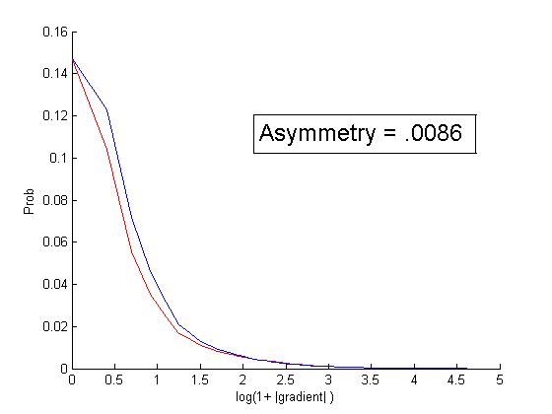
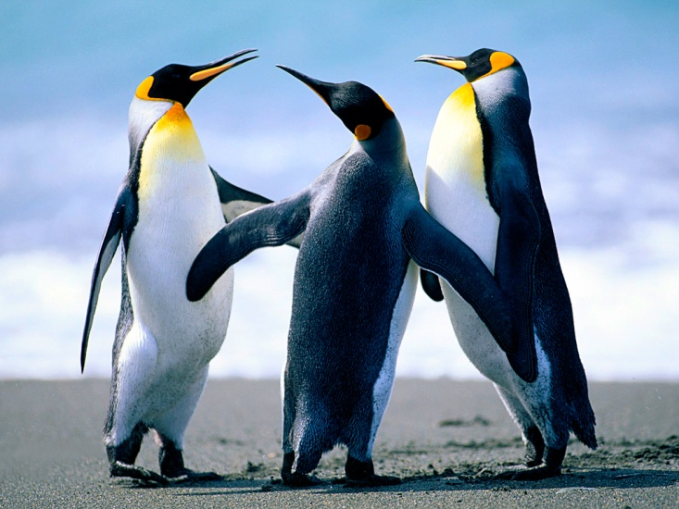
The method (Cont)
Observation:
For ‘normal’ images the distribution of the radial gradients is symmetric.

Slide 8
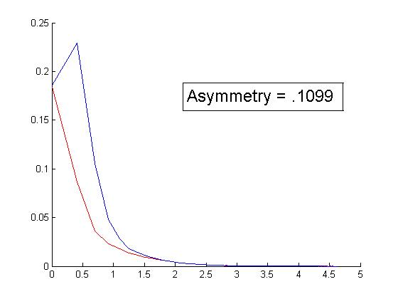
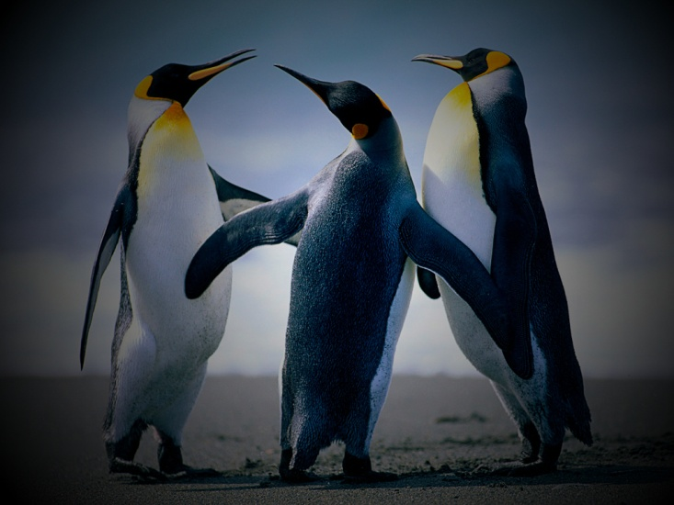
The method (Cont)
For images with vignetting the distribution is asymmetric

Slide 9
Correction
Model input image as the pure image times a vignetting function:
If we find V, we can determine I.

Slide 10
Correction (Cont.)
Fit a function for V by minimizing the asymmetry in I.
They proposed both a least-squares and a nonlinear optimization method
The least squares function is flexible in terms of types of images
The nonlinear model had better results

Slide 11
My Implementation
So far I have implemented the asymmetry measure in matlab.
Demo time

Slide 12
To Do
Add the image correction features using the MATLAB optimization toolbox.
But I should get something like this…

Slide 13


Results (from Paper)

Slide 14
Questions?

