Slide 1
Recommendation challenges at Amazon
Airstream use case
Houssam Nassif
AISTATS’15

Slide 2
Mission Statement
To be Earth’s Most Customer-Centric Company Where People Can Find and Discover Anything They Want to Buy Online

Slide 3
Airstream
Notes:
Also show actual website

Slide 4
Visual Browse Experience
Beautiful
How to define and measure?
Engaging
What products to show?
Image parameters? Clicks? Hand curated?
Optimize for discovery or repeatability?
How to engage users?

Slide 5
Optimize for Users
Customers
244MM active accounts
Recommendation at scale
Personalized
14 countries
Milliseconds latency
What metric to optimize?

Slide 6
Temporal Variations
Value (clicks, purchases)
Time (in hours)
Notes:
Day/night, weekend/weekday variations

Slide 7
Zero-Inflated Distribution
Customers
Engagement

Slide 8
How to Recommend?
Multi-armed bandits
Collaborative filtering
Deep learning
Regression analysis
…

Slide 9
Need for Diversity

Slide 10
How to Diversify?
Determinantal Point Processes
Submodular Functions
Possible solutions
Challenges
How to learn ideal mix?
How to balance between diversity and metric of interest?

Slide 11
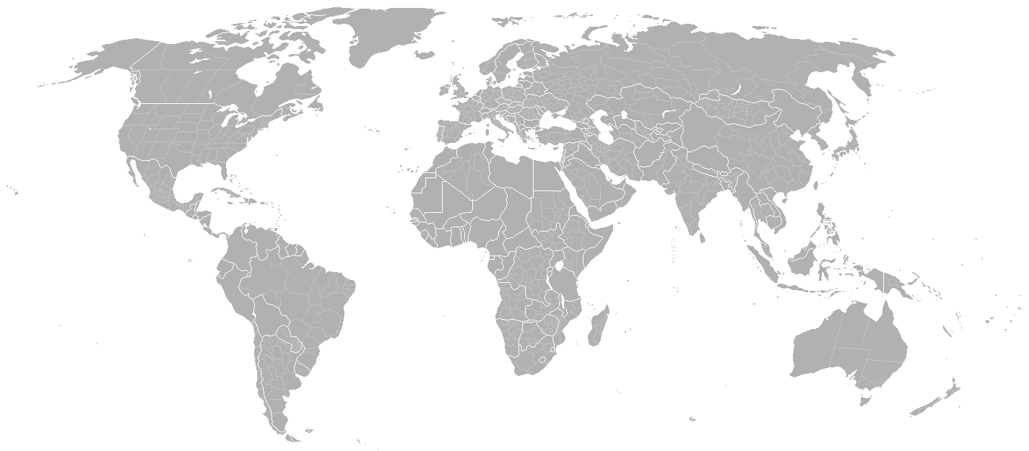
ML Teams @ Amazon
S9
ML Seattle
Toronto Dev Center
ML Berlin
ML Bay Area
A2Z
A9
ML Bangalore

