Slide 1
ML in practice: Thinking like a scientist
Houssam Nassif, Prime, Senior Applied Scientist

Slide 2
Background
Me in one word: Curious
Career path: A biologist turned Artificial Intelligence scientist
Biomedical research hospital, Cisco, Google, Amazon
Amazon research: https://www.aboutamazon.com/research
More on my research: http://pages.cs.wisc.edu/~hous21/
Notes:
Applied science

Slide 3
Recommender systems I helped build
Shop by look
Amazon Instant Video recommendation
Fast-learning recommenders
Music app recommendation
Interesting finds (window shopping)

Slide 4
Industrial data science
Science in industry is applied
Start from customer, and work backwards to solution
Remainder of talk: How to conduct data science in practice
All materials from published Amazon research

Slide 5
Start with a real-world problem
Applied research to solve concrete customer problems

Slide 6
Biking competition
Stop biking pointlessly, join team Circle!
Year-round carousel rides!
Unlimited laps!
All you can eat Pi!
No corners to hide!
Hurry, don’t linger around!
Join now!
Check other teams
Notes:
Let us use a non-dscript example. Terrible mistake of hiring a lousy designer. Luckily amazon has way better designers

Slide 7
Multiple-slot template
Stop biking pointlessly, join team Circle!
Slot
Year-round carousel rides!
Unlimited laps!
All you can eat Pi!
No corners to hide!
Hurry, don’t linger around!
Join now!
Check other teams
Notes:
I recognize it may be sub-optimal. The page has multiple component slots: heading, image, textual description, and two buttons

Slide 8
Each slot has multiple variations
Alternative
variants
Image
slot
Notes:
each with possible variations

Slide 9
Template combinatorics: 48 layouts
Stop biking pointlessly, join team Circle!
x2
x3
Best way to bicycle!
We cycle and re-cycle!
No point in not joining!
x2
Join now!
Check other teams
x2
x2
Notes:
Exponential explosion. Total of 48 possible combinations

Slide 10
A/B testing?
A/B testing with 48 treatments would take months!
5 different A/B testing experiments, each varying one slot
Doesn’t take slot dependencies in account
Solution?
Multi-Variate Testing Bandit

Slide 11
Divide and conquer
Identify different challenges, solve each at a time
Notes:
Identify problems, tackle each at a time

Slide 13
Challenges
Learn good layouts fast
Bandit algorithms
Quickly recommend the next layout to show
Hill climbing optimization
Be able to generalize
Model pairwise interactions

Slide 14
Deploy at scale
Hundreds of millions of customers and products

Slide 15
Time complexity
D: nb of slots, N: nb of variations per slot
Number of possible layout combinations: O(N^{D})
Sequential evaluation of a layout: O(D)
Exhaustive evaluations: O(DN^{D})
Repeat Hill Climbing loop K times.
S random restarts
Hill Climbing evaluations: O(DSKN)
Notes:
N=10, D=6. 6 millions time unit. SK = 500. 30K

Slide 16
Experimental results
1 week (MVT bandit)
vs.
2 months (A/B testing)
Winning layout:
21% lift vs median layout
44% lift vs worse layout
Faster convergence and better messages

Slide 17
Repeat in different domain
Keep thinking outside the box
Notes:
Keep innovating

Slide 18
Music considerations
Explicit clusters: album, artist
Same album: same meta-data (album cover graphic, title)
User behavior: play album songs back-to-back
Similar scores to same-album songs
Notes:
Unlike other digital and physical products, music content tends to have explicit clusters.
album contains multiple songs. Share same album cover graphic, title and description.
In addition to overlapping content features, album songs also share behavioral features as users play them back to back.
As a result, Recommender systems tend to score same-album songs similarly.

Slide 19
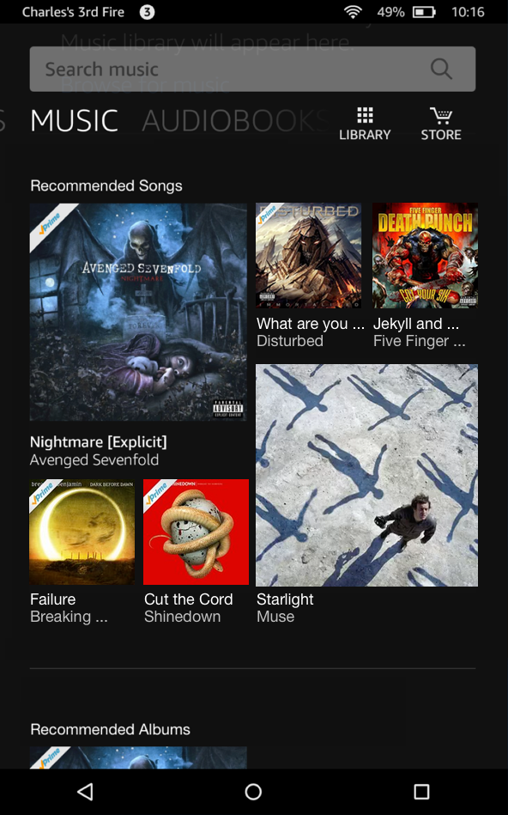
Why diversify music stream?
Notes:
Simply scoring by relevance, a musical stream may look like this. Not an enticing visual appearance.
Diverse & visually pleasing, yet relevant.
Thus the need to establish balance between relevance and diversity. this paper: move from to

Slide 20
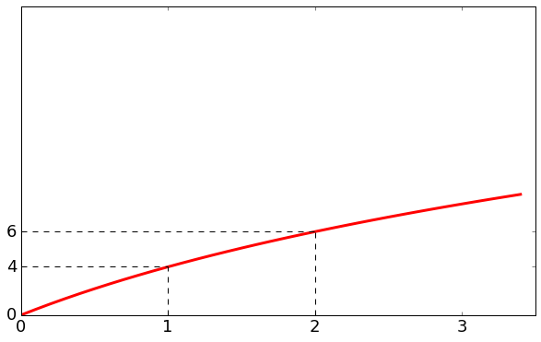
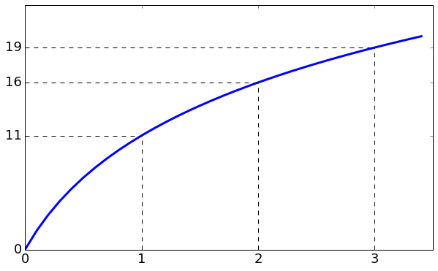
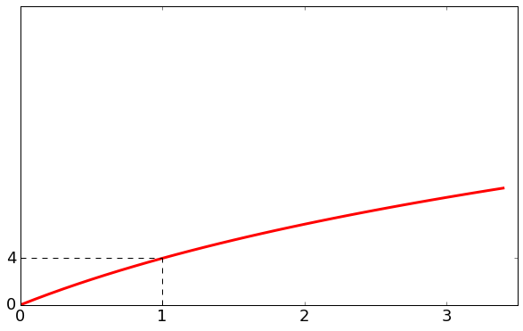
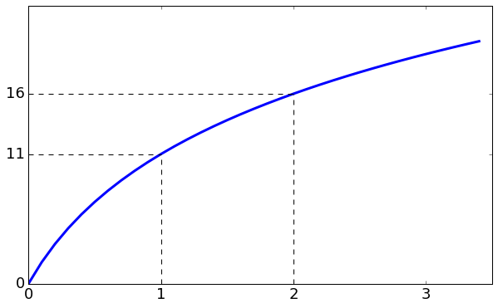
Submodular diversity mix
+3
+5
+11
+2
+4
Diversified list:

Slide 21
Combine and extrapolate
Combine solutions and extrapolate to new challenges

Slide 22
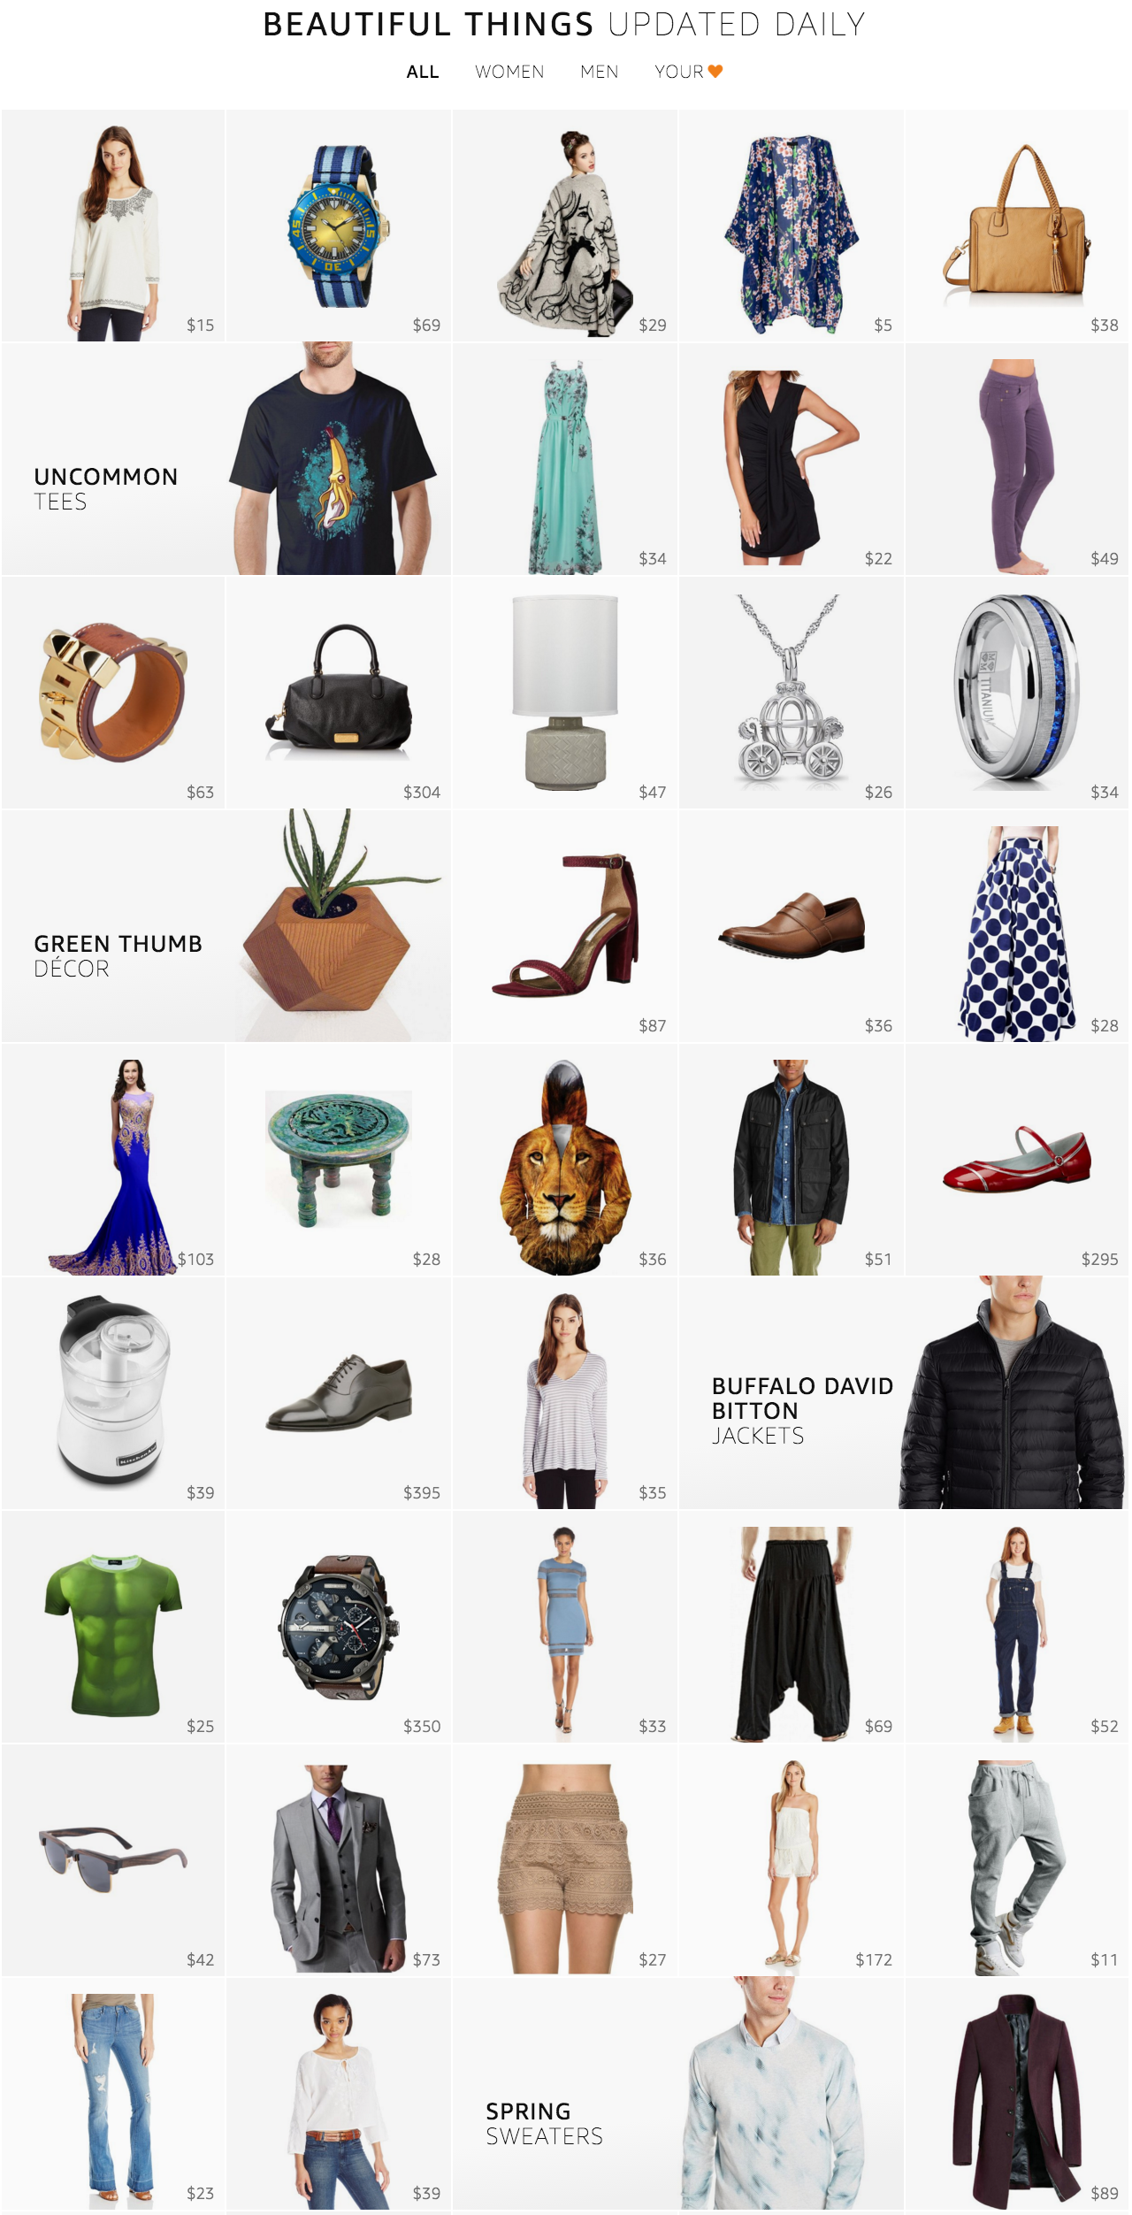
Interesting finds
Notes:
Stream is a new product discovery experience designed to show customer a large collection of products in an endless beautiful imagery.
No customer intent. Window shopping.
This paper describes our solutions for overcoming the challenges we faced

Slide 23
Challenges
Need for product scoring function
Explore new products and leverage popular ones
Need for diverse stream
Hedge against the uncertainty in customer intent
Need for season-aware stream
Customers can engage with relevant products all year round
Need for personalized stream
Customers can focus more on products that they like
Bandits!
Notes:
We used Thompson sampling bandits

Slide 24
Challenges
Need for product scoring function
Explore new products and leverage popular ones
Need for diverse stream
Hedge against the uncertainty in customer intent
Need for season-aware stream
Customers can engage with relevant products all year round
Need for personalized stream
Customers can focus more on products that they like
Submodularity, 9.82% lift in clicks

Slide 25
Challenges
Need for product scoring function
Explore new products and leverage popular ones
Need for diverse stream
Hedge against the uncertainty in customer intent
Need for season-aware stream
Customers can engage with relevant products all year round
Need for personalized stream
Customers can focus more on products that they like
Notes:
extrapolate

Slide 26
Adaptive stream
Fashion trends are seasonal
Learn about seasonal trends from customer behavior
Train model over rolling-window
8.29% lift in clicks
Notes:
estimate adaptive or seasonal category weights by smoothed per-category CTR over a rolling-window.
More concretely, the adaptive weight for a category is the total clicks plus some alpha prior, divided by the sum of total views of the same category, alpha, and beta priors.
[We also tried click over expected clicks and logistic regression with position-bias correction. The three models are qualitatively comparable but we adopted CTR as it is much simpler to implement and allow easy incorporation of signals from external sources.]

Slide 27
Challenges
Need for product scoring function
Explore new products and leverage popular ones
Need for diverse stream
Hedge against the uncertainty in customer intent
Need for season-aware stream
Customers can engage with relevant products all year round
Need for personalized stream
Customers can focus more on products that they like
Notes:
We used Thompson sampling bandits

Slide 28
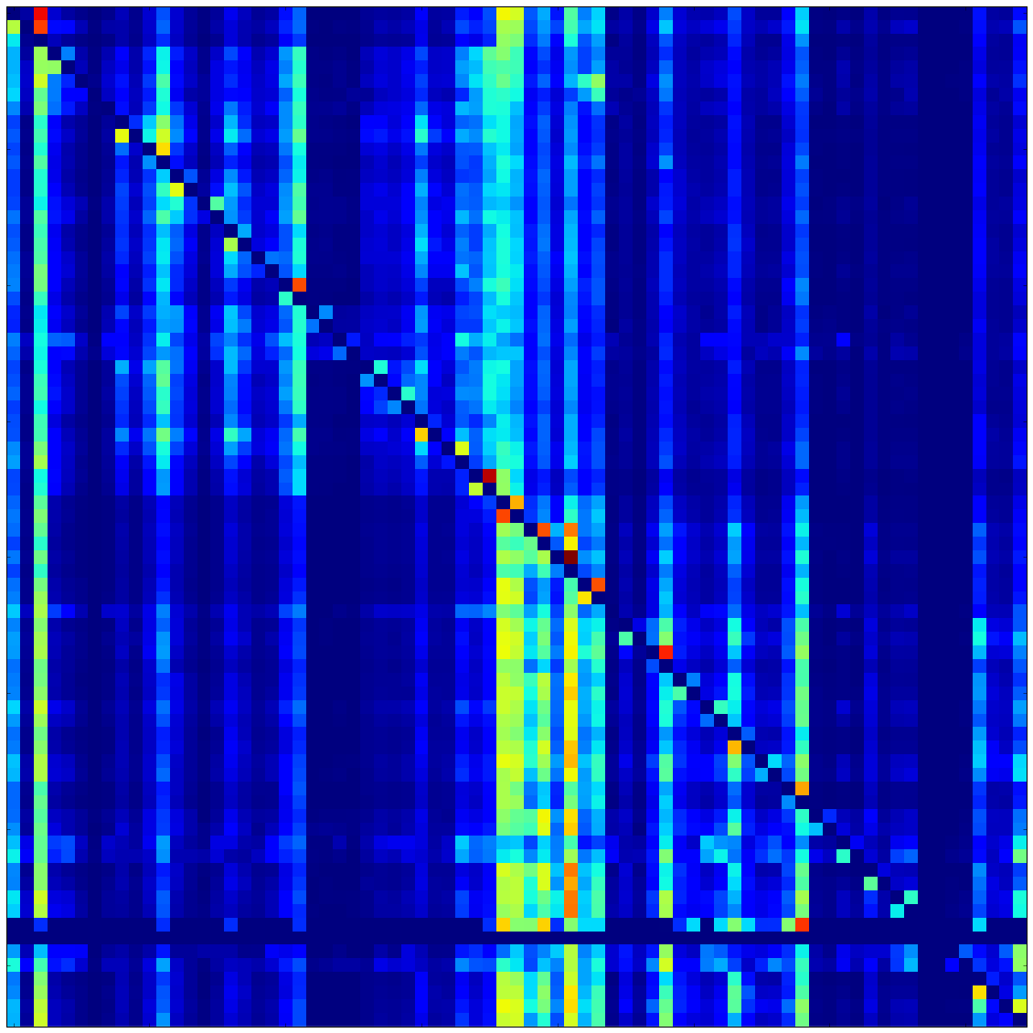
Personalized weights
12.58% lift in clicks
×
Customer preference vector
Category-category correlations
⬇
Smoothed customer preference vector
Notes:
The diffusion of preferences is simply a multiplication of the category-category correlation matrix and the customer’s preference vector.
The resulting customer preference vector is smoother and exposes more categories for the purpose of discovery.

Slide 29
Thank you!
Questions? Comments?
houssamn@amazon.com
http://pages.cs.wisc.edu/~hous21/
Want to help?
Amazon is hiring!

