Slide 1
Ad Clustered User Randomized Trials
CODE@MIT 2024
Edvard Bakhitov
Congshan Zhang
Ivan Sherstobitov
Brett Daley
Daniel Ting
Houssam Nassif
Sergei Leonenkov

Slide 2
A fresh take on cluster randomization
Throughput bottleneck is one of the major challenges in online experimentation
  Large amount of A/B tests per year
  True effect sizes are small and hard to detect
Post-experiment methods
  Regression adjustment
  Post-stratification
Design-based methods
  Cluster randomization -> Ad Clustered User RAndomized Trial (ACURAT)
    More efficient way of using user information
    In A/A tests, at Meta’s scale, achieves throughput increase
      Up tp 30% for 2 week experiments
      Up to 40% for 3 week experiments
    Can be potentially combined with regression adjustment

Slide 3
Agenda
ACURAT experiment design
Role of ads clustering
Heterogenous Balanced Partitioning
Empirical performance

Slide 4
01 ACURAT experiment design

Slide 5
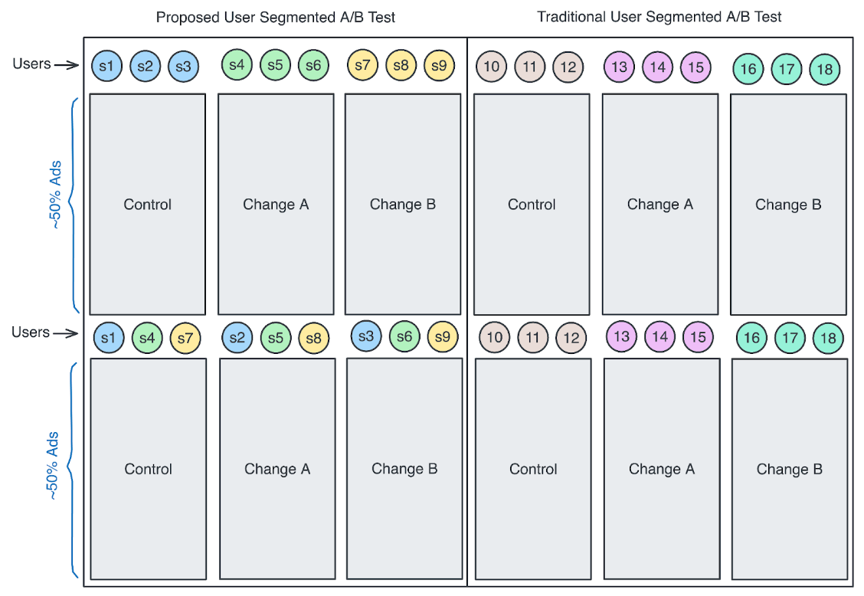
ACURAT design
Differentiated user randomization on ad clusters
Ads are grouped into two clusters
based on their auction participation graph
Users are randomized within each ad cluster
User-cluster pair level metric values are aggregated onto each treatment condition
This ad segmentation design
allows for more efficient utilization of user information, resulting in substantial throughput
benefits.
ACURAT Traditional A/B Test

Slide 6
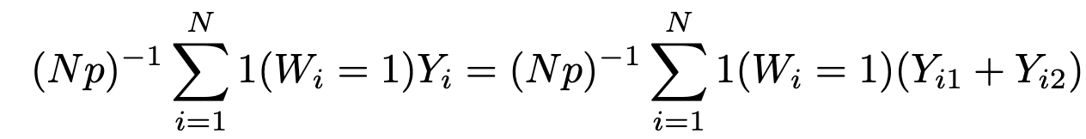
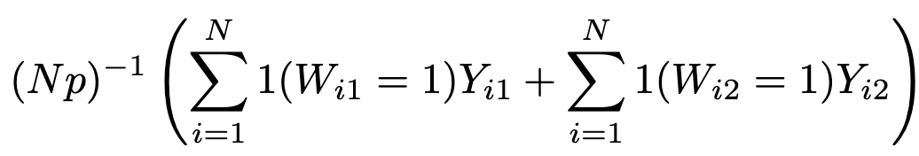
Ad clustering to reduce variance
Intuition behind the experiment design
The standard IPW estimator for E[Y(1)]
Within-user variance is
  Cov > 0 for a typical business metric
To remove this positive correlation, we reshuffle users in the second cluster
The estimator is unbiased under SUTVA

Slide 7
02 Role of ads clustering

Slide 8
Ad clustering is key to desired performance
ACURAT requires an explicit trade-off between bias (potential SUTVA violations) and variance.
High Auction Purity
An auction is pure if all (competitive) ads participating in the auction belong to the same cluster
Auction outcomes are only affected by a single treatment (all else equal)
Close-to-negligible bias
High Intra-User Mixture
A user is mixed if auctions under the same user belong to different clusters
The more mixed users we have, the more within-user variance will be removed
Lower platform MDE

Slide 9
03 Heterogeneous Balanced Partitioning

Slide 10
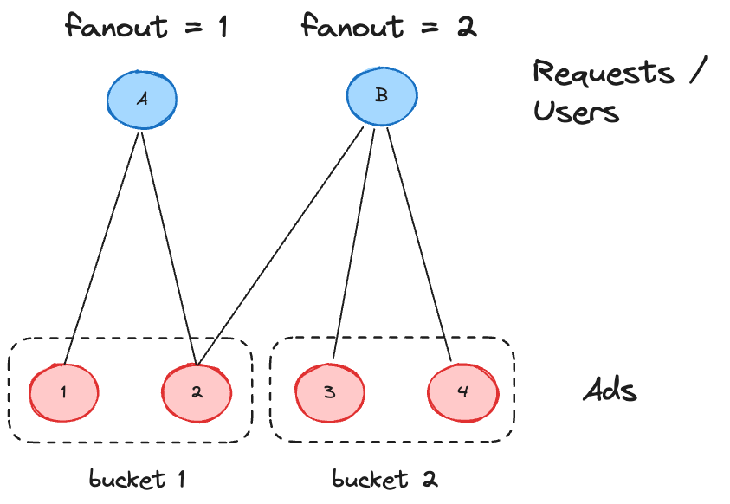




Clustering objective
Goal:
Partition ads into 2 buckets of approximately the same size such that we achieve high levels of auction purity and intra-user mixture.
Measuring cluster quality:
Undirected heterogeneous graph that connects ad campaigns (A), users (U) and user requests/auctions (R)
For a given partitioning of and vertex , with , we define the fanout of v as the number of distinct buckets having an ad node incident to v,
  fanout(P, r) = 1 => request r is pure
  fanout(P, u) = 2 => user u is mixed
Fanout is a measure of impurity/mixture

Slide 11
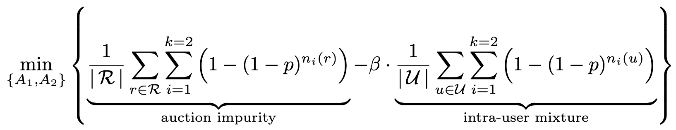

Heterogeneous Balanced Partitioning (HBP)
Objective function:
Explicitly models the trade-off between auction purity and intra-user mixture through the penalty parameter
Use probabilistic fanout to achieve smoothness
is a tuning parameter that balances out auction purity and intra-user mixture

Slide 12
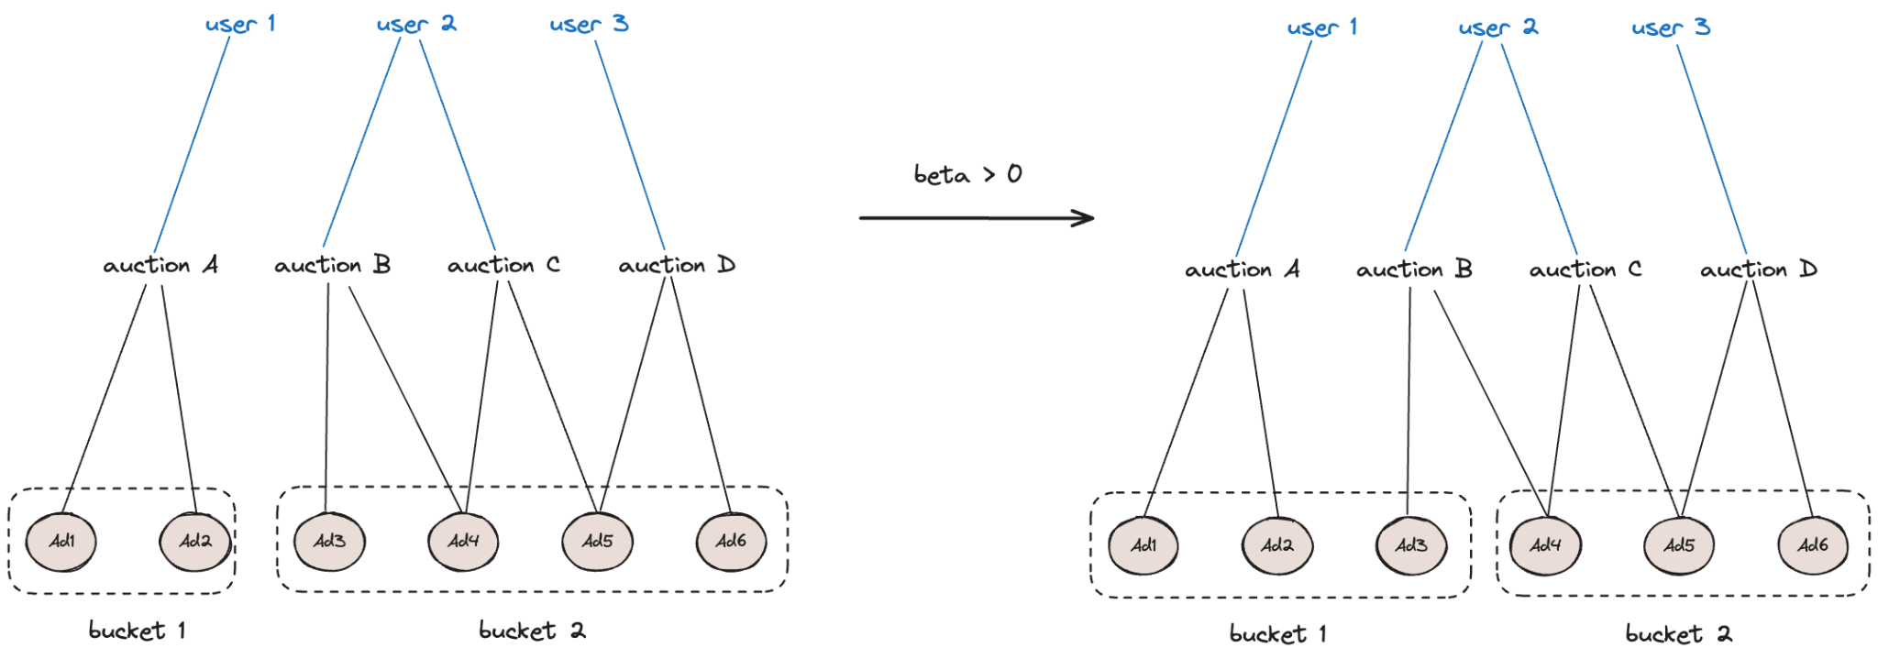
Auction purity vs Intra-User mixture
All auctions are pure
Zero mixed users
Auction B is impure
User 2 is mixed

Slide 13
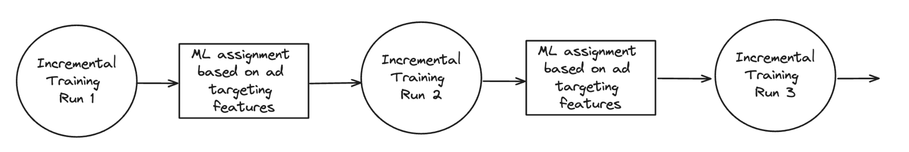
Maintaining cluster quality
Ads turnover rate is very high → Need a reliable way of assigning newly created ads
We utilize ads targeting feature for ML-based incremental training
A NN model is trained between two consecutive graph-based incremental training runs
This procedure introduces almost zero latency

Slide 14
04 Empirical performance

Slide 15
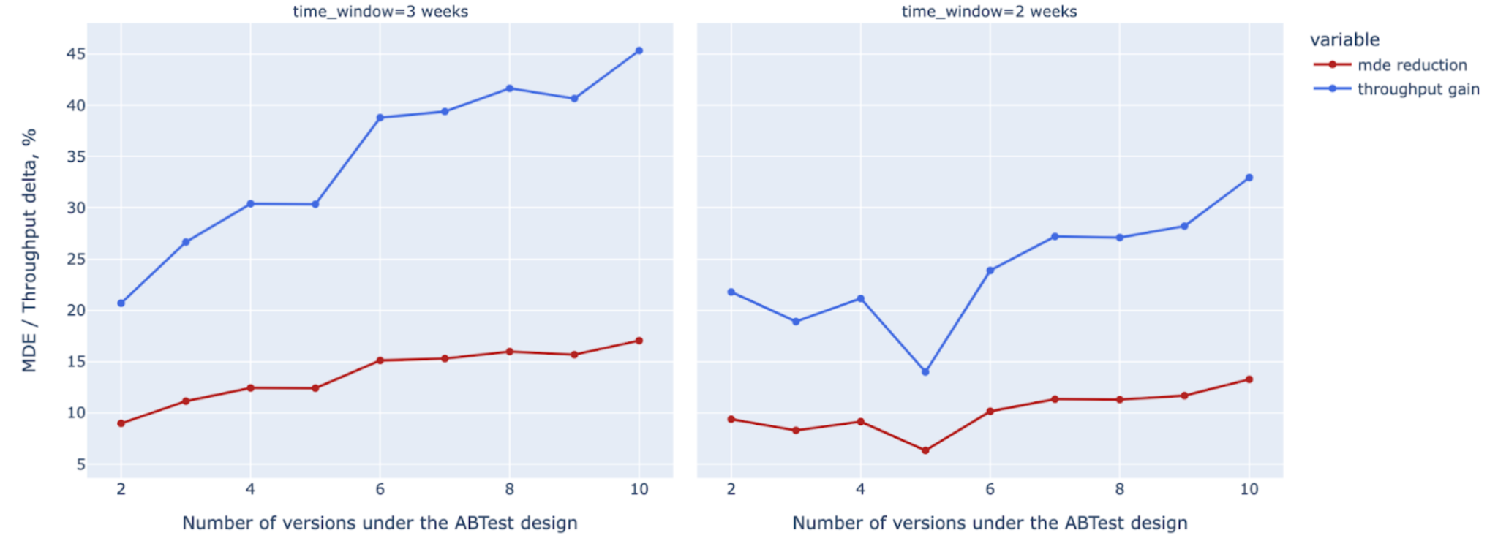
Empirical performance

Slide 16
Conclusion
This paper:
We proposed a design-based variance reduction method via ads segmentation - Ad Clustered User Randomized Trial (ACURAT).
We developed a heterogeneous balanced partitioning algorithm (HBP) with a near real-time ML approach to incrementally maintain cluster quality throughout the experiment.

