Slide 1
Bayesian Predictive Probabilities for Online Experimentation
Abbas Zaidi, Rina Friedberg, Houssam Nassif, Samir Khan, Yao-Yang Leow, Maulik
Soneji, and Richard Mudd
CODE@MIT 2025

Slide 2
Agenda
Predictive probabilities
Utility for online experiments
Inference strategy
Averaging over the posterior
Estimation strategy
Predictive simulation
Results
Superior performance relative to other methods
Future work
Encoding additional information in the prior
Selected References

Slide 3
Utility of Predictive Probabilities for Online Experimentation
Resource Constraints Lead to a Perversion of Incentives
Experimentation is core to the product life-cycle (ideation, iteration and launch).
A firm’s ability to run experiments and is always resource constrained.
As a consequence optimizing for resources leads to peeking as experiment owners attempt to make fast decisions: leading to inadvertent peeking.
Bayesian Predictive Probabilities Enable Principled Resource Optimization
Provide an ignorable stopping rule that is robust to peeking
Enable faster decision making without loss of fidelity

Slide 4
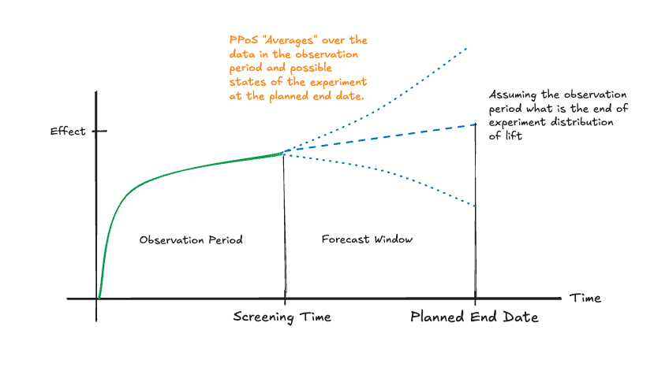
Inference Based on Predictive Probabilities

Slide 5
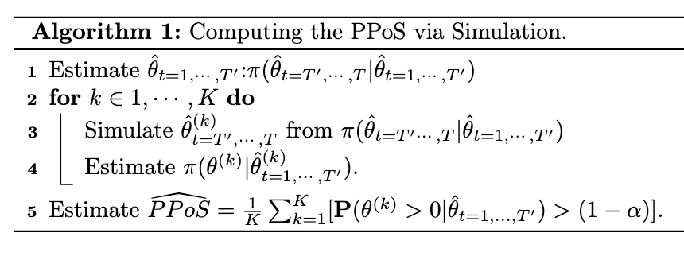
Estimation Strategy via Simulation

Slide 6
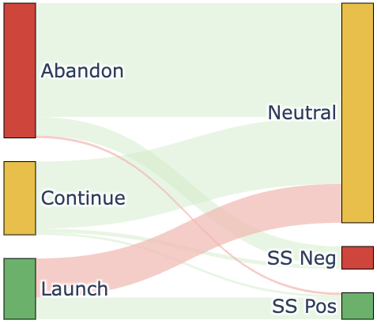
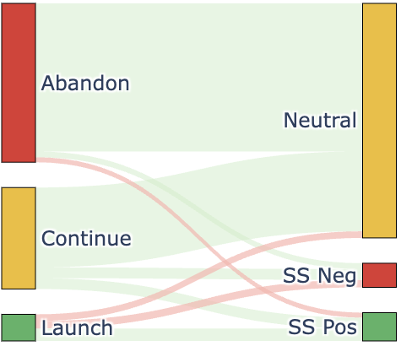
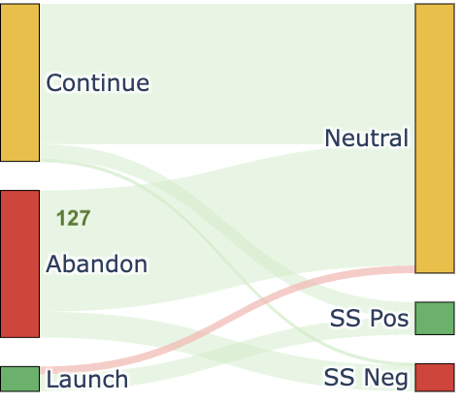
Results: Superior Performance of Predictive Probabilities
We analyze a total of 345 Experiments with interim analysis at day 7 of 14
Practical Heuristic
170 curtailments
50 false positives
28 true positives
Always Valid P-values
185 curtailments
17 false positives
15 true positives
PPoS
156 curtailments
8 false positives
18 true positives

Slide 7
Future Work: Improving Efficiency and Accuracy
Prior Elicitation
Utilize formal prior elicitation [Johnson et al., 2010] to improve expediency in decision making by means of subjective Bayesian analysis.
Handling Low Power
Handle sign and magnitude errors [Gelman and Carlin, 2014] in low power settings common in the online experimentation domain by way of using shrinkage priors.

Slide 8
Select References
J. Barajas, N. Bhamidipati, and J. G. Shanahan. Online advertising incrementality testing: practical lessons and emerging challenges. In Proceedings of the 30th ACM International Conference on Information & Knowledge Management, pages 4838–4841, 2021.
R. Berman, L. Pekelis, A. Scott, and C. Van den Bulte. P-hacking and false discovery in A/B testing, volume 10. SSRN, 2018.
A. Gelman and J. Carlin. Beyond power calculations: Assessing type s (sign) and type m (magnitude) errors. Perspectives on psychological science, 9(6):641–651, 2014.
B. R. Saville, J. T. Connor, G. D. Ayers, and J. Alvarez. The utility of bayesian predictive probabilities for interim monitoring of clinical trials. Clinical Trials, 11(4):485–493, 2014.
T. Zhou and Y. Ji. On bayesian sequential clinical trial designs. arXiv preprint arXiv:2112.09644, 2021.

