Slide 1
Breaking the Winner's Curse with Bayesian Hybrid Shrinkage
Richard Mudd, Rina Friedberg, Ilya Gorbachev, Houssam Nassif, Abbas Zaidi
Meta
CODE@MIT 2025

Slide 2
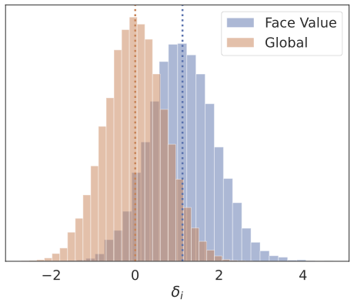
Selection & The Winner’s Curse
When the same experiments are used to both select treatments and evaluate their effects:
Standard effect estimators biased upwards
Conventional confidence intervals invalid
Practical Consequences
Bias increases as:
Sampling variance
Selection threshold increases
True effect sizes decrease

Slide 3
Bayesian Selective Inference: Model Misspecification Matters
A Paradox (Dawid’s) Classical approaches need adjustment for selection but Bayesian approaches don’t?
An Interpretation Unadjusted likelihood is often correct - sensitivity to prior is amplified by selection
A Consequence: Practical analyses need to safeguards against misspecification of the prior
Goal A parameterization that mitigates sensitivity to the choice of prior and improves robustness to assumption violations

Slide 4
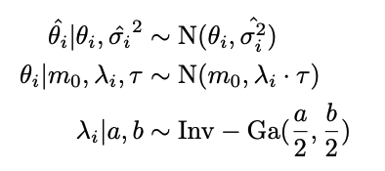


Secret Sauce: Two-Stage “Hybrid” Estimation
The Hybrid Approach is formulated as a post-hoc model:
Global scale parameter
Modulated by local shrinkage factor
Special case when local shrinkage factor fixed at 1: global shrinkage only

Slide 5
Simulating Experiments with Misspecification
Simulate cases where the model is misspecified
Evaluate in terms of Mean Squared Error, Bias, and Coverage Probability

Slide 6
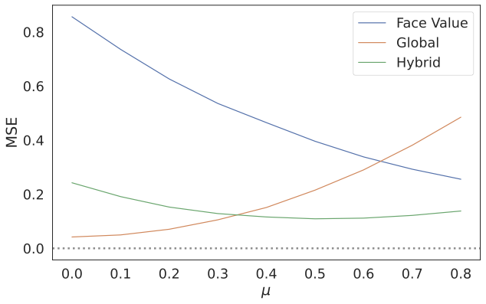
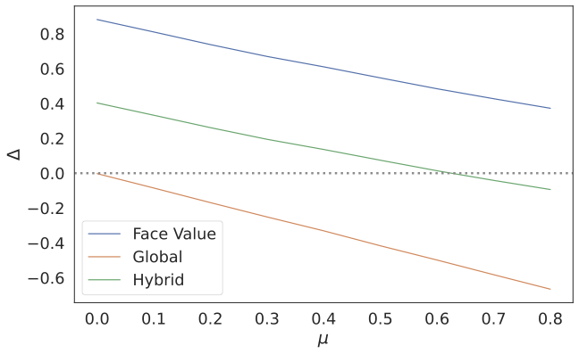
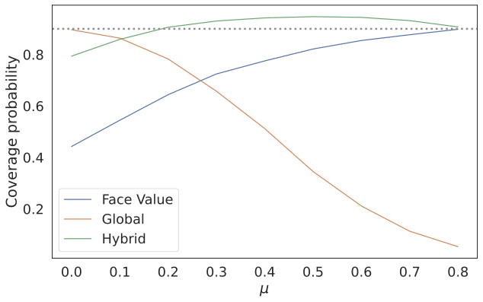

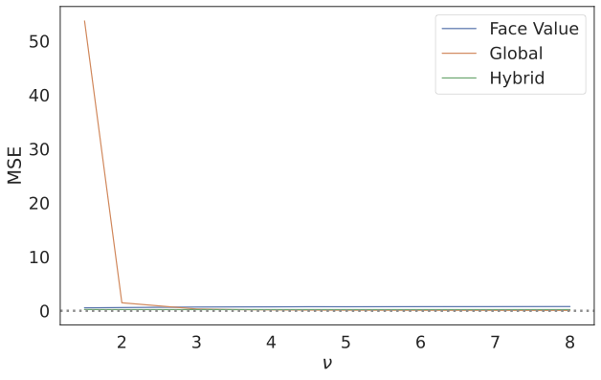
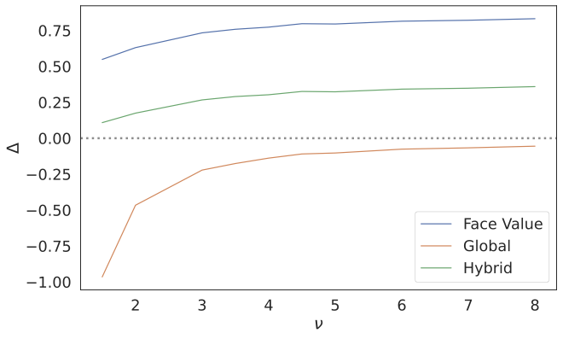
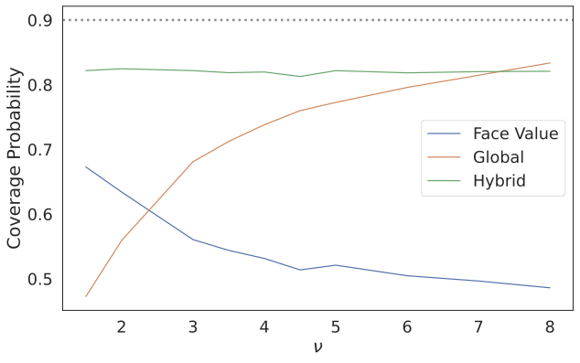

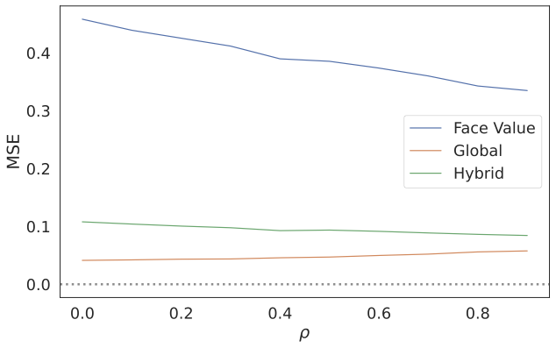
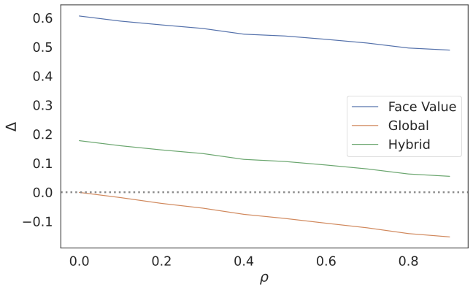
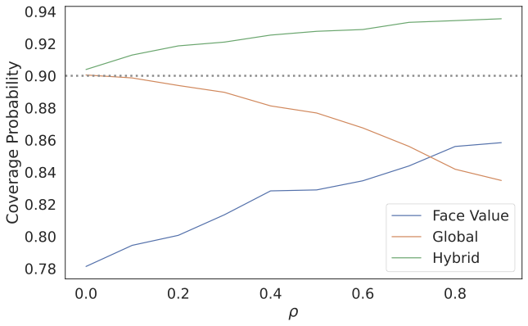

1. Prior Mean Misspecified
2. Heavy-tailed effects
3. “Hidden” Selection

Slide 7
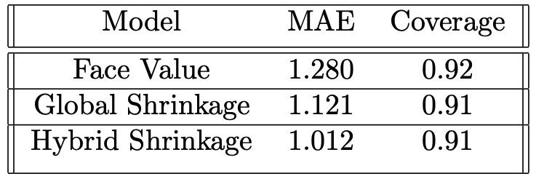
Empirical Analysis with Paired Experiments
167 real experiments evaluated against replication studies

Slide 8
Summary: Break the Curse, Hedge against Misspecification
Winner’s Curse → standard effect estimators biased upwards with invalid intervals
Appropriate choice of prior → mitigate the implications of the Winner’s curse, with effect estimates more closely aligned with the true values of targets of inference
Two-stage (‘hybrid’) shrinkage approach →
More accurate estimates of the effect with well calibrated uncertainty
Improved robustness to misspecification of the prior

Slide 9
Select References
AP Dawid. Selection paradoxes of bayesian inference. Lecture Notes-Monograph Series, pages 211–220, 1994.
Minyong R Lee and Milan Shen. Winner’s curse: Bias estimation for total effects of features in online controlled experiments. In Proceedings of the 24th ACM SIGKDD international conference on knowledge discovery & data mining, pages 491–499, 2018.
Isaiah Andrews, Toru Kitagawa, and Adam McCloskey. Inference on winners. The Quarterly Journal of Economics, 139(1):305–358, 2024
Erik W van Zwet and Eric A Cator. The significance filter, the winner’s curse and the need to shrink. Statistica Neerlandica, 75(4):437–452, 2021
Ryan Kessler. Overcoming the winner’s curse: Leveraging bayesian inference to improve estimates of the impact of features launched via a/b tests. 2024.

