Slide 1
Bayesian Meta-Prior Learning Using Empirical Bayes
Sareh Nabi
University of Washington – Microsoft Dynamics
Work started while intern at Amazon
Paper in collaboration with:
Houssam Nassif, Joseph Hong, Hamed Mamani, Guido Imbens
Notes:
Thank you X, hello everyone

Slide 2
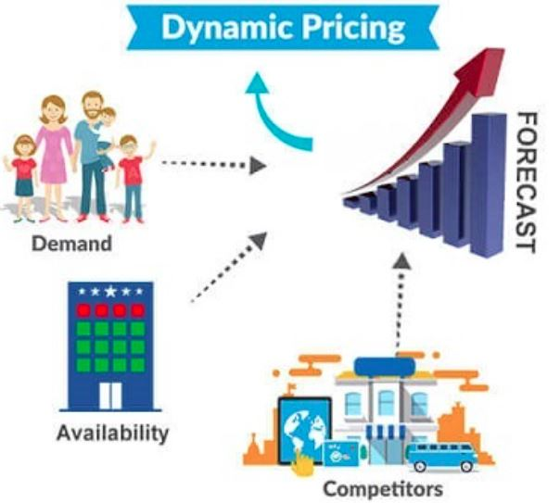
Sequential decision making under uncertainty

Slide 3
Exploration vs Exploitation Trade-off
Explore/Learn Learn more about what is good and bad
Exploit/Earn Make the best use of what we believe is good

Slide 4
Multi-armed Bandit (MAB)
Originally proposed by Robbins (1952).
Reward under arm i follows a Bernoulli dist. with unknown mean reward $µ_{i}$
Goal: Pull arm sequentially to maximize total reward.

Slide 5
MAB Algorithms …
Algorithms that solve MAB problems
Index policies: Gittin's index
Frequentist approach: Upper Confidence Bound type algs
Bayesian approach: challenge of non-informative prior

Slide 6
What we address …
Propose a framework to learn meta-prior from initial data using empirical Bayes
Decouple learning rates of model parameters by grouping similar ones in the same category and learning their meta-prior separately
Next: Overview of our meta-prior framework and its application to our ad layout optimization problem (in Amazon production system) and classification problem (on a public dataset). Lastly, review our theoretical results.

Slide 7
Biking competition
Stop biking pointlessly, join team Circle!
Year-round carousel rides!
Unlimited laps!
All you can eat Pi!
No corners to hide!
Hurry, don’t linger around!
Join now!
Check other teams
Notes:
Terrible mistake of hiring a lousy designer.

Slide 8
Multiple-slot template
Stop biking pointlessly, join team Circle!
Slot
Year-round carousel rides!
Unlimited laps!
All you can eat Pi!
No corners to hide!
Hurry, don’t linger around!
Join now!
Check other teams
Notes:
The page has multiple component slots: heading, image, textual description, and two buttons

Slide 9
Template Combinatorics: 48 layouts
Stop biking pointlessly, join team Circle!
x2
x3
Best way to bicycle!
We cycle and re-cycle!
No point in not joining!
x2
Join now!
Check other teams
x2
x2
Notes:
Exponential explosion. Total of 48 possible combinations

Slide 10
Featurization
First-order features, X¹: variant values
E.g. “image1”, “title2”, “color1”
Second-order features, X²: variant combinations/interactions
E.g. “image1 AND title2”, “image1 AND color1”
Concatenate for final feature vector representation:
X = [X¹, X²]
Notes:
First step is featurization. I will use the simplest non-contextual case, but our methods and systems extend to contextual and personalized cases. We have two categories of features:

Slide 11
Generalized Linear Models (GLM)
Assign one weight w_{i} per feature x_{i}
Let r: reward (e.g. click), g: link function
$$E\left(r | X\right)=g^{−1}(X^{⊤}W)$$
$$X^{⊤}W=w^{0}+\sum_{i}{w_{i}^{1}x_{i}^{1}+\sum_{i}{\sum_{j}{w_{ij}^{2} x_{ij}^{2}}}}$$
intercept + 1st order + 2nd order effect
Notes:
Our model is a GLM. Basically a regression within an inverse link function. In the simple linear case, g is identity and we recover simple linear regression

Slide 12
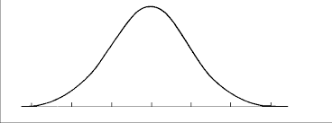
Bayesian GLM
At time t, each weight w_{i} is represented by a distribution:
$$w_{i,t} \sim N({\tilde{μ}}_{i,t}, {\tilde{σ}}_{i,t}^{2})$$
$X^{⊤}W=$
Eg: $w_{image1}∗1+{w_{image2}∗0+⋯+w}_{title3}∗0+w_{color1}∗1+⋯$
${∗x}_{1}$+
${∗x}_{2}+⋯$ =
$$w_{1}$$
$$w_{2}$$
$$∑w_{i}x_{i}$$
Notes:
A Bayesian GLM is one where the weights w are not point estimates, but rather normal distributions.

Slide 13
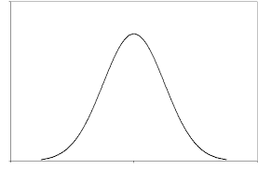
Bayesian GLM weight updates
w_{i,t} update:
Starting prior: Non-informative standard normal
$$w_{i,0}∼N(0,1)$$
Bayesian GLM bandits (Thompson Sampling):
Sample W, then ${{argmax}_{X }g^{−1}(X}^{⊤}W$)
+ data =
w_{i,t} prior
w_{i,t+1} posterior
Notes:
The update is Bayesian. At time t u have prior. + data posterior. Variance shrinks. Bandit: sample from W and take maximal X

Slide 14
Empirical Bayes Approach
Notes:
It turns out we can, using EB

Slide 15
Impose Bayesian hierarchy
Let $μ_{i}$: true mean of weight $w_{i}$
${\tilde{μ}}_{i,t}, {\tilde{σ}}_{i,t}^{2}$: GLM-estimated mean and variance of weight $w_{i}$
Critical model assumptions:
Group features into C_{k}=2 categories (1st order, 2nd order)
Each category $k$ has a hierarchical meta-prior $N(ν_{k}, τ_{k}^{2})$
True mean $μ_{i}∼N\left(ν_{k}, τ_{k}^{2}\right), ∀i∈C_{k}$
Observed mean ${\tilde{μ}}_{i,t}|μ_{i}∼N\left(μ_{i},{\tilde{σ}}_{i,t}^{2}\right), ∀i,t$
Notes:
Define: mu, mu, sigma
First, we group our features into two categories.
Impose on each grouping a meta-prior. hierarchy.
Each feature’s true mean μi is drawn from that feature’s category meta-prior
observed mean μ ̃i,t is drawn from Gaussian with true mean and observed variance

Slide 16
Model assumptions
Meta prior $μ_{i}\sim N\left(ν_{1},τ_{1}^{2}\right), ∀i∈C_{1}$
Meta prior $μ_{ij}\sim N\left(ν_{2},τ_{2}^{2}\right), ∀ij∈C_{2}$
${\tilde{μ}}_{i,t}|μ_{i}∼N\left(μ_{i},{\tilde{σ}}_{i,t}^{2}\right), ∀i,t$ ${\tilde{μ}}_{ij,t}|μ_{ij}∼N\left(μ_{ij},{\tilde{σ}}_{ij,t}^{2}\right), ∀i,j,t$
$μ_{1}, μ_{2}$,
…
$μ_{1,2}, μ_{1,3}$, …
Empirical prior helps, eve with one batch

Slide 17
Empirical prior estimation
Using variance decomposition & our assumptions:
$$τ_{k}^{2} = V\left[{\tilde{μ}}_{i}\right] − E[{\tilde{σ}}_{i}^{2}]$$
Substituting empirical mean and variance estimators,
$${\hat{τ}}_{k}^{2}=\frac{\sum_{i∈C_{k}}{{\left({\tilde{μ}}_{i}−{\hat{ν}}_{k}\right)}^{2}}}{N_{k}−1}−\frac{\sum_{i∈C_{k}}{{\tilde{σ}}_{i}^{2}}}{N_{k}}; {\hat{ν}}_{k}= \frac{\sum_{i∈C_{k}}{{\tilde{μ}}_{i}}}{N_{k}}$$

Slide 18
Empirical Bayes (EB) algorithm
Start Bayesian GLM with non-informative prior $N(0,1)$
After time t, compute $ν_{k}, τ_{k}$ for each category
Restart model with per-category empirical priors $N(ν_{k},τ_{k}^{2})$
Retrain using data from elapsed t timesteps
Continue using GLM as normal
Algorithm used the same data twice, to compute the empirical prior and to train the model
Works with online or batch settings
Notes:
U bootsrap yourself.

Slide 19
Experiments and Results

Slide 20
Experimental setup
Used Bayesian Linear Probit (BLIP) as our Bayesian GLM
Grouped features as 1st and 2nd order features
batch updates
Simulations on classification task (UCI income prediction)
Live experiments in Amazon production system
$ν_{k}$ had little effect, we focus on $τ_{k}$

Slide 21
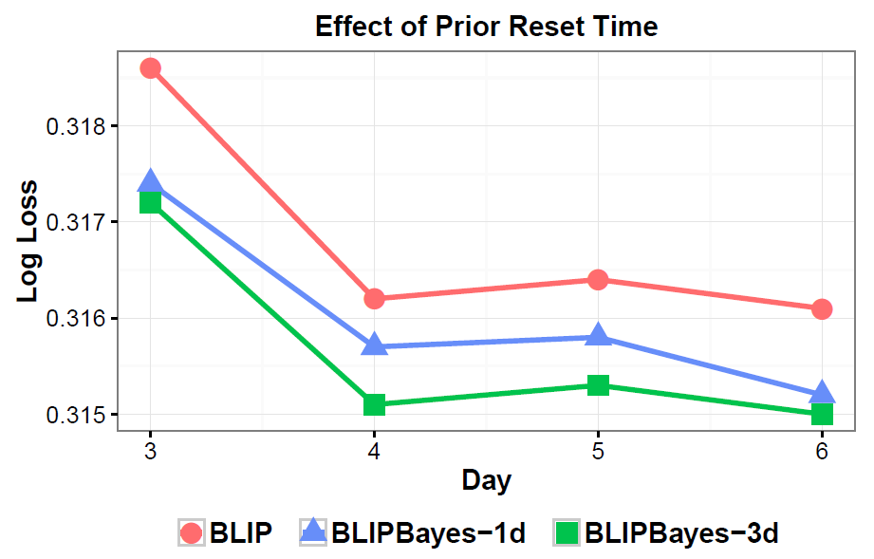
When to compute empirical prior
Empirical prior helps, even with one batch
Longer reset time helps more
Notes:
Compute EB prior after 0, 1, 3 batches. Lower is better.

Slide 22
Lasting effect on small batches
BLIPBayes outperforms both other methods
BLIPBayes can be especially valuable for small batch training
Notes:
overfitting

Slide 23
Empirical $τ$ outperforms random $τ$
Empirical Bayes did best
Erring towards a large prior variance is more easily overcome by data than erring towards a small prior variance
Notes:
Could it be that smaller Tau just works? Tried different taus, blip did better. EB did best.

Slide 24
Live experiment
BLIP with Empirical Bayes meta-prior has higher success rate & converges faster
Notes:
Live experiment, on Prime acquisition ads. No loss to compute. Y is success rate, higher is better. EB converges faster (time unit 5 vs 8), and is more stable.

Slide 25
Theoretical Results
Unbiasedness property of meta-prior variance estimator:
$E\left[{\hat{τ}}_{k}^{2}\right]=$ $τ_{k}^{2}$- $\frac{1}{N_{k} (N_{k}−1)}$ $\sum_{\begin{aligned}i,j∈C_{k} \\ i≠j\end{aligned}}{Cov({\tilde{μ}}_{i},{\tilde{μ}}_{j})}$
Our meta-prior variance estimator is strongly consistent when:
Feature estimates ${\tilde{μ}}_{i}$ and their observed variances ${\tilde{σ}}_{i}^{2}$ are independent
Expectation and variance exist for ${\tilde{μ}}_{i}$,${ \tilde{μ}}_{i}^{2}$, and ${\tilde{σ}}_{i}^{2}$.
Cumulative regret of our EB TS bandit is of order $\tilde{O}(d^{\frac{3}{2}} \sqrt{T})$

Slide 26
Takeaways
Empirical Bayes prior helps, mostly on low/medium traffic
Promising, as low traffic cases are harder to optimize
Effectively decouples learning rates by imposing a Bayesian hierarchy and learning meta-prior per category of features
Model converges faster with Empirical Bayes’ meta-prior
Works for any feature grouping in a Bayesian setting
Applies to contextual and personalization use cases

Slide 27
Paper is on arXiv: arxiv.org/abs/2002.01129
Slides available on my website.
Feel free to reach out:
Website: www.sarehnabi.com
LinkedIn: www.linkedin.com/in/sarehnabi
Twitter: twitter.com/SarehNabi
Thank you!
Any Questions? Comments?
Notes:
If you want to help, we would love to talk to you.
With this I am ready for questions

