Slide 1





Adaptive Experimentation and Counterfactual Inference
Consequences Workshop at Recsys 2022
Amazon Prime
** University of Washington
Tanner Fiez*
Sergio Gamez*
Arick Chen*
Houssam Nassif*
Lalit Jain**
Notes:
Thank you for having me here. Today I will be talking about some work at amazon with my esteemed colleagues, and my goal is not as much to provide solutions, but rather to raise some questions that arose as the result of running many experiments at Amazon Prime.

Slide 2

Case Study
T1
T2
….
Marketer is testing up to 10 different messages
Will run an experiment for two to three weeks
Wants to know the best performing message
Notes:
Ok, so here is a real life example of the setting I’ll consider in this talk
A marketer has several different potential messages that they can show, generally less than 10
They decide to run an experiment over these messages

Slide 3
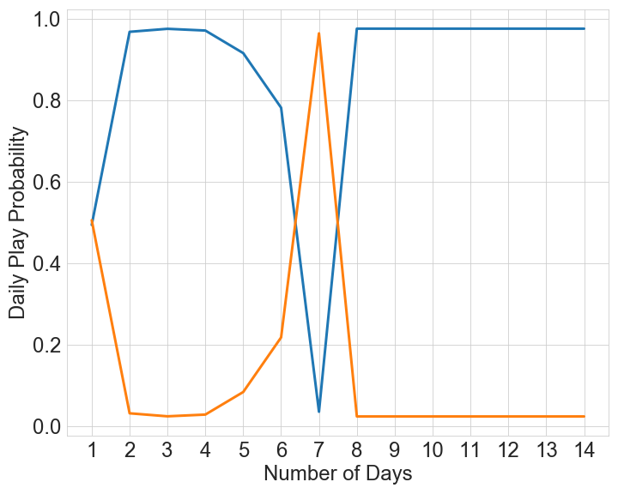
Case Study
Daily Traffic Split
Experiment Overview
Regret-minimizing algorithm allocating traffic in content optimization A/B experiment
Runs an experiment for 3 weeks
Bandit is convinced arm A is better…but a t-test leads an insignificant result
Marketer decides to trust the bandit, and
Notes:
Hoping to save potentially lost conversions, they run a Thompson sampling algorithm based experiment. After two weeks they look at the dashboard and see something like this plot on the LHS.
From looking at the traffic allocation, they are fairl convinced that message A is the best, indeed Thompson sampling is giving it all the traffic.
As you can see, the Thompson sampling algorithm is rather aggressive – but by day 8 seems to have moved into a world where it believes that message 1 is where to place its full traffic allocation.

Slide 4
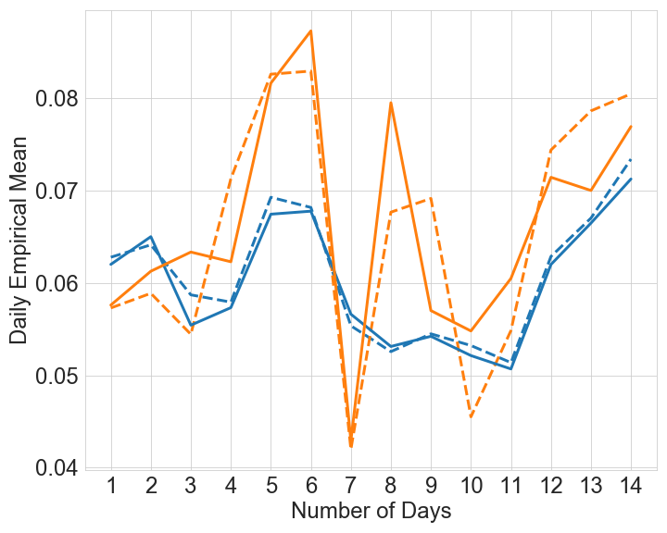
Case Study
Daily Traffic Split
Daily Message Means
Experiment Overview
Regret-minimizing algorithm allocation traffic in content optimization A/B experiment
Bandit is convinced arm A is better…but a t-test leads an insignificant result
Experimenter looks at means a few days later…and is convinced the algorithm is broken.
Intuitively Arm A does not seem correct.
Notes:
Hoping to save potentially lost conversions, they run a Thompson sampling algorithm based experiment. After two weeks they look at the dashboard and see something like this plot on the LHS.
From looking at the traffic allocation, they are fairl convinced that message A is the best, indeed Thompson sampling is giving it all the traffic.
In the left hand plot you can see the daily traffic allocation, and on the right hand side, I have plotted the daily true means, and our daily empirical estimates (not running).
As you can see, the Thompson sampling algorithm is rather aggressive – but by day 8 seems to have moved into a world where it believes that message 1 is where to place its full traffic allocation.

Slide 5
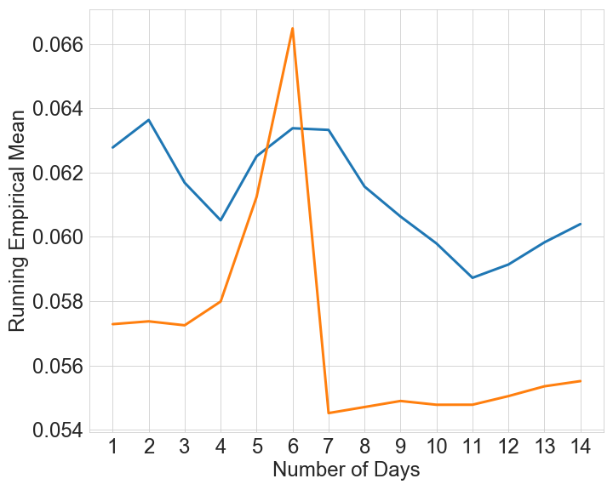
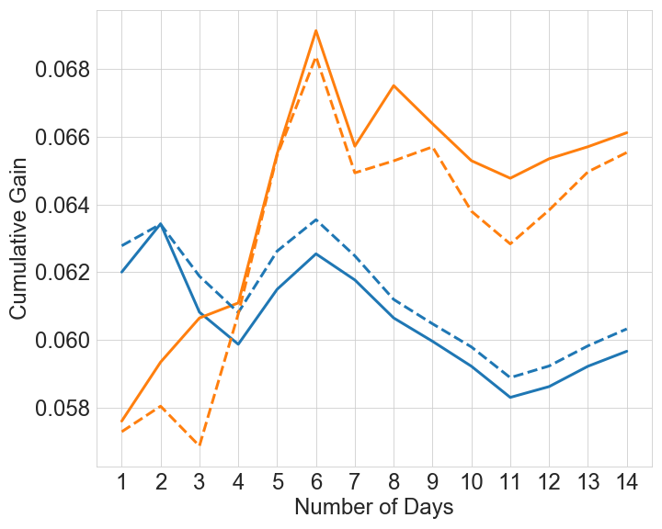
Case Study
Daily Traffic Split
Daily Means
Experiment Overview
Empirical means are misleading!
Example of Simpson’s Paradox
Cumulative gain* metric fixes bias introduced by traffic split & time-variation
Intuitively measure the performance of an arm by the counterfactual: how much reward it would gain if it received all the traffic.
Running Empirical Mean
Normalized Cumulative Gain
*Best of both worlds: Stochastc & adversarial best-arm identification Abbasi-Yadkori, Bartlett, Gabillon, Malek, Valko COLT ‘18
Notes:
So what happened in this experiment? We can gain some insight if we take a closer look at the running empirical means.
Interestingly, the running empirical mean also reflects the conclusion of the Bandit – indeed that the arm 2 should be better. This phenomenon is commonly known as Simpsons paradox.
However, and this is part of the point of the talk, there is a better quantity that we could measure that in fact is far more immune to the time variation – known as the cumulative gain – intuitively speaking, the cumulative gain is the answer to the counterfactual – how much reward would an arm have if it had received all the traffic.
If you look at the daily means you will notice that if we were to have given all our traffic to message B instead of message A, we would maybe have made a more reasonable intuitive decision
Now at Prime, I work with a team that deploys Thompson sampling algorithms for long-term experiments. And we realized that this setting described above was happening over and over again.
On the right we show the CG for both messages, the true quantity and an empirical estimate, and indeed if a decision had been made from the CG, we see that the

Slide 6
Lessons Learned: Regret Minimization isn’t Enough
Goal of experimentation is not just informing the current decision, but more importantly the next decision!
Critical to provide content creators feedback on what worked, and what didn’t.
But Traditional Bandit algorithms do not have sufficient power, and (in the short run) can introduce biases that are challenging to overcome.
Oftentimes you may have system shocks (Prime Day), non-informative features.
Insights Generation
Content Development/Experimentation Setup
Experimentation
Best arm identification in multi-armed bandits. Audibert, Bubeck, Munos COLT ‘10
Notes:
From these examples we learned several lessons. Firstly, Regret minimization is rarely enough. I think there is often an interesting tension between the goals of the business and the goals of those running experiments. The business is interested in maximizing their cumulative reward, but an individual marketer is maybe taking more of an RL style approach – they want to run this experiment to learn something that informs their current decision, and maybe more importantly what content to generate next.
No ` ASSDDEXSXDZA
Decisions are rarely the evergreen setting of set and forget. In reality,
Highlight – this is not an evergreen setting of set and forget. People will run more experiments.

Slide 7
Lessons Learned: Identify the Counterfactual Best
Empirical mean in time varying settings is a poorly interpretable quantity - Simpson’s paradox is the norm, not the exception.
Cumulative Gain: Identify the counterfactual best, i.e. the arm with the highest total reward over experimentation period*
Similar to best arm/policy identification
Easy to understand, does not depend on any choices, and can easily estimate/make inferences (IPS)
Best-arm identification in time-varying settings is poorly defined and less well-studied
Empirical Means
Cumulative Gain
*Best of both worlds: Stochastic & adversarial best-arm identification Abbasi-Yadkori, Bartlett, Gabillon, Malek, Valko COLT ‘18
Notes:
As discussed before

Slide 8
Lessons Learned: Be Wary of the Batch
Experimentation systems tend to do model updates in batches
In our example, updates were daily – allowing TS to get overly confident
But batch updates could be forced – data drops, downstream outages
Daily Traffic Split
Daily Message Means
Notes:
Part of what caused our problem was the impact of batch updating. For the first few days, it indeed seems that arm 1 is better than arm 2, and so Thompson sampling rather aggressively placed all its traffic on arm 1. These initial large batches swayed the algorithm causing it to perform poorly on later days.

Slide 9
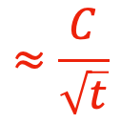
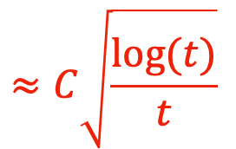
Lessons Learned: Provide Always Valid Inference
Dashboards should report daily means, and allow experimenters insights into non-stationarity.
Bayesian metrics, i.e. posterior probability, are highly model dependent and can be biased – inflating Type 1 error
Always-Valid confidence intervals* provide for sequential monitoring for ANY adaptive procedure.
Traditional CI
Always-Valid CI
$$≈C\sqrt{\frac{log(t)}{t}}$$
$$≈\frac{C}{\sqrt{t}}$$
Time-uniform, nonparametric, nonasymptotic confidence sequences. Howard, Ramdas, McAuliffe, Sekhon 2021
Notes:
In general dashboards should report daily arm performances allowing experimenters to get insights into potential non-stationarity and for them to have inference. In general if something on a dashboard, it will probably be employed so statistis that are reported should be robust and error prone. One way that we have handled this is by reporting always valid confidence intervals on our dashboards. These intervals tend to be slightly larger than traditional confidence intervals, but can be sequentially monitored.
In practice these may be seem too large if you are using them after the fact for evaluation, however they are critical to use if you are actively monitoring your experiment.

Slide 10
Our Goal: Best of Three Worlds
Minimize Opportunity Cost of Experiments
Identify the Counterfactual Best
Mostly Model Agnostic
Open Question – is there an algorithm that performs well on all three in reasonable settings?
Our Very First Attempt: Elimination on the Cumulative Gain
Notes:
Model Agnostic – We can’t always trust our features, maybe context isn’t useful
Identify the Counterfactual Best – It’s a well defined quantity that is easily interpretable and immune to Simpsons paradox
Minimize Opportunity Cost – We can always do AB Testing, but it would be nice if we can do a bit better
In general you can’t hope to do well in all three cases simultaneously – there are sequences of rewards which are extremely adversarial. But real-life data is somewhere between fully stochastic and full worst case. So my question is, are there algorithms that perform reasonably well on lal three of these objectives in reasonable settings?
I don’t have an answer to this question, but at Prime it’s been an issue that affects us. So for the rest of the talk, I will quickly describe the adaptive experimental design method that we have adopted for short term experiments.

Slide 11
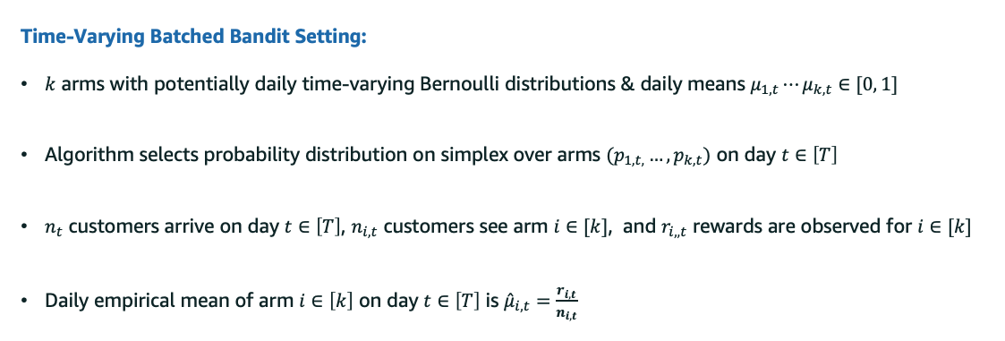
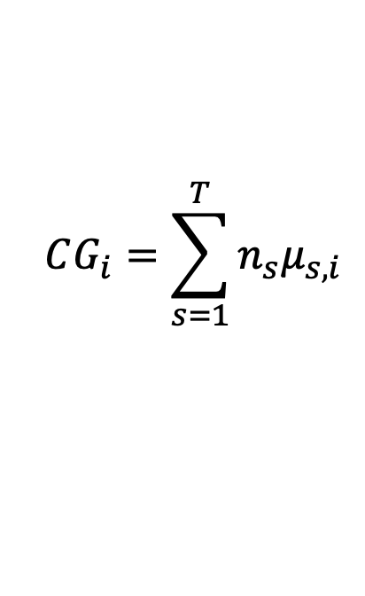
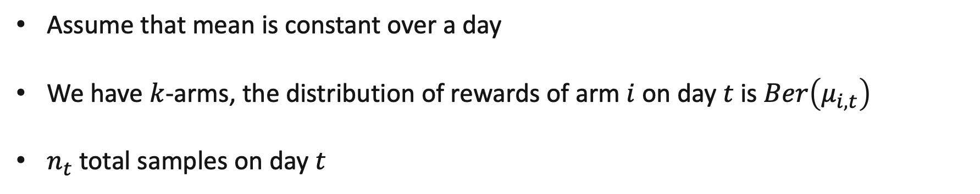
Cumulative Gain
Assume that mean is constant over a day
We have $k$-arms, the distribution of rewards of arm $i$ on day $t$ is $Ber\left(μ_{i,t}\right)$
$n_{t}$ total samples on day $t$
Cumulative Gain
$$CG_{i}=\sum_{s=1}^{T}{n_{s}μ_{s,i}}$$
Notes:
Firstly, let me mathematically define our framework. We will assume that we have k arms, each one a Bernoulli distribution and on any given day the mean of an arm will be fixed - though the means can change every day. The period of time is not critical – instead of a day, it could be an hour or even a week.
Each day we assume that we assume a total traffic of n_t. Then the cumulative gain is the expected reward if the arm received all the traffic, which is naturally given by a sum over days, the amount of traffic each day times the expected conversion rate of the arm on that day

Slide 12
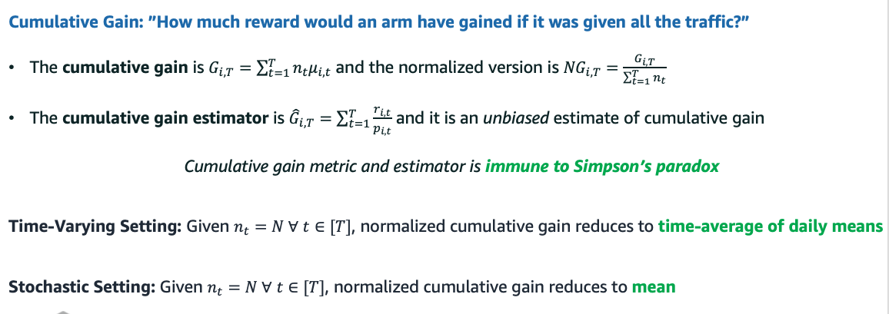
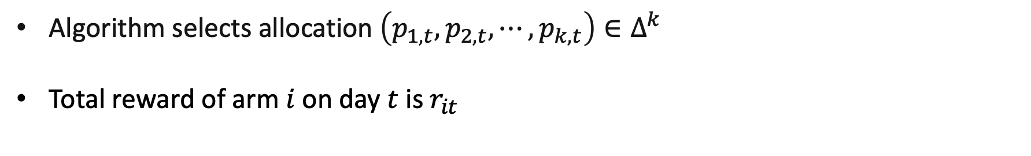
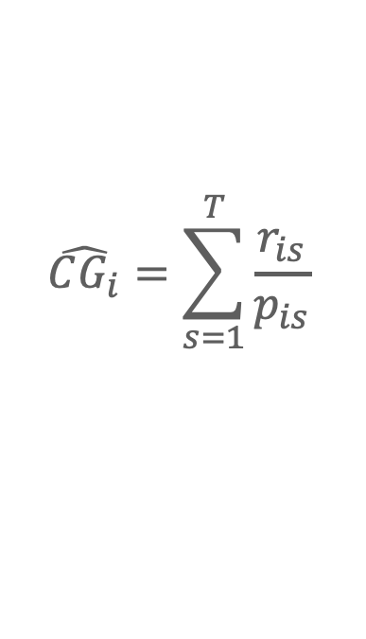
Our Approach: Cumulative Gain Estimator
Algorithm selects allocation $\left(p_{1,t}, p_{2,t},⋯, p_{k,t}\right)∈Δ^{k}$
Total reward of arm $i$ on day $t$is $r_{it}$
IPS Estimator
$$\hat{CG_{i}}=\sum_{s=1}^{T}{\frac{r_{is}}{p_{is}}}$$
Always Valid Confidence Interval: Exists a function $C_{i,t}(δ)$such that
Notes:
Again, assuming a batch setting, the probability that arm I is shown to a user on day t is p_it. Denoting the total reward for arm I on day t by r_it, we define the IPS estimator for the cumulative gain as follows. In addition, we assume access to an always valid confidence interval on this quantity – the always valid confidence interval is immune to peaking and basically guarantees that it never
This estimator is naturally estimated. If the proba of the

Slide 13
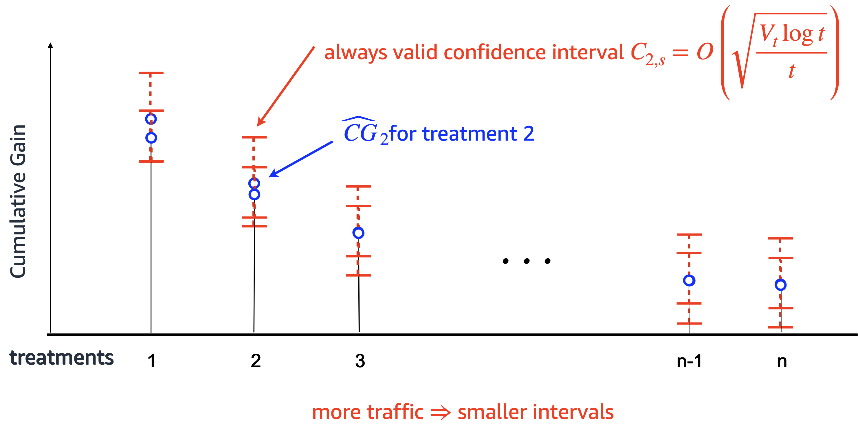
Quantifying Uncertainty
Notes:
Now, to visualize our solution, we consider the following schematic. On each day, we can plot the empirical cumulative gain of each arm, and naturally, as the amount of traffic goes up on an arm, we should expect this confidence interval to shrink.

Slide 14
Traditional A/B/n Testing
collecting samples uniformly
1
2
3
n-1
n
until there is a statistically significant winner
1
2
3
n-1
n
Notes:
In traditional AB testing, we basically experiment until there is one arm whose lower confidence bound dominates the upper confidence bound of every other arm. This is a significant winner. However, if you look at arms that are sub-optimal we have overestimated their cumulative gains. In general, this is not a problem in AB testing, but if you have more than 2 arms it could be extremely wasteful.

Slide 15
Elimination: Adaptive Selection of Treatments
But: we can stop showing treatments with upper confidence bounds that are less than the greatest lower confidence bound
x
x
x
1
2
3
n-1
n
adaptive sampling finds the top treatments with fewer samples
Notes:
To get around this, we introduce a very simple heuristic – namely remove arms as soon as you know they are dominated by another arm. Because you are using always valid confidence intervals, this approach does not face the issues of p-hacking that traditional peeking in AB testing faces. This focuses sampling on the best arms.

Slide 16
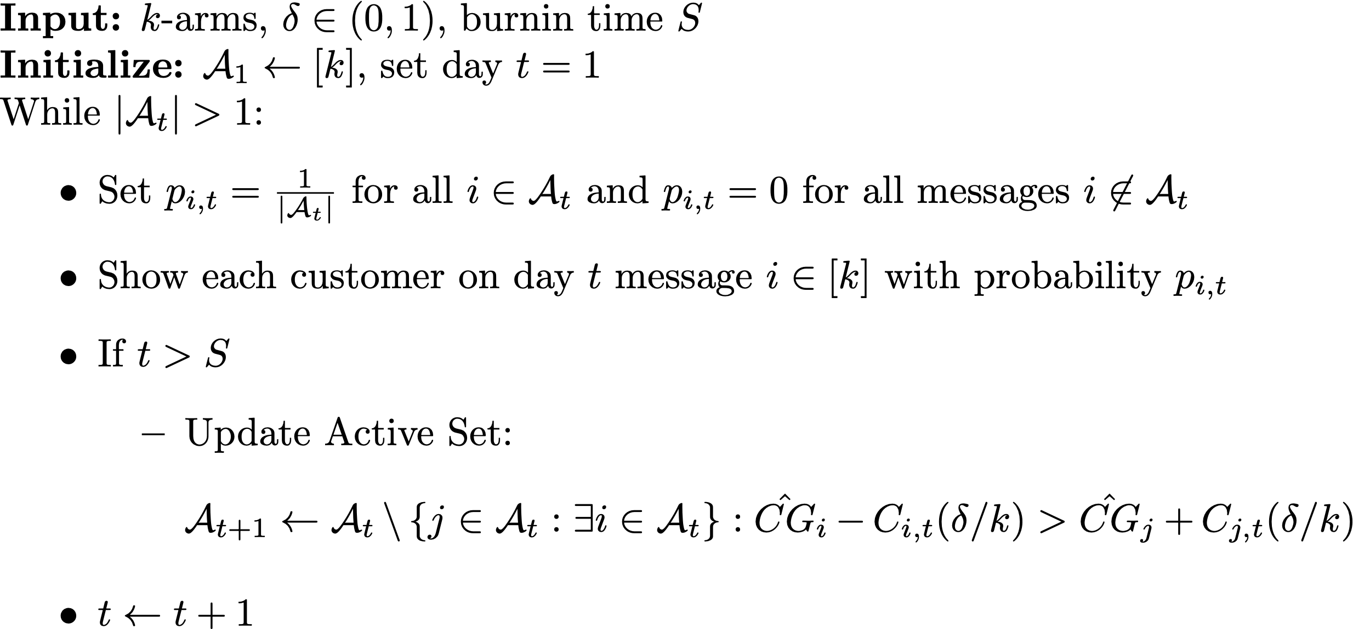
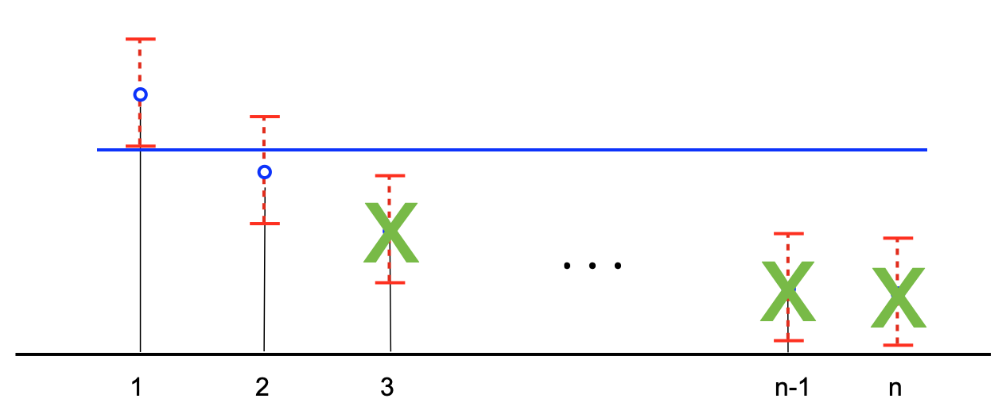
IPS Elimination on Cumulative Gain
Uniform allocation over active set with elimination of significantly suboptimal arms
Simple algorithm to implement, track, and desirable performance guarantees
Notes:
Here is the Successive elimination algorithm

Slide 17
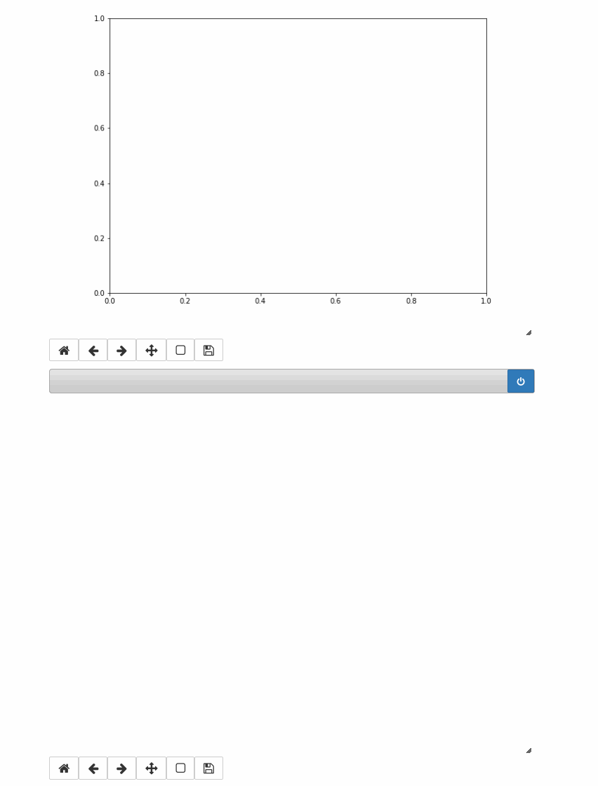

Slide 18
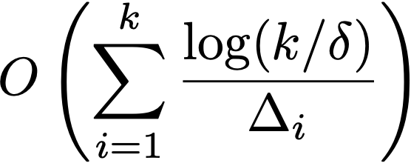

IPS Elimination: Pros
Stochastic Setting: $μ_{i,t}=μ_{i,t+1}$
  Near-optimal regret in high probability
  Near-optimal fixed confidence identification time
Non-Stationary Setting: When arm is eliminated its cumulative gain is significantly worse than some other arm
  If there is a constant (non time-varying) gap between any two arms, will return arm with highest mean in optimal sample complexity.
  $μ_{it}−μ_{jt}=Δ_{ij}$
Notes:
The pros of this IPS based elimination is that up to stochastic settings, i.e. if the mean is the same each day we match existing optimal rates for best arm identification and optimal regret within a constant factor.
In non-stationary settings, it’s hard to make precise claims on what the algorithm is doing. two important settings in which it is optimal is if there is an arm that is correct each day, and secondly when the gap between any two arms is constant each day.

Slide 19
Successive Elimination: Negatives
Non-Stationary Setting: When arm is eliminated its cumulative gain is significantly worse than some arm
  Aggressive approach by eliminating, but empirical evidence suggests this is reasonable
Arm B
Arm A
Cumulative Gain
Eliminated
Notes:
Of course there is a glaring issue with this approach - there is the possibility that an arm could be eliminated too early. However in practice, based on data from many AB tests, we find this to be a rare occurrence.

Slide 20
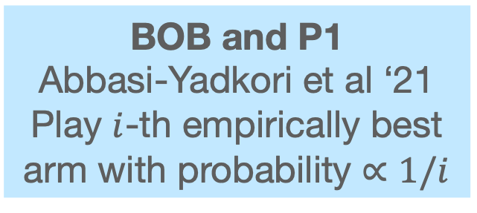
Successive Elimination: Comparisons
Thompson Sampling and Variants
Rate-optimal in stochastic case
Can fail with time-variation
Elimination
Rate-optimal in stochastic case
Does something reasonable in adversarial settings.
BOB and P1
Abbasi-Yadkori et al ‘21
Play $i$-th empirically best arm with probability $∝1/i$
Is there a Goldilocks algorithm out there?
Rate-optimal in adversarial case, reasonable in stochastic
Notes:
To put this work in context, we mention two other lines of work. On one end is the top-two methods, and other luch style algorithms for pure-exploration which is optimal in the stochastic setting but may do poorly in stochastic settings. On the other end we have the BOB P1 algorithm of Abbasi-Yadkori et al. Their algorithm plays the i-th highest empirical mean with probability proportional to 1/i. Their algorithm is rate-optimal in the adversarial setting and has reasonable performance guarantees in the stochastic setting – but tends to be conservative in practice.e
Finally I just want to mention that we have strong guarantees in the setting of regret minimization, but there are many open questions for best-arm identification.

Slide 21
Simulation Setup
Logged past experiment
Experiment repeated 100 times
Daily batch size of 10k
Stopping criterion for each algorithm based on cumulative gain anytime confidence intervals
Notes:
Finally we have a quick experiment.

Slide 22
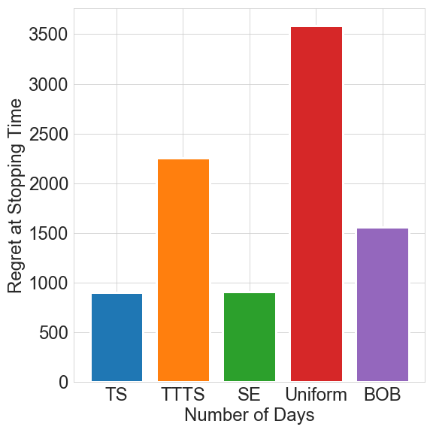
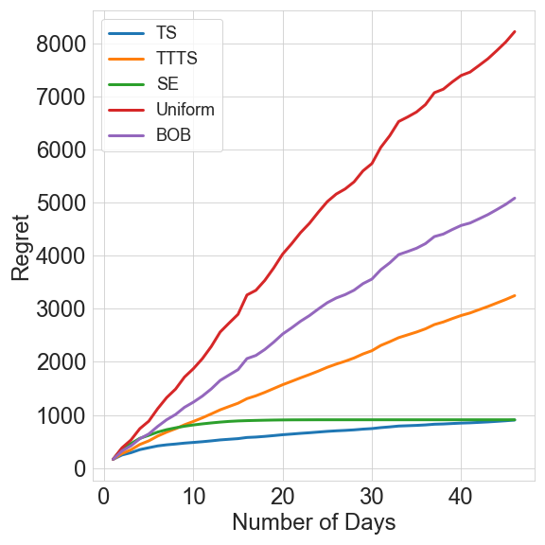
Experiment Results
Elimination obtains significance quickly, is robust to time-variation, and has low experiment cost
Stopping Times
Regret at Stopping
Regret
BOB: Play i-th empirically best arm with probability $∝1/i$
*Best of both worlds: Stochastic & adversarial best-arm identification Abbasi-Yadkori, Bartlett, Gabillon, Malek, Valko COLT ‘18
Notes:
In general elimination did well, and did not incur a large amount of regret as well. A

Slide 23
Summary & Conclusion
Goal is best of three worlds: being agnostic to models, identifying the counterfactual best, and doing so in a way that minimizes opportunity cost.
Elimination algorithm with always-valid confidence intervals for fast, robust, & low cost experimentation
Open Question: Can we do better?

Slide 24
Case Study
  Be wary of the batch – early decisions have large later impacts
  Regret minimization isn’t enough – decision making is a feedback cycle, the decision I make today impacts content I produce tomorrow, Fixed budget doesn’t make sense when traffic varies so much daily
  Identify the counterfactual best – it’s a well defined object
  Always Valid Inference – “using the posterior probability is dangerous”, people are going to monitor, if it’s on a dashboard, they will use it
Goal: Best of Three Worlds: be model agnostic (i.e. even contextual settings may not be right), identification of counterfactual best, regret minimization
Our very elementary approach based on this.
  PROS – robust in stochastic settings, within a factor of 2 of optimal regret, captures a constant difference model, it’s a horse race, will do the right thing in many practical settings
  CONS – What if something comes back?
Where do we go from here: Top-two robust to time variation
We have been doing this for a couple years, what we do is robust in practice, interpretable, and gives better decisions/you know whats better.
Notes:
Look at Russo

Slide 25
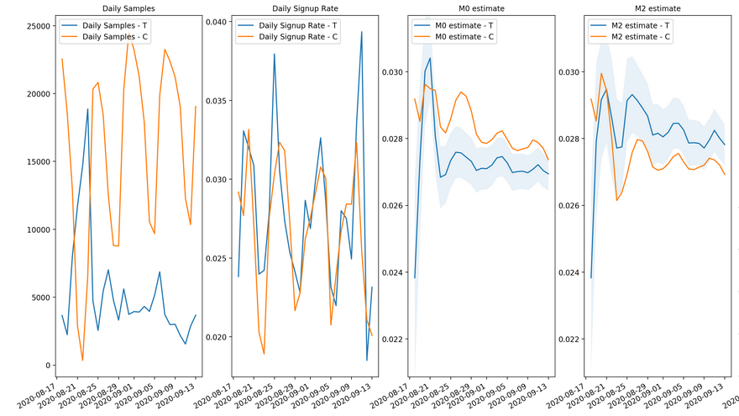
POC example
Current KPI
Proposed KPI
Daily samples
Daily signup rate
Success rate
Cumulative gain
Notes:
This problem is not going away. Not reflected in rate

Slide 26
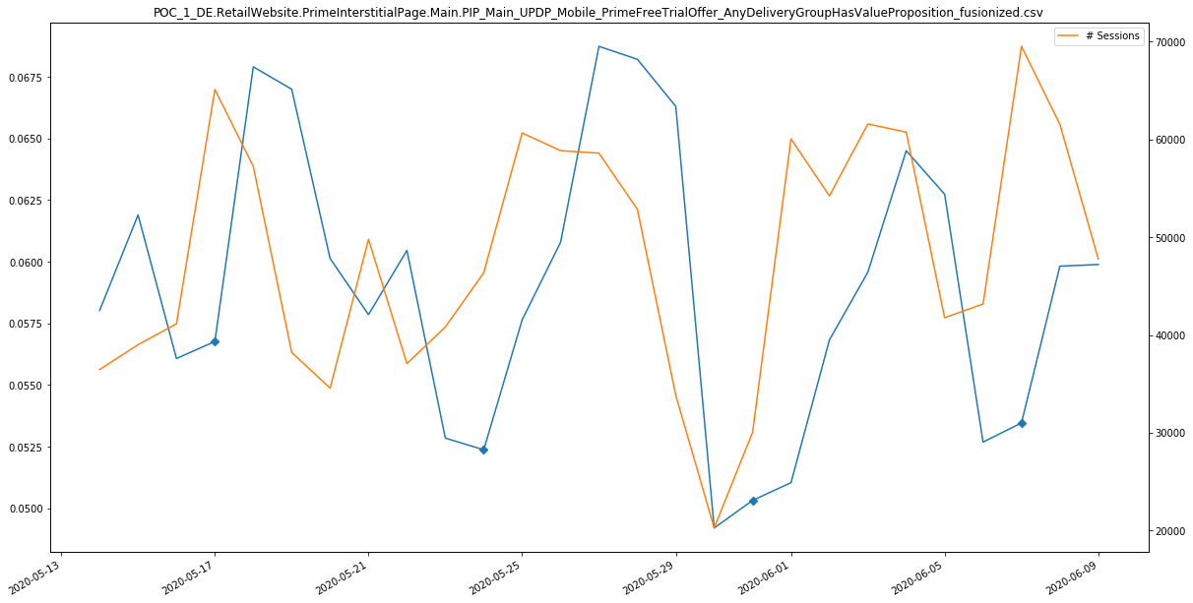
Seasonal fluctuations
Daily signup rate

Slide 27
Example

Slide 28
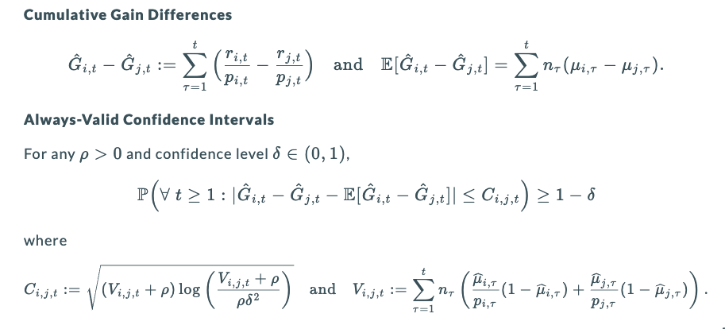
Always Valid Confidence Intervals For Decision-Making

Slide 29
Our Approach: Cumulative Gain

Slide 30
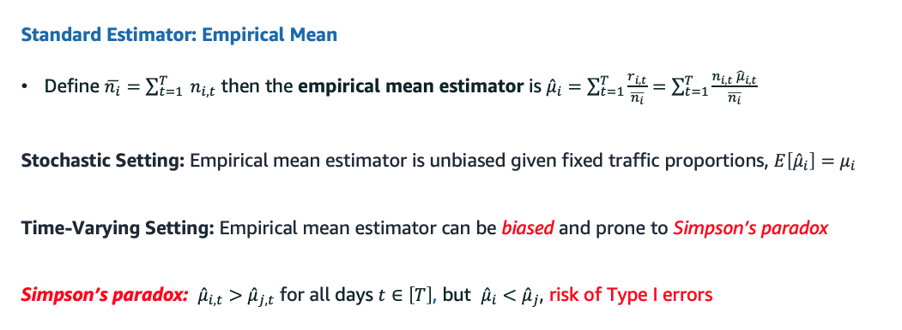
Empirical Mean Estimator

Slide 31
Case Study
Daily Traffic Split
Daily Message Means
Experiment Overview
Regret-minimizing algorithm allocation traffic in A/B experiment
Time-variation in message means
Algorithm gives majority of traffic to message with lower mean on majority of days. Why?
Notes:
Orange is better on almost all days, but it gets almost all of its traffic on the 2 days which it is worse which makes thompson sampling think it is bad

Slide 32
Robust Estimation: Cumulative Gain

Slide 33
Talk Overview
Background on Experimentation Methods at Amazon
Motivation Based on Historical Experimentation Process
Overview of Anduril Methods & Results

Slide 34
Background on Experimentation Methods at Amazon

Slide 35
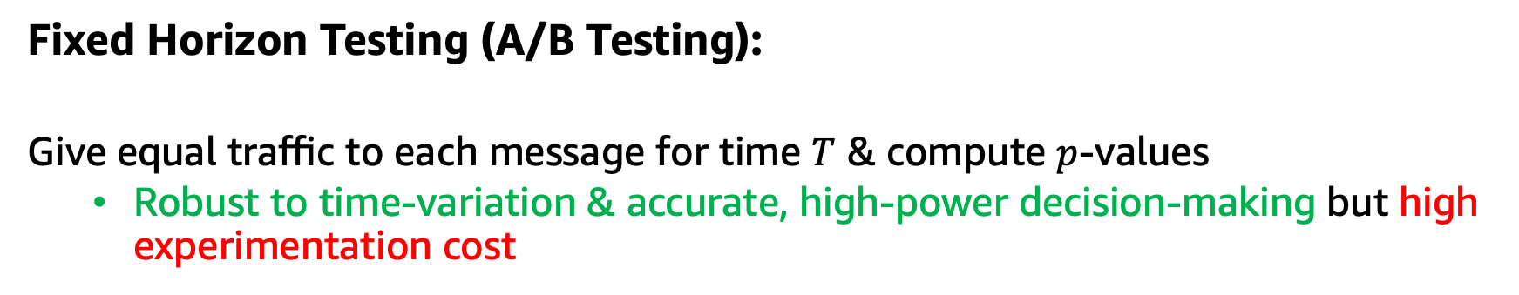
Experimentation at Amazon
Fixed Horizon Testing (A/B Testing):
Give equal traffic to each message for time $T$ & compute $p$-values
  Robust to time-variation & accurate, high-power decision-making but high experimentation cost
Regret Minimizing Bandits:
Dynamic allocations to progressively give more traffic to best treatments
  Minimal experimentation cost but suboptimal for identification & sensitive to time-variation

Slide 36
A/B Testing: WebLab at Amazon
Control
Treatment

Slide 37



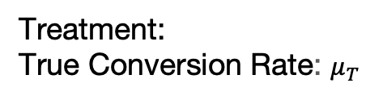
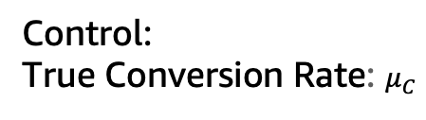
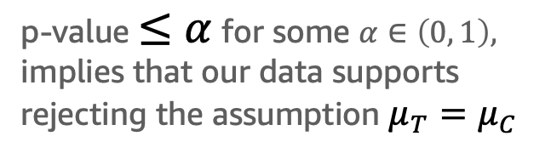
WebLab: Fixed Horizon Experimentation
Control:
True Conversion Rate: $μ_{C}$
After a fixed amount of time or observations compute p-value from statistical test
Treatment:
True Conversion Rate: $μ_{T}$
Significance:
p-value $≤α$ for some $α∈\left(0, 1\right),$ implies that our data supports rejecting the assumption $μ_{T}=μ_{C}$
Notes:
Typically choose time based on desired power or effect size that you are interested in.

Slide 38
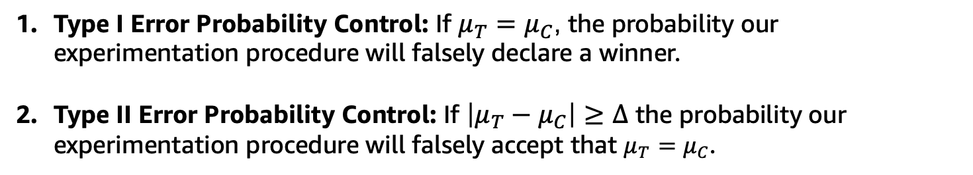
Guarantees of A/B Testing
A/B Testing: WebLab at Amazon
Type I Error Probability Control: If $μ_{T}=μ_{C}$, the probability our experimentation procedure will falsely declare a winner.
Type II Error Probability Control: If $\left|μ_{T}−μ_{C}\right|≥Δ$ the probability our experimentation procedure will falsely accept that $μ_{T}=μ_{C}$.
Key Drawbacks of Fixed Horizon Testing
There is opportunity cost to waiting for an experiment duration.
If the experiment is not significant after the duration, it is tempting to continue
Notes:
Making experimental decisions by sequentially monitoring p-values is commonly known as p-hacking.
At an individual and organization level, this can lead to inferences that are not robustly supported by data. There may not be an effect, but we will declare one.
No early stopping
What to do with a flat result
There is a opportunity cost to waiting for an experiment duration.
If the experiment is not significant after the duration, it is tempting to continue.

Slide 39
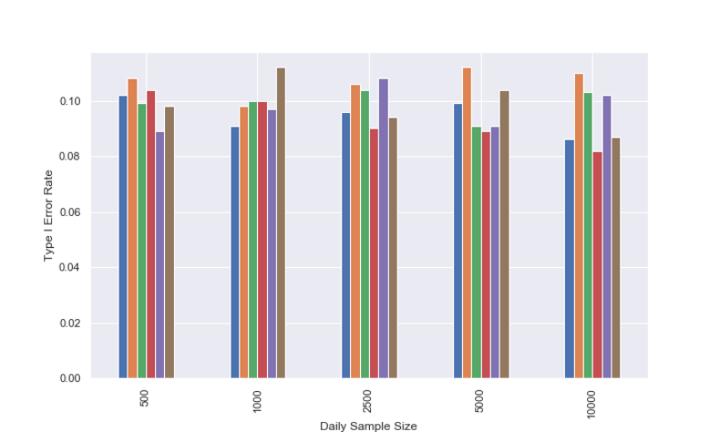
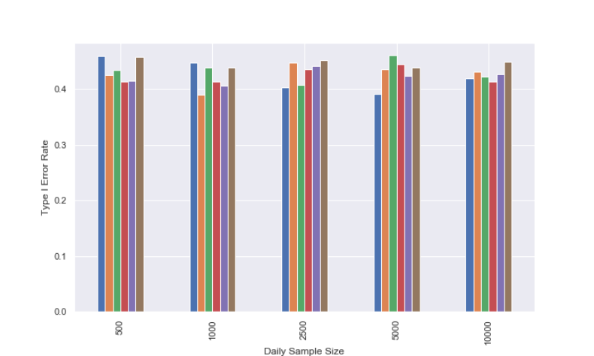
Risks of Peeking at A/B Testing Results
A/A Tests: Sequential Monitoring Drastically Inflates Type I Error Rates
Fixed Horizon
Sequential Monitoring
Desired Type I Error Rate

Slide 40
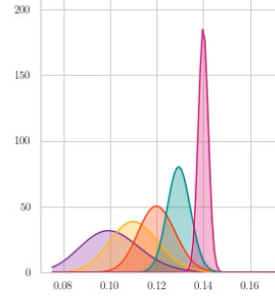
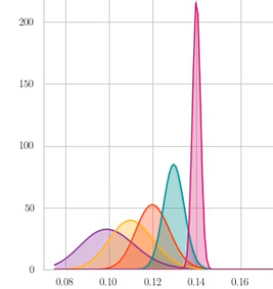
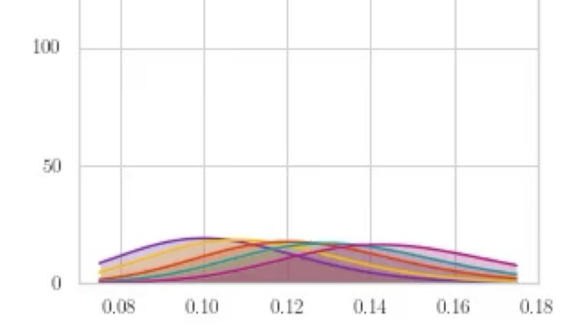
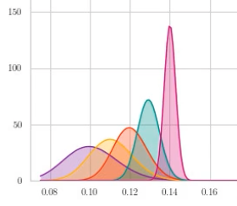
Regret Minimizing Bandits
Adaptive bandit algorithms balance exploration (learning) and exploitation (optimization) through optimism under uncertainty to maximize accumulation of metric (minimize cost)
Posterior Densities
Distribution Means

Slide 41
Regret Bandits: Lack of Power and Decision-Making Bias
Trade-Off: Regret Minimization vs Identification Power
Progressively giving more traffic to the optimal arm reduces experiment cost
Failing to give enough traffic to suboptimal arms increases the time to statistical significance
Time to Finish vs Cost
Cost relative to equal allocation
Decision-Making Bias
Adaptive traffic allocations can bias performance estimates, particularly with time-variation
Days to reach significance relative to equal allocation

Slide 42
Motivation Based on Historical Experimentation Process

Slide 43
Content Experimentation in Prime
Insights Generation
Content Development/Experimentation Setup
Decision-Making & Reporting
Traffic Allocated by Bandit Algorithm
Notes:
Due to the loop, correctness is important and errors cascade
Being used as experimentation system, not just optimization system

Slide 44
Historical Experimentation Approach in Prime
Experimentation Process
Pitfalls and Pain Points
Notes:
Some motivation: Observing that treatments launched quickly got all the traffic or almost none of it, also dropping win rate. Regret bandits really meant for evergreen use

Slide 45
Historical Experimentation Approach in Prime
Experimentation Process
Pitfalls and Pain Points
Periodically add treatments to an existing pool of messages
Traffic allocated by Thompson Sampling (TS)
Compute fixed horizon p-values relative to control
Take action on what stays in pool and what is removed
Algorithm biased by historical data for existing messages and time-variation
P-hacking & Simpson’s paradox inflate type I errors
Unclear delineation between short-term experimentation and long-term optimization

Slide 46
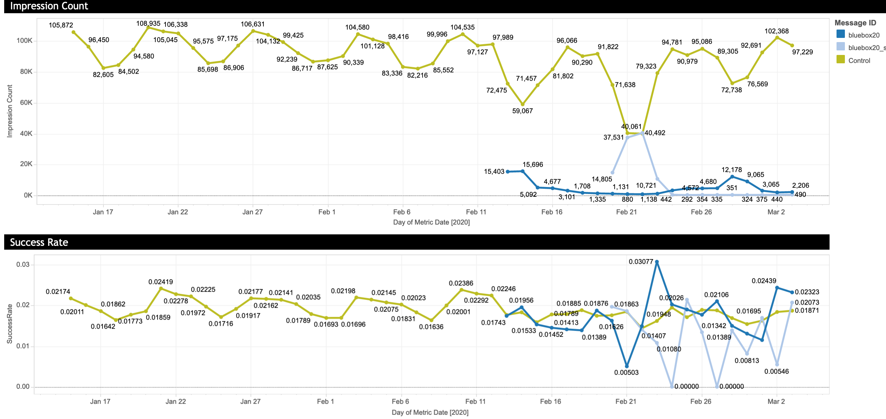
Algorithmic Bias from Historical Data

Slide 47
Historical Experimentation Approach in Prime
Experimentation Process
Pitfalls and Pain Points
Algorithm biased by historical data for existing messages and time-variation
Arbitrary time horizon is problematic
P-hacking & Simpson’s paradox inflate type I errors
Unclear delineation between short-term experimentation and long-term optimization
Periodically add treatments to an existing pool of messages
Traffic allocated by Thompson Sampling (TS)
Compute fixed horizon p-values relative to control
Take action on what stays in pool and what is removed

Slide 48
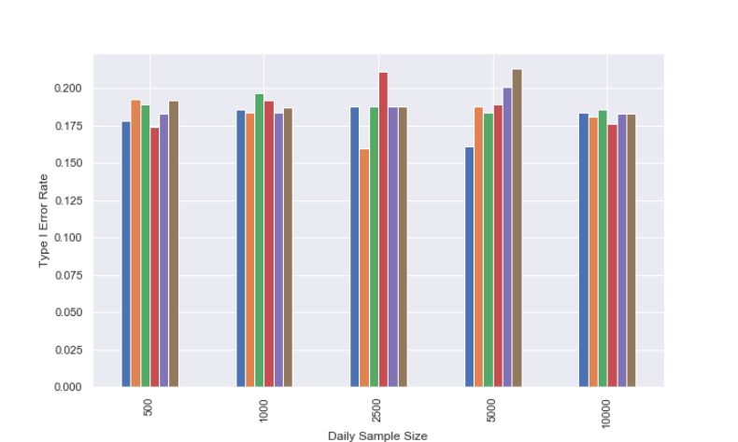
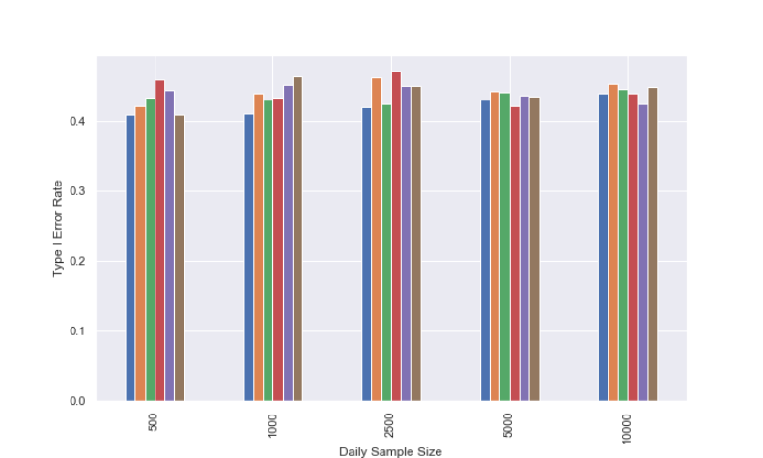
Risks of A/B Testing Methods with Regret Minimization
A/A Tests: Bias and Sequential Monitoring Drastically Inflates Type I Error Rates
Fixed Horizon
Sequential Monitoring
Desired Type I Error Rate

Slide 49
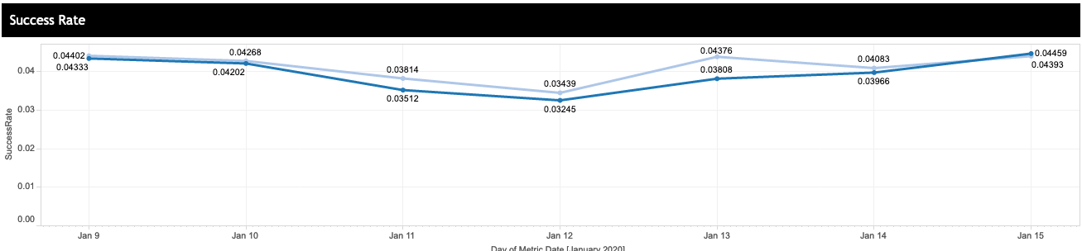
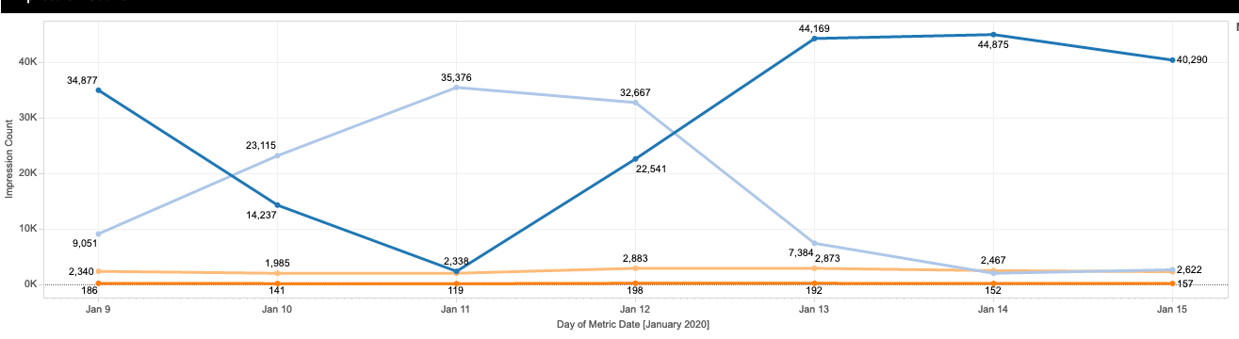
Simpsons’s Paradox
On any given day, Light > Dark
Notes:
Trend is going down, but light blue gets most the traffic on the low days

Slide 50
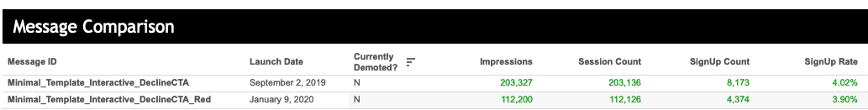
Simpsons’s Paradox
Dark blue
Light blue
On any given day, Light > Dark; in aggregate, Dark > Light.
Simpson’s paradox arises due to a combination of factors:
Dynamic traffic allocation
Seasonal fluctuations
The metric

Slide 51
Historical Experimentation Approach in Prime
Experimentation Process
Pitfalls and Pain Points
Algorithm biased by historical data for existing messages and time-variation
Arbitrary time horizon is problematic
P-hacking & Simpson’s paradox inflate type I errors
Unclear delineation between short-term experimentation and long-term optimization
Periodically add treatments to an existing pool of messages
Traffic allocated by Thompson Sampling (TS)
Compute fixed horizon p-values relative to control
Take action on what stays in pool and what is removed

Slide 52
Overview of Anduril Methods & Results

Slide 53
Anduril Methods
Algorithms Optimizing Identification
Sequential Monitoring via Always Valid Inference
Balanced Measurement
Split Experimentation and Optimization

Slide 54
Project Anduril
Objectives
Solutions

Slide 55
Project Anduril
Objectives
Solutions
Clarity in the optimization goal: identification or regret
Develop metrics immune to Simpson’s paradox & interpretable in the presence of time-variation
Simplify the marketers process & eliminate opportunities for user error (such as p-hacking)
Balance identification power & regret in short-term experiments
Split experimentation into 2 pools: short-term & long term, optimizing for identification & regret, respectively
``How many signups would the message have gotten if it received all the traffic
Improved reporting dashboard & always-valid confidence intervals for safe sequential monitoring
Successive elimination algorithm for short-term experimentation pool
Train BLIP models to promote to long-term pool

Slide 56
Pool Splitting: Child Experiments
50% of Traffic
Long Term Pool
Long Term Pool
MVLab Child Experiment
Long Term Pool
100% of Traffic
Short Term Pool
100% of Traffic
50% of Traffic
Long Term Pool = KPI Optimization
Short Term Pool = Experimentation
Notes:
We start on equal footing in the short term experiment, i.e. throw out history

Slide 57
Project Anduril
Objectives
Solutions
Clarity in the optimization goal: identification or regret
Develop metrics immune to Simpson’s paradox & interpretable in the presence of time-variation
Simplify the marketers process & eliminate opportunities for user error (such as p-hacking)
Balance identification power & regret in short-term experiments
Split experimentation into 2 pools: short-term & long term, optimizing for identification & regret, respectively
Cumulative Gain: ``How many successes would the message have gotten if it received all the traffic’’
Improved reporting dashboard & always-valid confidence intervals for safe sequential monitoring
Successive elimination algorithm for short-term experimentation pool
Train BLIP models to promote to long-term pool

Slide 58
Anduril
Objectives
Solutions
Split experimentation into 2 pools: short-term & long term, optimizing for identification & regret, respectively
Cumulative Gain: “How many successes would the message have gotten if it received all the traffic’’
Improved reporting dashboard & always-valid confidence intervals for safe sequential monitoring
Successive elimination algorithm for short-term experimentation pool
Train BLIP models to promote to long-term pool
Clarity in the optimization goal: identification or regret
Develop metrics immune to Simpson’s paradox & interpretable in the presence of time-variation
Simplify the marketers process & eliminate opportunities for statistical violations (such as p-hacking)
Balance identification power & regret in short-term experiments

Slide 59
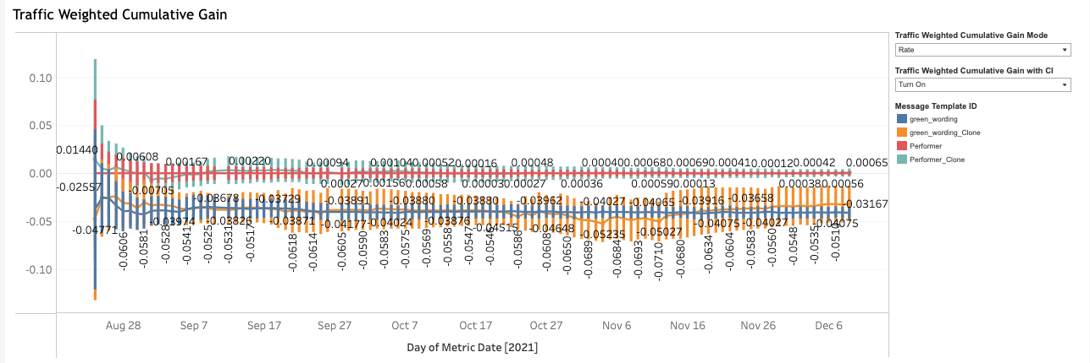
Anduril Dashboard

Slide 60
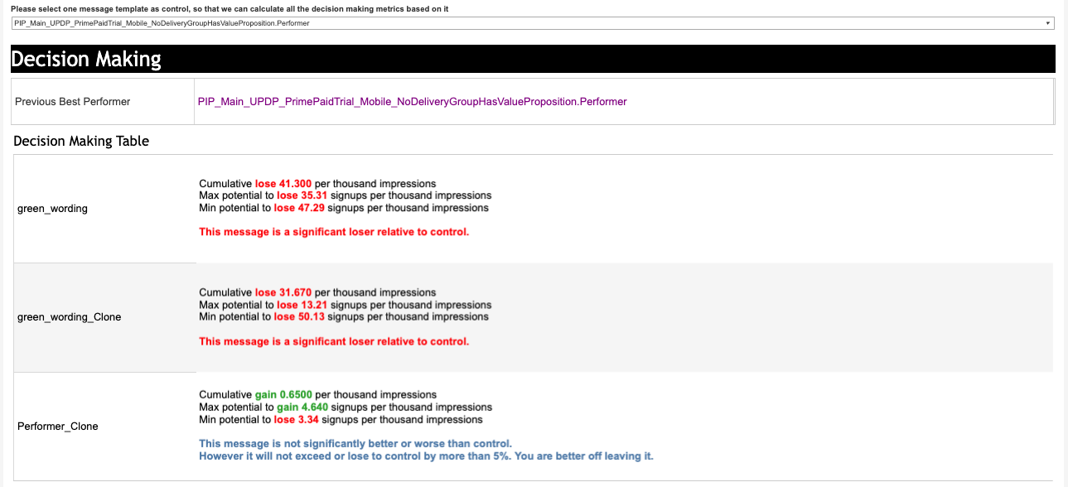
Anduril Dashboard

Slide 61
Project Anduril
Objectives
Solutions
Split experimentation into 2 pools: short-term & long term, optimizing for identification & regret, respectively
Cumulative Gain: ``How many successes would the message have gotten if it received all the traffic’’
Improved reporting dashboard & always-valid confidence intervals for safe sequential monitoring
Successive elimination algorithm for short-term experimentation pool
Train BLIP models to promote to long-term pool
Clarity in the optimization goal: identification or regret
Develop metrics immune to Simpson’s paradox & interpretable in the presence of time-variation
Simplify the marketers process & eliminate opportunities for user error (such as p-hacking)
Balance identification power & regret in short-term experiments

Slide 62
Impact
Estimated impact of 1.0-1.73 million incremental members per year incrementality quip, which comes from improved decision making accuracy and faster experiments.
Significant adoption: 663 out of 797 experiments launched in AT acquisition this year have been run through AT-Anduril.
Higher throughput: 663 experiments launched year to date through AT-Anduril compared to 517 experiments launched through all of AT during the same time period a year ago (28% increase through AT-Anduril).
150 winning experiments year to date out of 510 completed experiments with an estimated ~15k annualized impact per win (2.25 million annualized impact YTD in terms of incremental members).
Successive elimination algorithm launched in June with pilot experiments ongoing.

Slide 63
Thanks! Questions?

