Slide 1
Diversifying Amazon Recommendations
Houssam Nassif
houssamn@amazon.com
Notes:
Thank you all for coming.

Slide 2
Recently published Amazon papers
Diversifying Music Recommendations Nassif H, Cansizlar KO, Goodman M, and Vishwanathan SVN International Conference on Machine Learning (ICML'16) Workshops, New York, 2016.
Adaptive, Personalized Diversity for Visual Discovery (Best Paper Award) Teo CH, Nassif H, Hill D, Srinavasan S, Goodman M, Mohan V, and Vishwanathan SVN ACM Conference on Recommender Systems (RecSys'16), Boston, pp. 35-38, 2016.
Notes:
I will be presenting today 2 recently published papers on diversifying amazon recs. The first tackles music and was published at the ICML music W. The second describes the amazon stream framework and won a best paper award at recsys

Slide 3
Recently published Amazon papers
Diversifying Music Recommendations Nassif H, Cansizlar KO, Goodman M, and Vishwanathan SVN International Conference on Machine Learning (ICML'16) Workshops, New York, 2016.
Adaptive, Personalized Diversity for Visual Discovery (Best Paper Award) Teo CH, Nassif H, Hill D, Srinavasan S, Goodman M, Mohan V, and Vishwanathan SVN ACM Conference on Recommender Systems (RecSys'16), Boston, pp. 35-38, 2016.
Notes:
I will start with Prime music

Slide 4
Outline
Motivation
Jaccard Swap diversity method
Submodular diversity method
Experiment
Notes:
So why do we care about diversity in music recommendations?

Slide 5
About Amazon Prime Music
Free benefit for prime members
Millions of songs
Thousands of expert-programmed playlists
Upload your own music
Create personal playlists
Notes:
Prime music: “browse by”, various carousels
have recommendations based on similarity

Slide 6
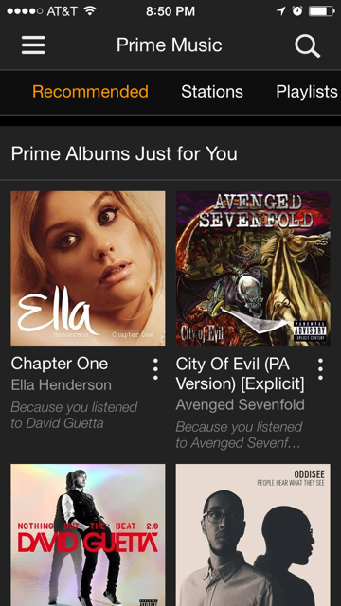
Amazon Prime Music mobile app
Access your music from anywhere
List-form recommendation
Devices with limited interaction capability
Notes:
This work presents experiments to diversify Amazon Music mobile app recommendations.
Existing recommender engine based on sims. Display recommended content in list form.
Limited space: Duplication problem amplified, more onerous to navigate

Slide 7
Music considerations
Explicit clusters: album, artist
Same album: same meta-data (album cover graphic, title)
User behavior: play album songs back-to-back
Similar scores to same-album songs
Notes:
Unlike other digital and physical products, music content tends to have explicit clusters.
album contains multiple songs. Share same album cover graphic, title and description.
In addition to overlapping content features, album songs also share behavioral features as users play them back to back.
As a result, Recommender systems tend to score same-album songs similarly.

Slide 8
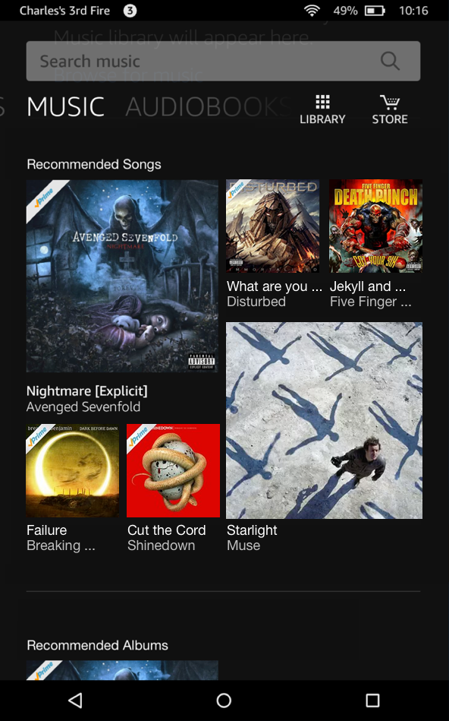
Why diversify music stream?
Notes:
Simply scoring by relevance, a musical stream may look like this. Not an enticing visual appearance.
Diverse & visually pleasing, yet relevant.
Thus the need to establish balance between relevance and diversity. this paper: move from to

Slide 9
Outline
Motivation
Jaccard Swap diversity method
Submodular diversity method
Experiment
Notes:
We experiment with two diversification methods. The first, Jaccard Swap, is

Slide 10
Explanation-based diversity
C. Yu, L. Lakshmanan, S. Amer-Yahia. It takes variety to make a world: Diversification in recommender systems. EDBT 2009.
$u$: user, $i$: item
$\text{ItemSim}\left(i, i^{′}\right)$: similarity measure between two items
$\text{Items}(u)$: Set of items user $u$ interacted with
$\text{E}\text{xpl}\left(u,i\right)=\left\{i^{′} \right| \text{ItemSim}\left(i, i^{′}\right)>ε \text{\& }i’∈\text{Items}(u)\}$
Notes:
An explanation based method by yahoo research.
U, I, Some similarity measure. Obtained by content-based, or filtering and latent methods.
Interacted with: listened, rated
The explanation of recommending item (i) to user (u) is the set of items similar to item (i) that user (u) has interacted with.

Slide 11
Jaccard diversity distance
$$Du(i,j) =1 − \frac{\left|\text{Expl}\left(u,i\right) ∩ \text{Expl}\left(u,j\right)\right|}{\left|\text{Expl}\left(u,i\right) ∪ \text{Expl}\left(u,j\right)\right|}$$
$Du\left(i,j\right)=1$ if explanation sets completely separate
$Du\left(i,j\right)=0$ if explanation sets are identical
Notes:
Jaccard diversity distance between items (i,j) for user (u) :
1- ratio of the intersection over the union of their explanation sets
Dissimilarity measure. Ranges between 1 if sets completely separate, to 0 for identical sets

Slide 12
Algorithm Swap
$$Di=\sum_{j}{Du\left(i,j\right)}$$
Recommender score
Explanatory set
$$Du(i,j)$$
7
1.17
2/3
6.2
1/2
1.66
And if $Δ\text{score}< τ$
If diversity increases
1
6
1.5
5
1.5
1
Notes:
Heuristic. Sort items by recommender score, pick top K
Compute pairwise Jaccard diversity distance
Compute diversity sum for each item, pick min
Swap if diversity increases
And if score doesn’t drop below threshold

Slide 13
Outline
Motivation
Jaccard Swap diversity method
Submodular diversity method
Experiment
Notes:
Now we turn our attention to the submodular method, which is more principled

Slide 14
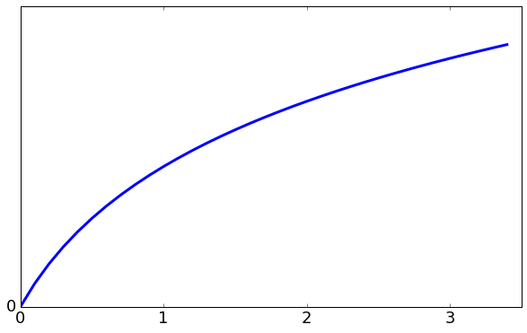
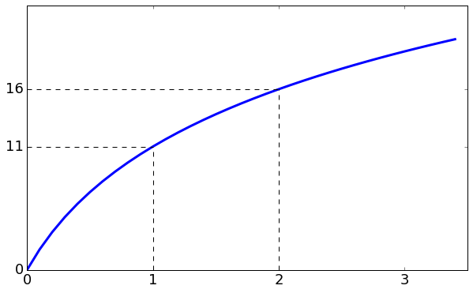
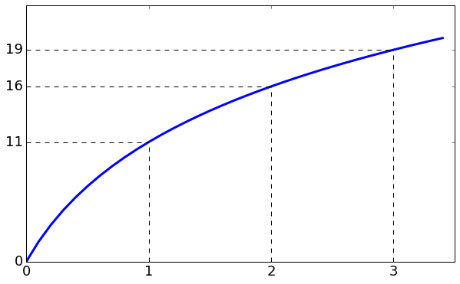
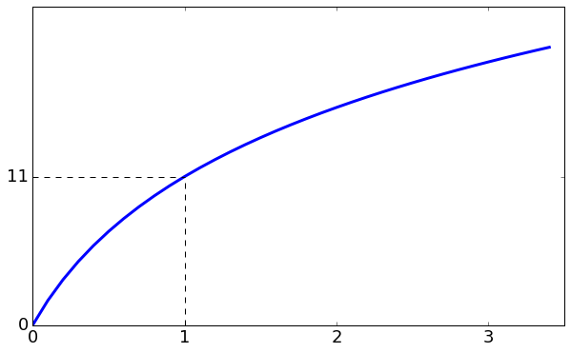
Diminishing returns
Set utility
+3
Incremental utility
tapers off
+5
+11
Cumulative number of explanation items in set
Notes:
Submodular function nicely models diminishing returns.
http://choonhui.aka.amazon.com:8888/notebooks/research/airstream/notebooks/airstream%20talk%20slides.ipynb

Slide 15
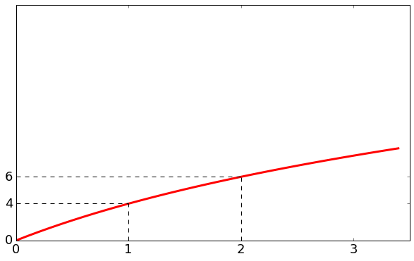
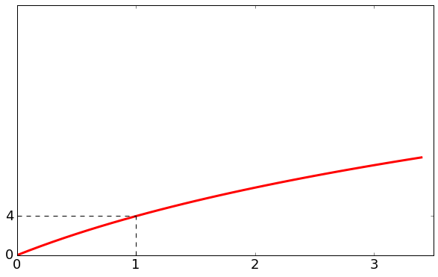
Submodular diversity mix
+3
+5
+11
+2
+4
Diversified list:
Notes:
Two submodular functions with different utilities. Create a mix.
At some point the incremental utility of adding a circle is higher.
Let us formalize

Slide 16
Submodular diversity
$c$: category, $i$: item, $S$: diversified set, score($i$): $i$’s recommender score
Category utility:
$$fc(S) = log\left(1 + \sum_{i∈S∩c}{\text{score}(i)}\right)$$
Maximize sum of all category utilities:
$${argmax}_{S}\left(ρ\left(S\right)=\sum_{c}{fc\left(S\right)}\right)$$
Greedy near-optimal solution: $S_{t+1}=S_{t}∪\{{argmax}_{i\backslash S_{t}}ρ\left(S_{t}∪\{i\}\right)\}$
Notes:
category utility: log of sum of item scores.
Incorporate recommender score into diversity measure
Maximize sum of all category utilities: submodular.
Near optimal solution achieved iteratively, greedily adding item with highest incremental utility.

Slide 17
Outline
Motivation
Jaccard Swap diversity method
Submodular diversity method
Experiment

Slide 18
Experimental setup
Baseline: Rank by recommender score
Item-to-item collaborative filtering recommender provides item score and explanation set
Artist and album as Jaccard explanation set features and submodular categories ( , , , …)
Notes:
We get scores from recommender system.
Based on collaborative filtering. provide score and explanation set.

Slide 19
Results
Treatment comparison | Increase in minutes streamed
Submodularity vs Baseline | 0.64% (p=0.03)
Jaccard Swap vs Baseline | 0.40% (p=0.18)
Submodularity vs Jaccard Swap | 0.24% (p=0.41)
Diversity affects recommendation quality
Submodularity method improvement is significant
Notes:
We measure minutes streamed, which is the number of minutes customers listen to recommended songs.

Slide 20
Baseline vs Submodular

Slide 21
Submodular approach benefits
Smoothness:
Submodularity produces uniformly diverse set. All contiguous subsets are also diverse.
Jaccard Swap doesn’t.
Relevance:
Swap may not retain most relevant content.
Submodularity ensures most relevant item is first, followed by mix of most relevant items within each category.
Notes:
Our submodular solution fares better. One reason is that Submodularity produces uniformly diverse stream. Diminishing returns property holds for any contiguous part of the recommended list.
Another is that swap may not retain most relevant content, like we saw in our toy example. Submod ensures most relevant item is first, followed by mix of most relevant items within categories

Slide 22
Recently published Amazon papers
Diversifying Music Recommendations Nassif H, Cansizlar KO, Goodman M, and Vishwanathan SVN International Conference on Machine Learning (ICML'16) Workshops, New York, 2016.
Adaptive, Personalized Diversity for Visual Discovery (Best Paper Award) Teo CH, Nassif H, Hill D, Srinavasan S, Goodman M, Mohan V, and Vishwanathan SVN ACM Conference on Recommender Systems (RecSys'16), Boston, pp. 35-38, 2016.
Notes:
Moving to amazon stream

Slide 23
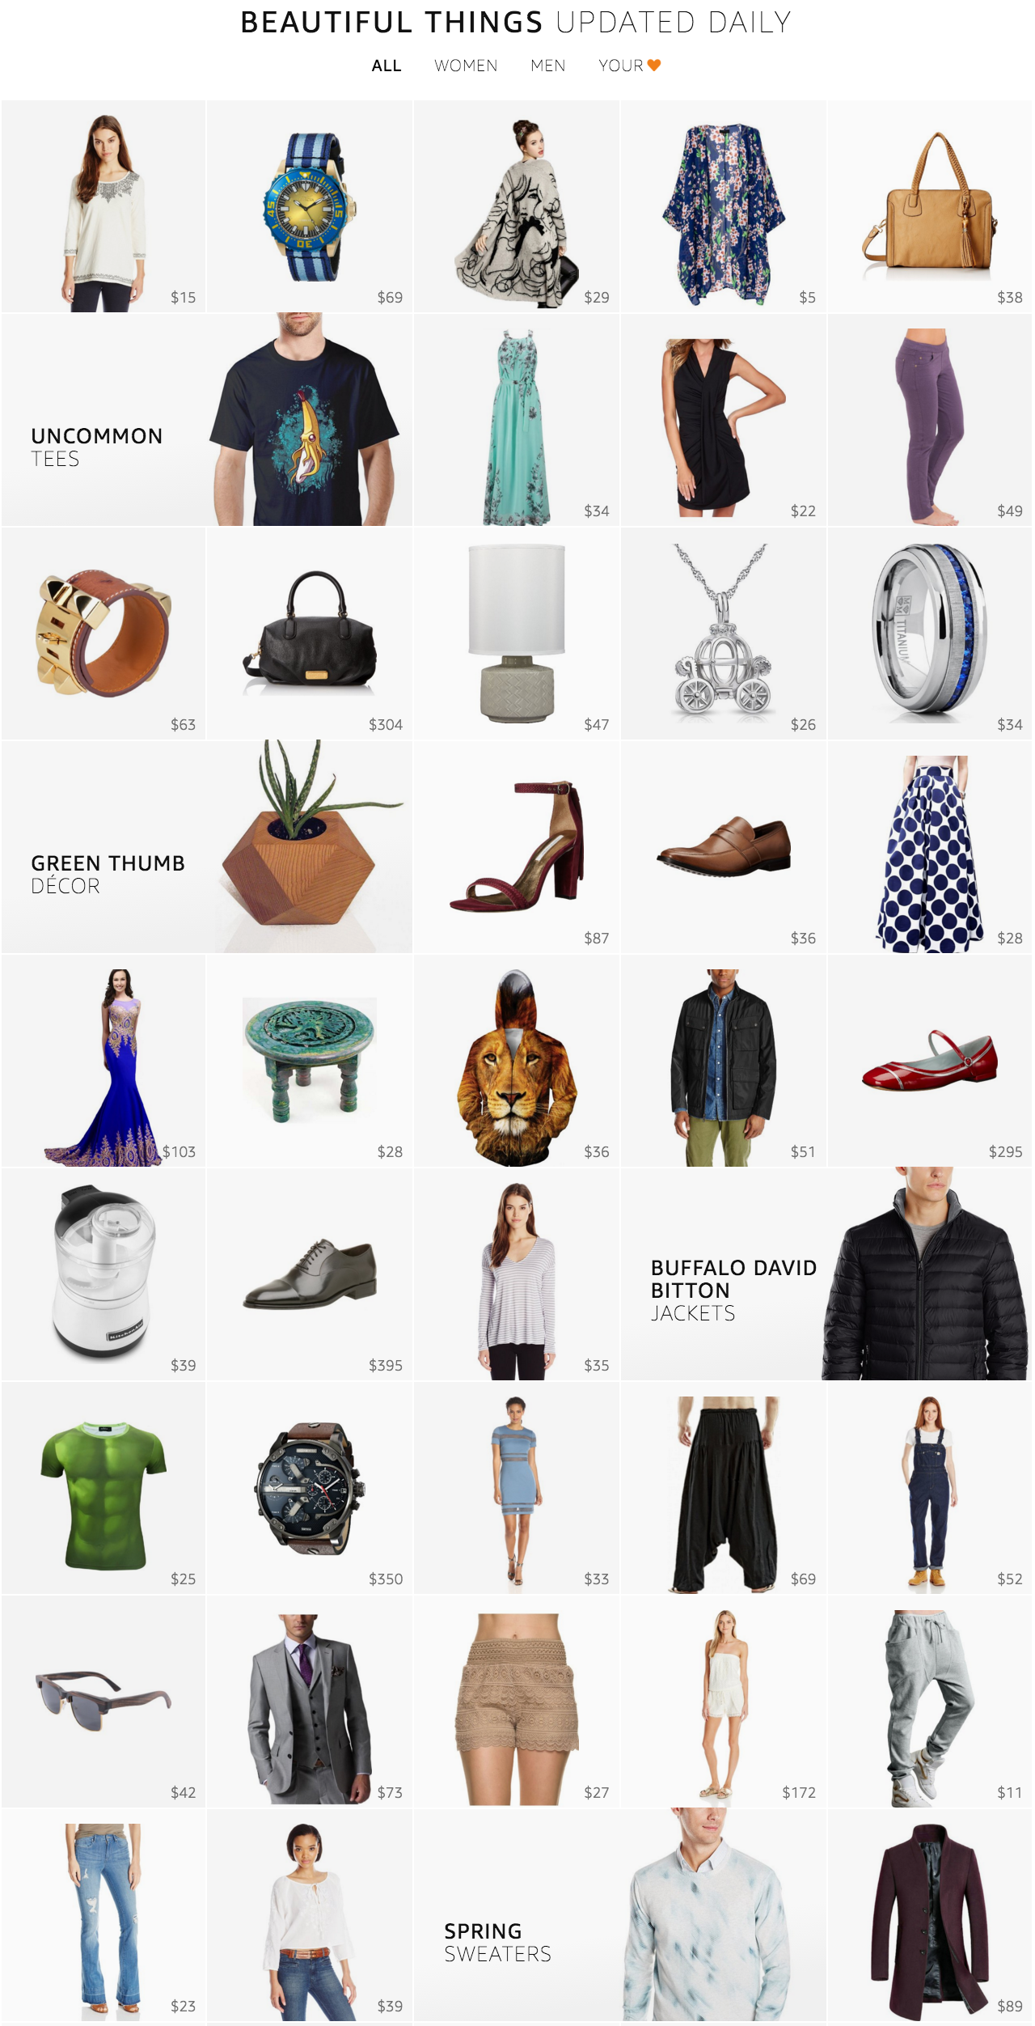
Amazon Stream: www.amazon.com/stream
Notes:
Stream is a new product discovery experience designed to show customer a large collection of products in an endless beautiful imagery.
No customer intent. Window shopping.
This paper describes our solutions for overcoming the challenges we faced

Slide 24
Challenges
Need for product scoring function
Explore new products and exploit popular ones
Need for diverse stream
Hedge against the uncertainty in customer intent
Need for season-aware stream
Customers can engage with relevant products all year round
Need for personalized stream
Customers can focus more on products that they like
Notes:
The first challenge is to come up with a method for scoring products.
Since new products get added to our catalog everyday, we need trade-off between exploring new products and exploiting the popular ones.

Slide 25
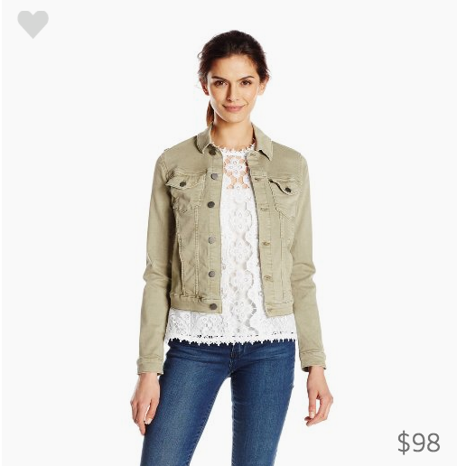
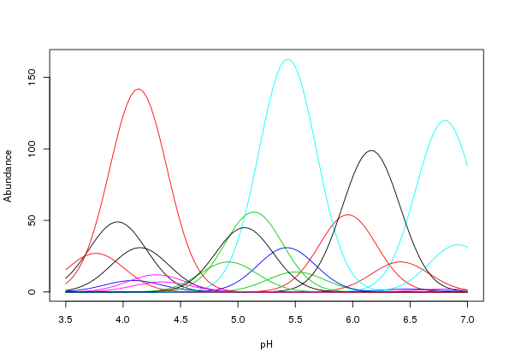
Explore-exploit in product scoring
Product attributes, x
Customer actions
Product ID
100352463
Click
or
No-click
Bayesian Linear
Probit Regression
Category
Jacket
Brand
Calvin Klein
Price
Attribute weight distributions, w
$98
Thompson Sampling
Bandit
Product Score = Φ( Σ_{i} w_{i} x_{i} )
W_{i} ~ N(0,1)
Notes:
Scoring function based on a Bayesian Linear Probit Regression trained on airstream.
Model maintains a weight distribution for each product attribute.
Sample using multi-arm bandit to balance between exploring new products and exploiting the popular ones. Explain bandits.

Slide 26
Ranking by Product Scores
Notes:
If we rank products only by their scores, we might end up with a stream of very similar products.

Slide 27
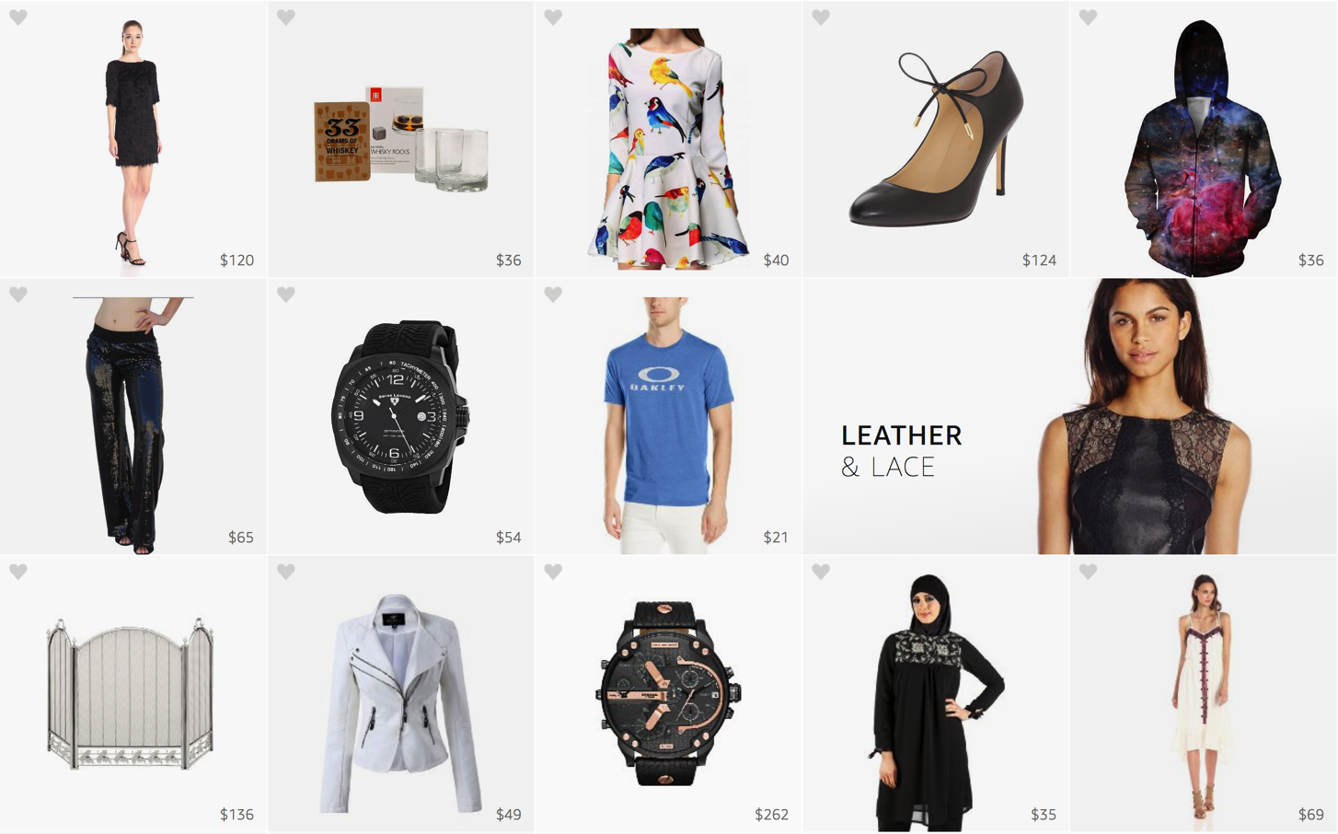
More Variety of Products for Discovery
Notes:
A stream with more variety of products seems much more interesting…

Slide 28
Challenges
Need for product scoring function
Explore new products and exploit popular ones
Need for diverse stream
Hedge against the uncertainty in customer intent
Need for season-aware stream
Customers can engage with relevant products all year round
Need for personalized stream
Customers can focus more on products that they like
Notes:
So, there is a real need for diverse stream as it would help hedging against the uncertainly in customer intent and provides more exciting experience.

Slide 29
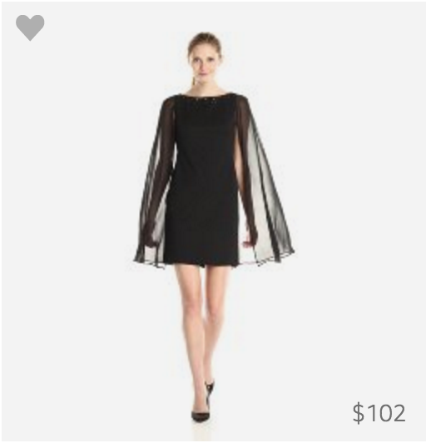
Diversity
Diverse stream consists of a large variety of categories
Stream Category: (Department, Product Type, Price Range)
womens-dress-high
Notes:
A stream is considered diverse if it consists of products from a large variety of categories.
In Stream, we define a category as the combination of three product attributes, namely, department, product type, and price range.

Slide 30
Submodular Utility
Define utility of a product set D:
“weighted sum of per-category product counts and scores”
utility(D) = Σ_{k} w_{k} log[1 + c(k, D) + s(k,D)]
Weight for category k
Number of products in category k
Total score of products in category k
Notes:
Utility of product set is defined as the weighted sum of per-category product counts and scores.
the larger the weight for a category, the more products from that category will appear in the stream. If W of category A is twice that of B, we will have twice as much A than B.

Slide 31
Multinomial Diversified Ranking
Assign a category, k ~ Multinomial(w), to each position
Assign products from each category to their corresponding positions in decreasing order of their scores
Notes:
we compared submodularity with a randomized baseline algorithm.
First it randomly assigns a category to each position with probability proportional to category weights.
In both cases, assigns products to the positions corresponding to their categories in decreasing order of their scores.

Slide 32
Results: Diversified Ranking
Submodular vs multinomial diversity
Submodular ranker put more relevant products at the top
Metric | Result
Time spent | +0.05%
product view count | -1.32%
Product clicks | +9.82%
Notes:
The is no significant difference in the time spent between the two ranking algorithms. View count decreased by 1.3% but action counts increased by 9.8%.
The results suggests that submodular diversified ranking is better at putting more relevant product at the top of stream.

Slide 33
Challenges
Need for item scoring function
Explore new products and exploit popular ones
Need for diverse stream
Hedge against the uncertainty in customer intent
Need for season-aware stream
Customers can engage with relevant products all year round
Need for personalized stream
Customers can focus more on products that they like
Notes:
Next, we need to make sure that our customers can continue engaging with stream all year round.
So, we needed a season-aware stream that puts more weights on in-season products and less on off-season ones.

Slide 34
Seasonality
Fashion trends are seasonal
Popularity of categories change with seasons
Fall colors are different from spring colors
Learn about seasonal trends from customer behavior
Notes:
as we all know, fashion trends are seasonal

Slide 35
Adaptive Category Weights
Estimate weight for a category by its smoothed click-through-rate over a rolling-window
w_{k} = (clicks_{k} + α_{k}) / (views_{k} + α_{k} + β_{k})
Notes:
estimate adaptive or seasonal category weights by smoothed per-category CTR over a rolling-window.
More concretely, the adaptive weight for a category is the total clicks plus some alpha prior, divided by the sum of total views of the same category, alpha, and beta priors.
[We also tried click over expected clicks and logistic regression with position-bias correction. The three models are qualitatively comparable but we adopted CTR as it is much simpler to implement and allow easy incorporation of signals from external sources.]

Slide 36
Results: Seasonality
Adaptive vs static global weights
Showing seasonally relevant products increases customer engagement
Metric | Result
Time spent | +5.39%
Item view count | +1.08%
Product clicks | +8.29%
Notes:
The results showed significant improvement across all metrics.

Slide 37
Challenges
Need for product scoring function
Explore new products and exploit popular ones
Need for diverse stream
Hedge against the uncertainty in customer intent
Need for season-aware stream
Customers can engage with relevant products all year round
Need for personalized stream
Customers can focus more on products that they like
Notes:
Finally we consider a personalized stream so that our customers can focus more on the products that they like.

Slide 38
Recall
Define utility of a product set D:
“weighted sum of per-category product counts and scores”
utility(D) = Σ_{k} w_{k} log[1 + c(k, D) + s(k,D)]
Weight for category k
Number of products in category k
Total score of products in category k
Notes:
The highlighted weights are what we are personalizing for the customers

Slide 39
Personalization
Category weights are personalized using past actions
Agnostic of the diversification
Easy to incorporate: searches, purchases, or returns
Modeling:
clicks, | c ~ Multinomial(w)
weights, | w ~ Dirichlet(d)
where d are default weights
Personalized weights, E_{p(w|c,d)}[w] = (c + d) / |c + d|₁
Notes:
Personalized category weights learned from customer past actions. See clicks as drawn from a Multinomial distribution with the parameter vector w as Dirichlet prior.
Generative model. Estimate personalized weights as expected value of posterior weights given data. Can incorporate external signals such as searches, purchases, or returns.

Slide 40
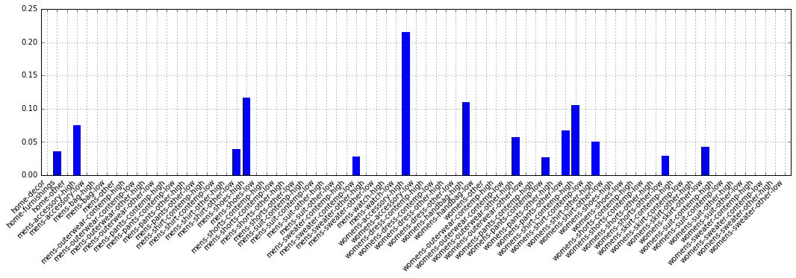
Personalized Category Weights
Distribution over categories might be sparse (i.e., filter bubble)
Notes:
personalized category weight vector eg.
Mostly sparse.
There is issue of filter bubble in which customers may not see interesting products in other categories. So, we need a way to encourage discovery in such cases.

Slide 41
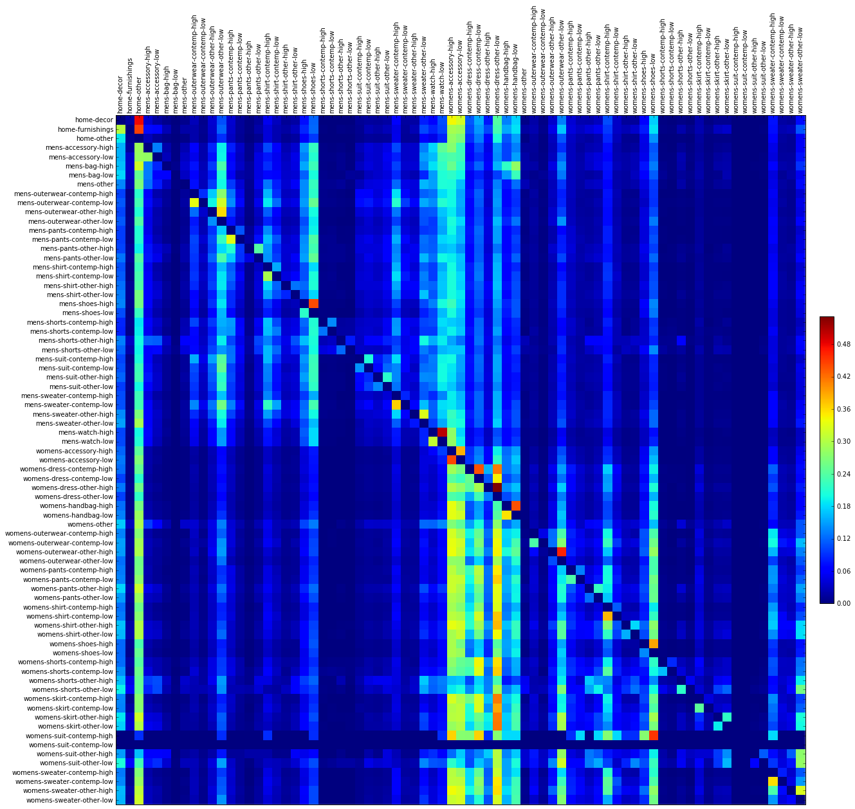
Category-category Correlations
Diffuse preference for category A to category B based on the correlation between A and B
“clicked A then clicked B”
Customers who interacted with any women’s categories tend to also interact with women’s accessory, low-price dress and low-price handbag.
Notes:
diffuse customer preferences for a category to another category based on their correlation.
Matrix of conditional probabilities. probability of customer interacting with product from column B given that customer had interacted with raw A
high intensity: see text

Slide 42
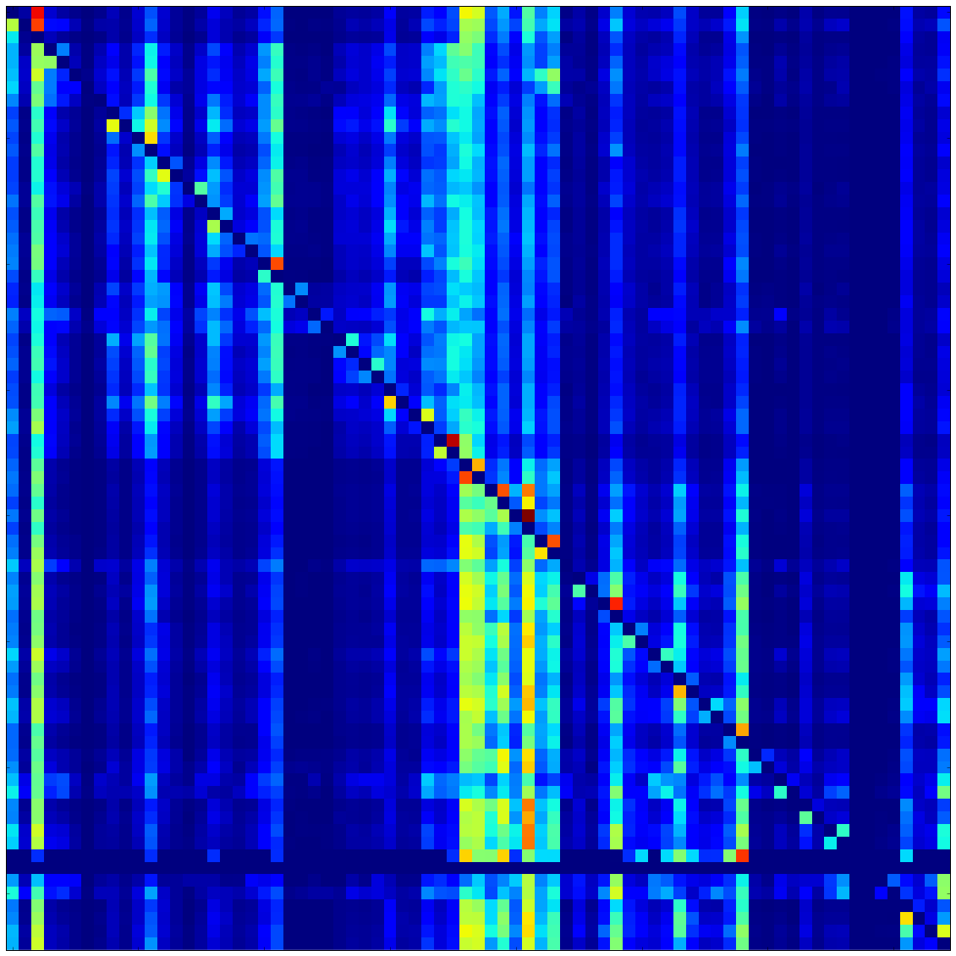
×
Customer preference vector
Category-category correlations
⬇
Smoothed customer preference vector
Notes:
The diffusion of preferences is simply a multiplication of the category-category correlation matrix and the customer’s preference vector.
The resulting customer preference vector is smoother and exposes more categories for the purpose of discovery.

Slide 43
Results: Personalized Diversifier
Personalized vs global weights
Personalizing weights:
Decreases scroll through
Increases customer interactions
Metric | Result
Time spent | +1.10%
Item view count | -4.95%
Product clicks | +12.58%
Notes:
We don’t observe significant difference in time spent but the personalization did increased customer interactions at the expense of decreased scroll through.
This results suggested that personalization exposed more relevant products at the top of stream.

Slide 44
Takeaways
Explore/exploit strategy is important for product discovery
Modeling diminishing returns is essential for diversity
Seasonal and fashion trends can be learned from customer behavior
Personalization enhances customer experience
Notes:
Informational pitch

Slide 45
Why Amazon?
Great data and problems – seriously.
If you can convince the powers that be that it is an important project, resources will be provided.
I am rarely the smartest person in the room.
Even our worst employees are competent.
Notes:
Very high bar

Slide 46
Data @ Amazon
Product search/browse/purchase
Customer contact
Product catalog
Seller marketplace and offers
Product reviews & seller feedback
Pricing, inventory, fulfillment, shipping, and demand
Click-stream
Digital content (books, movies, music, etc.)
Local offers data (Amazon Local)
Advertisements
AWS performance and resource utilization
High quality product images
Notes:
The world’s largest product search, user-action interaction, browse data
The world's largest catalogue of products with over 1B entries from over 2M sellers (entity matching, deduplication & categorization)
One of the largest collections of digitized books, digital music and videos (rich data and natural language processing)
Over 1B high-quality images of over 300M+ products (object recognition)

Slide 47
Research @ Amazon
Opportunity to work on exciting new amazon initiatives
Customer facing experience, direct impact on customers
Significant business impact, huge potential for growth
A culture of experimentation and ownership
Already established research and applied scientist career tracks
Notes:
Speech – Echo Device
Robotics – Prime Air.

Slide 48
Global Research Groups
Seattle
Machine Learning
Forecasting
Amazon Prime
Data Science
Operations Research
Computer Vision
Natural Language
Information Security
Prime Air
AWS
Bay Area
Search
Computer Vision
AWS
Boston
Speech Recognition
Computer Vision
Berlin, Germany
Machine Learning
Computer Vision
Natural Language
Aachen, Germany
Speech Recognition
Bangalore, India
Machine Learning
Cambridge, UK
Speech Recognition
Prime Air

Slide 49
Thank you!
Questions?
houssamn@amazon.com

