Slide 1
Lecture 4
Confidence Intervals

Slide 2
Lecture Summary
Last lecture, we talked about summary statistics and how “good” they were in estimating the parameters
  Risk, bias, and variance
  Sampling distribution
Another quantitative measure of how “good” the statistic is called confidence intervals (CI)
CIs provide an interval of certainty about the parameter

Slide 3
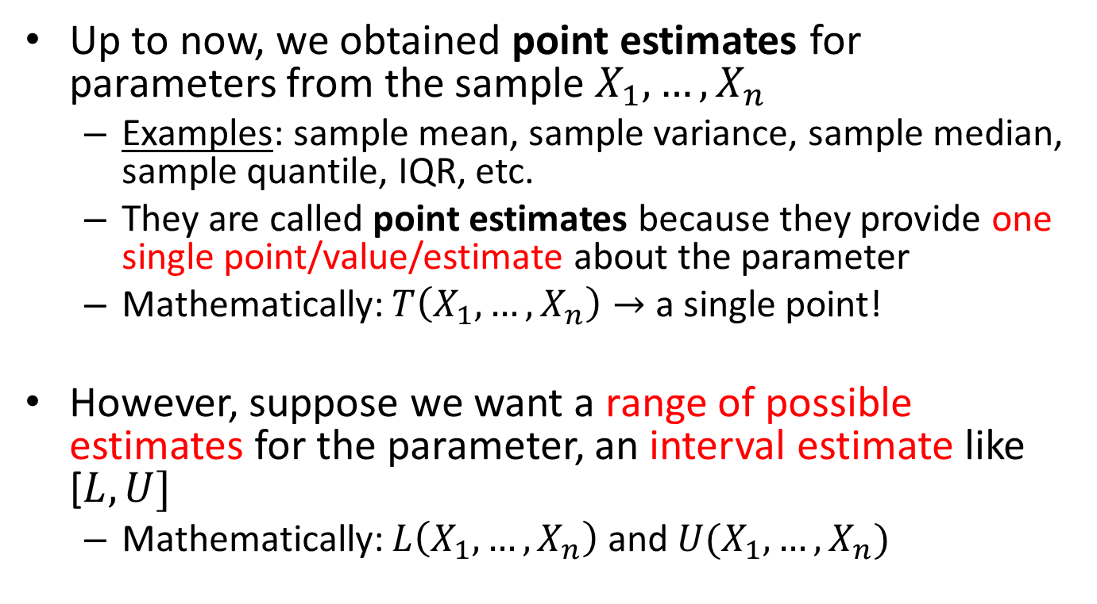
Introduction
Up to now, we obtained point estimates for parameters from the sample $X_{1},…,X_{n}$
  Examples: sample mean, sample variance, sample median, sample quantile, IQR, etc.
  They are called point estimates because they provide one single point/value/estimate about the parameter
  Mathematically: $T\left(X_{1},…,X_{n}\right)→$ a single point!
However, suppose we want a range of possible estimates for the parameter, an interval estimate like [$L,U]$
  Mathematically: $L\left(X_{1},…,X_{n}\right)$ and $U(X_{1},…,X_{n})$

Slide 4
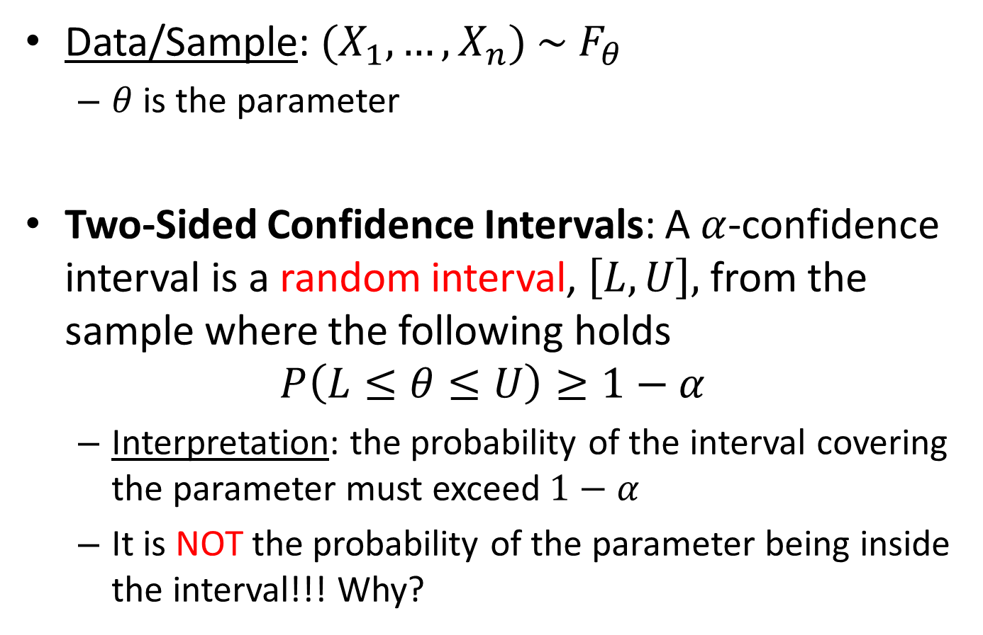
Two-Sided Confidence Intervals
Data/Sample: ${(X}_{1},…,X_{n})$ $∼$ $F_{θ}$
  $θ$ is the parameter
Two-Sided Confidence Intervals: A $α$-confidence interval is a random interval, $\left[L,U\right],$ from the sample where the following holds
$$P\left(L≤θ≤U\right)≥1−α$$
  Interpretation: the probability of the interval covering the parameter must exceed $1−α$
  It is NOT the probability of the parameter being inside the interval!!! Why?
Confidence Level

Slide 5
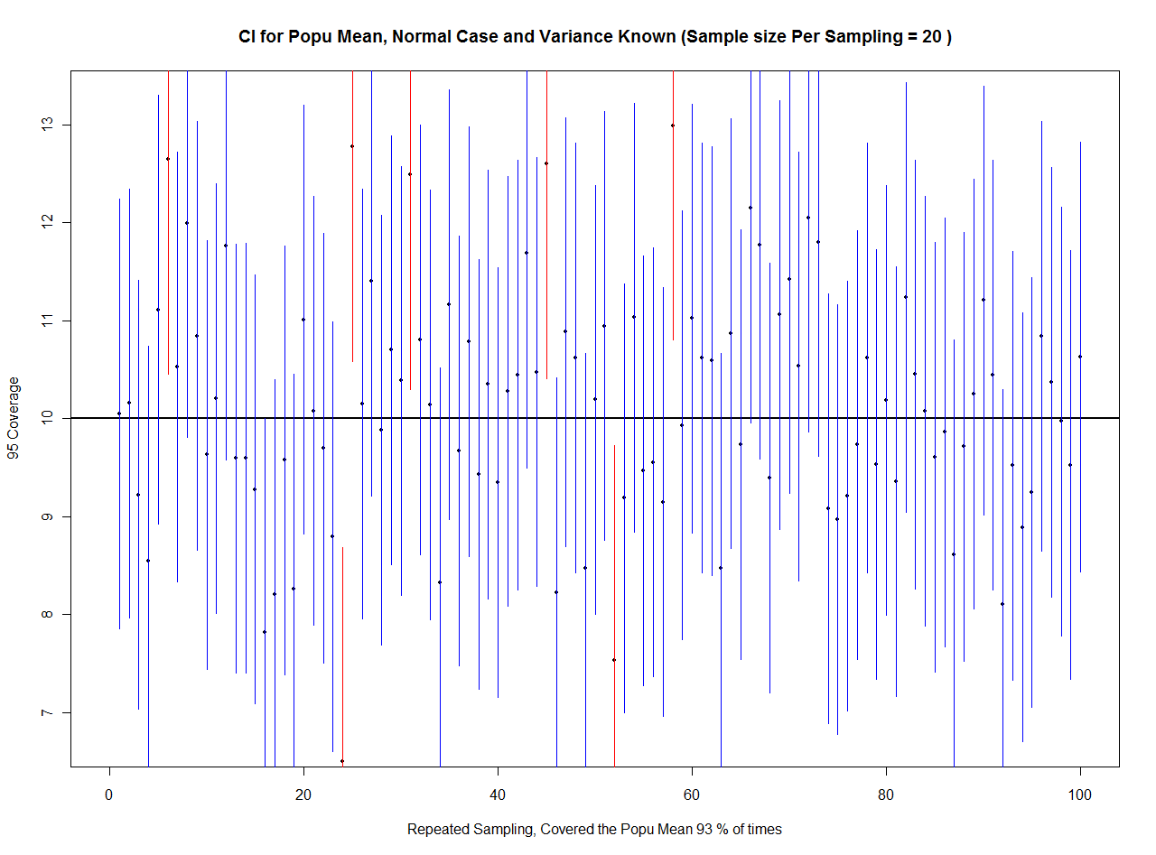

Slide 6
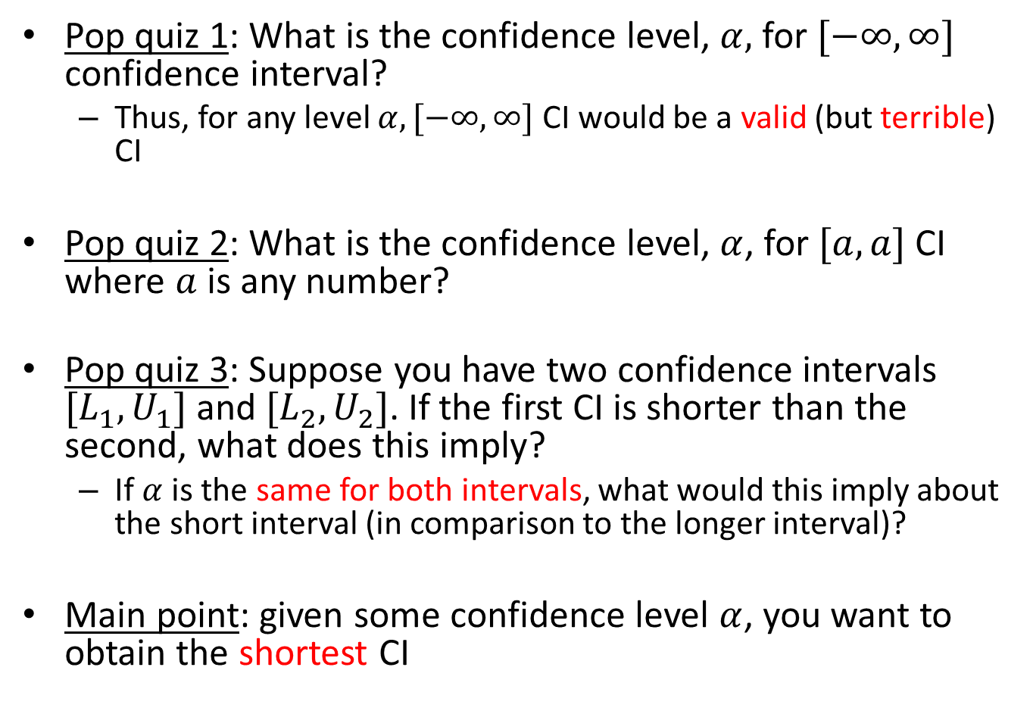
Comments about CIs
Pop quiz 1: What is the confidence level, $α,$ for $[−∞, ∞]$ confidence interval?
  Thus, for any level $α, [−∞, ∞]$ CI would be a valid (but terrible) CI
Pop quiz 2: What is the confidence level, $α$, for $[a,a]$ CI where $a$ is any number?
Pop quiz 3: Suppose you have two confidence intervals $[L_{1},U_{1}]$ and $[L_{2},U_{2}]$. If the first CI is shorter than the second, what does this imply?
  If $α$ is the same for both intervals, what would this imply about the short interval (in comparison to the longer interval)?
Main point: given some confidence level $α$, you want to obtain the shortest CI

Slide 7
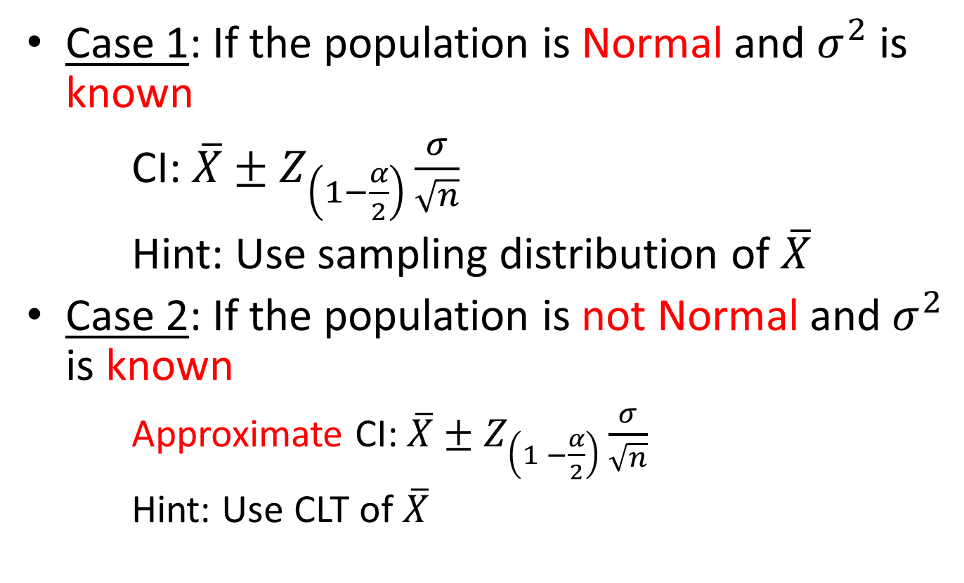
CIs for Population Mean
Case 1: If the population is Normal and $σ^{2}$ is known
CI: $\overline{X}±Z_{\left(1−\frac{α}{2}\right)}\frac{σ}{\sqrt{n}}$
Hint: Use sampling distribution of $\overline{X}$
Case 2: If the population is not Normal and $σ^{2}$ is known
  Approximate CI: $\overline{X}±Z_{\left(1 −\frac{α}{2}\right)}\frac{σ}{\sqrt{n}}$
  Hint: Use CLT of $\overline{X}$

Slide 8

What if the variance,$σ^{2}$,is unknown?

Slide 9

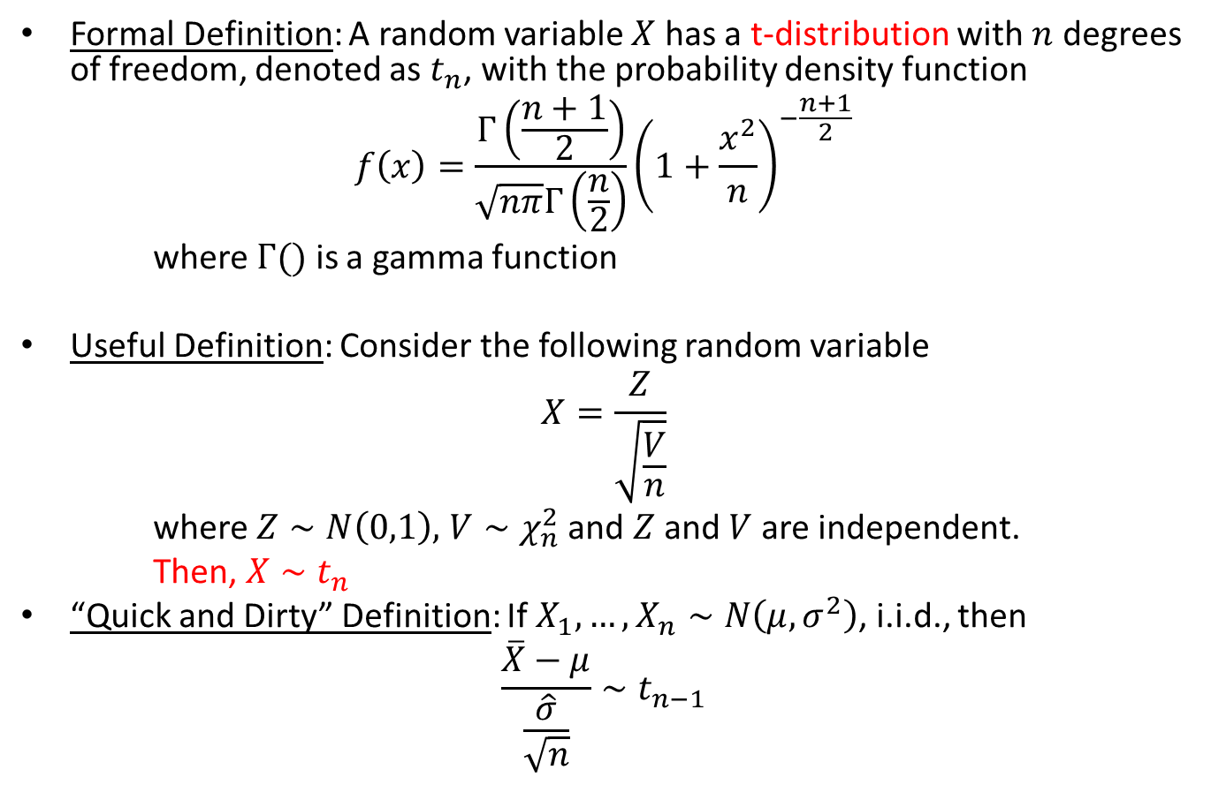
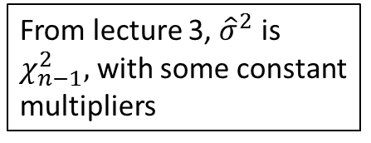
t Distribution
Formal Definition: A random variable $X$ has a t-distribution with $n$ degrees of freedom, denoted as $t_{n}$, with the probability density function
$$f\left(x\right)=\frac{Γ\left(\frac{n+1}{2}\right)}{\sqrt{nπ}Γ\left(\frac{n}{2}\right)}{\left(1+\frac{x^{2}}{n}\right)}^{−\frac{n+1}{2}}$$
where $Γ()$ is a gamma function
Useful Definition: Consider the following random variable
$$X=\frac{Z}{\sqrt{\frac{V}{n}}}$$
where $Z∼N\left(0,1\right),$ $V∼χ_{n}^{2}$ and $Z$ and $V$ are independent.
Then, $X∼t_{n}$
“Quick and Dirty” Definition: If $X_{1},…,X_{n}∼N\left(μ,σ^{2}\right)$, i.i.d., then
$$\frac{\overline{X}−μ}{\frac{\hat{σ}}{\sqrt{n}}}∼t_{n−1}$$
Notice that you can transform $\overline{X}−μ$ into a standard Normal
You will prove the relation between the two in the homework
From lecture 3, ${\hat{σ}}^{2}$ is $χ_{n−1}^{2},$ with some constant multipliers

Slide 10
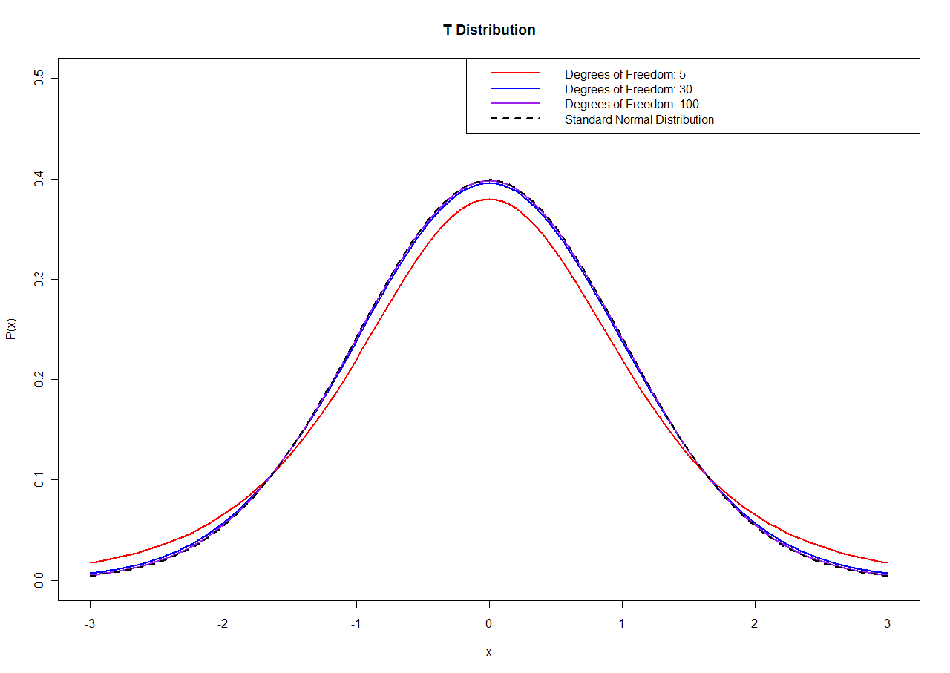

Slide 11
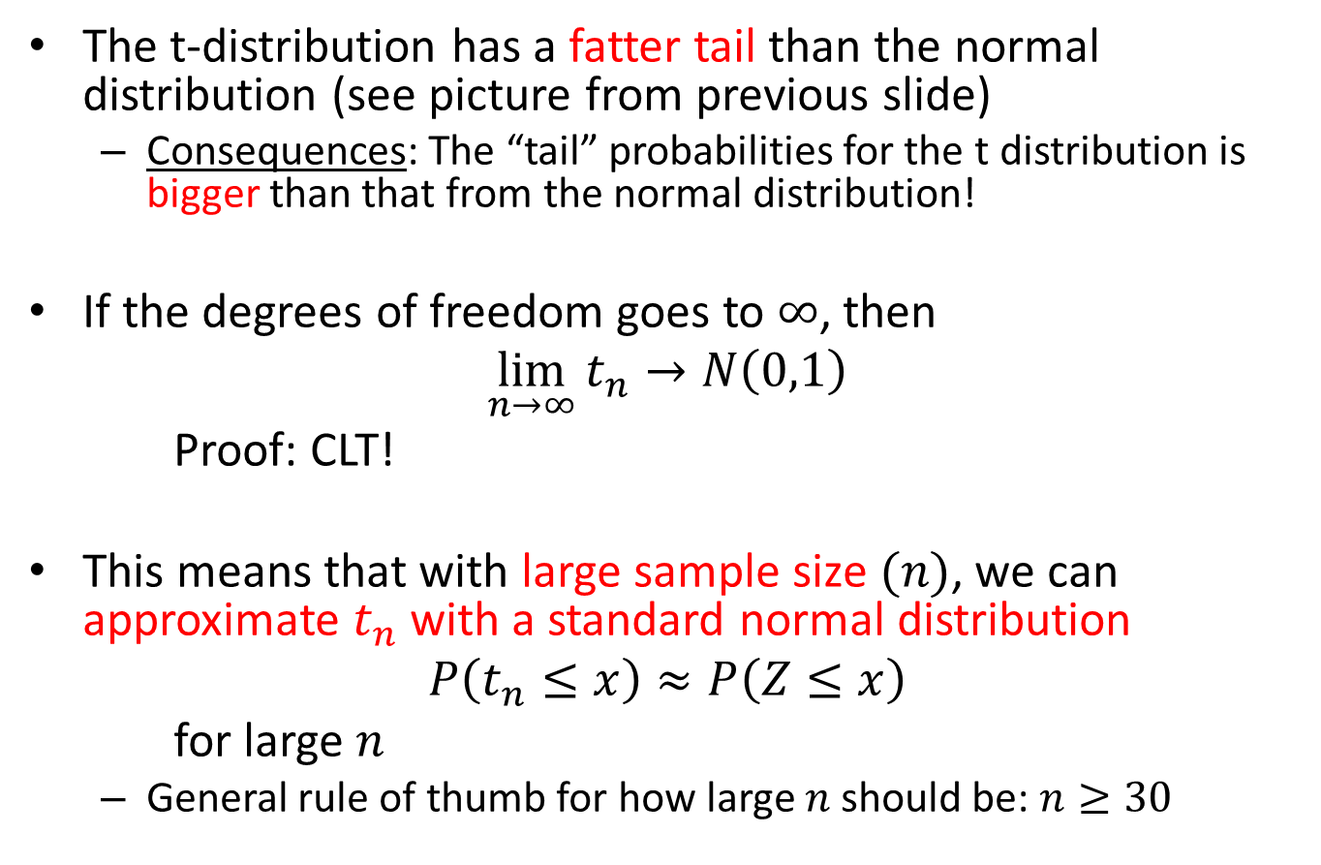
Property of the t Distribution
The t-distribution has a fatter tail than the normal distribution (see picture from previous slide)
  Consequences: The “tail” probabilities for the t distribution is bigger than that from the normal distribution!
If the degrees of freedom goes to $∞$, then
$$\lim_{n→∞}{t_{n}}→N\left(0,1\right)$$
Proof: CLT!
This means that with large sample size $(n)$, we can approximate $t_{n}$ with a standard normal distribution
$$P\left(t_{n}≤x\right)≈P\left(Z≤x\right)$$
for large $n$
  General rule of thumb for how large $n$ should be: $n≥30$

Slide 12
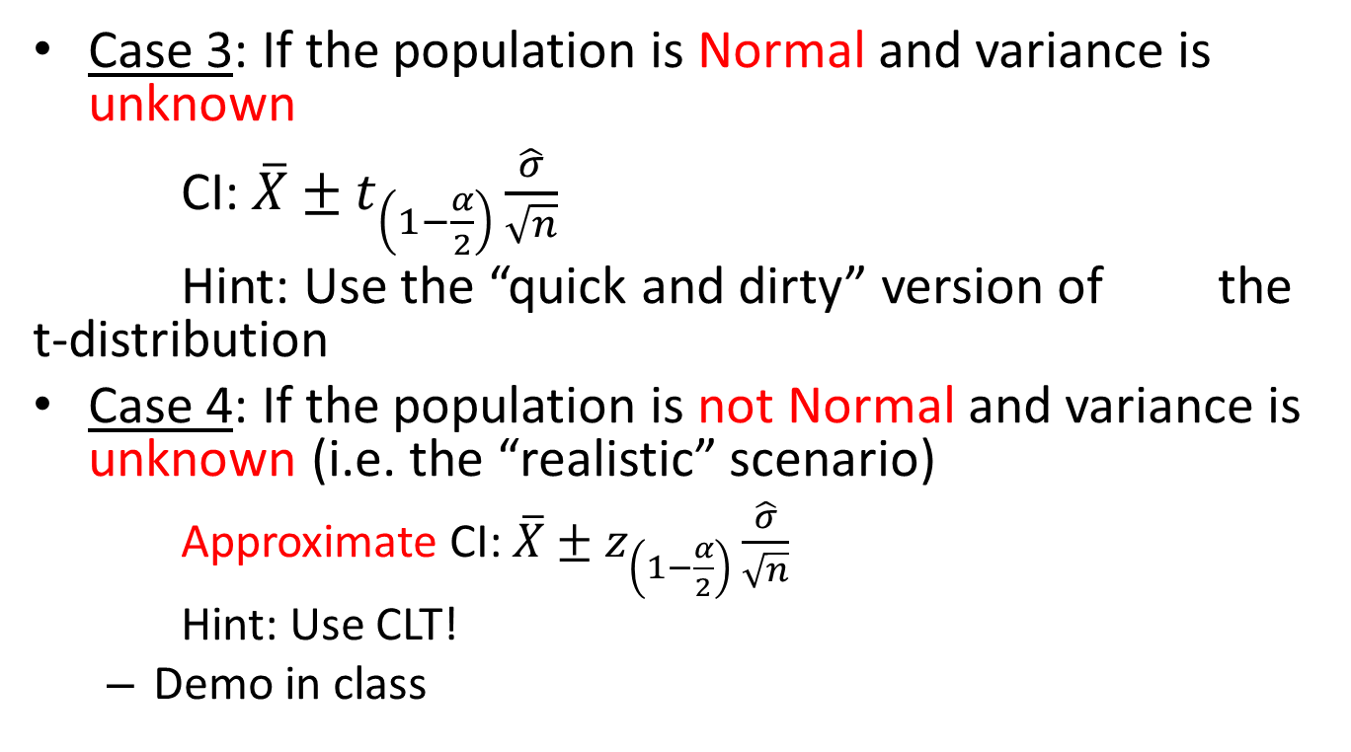
CIs for Population Mean
Case 3: If the population is Normal and variance is unknown
CI: $\overline{X}±t_{\left(1−\frac{α}{2}\right)}\frac{\hat{σ}}{\sqrt{n}}$
Hint: Use the “quick and dirty” version of the t-distribution
Case 4: If the population is not Normal and variance is unknown (i.e. the “realistic” scenario)
  Approximate CI: $\overline{X}±z_{\left(1−\frac{α}{2}\right)}\frac{\hat{σ}}{\sqrt{n}}$
  Hint: Use CLT!
  Demo in class

Slide 13
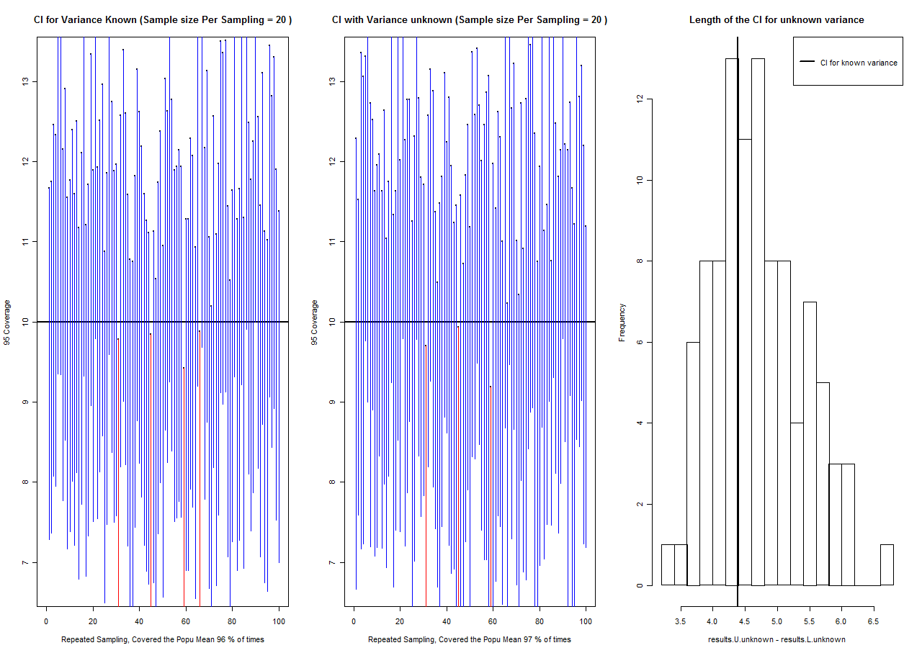

Slide 14
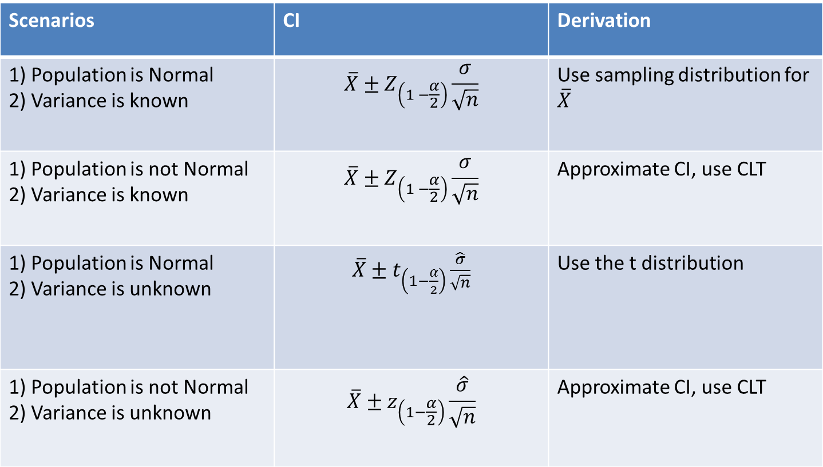
Summary of CIs for the Population Mean
Fixed width CI
Scenarios | CI | Derivation
1) Population is Normal 2) Variance is known | $$\overline{X}±Z_{\left(1 −\frac{α}{2}\right)}\frac{σ}{\sqrt{n}}$$ | Use sampling distribution for $\overline{X}$
1) Population is not Normal 2) Variance is known | $$\overline{X}±Z_{\left(1 −\frac{α}{2}\right)}\frac{σ}{\sqrt{n}}$$ | Approximate CI, use CLT
1) Population is Normal 2) Variance is unknown | $\overline{X}±t_{\left(1−\frac{α}{2}\right)}\frac{\hat{σ}}{\sqrt{n}}$ | Use the t distribution
1) Population is not Normal 2) Variance is unknown | $$\overline{X}±z_{\left(1−\frac{α}{2}\right)}\frac{\hat{σ}}{\sqrt{n}}$$ | Approximate CI, use CLT
Variable width CI

Slide 15
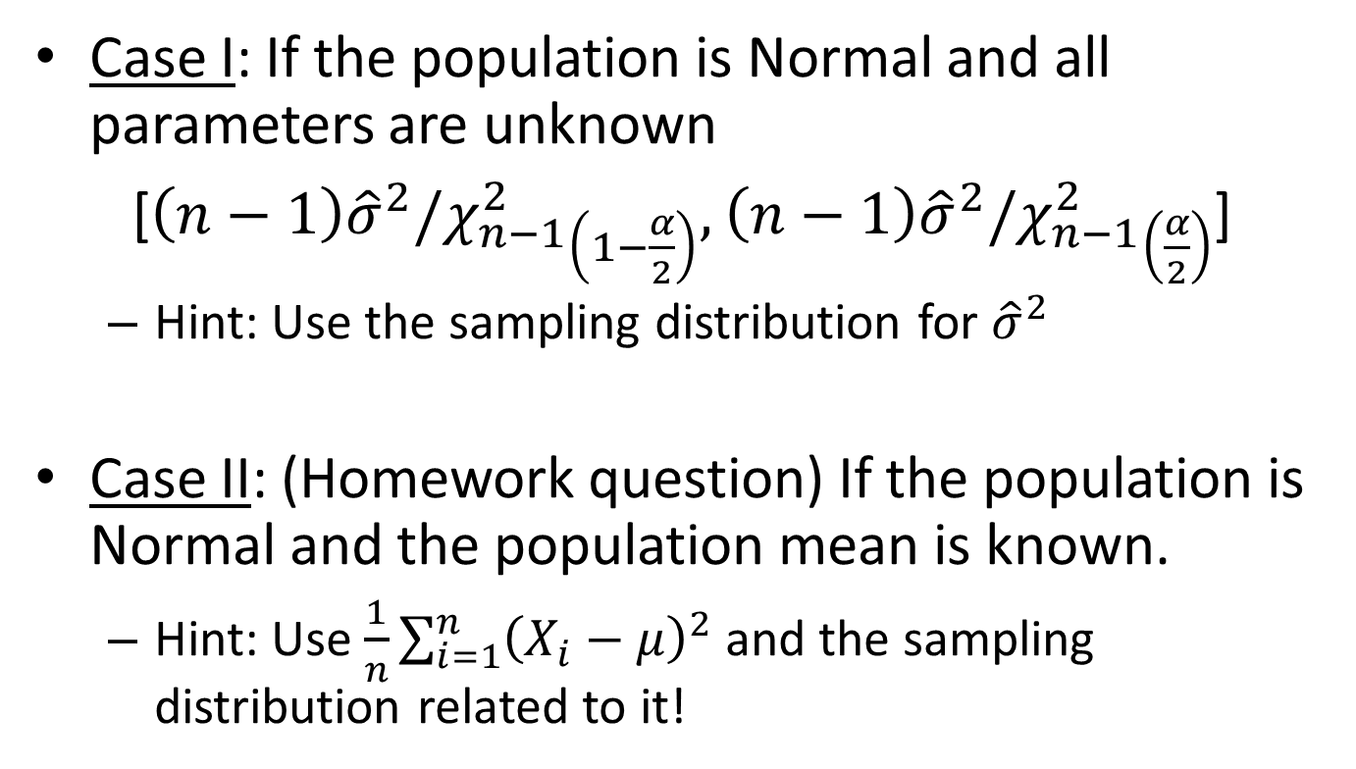
CIs for Population Variance
Case I: If the population is Normal and all parameters are unknown
[${\left(n−1\right)\hat{σ}}^{2}/{χ_{n−1}^{2}}_{\left(1−\frac{α}{2}\right)},$ ${\left(n−1\right)\hat{σ}}^{2}/{χ_{n−1}^{2}}_{\left(\frac{α}{2}\right)}$]
  Hint: Use the sampling distribution for ${\hat{σ}}^{2}$
Case II: (Homework question) If the population is Normal and the population mean is known.
  Hint: Use $\frac{1}{n}\sum_{i=1}^{n}{{\left(X_{i}−μ\right)}^{2}}$ and the sampling distribution related to it!

Slide 16
Lecture Summary
Another quantitative measure of how “good” the statistic is called confidence intervals (CI)
CIs provide an interval of certainty about the parameter
We derived results for the population mean and the population variance, under various assumptions about the population
  Normal vs. not Normal
  known variance vs. unknown variance

Slide 17
Extra Slides

Slide 18
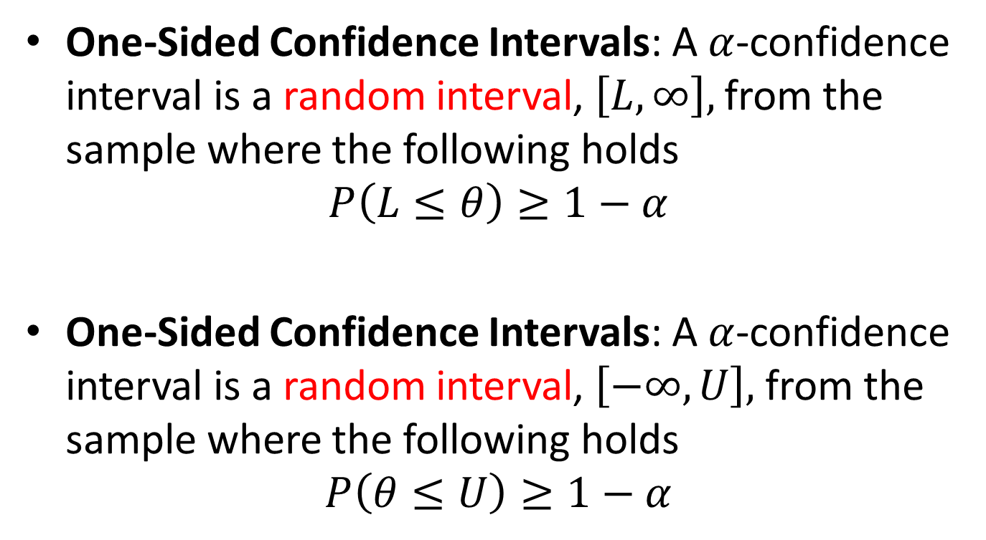
One-Sided Confidence Intervals
One-Sided Confidence Intervals: A $α$-confidence interval is a random interval, $\left[L,∞\right],$ from the sample where the following holds
$$P\left(L≤θ\right)≥1−α$$
One-Sided Confidence Intervals: A $α$-confidence interval is a random interval, $\left[−∞,U\right],$ from the sample where the following holds
$$P\left(θ≤U\right)≥1−α$$

