Slide 1
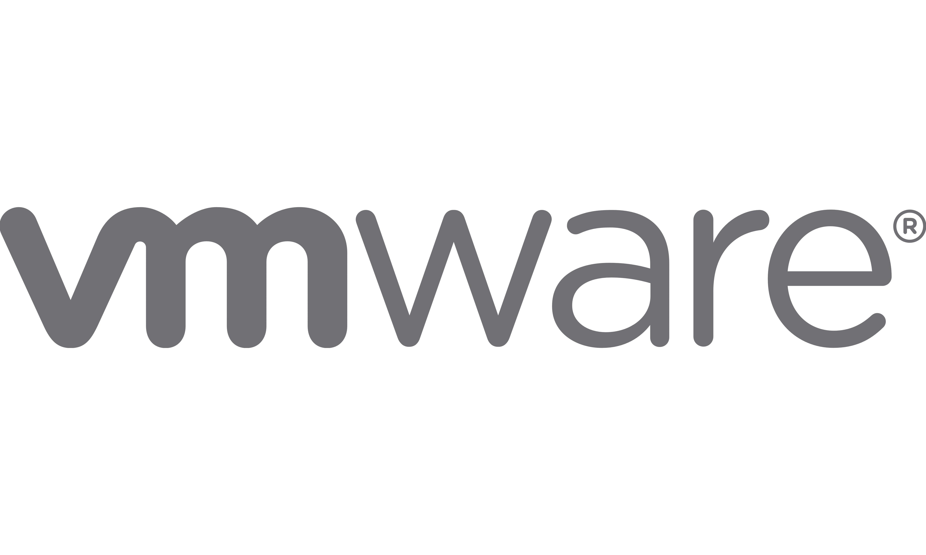
Fast Local Page-Tables for Virtualized
NUMA Servers with vMitosis
Ashish
Panwar¹
Reto
Achermann²
Arkaprava Basu¹
Abhishek Bhattacharjee³
Kanchi
Gopinath¹
Jayneel
Gandhi⁴
¹ Indian Institute of Science ²University of British Columbia ³ Yale University ⁴ VMware Research
Architectural Support for Programming Languages and Operating Systems 2021 (ASPLOS’21)
Notes:
-- Hi everyone, My name is Ashish and I am excited to present vMitosis -- a system design that makes page-tables local virtualized NUMA servers.
-- This is a joint work with my co-authors Reto, Arkaprava, Abhishek, Gopinath and Jayneel.

Slide 2
Virtualized address translation
1
guest physical
address
2
host physical
address
guest virtual
address
gVA
gPA
hPA
guest page-table
(gPT)
extended page-table
(ePT)
Performance implication
NUMA exacerbates
address translation overhead [Mitosis – ASPLOS’20]
vMitosis
Up to 24 memory references
10-50% runtime overhead
Two-dimensional page-tables
Hidden NUMA topology
Notes:
- The working-sets of current applications are far bigger than the reach of hardware TLB.
-- In a virtualized system, a TLB miss requires a two-dimensional page-table walk over guest page-tables (or gPT) and extended page-tables (or ePT).
-- This requires up to 24 memory accesses which is known to contribute 10-50% runtime overhead – these overheads will increase further with Intel’s upcoming 5-level page-tables that will require up to 35 memory accesses.
-- In this work, we focus on NUMA systems --- where the access latency of remote objects can be 2 time or more expensive than local memory. We show that NUMA effect can amplify virtualized address translation overheads and make them much worse than a traditional MA system.
-- Our previous work Mitosis that appeared in ASPLOS2020 looked at this problem in the context of native execution.
-- However, Mitosis is not a complete solution for virtualized systems – that not only involve two-dimensional page-tables but can also hide platform details from the guest OS – e.g., the NUMA topology of the physical machine – these details are important for Mitosis to implement its optimizations.
-- vMitosis bridges this gap and makes two-dimensional page-table walks local.

Slide 3
NUMA effect on virtualized address translation
Scenario 1: VM/workload migration
Existing NUMA optimizations target only user-level data
Page size: 4KiB
384 GB
384 GB
Xeon Gold 6252
Xeon Gold 6252
3.1x
2x
2.4x
2.3x
Xeon Gold 6252
Xeon Gold 6252
Threads
384 GB
D
gPT
ePT
384 GB
remote
page-tables are pinned!
3
3
Notes:
-- We focus on two common scenarios that lead to expensive page-table walks on virtualized NUMA systems.
-- The first one is related to the migration of VMs and workloads.
-- For a small workload that fits within a NUMA socket, the system tries to keep its threads and data objects close to each other.
-- These workloads are occasionally migrated across NUMA sockets e.g., to improve load balancing in the system.
-- With the help of NUMA-aware optimizations, the system also migrates data pages along with the threads.
-- Unfortunately, operating system designs today pin kernel objects in memory --- including page-tables.
-- Therefore, cross NUMA-socket migration makes page-tables remote.
-- The graph on the right quantifies the overhead of remote page-tables.
-- We find that remote page-tables can slow down an application by more than 50%.
-- The effect of NUMA increases further when page-table accesses are not only remote but also experience interference due to other workloads.
-- Overall, remote page-table walks can increase application runtime by more than 3x.

Slide 4
NUMA effect on virtualized address translation
Scenario 2: multi-socket workloads
Many threads, multiple sockets – one page-table
D
D
384 GB
384 GB
Graph500
Xeon Gold 6252
Xeon Gold 6252
Threads
Threads
Xeon Gold 6252
Xeon Gold 6252
Threads
Threads
D
D
gPT
ePT
384 GB
384 GB
4
4
Notes:
-- In the second scenario, we focus on scale-out workloads -- threads and possibly data pages of these workloads span multiple NUMA sockets.
Note that each page-table translation entry is local to 1 socket -- and remote to rest of the sockets.
For multi-socket workloads, we observe that more than 80% of their page-table walks involve at least 1 remote memory access --- and that too when the host and guest both optimize data placement for better locality -- which is possible when system NUMA topology is exposed to the virtual machine.
If the NUMA topology is hidden from the OS -- which a common case for virtualized machines -- then we find that no page-table walk can be completed without involving remote memory accesses.
This shows that multi-socket workloads are subject to high NUMA latencies due to page-table walks.

Slide 5
vMitosis: Making two-dimensional page-tables local
Scenario 1: VM/workload migration
Migrating page-tables
384 GB
384 GB
Xeon Gold 6252
Xeon Gold 6252
Xeon Gold 6252
Xeon Gold 6252
Threads
384 GB
D
gPT
ePT
384 GB
5
5
Notes:
In vMitosis, we propose techniques to handle both these cases.
-- Our solution for the migration case is quite intuitive --- when the OS or the hypervisor move workloads or virtual machines across sockets we also migrate the guest page-tables and extended page-tables.

Slide 6
vMitosis: Making two-dimensional page-tables local
Scenario 1: VM/workload migration
Page size: 4KiB
3.1x
2.4x
2.3x
2x
6
6
Notes:
-- This way, workloads execute at the same performance level in vMitosis as in an ideal system -- which is as much as 3.1x faster when compared to Linux and KVM.

Slide 7
vMitosis: Making two-dimensional page-tables local
Scenario 2: multi-socket workloads
Replicating page-tables
D
gPT³
ePT³
D
gPT²
ePT²
384 GB
384 GB
Xeon Gold 6252
Xeon Gold 6252
Threads
Threads
Xeon Gold 6252
Xeon Gold 6252
Threads
Threads
D
gPT⁴
ePT⁴
D
gPT
ePT
384 GB
384 GB
Notes:
For multi-socket workloads, we propose replicating page-tables -- that is
-- We create multiple copies of the guest and extended page-tables. Once replicated, we schedule all threads and vCPUs with their local replica.
-- This way, page-table walks can be completed without having to access remote memory.

Slide 8
vMitosis: Making two-dimensional page-tables local
Scenario 2: multi-socket workloads
Page size: 4KiB
1.2x
1.3x
1.6x
1.27x
Notes:
And this improves application performance by as much as 60%.

Slide 9
vMitosis in a nutshell
Observations
Contributions
Results
NUMA exacerbates virtualized address translation overhead
Existing NUMA optimizations
ignore kernel objects
Analysis of page-table walk access locality
Replication and migration of two-
dimensional page-tables
Prototype implementation in Linux and KVM
1.06 - 1.6x speed up for
multi-socket workloads
1.8 - 3.1x speed up for
single-socket workloads
1.0 – 1.47x speed up over
2MiB THP
Available on GitHub
https://github.com/mitosis-project
More details in the paper!
Notes:
-- To summarize, we show how NUMA increases address translation overheads because existing NUMA optimizations ignore the placement and access latency of kernel objects.
-- We present a prototype implementation of vMitosis in Linux and KVM.
-- vMitosis enables faster address translation for virtualized systems by migrating and replicating page-tables.
-- We evaluate our ptoyotype on a real 4-socket system with 1.5TiB memory and demonstrate up to 1.6x performance speed up for multi-socket workloads and up to 3.1x speed up for single-socket workloads.
-- vMitosis also improves performance over 2 megabyte huge pages by as much as 47%.
To checkout other details about vMitosis and more results --- please refer to the full paper.

