Slide 1
Algebraic Program Analysis
Ashkan Boroujeni, Jason Breck, John Cyphert, Azadeh Farzan, Zachary Kincaid, Thomas Reps, Jake Silverman

Slide 2
Recent Work
Compositional Recurrence Analysis [FMCAD 15]
Compositional Recurrence Analysis Revisited [PLDI 17]
Non-Linear Reasoning For Invariant Synthesis [POPL 18]
Numerical Invariants via Abstract Machines [Invited talk at SAS 18]
Closed Forms for Numerical Loops [POPL 19]
Refinement of Path Expressions for Static Analysis [POPL 19]
Loop Summarization with Rational Vector Addition Systems [CAV 19]
I’m going to refer to the resulting tool from this work as (I)CRA

Slide 3
Traditional Analysis
Algebraic Analysis
Abstract Domain $L= <L,⊑, ⊔, ⊥,∇>$
$L$: Space of abstract properties
$⊑$: Approximation Order
$⊔$: Join (Least upper bound)
$∇$: Widening operator
Transformers $L⟦•⟧:Inst→(L→L)$:
Maps each instruction to a monotone function
Summarize by iteratively applying transformers and join until fixed-point is reached
If necessary, apply widening to ensure termination at the sacrifice of precision
Algebra $D= <D,⊕, ⊗, ⊛, 0, 1>$
$D$: Space of abstract summaries
$⊕$: Abstract combine
$⊗$: Abstract extend
$⊛$: Iteration
$0$ and $1$: Identities
Interpretation $D⟦•⟧:Inst→D$
Maps each instruction to an abstract summary
Compute path summaries by evaluating path expressions
Notes:
The presence of $⊕$ and $⊗$ is not too strange. Many analyses are formulated as a semiring. However, the existence of an explicit iteration operator $⊛$ is what distinguishes an algebraic analysis

Slide 4
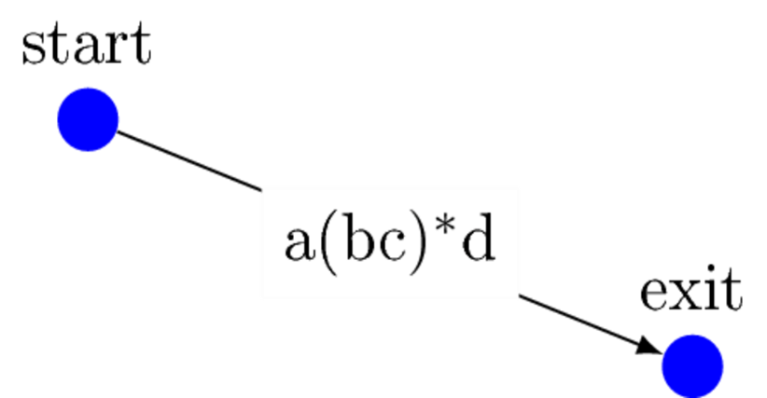
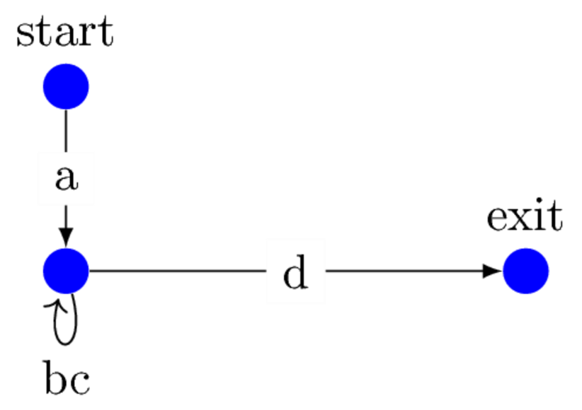
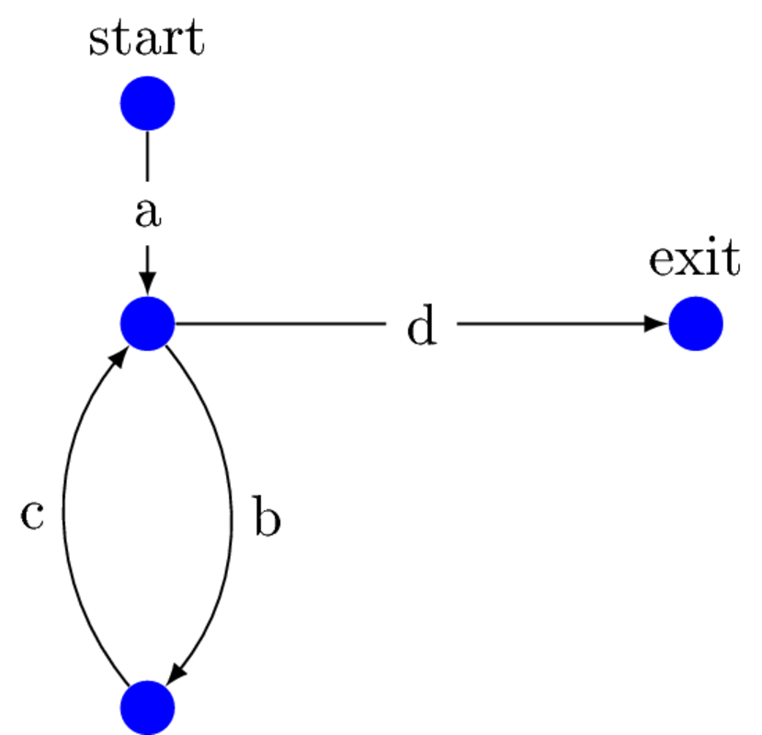
x=0;
while (x < n){
x = x+1;
}
$$a ≝ x:=0$$
$$b ≝ [x<n]$$
$$c ≝ x:=x+1$$
$$d ≝ [x≥n]$$
Goal: Summarize how the paths between these locations affect the program state
Step 1: Compute the set of paths from entry to exit as a regular expression
Step 2: Reinterpret and evaluate the regular expression operators in a semantic algebra
$$a⋅{\left(b⋅c\right)}^{∗}⋅d → ⟦a⟧⊗{\left(⟦b⟧⊗⟦c⟧\right)}^{⊛}⊗⟦d⟧$$

Slide 5
Compositional Recurrence Analysis [FMCAD15]
Let $CRA= <TF\left(x, x^{′}\right), ⊕, ⊗,⊛, 0, 1>$ be a semantic algebra with
$TF\left(x, x^{′}\right)$: Domain of two vocabulary transition formulas over the variables $x$
$φ\left(x,x^{′}\right)⊕ψ\left(x, x^{′}\right)≝φ\left(x,x^{′}\right)∨ψ\left(x, x^{′}\right)$
$φ\left(x,x^{′}\right)⊗ψ\left(x, x^{′}\right)≝∃x^{′′}.φ\left(x,x^{′′}\right)∧ψ\left(x^{′′}, x^{′}\right)$
$0≝false$
$1≝x^{′}=x$
The details $φ^{⊛}$ are the ‘’real magic’’.
$$CRA⟦b⋅c⟧≜CRA⟦b⟧⊗CRA⟦c⟧$$
$≜∃x^{′′}. x<n∧x^{′′}=x∧x^{′}=x^{′′}+1$
$≜x<n∧x^{′}=x+1$
This is our abstract summary for the loop body
To summarize the loop we directly compute
$$CRA⟦{\left(b⋅c\right)}^{∗}⟧≜{\left(x<n∧x^{′}=x+1\right)}^{⊛}$$
$≜∃k≥0. x<n∧x^{′}=x+k$
$$CRA⟦a⋅{\left(b⋅c\right)}^{∗}⋅d⟧$$
$≜x^{′}=0⊗∃k≥0. x<n ∧x^{′}=x+k⊗x≥n∧x^{′}=x$
$≜x^{′′}=0∧∃k≥0 . x′′<n∧x^{′′′}=x′′+k∧x′′′≥n∧x^{′}=x′′′$
$≜x^{′}=n∧n^{′}=n$
x=0;
while (x < n){
x = x+1;
}
$$a ≝ x:=0$$
$$b ≝ [x<n]$$
$$c ≝ x:=x+1$$
$$d ≝ [x≥n]$$
Each one of these also has $n^{′}=n$
$$CRA⟦a⟧≜ x^{′}=0$$
$$CRA⟦b⟧≜x<n∧x^{′}=x$$
$$CRA⟦c⟧≜x^{′}=x+1$$
$$CRA⟦d⟧≜x≥n∧x^{′}=x$$
$$a⋅{\left(b⋅c\right)}^{∗}⋅d$$
Notes:
In actuality there would be another clause for the case n<0, but this is omitted for presentation purposes.

Slide 6
General Strategy For Summarizing Loops [POPL18]
The Loop Guard
$$≜∃k≥0. guard\left(φ\right)∧g\left(x^{′}\right)⋈f_{sol}(g\left(x\right))$$
To compute ${φ(x, x′)}^{⊛}$
I’ll talk more about the purpose of $g$ in a moment, but for now we’ll say it’s determined by the recurrence extraction algorithm
The recurrence solver determines which class of functions $f$ it can handle
What’s this g?
Is this f arbitrary?
Recurrence Extractor
Recurrence Solver
$$φ(x, x^{′})$$
$${g(x)}^{[k+1]}⋈f({g(x)}^{\left[k\right]})$$
$${g(x)}^{[k]}⋈f_{sol}(g({x)}^{\left[0\right]})$$
$$⋈∈\{<,≤,=,>,≥\}$$

Slide 7
ICRA’s Recurrence Solving
A C-finite recurrence over $y∈ℚ^{n}$ can be written as$y^{\left[k+1\right]}=Ay^{\left[k\right]}$ where $A∈ℚ^{n×n}$
The solution of the recurrence for an element of $y^{\left[k\right]}$ is a polynomial-exponential.
$$y_{j}^{\left[k\right]}=λ_{1}^{k}\left(p_{1}\left(k\right)⋅y^{\left[0\right]}\right)+…+λ_{m}^{k}\left(p_{m}\left(k\right)⋅y^{\left[0\right]}\right)$$
Each $λ_{i}$ is an eigenvalue of $A$, and the polynomials $p_{i}(k)$ can be determined from the $λ$’s.
$y^{\left[k+1\right]}=Ay^{\left[k\right]}+b$ is also a c-finite recurrence if the elements of $b$ are polynomial-exponentials in $k$.

Slide 8
Example
i,x,y=0;
while (i < 10){
tmp = x;
x = 2*x+y+i;
y = tmp+2*y;
i = i+1;
}
Summary
$$x^{′}=7401∧y^{′}=7356∧i^{′}=10$$
Assuming initial values of $x,y,i$
$${\left[\begin{aligned}x \\ y \\ i\end{aligned}\right]}^{\left[k+1\right]}= \left[\begin{matrix}2 & 1 & 1 \\ \begin{aligned}1 \\ 0\end{aligned} & \begin{aligned}2 \\ 0\end{aligned} & \begin{aligned}0 \\ 1\end{aligned}\end{matrix}\right]{\left[\begin{aligned}x \\ y \\ i\end{aligned}\right]}^{\left[k\right]}+\left[\begin{aligned}0 \\ 0 \\ 1\end{aligned}\right]$$
Recurrence Solver
$${\left[\begin{aligned}x \\ y \\ i\end{aligned}\right]}^{\left[k\right]}= \left[\begin{aligned}1/8∗3^{k}+1/{4∗}k^{2}−1/2∗k −1/8 \\ 1/8∗3^{k}−1/4∗k^{2}−1/8 \\ k\end{aligned}\right]$$

Slide 9
General Strategy For Summarizing Loops
$$≜∃k≥0. guard\left(φ\right)∧g\left(x^{′}\right)⋈f_{sol}(g\left(x\right))$$
To compute ${φ(x, x′)}^{⊛}$
$f_{sol}$ is a system of polynomial-exponentials
C-finite Recurrence Solver
Recurrence Extractor
Recurrence Solver
$${g(x)}^{[k+1]}⋈A({g(x)}^{\left[k\right]})$$
$$φ(x, x^{′})$$
$${g(x)}^{[k+1]}⋈f({g(x)}^{\left[k\right]})$$
$${g(x)}^{[k]}⋈f_{sol}(g({x)}^{\left[0\right]})$$

Slide 10
Recurrence Extraction
For the previous examples you could simply read of implied recurrence relations from the loop body, and compute exact closed forms.
In reality loops have complicated control flow: branches in loops, nested loops, non-linear relationships, etc.
Our recurrence extraction procedure must be able to handle such general situations and produce an over-approximating recurrence.

Slide 11
Term Recurrences
i=0;
while (*){
if(*) x = 2*x+y+i;
else y = x+2*y+i;
i = i+1;
}
$$φ_{body}≜i^{′}=i+1 ∧$$
$$(x^{′}=2x+y+i ∧y^{′}=y∨x^{′}=x ∧y^{′}=x+2y+i)$$
Neither the variable $x$ nor the variable $y$ satisfies a c-finite recurrence
The term $x+y$ does: $x^{′}+y^{′}=2x+2y+i∧i^{′}=i+1$
Let $v$ and $v$’ be $x+y$ and $x′+y′$
${\left[\begin{aligned}v \\ i\end{aligned}\right]}^{\left[k+1\right]}=\left[\begin{matrix}2 & 1 \\ 0 & 1\end{matrix}\right]{\left[\begin{aligned}v \\ i\end{aligned}\right]}^{\left[k\right]}+\left[\begin{aligned}0 \\ 1\end{aligned}\right]$
${\left[\begin{aligned}v \\ i\end{aligned}\right]}^{\left[k\right]}=\left[\begin{aligned}2^{k}∗{(v}^{\left[0\right]}+1)−k−1 \\ k\end{aligned}\right]$
Final Summary: $∃k≥0. x^{′}+y^{′}=2^{k}\left(x+y+1\right)−k−1∧i^{′}=k$
Note this summary doesn’t exactly characterize $x$ or $y$.

Slide 12
Recurrence Inequations
while (*){
if(*) x = x+1;
}
$$φ_{body}≜x^{′}=x+1 ∨x^{′}=x$$
$x$ does not satisfy a recurrence
There is no term satisfying a recurrence
There is a recurrence inequation that gives some information about the dynamics of $x$
$x≤x^{′}≤x+1⇒x^{\left[k+1\right]}≤x^{\left[k\right]}+1∧x^{\left[k+1\right]}≥x^{\left[k\right]}$
${\left(φ_{body}\right)}^{⊛}≜∃k≥0. x≤x^{′}≤x+k$

Slide 13
Recurrence Extraction [POPL 18]
Abstract a formula $φ\left(x,x^{′}\right)$ with a bounding polyhedron
$$φ\left(x,x^{′}\right)⇒Dx^{′}=Mx+d$$
Find a linear transformation $T$, such that $TD=B$ and $TM$ factors as $A∗B$ with $A$ having as large of a dimension as possible
Return the term recurrence $Bx^{\left[k+1\right]}=A∗Bx^{\left[k\right]}+c,$ where
$Td=c$
Recurrence inequation extraction is similar.
Notes:
First extract recurrence equations, then recurrence inequations

Slide 14
General Strategy For Summarizing Loops
$$≜∃k≥0. guard\left(φ\right)∧Bx^{′}⋈f_{sol}(Bx)$$
$$≜∃k≥0. guard\left(φ\right)∧g\left(x^{′}\right)⋈f_{sol}(g\left(x\right))$$
To compute ${φ(x, x′)}^{⊛}$
Polyhedral techniques
C-finite Recurrence Solver
Recurrence Extractor
$${Bx}^{[k+1]}⋈A{∗Bx}^{\left[k\right]}+c$$
$${Bx}^{[k]}⋈f_{sol}(Bx^{\left[0\right]})$$
$$φ(x, x^{′})$$
$${g(x)}^{[k+1]}⋈A({g(x)}^{\left[k\right]})$$
$${g(x)}^{[k]}⋈f_{sol}(g({x)}^{\left[0\right]})$$

Slide 15
Control Flow Refinement [POPL19]
x=0;
y=50;
while (x < 100){
x = x+1;
if (x > 50)
y = y + 1;
}
assert(y==100);
$${(φ_{body})}^{⊛}$$
$$($$
$$A$$
$$+$$
$$B$$
$$)^{∗}$$
$${(φ_{body})}^{⊛}≔∃k. x<100∧x^{′}=x+k∧y≤y^{′}≤y+k$$
$${(x=0∧y=50)⊗(φ_{body})}^{⊛}⊗\left(x≥100\right)≔x^{′}=100∧50≤y^{′}≤150$$
$φ_{body} ≔$ $x<100 ∧x^{′}=x+1∧x^{′}≤50∧y^{′}=y$ $∨$
$x<100 ∧x^{′}=x+1∧x^{′}>50∧y^{′}=y+1$
$φ_{A} ≔x<100 ∧x^{′}=x+1∧x^{′}≤50∧y^{′}=y$
$φ_{B} ≔x<100 ∧x^{′}=x+1∧x^{′}>50∧y^{′}=y+1$
Our resulting summary
Only a recurrence Inequation for $y$
This analysis was unable to prove the assertion

Slide 16
Original Representation
Loop Path Expression
Refined Path Expression
x=0;
y=50;
while (x < 100){
x = x+1;
if (x > 50)
y = y + 1;
}
assert(y==100);
$${\left(A+B\right)}^{∗}$$
$$A^{∗}B^{∗}$$
$$D= <D,⊕, ⊗, ⊛, 0, 1>$$
This expression comes from the syntax of the program
The semantics indicate any path containing $BA$ is not feasible
The analysis of this expression was too imprecise to prove the assertion
$$x^{′}=100∧y^{′}=100$$
$A$ represents the path where the
then branch is not taken
$B$ represents the path where the
then branch is taken
Notes:
(A+B)^* and A^*B^* are the same, except A^*B^* has infeasible paths removed. The analysis of (A+B)^* was unable to prove the assertion but the analysis of A^*B^* was able to prove the assertion.

Slide 17
Idea: Control-flow Refinement
Can $S′$ ever be worse than $S$?
Original Representation
Interpretation of $R$ in the domain
Interpretation of $R′$ in the domain
Path Expression
YES!
$S′$ can be worse than $S$
Refined Path Expression
x=0;
y=50;
while (x < 100){
x = x+1;
if (x > 50)
y = y + 1;
}
assert(y==100);
$$D= <D,⊕, ⊗, ⊛, 0, 1>$$
$$D= <D,⊕, ⊗, ⊛, 0, 1>$$
$$R$$
$$R′$$
$$S$$
$$S′$$
$R$ and $R′$ still represent the same set of concrete actions, but $L\left(R′\right)⊂L(R)$
Detect and remove infeasible paths from $R$ to create $R′$
$$D= <D,⊕, ⊗, ⊛, 0, 1>$$
$$S$$
$S′$ is often better than $S$

Slide 18
Contribution: Guaranteed No Precision Loss
We give an axiomatization for a class of algebraic analyses
Previous axiomatizations such as Kleene Algebra’s (KA) are too strong. They imply * is a least fixed-point
We introduce Pre-Kleene Algebra’s (PKA) which allows us to weakly characterize algebraic analysis precision
We give an algorithm that when given a path expression $R$ and infeasible words ℇ, produce another path expression $R^{′}$ with
$R^{′}$ is equivalent to $R$ modulo ℇ
${L(R}^{′})⊆L(R)$
$R^{′}≤_{PKA}R$
This distinguishing property is what gives us precision guarantees.

Slide 19
Recent Experimental Results
Kincaid, Cyphert, Breck, Reps
Non-Linear Reasoning for Invariant synthesis
Not a PKA
Ancourt, Coelho, Irigoin
A Modular Static Analysis Approach to Affine Loop Invariants Detection
A PKA
State of the Art Model Checkers
Time in seconds
Programs with true assertions
Summary:
25% more assertions proved with refinement
50% increase in analysis time
Assertions Proved

Slide 20
Conclusion
Algebraic Analysis builds path summaries non-iteratively
Often, gives more consistent analyses in terms of precision and analysis time
An example of an Algebraic Analysis is (I)CRA
Summarizes paths using transition formulas
Summarizes loops by extracting and solving recurrences
Generates non-linear summaries (exponentials, logarithms, polynomials)
ICRA [PLDI 17] generalizes to interprocedural analysis
Applications include complexity analysis and assertion checking
We are exploring how our techniques can apply to
Hypersafety analysis
Other data-types (arrays, strings, etc)
Horn-clause solving

Slide 21
Other Features and Future Work
ICRA [PLDI 17] generalizes to interprocedural analysis
ICRA generates non-linear summaries (exponentials, logarithms, polynomials)
Has applications in complexity analysis, assertion checking, and invariant generation
We are exploring how our techniques can apply to
Hypersafety analysis
Other data-types (arrays, strings, etc)
Horn-clause solving

Slide 22
Another Example
i=0;j=0;
while (*){
if (pos > 0) {
if (*) {
i=i+1;j=j+1;
pos=1;
} else {
i=i+1;j=j+1;
pos=0;
}
} else {
i=i+1;j=j+1;
pos=1;
}
}
assert(i==j);
$$($$
$$A$$
$$+$$
$$+$$
$$C$$
$$)^{∗}$$
$$D= <D,⊕, ⊗, ⊛, 0, 1>$$
$$i=j$$
$$B$$
$${\left(w_{body}\right)}^{⊛}≔{∃k. i}^{′}−i=k∧j^{′}−j=k∧0≤pos^{′}≤1$$
$$w_{body}≔i^{′}−i=1∧j^{′}−j=1∧0≤pos^{′}≤1$$
$$\left(ε+C\right){\left(A+BC\right)}^{∗}(ε+B)$$
$$D= <D,⊕, ⊗, ⊛, 0, 1>$$
$$i≤2j∧j≤2i$$
$AC, BA, BB,$and $CC$ are infeasible subwords
We’ve lost equality for $i$ and $j$
$$\left(φ_{A}⊕{(φ}_{B}⊗φ_{C})\right)≔{(i}^{′}=i+1∧j^{′}=j+1∧pos≥0∧pos^{′}=1)∨$$
${(i}^{′}=i+2∧j^{′}=j+2∧pos≥0∧pos^{′}=1)$
$$\left(w_{body}^{′}\right)≔{(1≤i}^{′}−i≤2∧{1≤j}^{′}−j≤2 ∧pos≥0∧pos^{′}=1)$$

Slide 23
Control-flow Refinement
Original Representation
Interpretation of $R′$ in the domain
Path Expression
Refined Path Expression
x=0;
y=50;
while (x < 100){
x = x+1;
if (x > 50)
y = y + 1;
}
assert(y==100);
$$R$$
$$R′$$
$$D= <D,⊕, ⊗, ⊛, 0, 1>$$
$$S′$$
$$S$$
Previously refining was a transformation based solely on reducing languages
Such a transformation is thus based on the algebra of regular expressions
Instead we need to create transformations based on this algebra

Slide 24
Contributions
Algebra for understanding analysis precision
Pre-Kleene Algebra
An algorithm for control-flow refinement
Comes with precision guarantees
Works in a uniform way for any algebraic analysis that satisfies the PKA axioms
Experimental Evaluation

Slide 25
Kleene Algebra (Kozen 1994)
Kleene Algebra $=<A, +,⋅,∗,0,1>$
$<A, +,⋅,0,1>$ is an idempotent semiring.
$+$ and $⋅$ are associative and satisfy distributivity
$+$ is commutative
0 and 1 are identities for $+$ and $⋅$
$a+a=a$ for all $a∈A$
Partial order: $a≤b↔a+b=b$
$∗−axioms$
$1+a{\left(a\right)}^{∗}≤a^{∗}$ and $1+{\left(a\right)}^{∗}a≤a^{∗}$ for all $a∈A$
If $a, x∈A$ with $ax≤x$, then $a^{∗}x≤x$
If $a, x∈A$ with $xa≤x$, then $xa^{∗}≤x$
$$<REG_{Σ}, +,⋅,∗,∅,ε>$$
Regular languages over alphabet $Σ$
Concatenation
Union
Kleene star
These axioms allow for the interpretation
$a^{∗}=1+a+aa+…$

Slide 26
What is an Algebra of Abstract Domains?
Kleene-Algebra is too strong
The axioms imply $a^{∗}$ is equal to the least fixed point of $f_{a}\left(x\right)=1+ax$
For many abstract domains, especially ones which don’t satisfy the ascending chain condition, least fixed points are not computable.
We need a weaker axiomatization for $D= <D,⊕, ⊗, ⊛, 0, 1>$

Slide 27
Pre-Kleene Algebra (Our Algebra of Abstract Domains)
All Kleene algebras are Pre-Kleene algebras, but the converse is not true
Pre-Kleene Algebra $=<A, +,⋅,∗,0,1>$
$<A, +,⋅,0,1>$ is an idempotent semiring.
$+$ and $⋅$ are associative and satisfy distributivity
$+$ is commutative
0 and 1 are identities for $+$ and $⋅$
$a+a=a$ for all $a∈A$
Partial order: $a≤b↔a+b=b$
$∗−axioms$
(Reflexivity) $1≤a^{∗}$ for all $a∈A$
(Extensitivity) $a≤a^{∗}$ for all $a∈A$
(Transitivity) $a^{∗}⋅a^{∗}=a^{∗}$ for all $a∈A$
(Monotonicity) If $a,b∈A$ with $a≤b$ then $a^{∗}≤b^{∗}$
(Unrolling) ${\left(a^{n}\right)}^{∗}≤a^{∗}$ for $n∈ℕ$ and $a∈A$
The semantic algebra given earlier is a PKA but not a KA

Slide 28
$$R^{′}≤_{PKA}{\left(a_{1}+…+a_{k}\right)}^{∗}$$
What properties must $R^{′}$ satisfy?
$R^{′}≤_{PKA}{\left(a_{1}+…+a_{k}\right)}^{∗}$ if and only if
$R′$ has star-height 0 or 1
For every ${{(R}_{i})}^{∗}$ of $R′$, $L\left(R_{i}\right)⊆L({\left(a_{1}+…+a_{k}\right)}^{n})$
$A^{∗}B^{∗}≤_{PKA}{\left(A+B\right)}^{∗}$
$\left(ε+C\right){\left(A+BC\right)}^{∗}\left(ε+B\right)≰_{PKA}{\left(A+B+C\right)}^{∗}$
Equal-Unrolling Property

Slide 29
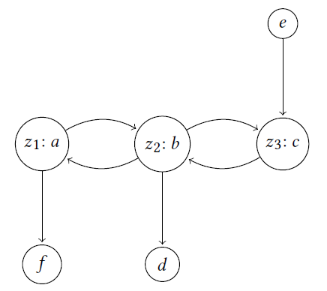
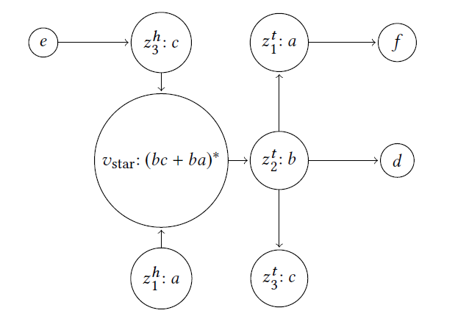
Loop Refinement Procedure
Compute Path-Expression over the resulting DAG
Given ${\left(a_{1}+…+a_{k}\right)}^{∗}$
Create a graph with vertices $\left\{a_{1},…,a_{k}\right\}$
For each pair, $(a_{i},a_{j})$, if $a_{i}⋅a_{j}$ is feasible add edge $(a_{i},a_{j})$
Detect SCCs and capture with a single $∗$

Slide 30
Refining Arbitrary Expressions
GeneralRefinement$(E)$
Recursively calls itself for $+$ and $⋅$ operators
For a $∗$
Take star-body to a sum-of-products
Recursively refine each summand
Syntactically refine the single level loop
Replace refined summands in the refined loop
Theorem 5.2
Let $E^{′}=$GeneralRefinement$(E)$
Then $L\left(E^{′}\right)⊆L(E)$ and $E^{′}≤_{PKA}E$

Slide 31
Conclusion
Algebra for understanding analysis precision
Pre-Kleene Algebra
An algorithm for control-flow refinement
$R^{′}$ is equivalent to $R$ modulo ℇ
${L(R}^{′})⊆L(R)$
$R^{′}≤_{PKA}R$ (٭)
25% more assertions
50% increase in analysis time
Thank you for your time

Slide 32
Outline
Iterative vs Algebraic Analysis

Slide 33
The cloud represents the actual concrete states of a program.
In general we can’t exactly describe the cloud
Thus we approximate it
Re
Initial States
Each green circle covers previous green circles
A sound analysis ensures the final fix-point will cover the cloud
Our abstract description didn’t change. We reached a fix-point
Apply abstract transfer function

Slide 34
The Good ☺
Kleene’s fixed-point theorem ensures our final description is a least fixed-point.
In other words, if the iterative process terminates, we are guaranteed to have the most precise answer given our choice of abstract domain.
The Bad 😐
The process is not parallelizable.
The Ugly ☹
The naïve iteration may not terminate

Slide 35
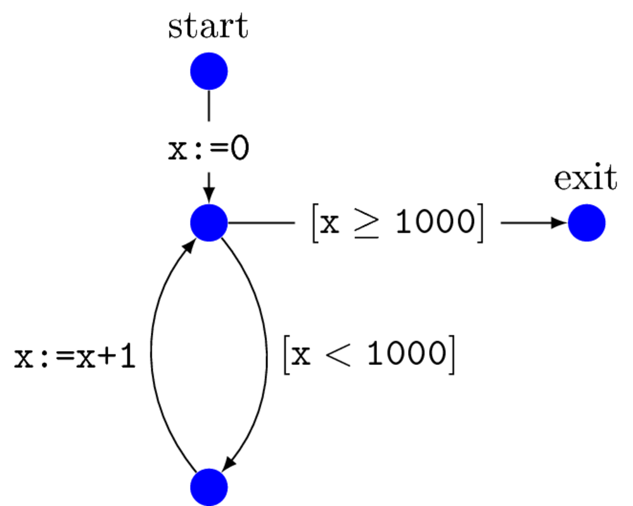
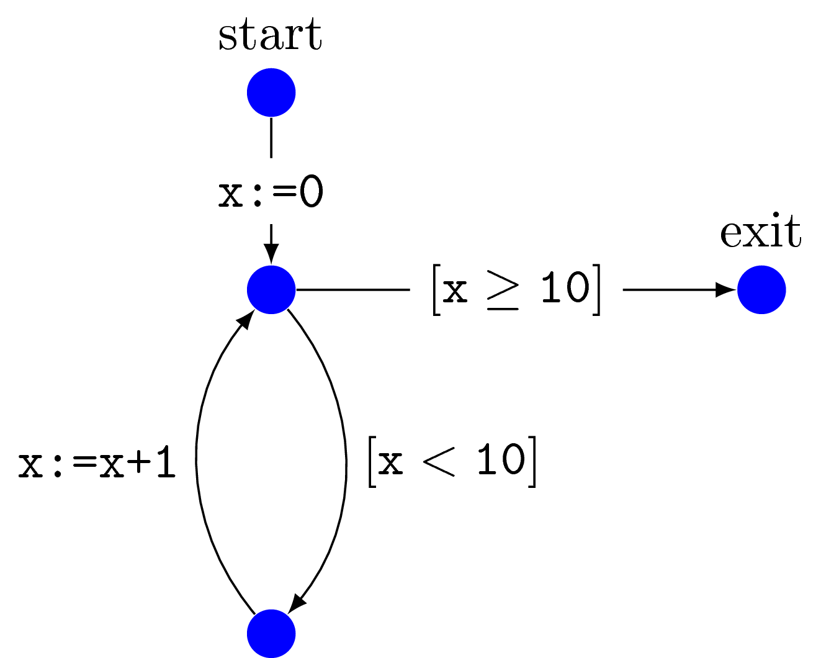
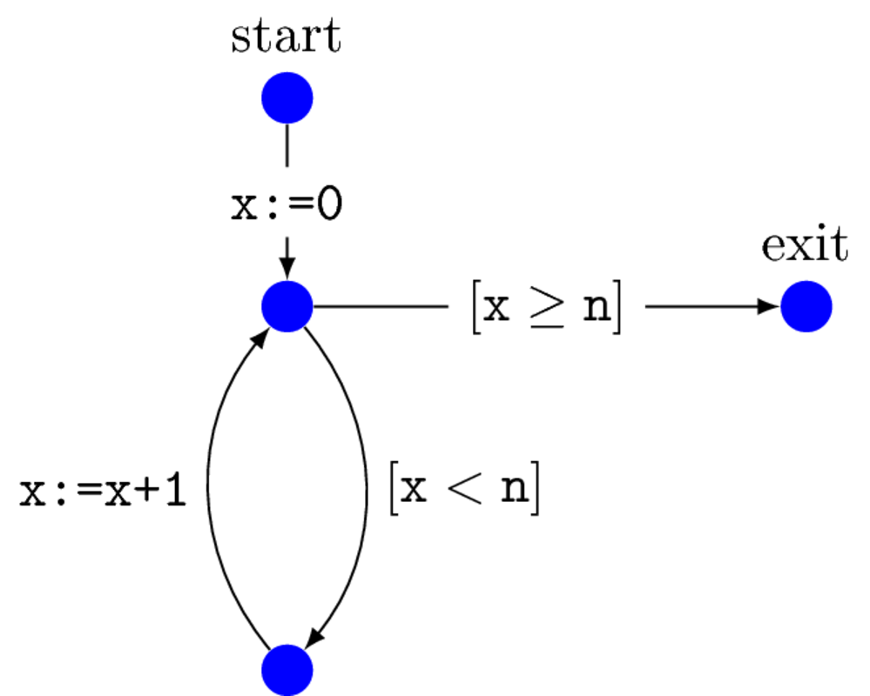
A Modified Example
x=0;
while (x < n){
x = x+1;
}
x=0;
while (x < 10){
x = x+1;
}
x=0;
while (x < 1000){
x = x+1;
}
Iteration will never reach a fixed-point
The analysis of this program will take 1000 iterations.
The analysis of this program took roughly 10 iterations.

Slide 36
Traditional Iterative Analysis
Goal: Assign an abstract property for each control location.
x=0;
while (x < 10){
x = x+1;
}
$$x∈[−∞, ∞]$$
$$x∈\left[1,1\right]⊔$$
$$x∈\left[1,2\right]⊔$$
$$x∈\left[0,9\right]$$
$$x∈\left[0,8\right]$$
$$x∈\left[1,9\right]⊔$$
$$x∈[0,0]$$
$$x∈\left[1,10\right]⊔$$
$$x∈\left[0,10\right]$$
$$x∈\left[0,2\right]$$
$$⊥$$
$$x∈\left[0,1\right]$$
$$⊥$$
$$x∈\left[10,10\right]$$
What did we need?
Abstract Domain $L= <L,⊑, ⊔, ⊥>$
$L$: Space of abstract properties
$⊑$: Approximation Order
$⊔$: Join (Least upper bound)
Transformer $L⟦•⟧:Edge→(L→L)$:
Maps each instruction to a monotone function
CFG = <Loc, Edge>
Loc : control locations
Edge : instruction-labeled edges
$$x∈\left[0,2\right]$$
$$x∈\left[0,9\right]$$
$$x∈\left[0,8\right]$$
$$x∈[0,0]$$
$$x∈[0,1]$$
$$⊥$$
Notes:
The choice of abstract domain illustrates a tradeoff. More precise domains usually require more expensive operations. Mostly notably equality testing.

Slide 37
Alternative Approach
Instead of approximating states, approximate transformers.
Compute abstract path summaries for program fragments
Create more complex summaries bottom-up in a compositional manner.
Don’t necessarily rely on an iterative fixed-point finding procedure

