Slide 1
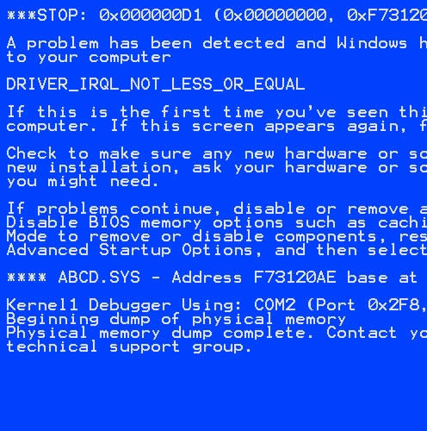
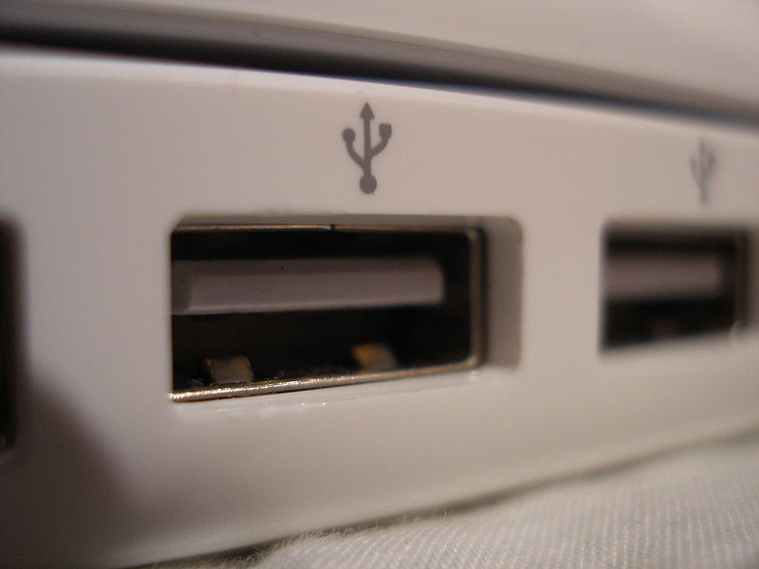

Understanding Modern Device Drivers
Asim Kadav and Michael M. Swift
University of Wisconsin-Madison

Slide 2
Why study device drivers?
  Linux drivers constitute ~5 million LOC and 70% of kernel
  Little exposure to this breadth of driver code from research
  Better understanding of drivers can lead to better driver model
Large code base discourages major changes
  Hard to generalize about driver properties
  Slow architectural innovation in driver subsystems
Existing architecture: Error prone drivers
  Many developers, privileged execution, C language
  Recipe for complex system with reliability problems

Slide 3
Our view of drivers is narrow
Driver research is focused on reliability
  Focus limited to fault/bug detection and tolerance
  Little attention to architecture/structure
Driver research only explores a small set of drivers
  Systems evaluate with mature drivers
  Volume of driver code limits breadth
  Necessary to review current drivers in modern settings

Slide 4
Difficult to validate research on all drivers
Improvement | System | Validation
 |  | Drivers | Bus | Classes
New functionality | Shadow driver migration ^{[OSR09]} | 1 | 1 | 1
 | RevNIC ^{[Eurosys 10]} | 1 | 1 | 1
Reliability | Nooks ^{[SOSP 03]} | 6 | 1 | 2
 | XFI ^{[ OSDI 06]} | 2 | 1 | 1
 | CuriOS ^{[OSDI 08]} | 2 | 1 | 2
Type Safety | SafeDrive ^{[OSDI 06]} | 6 | 2 | 3
 | Singularity ^{[Eurosys 06]} | 1 | 1 | 1
Specification | Nexus ^{[OSDI 08]} | 2 | 1 | 2
 | Termite ^{[SOSP 09]} | 2 | 1 | 2
Static analysis tools | SDV ^{[Eurosys 06]} | All | All | All
 | Carburizer ^{[SOSP 09]} | All/1 | All | All
 | Cocinelle ^{[Eurosys 08]} | All | All | All
Device availability/slow driver development restrict our research runtime solutions to a small set of drivers

Slide 5
Difficult to validate research on all drivers
Improvement | System | Validation
 |  | Drivers | Bus | Classes
New functionality | Shadow driver migration ^{[OSR09]} | 1 | 1 | 1
 | RevNIC ^{[Eurosys 10]} | 1 | 1 | 1
Reliability | Nooks ^{[SOSP 03]} | 6 | 1 | 2
 | XFI ^{[ OSDI 06]} | 2 | 1 | 1
 | CuriOS ^{[OSDI 08]} | 2 | 1 | 2
Type Safety | SafeDrive ^{[OSDI 06]} | 6 | 2 | 3
 | Singularity ^{[Eurosys 06]} | 1 | 1 | 1
Specification | Nexus ^{[OSDI 08]} | 2 | 1 | 2
 | Termite ^{[SOSP 09]} | 2 | 1 | 2
Static analysis tools | SDV ^{[Eurosys 06]} | All | All | All
 | Carburizer ^{[SOSP 09]} | All/1 | All | All
 | Cocinelle ^{[Eurosys 08]} | All | All | All
“...Please do not misuse these tools!(Coverity).... If you focus too much on fixing the problems quickly rather than fixing them cleanly, then we forever lose the opportunity to clean our code, because the problems will then be hidden.”
LKML mailing list http://lkml.org/lkml/2005/3/27/131

Slide 6
Understanding Modern Device Drivers
Study source of all Linux drivers for x86 (~3200 drivers)
Understand properties of driver code
  What are common code characteristics?
  Do driver research assumptions generalize?
Understand driver interactions with outside world
  Can drivers be easily re-architected or migrated ?
  Can we develop more efficient fault-isolation mechanisms?
Understand driver code similarity
  Do we really need all 5 million lines of code?
  Can we build better abstractions?

Slide 7
Outline
Methodology
Driver code characteristics
Driver interactions
Driver redundancy

Slide 8
Methodology of our study
Target Linux 2.6.37.6 (May 2011) kernel
Use static source analyses to gather information
Perform multiple dataflow/control-flow analyses
  Detect driver properties of the drive code
  Detect driver code interactions with environment
  Detect driver code similarities within classes

Slide 9
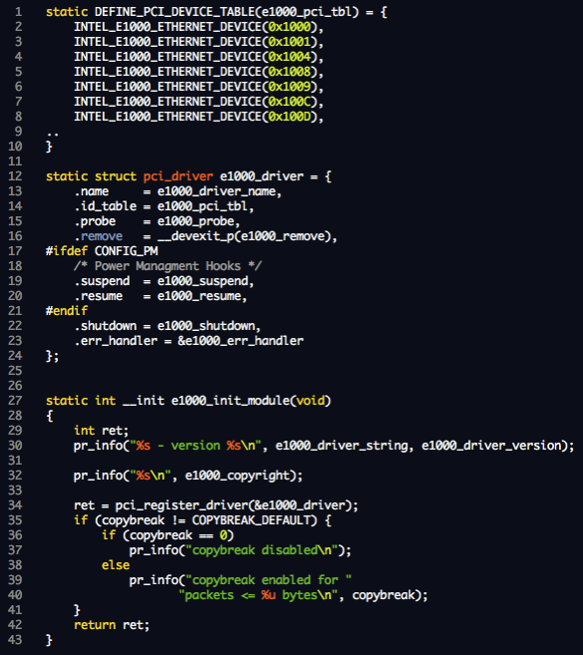
Extract driver wide properties for individual drivers
Step 1: Determine driver code characteristics for each driver from driver data structures registered with the kernel

Slide 10
Determine code characteristics of each driver function
Step 2: Propagate the required information to driver functions and collect information about each function

Slide 11
Determining interactions of each driver function
Step 3: Determine driver interactions from I/O operations and calls to kernel and bus for each function and propagate to entry points

Slide 12
Outline
Methodology
Driver code characteristics
Driver interactions
Driver redundancy

Slide 13
Part 1: Driver Code Behavior
A device driver can be thought of as a translator. Its input consists of high level commands such as “retrieve block 123”. Its output consists of low level, hardware specific instructions that are used by the hardware controller, which interfaces the I/O device to the rest of the system.
-- Operating System Concepts VIII edition
Driver code complexity and size is assumed to be a result of its I/O function.

Slide 14
1-a) Driver Code Characteristics
Core I/O & interrupts – 23%
Initialization/cleanup – 36 %
Device configuration – 15%
Power management – 7.4%
Device ioctl – 6.2%

Slide 15
Driver Code Characteristics
Core I/O & interrupts – 23%
Initialization/cleanup – 36 %
Device configuration – 15%
Power management – 7.4%
Device ioctl – 6.2%
Only 23% of driver code is dedicated to I/O and interrupts
Notes:
First, we find that only 23% of overall driver code is dedicated to perform core I/O and interrupt processing. This means bulk of code in a driver is not towards core I/O and hence driver improvement should also look at non I/O code for improving the quality of drivers.

Slide 16
Driver Code Characteristics
Core I/O & interrupts – 23%
Initialization/cleanup – 36 %
Device configuration – 15%
Power management – 7.4%
Device ioctl – 6.2%
Driver code complexity stems mostly from initialization/cleanup code.
Notes:
Next, we find that majority of driver code – about 36% is dedicated towards driver initialization and cleanup. Efforts at reducing the complexity of drivers should also focus on better mechanisms for driver initialization and cleanup. For example, as devices are increasingly becoming virtualization aware, quick ways to initialize devices are critical for important I/O virtualization features such as re-assignment of devices.

Slide 17
Driver Code Characteristics
Core I/O & interrupts – 23%
Initialization/cleanup – 36 %
Device configuration – 15%
Power management – 7.4%
Device ioctl – 6.2%
Better ways needed to manage device configuration code
Notes:
We also find, that the device configuration is the third biggest contributor to driver code. Network and video drivers have upto 30% of their code as device configuration. OS research should also look at better mechanisms for managing shared configuration code. About 6% of driver code is also exposed as opaque iocts. There are oppurtunites to make better interfaces and present more informed view of this part of configuration code to the kernel

Slide 18
1-b) Do drivers belong to classes?
Drivers registers a class interface with kernel
  Example: Ethernet drivers register with bus and net device library
Class definition includes:
  Callbacks registered with the bus, device and kernel subsystem
  Exported APIs of the kernel to use kernel resources and services
Most research assumes drivers obey class behavior
Notes:
We next look at whether drivers can be described based on their class definitions. Most drivers register a class interface with kernel to utilize device library services of that class. For example, PCI network drivers register with the network device subsystem and PCI bus subsystem to use its services. It is often assumed that drivers will behave within the boundaries of the class definition and the complete semantics of drivers can be understood by its registered calls to and from the kernel. However, many vendors introduce non-class behavior in driver to introduce non-standard features for competetive advantage in their products.

Slide 19
Class definition used to record state
Modern research assumes drivers conform to class behavior
Example: Driver recovery (Shadow drivers^{[OSDI 04]} )
Driver state is recorded based on interfaces defined by class
State is replayed upon restart after failure to restore state
Non-class behavior can lead to incomplete restore after failure
Figure from Shadow drivers paper
Notes:
Most research assumes that drivers observe class behavior. For example, shadow drivers which automatically recovers device state after failures, records driver state based on class definition. It then replays this state upon failure, to bring back the driver to its previous state. ENTER. Non class behavior can lead to incomplete restore after failure since the state via non-class behavior is not recorded

Slide 20
Class definition used to infer driver behavior
Example2 : Reverse engineering of drivers - Revnic^{[Eurosys 10]}
Driver behavior is reverse engineered based on interfaces defined by class
Driver entry points are invoked to record driver operations
Code is synthesized for another
OS based on this behavior
Figure from Revnic paper
Non-class behavior can lead to incomplete reverse engineering of device driver behavior
Notes:
Another example is reverse engineering of drivers.For example, a recent system, RevNIC records driver behavior state for one operating system and synthesizes it for another operating system by observing the traces. The traces are generated by invoking driver operations based on class behavior.
PRESS Hence, non class behavior can lead to synthesis of incomplete driver.
----- Meeting Notes (3/1/12 16:20) -----
Drop this revnic

Slide 21
Do drivers belong to classes?
Non-class behavior stems from:
  Load time parameters, unique ioctls, procfs and sysfs interactions
... qlcnic_sysfs_write_esw_config (...) {
...
switch (esw_cfg[i].op_mode) {
case QLCNIC_PORT_DEFAULTS:
qlcnic_set_eswitch_...(...,&esw_cfg[i]);
...
case QLCNIC_ADD_VLAN:
qlcnic_set_vlan_config(...,&esw_cfg[i]);
...
case QLCNIC_DEL_VLAN:
esw_cfg[i].vlan_id = 0;
qlcnic_set_vlan_config(...,&esw_cfg[i]);
...
Drivers/net/qlcnic/qlcnic_main.c: Qlogic driver(network class)
Notes:
In Linux drivers, non class behavior manifests as load time parameters to the driver, unique ioctols to the device and interactions with the sys and proc file system. For, example, the Qlogic network driver shown in the figure, was detected by our analysis as an example of non-class behavior. The driver configuration settings are read from the sysfs and appropriate driver functions are called to change the driver state. This behavior is not recorded or invoked if one is only tracking class behavior operations.

Slide 22
Many drivers do not conform to class definition
Results as measured by our analyses:
  16% of drivers use proc /sysfs support
  36% of drivers use load time parameters
  16% of drivers use ioctl that may include non-standard behavior
Breaks systems that assume driver semantics can be completely determined from class behavior
Overall, 44% of drivers do not conform to class behavior
Systems based on class definitions may not work properly when such non-class extensions are used
Notes:
We used our analyses to identify such behavior across all drivers and find that code supporting /proc and /sys is present in 16% of drivers. 36% of drivers have atleast one parameter to control behavior and configuration options not available through the class interface. Additionally, 16% of driver code contains ioctl, which can cause non-class behavior.
Overall, 44% of drivers use one of the first two non-class features and such code breaks systems that use class behavior to interpret the semantics of drivers

Slide 23
1-c) Do drivers perform significant processing?
Drivers are considered only a conduit of data
Example: Synthesis of drivers (Termite^{[SOSP09]})
  State machine model only allows passing of data
  Does not support transformations/processing
But: drivers perform checksums for RAID, networking, or calculate display geometry data in VMs
Notes:
Another common assumption is that drivers perform little processing and just shuttle data between OS and device. For example, automatic synthesis of drivers only allows operations primarily based on communicating data. It does not support memory transformations or processing made by drivers. However, if drivers perform processing for example to compute checksums for RAID, or to calculate display data, then automatic synthesis is unable to generate code for these parts of the driver

Slide 24
Instances of processing loops in drivers
Detect loops in driver code that:
  do no I/O,
  do not interact with kernel
  lie on the core I/O path
static u8 e1000_calculate_checksum(...)
{ u32 i;
u8 sum = 0;
...
for (i = 0; i < length; i++)
sum += buffer[i];
return (u8) (0 - sum);
}
drivers/net/e1000e/lib.c: e1000e network driver
Notes:
In order to detect processing, we detect loops in driver code that do not perform I/O, do not interact with kernel and lie on the core I/O path. The goal here was to detect driver code that transforms incoming or outgoing driver data in a loop without invoking a kernel service or making device calls. ENTER For example, in this figure, in the processing instance detected by our driver, we can see that the network driver is computing checksum for the network packets.

Slide 25
Many instances of processing across classes
static void _cx18_process_vbi_data(...)
{
// Process header & check endianess
// Obtain RAW and sliced VBI data
// Compress data, remove spaces, insert mpg info.
}
void cx18_process_vbi_data(...)
{
// Loop over incoming buffer
// and call above function
}
drivers/media/video/cx18/cx18-vbi.c:cx18 IVTV driver
Notes:
We also find other classes of drivers that perform processing. Here in this figure, we can see video processing being done by media drivers on the incoming video data. Other forms of processing include, wireless drivers which use processing to calculate power levels at different frequencies. Even CDROM drivers, use computation to analyze table of content information for CD-ROMS

Slide 26
Drivers do perform processing of data
Processing results from our analyses:
  15% of all drivers perform processing
  28% of sound and network drivers perform processing
Driver behavior models should include processing semantics
  Implications in automatic generation of driver code
  Implications in accounting for CPU time in virtualized environment
Driver behavior models should consider processing
Notes:
We also see that higher percentage of network and sound drivers perform processing. These results have implications in not just automatic generation of drivers but also in virtualized settings where heavy I/O from one guest VM can substantially reduce CPU for other guest VMs without proper accounting.

Slide 27
Outline
Methodology
Driver code characteristics
Driver interactions
Driver redundancy
Notes:
We next looks at couple of results from our driver interactions study.

Slide 28
Part 2: Driver interactions
a) What are the opportunities to redesign drivers?
  Can we learn from drivers that communicate efficiently?
  Can driver code be moved to user mode, a VM, or the device for improved performance/reliability?
b) How portable are modern device drivers?
  What are the kernel services drivers most rely on?
c) Can we develop more efficient fault-tolerance mechanisms?
Study drivers interaction with kernel, bus, device, concurrency
Notes:
In this section, we look at how drivers use the kernel and how drivers communicate with devices? We see three reasons to study these interactions. First, extra processing power on devices or extra cores on host CPU provide an oppurtunity to redesign the driver architecture for improved reliability and performance
Second, much of the difficulty in moving drivers comes from the driver/kernel interface, so investigating what drivers request from kernel can aid in designing more portable drivers. Third the cost of isolation and reliability are proportional to the size of the interface and the frequency of interactions, so understanding the interface can lead to more efficient fault tolerance mechanisms

Slide 29
2-a) Driver kernel interaction
Calls/driver from all entry points
Notes:
We use our analyses to detect driver interactions with the kernel. The yaxis.. We classify these invocations based on 5 categories using static analysis: First is : Memory management (e.g. allocation): Second is Synchronization (e.g. Locks), Third is Kernel Library (generic stateless support routines – like timers, checksums, reporting etc. Fourth is Kernel Services (access to other subsystems like vfs, cpu, etc) Finally,Device Library (device subsystem supporting a class such as the network drivers)

Slide 30
Driver kernel interaction
Calls/driver from all entry points
Common drivers invoking device specific routines reduces driver code significantly (and more classes can benefit)
Notes:
While we expect diversity in kernel interaction, we see that some of the drivers such as ATA, IDE, gpio, drivers make limited use of kernel services.We look closely and find that in these drivers, rather than having a driver that invokes support routines, these drivers are a small set of device specific routines called from a much larger common driver. This design is similar to miniport drivers in Windows. ENTERConverting more drivers into this architecture can be benefical in reducing driver code as we see in the last part of the talk
----- Meeting Notes (3/1/12 16:20) -----
remove uwb
double check acpi and gpio (and thats why they have simple)

Slide 31
Driver kernel interaction
Calls/driver from all entry points
Many classes are portable: Limited interaction with device library and kernel services
Notes:
We next look at portability of drivers? We look at what does the driver need the kernel for? If we want to run driver code elsewhere, such as user-mode, what does it need?
Device library and kernel services require core kernel features which can be difficult to provide outside the kernel. Drivers with rich device library support are fairly limited (like network and sound) while other drivers such as video drivers have limited device library support and are more common
From our results, we see that most invocations are for kernel library routines, memory management and synchronization which are primary local to the driver and a driver executing in a separate execution context will not need to call into the kernel for these services. ENTER. Hence many driver classes such as crypto, firewire, media, mtd are portable to other environments.

Slide 32
2-b) Driver-bus interaction
Compare driver structure across buses
Look for lessons in driver simplicity and performance
Can they support new architectures to move drivers out of kernel?
  Efficiency of bus interfaces (higher devices/driver)
  Interface standardization helps move code away from kernel
  Granularity of interaction with kernel/device when using a bus
  Coarse grained interface helps move code away from kernel
Notes:
We now study structural properties of drivers to identify differences between buses. We look for lessons on driver simplicity and performance. And review which buses support newer architectures that move drivers out of the kernel. We do so by looking at interface standardization and granularity of accesses across drivers from different buses. Both features are good indicators of portability of driver code

Slide 33
PCI drivers: Fine grained & few devices/driver
BUS | Kernel Interactions (network drivers) |  |  |  |  | Device Interactions (network drivers)
 | mem | sync | dev lib | kern lib | services | port/mmio | DMA | bus | Devices/driver
PCI | 29.3 | 91.1 | 46.7 | 103 | 12 | 302 | 22 | 40.4 | 9.6
PCI drivers have fine grained access to kernel and device
  Support low number of devices per driver (same vendor)
  Support performance sensitive devices
  Provide little isolation due to heavy interaction with kernel
  Extend support for a device with a completely new driver
Notes:
We first look to quantify efficiency of PCI devices. We intentionally pick a single class and compare how devices belong to a single class differ according to the bus. The table shows kernal and device interactions across all entrypoints for network drivers. The data about all classes is in the paper. PCI devices have fine grained and heavy access to kernel and driver. They support only 10 devices per driver which are usually from the same vendor. In order to support a new device, in most cases, one needs to write a new driver.Hence, we see that high performance of PCI drivers comes at a cost: increased driver complexity, and less interface standardization, and supporting a new device usually means writing a new driver

Slide 34
USB: Coarse grained & higher devices/driver
BUS | Kernel Interactions (network drivers) |  |  |  |  | Device Interactions (network drivers)
 | mem | sync | dev lib | kern lib | services | port/mmio | DMA | bus | Devices/driver
PCI | 29.3 | 91.1 | 46.7 | 103 | 12 | 302 | 22 | 40.4 | 9.6
USB | 24.5 | 72.7 | 10.8 | 25.3 | 11.5 | 0.0 | 6.2* | 36.0 | 15.5
USB devices support far more devices/driver
  Bus offers significant functionality enabling standardization
  Simpler drivers (like, DMA via bus) with coarse grained access
  Extend device specific functionality for most drivers by only providing code for extra features
* accessed via bus
Notes:
USB drivers are slightly more efficient and support almost 60% as many devices per driver often from many vendors. While the USB standardization efforts have been instrumental in increasing the bus efficiency The coarse grained interface to kernel and device offered by the bus also helps reducing driver code and produces better drivers. Here, a vendor can add non-standard code just for the features without creating new drivers in order to support a new device.

Slide 35
Xen : Extreme standardization, limit device features
BUS | Kernel Interactions (network drivers) |  |  |  |  | Device Interactions (network drivers)
 | mem | sync | dev lib | kern lib | services | port/mmio | DMA | bus | Devices/driver
PCI | 29.3 | 91.1 | 46.7 | 103 | 12 | 302 | 22 | 40.4 | 9.6
USB | 24.5 | 72.7 | 10.8 | 25.3 | 11.5 | 0.0 | 6.2* | 36.0 | 15.5
Xen | 11.0 | 7.0 | 27.0 | 7.0 | 7.0 | 0.0 | 0.0 | 24.0 | 1/All
Xen represents extreme in device standardization
  Xen can support very high number of devices/driver
  Device functionality limited to a set of standard features
  Non-standard device features accessed from domain executing the driver
Efficient remote access to devices and efficient device driver support offered by USB and Xen
Notes:
Xen pushes standardization further by supporting all drivers of a class using a single driver in the guest domain. Additional non-standard features can only be accessed from the domain executing the driver and are not available to guest OS. Hence, XEN can be more efficient than USB but one loses the ability to support non-standard driver code. Addition of non-standard behavior requires separate messaging protocol from outside the driver such as RPC. These results imply that Xen and USB provide interface standardization that could help move driver code away from the kernel and also provide a coarse grained accesses, reducing the cost of isolation.

Slide 36
Outline
Methodology
Driver code characteristics
Driver interactions
Driver redundancy
Notes:
I will now talk about redundancy in driver code

Slide 37
Part 3: Can we reduce the amount of driver code?
Are 5 million lines of code needed to support all devices?
  Are there opportunities for better abstractions?
  Better abstractions reduce incidence of bugs
  Better abstractions improve software composability
Goal: Identify the missing abstraction types in drivers
  Quantify the savings by using better abstractions
  Identify opportunities for improving abstractions/interfaces
Notes:
Given that all the drivers for a class perform essentially the same task, one may ask why so much code is needed.
The problem of writing similar/repeated code is well documented. It causes bugs, prevents standardization and causes maintainability issues. Our goal in this section is to quantify the repeated code in drivers and what are the missing abstractions in that are creating repeated code.

Slide 38
Finding out similar code in drivers
Determine similar driver code by identifying clusters of code that invoke similar device, kernel interactions and driver operations
Notes:
We are not just looking for cloned code but similar code in drivers. To do so, we use an existing clustering technique from machine learning, called shape analysis, often used to cluster related documents. We generate a set of multi dimensonal coordinates representing the statement type and edit distance to represent the shape of every driver function. We then use a euclidean function to reduce these coordinates to a single signature value. This methodology helps us scale better to whole set of drivers since we are only comparing signature values. It also gives us a knob to control the amount of similarity that we wish to see by clustering signature values appropriately in the results obtained

Slide 39
Drivers within subclasses often differ by reg values
.. nv_mcp55_thaw(...) {
void __iomem *mmio_base = ap->host->iomap[NV_MMIO_BAR];
int shift = ap->port_no * NV_INT_PORT_SHIFT_MCP55;
...
writel(NV_INT_ALL_MCP55 << shift, mmio_base+NV_INT_STATUS_MCP55);
mask = readl(mmio_base + NV_INT_ENABLE_MCP55);
mask |= (NV_INT_MASK_MCP55 << shift);
writel(mask, mmio_base + NV_INT_ENABLE_MCP55);
.. nv_ck804_thaw(...) {
void __iomem *mmio_base = ap->host->iomap[NV_MMIO_BAR];
int shift = ap->port_no * NV_INT_PORT_SHIFT;
...
writeb(NV_INT_ALL << shift, mmio_base + NV_INT_STATUS_CK804);
mask = readb(mmio_base + NV_INT_ENABLE_CK804);
mask |= (NV_INT_MASK << shift);
writeb(mask, mmio_base + NV_INT_ENABLE_CK804);
drivers/ata/sata_nv.c
Notes:
We now look at two of the most common similarity types identified by our analyses. Here is an example of similar code where we see drivers invoking device by using different register values!

Slide 40
Wrappers around device/bus functions
static int nv_pre_reset(...)
{..
struct pci_bits nv_enable_bits[] = {
{ 0x50, 1, 0x02, 0x02 },
{ 0x50, 1, 0x01, 0x01 }
};
struct ata_port *ap = link->ap;
struct pci_dev *pdev = to_pci_dev(...);
if (!pci_test_config_bits
(pdev,&nv_enable_bits[ap->port_no]))
return -ENOENT;
return ata_sff_prereset(..);
}
static int amd_pre_reset(...)
{..
struct pci_bits
amd_enable_bits[] = {
{ 0x40, 1, 0x02, 0x02 },
{ 0x40, 1, 0x01, 0x01 }
};
struct ata_port *ap = link->ap;
struct pci_dev *pdev = to_pci_dev(...);
if (!pci_test_config_bits
(pdev,&amd_enable_bits[ap->port_no]))
return -ENOENT;
return ata_sff_prereset(..);
}
drivers/ata/pata_amd.c
Notes:
This is an example of similar code found in drivers. We find here drivers are in many cases repeating wrappers around kernel functions in same sequence.

Slide 41
Significant opportunities to improve abstractions
At least 8% of all driver code is similar to other code
Sources of redundancy | Potential applicable solutions
Calls to device/bus with different register values | Table/data driven programming models
Wrappers around kernel/device library calls | Procedural abstraction for device classes
Code in family of devices from one vendor | Layered design/subclass libraries
Notes:
Overall we find 8% of driver code is very similar (which is approximately 400, 000 lines!)
we find three cateogaries of similar code. First is calls to device/bus with different register values. Many drivers have a similar pattern of communicating with device, except using a different register values. This can be abstracted out by using a table driven programming, where common code executes and looks up tables to invoke appropriate device.
Next is wrappers around kernel libraries, where kernel libraries are either missing interfaces or provide incomplete interfaces for accomplishing a task. For example, suspending a device requires holding appropriate locks, saving state, disabling device. Such wrappers are common across large number of drivers. Providing a common procedural abstraction for these kernel functions can help reduce driver code.
Finally, we also see lots of repeated code amongst family of devices within a class. Provding object oriented design features or sub class librarries can further reduce this driver code.
By removing these sources, one can reduce driver code, reduce incidence of bugs and improve software composability to support newer features such as power management.

Slide 42
Conclusions
Many driver assumptions do not hold
  Bulk of driver code dedicated to initialization/cleanup
  44% of drivers have behavior outside class definition
  15% of drivers perform computation over drivers
USB/Xen drivers can be offered as services away from kernel
8% of driver code can be reduced by better abstractions
More results in the paper!
Notes:
To summarize, we review the large body of driver code and revisited generalizations about them and find that many assumptions about driver code do not hold. We also study interactions and reviewed how drive code can be moved away from kernel. We also, find missing interfaces in driver code, and providing them can reduce the driver code significantly.

Slide 43
Thank You
Contact
Email
  kadav@cs.wisc.edu
Driver research webpage
  http://cs.wisc.edu/sonar
Taxonomy of Linux drivers developed using static analysis to find out important classes for all our results (details in the paper)

Slide 44
Extra slides

Slide 45
Drivers repeat functionality around kernel wrappers
... delkin_cb_resume(...) {
struct ide_host *host = pci_get_drvdata(dev);
int rc;
pci_set_power_state(dev, PCI_D0);
rc = pci_enable_device(dev);
if (rc)
return rc;
pci_restore_state(dev);
pci_set_master(dev);
if (host->init_chipset)
host->init_chipset(dev);
return 0;
}
... ide_pci_resume(...) {
struct ide_host *host = pci_get_drvdata(dev);
int rc;
pci_set_power_state(dev, PCI_D0);
rc = pci_enable_device(dev);
if (rc)
return rc;
pci_restore_state(dev);
pci_set_master(dev);
if (host->init_chipset)
host->init_chipset(dev);
return 0;
}
drivers/ide/ide.c
drivers/delkin_cb.c
Notes:
This is an example of similar code in family of drivers. We see that much of the code is same, except for difference for driver data structures for different devices.
----- Meeting Notes (2/28/12 16:28) -----
example is bad
not initialziing is not good
look for wrappers (before and afer calls)? Look in paper
----- Meeting Notes (3/1/12 16:20) -----
add ide (in delkin_cb.c)
FIX swap titles
CODE CAN BE ABSTRACTED (NOT CLEAR - REPEAT WRAPPERS AROUND KENRLE FNCITONS)

Slide 46
Drivers covered by our analysis
All drivers that compile on x86 platform in Linux 2.6.37.6
Consider driver, bus and virtual drivers
Skip drivers/staging directory
  Incomplete/buggy drivers may skew analysis
Non x86 drivers may have similar kernel interactions
Windows drivers may have similar device interactions
  New driver model introduced (WDM), improvement over vxd
Notes:
The Windows Driver Model, while a significant improvement over the VxD and Windows NT driver model used before it, has been criticised by driver software developers [1], most significantly for the following:
WDM has a very steep learning curve.
Interactions with power management events and plug and play are difficult. This leads to a variety of situations where Windows machines cannot go to sleep or wake up correctly due to bugs in driver code.
I/O cancellation is almost impossible to get right.
Thousands of lines of support code are required for every driver.
No support for writing pure user-mode drivers.

Slide 47
Limitations of our analyses
Hard to be sound/complete over ALL Linux drivers
Examples of incomplete/unsound behavior
  Driver maintains private structures to perform tasks and exposes opaque operations to the kernel

Slide 48
Repeated code in family of devices (e.g initialization)
... asd_aic9405_setup(...) {
int err = asd_common_setup(...);
if (err)
return err;
asd_ha->hw_prof.addr_range = 4;
asd_ha->hw_prof.port_name... = 0;
asd_ha->hw_prof.dev_name... = 4;
asd_ha->hw_prof.sata_name... = 8;
return 0;
}
... asd_aic9410_setup(...) {
int err = asd_common_setup(...);
if (err)
return err;
asd_ha->hw_prof.addr_range = 8;
asd_ha->hw_prof.port_name_...= 0;
asd_ha->hw_prof.dev_name_... = 8;
asd_ha->hw_prof.sata_name_...= 16;
return 0;
}
drivers/scsi/aic94xx driver
Notes:
This is an example of similar code in family of drivers. We see that much of the code is same, except for difference for driver data structures for different devices.
----- Meeting Notes (2/28/12 16:28) -----
example is bad
not initialziing is not good
look for wrappers (before and afer calls)? Look in paper

Slide 49
How many devices does a driver support?
Many research projects generate code for specific device/driver
Example, safety specifications for a specific driver

Slide 50
How many devices does a driver support?
static int __devinit cy_pci_probe(...)
{
if (device_id == PCI_DEVICE_ID_CYCLOM_Y_Lo) { ...
if (pci_resource_flags(pdev,2)&IORESOURCE_IO){ ...
if (device_id == PCI_DEVICE_ID_CYCLOM_Y_Lo ||
device_id == PCI_DEVICE_ID_CYCLOM_Y_Hi) {...
}else if (device_id==PCI_DEVICE_ID_CYCLOM_Z_Hi)
....
if (device_id == PCI_DEVICE_ID_CYCLOM_Y_Lo ||
device_id == PCI_DEVICE_ID_CYCLOM_Y_Hi) {
switch (plx_ver) {
case PLX_9050: …
default: /* Old boards, use PLX_9060 */
}
drivers/char/cyclades.c: Cyclades character driver
Notes:
Cut out devices/driver

Slide 51
How many devices does a driver support?
28% of drivers support more than one chipset

Slide 52
How many devices does a driver support?
28% of drivers support more than one chipset
83% of the total devices are supported by these drivers
Linux drivers support ~14000 devices with 3200 drivers
Number of chipsets weakly correlated to the size of the driver (not just initialization code)
Introduces complexity in driver code
Any system that generates unique drivers/specs per chipset will lead in expansion in code

Slide 53
Driver device interaction
Portio/mmio: Access to memory mapped I/O or x86 ports
DMA: When pages are mapped
Bus: When bus actions are invoked
Varying style of interactions
Varying frequency of operations
Notes:
Gpu drivers do many register reads/wrtites before performing a DMA

Slide 54
Class definition used to record state
Modern research assumes drivers conform to class behavior
Driver behavior is reverse engineered based on interfaces defined by class
Code is synthesized for another
OS based on this behavior
Driver state is recorded based on interfaces defined by class
State is replayed upon restart after failure to restore state
Notes:
Most research assumes that drivers observe class behavior. For example, shadow drivers which automatically recovers device state after failures, records driver state based on class definition. It then replays this state upon failure, to bring back the driver to its previous state. ENTER. Non class behavior…since the state via non-class behavior is not recorded

