Slide 1
Implementing Remote Procedure Calls
ANDREW D. BIRRELL and BRUCE JAY NELSON
Presented by
Nandini Mahendran

Slide 2
RPC: What? But Why?
What: a mechanism for inter-process communication.
Why: Facilitates distributed computing.
Code reuse- SAS, SOA.
Fundamental to the evolution of:
CORBA
RMI
DCOM
Web-Services (SOAP & REST)
AJAX and many more…
Easy to use: Abstracts the interaction between remote machines, as it mimics a function call

Slide 3
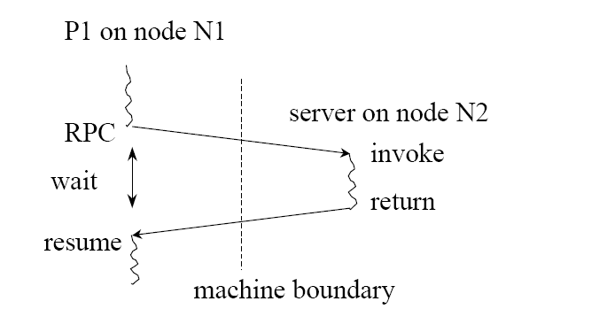
RPC: How?
RPC: Pass control and data across network (like function calls within a single program)
Node N1 can run other processes, while process P1 is waiting for the result.
Hmm… sounds similar to what???

Slide 4
RPC: the idea- Procedures
All the code runs on one machine – the server.
class SumApp {
void main(){
int x= 2, y=3;
int z= doMath(x, y);
}
int doMath(int m, int n){
int sum= m+n;
return sum;
}
}
SERVER

Slide 5
RPC- distributed procedures
Code is distributed between a client (caller) & server (callee).
class SumApp {
void main(){
int x=2,y=3;
z = doMath(x,y);
}
}
class SumService {
int doMath(int m,int n)
{
int sum = m+n;
return sum;
}
}
call
result
CLIENT
SERVER

Slide 6
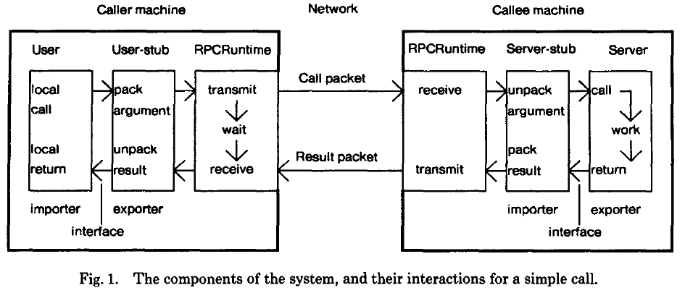
RPC: Components

Slide 7
RPC: The Players
ONWARD:
User: makes a procedure call.
User-stub: does binding & creates packets using procedure call and arguments.
Communication package transfers the packets reliably.
Server-stub: unpacks the packets, local call to server.
RETURN:
Server-stub: packs the result of the local call.
Communication package transfers the result packets.
User-stub: unpacks the packet & passes result to user.

Slide 8
RPC Implementation
User Code invokes functions that resides in a different address space
Server returns results to separate address space
How do we locate the Server?
How to pass the data (across processes/network)?
And return result to right Caller/Client?
What if there is a failure?
This must be expensive?
Lets dive right in …..

Slide 9
Locating the Server/Callee BINDING
Bind an importer (user) of an interface to an exporter (provider) of an interface.
Binding consists of:
Naming: : Interface name i.e. who to call
Locating :: Address of Server i.e. where to call
Interface consists of:
Type: interface method with arguments and return type
Instance: provider or object that implements the interface
Example: Type: mail server Instance: a specific mail server of type mail server
Naming is a compile time decision.

Slide 10
User Stubs Import/Server Stubs Export Interfaces
Client
Application
Interface Module
bool Foo(int)
int Bar(char)
int Baz(int)
Server/Function
Library
Client Stubs
(Import)
Server Stubs
(Export)
RPC
Runtime
RPC
Runtime
NETWORK
User writes interface, server code & client code (top grey boxes alone)
RPC runtime manages communication between machines/processes. No need to write any code (provided by the platform)
Stubs (Server & Client): Auto generated (using generators/accelerators) based on interface module.

Slide 11
Locating
Options available for locating the server are:
Early binding: Hard-coding–server m/c address in client!! (Easier & Efficient but change in address requires deployment, no server redundancy)
Broadcast to locate a server: Too much interference.
Use Database: (or some form of register) to dynamically lookup address at run-time.

Slide 12
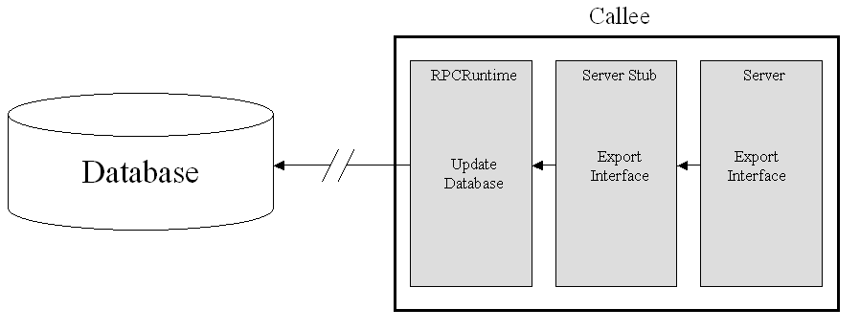
PRIOR TO A CALL How does a callee export an interface?
When a callee wishes to export an interface (make it available to callers), it stores information about its interface in a network accessible database.
Database consists of two types of entries: Group &Individual
Group
Individual
Export table
Type | Instance
Fileaccess | wpi
MailServer | alpine
Fileaccess | elb
Instance | Address
wpi | #33#
alpine | #23#
elb | #11#
Index | UId | Interface Name | Disp Proc
1 | xx12 | Fileaccess.wpi | abc
2

Slide 13
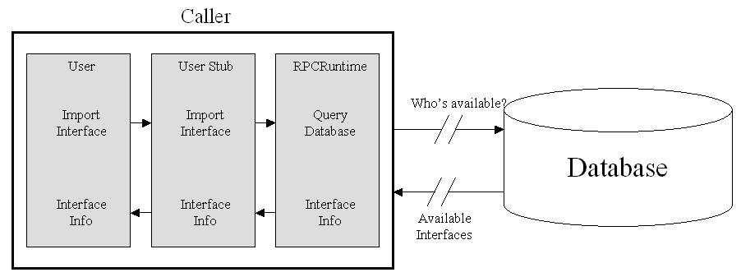
PRIOR TO A CALL How does a caller import an interface?
Caller finds server/callee in a database lookup by :
-specifying a particular instance of the desired interface type
-or by specifying the type of the interface and receiving a list of instances and then iterating through them
Importer RPCRuntime makes rpc to exporter RPCRuntime -for binding info.
Export table in RPCRuntime yields UID,TableIndex
User Stub uses: exporter address, UID, &TableIndex for its calls
Group
Individual
Type | Instance
Fileaccess | wpi
MailServer | alpine
Fileaccess | elb
Instance | Address
wpi | #33#
alpine | #23#
elb | #11#

Slide 14
Passing Data
Can't use the stack!
Can't use shared memory!
Generally use message passing

Slide 15
Packet level Transport protocols
Substantial performance gains
Minimize the elapsed real-time between initializing a call and getting results.
Unacceptable to have large amount of state info.
Unacceptable to have an expensive handshaking.
Guarantee procedure in the server has been invoked precisely once.

Slide 16
Exception Handling
Exception arises -> callee returns an exception pkt instead of a result pkt.
RPC runtime on the callee/server raises the exception to the client process.
User handling procedure terminate process.
Return value of catch procedure is returned to callee or notifies callee about abort.
Callee process resumes its exception or unwinds its call stack.
What about in a case of communication failure?
RPC runtime raises a call failed exception
Other issues (which may occur with a local procedure call too):
Remote procedure infinite loops
Remote procedure generates wrong results

Slide 17
Security
RPC package and protocol provides Encryption-based security of calls
End-to-end encryption of calls and results
Detect tempts of modification, reply, or creation of calls.
Restricted set of users who can update Grapevine DB.
Exporting services is restricted
Grapevine DB used as authentication service.

Slide 18
Optimizations
Caller sends call packet with: Call Id, desired proc, arguments.
Call ID (CID) : consists of [Activity, Seq Nos]
Seq Nos: is monotonic or unique.
Activity: made of [Caller M/C Id, Process]
CID helps server ignore dupe requests & also identify which caller gets the result.
Servers maintain no state on clients
No penalty for a large number of clients
Messages must be ack'd
for short calls, result serves as acknowledgement
for frequent calls, next call acknowledges last result
for long requests, only last request message gets acknowledged
for long results, only last result message gets acknowledged
Bound to "closest" server
Minimum transmission delay

Slide 19
Protocol-Level Optimizations
Caller
Callee
v
User
RPCRuntime
RPCRuntime
Server
Procedure call
Transmit first packet
Call[Ids, packet=0]
Receive packet 0
Ack[Ids, packet=0]
Transmit ack
Receive ack
Transmit next packet
Call[Ids, packet=1]
Receive packet 1
Procedure call
Retransmit next packet
Call[Ids, packet=1, needAck]
Receive packet 1
Ack[Ids, packet=1]
Transmit ack
Receive ack
procedure return
Receive result
Result[Ids]
Transmit result
procedure return
Receive result
Result[Ids, needAck]
Transmit ack request
Ack[Ids]
Transmit ack
Receive ack

Slide 20
RPC -A wrap up
Individual processes have their own address spaces providing a natural protection boundary relative to other processes.
RPCs allow for procedure oriented programming across process boundaries
Programmatically generated stubs abstract transition between processes
RPC runtime translates calls to network
User only writes application and server code
Lightweight protocol minimizes per-client server load, handshaking, and idle state maintenance
System of time-based ID’s along with active state pinging enhances reliability and aids in securing network

Slide 21
RPC: The not so obvious..
Concepts from thread & event based programming
RPC by name alludes to procedures (thread based ) but underlying this it is using messages (event based) to pass information across.
Send is asynchronous and the receive is blocked!(Duality)
Stack Ripping: State of the caller process
Needs to be transmitted to remote procedure (off the stack and into a message)
And partly saved to resume, when result arrives(continuation)
Stubs==Adapters!! Wrap calls and interprets results -they abstract the communication between the procedure and message.
Pass by Reference? – No shared memory, so addresses in remote space will have no meaning to the other. So more of pseudo Pass by Reference.

