Slide 1
Automatic Photo Quality Assessment
Presenter: Yupu Zhang, Guoliang Jin, Tuo Wang
Computer Vision – 2008 Fall

Slide 2
Estimating the photorealism of images:
Distinguishing
paintings from photographs
Florin Cutzu, Riad Hammoud, Alex Leykin
Department of Computer Science
Indiana University
Bloomington, IN 47408
Presenter: Yupu Zhang
yupu@cs.wisc.edu

Slide 3
Outline
Introduction
Distinguishing Features
Proposed Classifiers
Classifier Performance
Psychophysical Experiments

Slide 4
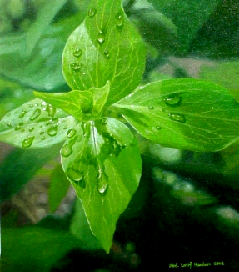
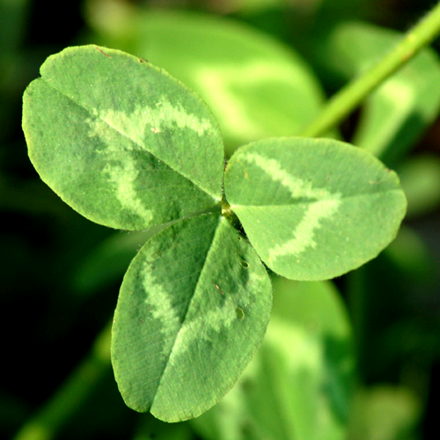
Introduction
Photorealism
a style of painting in which an image is created in such exact detail that it looks like a photograph
Notes:
http://www.bluemoonwebdesign.com/art-glossary-3.asp
http://www.latifm.com/painting_show/leaves_2_oil_painting.htm
http://z.about.com/d/landscaping/1/0/z/K/clover_red_leaf_large.jpg

Slide 5
Introduction
Class Definition
Photograph (degree of photorealism is high)
color photographs of 3D real-world scenes
Painting (degree of photorealism is low)
conventional canvas paintings, frescoes and murals
Goal
Automatically differentiate photographs from paintings without constraints on the image content

Slide 6
Distinguishing Features
Three sets of features for discriminating paintings from photographs:
Visual features
Spatial-color feature
Texture-based feature

Slide 7
Visual features (1)
If we convert a color picture to gray-scale
edges in photos are still clear
most of the edges in paintings are eliminated
Color edges vs intensity edges
Paintings: color edges, due to color changes
Photos: intensity edges, resulting from intensity changes
Quantify : Eg
Paintings will have smaller Eg

Slide 8
Visual features (2)
Color changes to a larger extent from pixel to pixel in paintings than in photos
Spatial variation of color : R
For each pixel and its 5x5 neighborhood, calculate the local variation of color around the pixel
R is the average of the variations taken over all pixels
Paintings have larger R
Notes:
three normals nr, ng, nb

Slide 9
Visual features (3)(4)
Number of unique colors : U
Paintings have a larger color palette than photos
U = # of unique colors / # of pixels
Pixel saturation : S
Paintings contain a larger percentage of highly saturated pixels
RGB => HSV
Create a saturation histogram, using 20 bins
S is the ratio between the highest bin and the lowest bin

Slide 10
Spatial-color feature
RGB (3D) => RGBXY (5D)
X and Y are the two spatial coordinates
Calculate a 5x5 covariance matrix of the RGBXY space
The singular value could represent the variability of the image pixels in both color space and “location space”
paintings should have a larger singular value

Slide 11
Texture-based feature
Observation
In photos texture elements tend to be repetitive
In paintings it’s difficult to maintain texture uniformly
Method
Gabor filter: extract textures from images
Calculate the mean and the standard deviation of the result of the filter over all pixels
Photos tend to have larger values at horizontal and vertical orientations
Paintings should have larger values at diagonal orientations

Slide 12
Proposed Classifiers
Individual classifier:
{Eg, U, R, S} space
a combination of four thresholds
RGBXY space
singular value
Gabor space
means and standard deviations
Implementation
Neural network
Training

Slide 13
Proposed Classifiers
Combine all three classifiers
the “committees” of neural networks
How?
individual classifier gives a score between 0 and 1
0 perfect painting, 1 perfect photo
take the average of the three scores
<= 0.5 => painting
> 0.5 => photo

Slide 14
Classifier Performance
C1 {Eg, U, R, S} C2 RGBXY
C3 Gabor C committee

Slide 15
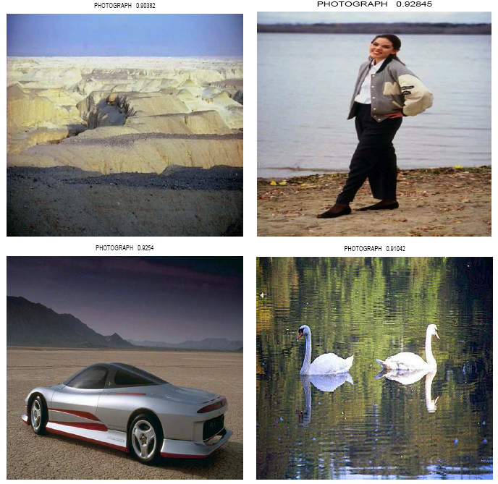
Classifier Performance
paintings ( score < 0.1)
photos ( score > 0.9)
0 perfect painting, 1 perfect photo

Slide 16
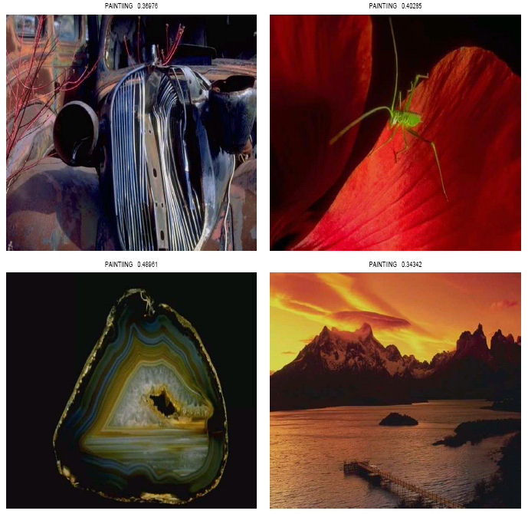
Classifier Performance
paintings classified as photos
photos classified as paintings

Slide 17
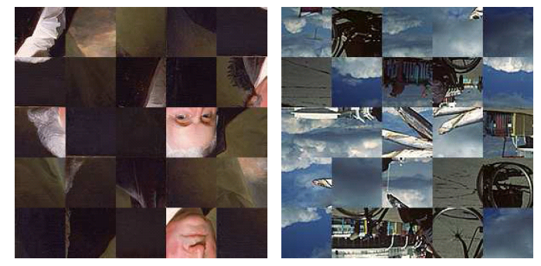
Psychophysical Experiments
The mistakes made by the classifiers seems to reflect the degree of perceptual photorealism of the image
How to verify this?
psychophysical experiment
human testers read
scrambled image patches
content independent
give scores [0, 10]
0 perfect painting
10 perfect photo
calculate the correlation coefficient between human ratings and classifier outputs
result: 0.865

Slide 18
Studying Aesthetics in Photographic Images Using a Computational Approach
Presenter: Guoliang Jin

Slide 19
What they did
Established significant correlation between various visual properties of photographic images and their aesthetics ratings.
using a community-based database and ratings
extracting certain visual properties
build a classifier that can qualitatively distinguish between pictures of high and low aesthetic value

Slide 20
Community-based Photo Ratings
Data Source: Photo.net
A large online photo sharing community
Primarily intended for photography enthusiasts
More than 400, 000 registered members
Photographers share photos, and rate and comment on photos taken by peers

Slide 21
The rating system in Photo.net
Photo peer-rated in terms of two qualities, namely aesthetics and originality
In the range of one to seven, with a higher number indicating better rating
Pro: photos are rated by a relatively diverse group which ensures generality in the ratings
Con: the acquired data was fairly noisy

Slide 22
How they use Photo.net
Download pictures and associated metadata
average aesthetics score between 1.0 and 7.0
average originality score between 1.0 and 7.0
number of times viewed by members
number of peer ratings

Slide 23
Aesthetics and Originality
Correlation between the aesthetics and originality ratings for 3581 photographs.

Slide 24
Visual Feature Extraction
Choice of features was principled, based on
rules of thumb in photography
common intuition
observed trends in ratings
They extracted 56 visual features for each image
refer them as candidate features
denote them as F = {fi|1 ≤ i ≤ 56}
Notes:
In photography and color psychology, color tones and saturation play
important roles, and hence working in the HSV color space makes computation
more convenient

Slide 25
Visual Feature Extraction (Cont.)
The RGB data of each image is converted to HSV color space, producing two-dimensional matrices IH, IS, and IV, each of dimension X × Y
color tones and saturation play important roles, and hence working in the HSV color space makes computation more convenient
The image is also transformed into the LUV space, since in this space locally Euclidean distances model the perceived color change well, so it will be easy to use a fast segmentation method based on clustering

Slide 26
Visual Feature Extraction (Cont.)
Exposure of Light and Colorfulness {f₁, f₂}
Saturation and Hue {f₃, f₄}
The Rule of Thirds {f₅ ~ f₇}
Familiarity Measure {f₈ ~ f₉}
Wavelet-based Texture {f₁₀ ~ f₂₁}
Size and Aspect Ratio {f₂₂, f₂₃}
Region Composition {f₂₄ ~ f₅₂}
Low Depth of Field Indicators {f₅₃ ~ f₅₅}
Shape Convexity {f₅₆}

Slide 27
Feature Selection
To discover features that show correlation with community-based aesthetics scores
Use a one-dimensional support vector machine (SVM)
SVMs are essentially powerful binary classifiers that project the data space into higher dimensions where the two classes of points are linearly separable
Two classes: high containing samples with aesthetics scores greater than 5.8, and low with scores less than 4.2
The top 15 among the 56 features in terms of model accuracy are obtained

Slide 28
Feature Selection, Classification, and Regression
A classifier that can separate low from high
Use SVM as well as the classification and regression trees (CART) algorithm
Filter-based methods and wrapper-based methods are two broad techniques for feature selection
Stop at 15 iterations (i.e. 15 features) and use this set to build the SVM-based classifier
Use the recursive partitioning (RPART) implementation to build a two-class classification tree model for the same set of 1664 data samples
Perform linear regression on polynomial terms of the features values to see if it is possible to directly predict the aesthetics scores in the 1 to 7 range from the feature vector

Slide 29
Measure the quality of regression
residual sum-of-squares error
worst case is chosen every time without using the regression model, yielding
(variance of Y ).
if the independent variables explain something about Y , it must be that

Slide 30
Experimental Results
The top 15 classification rates achieved by {f₃₁, f₁, f₆, f₁₅, f₉, f₈, f₃₂, f₁₀, f₅₅, f₃, f₃₆, f₁₆, f₅₄, f₄₈, f₂₂}, with accuracy over 54%.
The maximum classification rate achieved by any single feature was f₃₁ with 59.3%.
They act as weak classifiers and hence show some correlation with the aesthetics.

Slide 31
Experimental Results (Cont.)
The combined filter and wrapper method for feature selection yielded the following set of 15 features:{f₃₁, f₁, f₅₄, f₂₈, f₄₃, f₂₅, f₂₂, f₁₇, f₁₅, f₂₀, f₂, f₉, f₂₁, f₂₃, f₆}. The accuracy achieved with 15 features is 70.12%, with precision of detecting high class being 68.08%, and low class being 72.31%.

Slide 32
Experimental Results (Cont.)
Variation of accuracy with the minimum number of unique ratings per picture

Slide 33
Experimental Results (Cont.)
Variation of SVM accuracy with inter-class gap δ.

Slide 34
Experimental Results (Cont.)
Decision tree obtained using CART and the 56 visual features (partial view)

Slide 35
Experimental Results (Cont.)
The variance σ² of the aesthetics score over the 3581 samples is 0.69.
With 5 polynomial terms for each of the 56, achieves a residual sum-of-squares 0.5020
Randomly permuted the aesthetics scores (breaking the correspondence with the features) and performed the same regression. This time, is 0.65, clearly showing that the reduction in expected error was not merely by the over-fitting of a complex model.

Slide 36
Conclusion
Despite the inherent noise in data, our SVM-based classifier is robust enough to produce good accuracy using only 15 visual features in separating high and low rated photographs.

Slide 37
The Design of High-Level Features for Photo Quality Assessment
Yan Ke, Xiaoou Tang, Feng Jing
Presented by Tuo Wang
Computer Vision – Fall 2008

Slide 38
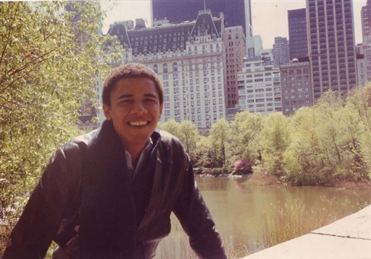
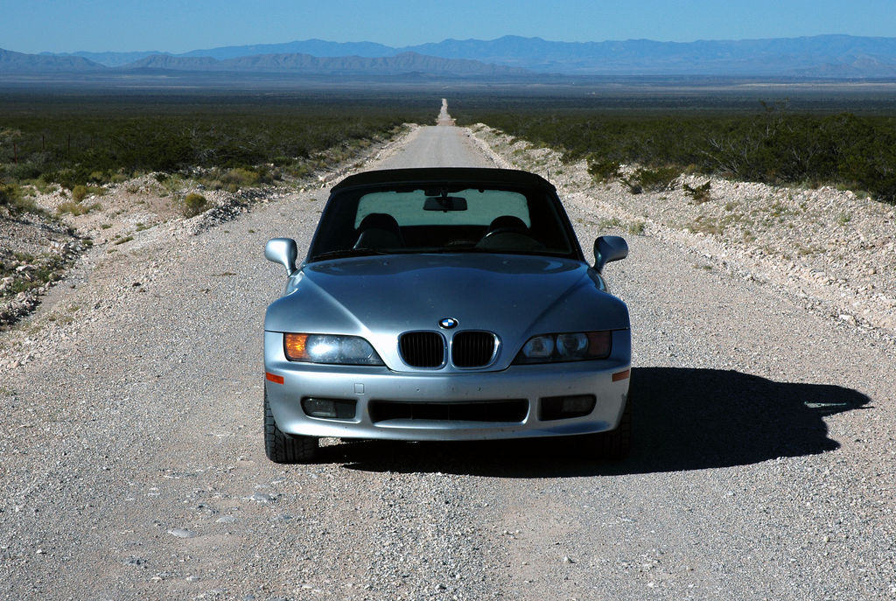

Slide 39
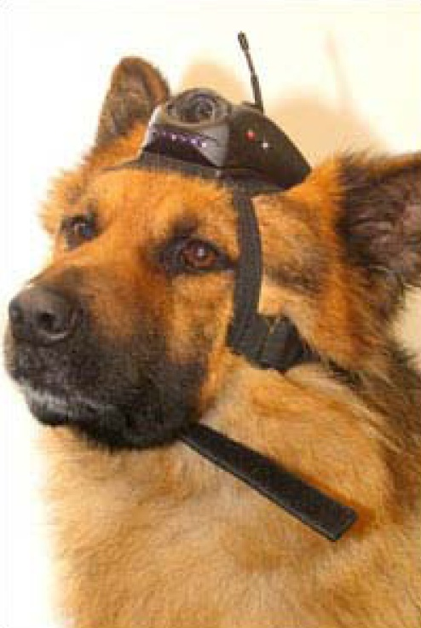
Anyone can take great photos
… if you can recognize the good ones.

Slide 40
Outline
High and low quality photo
Criteria between high and low quality photo
Proposed feature
Classifier
Experiment dataset
Results

Slide 41
High and low quality photo
Images classification:
photos or graphics
taken indoors or outdoors
city or landscape
photos or paintings
real or rendered photo
…
What makes a high quality photo?
Before design features to assess a photo’s quality, we must determine the perceptual criteria that people use to judge photos.

Slide 42
What makes a high quality photo
Three distinguishing factors between the high quality of photos and low quality of photos
Simplicity
Realism
Basic photographic technique

Slide 43
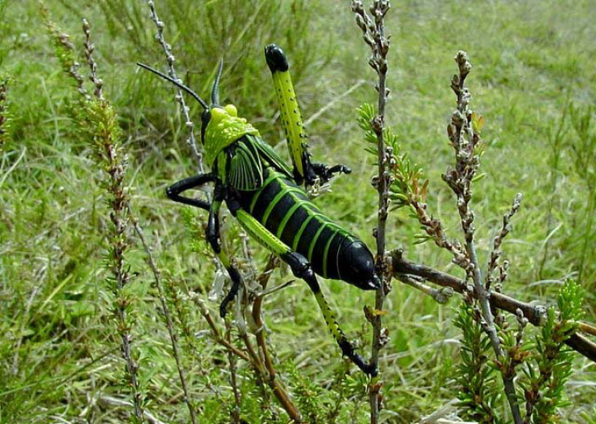
Simplicity - Background out of focus

Slide 44
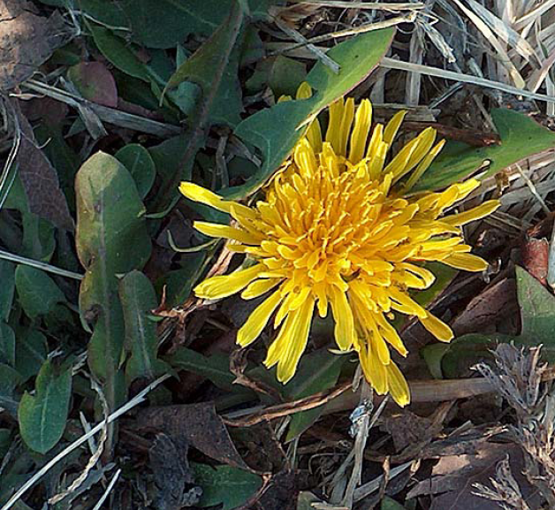
Simplicity - Color contrast

Slide 45
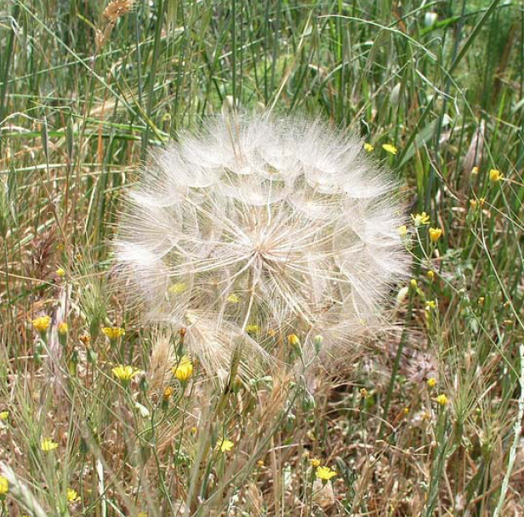
Simplicity - Lighting contrast

Slide 46
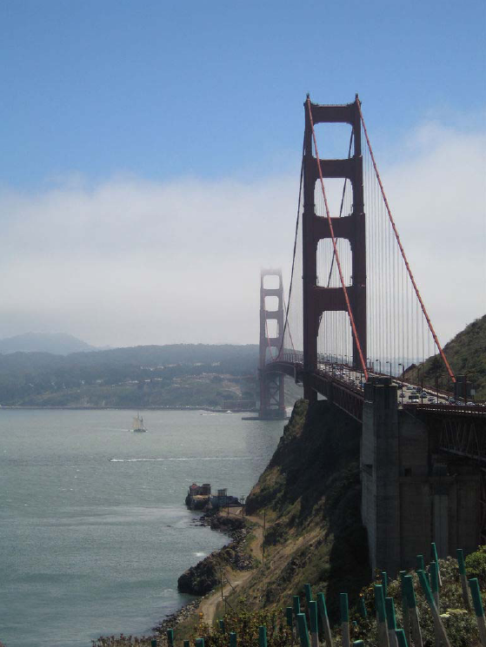
Realism - Color palette

Slide 47
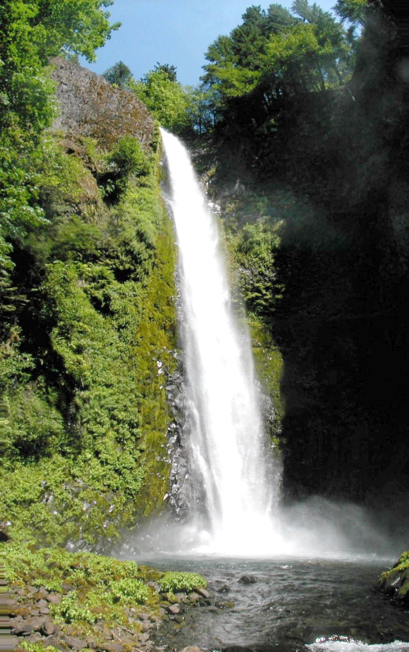
Realism - Camera settings

Slide 48
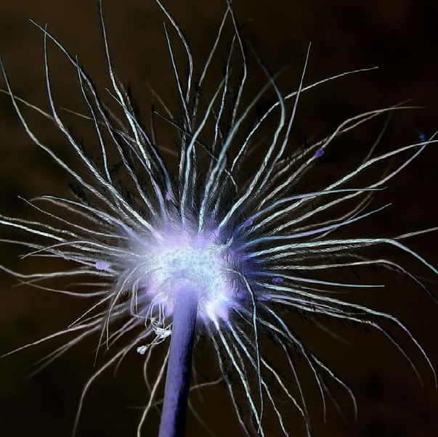
Realism - Subject matter

Slide 49
Basic photographic technique -- Blur

Slide 50
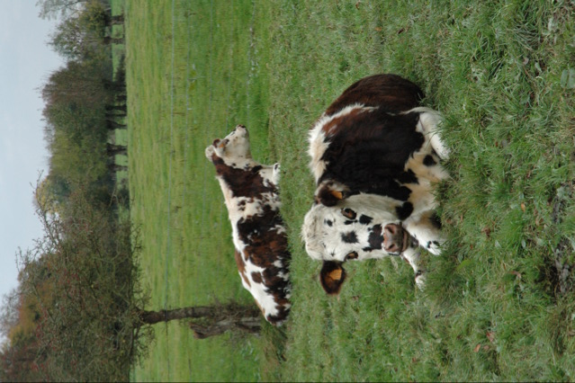
Basic photographic technique -- Contrast and Brightness

Slide 51
What features can we extract
Spatial Distribution of Edges
Color Distribution
Hue Count
Blur
Low Level Features

Slide 52
Features – Spatial Distribution of Edges
Edge spatial distribution feature extractor:
3*3 Laplacian filter
Resize Laplacian image size to 100*100
Normalize the image sum to 1
The quality of probe image: q_{l}=d_{s}-d_{p}, where:
M_{p} and M_{s} are the mean Laplacian image of the professional photos and snapshots

Slide 53
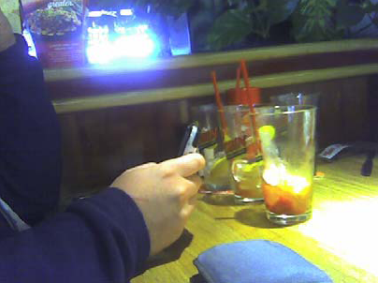
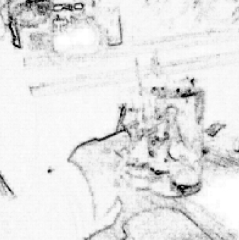
Features – Spatial Distribution of Edges

Slide 54
Features – Spatial Distribution of Edges
The amount of area that the edges occupy
w_{x} and w_{y} be the width of 98% mass of the projections P_{x} and P_{y} respectively. So the bounding box: w_{x}w_{y}, the quality of the image q_{a}: 1- w_{x}w_{y}.

Slide 55
Features – Spatial Distribution of Edges

Slide 56
Features – Color Distribution
Quantize the red, green, and blue channels into 16 values
A 4096 = 16³ bin histogram is created
Normalize the histogram to unit length
Use the L1 metric to calculate the distance between histograms
kNN on color histogram
q_{cd} = n_{p} - n_{s}
= #professional_neighbors - #snap_neighbors

Slide 57
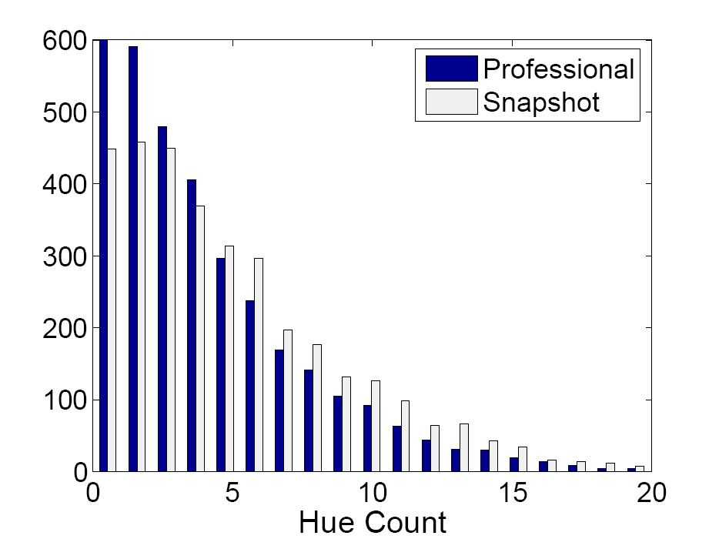
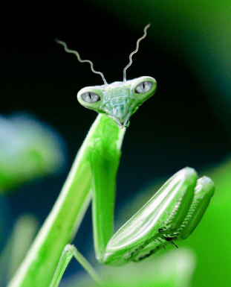
Features – Hue Count
||N||= (# hues > threshold)
q_{h} = 20 – ||N||

Slide 58
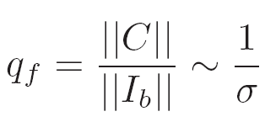
Features – Blur
Model a blurred image I_{b} as the result of a Gaussian smoothing filter applied to an otherwise sharp image I_{s},

Slide 59
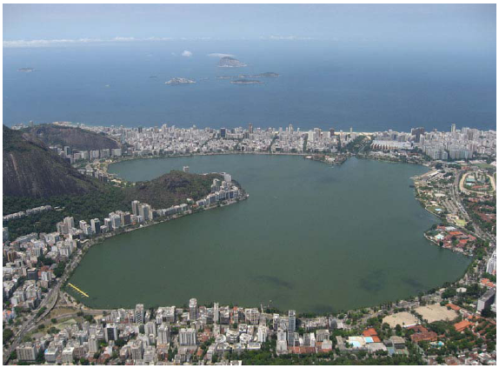
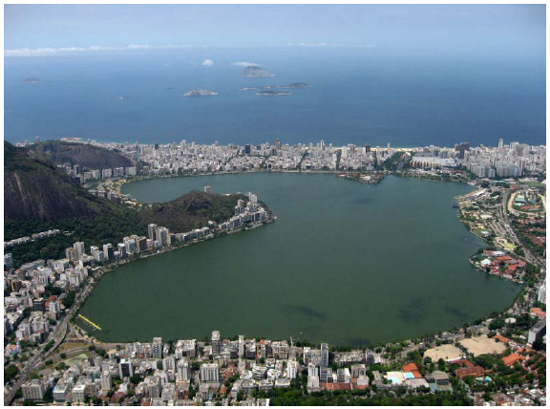
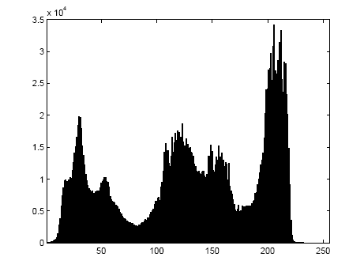
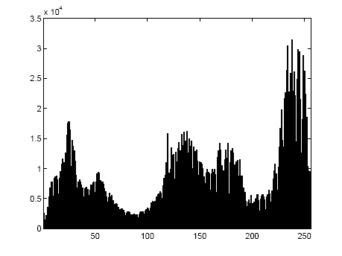
Low level features - Contrast
q_{ct}: equal to the width of middle 98% mass of the histogram

Slide 60
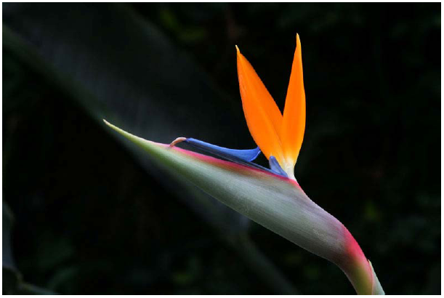
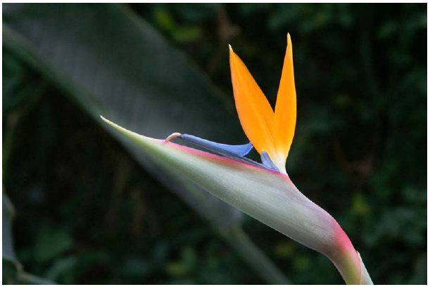
Low level features – Average Brightness
Average brightness: b

Slide 61
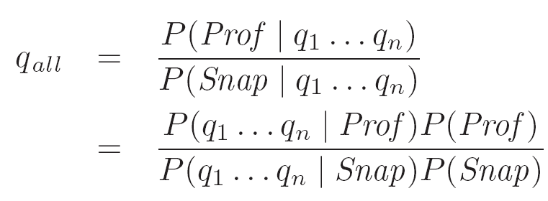
Classifier
Naives Bayes
Assume independence of the features

Slide 62
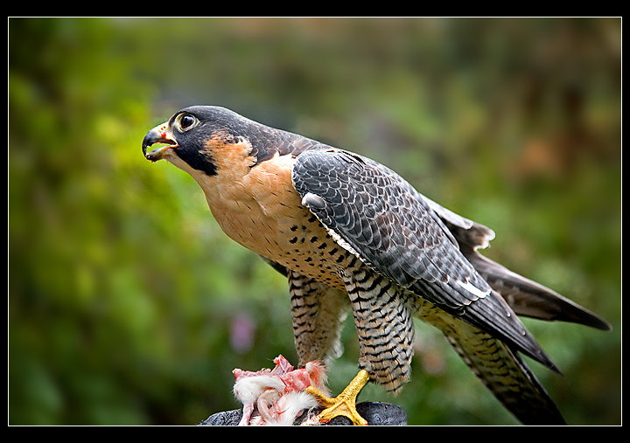
Dataset – DPChallenge.com
60K photos
40K photographers
10/90 percentile

Slide 63
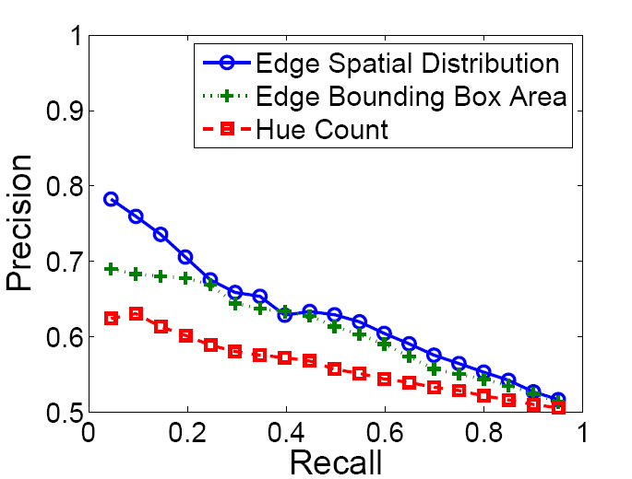
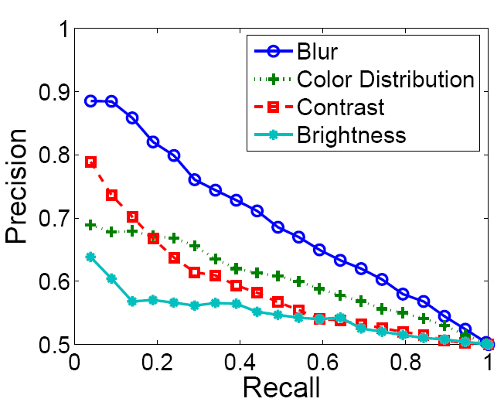
Results

Slide 64
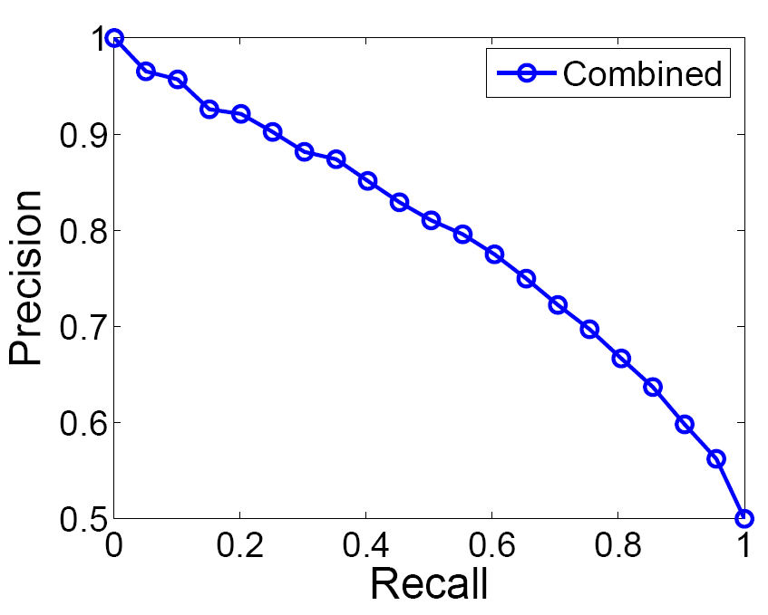
Results

Slide 65
Results
The difference between high and low quality photos are exaggerated when using a smaller test set. The error rate decreases as well, which suggests the quality metrics match the perceptual criteria in judging photos

Slide 66
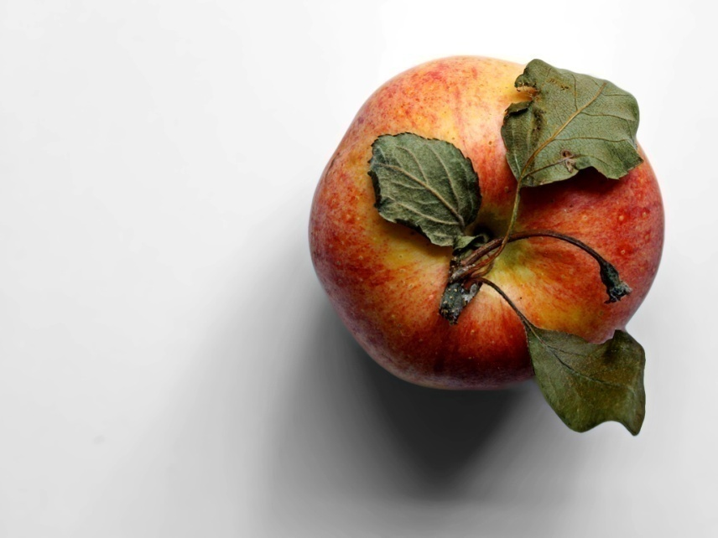
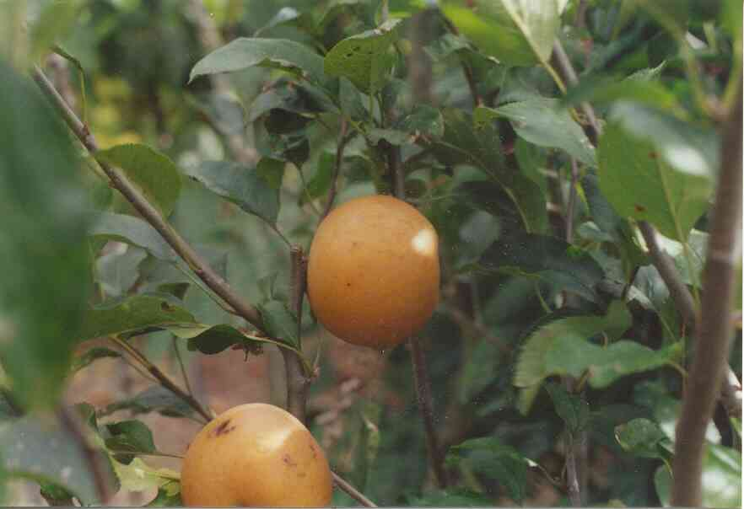
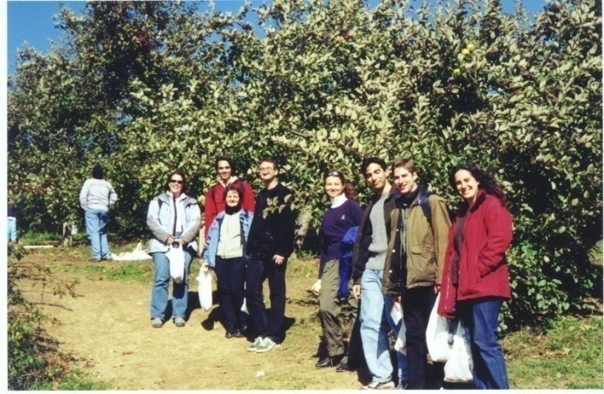
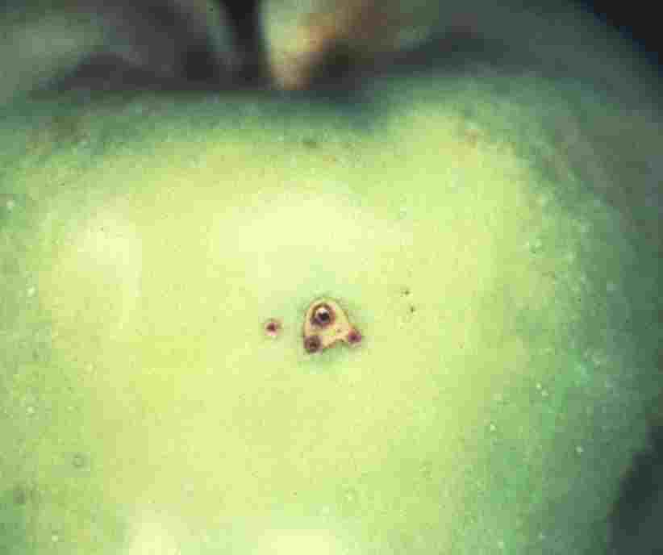
Web Retrieval Results

Slide 67
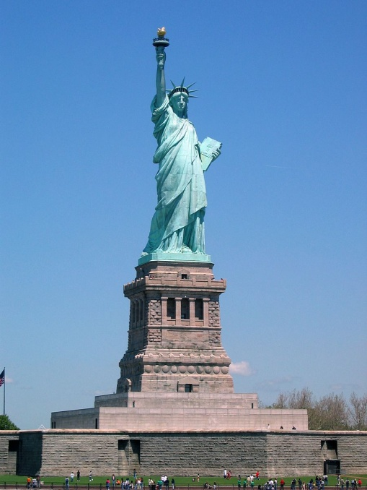
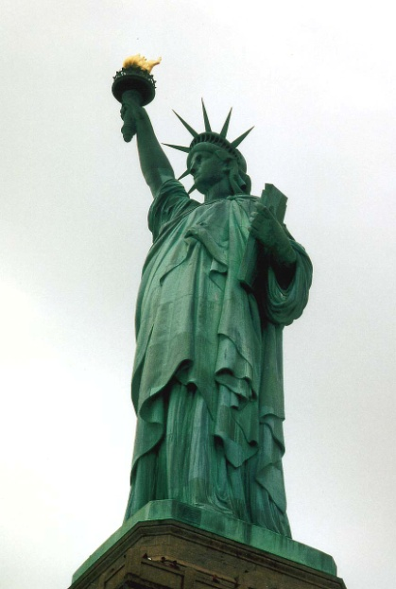
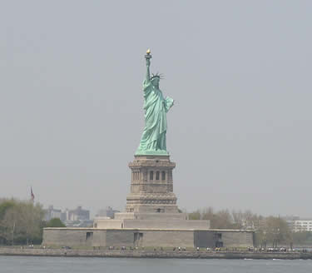
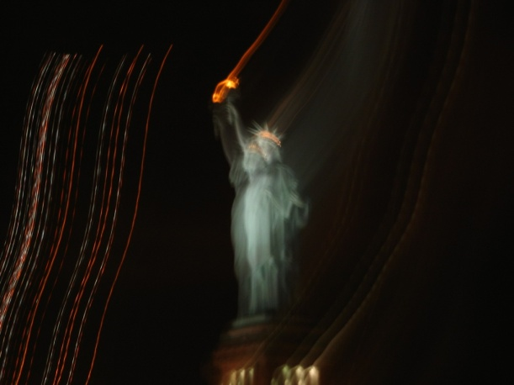
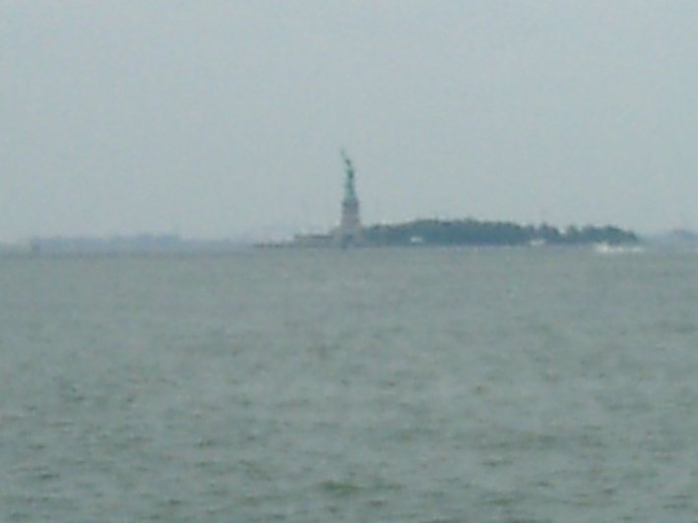
Web Retrieval Results

Slide 68
Reference
Y. Ke, X. Tang, and F. Jing. The Design of High-Level Features for Photo Quality Assessment. Computer Vision and Pattern Recognition, 2006
Yan Ke, Taking Great Pictures, http://www.cs.cmu.edu/~yke/photoqual/20071127_GreatPictures.pdf

Slide 69
The end
Thank you!

