Slide 1
Training Image Parsers using Label Strokes
Shengqi Zhu, Yiqing Yang, and Li Zhang
UW-Madison

Slide 2
Labeling Pixels
{sky}
{eyebrow}
{building}
{human}
{dog}
{hair}
{lip}

Slide 3
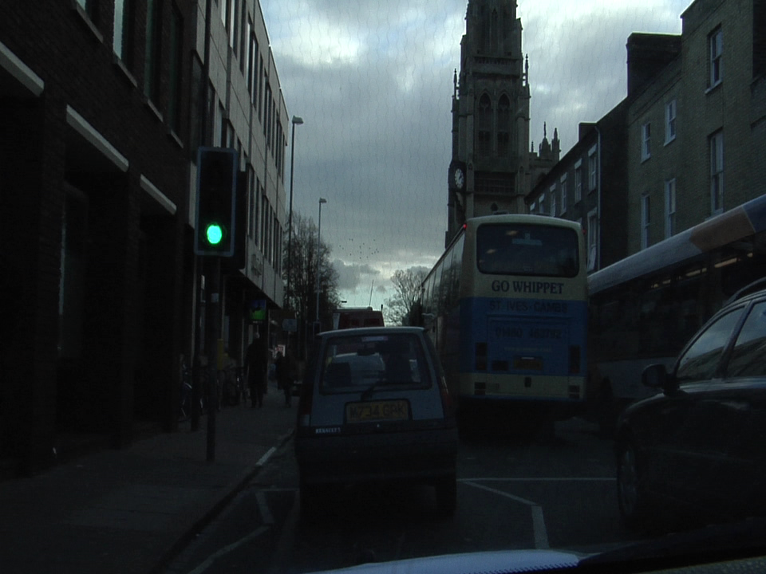
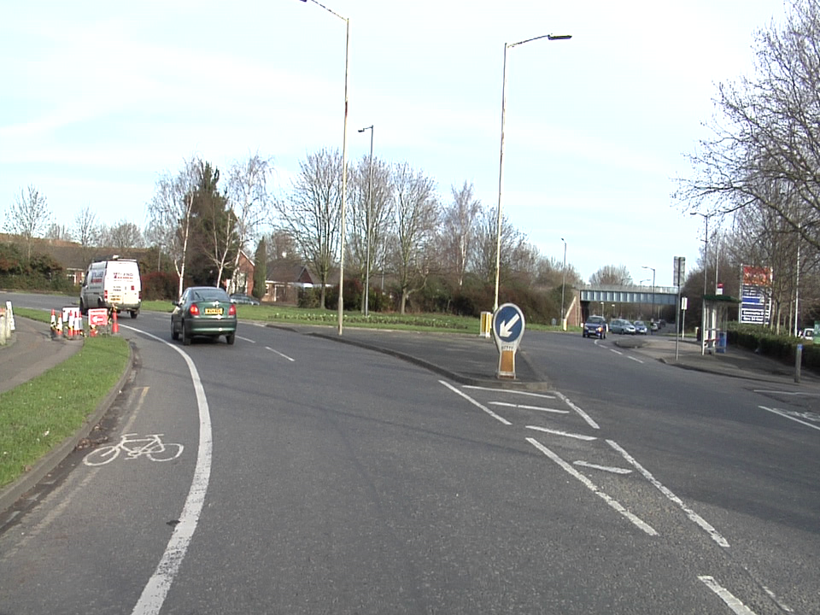
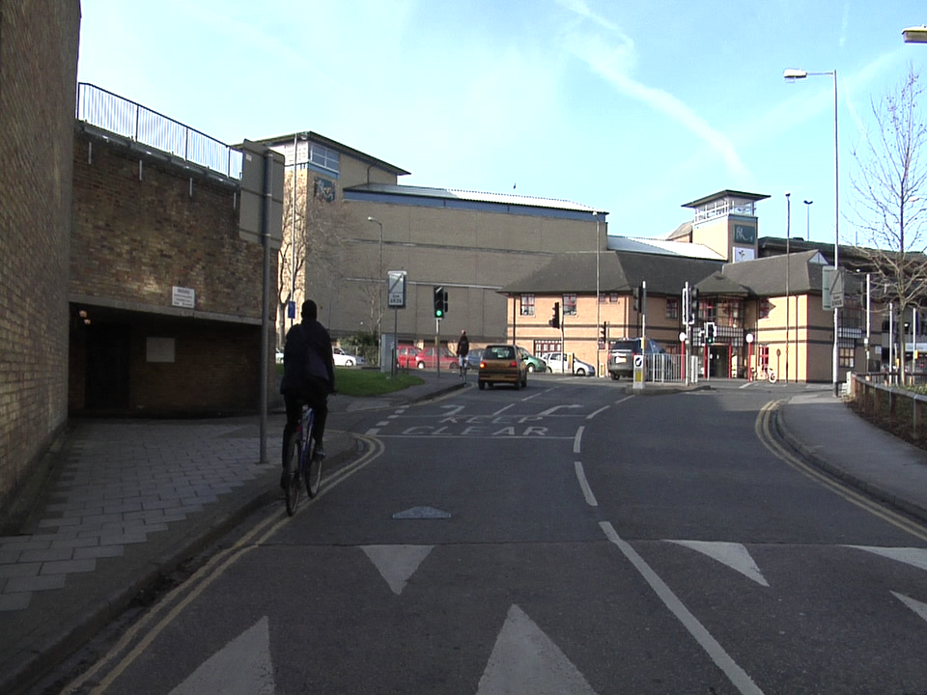
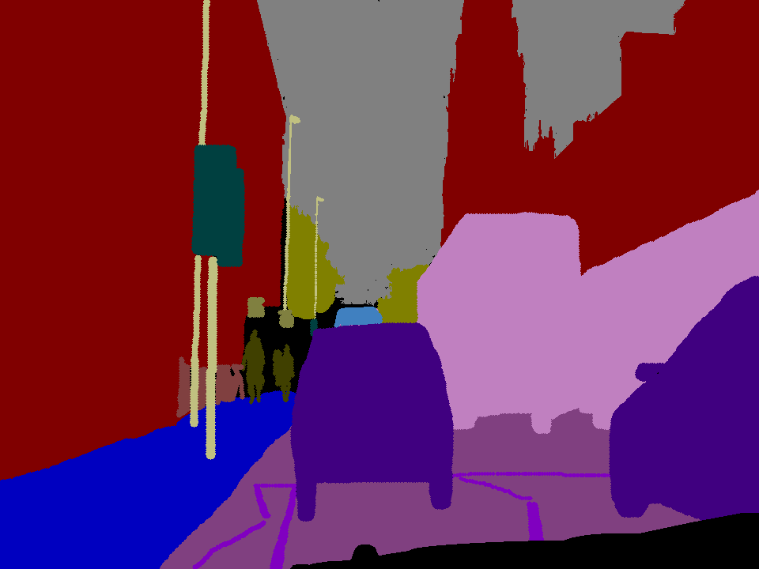
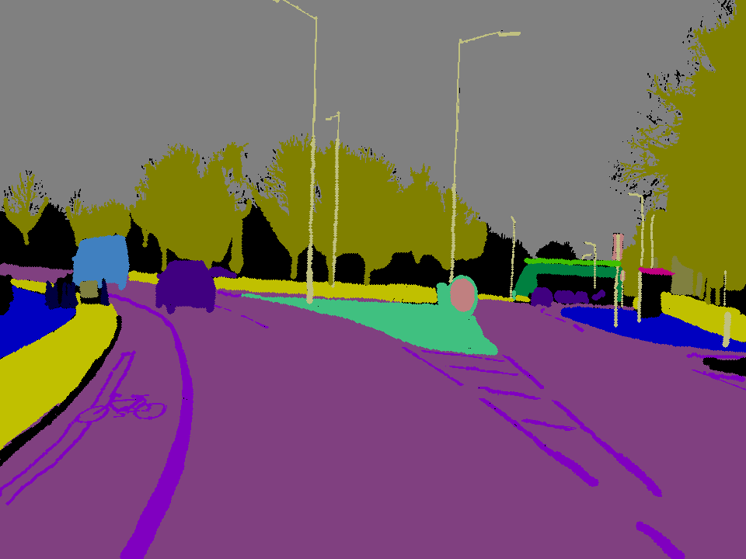
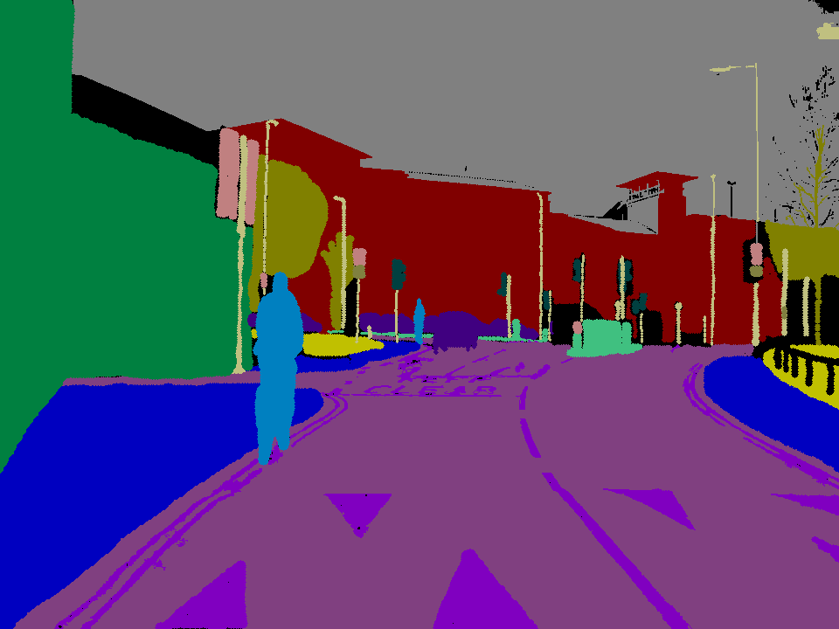
Training an Image Parser
Training Images:
Label Maps:
Approaches: CRF-based, Example-based, deep neural nets
Requiring fully labeled images

Slide 4
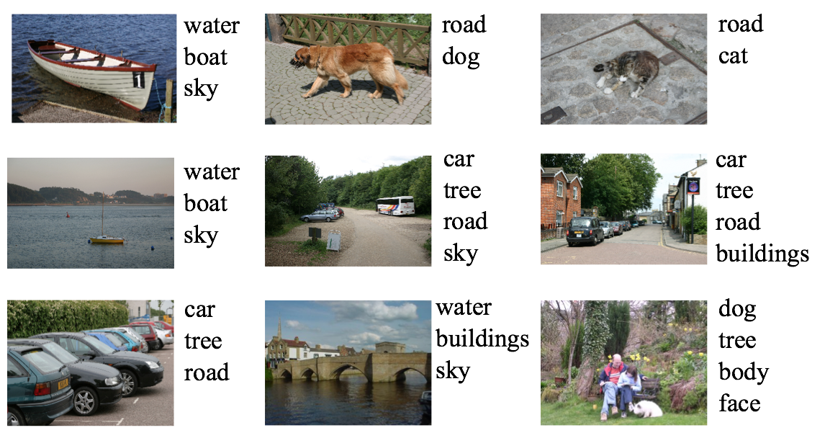
Training an Image Parser
Training Images:
Approaches: Weakly supervised
Weakly supervised semantic segmentation with a multi image model, A. Vezhnevets, V. Ferrari, and J. Buhmann, ICCV 2011
Requiring a complete set of labels per image
Notes:
1. need to provide a *complete* set of text labels for each image.
2. Even a complete set of text labels may not provide enough information for training. For example, all face images have the same set of text labels: eyebrows, lips, and ears etc. Knowing only text labels for each image may not be enough for training a parser.

Slide 5
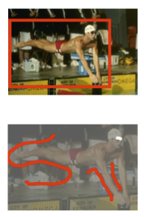
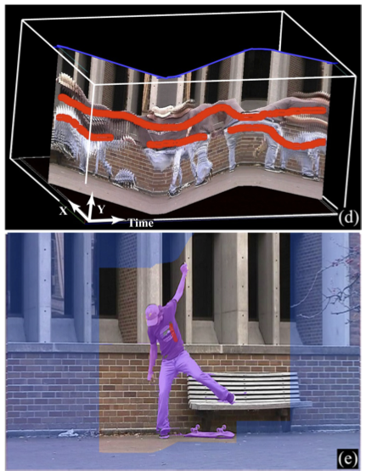
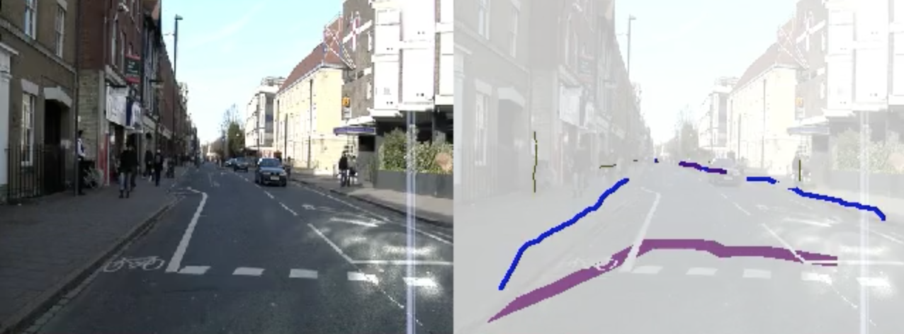
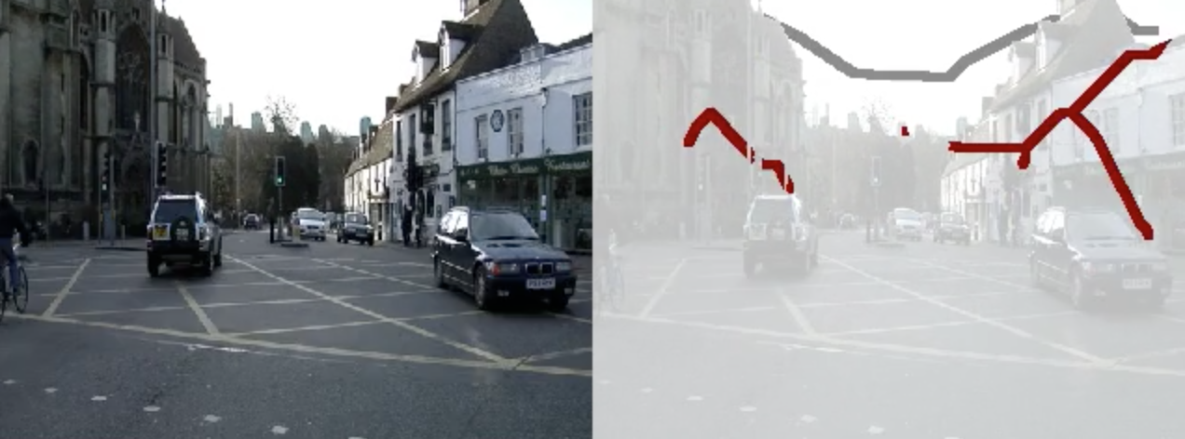
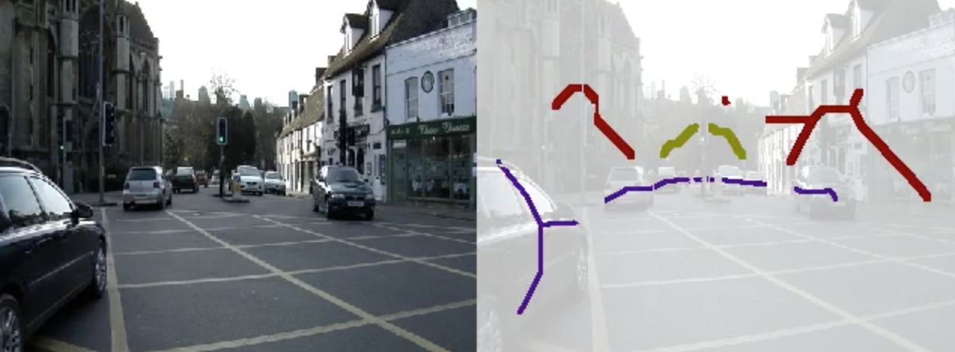
Inspiration from Graphics
Grabcut
Video Cutout
Training a Parser
Single Image
Single Video
Single User
Single User
Segmentation by Energy Minimization
Unorganized Image Sets
Single/Multiple Annotators
Parsing by Energy Minimization
Notes:
It doesn’t have be street views, can be face images.

Slide 6
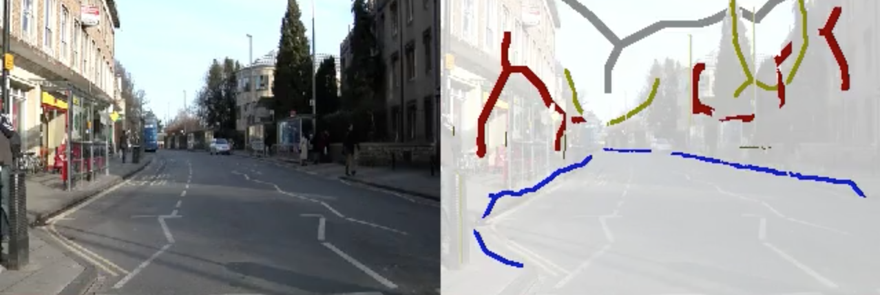
Training a Parser from Label Strokes
Testing Image
Training
Energy minimization based Image Parser
Label Map

Slide 7
Training a Parser from Label Strokes
Pixel i
Class k
Probability
Given x,
find y
by minimizing
Training
How to define
How to find
. . .

Slide 8
Training a Parser from Label Strokes
Given x,
find y
by minimizing
Training
. . .

Slide 9
Training a Parser from Label Strokes
Given x,
find y
by minimizing
Training
. . .

Slide 10
Training a Parser from Label Strokes
Given x,
find y
by minimizing
Training
. . .

Slide 11
Training a Parser from Label Strokes
. . .

Slide 12
Training a Parser from Label Strokes
. . .

Slide 13
Training a Parser from Label Strokes
. . .

Slide 14
Training a Parser from Label Strokes
. . .

Slide 15
Training a Parser from Label Strokes

Slide 16
Training a Parser from Label Strokes

Slide 17
Training a Parser from Label Strokes

Slide 18
Training a Parser from Label Strokes
How to set up
Vector-quantize local feature space

Slide 19
A Simple Test on Snake
Nowozin et al 2011
0 | 0 | 0 | 0 | 0 | 0
0 | 2 | 3 | 0 | 0 | 0
0 | 1 | 4 | 5 | 0 | 0
0 | 0 | 0 | 6 | 7 | 0
0 | 0 | 0 | 9 | 8 | 0
0 | 0 | 0 | 10 | 0 | 0
0 | 0 | 0 | 0 | 0 | 0
Movement Rules:
Red up
Yellow right
Green down
Cyan left
Blue stop
Input image
Output label
For a blue pixel

Slide 20
A Simple Test on Snake
Nowozin et al 2011
0 | 0 | 0 | 0 | 0 | 0
0 | 2 | 3 | 0 | 0 | 0
0 | 1 | 4 | 5 | 0 | 0
0 | 0 | 0 | 6 | 7 | 0
0 | 0 | 0 | 9 | 8 | 0
0 | 0 | 0 | 10 | 0 | 0
0 | 0 | 0 | 0 | 0 | 0
Movement Rules:
Red up
Yellow right
Green down
Cyan left
Blue stop
Input image
Output label
For a green pixel

Slide 21
A Simple Test on Snake
Previous:
Input image
Ours:

Slide 22
Test on Camvid

Slide 24
Quantitative Results
Missing Stroke | 0% |  | 20% |  | 40% |  | 60%
 | Training | Testing | Training | Testing | Training | Testing | Training | Testing
Building | .88 | .87 | .88 | .87 | .87 | .86 | .87 | .87
Car | .53 | .28 | .51 | .28 | .57 | .28 | .52 | .27
Road | .95 | .95 | .95 | .95 | .95 | .96 | .94 | .95
Sidewalk | .55 | .35 | .53 | .33 | .60 | .34 | .57 | .36
Sky | .94 | .88 | .94 | .88 | .95 | .89 | .95 | .90
Tree | .68 | .56 | .66 | .55 | .67 | .56 | .62 | .52
Overall | .84 | .75 | .83 | .75 | .84 | .75 | .83 | .75
Work badly on small objects (e.g. pedestrians) ➔ need more training data
+ Testing time very fast ➔ real time possible

