Slide 1
RegExps & DFAs
CS 536

Slide 2
Pre-class warm up
Write the regexp for Fortran real literals
An optional sign (‘+’ or ‘-‘)
An integer or:
1 or more digits followed by a ‘.’ followed by 0 or more digits
or: A ‘.’ followed by one or more digits
(‘+’|’-’|ε)(digit+(‘.’|ε))|
(digit*’.’digit+)

Slide 3
Last time
Explored NFAs
for every NFA there is an equivalent DFA
epsilon edges add no expressive power
Introduce regular languages / expressions

Slide 4
Today
Convert regexps to DFAS
From language recognizers to tokenizers

Slide 5
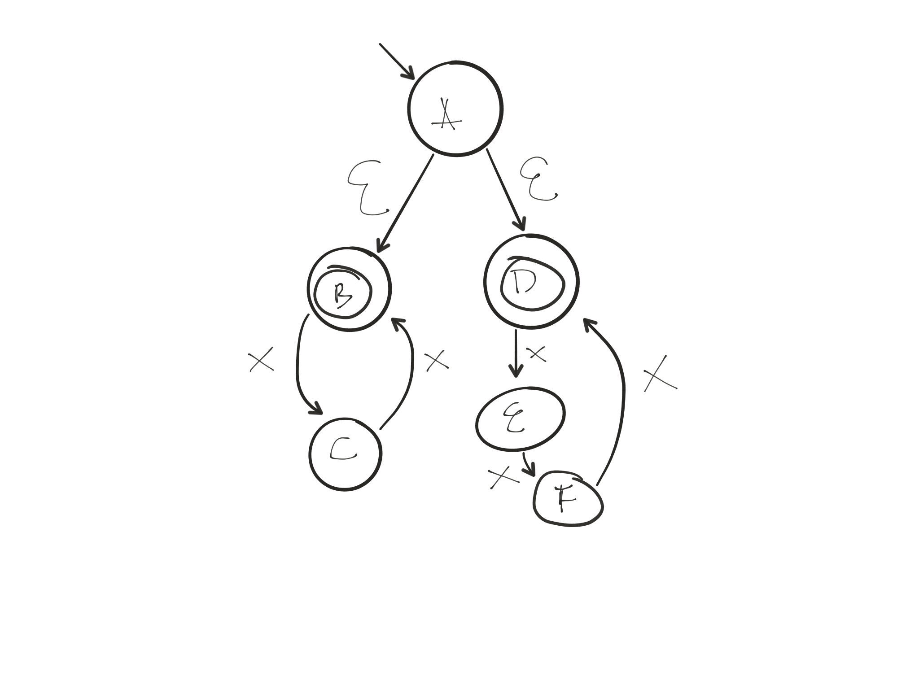
Regexp to NFAs
Literals/epsilon correspond to simple DFAs
Operators correspond to methods of joining DFAs
x^n, where n is even or divisible by 3

Slide 6
Regexp to NFA rules
Rules for operands

Slide 7
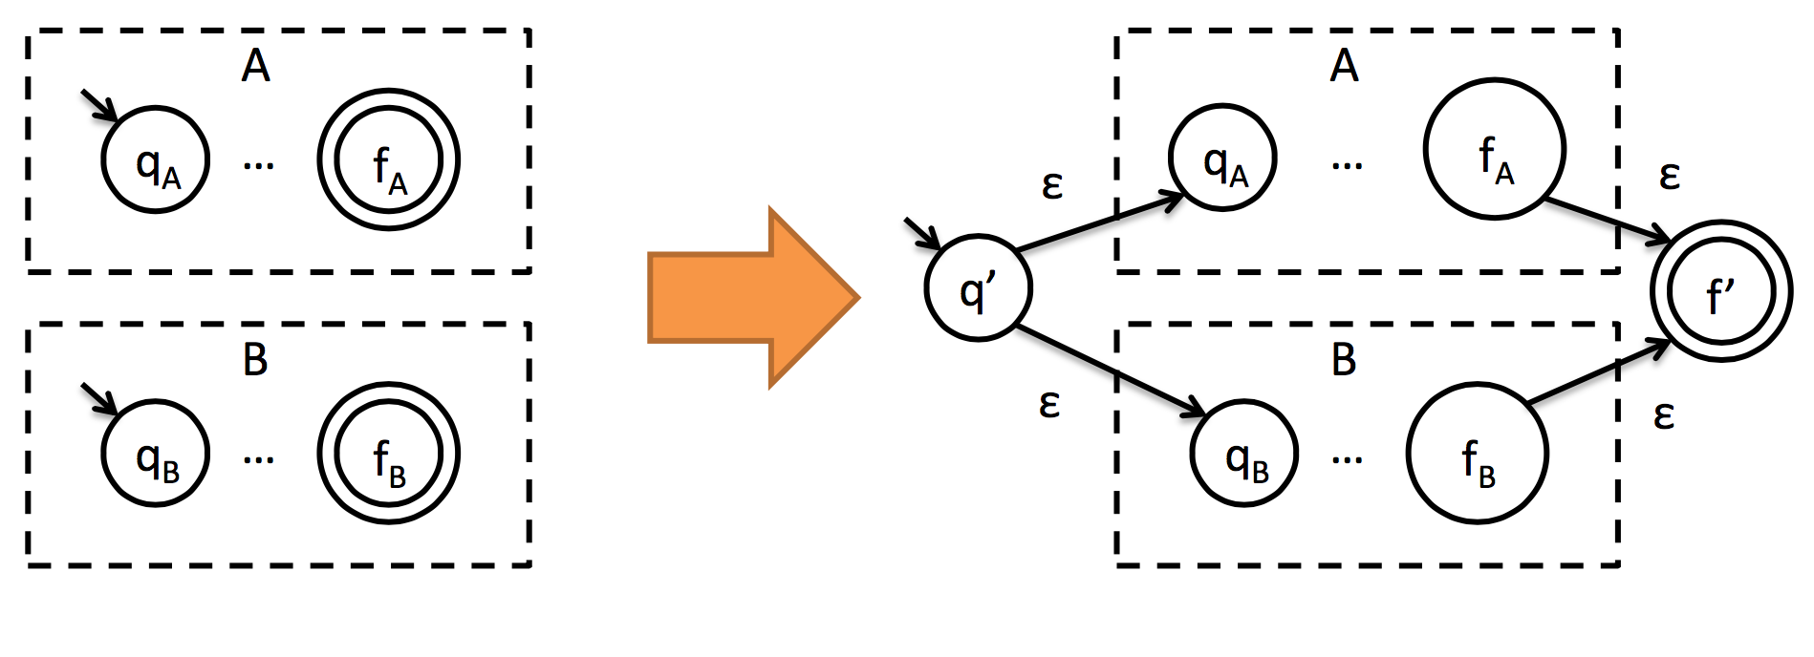
Regexp to NFA rules
Rules for alternation A|B
Make new start state q’ and new final state f’
Make original final states non-final
Add to δ:
q’,ε → q_{A}
q’,ε → q_{B}
F_{a},ε→f’
F_{b},ε→f’

Slide 8
Regexp to NFA rules
Rule for catenation A.B
Make new start state q’ and new final state f’
Make original final states non-final
Add to δ:
q’,ε → q_{A}
f_{A},ε → q_{B}
f_{b},ε→f’

Slide 9
Regexp to NFA rules
Rule for iteration A*
Make new start state q’ and new final state f’
Make original final states non-final
Add to δ:
q’,ε → q_{A}
q’,ε→f’
f’,ε→q_{A}

Slide 10
Regexp operator precedence
Operator | Precedence | Analogous math operator
| | low | addition
. | medium | multiplication
* | high | exponentiation

Slide 11
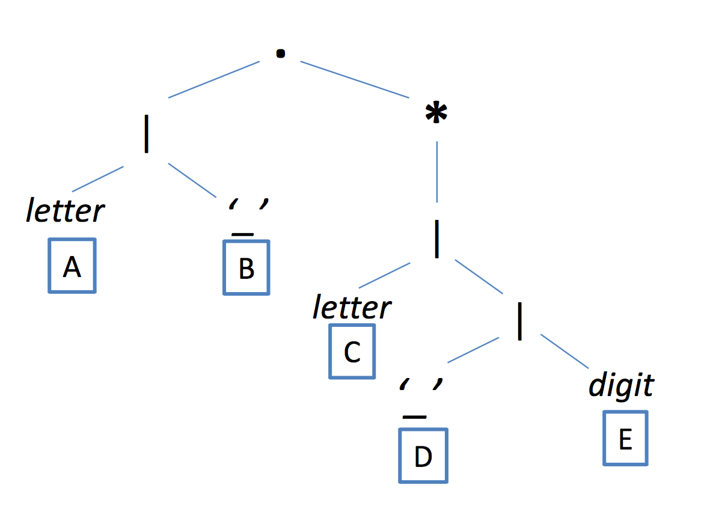
Tree representation of a regexp
Operator | Precedence
| | low
. | medium
* | high

Slide 12
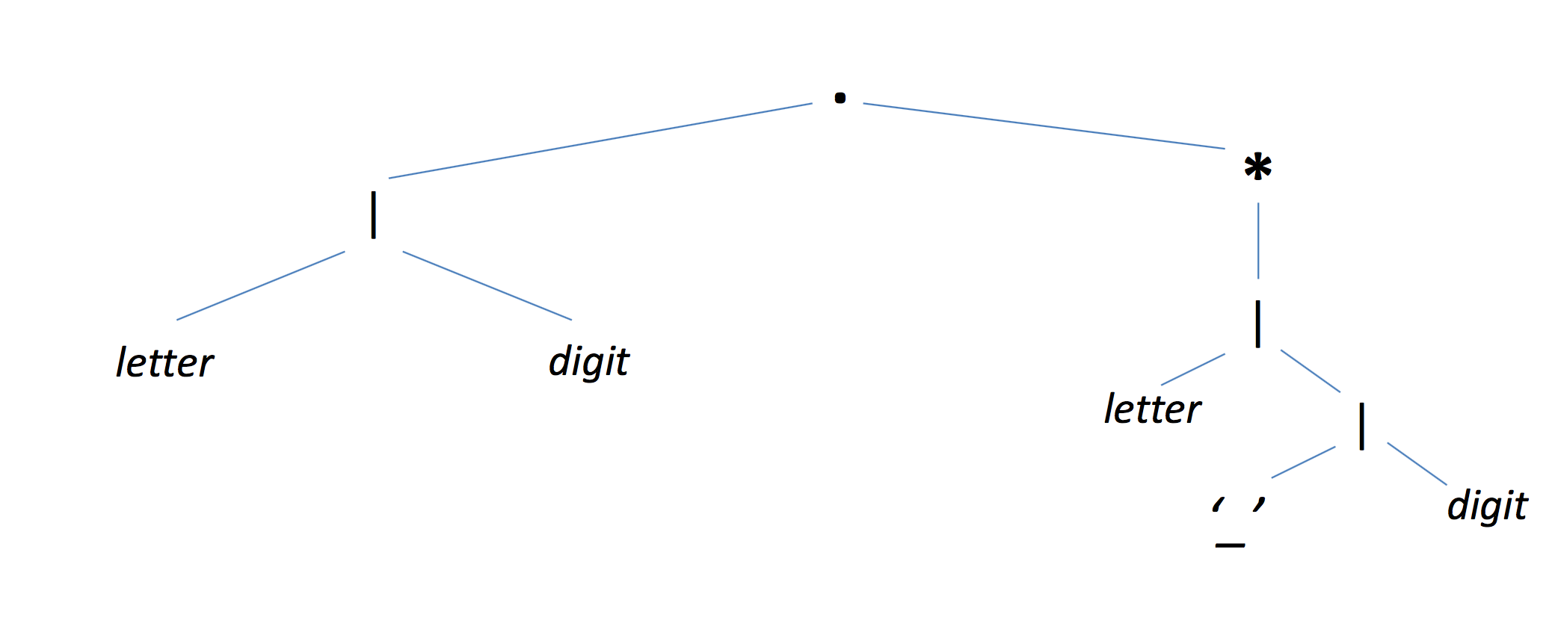
Bottom-up conversion

Slide 13
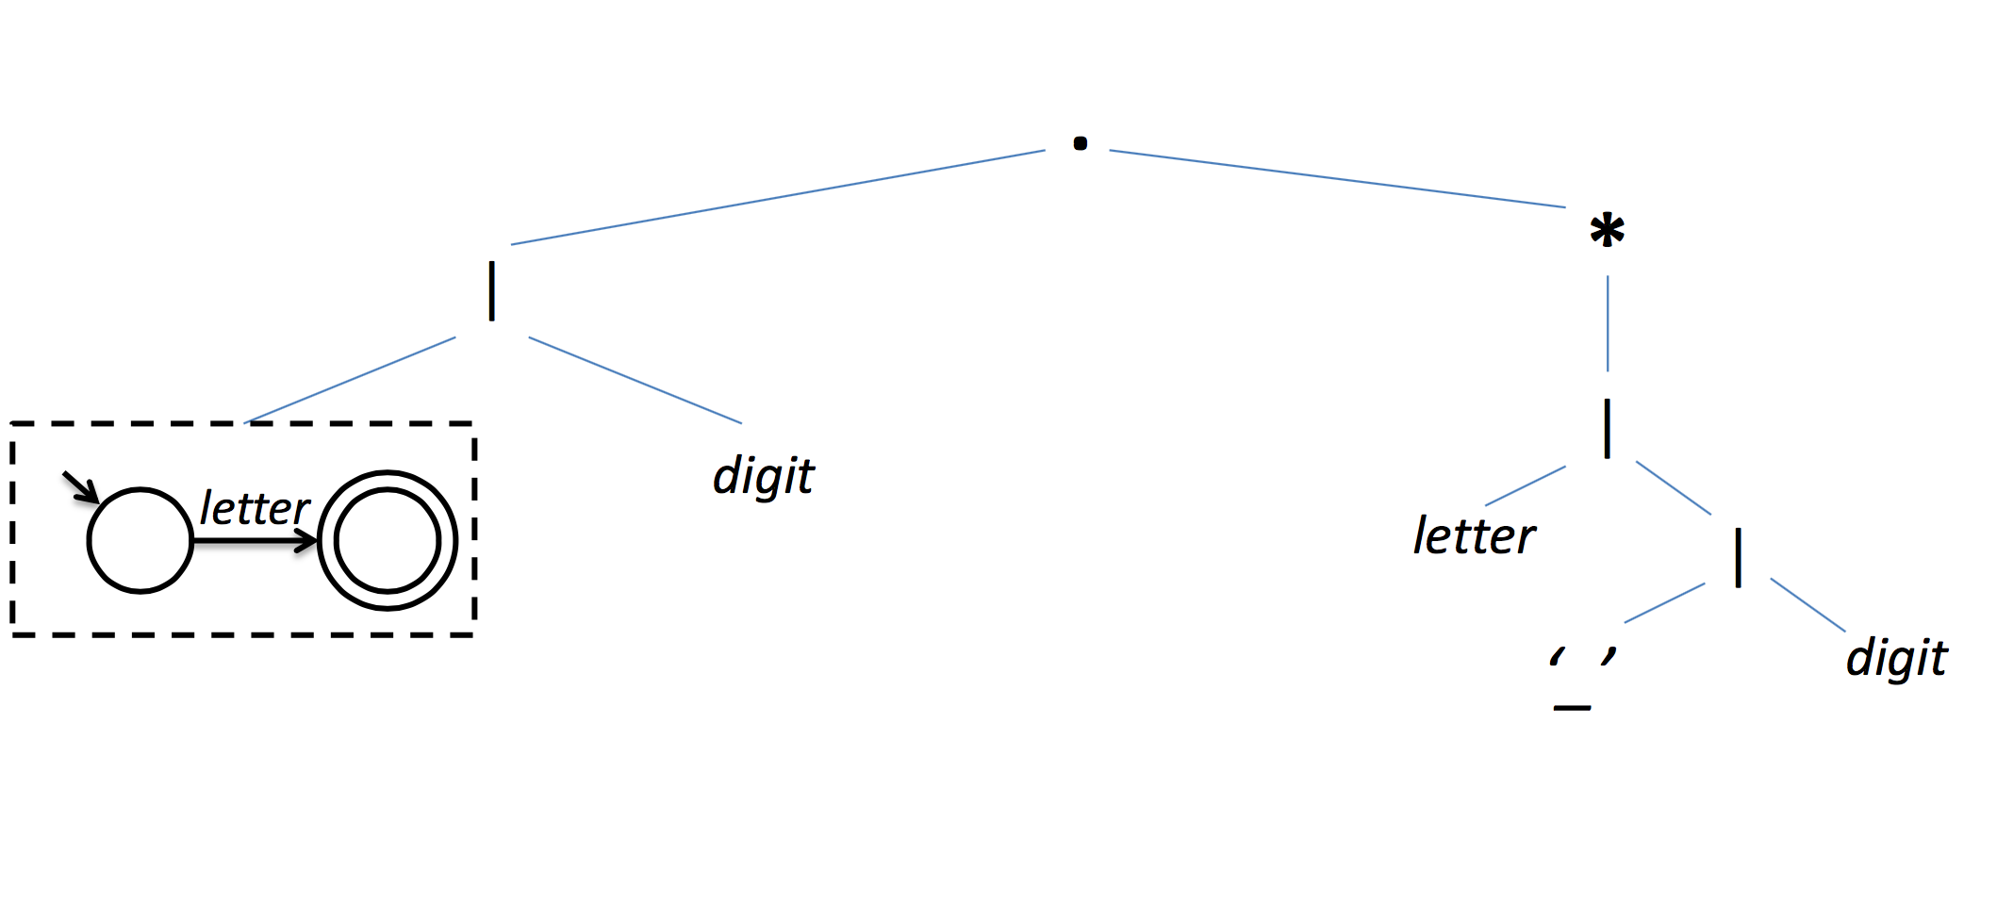
Bottom-up conversion

Slide 14
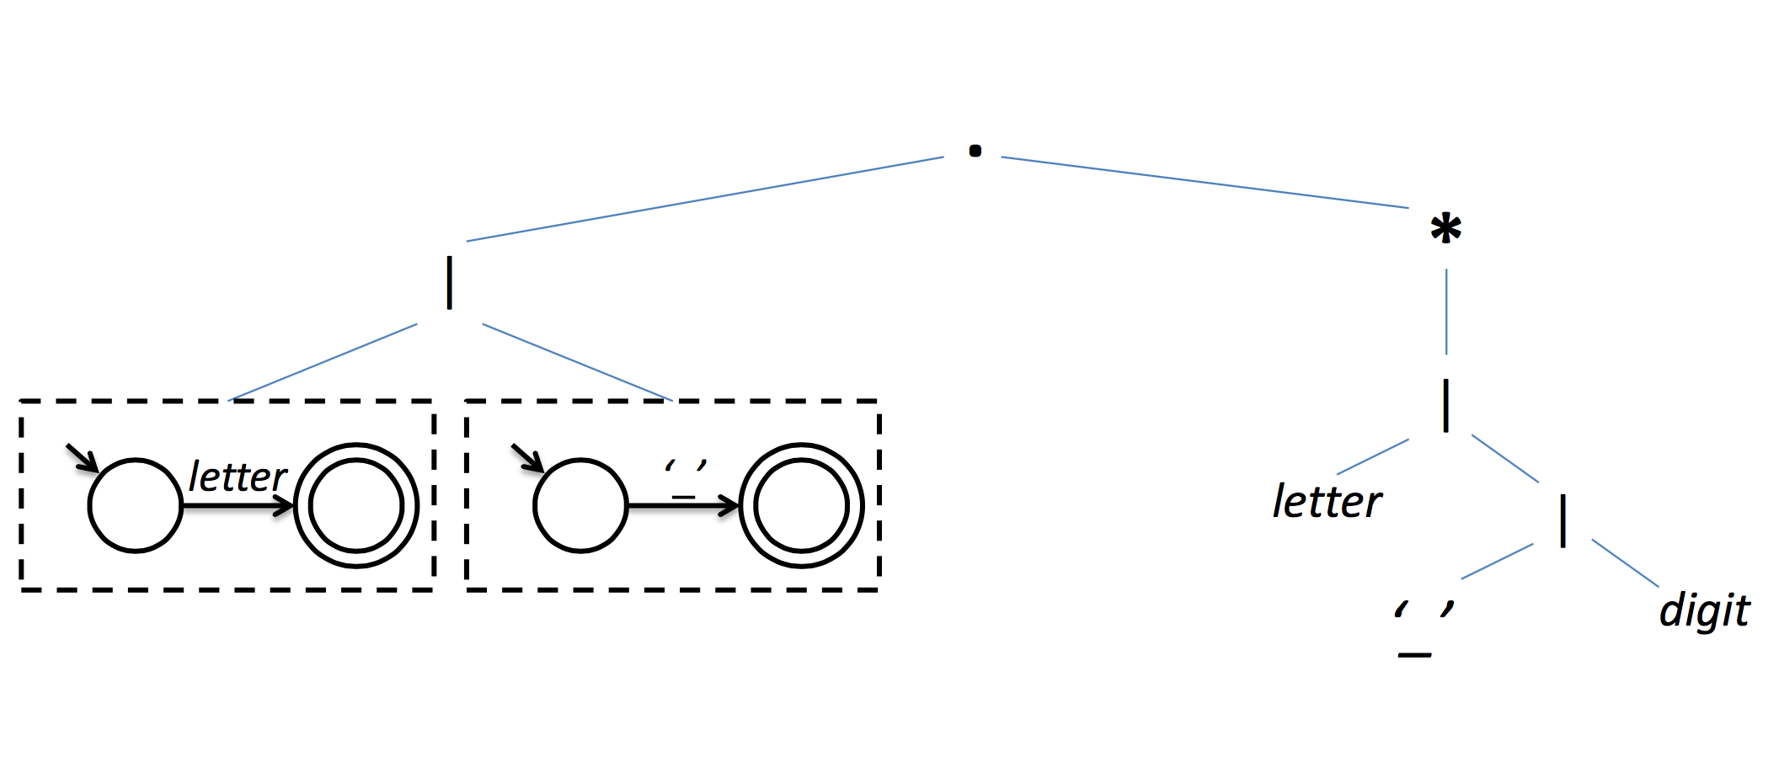
Bottom-up conversion

Slide 15
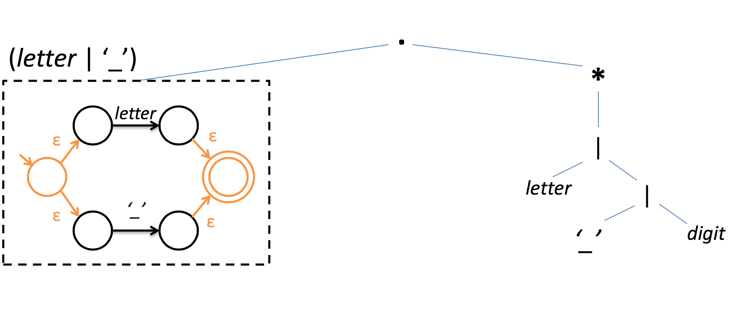
Bottom-up conversion

Slide 16
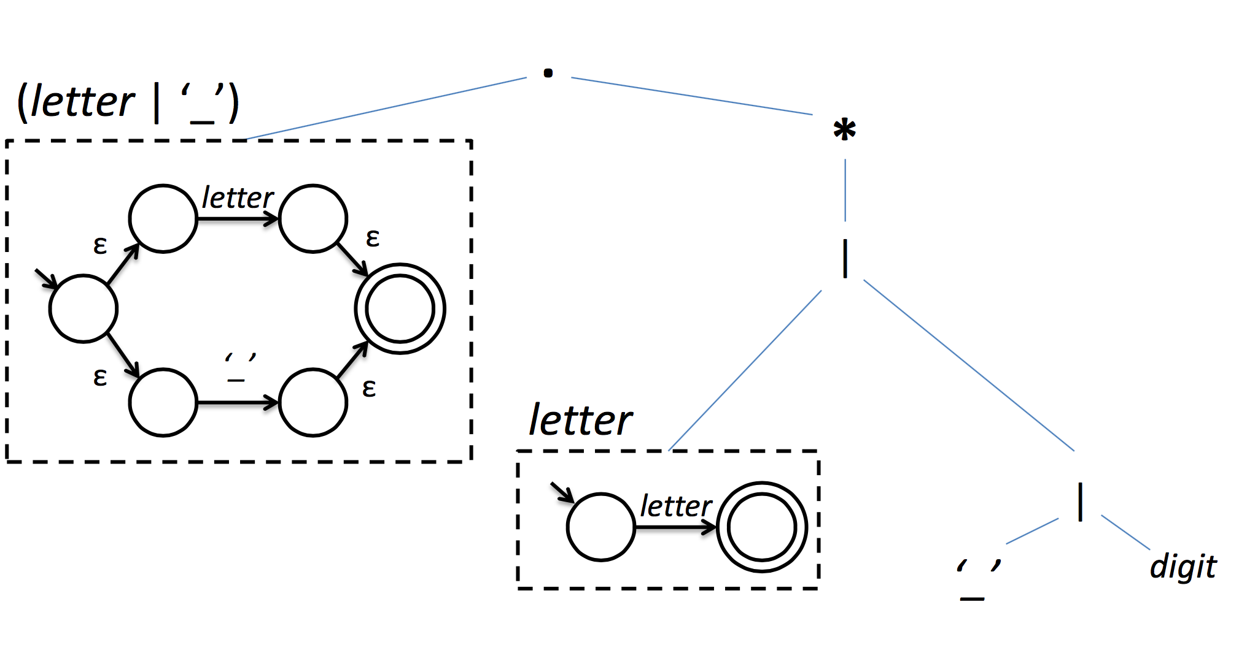
Bottom-up conversion

Slide 17
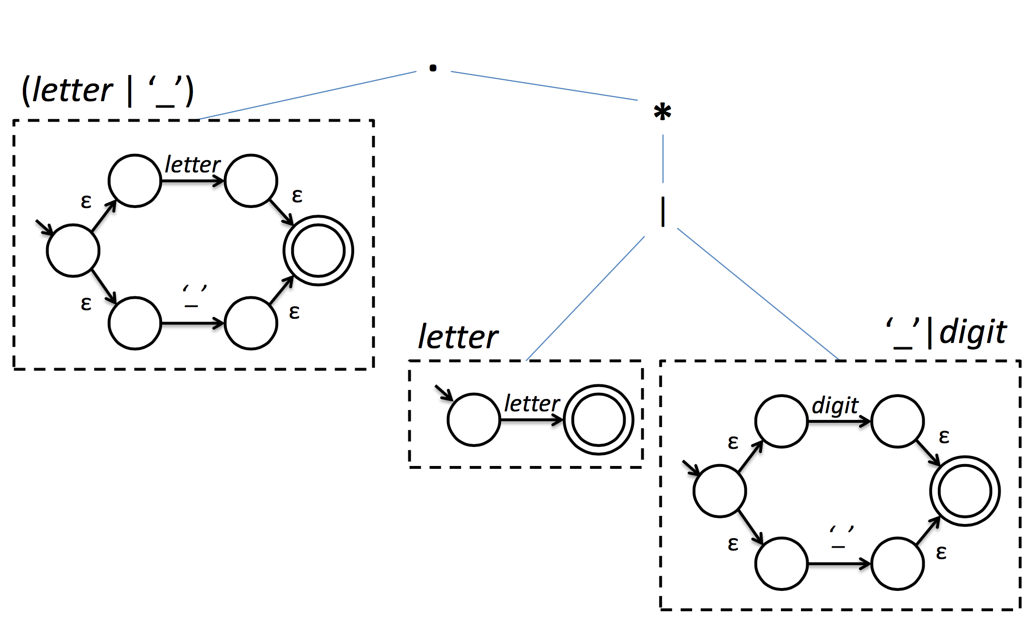
Bottom-up conversion

Slide 18
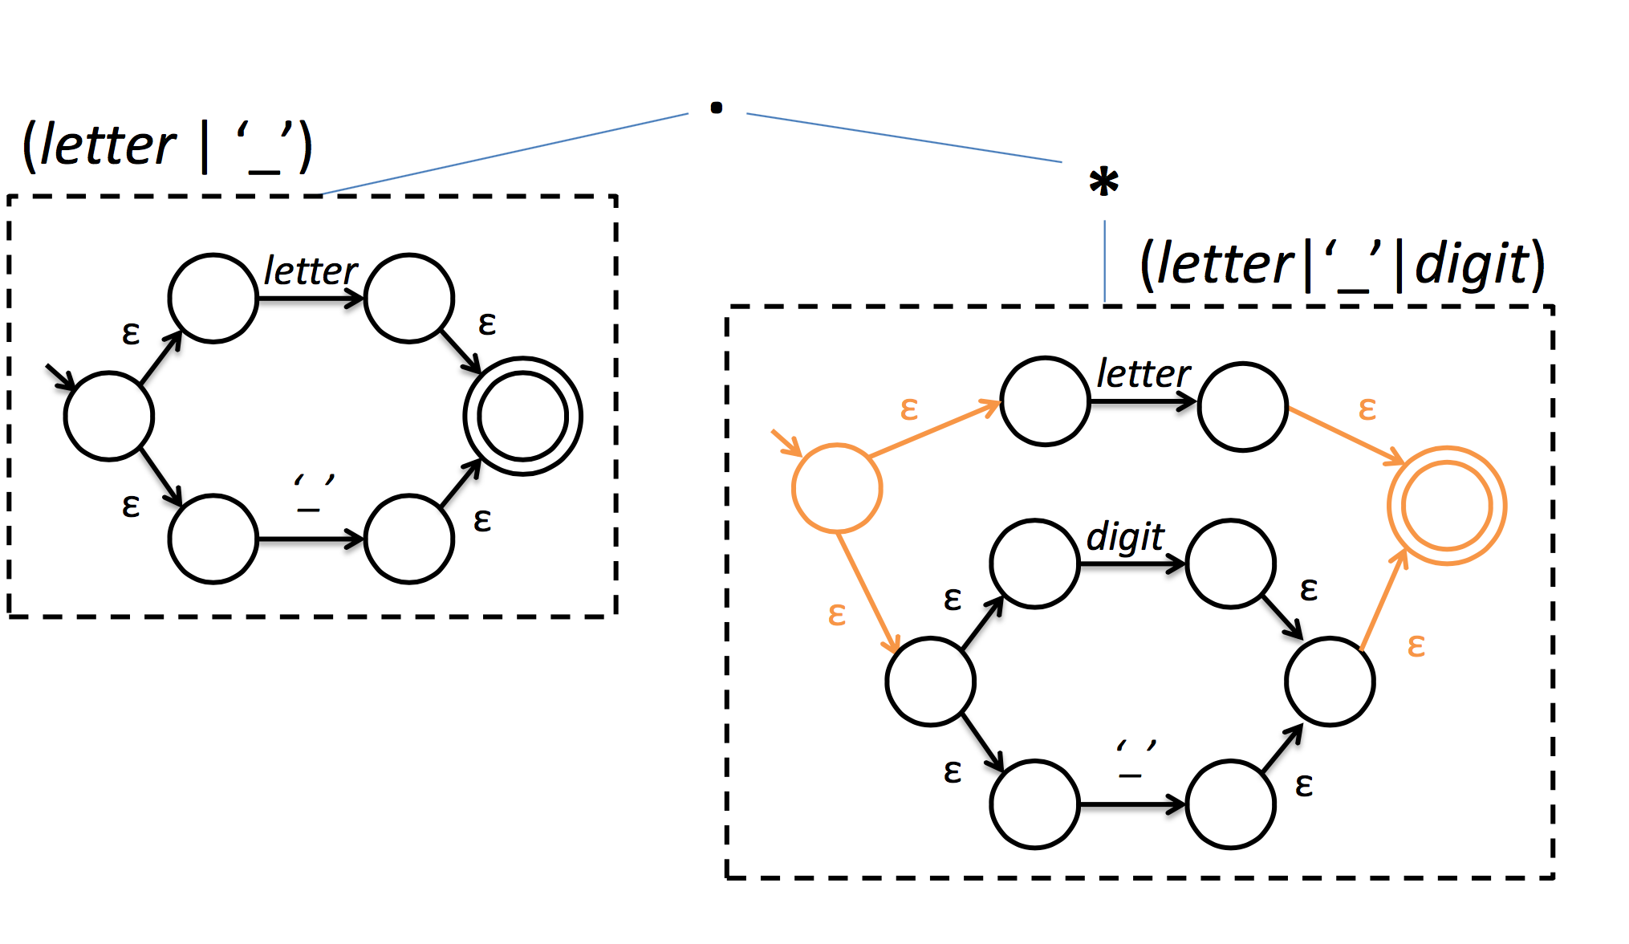
Bottom-up conversion

Slide 19
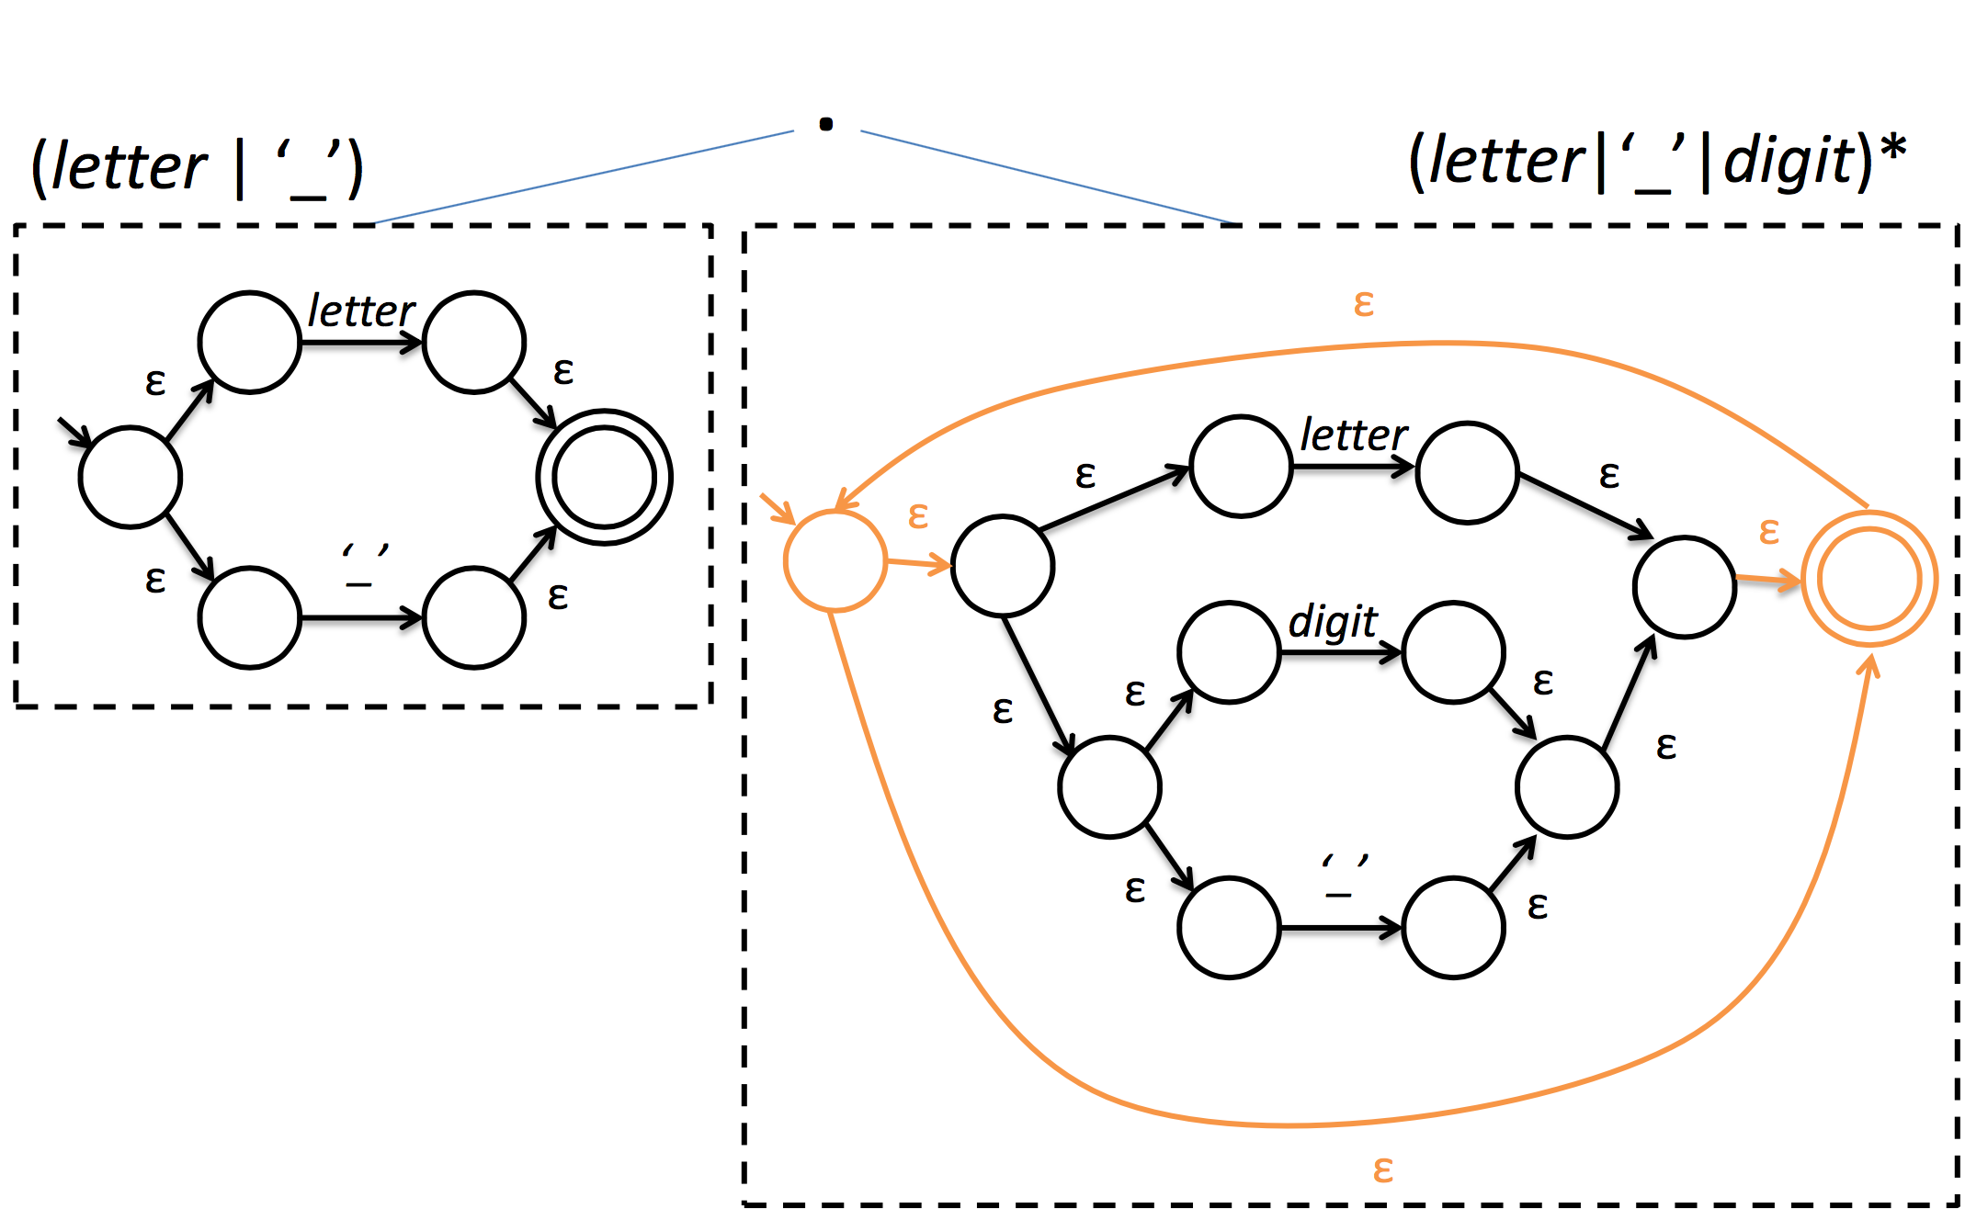
Bottom-up conversion

Slide 20
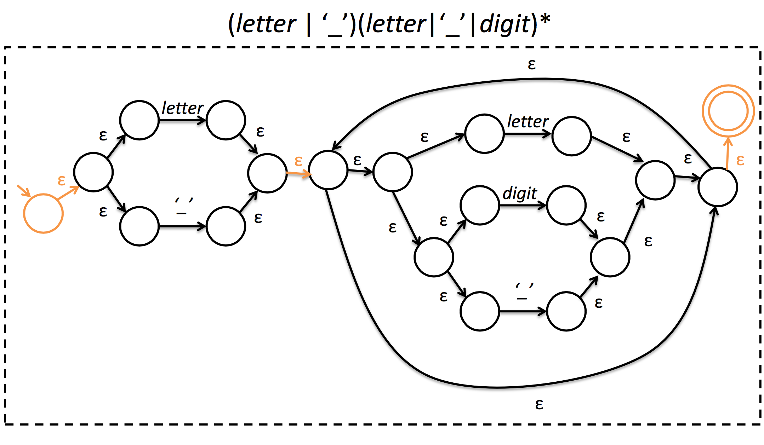
Bottom-up conversion

Slide 21
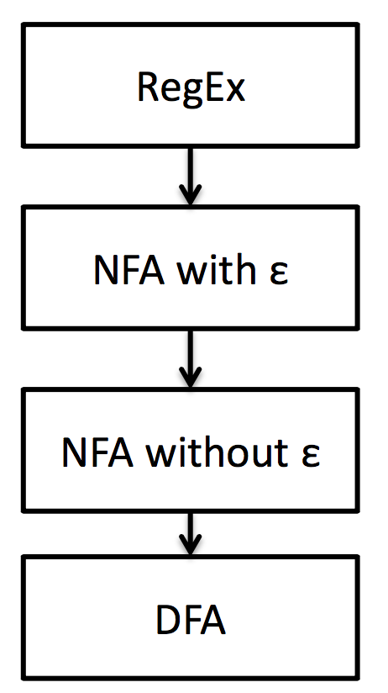
Regexp to DFAs
We now have an NFA
We need to go to DFA
But what’s so great about DFAs?

Slide 22
Table-driven DFAs
Recall that δ can be expressed as a table
This leads to a very efficient array representation
s = start state while (more input){
c = read char
s = table[s][c]
}
if s is final, accept

Slide 23
FSMs for tokenization
FSMs only check for language membership of a string
the scanner needs to recognize a stream of many different tokens using the longest match
the scanner needs to know what was matched
Idea: imbue states with actions that will fire when state is reached

Slide 24
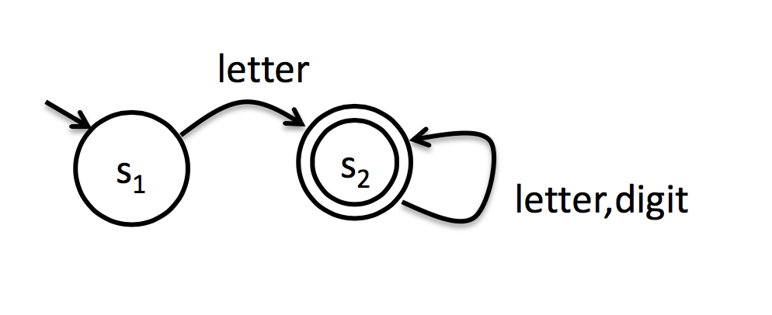
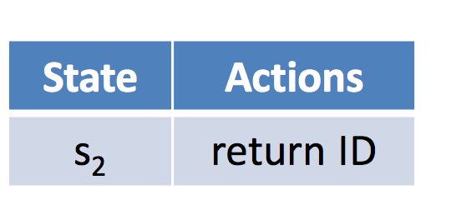
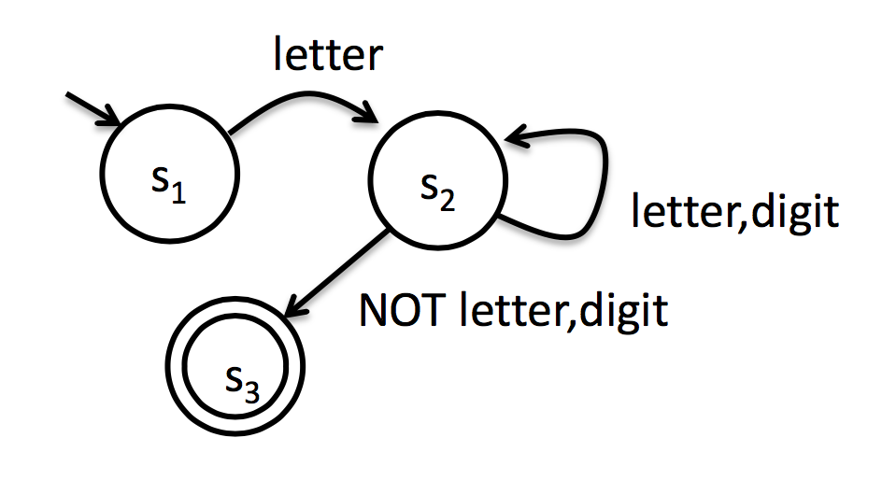
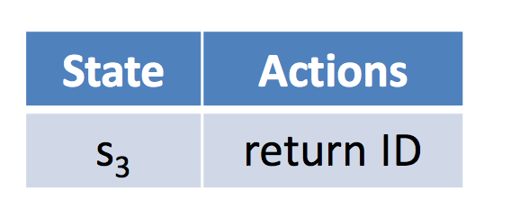
A first cut at actions
Consider the language of Pascal identifiers
BAD: not longest match
Accounting for longest matches
BAD: maybe we needed that
character

Slide 25
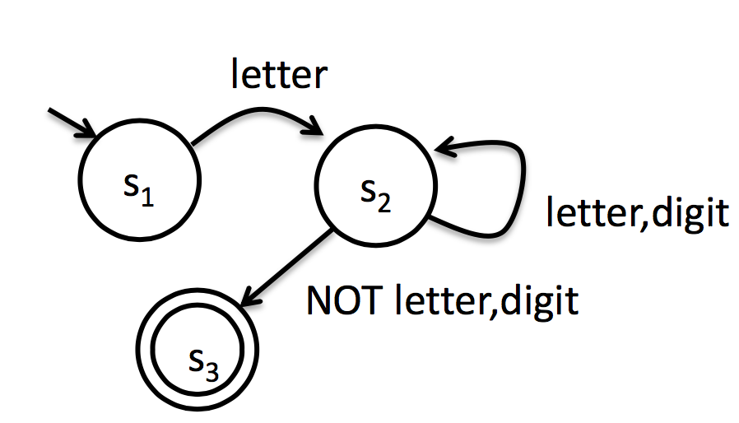
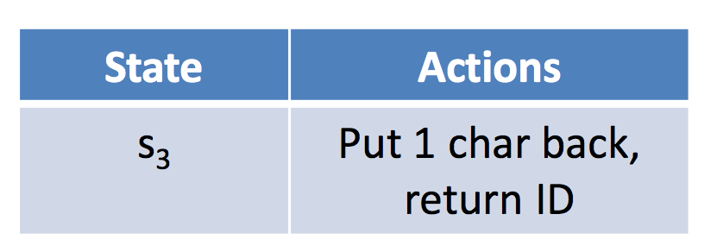
A second take at actions
Give our FSMs ability to put chars back
Since we’re allowing our FSM to peek at characters past the end of a valid token, it’s also convenient to add an EOF symbol

Slide 26
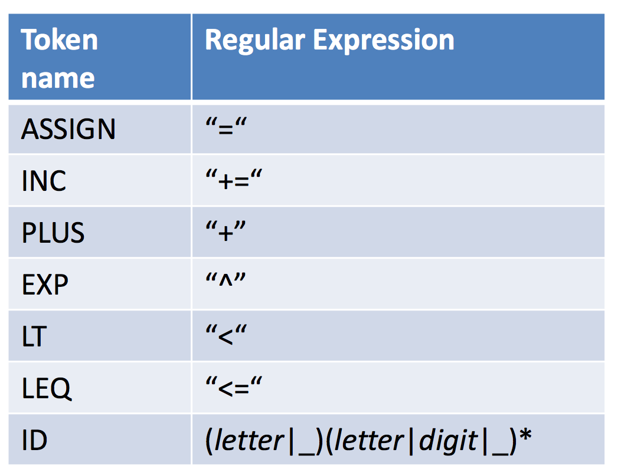
Our first scanner
Consider a language with two statements
assignments: ID = expr
increments: ID += expr
where expr is of the form
ID + ID
ID ^ ID
ID < ID
ID <= ID
Identifiers ID follow C conventions

Slide 27
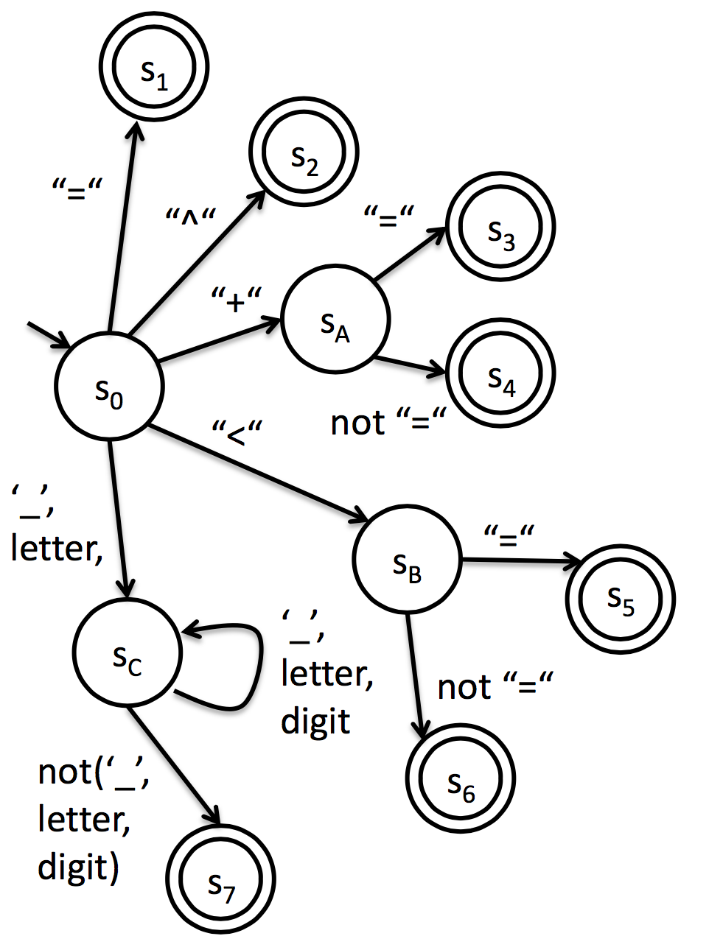
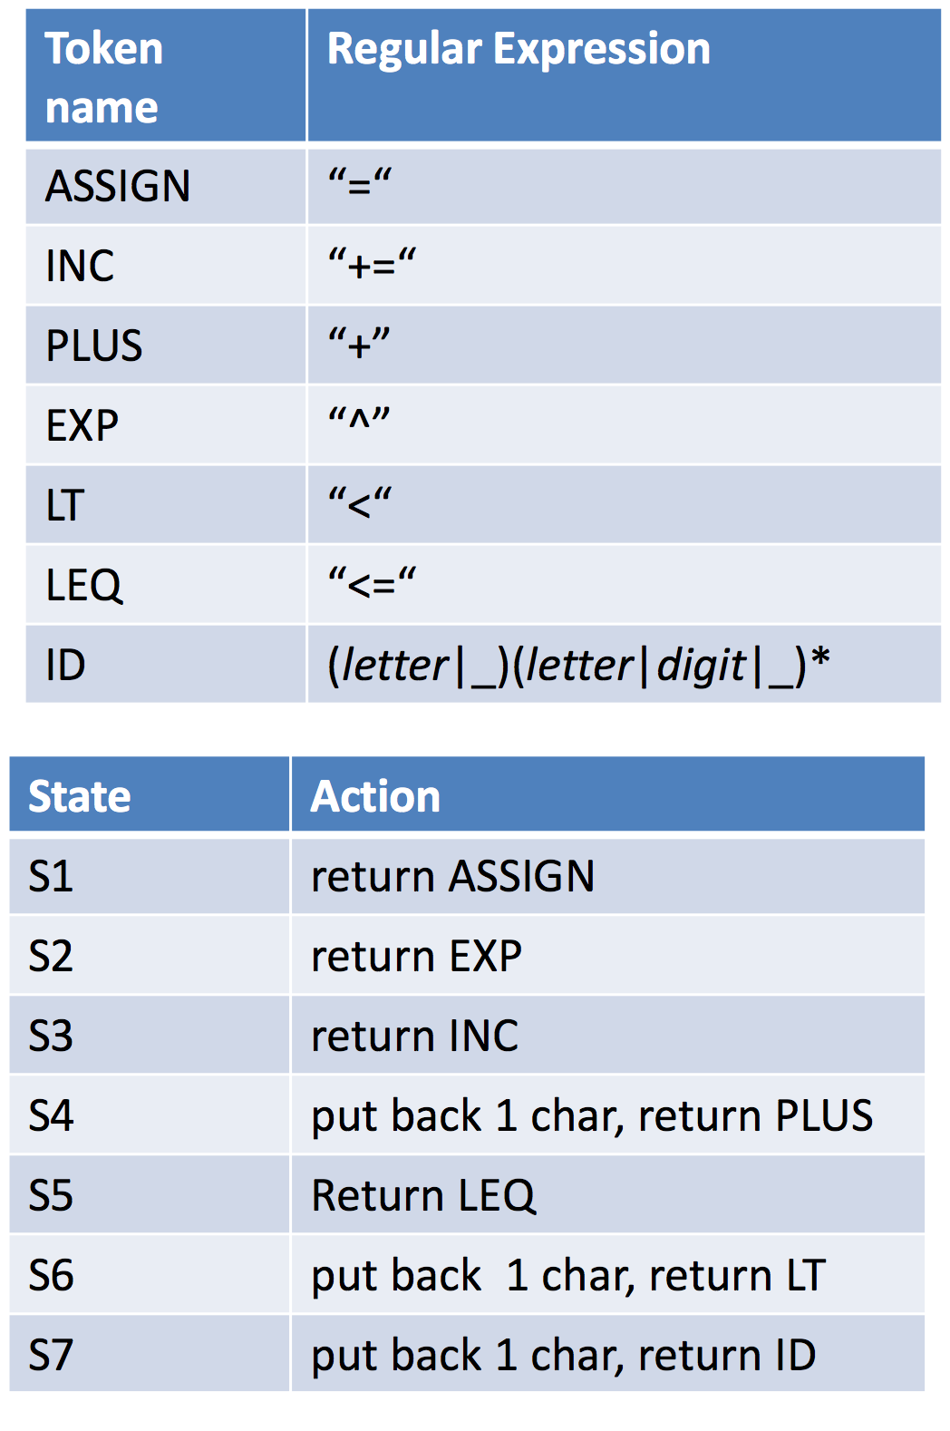
Combined DFA

Slide 28
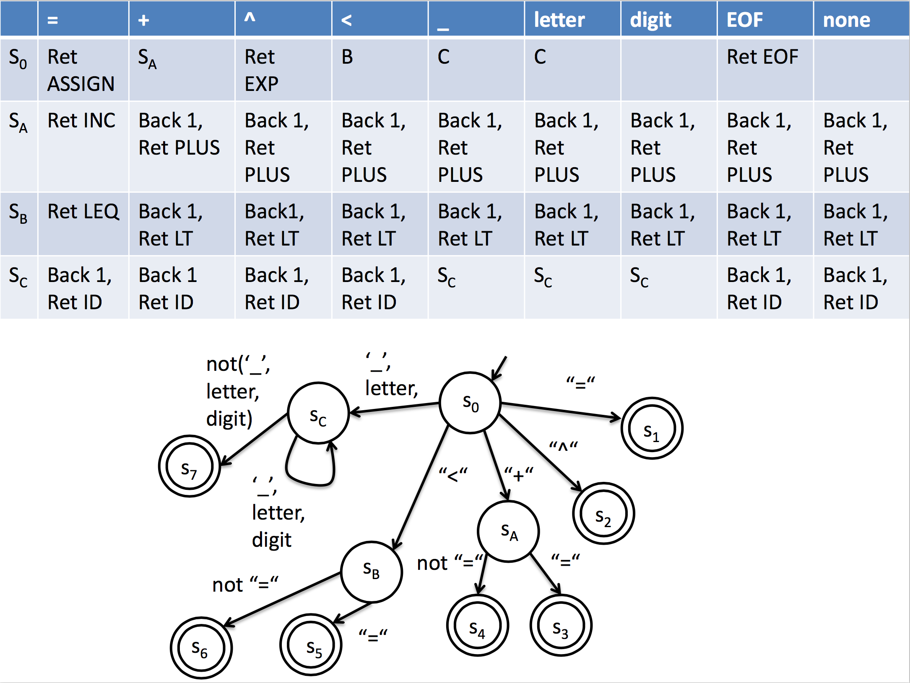

Slide 29
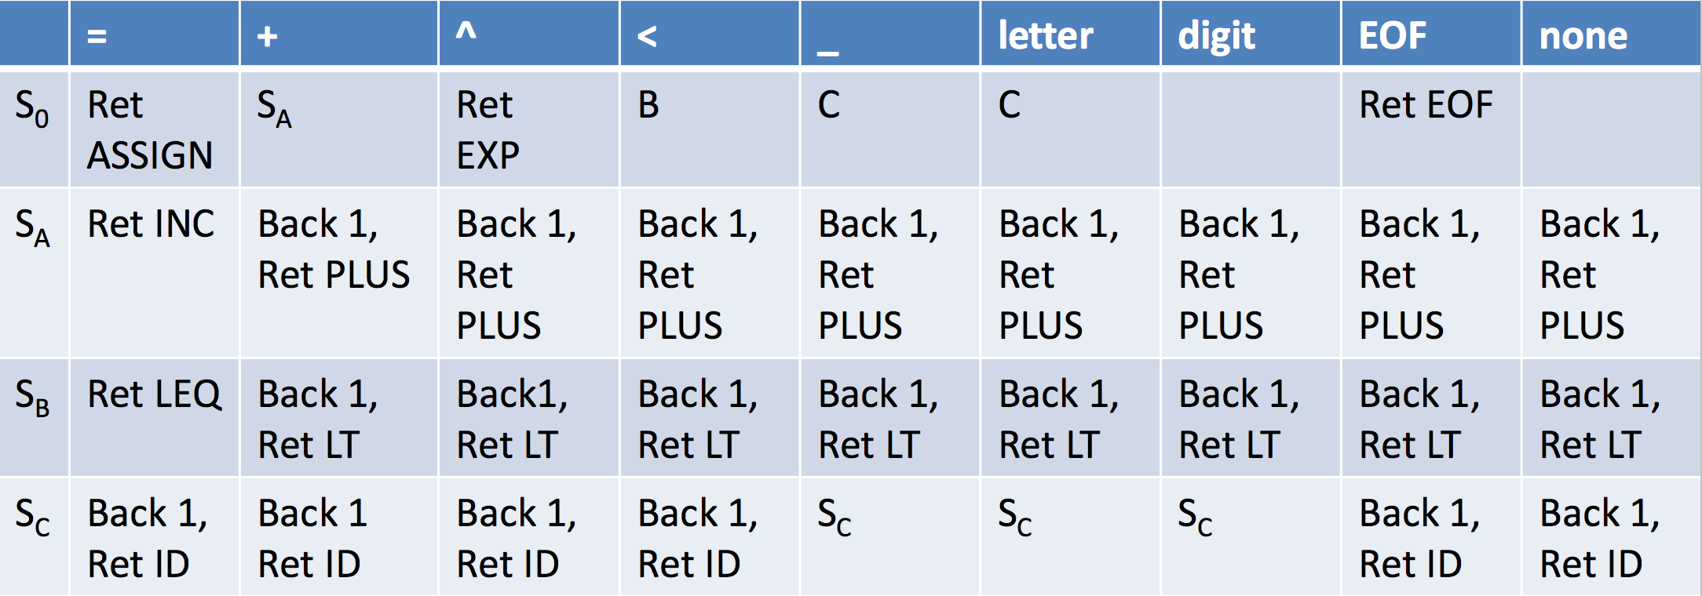
do{
read char
perform action / update state if (action was to return a token){
start again in start state
}
} (while not EOF or stuck);

Slide 30
Lexical analyzer generators
aka scanner generators
The transformation from regexp to scanner is formally defined
Can write tools to synthesize a lexer automatically
Lex: unix scanner generator
Flex: fast lex
JLex: Java version of Lex

Slide 31
JLex
Declarative specification
tell it what you want scanned, it will figure out the rest
Input: set of regexps + associated actions
xyz.jlex file
Output: Java source code for a scanner
xyz.jlex.java source code of scanner

Slide 32
jlex format
3 sections separated by %%
user code section
directives
regular expressions + actions

Slide 33
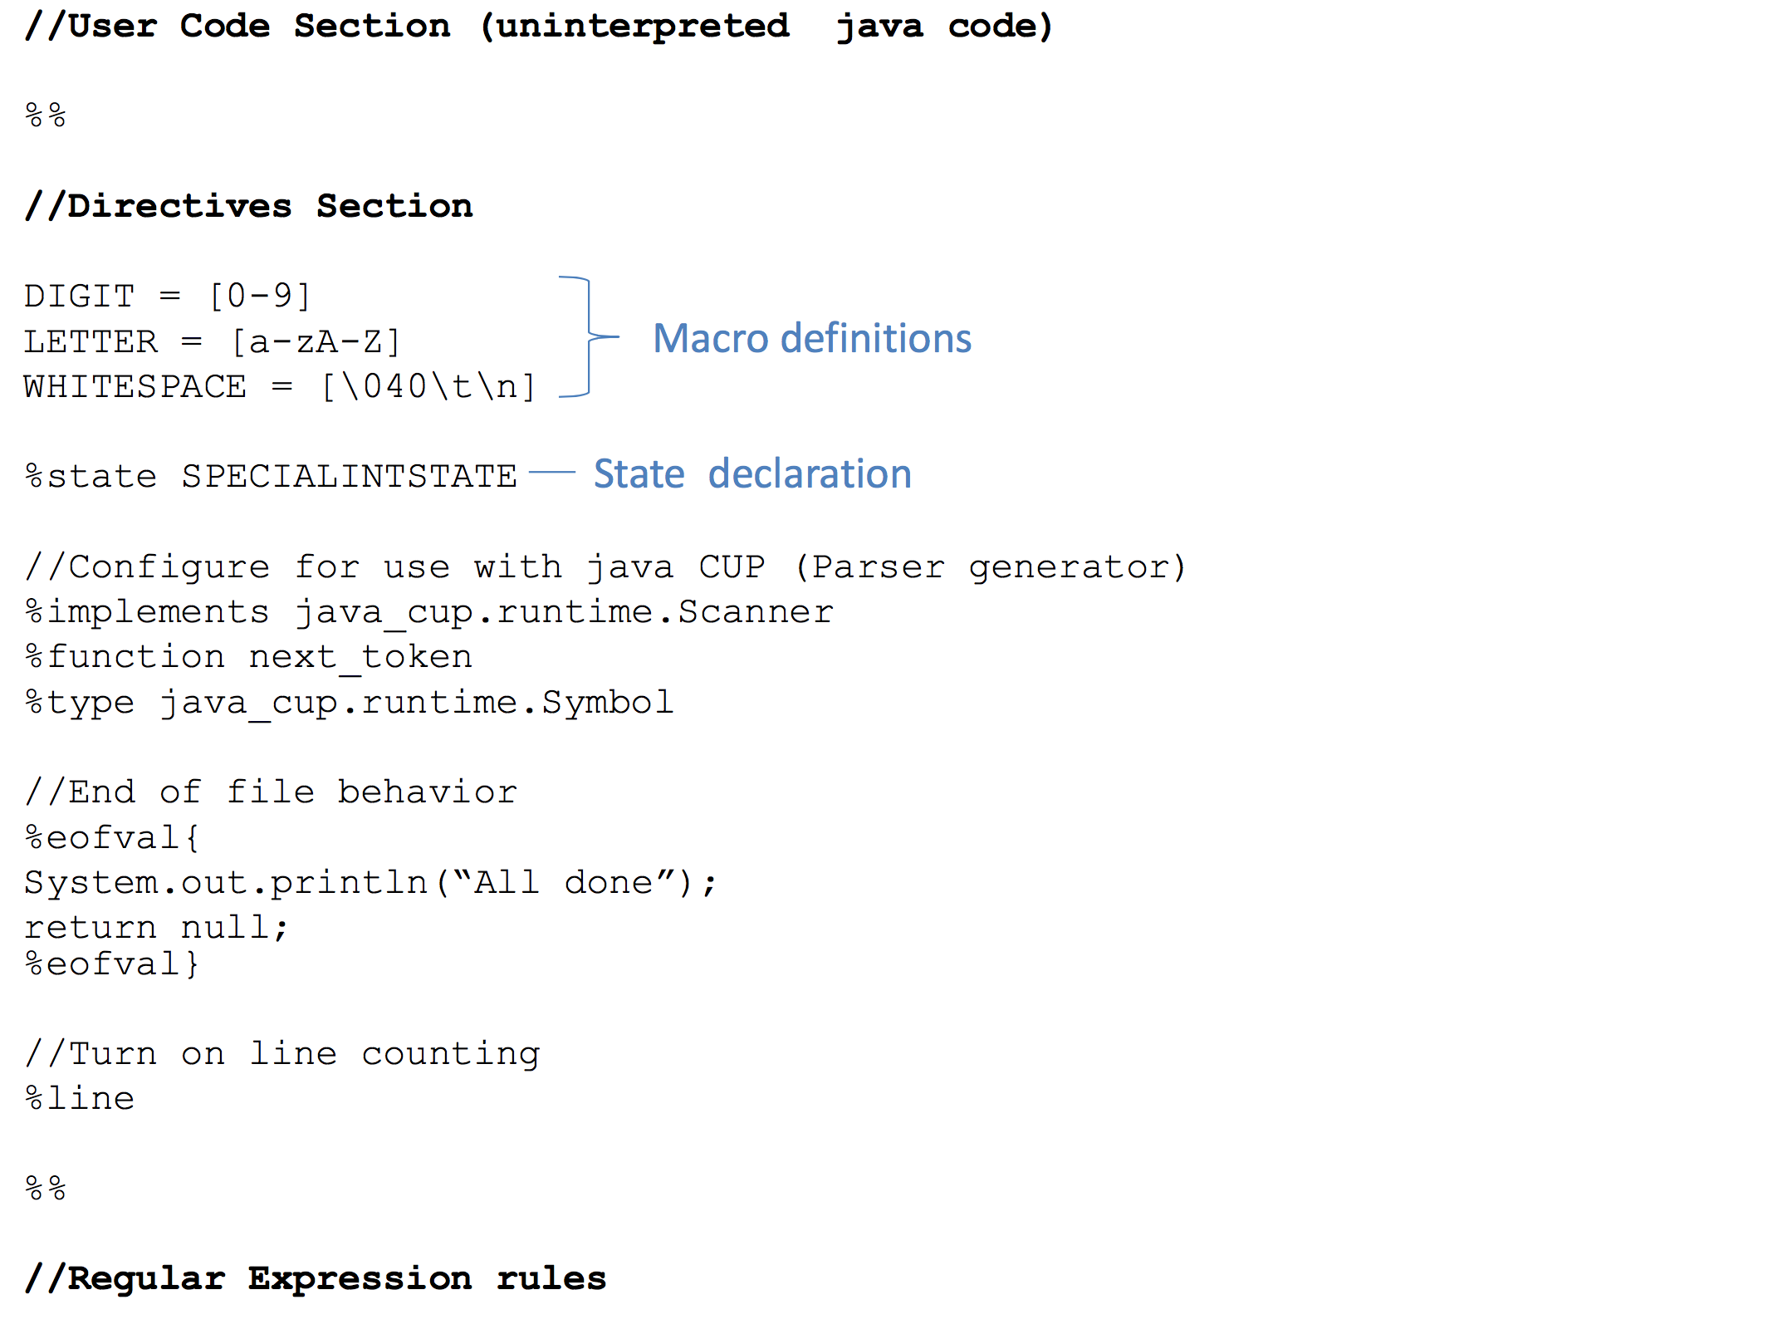

Slide 34
Rules section
Format is <regex>{code} where regex is a regular expression for a single token
can use macros from the directive sections in regex, surround with curly braces
Conventions
chars represent themselves (except special characters)
chars inside “” represent themselves (except \)
Regexp operators
| * + ? () .
Character class operators
- range
^ not
\ escape

Slide 35



