Slide 1

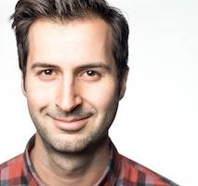
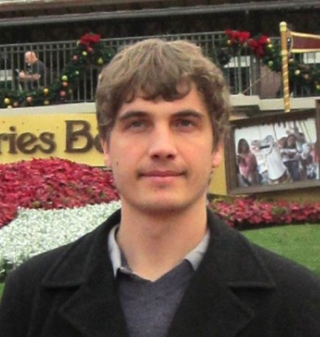
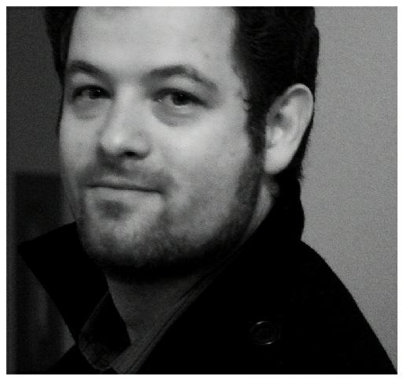






Program Boosting: program synthesis via crowd-sourcing
Robert Cochran
Loris D’Antoni
Benjamin Livshits
David Molnar
Margus Veanes
Notes:
30s intro
Overall experience
Background
Worked on areas w/o prior experience

Slide 2
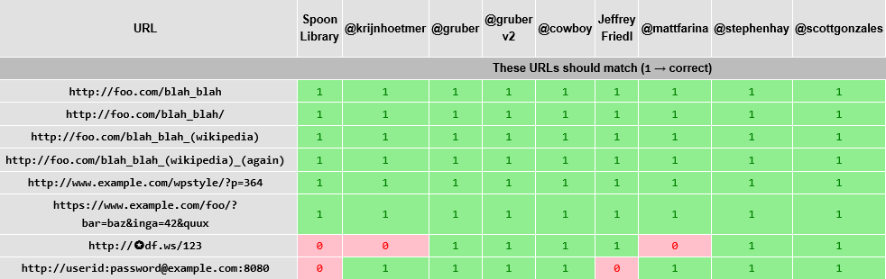
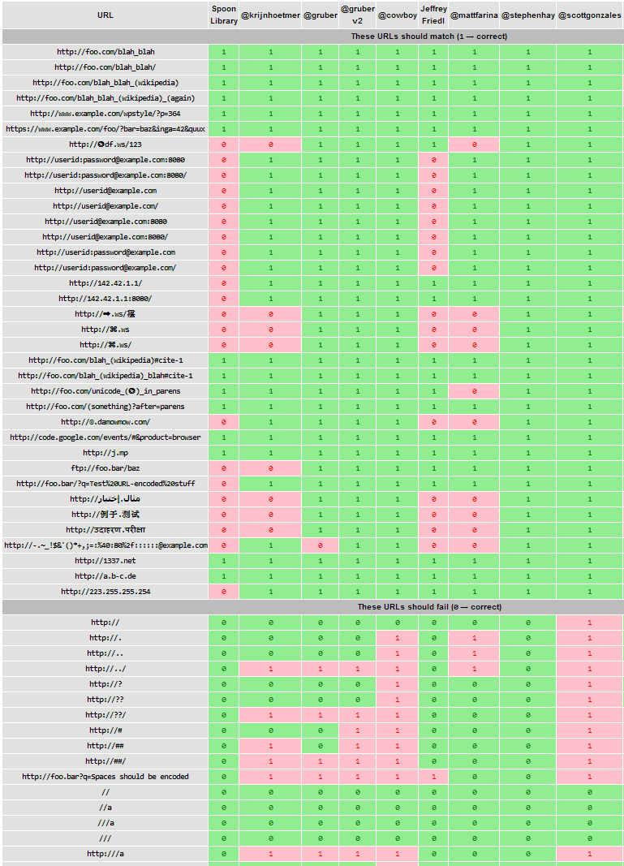

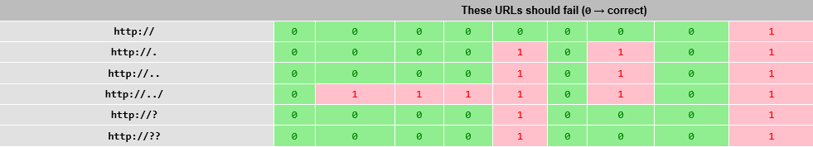

In Search of the Perfect URL Validation Regex
http://mathiasbynens.be/url-regex
Matias Bynens
Submissions:
@krijnhoetmer
@cowboy
@mattfarina
@stephenhay
@scottgonzales
@rodneyrehm
@imme_emosol
@diegoperini
“I’m looking for a decent regular expression to validate URLs.”
- @mathias
Notes:
Goal: Perfect Regex
Approach: advertise task on twitter
Judge: using positive and negative examples

Slide 3
Key Insight for Crowd-Sourcing of Programs
Regular expressions
CrowdBoost
Most people get easy cases right
People are good with positive examples
…but bad at rejecting negative examples – more permissive than they should be
However, piecing together different solutions will produce a good score on the examples
In this project we apply this intuition to programs
CrowdBoost
  Crowd-source initial programs
  “Blend” them together
  Refine the result
We call this program boosting

Slide 4
Overview of Program Boosting
Training set
Provided by whoever defines the task
Initial programs
Get something right
Specification
Textual description
Open to interpretation
Positive and negative examples
But usually get something wrong
Specification is not formal, and often elusive and incomplete
Broad space of inputs difficult to get full test coverage for
Easy to get started, tough to get good precision
Notes:
I’m not going to give you specific details, here but I want to highlight how this approach could be applied in different domains

Slide 5
Outline
Vision and motivation
Our approach: CrowdBoost
Technical details: regular expressions and SFAs
Experiment setup
Experimental results

Slide 6
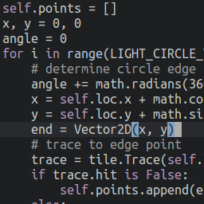
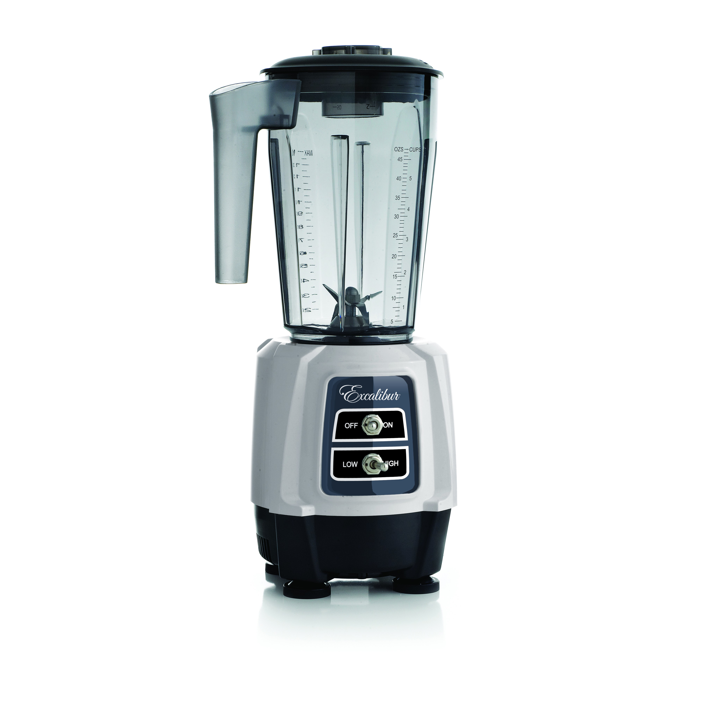
CrowdBoost in a nutshell
Specification
Notes:
The goal of this slide is to show a high level view of the over all process, later on I will show a things with a bit more technical detail.
Just to reiterate, we start with a crowd of human workers which produce a set of programs which we then blend in some manner to produce a result
That is better than the input, what we mean by “better” I will elaborate on a bit more in the next few slides.

Slide 7

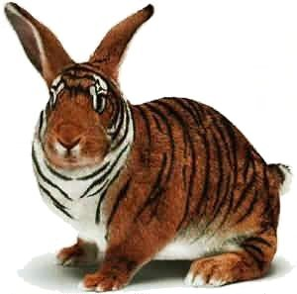
CrowdBoost Outline
Crowd-source initial programs
We use genetic programming approach for blending
Needed program operations:
  Shuffles (2 programs => program)
  Mutations (program => program)
  Training Set Generation and Refinement (program => new labeled examples)
ID | Label
Ex1 | +
Ex2 | -
Ex3 | +
Ex4 | -

Slide 8
Example of Program Blending
Input 1 (0.53)
Input 2 (0.58)
Mutation
(0.60)
Shuffle
(0.62)
Mutation
(0.60)
Need to prevent
over-fitting
Mutation
(0.50)
Mutation
(0.69)
Shuffle
(0.63)
…
Winner!
(0.85)
Iteration
Notes:
We have a notion of fitness, which is simply how well we perform on the example set
One undesirable result however is that we may have a problem with over fitting to the training set.

Slide 9
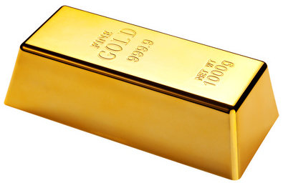

How Do We Measure Quality?
Candidate Fitness
Training Set Coverage
How well does a program perform on a given training set?
S = Examples accepted by program
P = Positive examples
N = Negative examples
Possible Input Space
?
+
Initial Examples
“Gold Set”
-
+
+
-
+
?
-
?
+
-
?
?
+
+
|S ∩ P| + |S \ A|
-
-
?
Accuracy =
-
+
?
?
?
+
|P ∪ N|
+
+
?
?
+
-
+
?
?
Notes:
Change formulas to consider sizes

Slide 10







Skilled and Unskilled Crowds
Skilled
Unskilled
More expensive, longer units of work (hours)
May require multiple rounds of interaction
Provide initial programs
Cheaper, smaller units of work (seconds or minutes)
Automated process for hiring, vetting and retrieving work
Used to grow/evolve training examples
Notes:
Skilled Task: Implements a program that fit’s their interpretation of a given spec.
LowSkilled Task: Given a spec, can tell if it matches the spec, i.e. is this a valid email address?

Slide 11

CrowdBoost
Shuffle / Mutate
Refine training set
Select successful candidates
Assess fitness
Specification
Initial Examples
“Gold Set”
-
-
+
+
+
-
CrowdBoost
$$Accuracy=\frac{+/−}{Total }$$

Slide 12
Outline
Vision and motivation
Our approach: CrowdBoost
Technical details: regular expressions and SFAs
Experiment setup
Experimental results

Slide 13
Working with Regular Expressions
Our approach is general
Tradeoff:
  expressiveness VS complexity
Our results are very specific
We use a restricted notion of programs
Regular expressions can be expressed as Automata, that permit efficient implementations of key operations
  Shuffles
  Mutations (positive and negative)
  Training Set Generation

Slide 14
Automata Shuffle: Overview
Not all shuffles are successful.
Success rates are sometimes less than 1%
Goal: Interleave two automata A and B
Large number of edges doesn’t scale
  Very high complexity
  We also don’t want to swap random edges, we want to have an alignment between A and B
A
B
i₂
i₁

Slide 15
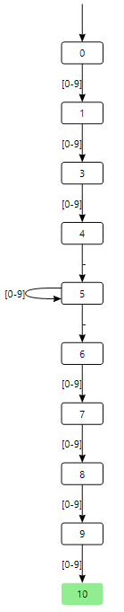
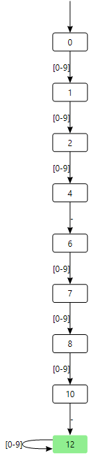
Shuffle: Example
A
B
Regular expressions for phone numbers
  ^[0-9]{3}-[0-9]*-[0-9]{4}$
  ^[0-9]{3}-[0-9]{3}-[0-9]*$
  Shuffle:
  ^[0-9]{3}-[0-9]{3}-[0-9]{4}$

Slide 16
Mutation
Positive Mutation: ftp://foo.com
Negative Mutation: http://#
Add edge for “f”
Remove “#”
Notes:
Examples, not a full description of the algorithm

Slide 17
Training Set Refinement
Existing Strings:
  http://foo.com/
  ftp://a.x/
✔
State to cover
✔
✔
✔
Generate new string
✔
✔
✔
✔
✔
✔
✔
✔
✔
✔

Slide 18
Training Set Generation
Compute automaton D of strings passing through uncovered states
Choose string s in D at random
    https://f.o/..Q/
    ftp://1.bd:9/:44ZW1
    http://h:68576/:X
    https://f68.ug.dk.it.no.fm
    ftp://hz8.bh8.fzpd85.frn7..
    ftp://i4.ncm2.lkxp.r9..:5811
    ftp://bi.mt..:349/
    http://n.ytnsw.yt.ee8o.w.fos.o
Given a string e, choose find the closest string to e in D
  e = “http://youtube.com”
    Whttp://youtube.com
    http://y_outube.com
    h_ttp://youtube.com
    WWWhttp://youtube.co/m
    http://yout.pe.com
    ftp://yo.tube.com
    http://y.foutube.com

Slide 19
Outline
Vision and motivation
Our approach: CrowdBoost
Technical details: regular expressions and SFAs
Experiment setup
Experimental results

Slide 20
Four Crowd-Sourcing Tasks
We consider 4 task specifications
  Phone numbers
  Dates
  Emails
  URLs
For Bountify sourcing we used a handful of + and - examples
Date Specification:
Please write a regular expression that validates dates in different formats. Note that we are asking for original work. Please do not copy your answer from other sites.
+ (9 total)
  June 7, 2013
  7/7/2013
  June-7-2013
- (10 total)
  Junu 7, 2013
  7/77/2013
  Jul-7-2013
Please provide the regular expression in the form /^ YOUR ANSWER IS HERE $/ as part of your answer. Please test your regex on the samples provided before submitting. You may want to use http://regexpal.com for testing.
Notes:
Increasing order of complexity

Slide 21
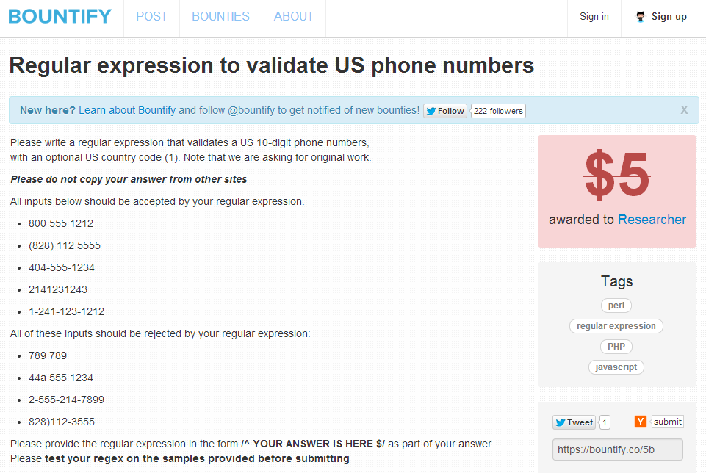
Bountify Experience

Slide 22
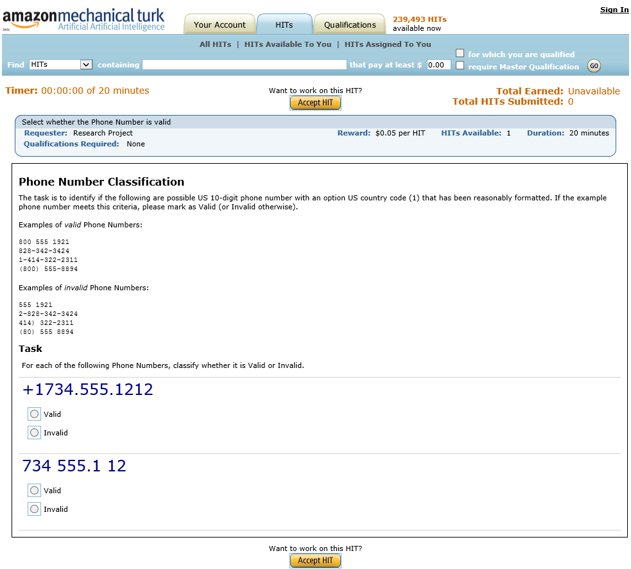
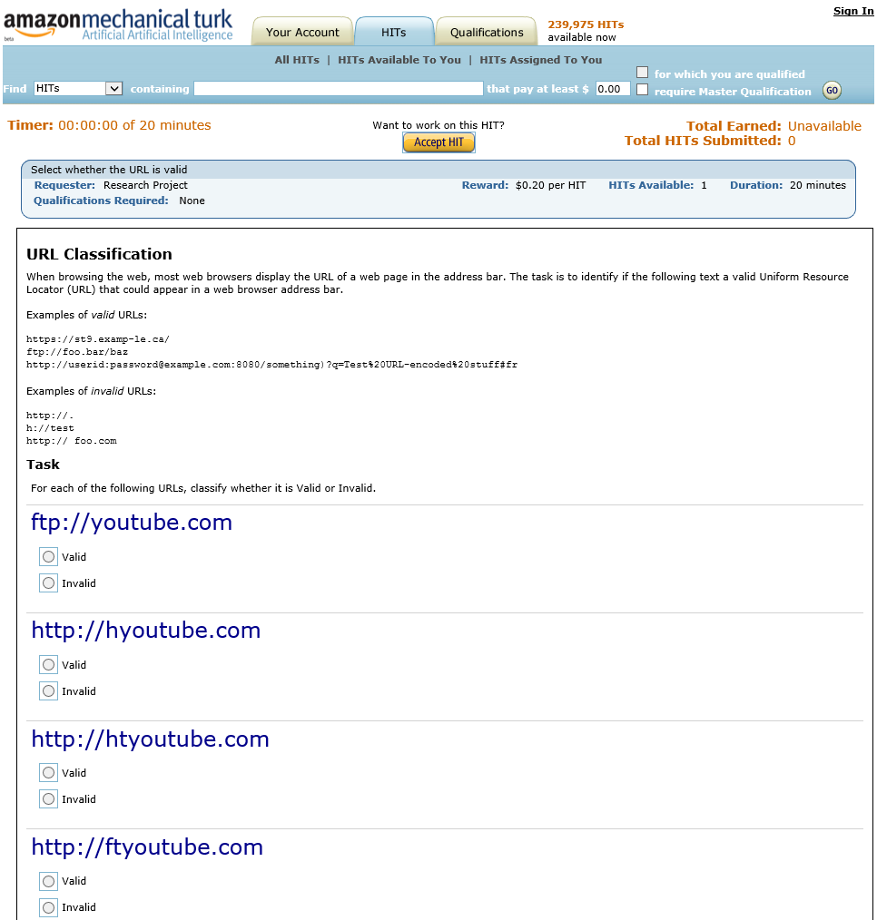
Worker Interface to Classify Strings

Slide 23
Outline
Vision and motivation
Our approach: CrowdBoost
Technical details: regular expressions and SFAs
Experiment setup
Experimental results

Slide 24


Experimental Analysis
Measure fitness using gold and refined example set
Generate examples using edit distance for state coverage
Classify new examples using Mturk
SFA Shuffle / SFA Mutate
Select successful candidates
Specification:
Phone, Email, Date or URL
Initial Examples
“Gold Set”
72+ / 90-
-
-
+
+
+
Results measured:
Boost in fitness
Mturk costs
Worker latency
Running times
-
Evolution
Process
465 experiments (pairs)
30 total regexes.
10 from Bountify, 20 found online.

Slide 25
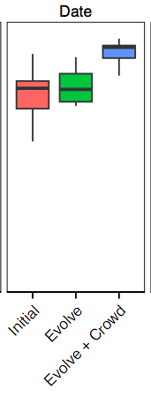
Final Fitness After Boosting
Final fitness
upwards of 90%
Positive boost
Notes:
Here are our overall boosting results
We start by just looking at the results for the date specification…

Slide 26
Other experimental results (per pair)
Task | Mechanical Turk Latency (avg) | Total running time (avg) | Mechanical Turk Cost (avg)
Phone | 8 minutes | 25 minutes | 0.41 $
Date | 30 minutes | 55 minutes | 2.59 $
Email | 11 minutes | 17 minutes | 0.50 $
URL | 30 minutes | 70 minutes | 3.00 $
We run up to 10 generations
Often 5 or 6 generations are enough to hit plateau
Classification tasks given in batches
We hire 5 workers per batch
Notes:
Classification tasks were batched into varying sizes (max 50) and had scaled payment rates ($0.5 - $1.00)

Slide 27
Potential Appliction: Sanitizers
Sanitizers for Security
  String sanitization functions on untrusted data
  Can be modeled as transducers (automata with output)
Training set
Input/output pairs
Initial programs
Sanitizers produced by developers
Specification
“Write an HTML sanitizer”
program sanitize(t);
string s;
s := iter(c in t) {b := false;} {
case (!(b) && ((c == '\'') || (c == '\"'))):
b := false;
yield ('\\');
yield (c);
case (c == '\\') :
b := !(b);
yield (c);
case (true) :
b := false;
yield (c);
};
return s;
“
\”
Notes:
The same property holds here, developers get them right for the obvious cases, but miss on corner cases, but different ones, this is the hope of program boosting, that better results could come from blending

Slide 28
Conclusions
Programs that implement non-trivial tasks can be crowd-sourced effectively
We focus on tasks that defy easy specification and involve controversy
CrowdBoost: use genetic programming, to produce an improvement in quality of crowdsourced programs
Experiments with regular expressions
Tested on 4 complex tasks
  Phone numbers, Dates, Emails, URLs
Considered pairs of regexes from Bountify, RegexLib, etc.
CONSISTENT BOOSTS | 0.12 -0.28 median increase in fitness
MTURK LATENCY | 8 – 37 minutes per iteration
RUNNING TIME | 10 minutes to 2 hours
MTURK COSTS | $0.41 to $3.00
Notes:
Overall = including shuffles

Slide 29
bACKUP

Slide 30
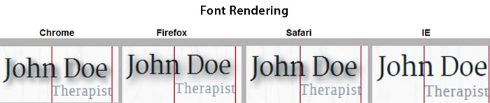
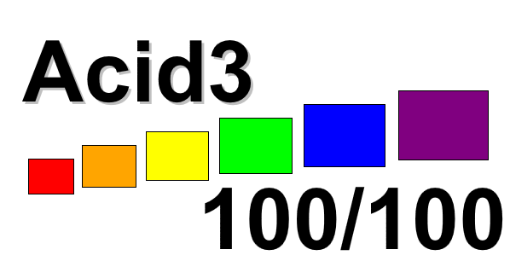

Potential Appliction: Browser Rendering
Training set
HTML/CSS/Javascript and render example pairs
Initial programs
Rendering Engines
Specification
“Render HTML/CSS/Javascript”
Notes:
Our goal is to produce the best possible rendering for web pages
take existing rendering engines, and combine them in order to produce a better result.
And one way we can do that is to take examples of numerous existing web pages
Our result would be a
Voting protocol / Blending browser rendering

Slide 31
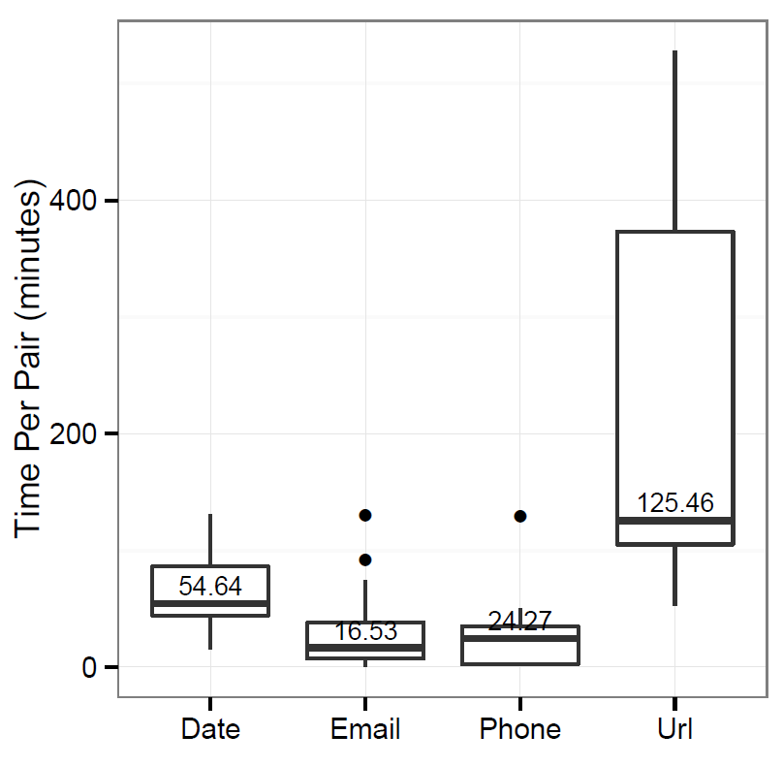
Overall Running Time
More optimization still possible
Notes:
Overall running times varied across our specification categories, from 15 to 20 minutes to multiple hours in some cases, there is still a lot of optimization that could be done for this process

Slide 32
New Strings in the Refined Training Set
Fewer strings, less money and time needs to be spent on mturk
Each generation we produce new strings to reach 100% coverage
The number of strings is relatively low, with max across all pairs being about 200

Slide 33
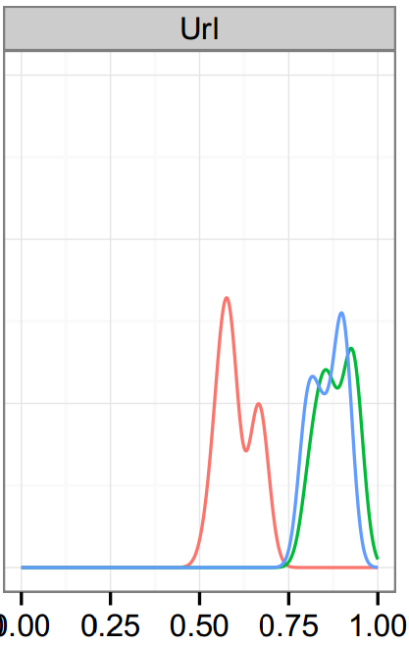
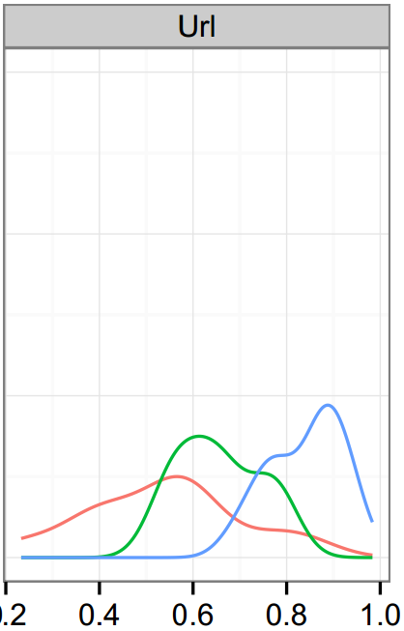
Value of Mechanical Turk Refinement

Slide 34
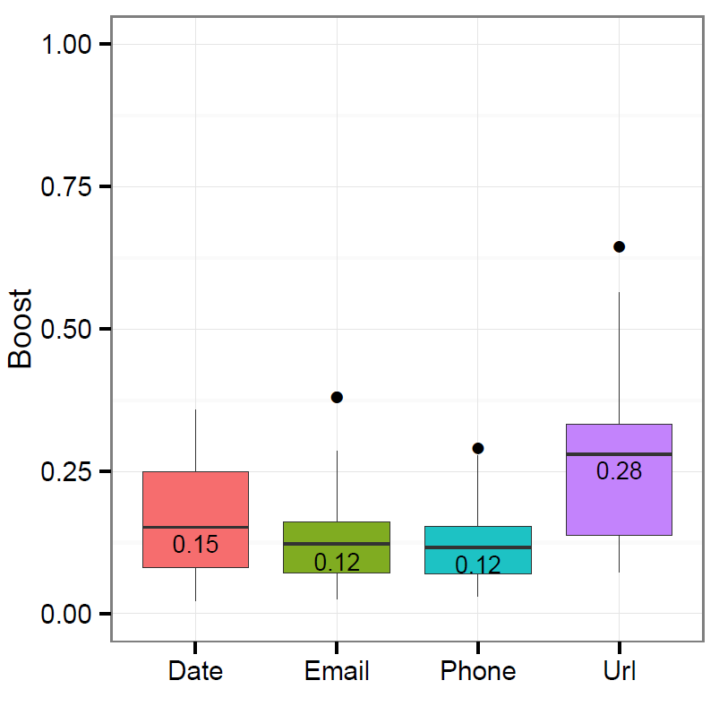
Boost

Slide 35
Successful Shuffles and Mutations (%)
Fewer considered, higher yield
Combining works well

Slide 36
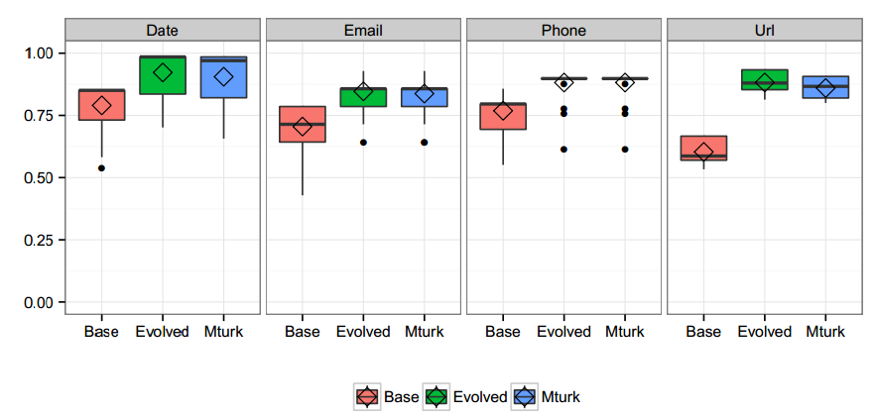
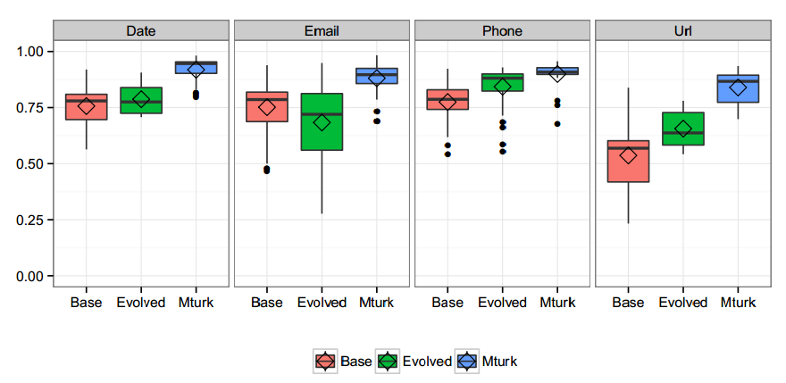
Final Fitness

Slide 37
Algorithm Outline
T := PositiveExamples U NegativeExamples
C := Program₁…Program_{n}
while(!IsPerfectFitness(C, T) && budget > 0 && generations < 10) {
foreach((C_{i}, C_{j}) in ShuffleCandidates(C))
C’ += Shuffle(C_{i}, C_{j})
foreach((C_{i}, s_{j}) in MutateCandidates(C, T))
C’ += Mutate(C_{i}, s_{j})
ΔT := GenerateCoveringStrings(C’,T)
(ΔP, ΔN, budget) := GetConsensusFromCrowd(ΔT, budget)
T := T U ΔP U ΔN
C := FilterByFitness(C, T, k)
generations++
}

Slide 38
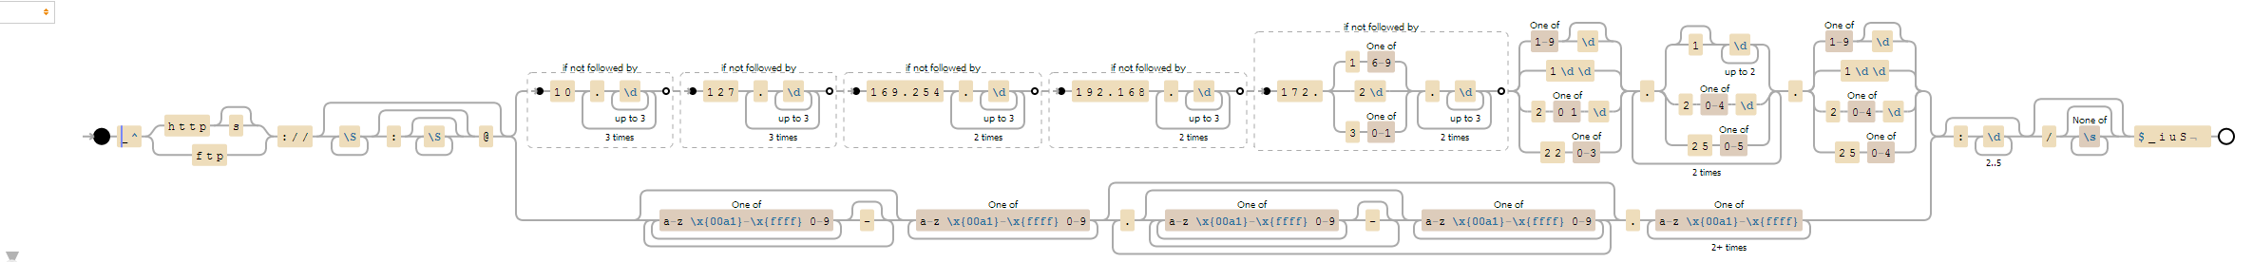
Winning Entry

Slide 39
Experimental Setup
Chose 4 representative regex tasks
  Phone
  Dates
  Email addresses
  URLs
Dimensions of evaluation
  Fitness boost
    Magnitude
    Consistency
  Latency
  Cost
Used several sources
  Bountify
  StackOverflow
  Regexlib
  Blogs and twitter
Collected 30 different regexes across 4 tasks
72+ and 97-

Slide 40
Characterizing the Input Regexes
Varying levels of length and complexity
Notes:
Varying levels of length and complexity for our input regexes, and as you will see, this impacted both running times and the complexity of our genetic programing operations

Slide 41
Shuffles and Mutations (in thousands)
Training set contains more examples with wide chars
Smaller automata produce fewer shuffles
Notes:
Now let’s look at characterizing our genetic operations that were used to get the fitness results in the previous slide,
This bar chart shows the median number of shuffles and mutations that were considered

Slide 42
Mechanical Turk Costs
Classification tasks were batched into varying sizes (max 50) and had scaled payment rates ($0.5 - $1.00)
5 workers per batch
Median cost per pair: $1.5 to $8.9
Notes:
Move description 1 or 2 behind

Slide 43
Training Set Refinement
Existing Strings:
  http://foo.com/
  ftp://a.x/
✔
✔
Initial state to q_{i}
✔
State to cover: q_{i}
Concat SFAs and generate string
✔
✔
✔
✔
✔
✔
✔
✔
✔
✔
✔
✔
q_{i} to final state
✔
✔
✔
✔
✔
✔

Slide 44
Latency
Larger batches for workers
Total
Notes:
mturk is fully automated
larger batches require more time
These results show the overall time spent waiting for results from mechanical turk

Slide 45
Characterizing the Boosting Process
Two representative pairs profiled from each category
Want the process to terminate: limit the # of generations to 10
  Occasionally, all are required
  Often finish after 5 or 6 generations
While we hit a plateau at 10, in some cases we’re likely to improve with more generations

Slide 46
Proposed Regexes
Notes:
We chose starting examples based on Mathias + Manually

Slide 47
Symbolic Finite Automata
Extension of classical finite state automata
Allow transitions to be labeled with predicates
Need to handle UTF16
  2¹⁶ characters
Implemented using Automata.dll
Notes:
Callout to Loris and Margus
Will now describe Shuffles, Mutations and Training Set refinements in the domain of SFAs
I’m going to give a high level description,
these algorithms were developed by loris and margus and not trivial,
if you want more details please take a look the draft of our paper.

Slide 48
Shuffle: Collapsing into Components
Manageable number of edges to shuffle
Stretches
SCC
One-Entry
One-Exit

Slide 49
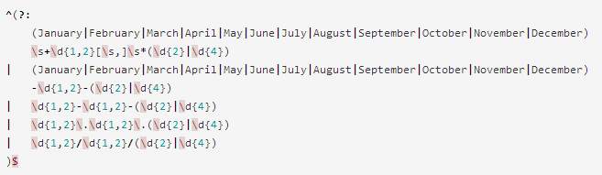
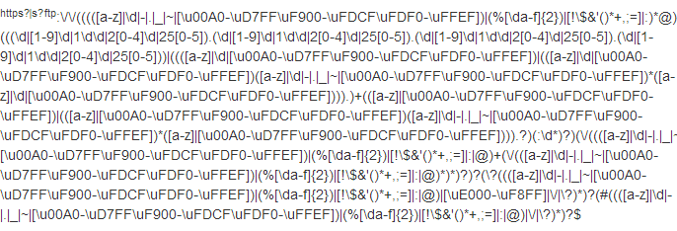
Some Regexes

Slide 50
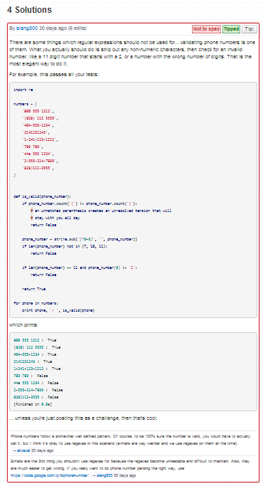
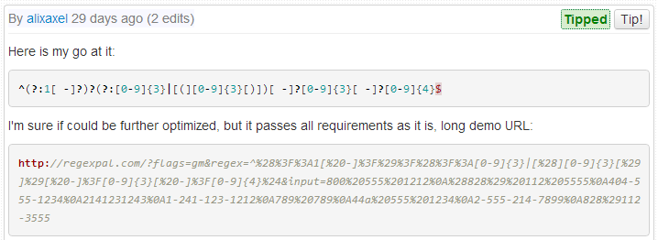
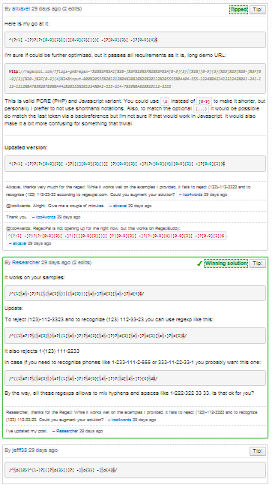
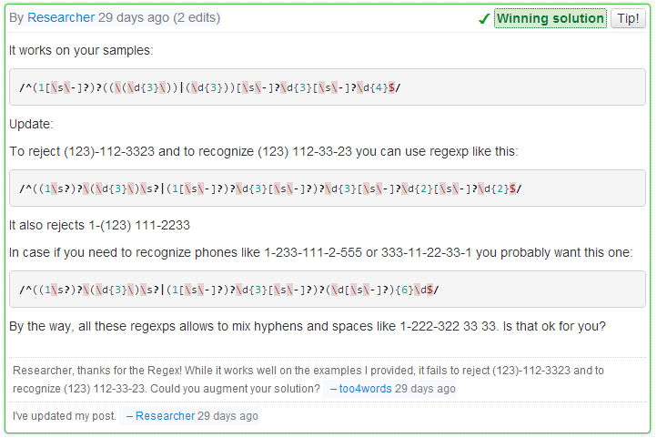
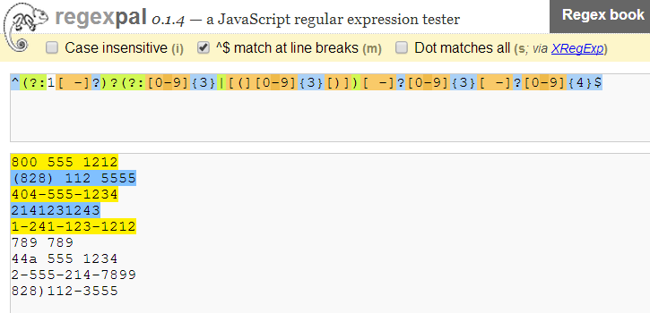
Bountify Process
Solution 2
Winner
Solution 4
Notes:
Simplified

