Slide 1
Report on ISAT/DARPA Workshop on Accuracy Trade-Offs Across the System Stack for Performance and Energy
(aka Approximate Computing)
Luis Ceze and James Larus
ISAT Advisors: Kathryn McKinley and Christos Kozyrakis
Workshop date: February 20 -21, 2014
Venue: Co-located with HPCA/PPoPP/CGO (Orlando, FL)
Approved for Public Release, Distribution Unlimited
The views expressed are those of the author and do not reflect the official policy or position of the Department of Defense or the U.S. Government.

Slide 2
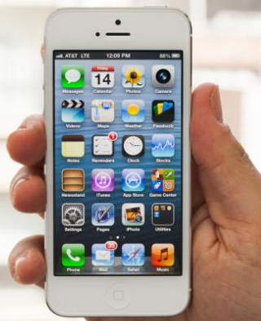
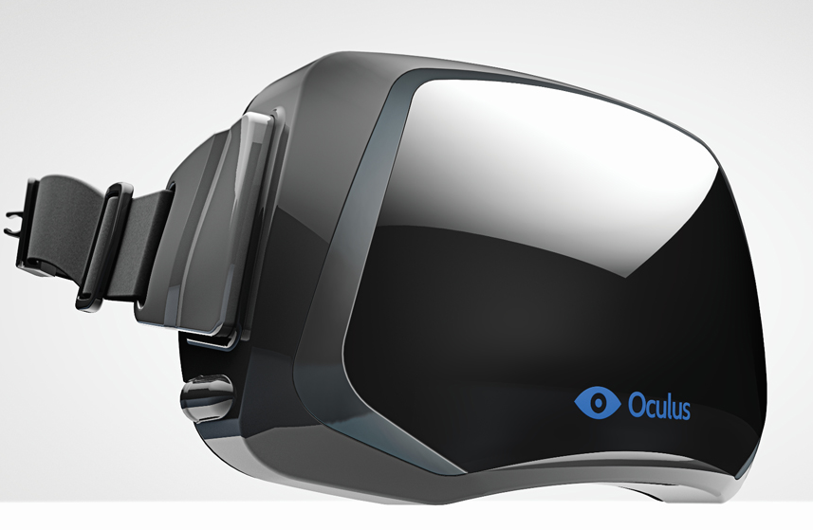
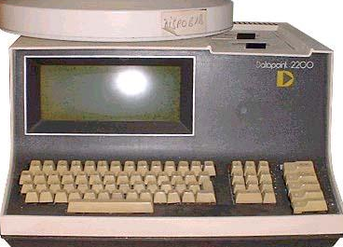


Motivation
Constrains innovation, industry of replacement?
performance and energy efficiency of underlying HW
Future HW will be unreliable, and many opportunities exist to improve performance and energy in non-deterministic, unreliable substrates.
Pressing need to create a science of inexact computation
  Create the software to fully utilize future hardware.
  Rethink fundamental abstractions we’ve relied on for a long time.
  National Strategic Computing Initiative: Beyond Moore’s Law
Approved for Public Release, Distribution Unlimited

Slide 3
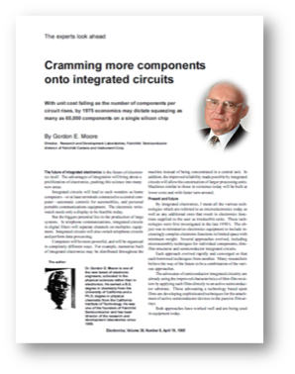
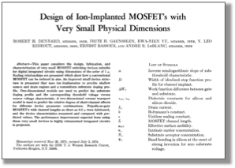
What’s fueling better computer systems? (“The Need”)
✗
But it is Dennard scaling that lets us use them:
2x transistor count, 40% faster, 50% more efficient…
Moore’s law gives us lots of transistors on a chip.
[Dennard, Gaensslen, Yu, Rideout, Bassous, Leblanc, IEEE JSSC, 1974]
Approved for Public Release, Distribution Unlimited

Slide 4
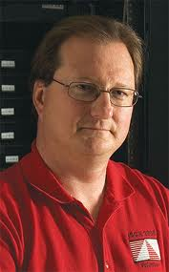
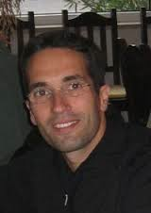
ISAT Workshop on Advancing Computer Systems without Technology Progress (April 2012)
Can we improve computer systems during this fallow period?
Approved for Public Release, Distribution Unlimited

Slide 5


Workshop on Resilient Computing Frameworks (March 2013)
Semiconductor industry will have increased difficulty presenting software with an efficient dependable hardware layer <10nm
  Many factors pointing to reduced processor lifetime, increased variability, and increased soft error (SER)
There is potential for a radically different “resilient computing” paradigm that addresses resilience at every layer of the stack
  Today’s hardware layers are over-engineered relative to what is needed
“Resilient computing” would have multiple benefits for DoD
  Potential for absolute performance advantage relative to conventional deterministic hardware models
  May address software errors as well as hardware errors, may improve system lifetime
DARPA is needed to build & prove out an end-to-end system
ISAT next steps: deep dive on approximate computing opportunity
Approved for Public Release, Distribution Unlimited

Slide 6
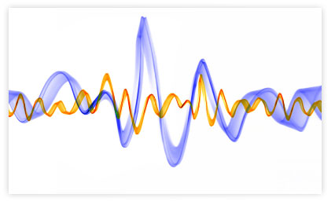
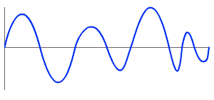
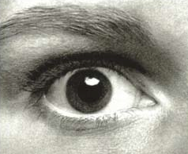
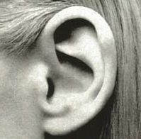
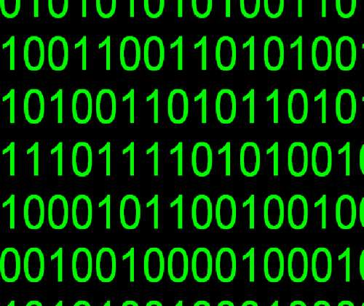
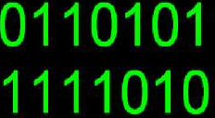
We might have gotten lucky with modern applications…
image, sound
and video processing
image rendering
✓
sensor data analysis,
computer vision
✓
✓
simulations, games,
search, machine learning
✓
Inexact/imprecise input data
Approximate/iterative algorithms
Loose constraints on output
Where a lot of (most?) resources go!
Approved for Public Release, Distribution Unlimited

Slide 7
What is “approximate computing”?
Building acceptable systems out of unreliable/inaccurate hardware and software components
  Compute, storage and communication
  Inaccuracy can be deterministic or non-deterministic
Trade fidelity of results to achieve better efficiency and performance
  Enable new applications or meet constraints (cost, power, etc.)
In summary, embrace widespread output quality trade-off and “closer to physics”, non-deterministic hardware
Approved for Public Release, Distribution Unlimited

Slide 8
Approximate computing visualization
Performance
2
New degree of freedom to
Increase performance & efficiency by reducing accuracy
Resource usage (e.g., energy)
Accuracy
Approved for Public Release, Distribution Unlimited

Slide 9

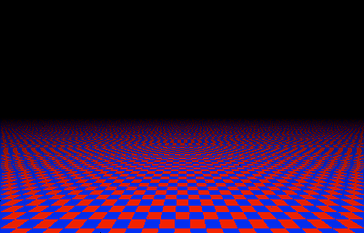
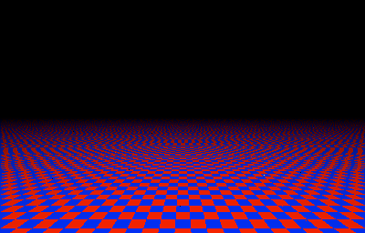
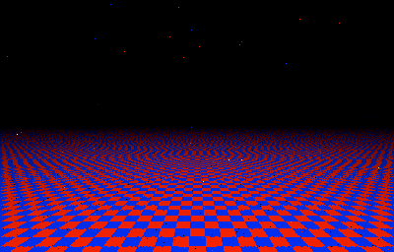
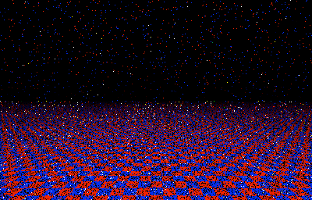
Approved for Public Release, Distribution Unlimited

Slide 10

Errors
Energy
Errors
Energy
Errors
Energy
Errors
Energy
Approved for Public Release, Distribution Unlimited
Notes:
Which one would you choose?

Slide 11
But approximation needs to be done carefully... or...
Approved for Public Release, Distribution Unlimited

Slide 12


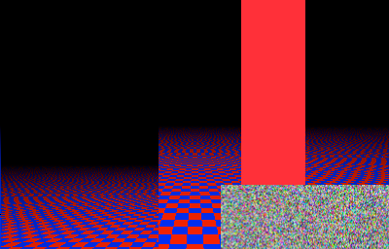
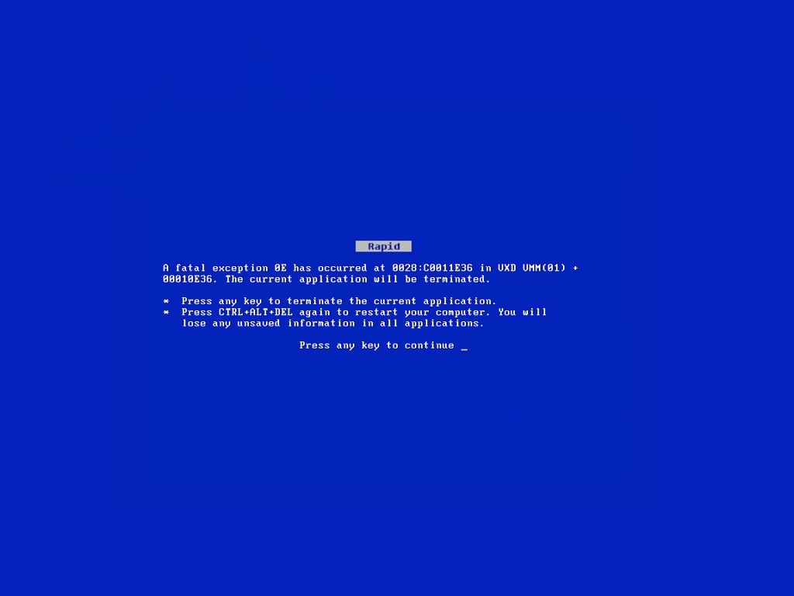
Approved for Public Release, Distribution Unlimited
Notes:
JPEG HEADER: The hardware doesn’t know which bits are important and which are unimportant!
Without a good way to separate these things, this is a programmability nightmare.

Slide 13
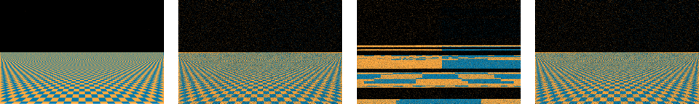
Quality of Result (QoR) is core concept
“How good is my result?”
  Is my result sufficient for my needs?
Metric is application dependent
  % of bad pixels, deviation from expected value, % of poorly classified images, frequency of car crashes, etc…
Approved for Public Release, Distribution Unlimited

Slide 14
Approximation is not new
Common in many disparate domains
  Inexact data from sensors
  Floating point calculations
  Failures in distributed systems, noise in control sys, …
Pervasive non-determinism in computation, storage, and communication is new
Need to rearchitect systems to enable more widespread trade-offs
  Across the stack, from device technology to PL and algorithm
  Flaky processors, flaky memory, noisy communication, flaky unreliable storage, etc…
PL
Compiler
OS/DB
Architecture
Hardware
Approved for Public Release, Distribution Unlimited

Slide 15
Potential Improvements of Approximate Computing
Unsound code transformations: 2 x
Use of probabilistic/unreliable transistors: 5 x
Effective use of analog computations: 100+ x
(Estimates in performance or power)
Approved for Public Release, Distribution Unlimited

Slide 16
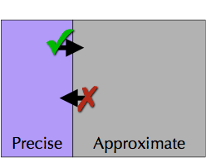
Potential principles
All pieces of a computation and data are not equivalent
  Some aspects need to be precise, others can be approximate,
  How do you take advantage of approximation without compromising important system properties?
In some applications, a partial/less accurate result by deadline is more valuable than a late, perfect result
Approved for Public Release, Distribution Unlimited
Notes:
Hand off to Jim here
If you play a game enough, you only need to win at the 99th percentile

Slide 17
Technical challenges
Appropriate software and hardware abstractions and design principles
Techniques for specifying and ensure quality
Means to compose approximate hardware/software
New techniques for debugging and testing
  “Correctness” and “performance”
Develop new algorithms and algorithmic transformations to exploit approximation
Avoiding Amdahl’s law effect
  E.g., applying to data-path only is not sufficient
It is all about hardware, but most challenges are software
Approved for Public Release, Distribution Unlimited

Slide 18
What is equivalent of the end-to-end argument for approximate computing?
Specification – Which properties must the result have? What should be the expected QoR?
Inaccuracies – Where can they exist in the system?
Monitoring – Which inaccuracies can be detected cheaply? When can they be completely ignored?
Adjusting QoR – How can inaccuracies be controlled to improve QoR? When is error correction necessary?
Abstraction – What is appropriate level for 3 & 4?
Cost – Which combination of techniques has desirable outcome at lowest cost?
Approved for Public Release, Distribution Unlimited
Notes:
Luis really does not know how to make this slide flow in the presentation. So it is out or Jim presents it during the meeting ☺

Slide 19
“Ideal” programming model
Desiderata: QoR is composable, verifiable/validatable, and understandable
  Deterministic and non-deterministic together?
  Machine independent – asking too much?
  Clear accuracy tradeoffs
Programmer can easily express algorithm, data structure, and component approximation properties
Programmer/user can express quality or result metrics/goals
System automatically chooses appropriate precision for compute, storage, and communication and monitors execution to adapt execution
Approved for Public Release, Distribution Unlimited

Slide 20
A few recent approximate computing efforts
PL
EnerJ (UW), Passert (MSR/UW), Rely (MIT), Relax (Wisconsin)
Uncertain<T> (MSR), Eon (UMass)
Compiler
Probabilistic transformations (MIT)
Runtime
Green (MSR), PowerDial (MIT), soft error control (UCLA), SAGE & Paraprox (Michigan), Swat (UIUC)
OS/DB
BlinkDB (Berkeley/MIT)
Architecture
ANNs (UW, MSR, INRIA, Wisconsin, Qualcomm)
Using Neural Nets for code approximation (GAtech/UW/MSR)
Stream Processing (Princeton)
Hardware
Stochastic Processors (UIUC), ERSA (Stanford), Flikker (MSR), QUORA (Purdue), Approximate Storage (MSR, UW)
Probabilistic CMOS (Rice), approximate components (Purdue)
Approved for Public Release, Distribution Unlimited
Notes:
Luis gets back.

Slide 21
Neural Algorithmic Transformation
[Emaeilzadeh et al.]
Code₁
Code₂
Code₃
Code₄
Code₅
Code₆
Source
Code
…
Common
Intermediate
Representation
Neural
Representation
+
×
CPU
NPU
Acceleration
Approved for Public Release, Distribution Unlimited

Slide 22
Program execution as a learning problem [Esmaeilzadeh et al.]
Program
Approved for Public Release, Distribution Unlimited
Notes:
Map entire regions of code to an (approximate) accelerator:
get rid of instruction processing overhead (von Neumann overhead/bottleneck)
enable new ways of doing approximate execution

Slide 23
Program execution as a learning problem [Esmaeilzadeh et al.]
Find an approximate
program component
Program
Approved for Public Release, Distribution Unlimited

Slide 24
Program execution as a learning problem [Esmaeilzadeh et al.]
Find an approximate
program component
Compile the program
and train a neural network
Program
Approved for Public Release, Distribution Unlimited
Notes:
THIS IS THE KEY: an algorithmic transformation
In the compilation step, we LEARN FROM THE IMPLEMENTATION provided by the programmer
the function can be COMPLEX, lots of CONTROL FLOW

Slide 25
Program execution as a learning problem [Esmaeilzadeh et al.]
Find an approximate
program component
Compile the program
and train a neural network
Program
Execute on a fast Neural Processing Unit (NPU)
Approved for Public Release, Distribution Unlimited

Slide 26
Neural Acceleration
[Emaeilzadeh et al.]
CPU
NPU
(Speed: ~4×↑,
Energy: ~10×↓,
Quality: 5%↓)
CPU
GPU
FPGA
Digital
ASIC
FPAA
Analog
ASIC
Approved for Public Release, Distribution Unlimited

Slide 27
Rely: a Language for Quantitative Reliability
[Carbin, Misailovic, Rinard OOPSLA‘13]
Programs execute on unreliable hardware using unreliable arithmetic and memory operations
Developer specifies reliability goal: e.g., 99 out of 100 runs should produce the correct result
Analysis verifies that the program executes on unreliable hardware as the developer expects
Output: probability of reliable execution
Approved for Public Release, Distribution Unlimited

Slide 28
Cross-stack approximate computing @ UW-CSE/MSR
Application
type system for where-to-approximate
[PLDI’11]
Language
quality of results verification
[PLDI’14]
EnerJ
QoR
Compiler
Architecture
neural
networks
as accelerators
[MICRO’12, ISCA’14]
ISA w/ variable
Accuracy
[ASPLOS’12]
Approximate VN processors
Approximate acceleration
Circuits
Approximate
Storage
Approximate
Wireless
[MICRO’13]
Approved for Public Release, Distribution Unlimited

Slide 29


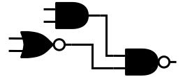
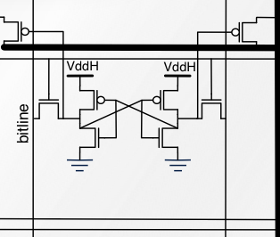
int p = 5;
@Approx int a = 7;
for (int x = 0..) {
  a += func(2);
  @Approx int z;
  z = p * 2;
  p += 4;
}
a /= 9;
p += 10;
socket.send(z);
write(file, z);
Disciplined Approximate Programming
(EnerJ, EnerC,...)
λ
Relaxed Algorithms
ɸ
Aggressive Compilation
Approximate Data Storage
Variable-quality wireless communication
Variable-Accuracy ISA
ALU
Approximate Logic/Circuits
Goal: support a wide range of approximation techniques with a single unified abstraction.
Approved for Public Release, Distribution Unlimited
Notes:
This is our vision. Single programming model, take advantage of approximation across the system.

Slide 30
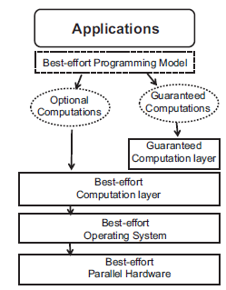
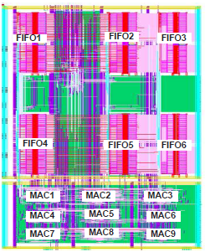
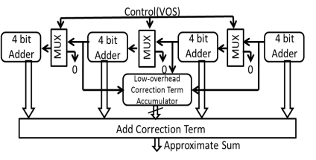
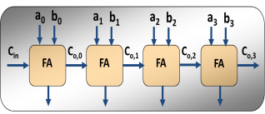
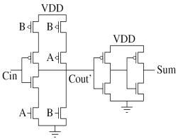
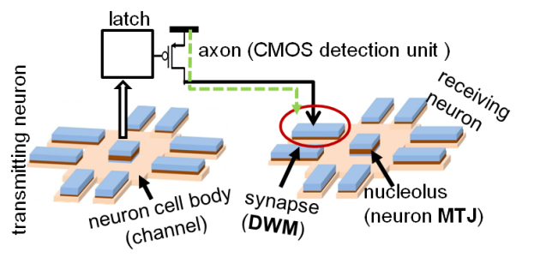
Approximate Computing @ Purdue
  Best-effort parallel computing (DAC 2010)
  Dependency relaxation (IPDPS 2009, 2010)
  Partitioned Iterative Convergence (Cluster 2012)
  Analysis and characterization of inherent application resilience (DAC 2013)
Selectively skip “expensive” operations to achieve better parallel scalability
Approximate Computing in Software
Joint with NEC Labs
  Scalable Effort Hardware (DAC 2010, DAC 2011, CICC 2013)
  Significance Driven Computation: MPEG, H.264 (DAC2009, ISLPED 2009)
  QUORA: Quality Programmable vector processor (MICRO 2013)
Approximate accelerators for RMS
HW/SW interface for approximate computing
Approximate Architecture & System Design
  Voltage scalable meta-functions (DATE 2011)
  Energy-quality tradeoff in DCT (ICASSP 2002)
  Approximate memory design (DAC 2009)
  IMPACT: Imprecise Adders for low power approximate computing (ISLPED 2011)
Circuits that operate efficiently under “overscaled” conditions
Functionally approximate circuits
Approximate Circuit Design
  Neuromorphic Computing with STT devices (DAC 2012, 2013 , IEDM 2012, TNANO 2012)
  Device Models (SISPAD 2012, 2013)
Match devices to (approximate) computing models
Computing in “physics”
Approximate Computing with Emerging Devices
Approved for Public Release, Distribution Unlimited

Slide 31
Summary of “The Research”
Abstractions
  QoR specification, verification and monitoring, composability
  What is the HW/SW interface
Algorithms
  Relationship between ML, numerical algorithms and approximation
  Algorithmic transformations for better approximation opportunities
Tools
  Testing, debugging, profiling
Hardware
  Specialization/approximation
  Mechanisms to exploit det/nondet approximation
System
  End-to-end cost benefit: communications, computation, storage
  Adaptive control
  Averting Amdahl’s Law
  Are there important security implications?
Approved for Public Release, Distribution Unlimited

Slide 32
Quick summary of the workshop
Approved for Public Release, Distribution Unlimited
Notes:
Luis gets back in

Slide 33
Workshop agenda
“Deep dive” on approximate computing
Discuss how approximate computing can be used to bring next orders of magnitude improvements in performance and MIPS/Watt
Focus on programming, HW/SW interfaces and system aspects, not underlying technology shifts
Ultimately, produce research agenda for approximate computing
  And, convince DARPA to invest in it ☺
Approved for Public Release, Distribution Unlimited

Slide 34
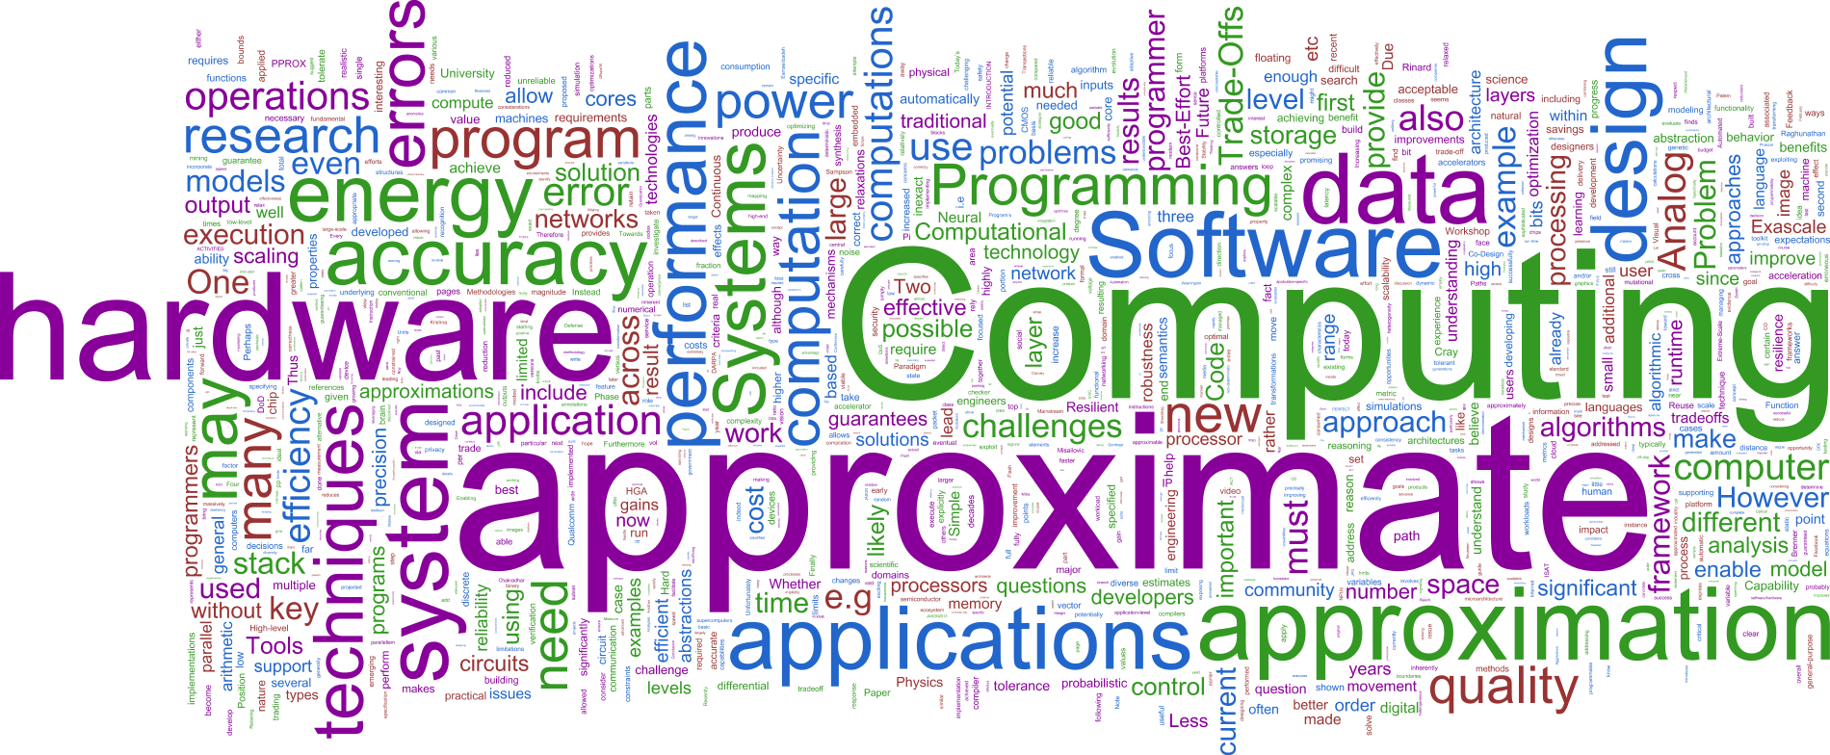
Who attended and format
Areas
  Applications (5)
  PL/Compilers/SE (12)
  Architecture (HW/SW Interface) (9)
  Hardware (7)
25 position papers received
Academia (25), Industry(10), DARPA (3)
Format: Intro, 5-min talks by 14 attendees, “vertical” breakout digging on 6 applications, and 5 break-outs on core challenges
Approved for Public Release, Distribution Unlimited

Slide 35
Applications
Group-wide brainstorming on applications that can showcase approximate computing
Voted out of 20:
  Vision + augmented reality
  UAV sensor data analysis and flight control
  Continuous analysis of event sensing streams
  Point of care medical devices
  Big and streaming data analysis
Approved for Public Release, Distribution Unlimited

Slide 36
Recurring Points
Many discussions also relevant to today’s HW
  Need to address: what is different about future approximate HW, deterministic and non-deterministic?
  Relation between specialization and approximation
Quality of Results specification, verification and dynamic checking
Composability
Testing/debugging
What is the end-to-end story? What’s the potential?
ML discussed in all applications
  Is model development affected by non-deterministic HW?
  Are learned models sensitive/insensitive to HW approximations?
Relationship between approximate computing and probabilistic programming
Approved for Public Release, Distribution Unlimited

Slide 37
A perspective from Joe Cross
Risks:
  domain of applicability
  how to write, debug, verify and tune
Can we just wait for industry?
How does approximate computing stack up against related and unrelated efforts that aim at improving performance and energy efficiency?
Success would be measured by how well it applies to DoD’s applications (e.g., SEAK)
Approved for Public Release, Distribution Unlimited

Slide 38
“The Backup”
Approved for Public Release, Distribution Unlimited

Slide 39
Position papers
Approved for Public Release, Distribution Unlimited

Slide 40
Applications
Group-wide brainstorming on applications that can showcase approximate computing
Voted out of 20:
  Vision + augmented reality
  UAV sensor data analysis and flight control
  Continuous analysis of event sensing streams
  Point of care medical devices
  Big and streaming data analysis
Approved for Public Release, Distribution Unlimited

Slide 41
What Did We Learn From the Application Discussion
Approximation can be applied across the stack
Many applications have similar aspects
  Replacement of precise computations with learned computation
  Unify reasoning of uncertainty with reasoning about approximation
  Shows there is possibility for “general” principles and reusable infrastructure
  Rich research area, e.g. security questions
  Need better understanding of of implications of future HW
Approved for Public Release, Distribution Unlimited

Slide 42
Recurring Points
Many discussions also relevant to today’s HW
  Need to address: what is different about future approximate HW, deterministic and non-deterministic?
  Relation between specialization and approximation
Quality of Results specification, verification and dynamic checking
Composability
Testing/debugging
What is the end-to-end story? What are the benefits?
ML discussed in all applications
  Is model development affected by non-deterministic HW?
  Are learned models sensitive/insensitive to HW approximations?
Approved for Public Release, Distribution Unlimited

Slide 43
Break-out Discussion Themes
QoR specification, verification and monitoring
  Includes discussion of the programming model
  Composability
Architecture and Hardware/Software Interface
  Including distinguishing approximation and specialization
  General purpose, vector, neural-nets, etc.
Effects of HW approximation, deterministic and non-deterministic
  Effect on training and evaluation of ML
  Effects on numeric algorithms
Debugging and testing
System challenges
  Adaptability, composability, system properties (e.g., security)
  End-to-end benefits
Approved for Public Release, Distribution Unlimited

