Slide 1
ECE 1755
Lecture 16
Interconnects:
Intro
Winter 2018
Prof. Natalie Enright Jerger

Slide 2
Interconnection Networks Introduction
How to connect individual devices together into a group of communicating devices?
Device:
  Component within a computer
  Single computer
  System of computers
Types of elements:
  end nodes (device + interface)
  links
  interconnection network
Internetworking: interconnection of multiple networks
End Node
End Node
End Node
End Node
Device
Device
Device
Device
…
SW Interface
SW Interface
SW Interface
SW Interface
HW Interface
HW Interface
HW Interface
HW Interface
…
Link
Link
Link
Link
Interconnection Network
…

Slide 3
Interconnection Networks Introduction
Interconnection networks should be designed
  to transfer the maximum amount of information
  within the least amount of time (and cost, power constraints)
  so as not to bottleneck the system

Slide 4
Types of Interconnection Networks
Four different domains:
  Depending on number & proximity of connected devices
On-Chip networks (OCNs or NoCs)
  Devices are microarchitectural elements (functional units, register files), caches, directories, processors
  Latest systems: dozens, hundreds of devices
    Ex: Intel TeraFLOPS research prototypes – 80 cores
    Xeon Phi – 60 cores
  Proximity: millimeters

Slide 5
System/Storage Area Networks (SANs)
Multiprocessor and multicomputer systems
  Interprocessor and processor-memory interconnections
Server and data center environments
  Storage and I/O components
Hundreds to thousands of devices interconnected
  IBM Blue Gene/L supercomputer
  (64K nodes, each with 2 processors)
Maximum interconnect distance
  tens of meters (typical)
  a few hundred meters (some)
    InfiniBand: 120 Gbps over a distance of 300m
Examples (standards and proprietary)
  InfiniBand, Myrinet, Quadrics, Advanced Switching Interconnect

Slide 6
Local Area Network (LANs)
Interconnect autonomous computer systems
Machine room or throughout a building or campus
Hundreds of devices interconnected (1,000s with bridging)
Maximum interconnect distance
  few kilometers
  few tens of kilometers (some)
Example (most popular): Ethernet, with 10 Gbps over 40Km

Slide 7
Wide Area Networks (WANs)
Interconnect systems distributed across the globe
Internetworking support is required
Many millions of devices interconnected
Maximum interconnect distance
  many thousands of kilometers

Slide 8
Interconnection Network Domains
5 x 10⁶
WANs
5 x 10³
LANs
Distance (meters)
SANs
5 x 10⁰
OCNs
5 x 10⁻³
1
10
100
1,000
10,000
>100,000
Number of devices interconnected

Slide 9
ECE 1755 Focus:
On-Chip Networks

Slide 10
On-Chip Networks (OCN or NoCs)
Why On-Chip Network?
  Ad-hoc wiring does not scale beyond a small number of cores
    Prohibitive area
    Long latency
OCN offers
  scalability
  efficient multiplexing of communication
  often modular in nature
  (eases verification)

Slide 11
Differences between on-chip and off-chip networks
Significant research in multi-chassis interconnection networks (off-chip)
  Supercomputers
  Clusters of workstations
  Internet routers
Leverage research and insight but…
  Constraints are different

Slide 12
Off-chip vs. on-chip
Off-chip: I/O bottlenecks
  Pin-limited bandwidth
  Inherent overheads of off-chip I/O transmission
On-chip
  Wiring constraints
    Metal layer limitations
    Horizontal and vertical layout
    Short, fixed length
    Repeater insertion limits routing of wires
      Avoid routing over dense logic
      Impact wiring density
  Power
    Consume 10-15% or more of die power budget
  Latency
    Different order of magnitude
    Routers consume significant fraction of latency

Slide 13
On-Chip Network Evolution
Ad hoc wiring
  Small number of nodes
Buses and Crossbars
  Simplest variant of on-chip networks
  Low core counts
  Like traditional multiprocessors
    Bus traffic quickly saturates with a modest number of cores
  Crossbars: higher bandwidth
    Poor area and power scaling

Slide 14
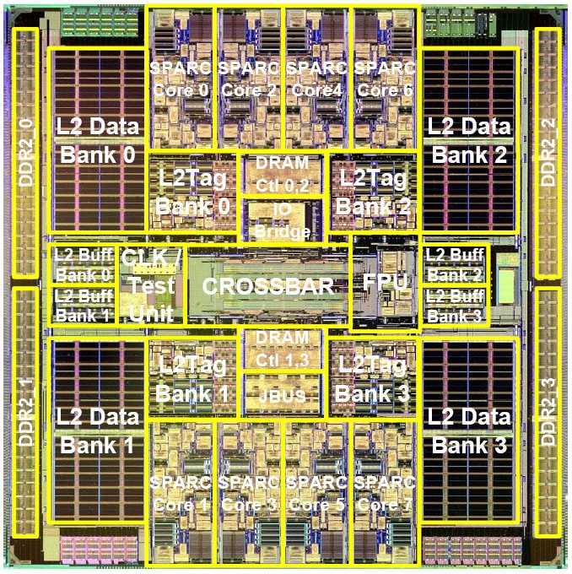
Multicore Examples (1)
0
1
2
3
4
5
0
1
XBAR
2
3
4
5
Sun Niagara
Niagara 2: 8x9 crossbar (area ~= core)
Rock: Hierarchical crossbar (5x5 crossbar connecting clusters of 4 cores)

Slide 15
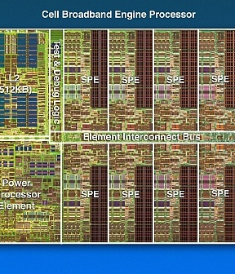
Multicore Examples (2)
IBM Cell
Element Interconnect Bus
  12 elements
  4 unidirectional rings
    16 Bytes wide
    Operates at 1.6 GHz
RING
IBM Cell
Notes:
\

Slide 16
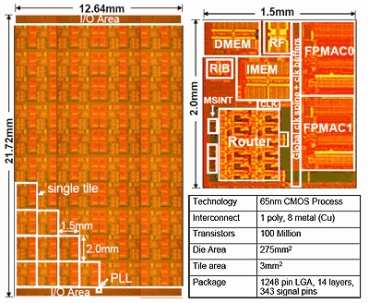
Many Core Example
Intel TeraFLOPS
  80 core prototype
  5 GHz
  Each tile:
    Processing engine + on-chip network router
2D MESH
Notes:
The next current example I have is the Intel Polaris prototype. This is an 80-core prototype that connects cores via a 2-D grid or mesh network. I’ve highlighted the mesh in white on the die photo. At each intersection in the mesh, there is a router. The router makes decisions about how messages travel through the network. If you look at the blown up photo of one of the 80 tiles, you can see that the router occupies roughly 25% of the area of a tile. Significant area and power will be devoted to the on-chip network in future designs so it is crucial that we utilize this area efficiently for high performing solutions.

Slide 17
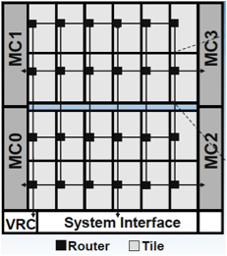
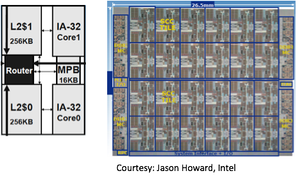
Many-Core Example (2): Intel SCC
Intel’s Single-chip Cloud Computer (SCC) uses a 2D mesh with state of the art routers

Slide 18
Performance and Cost
Latency (sec)
Zero load latency
Offered Traffic (bits/sec)
Saturation throughput
Performance: latency and throughput
Cost: area and power
Notes:
Amount of traffic network can accept before all message start to experience very high latencies
Theoretical lower bound on latency (zero load latency) and upper bound on throughput – topology, routing, flow control all impact these as we will see in coming weeks.

Slide 19
Topics to be covered
Interfaces
Topology
Routing
Flow Control
Router Microarchitecture

Slide 20
System Interfaces

Slide 21
Systems and Interfaces
Look at how systems interact and interface with network
Types of multi-processors
  Shared-memory
    From high end servers to embedded products
  Message passing
    Multiprocessor System on Chip (MPSoC)
      Mobile consumer market
    Clusters
We focus on on-chip networks for shared-memory multi-core

Slide 22
Shared Memory CMP Architecture
Core
L1 I/D Cache
L2 Cache
Router
Tags
Data
Logic
Controller
L2:
Private or distributed shared cache
Centralized shared cache will have a different organization
A tile could be a core or L2 bank

Slide 23
Impact of Coherence Protocol on Network Performance
Coherence protocol shapes communication needed by system
Single writer, multiple reader invariant
Requires:
  Data requests
  Data responses
  Coherence permissions

Slide 24
Broadcast vs. Directory
Directory receives request
Read Cache miss
Read Cache miss
1
1
2
Memory Controller
Directory
3
3
Send Data
Send Data
2
Request broadcast

Slide 25
Coherence Protocol Requirements
Different message types
  Unicast, multicast, broadcast
Directory protocol
  Majority of requests: Unicast
    Lower bandwidth demands on network
  More scalable due to point-to-point communication
Broadcast protocol
  Majority of requests: Broadcast
    Higher bandwidth demands
  Often rely on network ordering

Slide 26
Protocol Level Deadlock
Network End Node
Interconnection Network
Reply Q
Memory / Cache
Controller
Request Q
Request-Reply Dependency
  Network becomes flooded with requests that cannot be consumed until the network interface has generated a reply
Deadlock dependency between multiple message classes
Virtual channels can prevent protocol level deadlock
(to be discussed later)

Slide 27
Home Node/Memory Controller Issues
Heterogeneity in network
  Some tiles are memory controllers
    Co-located with processor/cache or separate tile
    Share injection/ejection bandwidth?
Home node
  Directory coherence information
  <= number of tiles
Potential hot spots in network?

Slide 28
Summary
Architecture
  Impacts communication requirements
  Coherence protocol: Broadcast vs. Directory
  Shared vs. Private Caches

