Slide 1
Persistency Programming 101 Understanding memory persistency
Aasheesh Kolli* Steven Pelley† Ali Saidi^
Peter M. Chen* Thomas F. Wenisch*
* University of Michigan
† Snowflake Computing
^ ARM
Notes:
:

Slide 2
Executive summary
NVMs -> in-memory, recoverable data structs
Require ordering of NVM writes (persists)
Consistency models do not order persists
Memory persistency [ISCA ‘14]
Consistency models for NVM
This talk:
Motivate memory persistency
Summarize persistency models

Slide 3
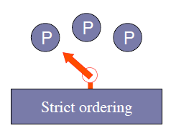
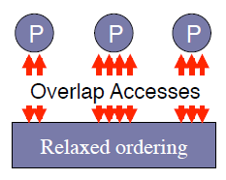
Background - Memory consistency
Contract b/w hardware and software on store visibility (implementation independent)
May be strict (SC) or relaxed (RMO)
Does not apply to persists
Consistency spectrum
Need persistency models to order persists

Slide 4
Future system abstraction
Memory events (stores/loads/barriers)
Core0
Core1
Core0
Core1
1
1
2
2
Persistency model governs store visibility in the presence of failures
3
3
4
4
5
5
6
6
Recovery
Time
No Failures
Failures
Volatile memory order
(consistency model)
Persist memory order
(persistency model)

Slide 5
Types of persistency models
Memory events (stores/loads/barriers)
Core0
Core1
Core0
Core1
Core0
Core1
1
1
1
2
2
2
3
3
3
4
4
4
5
5
5
6
6
6
Strict
persistency
Relaxed
persistency
Consistency

Slide 6
Strict vs relaxed persistency
Strict persistency
Consistency model = persistency model
Expensive (cost of persist > cost of store)
Relaxed persistency
Separate consistency and persistency models
Reduces persist memory order constraints
Might require more robust recovery software
Failures are infrequent → recovery overhead OK
Relaxed persistency models → performance

Slide 7
How do persists affect performance?
Persists form a directed acyclic graph (DAG)
Critical path limits overall performance
D[0]
D[0]
D[1]
1: persist Qe.data[0] = x
2: persist Qe.data[1] = y
3: persist Qe.valid = true
D[1]
V
V
Models should allow expression of minimal constraints

Slide 8
Strict persistency
Consistency model = persistency model
Two sources of persist concurrency:
Use a relaxed memory consistency model
Multi-threading

Slide 9
Strict persistency with SC
Program order => persist order
No annotations required
Suboptimal persist critical paths
1. lock (volatile mutex)
2. persist Qe.data[0] = x
3. persist Qe.data[1] = y
4. persist Qe.valid = true
5. unlock
D[0]
D[1]
V

Slide 10
Strict persistency with RMO
lock (volatile mutex)
barrier
persist Qe.data[0] = x
persist Qe.data[1] = y
barrier
persist Qe.valid = true
barrier
unlock
Barriers for synchronization and recovery
Annotation burden on the programmer
Affects volatile perf
D[0]
D[1]
V

Slide 11
Relaxed persistency models
Decouple consistency and persistency models
Expose additional persist concurrency
Important for conservative consistency models
Will use SC as underlying consistency model

Slide 12
Epoch persistency
Persist barriers divide program into epochs
Persists within epoch concurrent
Persists from successive epochs ordered
Store visibility still dictated by program order
lock (volatile mutex)
persist Qe.data[0] = x
persist Qe.data[1] = y
persist barrier
persist Qe.valid = true
unlock
D[0]
D[1]
Epoch 1
Epoch 2
V

Slide 13
Epoch persistency drawback
Ideal
DAG-1
DAG-2
persist A
persist barrier
persist B
persist C
persist A
persist barrier
persist C
persist B
persist A
persist C
persist barrier
persist B
persist C
persist A
persist barrier
persist B
persist A
persist B
persist C
A
A
A
C
C
B
B
C
B
Cannot express minimal constraints

Slide 14
Strand persistency
Divide thread’s execution into strands
A strand can be abstracted as a logical thread
Persists on different strands are concurrent
New memory event newStrand
Persist barriers order persists within a strand
persist A
persist barrier
persist B
newStrand
persist C
A
C
B
Can enforce only the necessary constraints

Slide 15
Ordering persists across threads
Conflicting accesses establish persist order
Two accesses to same address, at least one store
Persist order must match volatile order
Could be to volatile/non-volatile addresses
Strong persist atomicity

Slide 16
Strong persist atomicity example
Thread - 1
Thread - 2
lock X (volatile mutex)
persist barrier
persist A
persist barrier
unlock X
lock X
persist barrier
persist B
persist barrier
unlock X
Persist order
Conflicting
accesses
Time

Slide 17
Conclusions
Strict persistency
Unifies consistency and persistency model
Epoch persistency
Persists within epoch concurrent, epochs ordered
Strand persistency
Allows enforcing only minimal constraints
Strong persist atomicity
Allows ordering persists across threads

Slide 18
Thank You!
Questions?

Slide 19
Persistency terminology
Memory events: Stores/loads/barriers
Failure abstracted as recovery observer
Atomically loads all of memory at failure
Volatile memory order
Partial order of memory events
Governs visibility of stores to all processors
Persist memory order
Governs visibility of persists w.r.t recovery observer

Slide 20
Persist ordering constraints
Persists form a directed acyclic graph (DAG)
Critical path limits overall performance
Remove unnecessary ordering constraints
Requires an interface to describe constraints
1: Persist data[0]
2: Persist data[1]
3: Persist flag
Program order implies unnecessary constraints
1
2
3

Slide 21
Background – Memory consistency
Contract b/w hardware & software regarding visibility of stores
Implementation independent
Relaxed models improve store/load concurrency (performance)
However, do not extend to memory
Cache evictions
Memory controller optimizations

Slide 22
Strict persistency
Persist memory order = volatile memory order
Order of persists matches store visibility
Strict persistency with SC/TSO
Program order => persist order
No annotations necessary
Restrictive, suboptimal performance
Strict persistency with RMO
Program order + memory barriers => persist order
Need barriers to ensure correct store visibility and recovery correctness

Slide 23
Strict persistency
Task: persist data then persist flag
SC
RMO
lock (volatile mutex)
persist data[0]
persist data[1]
persist flag
unlock
lock (volatile mutex)
barrier
persist data[0]
persist data[1]
…
persist data[N]
barrier
persist flag
barrier
unlock (volatile mutex)

Slide 24
Epoch persistency
lock (volatile mutex)
persist data[0]
persist data[1]
…
persist data[N]
persist barrier
persist flag
Unlock
Persist barriers divide program into epochs
Persists within epoch concurrent
Program order => Store visibility
Program order + persist barriers
=> Persist order
Epoch persistency improves persist concurrency

Slide 25
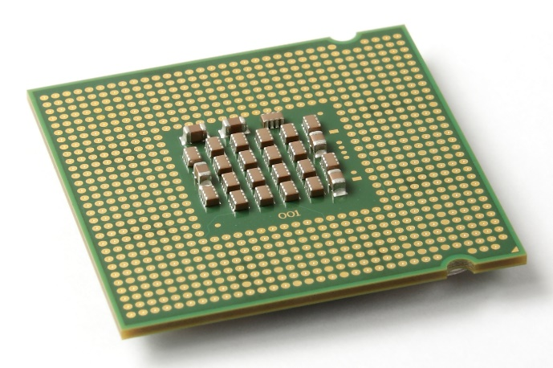
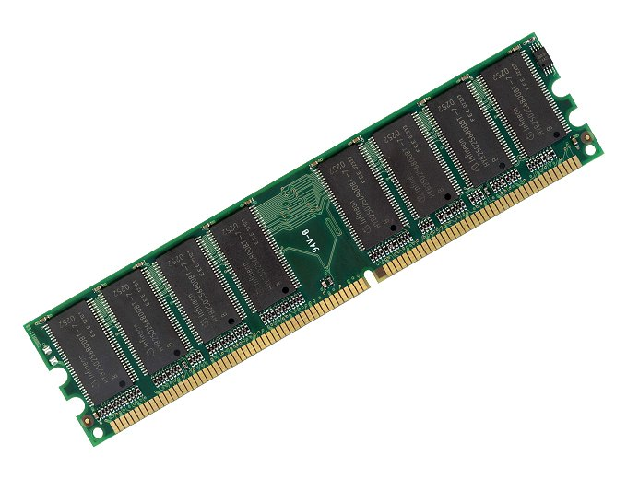
Nonvolatile memory (NVM) recovery
Future systems will have NVM on memory bus
In-memory, recoverable data structures
Recovery needs NVM write (persist) ordering
Writes unordered
Need a mechanism to express order of persists

Slide 26
Memory persistency: consistency models for NVRAM
Framework to reason about persist order while maximizing concurrency [ISCA ‘14]
Persistency models may be strict or relaxed
This talk:
Primer on persistency models
Discussion on achieving desired order of persists

Slide 27
Outline
Background
Strict persistency
Epoch persistency
Strand persistency
Multi-threaded persist ordering

Slide 28
Executive summary
NVMs -> in-memory, recoverable data structs
Require ordering of NVM writes (persists))
Consistency models govern visibility of stores
Do not extend guarantees to persists
Might want order of stores and persists to differ
Memory persistency [ISCA ‘14]
Consistency models for NVM
This talk:
Summary of persistency models
Example illustrating use of persistency models

Slide 29
Epoch persistency drawback
Persist barriers some times cause unnecessary persist order constraints
Task: persist A, then persist B, persist C not ordered
persist A
persist barrier
persist B
persist C
Unnecessary constraint: A->C
persist A
persist C
persist barrier
persist B
Unnecessary constraint: C->B

Slide 30
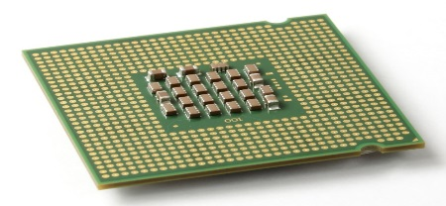
Future system abstraction
Processors
3
Volatile memory order
(consistency model)
Memory events
(stores/loads/barriers)
2
1
Caches (unordered)
Recovery observer
(atomically loads Mem
@Failure)
2
Persist memory order
(persistency model)
1
3
NVM
Notes:
Animate failure and recovery observer

Slide 31
Why two different models?
Consistency and persistency time scales differ
Cache access (10s ns) vs NVM write (100s ns)
Used for different purposes
Consistency -> synchronization correctness
Persistency -> recovery correctness
Unified model works (strict persistency), but
Must ensure correct synchronization & recovery
Suboptimal performance
Separate consistency and persistency models improve performance

Slide 32
Future system abstraction
Pre-failure
Post-failure
Core0
Core1
Memory events
(stores/loads/barriers)
3
2
Volatile memory order
(consistency model)
1
Memory cntrl
Persist memory order
(persistency model)
2
Recovery processor
(can only access
contents of NVM)
1
3
NVM
Notes:
Animate failure and recovery observer

Slide 33
Future system abstraction
Memory event on volatile address
Memory event on non-volatile (persistent) address
Time
Pre-failure
Post-failure
Core0
2
3
4
2
3
Core1
1
5
6
1
6
Store visibility
(consistency model)
Persist order
(persistency model)

Slide 34
Future system abstraction
Memory events (stores/loads/barriers)
Time
Core0
2
3
4
Store visibility
(consistency model)
Core1
1
5
6
No Failures
Core0
2
3
4
Persist order
(persistency model)
Core1
1
5
6
Failures

Slide 35
Future system abstraction
Memory events (stores/loads/barriers)
Time
Core0
2
3
4
Store visibility
(consistency model)
Core1
1
5
6
No Failures
Failures
Core0
2
3
4
Persist order
(persistency model)
Core1
1
5
6

Slide 36
Future system abstraction
Memory events (stores/loads/barriers)
Time
Core0
2
3
4
Store visibility
(consistency model)
Core1
1
5
6
No Failures
Failures
Core0
2
3
4
Persist order
(persistency model)
Core1
1
5
6
Persistency model governs store visibility across failures

