Slide 1
GPGPU Part II
In-depth on the memory system
Presented by: Jason Power
Slides from Derek Hower, Blake Hechtman, Mark Hill, Jason Power and others

Slide 2
GPU Architectures
A CPU Perspective
Derek Hower AMD Research 5/21/2013
Presented by Jason Power
Notes:
Ask student who has used a GPU. Should be all of them for graphics. Then ask about GP-GPU. Get one or two stoties.

Slide 3
Recap
Data Parallelism: Identical, Independent work over multiple data inputs
  GPU version: Add streaming access pattern
Data Parallel Execution Models: MIMD, SIMD, SIMT
GPU Execution Model: Multicore Multithreaded SIMT
OpenCL Programming Model
  NDRange over workgroup/wavefront
Modern GPU Microarchitecture: AMD Graphics Core Next (GCN)
  Compute Unit (“GPU Core”): 4 SIMT Units
  SIMT Unit (“GPU Pipeline”): 16-wide ALU pipe (16x4 execution)
  Memory: designed to stream
GPUs: Great for data parallelism. Bad for everything else.

Slide 4
Advanced Topics
GPU Limitations, Future of GPGPU

Slide 5
SIMT Control Flow
Consider SIMT conditional branch:
  One PC
  Multiple data (i.e., multiple conditions)
?
if (x <= 0)
y = 0;
else
y = x;

Slide 6
SIMT Control Flow
Work-items in wavefront run in lockstep
  Don’t all have to commit
Branching through predication
Active lane: commit result
Inactive lane: throw away result
All lanes active at start: 1111
if (x <= 0)
y = 0;
else
y = x;
Branch → set execution mask: 1000
Else → invert execution mask: 0111
Converge → Reset execution mask: 1111

Slide 7
SIMT Control Flow
Work-items in wavefront run in lockstep
  Don’t all have to commit
Branching through predication
Active lane: commit result
Inactive lane: throw away result
Branch divergence
All lanes active at start: 1111
if (x <= 0)
y = 0;
else
y = x;
Branch → set execution mask: 1000
Else → invert execution mask: 0111
Converge → Reset execution mask: 1111

Slide 8
Branch Divergence
When control flow diverges, all lanes take all paths
Divergence Kills Performance

Slide 9
Beware!
Divergence isn’t just a performance problem:
__global int lock = 0;
void mutex_lock(…)
{
…
// acquire lock
while (test&set(lock, 1) == false) {
// spin
}
return;
}
Notes:
Consider: one wavefront executes this code. One work-item will get the lock. The rest will not. The work-item that gets the lock can’t proceed because it is in lockstep with the work-items that failed to get the lock. No one makes progress.

Slide 10
Beware!
Divergence isn’t just a performance problem:
__global int lock = 0;
void mutex_lock(…)
{
…
// acquire lock
while (test&set(lock, 1) == false) {
// spin
}
return;
}
Deadlock: work-items can’t enter mutex together!

Slide 11
Memory Bandwidth
Lane
Lane
Lane
Lane
Lane
Lane
Lane
Lane
Lane
Lane
Lane
Lane
Lane
Lane
Lane
Lane
Cache block:
Word
✓ -- Parallel Access

Slide 12
Memory Bandwidth
Lane
Lane
Lane
Lane
Lane
Lane
Lane
Lane
Lane
Lane
Lane
Lane
Lane
Lane
Lane
Lane
Cache blocks
✗ -- Uncoalesced Access

Slide 13
Memory Bandwidth
Lane
Lane
Lane
Lane
Lane
Lane
Lane
Lane
Lane
Lane
Lane
Lane
Lane
Lane
Lane
Lane
Memory divergence
Cache blocks
✗ -- Uncoalesced Access

Slide 14
Memory Divergence
One work-item stalls → entire wavefront must stall
  Cause: Bank conflicts, cache misses
Data layout & partitioning is important

Slide 15
Memory Divergence
One work-item stalls → entire wavefront must stall
  Cause: Bank conflicts, cache misses
Data layout & partitioning is important
Divergence Kills Performance

Slide 16
Divergence Solutions
Dynamic warp formation [Fung: Micro 2007]
Thread block compaction [Fung: HPCA 2011]
Cache conscious wavefront scheduling [Rogers: Micro 2012]
Memory Request Prioritization [Jia: HPCA 2014]
And many others…

Slide 17
Communication and Synchronization
Work-items can communicate with:
  Work-items in same wavefront
    No special sync needed…they are lockstep!
  Work-items in different wavefront, same workgroup (local)
    Local barrier
  Work-items in different wavefront, different workgroup (global)
    OpenCL 1.x: Nope
    CUDA 4.x: Yes, but complicated

Slide 18
GPU Consistency Models
Very weak guarantee:
  Program order respected within single work-item
  All other bets are off
Safety net:
  Fence – “make sure all previous accesses are visible before proceeding”
  Built-in barriers are also fences
A wrench:
  GPU fences are scoped – only apply to subset of work-items in system
    E.g., local barrier
Take-away: confusion abounds

Slide 19
GPU Coherence?
Notice: GPU consistency model does not require coherence
  i.e., Single Writer, Multiple Reader
Marketing claims they are coherent…
GPU “Coherence”:
  Nvidia: disable private caches
  AMD: flush/invalidate entire cache at fences

Slide 20
QuickRelease:
A Throughput-oriented Approach to Release Consistency on GPUs
Blake A. Hechtman†§, Shuai Che†, Derek R. Hower†, Yingying Tian^{†Ϯ},
Bradford M. Beckmann†, Mark D. Hill‡†, Steven K. Reinhardt†, David A. Wood‡†
§Duke University
^{Ϯ}Texas A&M University
‡University of Wisconsin-Madison
†Advanced Micro Devices, Inc.

Slide 21
Quick-Release summary
GPU memory systems are designed for high throughput
  Goal: Expand the relevance of GPU compute
  Requires good performance on a broader set of applications
  Includes irregular and synchronized data accesses
Naïve solution: CPU-like cache coherent memory system for GPUs
  Efficiently supports irregular and synchronized data accesses
  Costs significant graphics and streaming performance → unacceptable
QuickRelease
  Supports both fine-grain synchronization and streaming applications
  Enhances current GPU memory systems with a simple write tracking FIFO
  Avoids expensive cache flushes on synchronization events

Slide 22
Future GPUs
Expand the scope of GPU compute applications
  Support more irregular workloads efficiently
  Support synchronized data efficiently
  Leverage more locality
Reduce programmer effort
  Support over-synchronization efficiently
  No labeling volatile (rw-shared) data structures
Allow more sharing than OpenCL 1.x (e.g. HSA or OpenCL 2.0)
  Global synchronization between workgroups
  Heterogeneous kernels with concurrent CPU execution w/ sharing

Slide 23
How can we support both?
To expand the utility of GPUs beyond graphics, support:
  Irregular parallel applications
  Fine-grain synchronization
  Both will benefit from coherent caches
But traditional CPU coherence is inappropriate for:
  Regular streaming workloads
  Coarse-grain synchronization
Graphics will still be a primary application for GPUs
Thus, we want coherence guided by synchronization
  Avoid the scalability challenges of “read for ownership” (RFO) coherence
  Maintain streaming performance with coarse-grain synchronization

Slide 24
Current gpuS
Maintain Streaming and Graphics performance
  High bandwidth, latency tolerant L1 and L2 caches
  Writes coalesced at the CU and write-through
LLC
Directory / Memory
L2
L2
GPU
CPU
L1
L1
L1
L1
CU0
CU1
CPU0
CPU1
Notes:
Maintaining coherence with the CPU requires coalescing writes with the CPU.
Describe FIGURE

Slide 25
Synchronization Operations
Traditional synchronization
  Kernel Begin: All stores from CPU and prior kernel completions are visible.
  Kernel End: All stores from a kernel are visible to CPU and future kernels.
  Barrier: All members of a workgroup are at the same PC and all prior stores in program order will be visible.
HSA specification includes Load-Acquire and Store-Release
  Load-Acquire (LdAcq): A load that occurs before all memory operations later in program order (like Kernel Begin).
  Store-Release (StRel): A store that occurs after all prior memory operations in program order (like Kernel End or Barrier).
Notes:
Prepare for questions on HSA semantics (CPU reading data).

Slide 26
Write-Through (WT) Memory System
Clean caches support fast reads
Wavefront coalescing of writes at the CU
Track byte-wise writes
LdAcq -> invalidate entire L1 cache
StRel -> ensure write-through
LLC
Directory / Memory
L2
L2
GPU
CPU
L1
L1
L1
L1
CU0
CU1
CPU0
CPU1

Slide 27
Read-for-ownership (RfO) memory system
Current CPUs
Single-Writer or Multiple-Readers invariant
Wavefront coalescing of writes at the CU
LdAcq, StRel are simply Ld and St operations (flush load/store queue)
Invalidations, dirty-writeback and data responses
LLC
Directory / Memory
L2
L2
GPU
CPU
L1
L1
L1
L1
CU0
CU1
CPU0
CPU1

Slide 28
QuickRelease
Notes:
Consider removing this slide.

Slide 29
QuickRelease BASICS
Coherence by “begging for forgiveness” instead of “asking for permission”
Separate read and write paths
Track byte-wise writes to avoid reading for ownership
Coalesce writes across wavefronts
  Supports irregular local writes and local read-after-writes (RAW)
  Reduces traffic of write-throughs
Only invalidate necessary blocks
  Reuse data across synchronization
  Overlap invalidations with writes to memory
  Precise: only synchronization stalls on invalidation acks
Notes:
Byte wise writes tracked without read-for-ownership

Slide 30
QuickRelease:
Efficient synchronization & sharing
Use FIFOs and write caches to support store visibility
Lazily invalidate read caches to maintain coherence
LLC
Directory / Memory
wL3
S-FIFO
wL2
rL2
L2
S-FIFO
GPU
CPU
wL1
rL1
wL1
rL1
L1
L1
S-FIFO
S-FIFO
CU0
CU1
CPU0
CPU1

Slide 31
QuickRelease Example
MEM
X: 0
A: 0
CU0
CU1
ST X (1)
ST_Rel A (2)
LD_Acq A (2)
LD X (1)
FIFO
L1
X: 1
…
X
CU0
CU1

Slide 32
QuickRelease Example
MEM
X: 0
A: 0
CU0
CU1
ST X (1)
ST_Rel A (2)
LD_Acq A (2)
LD X (1)
FIFO
L1
X: 1
…
X
Rel
CU0
CU1

Slide 33
QuickRelease Example
MEM
X: 1
A: 0
CU0
CU1
ST X (1)
ST_Rel A (2)
LD_Acq A (2)
LD X (1)
FIFO
L1
X: 1
FIFO
L1
A: 1
X: #
X
Rel
CU0
CU1

Slide 34
QuickRelease Example
MEM
X: 1
A: 0
CU0
CU1
ST X (1)
ST_Rel A (2)
LD_Acq A (2)
LD X (1)
FIFO
L1
X: 1
…
Rel
CU0
CU1

Slide 35
QuickRelease Example
MEM
X: 1
A: 2
CU0
CU1
ST X (1)
ST_Rel A (2)
LD_Acq A (2)
LD X (1)
FIFO
L1
A: 2
FIFO
L1
A: #
X:#
A
CU0
CU1

Slide 36
QuickRelease Example
MEM
X: 1
A: 2
CU0
CU1
ST X (1)
ST_Rel A (2)
LD_Acq A (2)
LD X (1)
FIFO
L1
FIFO
L1
A: 2
X:1
CU0
CU1

Slide 37
RECAP: QuickRelease vs rfo and wt
Design Goals | WT | RFO | QuickRelease
High bandwidth | YES | NO | YES
Only wait on synchronization | YES | NO | YES
Avoids L1 data responses | YES | NO | YES
Coalesce irregular writes | NO | YES | YES
Precise Cache invalidations | NO | YES | YES
Support RAW | NO | YES | YES

Slide 38
Read after Read REUSE in L1
Notes:
WHY intermediate reuse matters so much
Read after read explain better

Slide 39
Why GPUs should not have write-back caches

Slide 40
Conclusions
QuickRelease (QR) gets the best of both worlds (RFO and WT)
  High streaming bandwidth
  Efficient fine-grain communication and synchronization
QR achieves 7% average performance improvement compared to WT
For emerging workloads with finer-grain synchronization, 42% performance improvement compared to WT
QuickRelease Costs
  Separate read and write caches
  Synchronization FIFOs
  Probe broadcast to CUs
Notes:
MJS – Added “For QuickRelease”.
Overall 7% not bad, furthermore fine-grain

Slide 41
Heterogeneous-race-free Memory Models
Derek R. Hower, Blake A. Hechtman,
Bradford M. Beckmann, Benedict R. Gaster,
Mark D. Hill, Steven K. Reinhardt, David A. Wood
ASPLOS 3/4/2014

Slide 42
Heterogeneous SOFTWARE
hierarchical W/ Scopes
OpenCL Software Hierarchy
  Sub-group (CUDA Warp)
  Workgroup (thread block)
  NDRange (grid)
  System (system)
Scoped Synchronization
  Sync w.r.t. subset of threads
  OpenCL: flag.store(1,…, memory_scope_work_group)
  CUDA: __threadfence{_block}
Why? See Hardware
OpenCL Execution Hierarchy

Slide 43
Heterogeneous HAREWARE
hierarchical W/ Scopes
L2
L1
L1
Write buffers:
WI1
WI2
WI3
WI4
E.g. GPU memory system: Write combining caches
Scopes have different costs:
  Sync w/ work-group: flush write buffer
  Sync w/ NDrange: flush write buffer + L1 cache flush/invalidate
Programming with scoped synchronization?

Slide 44
Heterogeneous-race-free Memory Models
History
  1979: Sequential Consistency (SC): like multitasking uniprocessor
  1990: SC for DRF: SC for programs that are data-race-free
  2005: Java uses SC for DRF (+ more)
  2008: C++ uses SC for DRF (+ more)
Q: Heterogeneous memory model in < 3 decades?
2014: SC for Heterogeneous-Race-Free: SC for programs
  With “enough” synchronization (DRF)
  Of “enough” scope (HRF)
  Variants for current & future SW/HW

Slide 45
HRF-direct
Correct synchronization: communicating actors use exact same scope
  Including all stops in transitive chain
Example is a race: Y undefined
Work-group WG1
Work-group WG2
wi1 wi2 wi3 wi4
ST A = 1
Release_WG1
Acquire_WG1
X = LD A
Release_DEVICE
Acquire_DEVICE
Y = LD A
wi1, wi3 communicate
Use different scope

Slide 46
HRF-direct
Correct synchronization: communicating actos use exact same scope
  Including all stops in transitive chain
Example is a race: Y undefined
The fix: wi1-wi2 use DEVICE scope
Work-group WG1
Work-group WG2
wi1 wi2 wi3 wi4
ST A = 1
Release_WG1
Acquire_WG1
X = LD A
Release_DEVICE
Acquire_DEVICE
Y = LD A
wi1, wi3 communicate

Slide 47
HRF-indirect
Correct synchronization:
  All paired synchronization uses exact same scope
  Transitive chains OK
Example is a not a race: Y = 1
Work-group WG1
Work-group WG2
wi1 wi2 wi3 wi4
ST A = 1
Release_WG1
Acquire_WG1
X = LD A
Release_DEVICE
Acquire_DEVICE
Y = LD A
Paired synchronization
with same scope
Transitive chain
Through wi2

Slide 48
Heterogeneous-race-free Memory Models
HRF-direct: Synchronization Chains use Same Scope
  thread 1 sync w/ thread 2 sync w/ thread 3
HRF-indirect: Synchronization Chains w/ Different Scope
  thread 1 sync w/ thread 2 sync w/ thread 3
 | HRF-direct | HRF-indirect
Allowed HW Relaxations | Tomorrow’s potential | Today’s implementations
Target Workloads | Today’s regular workloads | Tomorrow’s irregular workloads
Scope Layout Flexibility | Heterogeneous | Hierarchical
✓
✓
✓

Slide 49
CPU+GPU?
If there’s time…
No time?

Slide 50
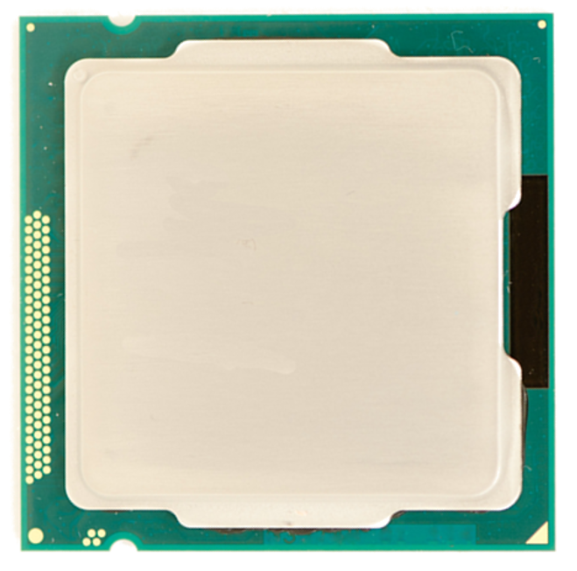
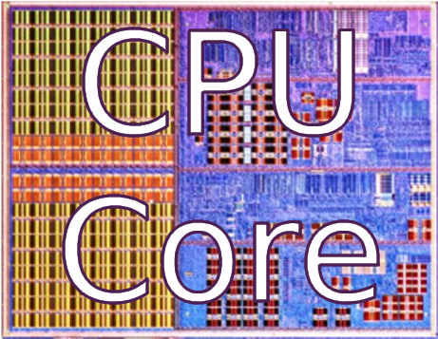
Physical Integration
Notes:
As we all know, Moore’s law has allowed the continued reduction of transistor size for decades.
Recently, as transistors have shrunk, more cores have been added to the chip

Slide 51
Physical Integration

Slide 52
Physical Integration

Slide 53
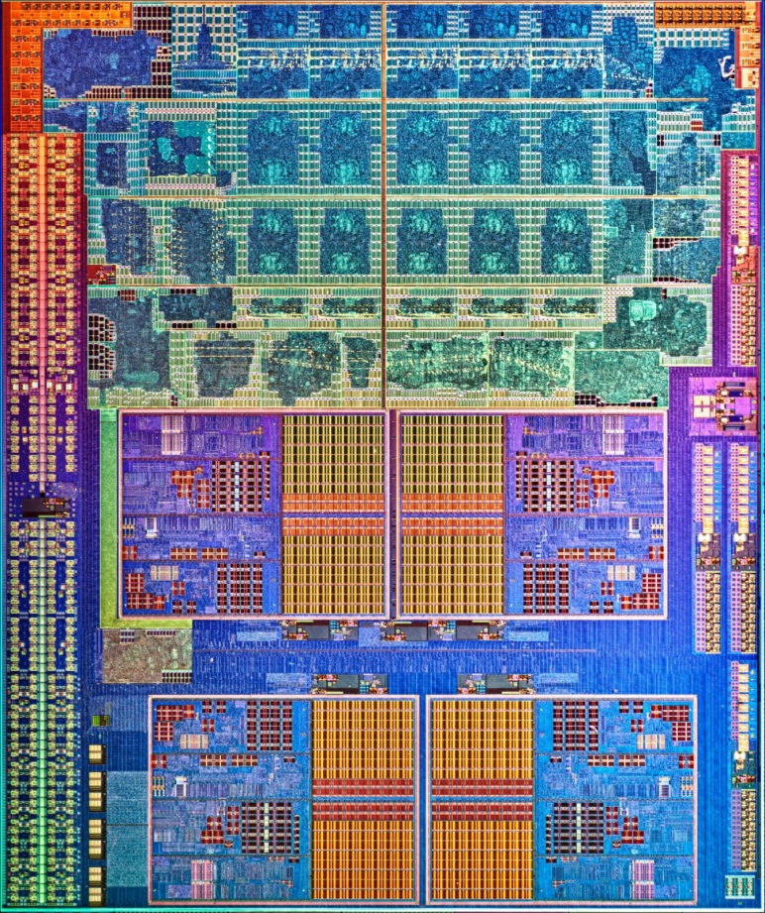
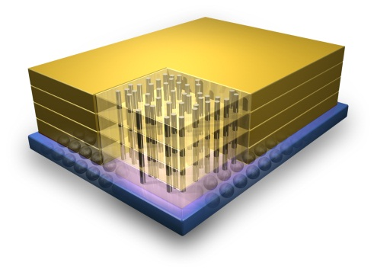
Physical Integration
Stacked High-bandwidth DRAM
GPU
CPU
Cores
Credit: IBM
Notes:
REMEMBER THE STACKED DRAM!!!!!

Slide 54
Shared virtual memory
Cache coherence

Slide 55
Supporting x86-64 Address Translation for 100s of GPU Lanes
Jason Power, Mark D. Hill, David A. Wood
Based on HPCA 20 paper

Slide 56
GPU MMU Paper Summary
CPUs & GPUs: physically integrated, logically separate
  Near Future: Cache coherence, Shared virtual address space
Proof-of-concept GPU MMU design
  Per-CU TLBs, highly-threaded PTW, page walk cache
  Full x86-64 support
  Modest performance decrease (2% vs. ideal MMU)
Design alternatives not chosen
Notes:
Say memory management unit

Slide 57
Motivation
Closer physical integration of GPGPUs
Programming model still decoupled
  Separate address spaces
  Unified virtual address (NVIDIA) simplifies code
  Want: Shared virtual address space (HSA hUMA)

Slide 58
Tree Index
Hash-table Index
CPU address space
Notes:
Tree index: something like barnes-hut

Slide 59
Separate Address Space
CPU address space
Transform to new pointers
Transform to new pointers
Simply copy data
GPU address space

Slide 60
Unified Virtual Addressing
CPU address space
1-to-1 addresses
GPU address space

Slide 61
Unified Virtual Addressing
void main() {
int *h_in, *h_out;
h_in = cudaHostMalloc(sizeof(int)*1024); // allocate input array on host
h_in = ... // Initial host array
h_out = cudaHostMalloc(sizeof(int)*1024); // allocate output array on host
Kernel<<<1,1024>>>(h_in, h_out);
... h_out // continue host computation with result
cudaHostFree(h_in); // Free memory on host
cudaHostFree(h_out);
}

Slide 62
Shared Virtual Address Space
CPU address space
1-to-1 addresses
GPU address space

Slide 63
Shared Virtual Address Space
No caveats
Programs “just work”
Same as multicore model

Slide 64
Shared Virtual Address Space
Simplifies code
Enables rich pointer-based datastructures
  Trees, linked lists, etc.
Enables composablity
Need: MMU (memory management unit) for the GPU
Low overhead
Support for CPU page tables (x86-64)
4 KB pages
Page faults, TLB flushes, TLB shootdown, etc
Notes:
6:16

Slide 65
GPU MMU Design 3
Shared by
16 CUs

Slide 66
Highly-threaded PTW

Slide 67
Heterogeneous System coherence for Integrated CPU-GPU Systems
Jason Power*, Arkaprava Basu*, Junli Gu†, Sooraj Puthoor†,
Bradford M Beckmann†, Mark D Hill*†, Steven K Reinhardt†, David A Wood*†
*University of Wisconsin-Madison
†Advanced Micro Devices, Inc.
Notes:
Thank you for the introduction.
Hi, I’m Jason Power and today I’m going to present our work on Heterogeneous System Coherence.
This work was completed while on and internship at AMD research.
I would like to thank my collaborators, listed here.

Slide 68
System overview
APU
Arrow thickness
→bandwidth
GPU compute accesses must stay coherent
Invalidation traffic
Direct-access bus
(used for graphics)
Notes:
In order to stay coherent need to put all GPU coherent requests through directory
Very high bandwidth
Arrow thickness

Slide 69
Baseline Directory Coherence
Initialization
Kernel Launch
Read result

Slide 70
Heterogeneous System Coherence (HSC)
Initialization
Kernel Launch
Notes:
2,3,7 5,6

Slide 71
Heterogeneous system coherence (HSC)
Region buffers coordinate with region directory
Direct-access bus
Direct-access bus
Notes:
Bring up region dir
Bring up regin buf
Coord with region dir
Direct access bus
Region of 16 64 B blocks or 1KB

Slide 72
HSC Summary
Key insight
  GPU-CPU applications exhibit high spatial locality
  Use direct-access bus present in systems
  Offload bandwidth onto direct-access bus
Use coherence network only for permission
Add region buffer to track region information
  At each L2 cache
  Bypass coherence network and directory
Replace directory with region directory
  Significantly reduces total size needed

Slide 73
GPU Architecture Research
Blending with CPU architecture:
  Dynamic scheduling / dynamic wavefront re-org
  Work-items have more locality than we think
Tighter integration with CPU on SOC:
  Fast kernel launch
    Exploit fine-grained parallel region: Remember Amdahl’s law
  Common shared memory
Reliability:
  Historically: Who notices a bad pixel?
  Future: GPU compute demands correctness
Power:
  Mobile, mobile mobile!!!

Slide 74
Computer Economics 101
GPU Compute is cool + gaining steam, but…
  Is a 0 billion dollar industry (to quote Mark Hill)
GPU design priorities:
  1. Graphics
  2. Graphics
  …
  N-1. Graphics
  N. GPU Compute
Moral of the story:
  GPU won’t become a CPU (nor should it)
1 billion
Cray Titan (#2 on top 500 supercomputers)
>$50,000,000 of GPUs

Slide 75
Disclaimer & Attribution
The information presented in this document is for informational purposes only and may contain technical inaccuracies, omissions and typographical errors.
The information contained herein is subject to change and may be rendered inaccurate for many reasons, including but not limited to product and roadmap changes, component and motherboard version changes, new model and/or product releases, product differences between differing manufacturers, software changes, BIOS flashes, firmware upgrades, or the like. AMD assumes no obligation to update or otherwise correct or revise this information. However, AMD reserves the right to revise this information and to make changes from time to time to the content hereof without obligation of AMD to notify any person of such revisions or changes.
AMD MAKES NO REPRESENTATIONS OR WARRANTIES WITH RESPECT TO THE CONTENTS HEREOF AND ASSUMES NO RESPONSIBILITY FOR ANY INACCURACIES, ERRORS OR OMISSIONS THAT MAY APPEAR IN THIS INFORMATION.
AMD SPECIFICALLY DISCLAIMS ANY IMPLIED WARRANTIES OF MERCHANTABILITY OR FITNESS FOR ANY PARTICULAR PURPOSE. IN NO EVENT WILL AMD BE LIABLE TO ANY PERSON FOR ANY DIRECT, INDIRECT, SPECIAL OR OTHER CONSEQUENTIAL DAMAGES ARISING FROM THE USE OF ANY INFORMATION CONTAINED HEREIN, EVEN IF AMD IS EXPRESSLY ADVISED OF THE POSSIBILITY OF SUCH DAMAGES.
ATTRIBUTION
© 2014 Advanced Micro Devices, Inc. All rights reserved. AMD, the AMD Arrow logo and combinations thereof are trademarks of Advanced Micro Devices, Inc. in the United States and/or other jurisdictions. SPEC is a registered trademark of the Standard Performance Evaluation Corporation (SPEC). Other names are for informational purposes only and may be trademarks of their respective owners.

Slide 76
Disclaimer & Attribution
The information presented in this document is for informational purposes only and may contain technical inaccuracies, omissions and typographical errors.
The information contained herein is subject to change and may be rendered inaccurate for many reasons, including but not limited to product and roadmap changes, component and motherboard version changes, new model and/or product releases, product differences between differing manufacturers, software changes, BIOS flashes, firmware upgrades, or the like. AMD assumes no obligation to update or otherwise correct or revise this information. However, AMD reserves the right to revise this information and to make changes from time to time to the content hereof without obligation of AMD to notify any person of such revisions or changes.
AMD MAKES NO REPRESENTATIONS OR WARRANTIES WITH RESPECT TO THE CONTENTS HEREOF AND ASSUMES NO RESPONSIBILITY FOR ANY INACCURACIES, ERRORS OR OMISSIONS THAT MAY APPEAR IN THIS INFORMATION.
AMD SPECIFICALLY DISCLAIMS ANY IMPLIED WARRANTIES OF MERCHANTABILITY OR FITNESS FOR ANY PARTICULAR PURPOSE. IN NO EVENT WILL AMD BE LIABLE TO ANY PERSON FOR ANY DIRECT, INDIRECT, SPECIAL OR OTHER CONSEQUENTIAL DAMAGES ARISING FROM THE USE OF ANY INFORMATION CONTAINED HEREIN, EVEN IF AMD IS EXPRESSLY ADVISED OF THE POSSIBILITY OF SUCH DAMAGES.
ATTRIBUTION
© 2014 Advanced Micro Devices, Inc. All rights reserved. AMD, the AMD Arrow logo and combinations thereof are trademarks of Advanced Micro Devices, Inc. in the United States and/or other jurisdictions. SPEC is a registered trademark of the Standard Performance Evaluation Corporation (SPEC). Other names are for informational purposes only and may be trademarks of their respective owners.

Slide 77
Disclaimer & Attribution
The information presented in this document is for informational purposes only and may contain technical inaccuracies, omissions and typographical errors.
The information contained herein is subject to change and may be rendered inaccurate for many reasons, including but not limited to product and roadmap changes, component and motherboard version changes, new model and/or product releases, product differences between differing manufacturers, software changes, BIOS flashes, firmware upgrades, or the like. AMD assumes no obligation to update or otherwise correct or revise this information. However, AMD reserves the right to revise this information and to make changes from time to time to the content hereof without obligation of AMD to notify any person of such revisions or changes.
AMD MAKES NO REPRESENTATIONS OR WARRANTIES WITH RESPECT TO THE CONTENTS HEREOF AND ASSUMES NO RESPONSIBILITY FOR ANY INACCURACIES, ERRORS OR OMISSIONS THAT MAY APPEAR IN THIS INFORMATION.
AMD SPECIFICALLY DISCLAIMS ANY IMPLIED WARRANTIES OF MERCHANTABILITY OR FITNESS FOR ANY PARTICULAR PURPOSE. IN NO EVENT WILL AMD BE LIABLE TO ANY PERSON FOR ANY DIRECT, INDIRECT, SPECIAL OR OTHER CONSEQUENTIAL DAMAGES ARISING FROM THE USE OF ANY INFORMATION CONTAINED HEREIN, EVEN IF AMD IS EXPRESSLY ADVISED OF THE POSSIBILITY OF SUCH DAMAGES.
ATTRIBUTION
© 2013 Advanced Micro Devices, Inc. All rights reserved. AMD, the AMD Arrow logo and combinations thereof are trademarks of Advanced Micro Devices, Inc. in the United States and/or other jurisdictions. SPEC is a registered trademark of the Standard Performance Evaluation Corporation (SPEC). Other names are for informational purposes only and may be trademarks of their respective owners.

