Slide 1
Memory Persistency
Steven Pelley, Peter M. Chen, Thomas F. Wenisch
University of Michigan

Slide 2
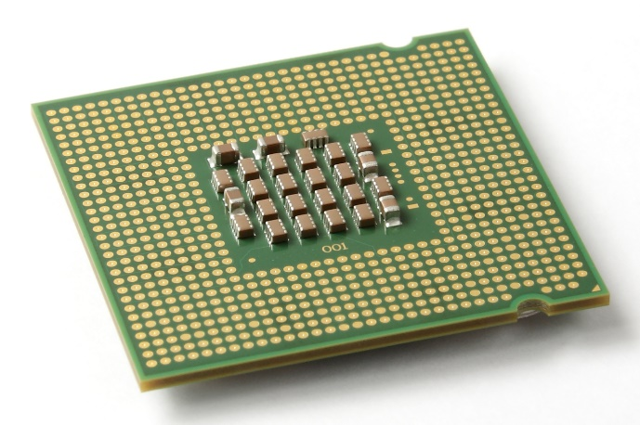
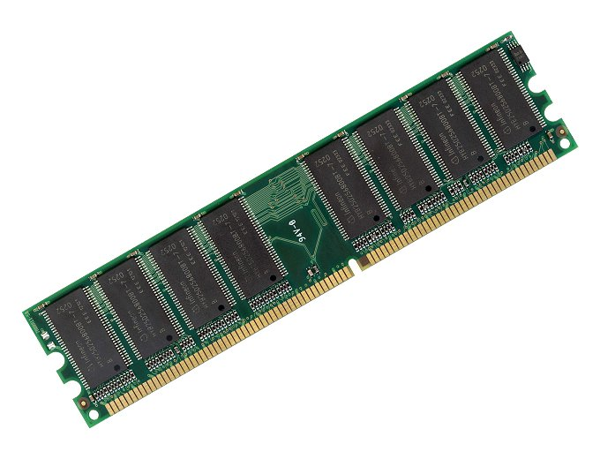
Nonvolatile memory (NVRAM) recovery
Writes unordered!
Writes to memory unordered (cache eviction)
But, recovery depends on write ordering
Enforcing order for all writes too slow!
Constrain persist order for correctness,
but reorder for performance

Slide 3
Persist performance
Persist ordering constraints form a directed acyclic graph (DAG)
Critical path limits overall performance
  Remove unnecessary ordering constraints
  Requires an interface to describe constraints
1: Persist data[0]
2: Persist data[1]
3: Persist flag
Program order implies unnecessary constraints
1
2
3

Slide 4
Persist performance
Persist ordering constraints form a directed acyclic graph (DAG)
Critical path limits overall performance
  Remove unnecessary ordering constraints
  Requires an interface to describe constraints
1: Persist data[0]
2: Persist data[1]
3: Persist flag
1
Need interface to specify necessary constraints
3
2
Expose persist concurrency; sounds like consistency!

Slide 5
Memory persistency: consistency models for NVRAM
Framework to reason about persist order while maximizing concurrency
Just as in consistency, may be strict or relaxed
  Strict: persist order matches store visibility order
  Relaxed: persist order need not match store order
Our contribution:
  Define memory persistency; explore design space
Relaxed persistency enables native instruction execution rate (30x speedup over strict persistency) while preserving data integrity across failure

Slide 6
Outline
Define memory persistency
Strict persistency and models
Relaxed persistency and models
Methodology and evaluation

Slide 7
Outline
Define memory persistency
Strict persistency and models
Relaxed persistency and models
Methodology and evaluation

Slide 8
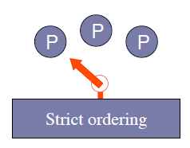
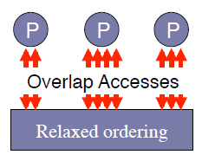
Memory consistency models
Enable performance via memory concurrency
  Provide ordering guarantees when needed
Model separate from implementation
May be strict or relaxed
Consistency spectrum
Persistency similarly decouples implementation from model, and allows both strict and relaxed models

Slide 9
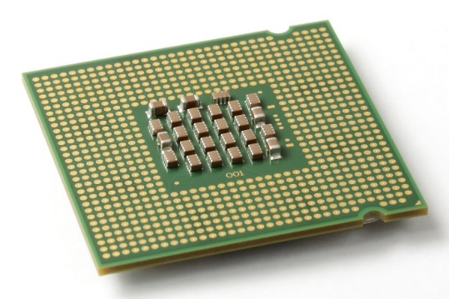
Abstracting failure: recovery observer
Memory consistency:
Constrain order of loads and stores between processors
Memory persistency:
Imagine failure as recovery observer
Atomically loads all memory at failure following consistency model
Use recovery observer to reason about recovery semantics
Persistency = Consistency + Recovery observer

Slide 10
Persistency design space
Volatile memory order
Persistent memory order
Happens before:
Strict persistency: single memory order
Relaxed persistency: separate volatile and
(new) persistent memory orders

Slide 11
Outline
Define memory persistency
Strict persistency and models
Relaxed persistency and models
Methodology and evaluation

Slide 12
Strict persistency
Enforce persist order to match store order
  Thus, consistency model also orders persists
  Store and persist are the same event
Persists to different addresses from different threads can still be concurrent
Implementation free to optimize
  In-hardware speculation? Logging/indirection?

Slide 13
Strict persistency under
Sequential Consistency (SC)
Lock(volatile mutex)
Persist data[0]
Persist data[1]
…
Persist data[N]
Persist flag
Unlock(volatile mutex)
No annotation required
Persists serialize according to program order
Volatile accesses synchronize persists from different threads
Must rely on multi-threading for persist concurrency

Slide 14
Strict persistency under
Relaxed Memory Order (RMO)
Lock(volatile mutex)
Barrier
Persist data[0]
Persist data[1]
…
Persist data[N]
Barrier
Persist flag
Barrier
Unlock(volatile mutex)
Barriers constrain visible order of loads/stores
These same barriers order persists
Persists within a single thread may be concurrent

Slide 15
Outline
Define memory persistency
Strict persistency and models
Relaxed persistency and models
Methodology and evaluation

Slide 16
Relaxed persistency
Decouple thread and persist synchronization
  Persist order may deviate from store order
  Separate volatile and persistent memory orders
Persist barriers order persists
Consistency and persistency time scales differ
Expose additional concurrency only where necessary

Slide 17
Relaxed persistency models
Epoch persistency [similar to BPFS cache]
  Persist barriers separate execution into epochs
  Persists within same epoch are concurrent
  Complex behavior when stores synchronized,
  but persists are not synchronized (see paper)
Strand persistency
  New model to minimally constrain persists
  Precisely defines DAG of ordering constraints

Slide 18
Epoch persistency example
Lock(volatile mutex)
Memory barrier
Persist data[0]
Persist data[1]
…
Persist data[N]
Persist barrier
Persist flag
Memory barrier
Unlock(volatile mutex)
Lock/Mutex synchronizes threads
No need to enforce persist order
Flag must not persist before data
Already locked, no need to synchronize threads
Stores reorder around persist barriers Persists reorder around store barriers Complicates store atomicity (see paper)
Relaxed persistency appropriately orders memory events

Slide 19
Strand persistency
Divide execution into strands
Each strand is an independent set of persists
  All strands initially unordered
  Conflicting accesses (i.e., 2 accesses to address, at least 1 is store) establish persist order
NewStrand label begins each strand
Barriers continue to order persists within each strand as in epoch persistency
Strand persistency precisely labels constraints

Slide 20
Strand persistency example
...
Epoch
Strand
A
B
A
B
Barrier
C
NewStrand
A
Barrier
C
NewStrand
B
A
Barrier
B
C
or
C
B must be ordered with A and/or C
...
Strands remove unnecessary ordering constraints

Slide 21
Outline
Define memory persistency
Strict persistency and models
Relaxed persistency and models
Methodology and evaluation

Slide 22
Methodology
µ-benchmark: concurrent, persistent queue
  See paper for pseudocode
Implementations under strict, epoch, and strand persistency models (under SC)
Measure native performance on real server (2.4Ghz Xeon) for 1 and 8 threads
Measure persist concurrency via memory trace simulation
Compare persist critical path against instruction execution rate

Slide 23
Relaxed persistency
Line = instruction execution rate
Assumes 500ns persists
30x
Relaxed persistency removes constraints, regains throughput

Slide 24
Conclusion
Must order persists, but over-constraining hurts performance (resembles consistency)
Memory persistency builds on consistency to enforce persist order
Persistency may be relaxed, de-coupling store and persist order constraints
Relaxed persistency enables instruction execution rate with recovery correctness
  30x speedup over strict persistency/SC

Slide 25
Thank You!
Questions?

Slide 26
Persist latency sensitivity
17ns
119ns
6.2µs
1 Thread
Relaxed persistency tolerates greater persist latency

Slide 27
Byte-addressable File System (BPFS) cache
BPFS persistency model:
  Only order according to persistent conflicts
    Accesses to vol. address space do not order persists
  No load-before-store conflict order (TSO ordering)
Newly introduced semantics:
  Consequences of simultaneously relaxing consistency and persistency
  Persist epoch races
    Volatile accesses synchronized; persists are not
  Atomic persists/persist coalescing

Slide 28
Memory Persistency
Steven Pelley, Peter M. Chen, Thomas F. Wenisch
University of Michigan

Slide 29
Memory Persistency:
Consistency Models for NVRAM
Writes unordered!
Writes to memory unordered (cache eviction)
But, recovery depends on write ordering
Enforcing order for all writes too slow!
Persistency models provide framework to reason about
NVRAM write order while maximizing concurrency

Slide 30
Nonvolatile memory (NVRAM)
DRAM and flash scaling slowing down
New NVRAMs provide fast, scalable storage (phase change, memristor, STT-RAM)
Storage technology | Random read latency | Durable?
Disk | 10ms | ✓
Flash | 90µs | ✓
DRAM | 100ns | ✗
NVRAM | 50-1000ns [IBM] | ✓
Performance of DRAM, durability of disk

