Slide 1


Networks-on-Chip:
Communication Challenges for Many-Core Architectures
Natalie Enright Jerger, University of Toronto

Slide 2
Introductions
Instructor: Natalie Enright Jerger
  PhD from University of Wisconsin-Madison (2008)
  Assistant Professor at University of Toronto (2009)
Research interests
  Many-core architecture
  Networks-on-Chip
  Heterogeneous/System-on-Chip/Mobile architectures
  Cache coherence protocols
www.eecg.toronto.edu/~enright
enright@eecg.toronto.edu

Slide 3
What is an Interconnection Network?
Application
Algorithm
Logic
Mem
Logic
Mem
Programming Language
Operating System
Instruction Set Architecture
Computer Architecture
Communication
Microarchitecture
Register Transfer Level
Circuits
Logic
Mem
Logic
Mem
Devices
Technology

Slide 4
What is an Interconnection Network?
Application
Algorithm
Logic
Mem
Logic
Mem
Programming Language
Operating System
Instruction Set Architecture
Dedicated
Channels
Computer Architecture
Microarchitecture
Register Transfer Level
Circuits
Logic
Mem
Logic
Mem
Devices
Technology
Application: Ideally wants low-latency, high-bandwidth, dedicated channels between logic and memory
Technology: Dedicated channels too expensive in terms of area and power

Slide 5
What is an Interconnection Network?
Application
Algorithm
Logic
Mem
Logic
Mem
Programming Language
Operating System
Instruction Set Architecture
Computer Architecture
Interconnection Network
Microarchitecture
Register Transfer Level
Circuits
Logic
Mem
Logic
Mem
Devices
Technology
An Interconnection Network is a programmable system that transports data between terminals
Technology: Interconnection network helps efficiently utilize scarce resources
Application: Managing communication can be critical to performance

Slide 6
Types of Interconnection Networks
Interconnection networks can be grouped into four domains
  Depending on number and proximity of devices to be connected
Networks on Chip (NoCs or OCNs)
  Devices include microarchitectural elements (functional units, register files), caches, directories, processors
  Current/Future systems: dozens, hundreds of devices
    Ex: Intel TeraFLOPS research prototypes – 80 cores
    Intel Single-chip Cloud Computer – 48 cores
  Proximity: millimeters

Slide 7
Types of Interconnection Networks (2)
System/Storage Area Networks (SANs)
  Multiprocessor and multicomputer systems
    Interprocessor and processor-memory interconnections
  Server and data center environments
    Storage and I/O components
  Hundreds to thousands of devices interconnected
    IBM Blue Gene/L supercomputer (64K nodes, each with 2 processors)
  Maximum interconnect distance: tens of meters (typical) to a few hundred meters
  Examples (standards and proprietary)
    InfiniBand, Myrinet, Quadrics, Advanced Switching Interconnect

Slide 8
Types of Interconnection Networks (3)
Local Area Networks (LANs)
  Interconnect autonomous computer systems
    Machine room or throughout a building or campus
  Hundreds of devices interconnected (1,000s with bridging)
  Maximum interconnect distance
    few kilometers to few tens of kilometers
  Example (most popular): Ethernet, with 10 Gbps over 40Km
Wide Area Networks (WANs)
  Interconnect systems distributed across globe
    Internetworking support required
  Many millions of devices interconnected
  Max distance: many thousands of kilometers
  Example: ATM (asynchronous transfer mode)

Slide 9
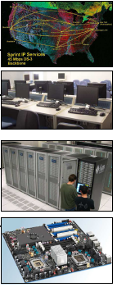
Interconnection Network Domains
Wide Area Networks
10⁶
Metropolitan Area Networks
10³
Local Area Networks
Distance (meters)
System/Storage Area Networks
10⁰
10⁻³
1
10
100
1,000
10,000
>100,000
Number of devices interconnected
Slide courtesy Timothy Mark Pinkston and José Duato

Slide 10
Interconnection Network Domains
Wide Area Networks
10⁶
Metropolitan Area Networks
10³
Local Area Networks
Distance (meters)
System/Storage Area Networks
10⁰
On-Chip Interconnection Networks/Networks-on-Chip
10⁻³
1
10
100
1,000
10,000
>100,000
Number of devices interconnected
Slide courtesy Timothy Mark Pinkston and José Duato

Slide 11
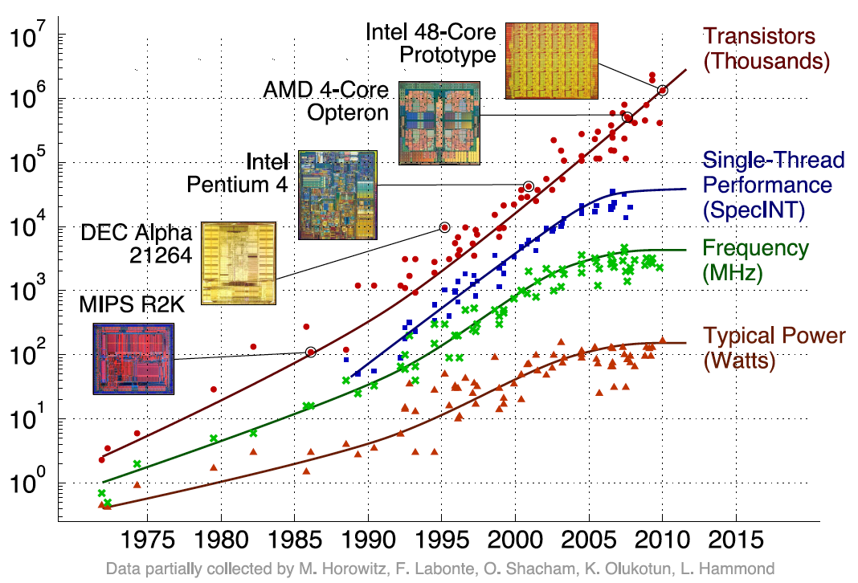
Why Study Networks on Chip?

Slide 12
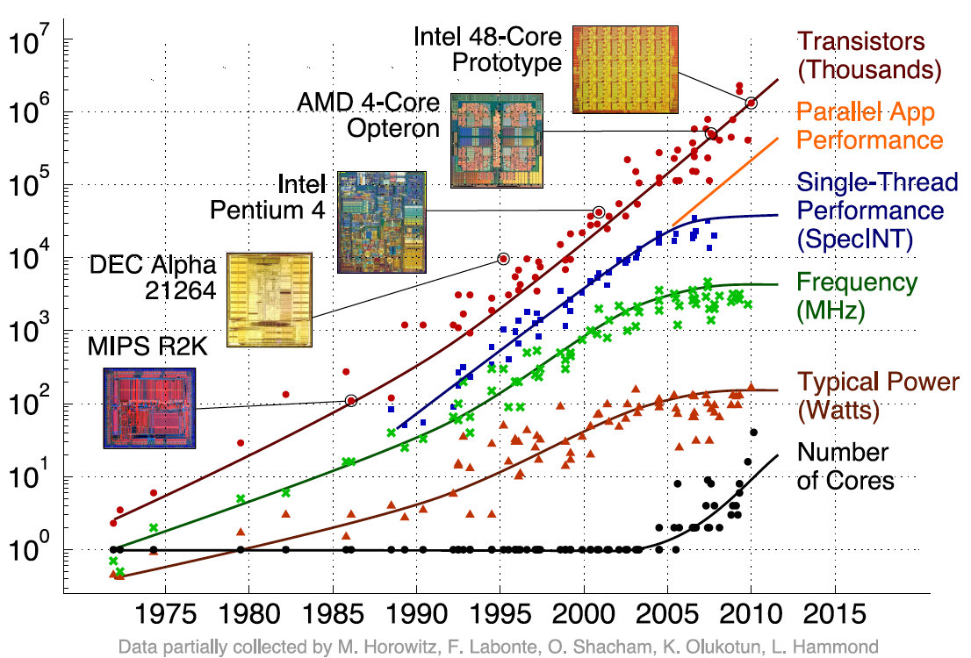
Why Study Networks on Chip?

Slide 13







Increasing Computing Demands
TIPs of compute power operating on Tera-bytes of data
Entertainment
TIPS
Source: electronic visualization lab University of Illinois
Learning & Travel
RMS
Personal Media Creation and Management
GIPS
Performance
3D &
Video
Many-Core
MIPS
Multi-
Media
Multi-core
KIPS
Text
Single-core
Health
Kilobytes
Megabytes
Gigabytes
Terabytes
Dataset Size
http://techresearch.intel.com/articles/Tera-Scale/1421.htm
[Ack. Jim Held, Intel Fellow]
Notes:
High performance computing is moving to the mainstream.
Becoming more visual, more immersive – processing increasing volume of data
Many involving simulation

Slide 14
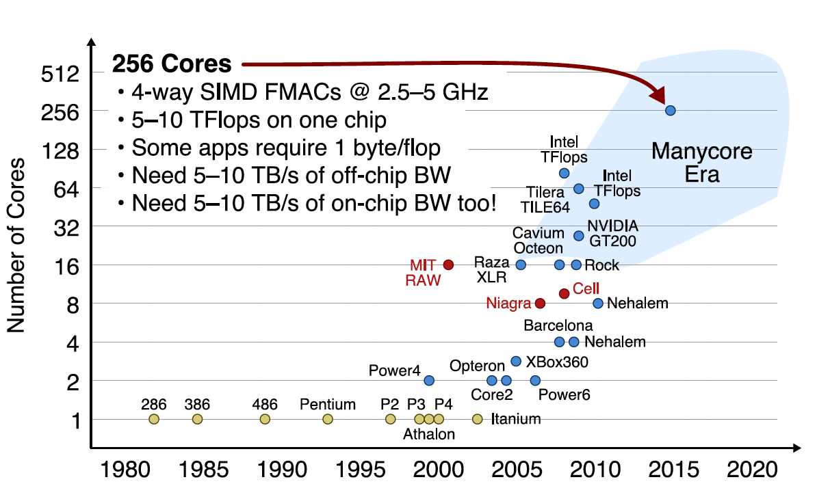
Example of Multi- and Many-Core Architectures

Slide 15
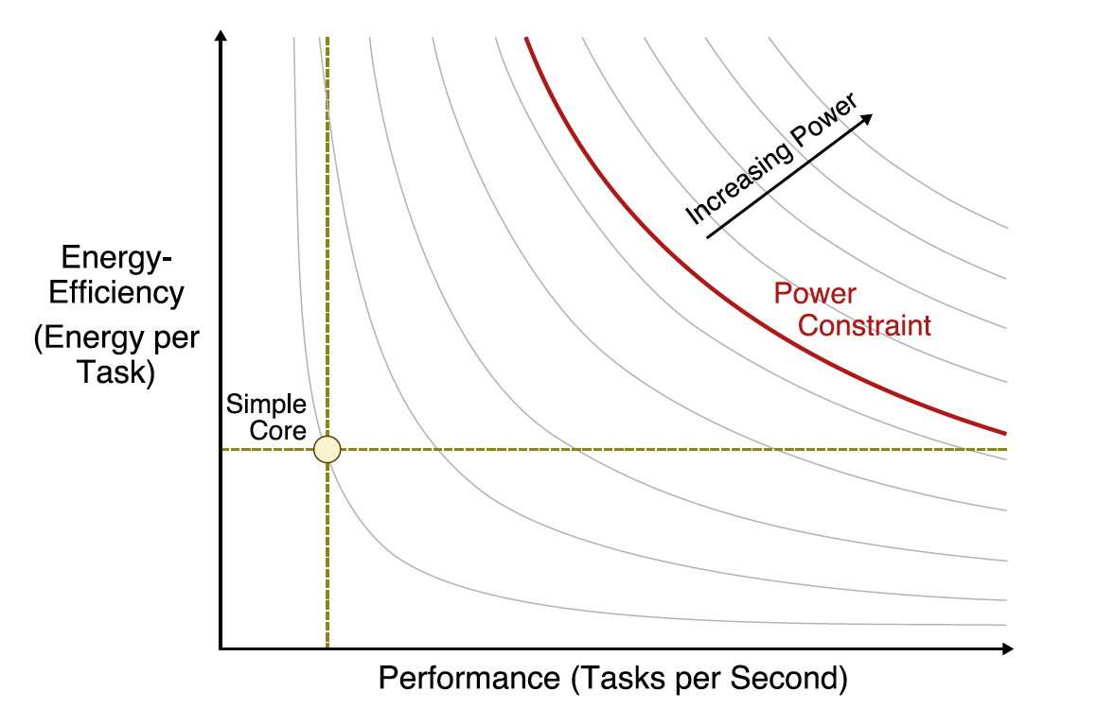
Energy and Performance (Single Core)
Slide courtesy of Chris Batten

Slide 16
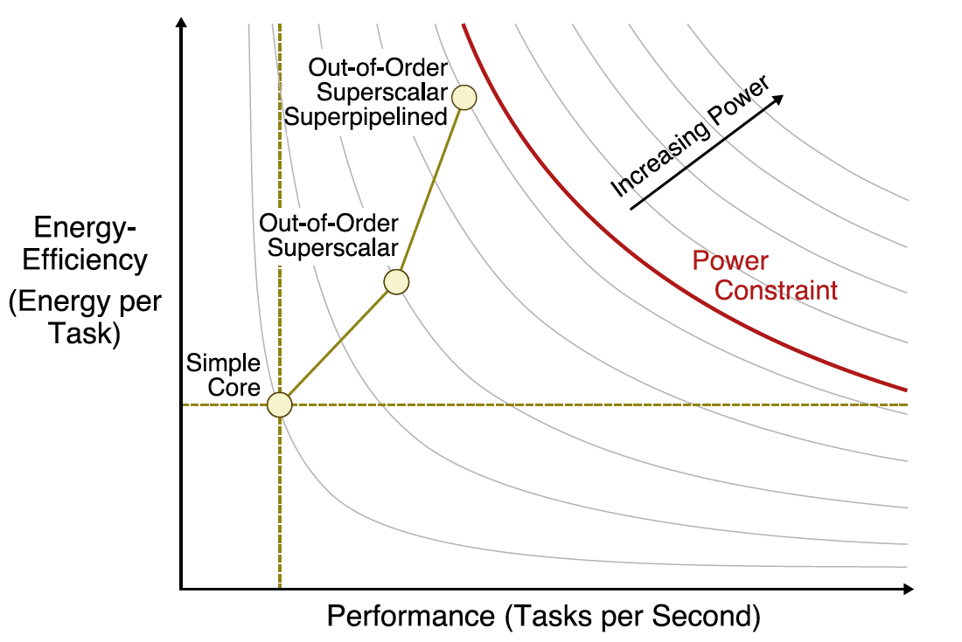
Energy and Performance (Single Core)
Slide courtesy of Chris Batten

Slide 17
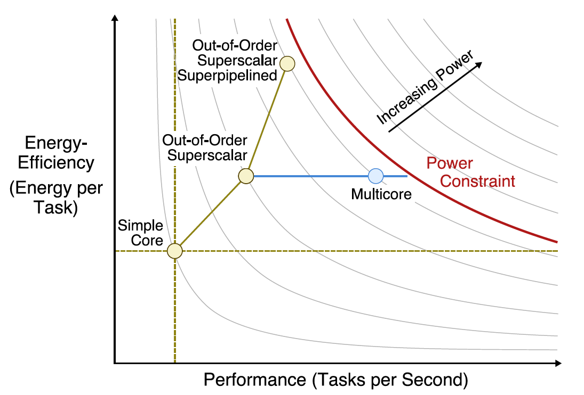
Energy and Performance (Multi-Core)
Slide courtesy of Chris Batten

Slide 18
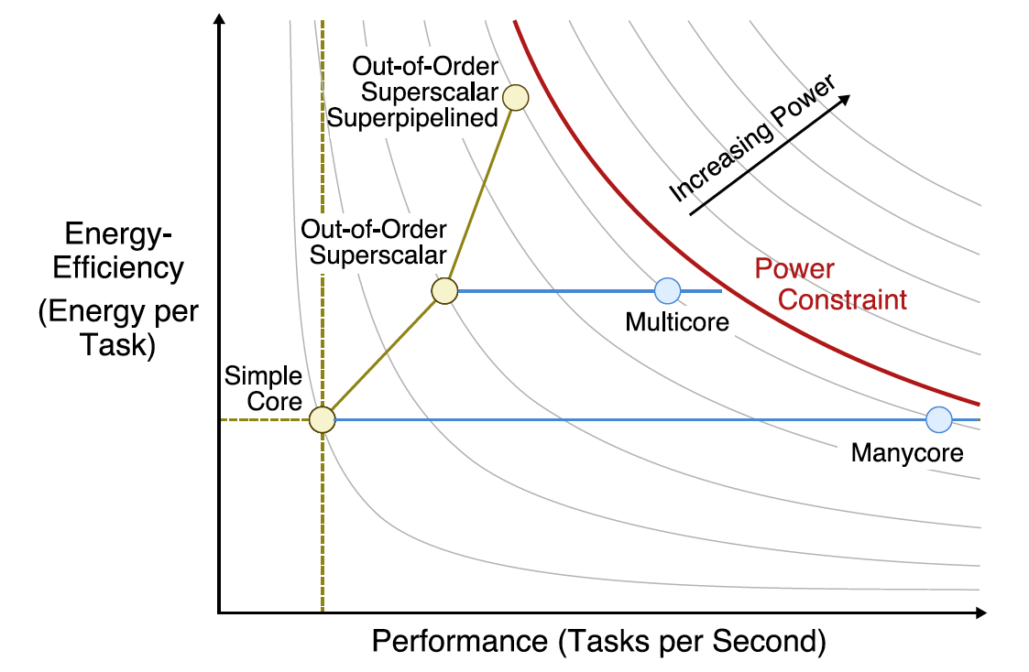
Energy and Performance (Many-Core)
Slide courtesy of Chris Batten

Slide 19
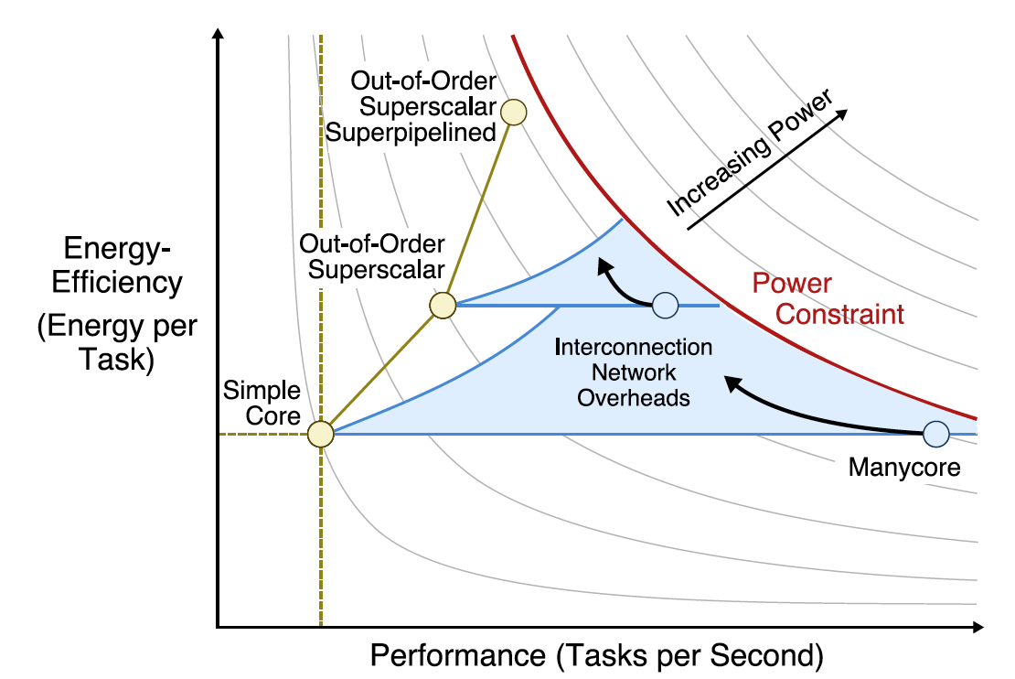
Energy and Performance (Many-Core)
Slide courtesy of Chris Batten

Slide 20
Why study interconnects?
They provide external connectivity from system to outside world
  Also, connectivity within a single computer system at many levels
    I/O units, boards, chips, modules and blocks inside chips
Trends: high demand on communication bandwidth
  Increased computing power and storage capacity
  Switched networks are replacing buses
Integral part of many-core architectures
  Energy consumed by communication will exceed that of computation in future systems
  Lots of innovation needed!
Computer architects/engineers must understand interconnect problems and solutions in order to more effectively design and evaluate systems
Slide courtesy Timothy Mark Pinkston and José Duato

Slide 21
Course Focus: Network-on-Chip
Interconnection network introduction
Network-on-chip overview
  New challenges and opportunities
  Recent products/prototypes
Network-on-chip subtopics + Recent research trends
  System-level Overview
  Topology
  Routing Algorithms
  Flow Control
  Router Microarchitecture
  System-level Design
  Emerging Technology
Discussion of recent trends and conclusions
Present recent research and in-depth discussion alongside introduction of each topic

Slide 22
Differences between on-chip and off-chip networks
Significant research in multi-chassis interconnection networks (off-chip)
  Supercomputers
  Clusters of workstations
  Internet routers
Leverage research and insight but…
  Constraints are different
  New opportunities

Slide 23
Off-chip vs. on-chip
Off-chip: I/O bottlenecks
  Pin-limited bandwidth
    Mix of short and long packets on-chip
  Inherent overheads of off-chip I/O transmission
On-chip
  Wiring constraints
    Metal layer limitations
    Horizontal and vertical layout
    Short, fixed length
    Repeater insertion limits routing of wires
      Avoid routing over dense logic
      Impact wiring density
Notes:
Tight area and power budgets
Ultra-low on-chip latencies
Abundant on-chip wires

Slide 24
Off-chip vs. on-chip
On-Chip
  Power
    Consume 10-15% or more of die power budget
  Latency
    Different order of magnitude
    Routers consume significant fraction of latency

Slide 25
New opportunities
Abundant wiring
  Change in relative cost of wires and buffers
  Many short flits
Tightly integrated into system
  Not commodity – fully customized design
  Allows for optimization with uncore
    Cache coherence
Emerging technology
  Optics
  3D
Introduce research in each of these areas
Notes:
Tight area and power budgets
Ultra-low on-chip latencies
Abundant on-chip wires

Slide 26
On-Chip Network Evolution
Ad hoc wiring
  Small number of nodes
Buses and Crossbars
  Simplest variant of on-chip networks
  Low core counts
  Like traditional multiprocessors
    Bus traffic quickly saturates with a modest number of cores
  Crossbars: higher bandwidth
    Poor area and power scaling

Slide 27
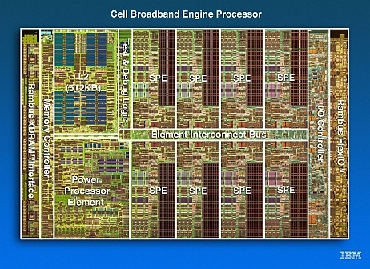
Multicore Example
IBM Cell
Element Interconnect Bus
  12 elements
  4 unidirectional rings
    16 Bytes wide
    Operates at 1.6 GHz
RING
IBM Cell
Notes:
\

Slide 28
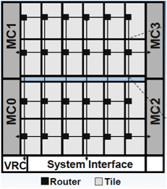
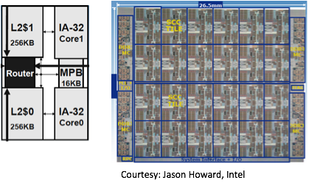
Many-Core Example: Intel SCC
2D mesh with state of the art VC routers
Notes:
Potential platform for project

Slide 29
Goals of course
Understand basic concepts of NoCs
  Cover concepts as they relate to focus areas
Understand where the field is headed
  Lots of interesting research spanning all facets of NoCs
Understand how NoCs relate to your research area
  Cross-layer optimizations
  Draw connections between NoCs and other areas

Slide 30
Outline
Interconnection network introduction
Network-on-chip overview
  New challenges and opportunities
  Recent products/prototypes
Network-on-chip subtopics + Recent research trends
  System-level considerations
  Topology
  Routing Algorithms
  Flow Control
  Router Microarchitecture
  System-level design
  Emerging technology
Discussion of recent trends and conclusions

Slide 31
System-level considerations
Look at how systems interact and interface with network
Two categories of systems
  General-purpose multi-core/many-core
    Focus: Shared memory
    From high end servers to embedded products
  Multiprocessor System on Chip (MPSoC)
    Mobile/consumer market
Many more systems/applications for interconnects

Slide 32
Memory Model in CMPs
Message Passing
  Explicit movement of data between nodes and address spaces
  Programmers manage communication
Shared Memory
  Communication occurs implicitly through loads/stores and accessing instructions
Will focus on shared memory
  Look at optimization for cache coherence protocols

Slide 33
Shared Memory CMP Architecture
Core
L1 I/D Cache
L2 Cache
Router
Tags
Data
Logic
Controller

Slide 34
Shared Memory Network for CMPs
Logically…
  all processors access same shared memory
Practically…
  cache hierarchies reduce access latency to improve performance
Requires cache coherence protocol
  to maintain coherent view in presence of multiple shared copies

Slide 35
Impact of Coherence Protocol on Network Performance
Coherence protocol shapes communication needed by system
Single writer, multiple reader invariant
Requires:
  Data requests
  Data responses
  Coherence permissions
Quick review of coherence
  Suggested reading:
    A Primer on Memory Consistency and Cache Coherence by Daniel Sorin, Mark Hill and David Wood. Morgan Claypool Publishers, 2011.

Slide 36
Hardware Cache Coherence
Hardware cache coherence
  Rough goal: all caches have same data at all times
  Minimal flushing, maximum caches ➔ best performance
Broadcast-based protocol
  All processors see all requests at the same time, same order
  Often relies on bus
    But can broadcast on unordered interconnect

Slide 37
Broadcast-based Coherence
P0
P1
P2
P3
$
$
$
$
Mem

Slide 38
Coherence Bandwidth Requirements
How much address bus bandwidth does snooping need?
  Well, coherence events generated on…
    Misses (only in L2, not so bad)
    Dirty replacements
Some parameters
  2 GHz CPUs, 2 IPC, 33% memory operations
  2% of which miss in L2, 50% of evictions are dirty
  (0.33 * 0.02) + (0.33 * 0.02 * 0.50)) = 0.01 events/insn
  0.01 events/insns * 2 insn/cycle * 2 cycle/ns = 0.04 events/ns
  Request: 0.04 events/ns * 4B/event = 0.16 GB/s = 160 MB/s
  Data response: 0.04 events/ns * 64 B/event = 2.56 GB/s
That’s 2.5 GB/s … per processor
  With 16 processors, that 40 GB/s!
  With 128 processors, that’s 320 GB/s!!
Notes:
Intel’s QPI provides 25.6 GB/s
256GB/s bisection bandwidth on SCC
Yes, you can use multiple buses… but that hinders global ordering

Slide 39
Scalable Cache Coherence
Scalable cache coherence: two part solution
Part I: bus bandwidth
  Replace non-scalable bandwidth substrate (bus)…
  … with scalable bandwidth substrate (point-to-point network, e.g. mesh)
Part II: processor snooping bandwidth
  Interesting: most snoops result in no action
  Replace non-scalable broadcast protocol (spam everyone)…
  … with scalable directory protocol (only spam processors that care)
BR/BW
I

Slide 40
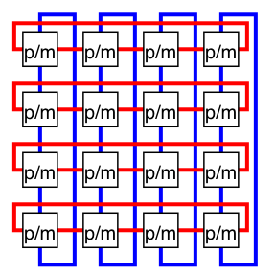
Directory Coherence Protocols
CPU($)
CPU($)
Mem
R
R
Mem
Mem
R
R
Mem
CPU($)
CPU($)
Observe: physical address space statically partitioned (Still shared!!)
  Can easily determine which memory module holds a given line
    That memory module sometimes called “home”
  Can’t easily determine which processors have line in their caches
  Bus-based protocol: broadcast events to all processors/caches
    Simple and fast, but non-scalable

Slide 41
Broadcast vs. Directory
Directory receives request
Read Cache miss
Read Cache miss
1
1
2
Memory Controller
Directory
3
3
Send Data
Send Data
2
Request broadcast

Slide 42
Coherence Protocol Requirements
Different message types
  Unicast, multicast, broadcast
Directory protocol
  Majority of requests: Unicast
    Lower bandwidth demands on network
  More scalable due to point-to-point communication
Broadcast protocol
  Majority of requests: Broadcast
    Higher bandwidth demands
  Often rely on network ordering

Slide 43
Protocol Level Deadlock
Network End Node
Interconnection Network
Reply Q
Memory / Cache
Controller
Message Coupling
Request-Reply Dependency
Request Q
Request-Reply Dependency
  Network becomes flooded with requests that cannot be consumed until the network interface has generated a reply
Deadlock dependency between multiple message classes
Slide courtesy Timothy Mark Pinkston and José Duato
Notes:
Virtual channels can prevent protocol level deadlock (to be discussed later)

Slide 44
Protocol Level Deadlock: Example
Consider the chain of dependencies between message types required to implement a transaction
Key: dependencies prevent consumption
  I can’t respond to B until I get a response to my request which is trapped in the network
Slide courtesy Sudhakar Yalamanchili

Slide 45
Using Virtual Networks for Deadlock Avoidance
RQ & Reply
RQ/Reply
OUT
IN
RQ & Reply
OUT
IN
OUT
Reply
IN
IN
OUT
IN
RQ
IN
RQ
RQ
OUT
OUT
Slide courtesy Sudhakar Yalamanchili
Notes:
Might change animation??

Slide 46
Impact of Cache Hierarchy
Sharing of injection/ejection port among cores and caches
Caches reduce average memory latency
  Private caches
    Multiple L2 copies
    Data can be replicated to be close to processor
  Shared caches
    Data can only exist in one L2 to bank
    Addresses striped across banks
      (Lots of different ways to do this)
  Aside: lots of research on cache block placement, replication and migration
Serve as filter for interconnect traffic

Slide 47
Private vs. Shared Caches
Private caches
  Reduce latency of L2 cache hits
    keep frequently accessed data close to processor
  Increase off-chip pressure
Shared caches
  Better use of storage
  Non-uniform L2 hit latency
  More on-chip network pressure
    all L1 misses go onto network

Slide 48
Home Node/Memory Controller Issues
Heterogeneity in network
  Some memory controller tiles
    Co-located with processor/cache or separate tile
    Share injection/ejection bandwidth?
  Different types of cores
Home node
  Directory coherence information
  <= number of tiles
Potential hot spots in network?

Slide 49
Evaluating Networks
Important to consider traffic pattern
Talked about system architecture impact on traffic
  Full-system simulation will give you coherence and cache behavior
If actual traffic pattern unknown
  Synthetic traffic patterns
    Evaluate common scenarios
    Stress test network
    Derive various properties of network

Slide 50
Synthetic Traffic Patterns
Historically derived from particular applications of interest
  Spatial distribution
  Matrix Transpose → Transpose traffic pattern
    d_{i} = s_{i+b/2} _{mod b}
    b-bit address, d_{i}: i^{th} bit of destination

Slide 51
Synthetic Traffic Patterns (2)
Fast Fourier Transform (FFT) or sorting application → shuffle permutation
Fluid dynamics → neighbor patterns
Need to ask yourself: Does this resemble my application?
Shuffle: d_{i} = s_{i-1 mod b}
Neighbor: d_{x} = s_{x}+ 1 mod k

Slide 52
Synthetic Traffic Patterns (3)
Uniform random
  Each source equally likely to communication with each destination
  Most commonly used traffic pattern
    Very benign
    Traffic is uniformly distributed
      Balances load even if topology/routing algorithm has very poor load balancing
      Need to be careful
  But can be good for debugging/verifying implementation
    Well-understood pattern

Slide 53
Stress-testing Network
Uniform random can make bad topologies look good
Permutation traffic will stress-test the network
  Many types of permutation (ex: shuffle, transpose, neighbor)
  Each source sends all traffic to single destination
  Concentration of load on individual pairs
    Stresses load balancing

Slide 54
Final Thoughts: Traffic Patterns
For topology/routing discussion
  Focus on spatial distribution
Traffic patterns also have temporal aspects
  Bursty behavior
  Important to capture temporal behavior as well
Distribution of packet sizes
Coherence traffic and packet sizes are key aspects of some of the research we will discuss

Slide 55
CMP Summary
Architecture
  Impacts communication requirements
  Broadcast vs. Directory
  Shared vs. Private Caches
Cache hierarchies and coherence protocols
  On-going areas of research for many-core
    Important for memory/coherence designers to understand interconnection network
  NoC cares about how various organizations impact traffic
  Explore opportunities to optimize NoC
    For cache coherence protocol
    Based on characteristics of protocol

Slide 56
Outline
Interconnection network introduction
Network-on-chip overview
  New challenges and opportunities
  Recent products/prototypes
Network-on-chip subtopics + Recent research trends
  System-level Overview
  Topology
  Routing Algorithms
  Flow Control
  Router Microarchitecture
  System-level Design
  Emerging Technology
Discussion of recent trends and conclusions

Slide 57
Topology Overview
Determines arrangement of channels and nodes in network
  Analogous to road map
Often first step in network design
Significant impact on network cost-performance
  Determines number of hops
    Latency
    Network energy consumption
  Implementation complexity
    Node degree
    Ease of layout
      NoC: map to a 2D planar substrate
      Topologies for 3D stacked dies

Slide 58
Abstract Metrics
Use abstract metrics to evaluate performance and cost of topology
Also influenced by routing/flow control
  At this stage
    Assume ideal routing (perfect load balancing)
    Assume ideal flow control (no idle cycles on any channel)

Slide 59
Abstract Metrics: Degree
Switch Degree: number of links at a node
  Proxy for estimating cost
    Higher degree requires more links and port counts at each router
2
2,3,4
4

Slide 60
Abstract Metrics: Hop Count
Path: ordered set of channels between source and destination
Hop Count: number of hops a message takes from source to destination
  Simple, useful proxy for network latency
    Every node, link incurs some propagation delay even when no contention
Minimal hop count: smallest hop count connecting two nodes

Slide 61
Hop Count
Network diameter: large min hop count in network
Average minimum hop count: average across all source/destination pairs
  Implementation may incorporate non-minimal paths
    Increases average hop count

Slide 62
Hop Count
Max = 4
Avg. = 2.2
Max = 4
Avg. = 1.77
Max = 2
Avg. = 1.33
Uniform random traffic
  Ring > Mesh > Torus
Derivations (skip)
  See General References for more details

Slide 63
Latency
Time for packet to traverse network
  Start: head arrives at input port
  End: tail departs output port
Latency = Head latency + serialization latency
  Serialization latency: time for packet with Length L to cross channel with bandwidth b:
Approximate with hop count
  Other design choices (routing, flow control) impact latency
    Unknown at this stage

Slide 64
Abstract Metrics: Maximum Channel Load
Estimate max bandwidth the network can support
  Max bits per second (bps) that can be injected by every node before it saturates
    Saturation: network cannot accept any more traffic
  Determine most congested link
    For given traffic pattern
    Will limit overall network bandwidth
    Estimate load on this channel
Notes:
Start here on Tuesday

Slide 65
Bisection Bandwidth
Common off-chip metric
  Proxy for cost
  Amount of global wiring that will be necessary
  Less useful for on-chip
    Global on-chip wiring considered abundant
Cuts: partition all the nodes into two disjoint sets
  Bandwidth of a cut
Bisection
  A cut which divides all nodes into nearly half
  Channel bisection → min. channel count over all bisections
  Bisection bandwidth → min. bandwidth over all bisections
With uniform traffic
  ½ of traffic crosses bisection
Notes:
Not sure if I should include next two slides.

Slide 66
Throughput Example
0
1
2
3
4
5
6
7
Bisection = 4 (2 in each direction)
With uniform random traffic
  3 sends 1/8 of its traffic to 4,5,6
  3 sends 1/16 of its traffic to 7 (2 possible shortest paths)
  2 sends 1/8 of its traffic to 4,5
  Etc
Channel load = 1

Slide 67
Path Diversity
Multiple shortest paths between source/destination pair (R)
Fault tolerance
Better load balancing in network
Routing algorithm should be able to exploit path diversity
B
B
B
A
A
A

Slide 68
Types of Topologies
Focus on switched topologies
  Alternatives: bus and crossbar
  Bus
    Connects a set of components to a single shared channel
    Effective broadcast medium
  Crossbar
    Directly connects n inputs to m outputs without intermediate stages
    Fully connected, single hop network
    Component of routers

Slide 69
Types of Topologies
Direct
  Each router is associated with a terminal node
  All routers are sources and destinations of traffic
Indirect
  Routers are distinct from terminal nodes
  Terminal nodes can source/sink traffic
  Intermediate nodes switch traffic between terminal nodes
Most NoCs use direct topologies

Slide 70
Torus (1)
k-ary n-cube: k^{n} network nodes
n-Dimensional grid with k nodes in each dimension
3-ary 2-cube
2,3,4-ary 3-mesh

Slide 71
Torus (1)
k-ary n-cube: k^{n} network nodes
n-Dimensional grid with k nodes in each dimension
3-ary 2-mesh
2,3,4-ary 3-mesh

Slide 72
Hop Count
Average shortest distance over all pairs of nodes
Torus:
  For uniform random traffic
    Packet travels k/4 hops in each of n dimensions
Mesh:

Slide 73
Torus (4)
Degree = 2n
  2 channels per dimension
  All nodes have same degree
Total channels = 2nN

Slide 74
Channel Load for Torus
Even number of k-ary (n-1)-cubes in outer dimension
Dividing these k-ary (n-1)-cubes gives a 2 sets of k^{n-1} bidirectional channels or 4k^{n-1}
½ Traffic from each node cross bisection
Mesh has ½ the bisection bandwidth of torus
Notes:
4k^(n-1) = 4*k^n*k^-1 = 4N/k
N/2 traffic is going to be distributed over 4N/k channels so the load is (N/2)/(4N/k) = N/2 * k/4N
Mention adversarial traffic pattern for torus… some kind of permutation…

Slide 75
Deriving Channel Load: 4-ary 2-cube
Divide network in half
Number of bisection channels
  8 links, bidirectional = 16 channels
½ traffic crosses bisection
N/2 traffic distributed over 16 links
Channel load = ½
  Loaded at twice injection bandwidth
Notes:
Include or cut?
Channel load of 2
Channel is loaded with twice injection bandwidth
If each node injects a flit every cycle
2 flits will want to traverse bottleneck channel every cycle
If bottleneck channel can only handle 1 flit per cycle
Max network bandwidth is ½ link bandwidth
A flit can be injected every other cycle

Slide 76
Mesh
A torus with end-around connection removed
Same node degree
Bisection channels halved
  Max channel load = k/4
Higher demand for central channels
  Load imbalance

Slide 77
Butterfly
Indirect network
k-ary n-fly: k^{n} network nodes
Routing from 000 to 010
  Destination address used to directly route packet
  Bit n used to select output port at stage n
0
1
0
0
0
00
10
20
1
1
2
2
01
11
21
3
3
4
4
02
12
22
5
5
6
6
03
13
23
7
7
2-ary 3-fly
2 input switch, 3 stages
Notes:
all channels are unidirectional and flow from left to right

Slide 78
Butterfly (2)
No path diversity
Hop Count
  Log_{k}N + 1
  Does not exploit locality
    Hop count same regardless of location
Switch Degree = 2k
Requires long wires to implement
Channel load = 1
  Uniform random traffic equal loads all channels

Slide 79
Other topologies
Clos
Fat tree
Irregular networks
Hierarchical networks
  Scalable solutions will need to emphasize/exploit locality
Notes:
Do I plan to talk about hierarchy?

Slide 80
Implication of Abstract Metrics on Implementation
Degree: useful proxy for router complexity
  Increasing ports requires additional buffer queues, requestors to allocators, ports to crossbar
  All contribute to critical path delay, area and power
  Link complexity does not correlate with degree
    Link complexity depends on link width
    Fixed number of wires, link complexity for 2-port vs 3-port is same

Slide 81
Implications (2)
Hop Count: useful proxy for overall latency and power
  Does not always correlate with latency
    Depends heavily on router pipeline and link propagation
  Example:
    Network A with 2 hops, 5 stage pipeline, 4 cycle link traversal vs.
    Network B with 3 hops, 1 stage pipeline, 1 cycle link traversal
Hop Count says A is better than B
But A has 18 cycle latency vs. 6 cycle latency for B

Slide 82
Implications (3)
Topologies typically trade-off hop count and node degree
Max channel load useful proxy for network saturation and max power
  Higher max channel load → greater network congestion
  Traffic pattern impacts max channel load
    Representative traffic patterns important
  Max power: dynamic power is highest with peak switching activity and utilization in network

Slide 83
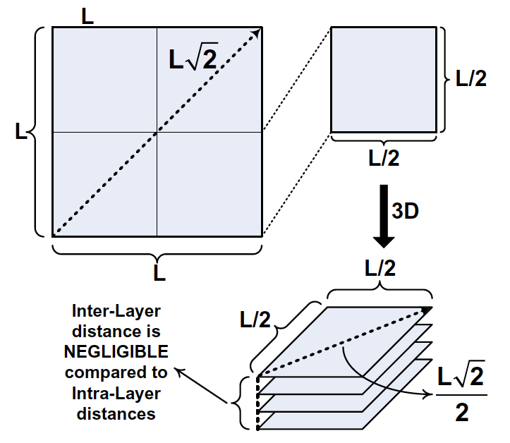
Topologies and 3D Stacking
3D stacked dies offer several advantages
  Low latency between vertical layers
  High bandwidth connections between layers
    Facilitated by through silicon vias (TSVs)
    Provide much higher bandwidth to memory than off-chip
  Opportunities to integrate heterogeneous technologies
    DRAM, photonics, analog
Inter-layer distance negligible compared to intra-layer distance
Courtesy of Li et al., ISCA 2006
Notes:
Other 3D die stacking details/background
Include a generic 3D stacking picture from a paper…

Slide 84
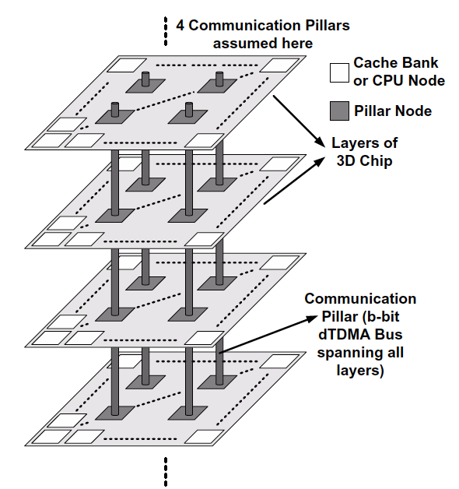
Topology choices for 3D dies
3D stacking → 3D topology
Simply move from a 2D mesh → 3D mesh?
  Problem: Inter-layer distances are small
  High overhead of routers will dominate
  Alternative: Consider vertical dimension as buses
Courtesy of Li et al., ISCA 2006
Notes:
Several examples: ISCA 2006, MIRA? Others?
Figure?

Slide 85
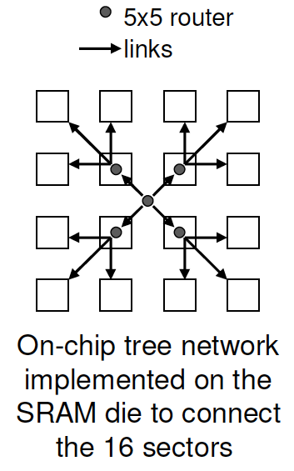
3D Stacked Die Topology Example
Consider context
  Typical design:
    I layer = cores
    Other layers = memory
  Access patterns, communication behavior
Example
  Architecture with SRAM and DRAM die
  Shared data placed in center banks of SRAM die
    Most cores will access the bank directly above them or the center banks
    Mesh topology not a good match
    Tree will provide needed connectivity without extra overhead
On-Chip tree network implemented on the SRAM die to connect 16 sectors
Courtesy of Madan et al., HPCA 2009
Notes:
Niti’s HPCA 2009 paper?

Slide 86
Data placement and NoCs
Locality optimizations influence NoC design choices
Intelligent data placement a must for large scale systems
  Cannot afford cost of random communication across entire die
Page coloring
  Previous example assumes shared data mapped to central banks
Cross-layer optimizations
  NoCs cannot solve all communication problems
  Consider data placement, sharing, etc.
Notes:
Cho and Jin [11] – page coloring

Slide 87
Topology Summary
First network design decision
Critical impact on network latency and throughput
  Hop count provides first order approximation of message latency
  Bottleneck channels determine saturation throughput
Topologies for 3D stacking
Optics leads to novel topologies (more later)

Slide 88
Outline
Interconnection network introduction
Network-on-chip overview
  New challenges and opportunities
  Recent products/prototypes
Network-on-chip subtopics + Recent research trends
  System-level Overview
  Topology
  Routing Algorithms
  Flow Control
  Router Microarchitecture
  System-level Design
  Emerging Technology
Discussion of recent trends and conclusions

Slide 89
Routing Overview
Discussion of topologies assumed ideal routing
In practice…
  Routing algorithms are not ideal
Goal: distribute traffic evenly among paths
  Avoid hot spots, contention
  More balanced → closer throughput is to ideal
Keep complexity in mind

Slide 90
Routing Basics
Once topology is fixed
Routing algorithm determines path(s) from source to destination

Slide 91
Routing Example
0
1
2
3
4
5
6
7
Some routing options:
  Greedy: shortest path
  Uniform random: randomly pick direction
  Adaptive: send packet in direction with lowest local channel load
Which gives best worst-case throughput?
Notes:
What’s the point of this example – just to illustrate that counter-intuitive or something else?

Slide 92
Routing Example (2)
0
1
2
3
4
5
6
7
Consider tornado traffic
  node i sends to i+3 mod 8

Slide 93
Routing Example (3)
Greedy:
  All traffic moves counterclockwise
    Loads counterclockwise with 3 units of traffic
      Each node gets 1/3 throughput
    Clockwise channels are idle
Random:
  Clockwise channels become bottleneck
    Load of 5/2
      Half of traffic traverses 5 links in clockwise direction
      Gives throughput of 2/5

Slide 94
Routing Example (4)
Adaptive:
  Perfect load balancing (some assumptions about implementation)
  Sends 5/8 of traffic over 3 links, sends 3/8 over 5 links
    Channel load is 15/8, throughput of 8/15
Note: worst case throughput is just 1 metric designer might optimize

Slide 95
Routing Algorithm Attributes
Types
  Deterministic, Oblivious, Adaptive
Number of destinations
  Unicast, Multicast, Broadcast?
Adaptivity
  Oblivious or Adaptive? Local or Global knowledge?
  Minimal or non-minimal?

Slide 96
Routing Deadlock
A
B
D
C
Each packet is occupying a link and waiting for a link
Without routing restrictions, a resource cycle can occur
  Leads to deadlock

Slide 97
Deterministic Routing
All messages from Source to Destination traverse the same path
Common example: Dimension Order Routing (DOR)
  Message traverses network dimension by dimension
  Aka XY routing
Cons:
  Eliminates any path diversity provided by topology
  Poor load balancing
Pros:
  Simple and inexpensive to implement
  Deadlock-free

Slide 98
Dimension Order Routing: Cube networks
aka X-Y Routing
  Traverse network dimension by dimension
  Can only turn to Y dimension after finished X

Slide 99
Oblivious Routing
Routing decisions are made without regard to network state
  Keeps algorithms simple
  Unable to adapt
Deterministic algorithms are a subset of oblivious

Slide 100
Adaptive Routing
Exploits path diversity
Uses network state to make routing decisions
  Buffer occupancies often used
  Coupled with flow control mechanism
Local information readily available
  Global information more costly to obtain
  Network state can change rapidly
  Use of local information can lead to non-optimal choices
Can be minimal or non-minimal

Slide 101
Minimal Adaptive Routing
d
s
Local information can result in sub-optimal choices

Slide 102
Non-minimal adaptive routing
Fully adaptive
Not restricted to take shortest path
Misrouting: directing packet along non-productive channel
  Priority given to productive output
  Some algorithms forbid U-turns
Livelock potential: traversing network without ever reaching destination
  Mechanism to guarantee forward progress
    Limit number of misroutings
Notes:
Fbfly is an on-chip example with non-minimal routing

Slide 103
Adaptive Routing Example
0
1
2
3
4
5
6
7
Should 3 route clockwise or counterclockwise to 7?
  5 is using all the capacity of link 5 → 6
Queue at node 5 will sense contention but not at node 3
Backpressure: allows nodes to indirectly sense congestion
  Queue in one node fills up, it will stop receiving flits
  Previous queue will fill up
If each queue holds 4 packets
  3 will send 8 packets before sensing congestion

Slide 104
Adaptive Routing: Turn Model
DOR eliminates 4 turns
  N to E, N to W, S to E, S to W
  No adaptivity
Some adaptivity by removing 2 of 8 turns
  Remains deadlock free (like DOR)
Example: West first
  Eliminates S to W and N to W
West first
Notes:
All eliminate the North to West turn and then each eliminates one other turn to remove deadlock.

Slide 105
Adaptive Routing and Deadlock
Option 1: Eliminate turns that lead to deadlock
  Limits flexibility
Option 2: Allow all turns
  Give more flexibility
  Must use other mechanism to prevent deadlock
  Rely on flow control (later)
    Escape virtual channels

Slide 106
Routing and Cache Coherence
Focused on unicast routing
  Single source ➔ single destination
Cache coherence protocols often rely on
  Multicast/broadcast
    Send invalidations to multiple sharers
  Reduction
    Collect acknowledgements from multiple sharers
  Found in both snooping- and directory-based protocols
Require novel routing mechanisms
  New opportunity: on chip
    Tight integration between network and caches hierarchy
  New demand
    Network innovations required to scale coherence protocols to many-core

Slide 107
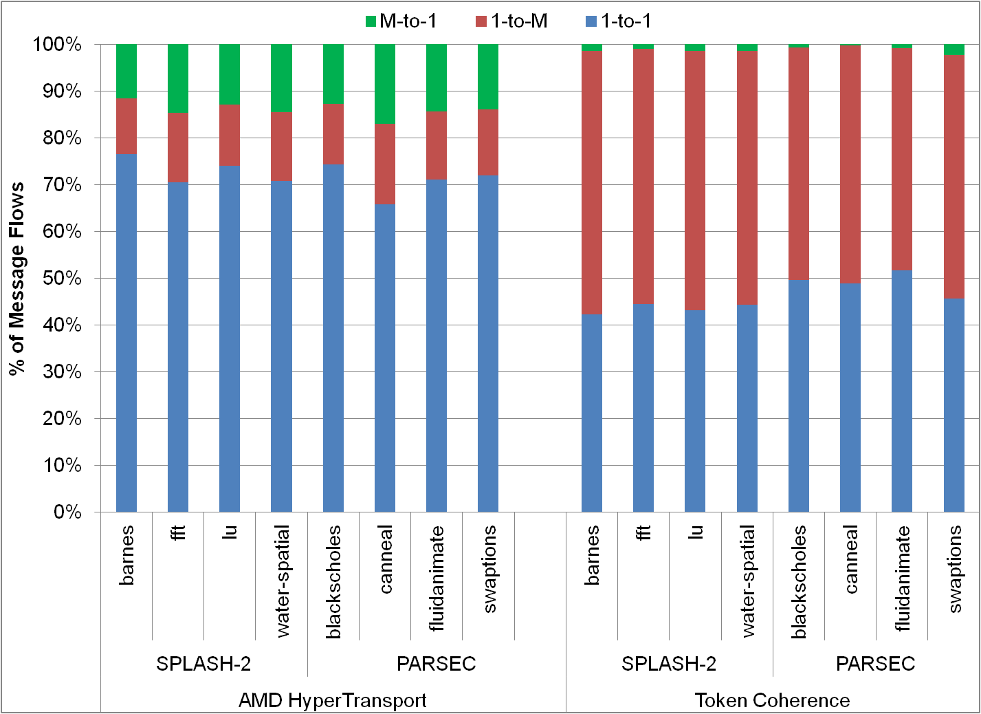
Cache Coherence Characterization
14 %
2%
51 %
14 %
71 %
47 %
AMD HyperTransport
Token Coherence
64-core full-system simulations
Courtesy of Krishna et al., MICRO 2011

Slide 108
One-to-Many Routing
Broadcasts
  Very expensive
  Experience high latency, require lots of bandwidth
Several recent solutions
  Common design goal
    Fork/replicate packets within a router for multiple destinations
    Tree-based routing
  Different routing algorithms, different implementations
    RPM
    Whirl
    BAM, VCTM, MRR, bLBDR (see references)

Slide 109
Problem: How to route broadcasts?
Sparse Multicast Tree
Broadcast/Dense Multicast Tree
Contention!
Idle links!
Tree constructed dynamically based on destination set
Same destination set (all nodes)
=> same tree structure
Courtesy of Krishna et al., MICRO 2011
Notes:
here

Slide 110
Recursive Partitioning Multicast (RPM)
DOR leads to unbalanced link utilization
  Route based on partitions that destinations fall into
1
0
Source node
2
N
3
7
W
E
4
8
5
Eight Parts
Three Parts (5, 6, 7)
S
Three Parts (0, 1, 7)
Three Parts (3, 4, 5)
Three Parts (1, 2, 3)
Courtesy of Wang et al., NOCS 2009

Slide 111
Basic Routing Rules
North: top right corner.
West: top left corner.
South: bottom left corner.
East: bottom right corner.
N
W
E
S
N
N
Source
E
E
W
S
W
S
Destination
Courtesy of Wang et al., NOCS 2009

Slide 112
Optimized Routing Rules
Source
Destination
Deadlock!!!
Courtesy of Wang et al., NOCS 2009

Slide 113
Whirl Multicast Routing
RPM limited to 1 tree for a given destination set
  Unbalanced link utilization
Whirl
  Randomly select between several trees to balance load

Slide 114
Whirl: load-balanced routing
2-bit encoding per direction
[LTB RTB]
(LeftTurnBit, RightTurnBit)
Chosen randomly by source
16 possible Whirl trees
Courtesy of Krishna et al., MICRO 2011

Slide 115
Whirl: load-balanced routing
2-bit encoding per direction
[LTB RTB]
(LeftTurnBit, RightTurnBit)
Chosen randomly by source
Much less contention!
X
16 possible Whirl trees
Courtesy of Krishna et al., MICRO 2011

Slide 116
Many-to-One Routing
Used in routing
  Acknowledgements
  Token collection
  Barrier synchronization
Multiple messages with same destination
  Carrying identical/similar information
    E.g. ACK count for a given memory address
  Create transient hot spots
Implementations
  Paired multicast-reduction routing
  FANIN (rWhirl)
  Dedicated control/barrier networks (see references)
    TLSync, Gather Control Network

Slide 117
Paired Multicast-Reduction Routing
9
Multicast routing forms a logical tree
Unicast response (ACK) generated
  Option 1: routing oblivious to logical tree
    Creates hotspots
Option 2: Many-to-One messages follow same logical tree as multicast
  Reduces load
  Adaptively route between fork routers
5
15
0
7
9
0
7
15
9
5
15
0
7

Slide 118
Reduction Implementation
Dedicated storage at each fork router to aggregate ACKs
  Entry allocated by multicast
  Total number of expected ACKs at each fork supplied by multicast message
Message Combination Table
  ACK updates table entry
  If current ACKs != total ACKs
    Drop message
Reduces network load
  Improves saturation throughput and reduces network latency

Slide 119
Route: reverse Whirl
1-to-M Whirl
M-to-1 rWhirl
Follow reverse route of 1-to-M flow
  Route computed from [LTB RTB]s of 1-to-M Whirl
Courtesy of Krishna et al., MICRO 2011

Slide 120
Aggregation mechanism: master ACKs
Pay
load
count
Header
master ACK: First ACK for a flow to reach an intermediate router
1
1
master ACK polls incoming ports
Courtesy of Krishna et al., MICRO 2011

Slide 121
Aggregation mechanism: master ACKs
Pay
load
count
Header
2
master ACK: First ACK for a flow to reach an intermediate router
3
1
6
X
1
master ACK polls incoming ports
Increment ACK count
Drop incoming ACK
6
3
X
Courtesy of Krishna et al., MICRO 2011

Slide 122
Routing Summary
Latency paramount concern
  Minimal routing most common for NoC
  Non-minimal can avoid congestion and deliver low latency
To date: NoC research favors DOR for simplicity and deadlock freedom
  On-chip networks often lightly loaded
Need to focus on more than just unicast
  Improve efficiency/scalability of cache coherence protocols
  Recent work shows significant improvements from multicast and reduction routing

Slide 123
Outline
Interconnection network introduction
Network-on-chip overview
  New challenges and opportunities
  Recent products/prototypes
Network-on-chip subtopics + Recent research trends
  System-level Overview
  Topology
  Routing Algorithms
  Flow Control
  Router Microarchitecture
  System-level Design
  Emerging Technology
Discussion of recent trends and conclusions

Slide 124
Switching/Flow Control Overview
Topology: determines connectivity of network
Routing: determines paths through network
Flow Control: determine allocation of resources to messages as they traverse network
  Buffers and links
  Significant impact on throughput and latency of network

Slide 125
Flow Control
Control State
Channel Bandwidth
Buffer capacity
Control state records
  allocation of channels and buffers to packets
  current state of packet traversing node
Channel bandwidth advances flits from this node to next
Buffers hold flits waiting for channel bandwidth

Slide 126
Packets
Messages: composed of one or more packets
  If message size is ≤ maximum packet size only one packet created
Packets: composed of one or more flits
Flit: flow control digit
Phit: physical digit
  Subdivides flit into chunks = to link width

Slide 127
Packets (2)
Off-chip: channel width limited by pins
  Requires phits
On-chip: abundant wiring means phit size == flit size
  Single-flit packets
Message
Header
Payload
Packet
Route
Seq#
Head Flit
Body Flit
Tail Flit
Flit
Type
VCID
Head, Body, Tail, Head & Tail
Phit

Slide 128
Packets(3)
Cache line
RC
Type
VCID
Addr
Bytes 0-15
Bytes 16-31
Bytes 32-47
Bytes 48-63
Head Flit
Body Flits
Tail Flit
Coherence Command
RC
Type
VCID
Addr
Cmd
Head & Tail Flit
Packet contains destination/route information
  Flits may not → all flits of a packet must take same route

Slide 129
Switching
Different flow control techniques based on granularity
  Message-based: allocation made at message granularity (circuit-switching)
    Skip
  Packet-based: allocation made to whole packets
  Flit-based: allocation made on a flit-by-flit basis

Slide 130
Packet-based Flow Control
Break messages into packets
Interleave packets on links
Requires per-node buffering to store in-flight packets
Two types of packet-based techniques
  Store and Forward
    Links and buffers are allocated to entire packet
    Head flit waits at router until entire packet is received before being forwarded to the next hop
      High latency (pays serialization latency at each hop)
  Virtual Cut Through (VCT)
Notes:
Better utilization
Not suitable for on-chip
Requires buffering at each router to hold entire packet

Slide 131
Packet-based: Virtual Cut Through
Links and Buffers allocated to entire packets
Flits can proceed to next hop before tail flit has been received by current router
  But only if next router has enough buffer space for entire packet
Reduces the latency significantly compared to SAF
But still requires large buffers
  Unsuitable for on-chip

Slide 132
Virtual Cut Through Example
Allocate 4 flit-sized buffers before head proceeds
0
Allocate 4 flit-sized buffers before head proceeds
5
Total delay = 1 cycle per hop x 3 hops + serialization = 6 cycles
Lower per-hop latency
Large buffering required

Slide 133
Virtual Cut Through
Cannot proceed because only 2 flit buffers available
Throughput suffers from inefficient buffer allocation

Slide 134
Flit-Level Flow Control
Help routers meet tight area/power constraints
Flit can proceed to next router when there is buffer space available for that flit
  Improves over SAF and VCT by allocating buffers on a flit-by-flit basis

Slide 135
Wormhole Flow Control
Pros
  More efficient buffer utilization (good for on-chip)
  Low latency
Cons
  Poor link utilization: if head flit becomes blocked, all links spanning length of packet are idle
    Cannot be re-allocated to different packet
    Suffers from head of line (HOL) blocking

Slide 136
Wormhole Example
Red holds this channel: channel remains idle until blue proceeds
Channel idle but red packet blocked behind blue
Buffer full: blue cannot proceed
Blocked by other packets
6 flit buffers/input port

Slide 137
Virtual Channels
First proposed for deadlock avoidance
  We’ll come back to this
Can be applied to any flow control
  First proposed with wormhole

Slide 138
Virtual Channel Flow Control
Virtual channels used to combat HOL blocking in wormhole
Virtual channels: multiple flit queues per input port
  Share same physical link (channel)
Link utilization improved
  Flits on different VC can pass blocked packet
VCs allocated to packets
  Compete for switch, link, buffers on flit-by-flit basis

Slide 139
Virtual Channel Example
Buffer full: blue cannot proceed
Blocked by other packets
6 flit buffers/input port
3 flit buffers/VC

Slide 140
Summary of techniques
 | Links | Buffers | Comments
Circuit-Switching | Messages | N/A (buffer-less) | Setup & Ack
Store and Forward | Packet | Packet | Head flit waits for tail
Virtual Cut Through | Packet | Packet | Head can proceed
Wormhole | Packet | Flit | HOL
Virtual Channel | Flit | Flit | Interleave flits of different packets

Slide 141
Deadlock
Using flow control to guarantee deadlock freedom give more flexible routing
  Recall: routing restrictions needed for deadlock freedom
If routing algorithm is not deadlock free
  VCs can break resource cycle
Each VC is time-multiplexed onto physical link
  Holding VC implies holding associated buffer queue
  Not tying up physical link resource
Enforce order on VCs

Slide 142
Deadlock: Enforce Order
A0
C
A1
Dateline
A
B
B1
B0
D
D0
B
D1
D
C
C1
C0
A
All message sent through VC 0 until cross dateline
After dateline, assigned to VC 1
  Cannot be allocated to VC 0 again

Slide 143
Deadlock: Escape VCs
Enforcing order lowers VC utilization
  Previous example: VC 1 underutilized
Escape Virtual Channels
  Have 1 VC that is deadlock free
  Example: VC 0 uses DOR, other VCs use arbitrary routing function
  Access to VCs arbitrated fairly: packet always has chance of landing on escape VC
    Impacts VC reallocation
Assign different message classes to different VCs to prevent protocol level deadlock
  Prevent req-ack message cycles

Slide 144
Virtual Channel Reallocation
When can a VC be reallocated to a new packet?
Two options: conservative and aggressive
  Conservative: only reallocate empty VC
  Aggressive: reallocate once tail flit has been received
Implications for deadlock
Notes:
here

Slide 145
VC Reallocation: Adaptive Routing
Adaptive routing
  Cyclic channel dependence
With aggressive reallocation
  Packet spans 2 VCs and head flit not at head of one VC
    Cannot reach escape VC
  Leads to deadlock
Requires conservative reallocation
  Can only reallocate an empty VC
  Low VC utilization

Slide 146
VC Reallocation: Aggressive
Turn-model and deterministic routing
  No cyclic channel dependence
  Can use aggressive reallocation
High VC utilization but low adaptivity
P1 can be forwarded immediately

Slide 147
Observation: Many single-flit packets
Abundant wiring ➔ wide channels
Exploit for new flow control
  Whole Packet Forwarding (WPF)

Slide 148
Whole Packet Forwarding
If a downstream VC has enough space to hold the whole packet
  Reallocate

Slide 149
WPF vs. Existing Flow Control Techniques
Packet-based flow control
  SAF and VCT
    Requires enough buffer space to whole entire packet
    VC must be as deep as maximum packet length

Slide 150
WPF Summary
Flow control has a significant performance impact
  Consider many short packets present in cache coherence protocols
Improve VC utilization and maintain high routing adaptivity
Can achieve the same (or better) performance as existing techniques with half the resources
  Buffers or VCs

Slide 151
Buffer Backpressure
Need mechanism to prevent buffer overflow
  Avoid dropping packets
  Upstream nodes need to know buffer availability at downstream routers
Significant impact on throughput achieved by flow control
Two common mechanisms
  Credits
  On-off

Slide 152
Flow Control Summary
NoCs require techniques with low buffering requirements
  Wormhole or Virtual Channel flow control
Avoid dropping packets in on-chip environment
  Requires buffer backpressure mechanism
Complexity of flow control impacts router microarchitecture (next)

Slide 153
Outline
Interconnection network introduction
Network-on-chip overview
  New challenges and opportunities
  Recent products/prototypes
Network-on-chip subtopics + Recent research trends
  System-level Overview
  Topology
  Routing Algorithms
  Flow Control
  Router Microarchitecture
  System-level Design
  Emerging Technology
Discussion of recent trends and conclusions

Slide 154
Router Microarchitecture Overview
Focus on microarchitecture of Virtual Channel router
  Router complexity increases with bandwidth demands
  Simple routers built when high throughput is not needed
    Wormhole flow control, unpipelined, limited buffer
  Virtual channels often used to avoid protocol-level deadlock

Slide 155
Virtual Channel Router
Credits Out
VC Allocator
Credits In
Route Computation
Switch Allocator
Input buffers
VC 1
Input 1
VC 2
Output 1
VC 3
VC 4
Input buffers
VC 1
VC 2
Input 5
VC 3
Output 5
VC 4
Crossbar switch

Slide 156
Router Components
Input buffers, route computation logic, virtual channel allocator, switch allocator, crossbar switch
Most NoC routers are input buffered
  Use single-ported memories
Buffer stores flits for duration in router
  Contrast with processor pipeline that latches between stages
Notes:
Add stuff to talk about output buffered routers?

Slide 157
Baseline Router Pipeline
Logical stages
  Fit into physical stages depending on frequency
Canonical 5-stage pipeline
  BW: Buffer Write
  RC: Routing computation
  VA: Virtual Channel Allocation
  SA: Switch Allocation
  ST: Switch Traversal
  LT: Link Traversal
BW
RC
VA
SA
ST
LT

Slide 158
Baseline Router Pipeline (2)
1
2
3
4
5
6
7
8
9
BW
RC
VA
SA
ST
LT
Head
BW
SA
ST
LT
Body 1
BW
SA
ST
LT
Body 2
BW
SA
ST
LT
Tail
Routing computation performed once per packet
Virtual channel allocated once per packet
Body and tail flits inherit this info from head flit

Slide 159
Router Pipeline Performance
Baseline (no load) delay
Ideally, only pay link delay
Techniques to reduce pipeline stages

Slide 160
Pipeline Optimizations: Lookahead Routing
At current router perform routing computation for next router
  Overlap with BW
  Precomputing route allows flits to compete for VCs immediately after BW
  RC decodes route header
  Routing computation needed at next hop
    Can be computed in parallel with VA
BW
RC
VA
SA
ST
LT

Slide 161
Atomic Modules and Dependencies in Router
Decode + Routing
Switch Arbitration
Crossbar Traversal
Wormhole Router
Decode + Routing
VC Allocation
Switch Arbitration
Crossbar Traversal
Virtual Channel Router
VC Allocation
Decode + Routing
Crossbar Traversal
Speculative Switch Arbitration
Speculative Virtual Channel Router
Dependence between output of one module and input of another
  Determine critical path through router
  Cannot bid for switch port until routing performed

Slide 162
Pipeline Optimizations: Speculation
Assume that Virtual Channel Allocation stage will be successful
  Valid under low to moderate loads
Entire VA and SA in parallel
If VA unsuccessful (no virtual channel returned)
  Must repeat VA/SA in next cycle
Prioritize non-speculative requests
BW
RC
VA
SA
ST
LT

Slide 163
Pipeline Optimizations: Bypassing
When no flits in input buffer
  Speculatively enter ST
  On port conflict, speculation aborted
  In the first stage, a free VC is allocated, next routing is performed and the crossbar is setup
VA
RC
Setup
ST
LT

Slide 164
Arbiters and Allocators
Allocator matches N requests to M resources
Arbiter matches N requests to 1 resource
Resources are VCs (for virtual channel routers) and crossbar switch ports.

Slide 165
Arbiters and Allocators (2)
Virtual-channel allocator (VA)
  Resolves contention for output virtual channels
  Grants them to input virtual channels
Switch allocator (SA) that grants crossbar switch ports to input virtual channels
Allocator/arbiter that delivers high matching probability translates to higher network throughput.
  Must also be fast and/or able to be pipelined
VC allocation typically determines cycle time

Slide 166
Separable Allocator
Need for pipelineable allocators
Allocator composed of arbiters
  Arbiter chooses one out of N requests to a single resource
Separable switch allocator
  First stage: select single request at each input port
  Second stage: selects single request for each output port

Slide 167
Separable Allocator
Requestor 1 requesting resource A
3:1 arbiter
Resource A granted to Requestor 1
Requestor 1 requesting resource C
4:1 arbiter
Resource A granted to Requestor 2
Resource A granted to Requestor 3
Resource A granted to Requestor 4
3:1 arbiter
4:1 arbiter
3:1 arbiter
Resource C granted to Requestor 1
4:1 arbiter
Resource C granted to Requestor 2
Requestor 4 requesting resource A
Resource C granted to Requestor 3
3:1 arbiter
Resource C granted to Requestor 4
A 3:4 allocator
First stage: 3:1 – ensures only one grant for each input
Second stage: 4:1 – only one grant asserted for each output

Slide 168
Separable Allocator Example
Requestor 1 wins A
A
3:1 arbiter
B
4:1 arbiter
C
A
3:1 arbiter
B
4:1 arbiter
A
3:1 arbiter
4:1 arbiter
Requestor 4 wins C
A
3:1 arbiter
C
Input-first allocator
4 requestors, 3 resources
Arbitrate locally among requests
  Local winners passed to second stage
Notes:
need to animate

Slide 169
Conventional separable allocation
Inputs
Outputs
Step 1:
Requests propagate to output arbiters
1,1
1
1
1,2
2
2,1
2
3
3,2
3
Example: output-first separable allocator
Courtesy of Michelogiannakis et al., MICRO 2011
Notes:
separate animation into multiple slides… ?

Slide 170
Conventional separable allocation
Inputs
Outputs
Step 1:
Requests propagate to output arbiters
1,1
1
2,1
1
Step 2:
Both output arbiters pick the same input (1)
2
1,2
2
3,2
3
3
Example: output-first separable allocator
Courtesy of Michelogiannakis et al., MICRO 2011
Notes:
separate animation into multiple slides… ?

Slide 171
Conventional separable allocation
Inputs
Outputs
Step 1:
Requests propagate to output arbiters
1,1
1
1
Step 2:
Both output arbiters pick the same input (1)
2
1,2
2
3
Step 3:
Input 1 can only pick one output
3
Example: output-first separable allocator
Arbitrating independently at each port degrades matching efficiency
  If output 2 was aware of output 1’s decision, it would have picked input 3
Courtesy of Michelogiannakis et al., MICRO 2011
Notes:
separate animation into multiple slides… ?

Slide 172
Ways to improve allocation
Increasing the number of iterations
Incremental allocation
  Ineffective for single-flit packets
  Single-flit packets common in NoCs
More complex allocators
  Wavefront:
    3x power and 20% more delay compared to a separable allocator
  Augmenting paths:
    Infeasible in a single cycle (approximately 10ns delay)

Slide 173
Packet chaining operation
Inputs
Outputs
Starting from previous
Example:
Input 1 granted output 1.
This forms a connection
1
1,1
1
1,2
2
2
3
3
Example: output-first separable allocator
Courtesy of Michelogiannakis et al., MICRO 2011

Slide 174
Packet chaining operation
Inputs
Outputs
Starting from previous
Example:
Input 1 granted output 1.
This forms a connection
1
1
2
2
Next clock cycle:
Input 1 sends another packet to output 1.
Output 2 grants input 3
3
3
Example: output-first separable allocator
Key: packet chaining enables connection reuse between different packets destined to the same output as departing packets
  The packets do not have to be in the same input
Courtesy of Michelogiannakis et al., MICRO 2011

Slide 175
Packet chaining pipeline
Chaining is performed in the PC stage, before SA
  Newly-arrived flits skip PC if SA does not have another flit. Thus, zero-load latency does not increase
  Connections released if they cannot be used productively
PC: packet chaining
SA: switch allocation
ST: switch traversal
Cycle
PC
SA
ST
1
Packet 1 Tail
Packet 1 Body
Packet 1 Head
Cycle 2:
When the tail flit enters the SA stage, the chaining logic considers eligible chaining requests
2
Packet 2 Head
Packet 1 Tail
Packet 1 Body
Cycle 2: At the end of cycle 2, the chaining logic selects packet 2.
Packet 2 will reuse packet 1’s connection
Courtesy of Michelogiannakis et al., MICRO 2011

Slide 176
Packet chaining pipeline
Chaining is performed in the PC stage, before SA
  Newly-arrived flits skip PC if SA does not have another flit. Thus, zero-load latency does not increase
  Connections released if they cannot be used productively
PC: packet chaining
SA: switch allocation
ST: switch traversal
Cycle
PC
SA
ST
1
Packet 1 Tail
Packet 1 Body
Packet 1 Head
Cycle 2:
When the tail flit enters the SA stage, the chaining logic considers eligible chaining requests
2
Packet 2 Head
Packet 1 Tail
Packet 1 Body
3
Packet 2 Body
Packet 2 Head
Packet 1 Tail
Cycle 2: At the end of cycle 2, the chaining logic selects packet 2.
Packet 2 will reuse packet 1’s connection
Cycle 3: Packet 2 does not participate in SA. Its inputs
and outputs remain connected, blocking other requests
Courtesy of Michelogiannakis et al., MICRO 2011

Slide 177
Packet Chaining Summary
Packet chaining outperforms other allocators – even ones that are slower or infeasible in one clock cycle
  True for packets of any length
  Throughput gains increase with single-flit packets
Optimization result of
  Aggressive clock frequency + need for single cycle allocation
  Presence of large fraction of single-flit packet in NoCs

Slide 178
Router Microarchitecture Summary
Optimizations
  Reduce number of pipeline stages
    Improve zero-load latency
  Increase efficiency of hardware structures
    Improved allocation
Focused on virtual channel routers
  Virtual channels useful in separately classes of cache coherence traffic
    Prevent protocol-level deadlock
Next…
  Consider system-level issues/design considerations

Slide 179
Multiplane Networks
Multiple parallel networks
  Provide isolation of traffic
  Differentiated service
  Make use of abundant wiring without large routers
  May offer simplified router microarchitecture
  Heterogeneous networks
Physical channels versus virtual channels
Several example designs
  CCNoC
    Tilera
Notes:
Should this go here or later? often done to simplify flow control… so maybe as a system level technique?

Slide 180
Protocol Level Deadlock (revisited)
Virtual channels
  Used to improve throughput
  Reduce/eliminate head-of-line (HOL) blocking
  Used to avoid protocol-level deadlock
    Break end-to-end cyclic dependences between requests and responses
    Different types of coherence messages assigned to different virtual channels (virtual networks)
  But virtual channels increase the area/complexity/power of the router microarchitecture
But wires are abundant on chip!
  Separate coherence traffic on multiple physical networks?

Slide 181
Virtual Channels vs. Multiple Physical Networks
Virtual Channels
  Offer higher throughput
  Better efficiency for larger buffer sizes
  “Swiss army knife” of interconnection networks
Multiple Physical Networks
  Wormhole routers can be clocked faster
    25-35% faster than a 4 VC router*
  Require less area/power
    With shallow buffer depths, VC incur substantial overhead
* See Yoon et al., “Virtual Channels vs. Multiple Physical Networks: a Comparative Study” DAC 2010

Slide 182
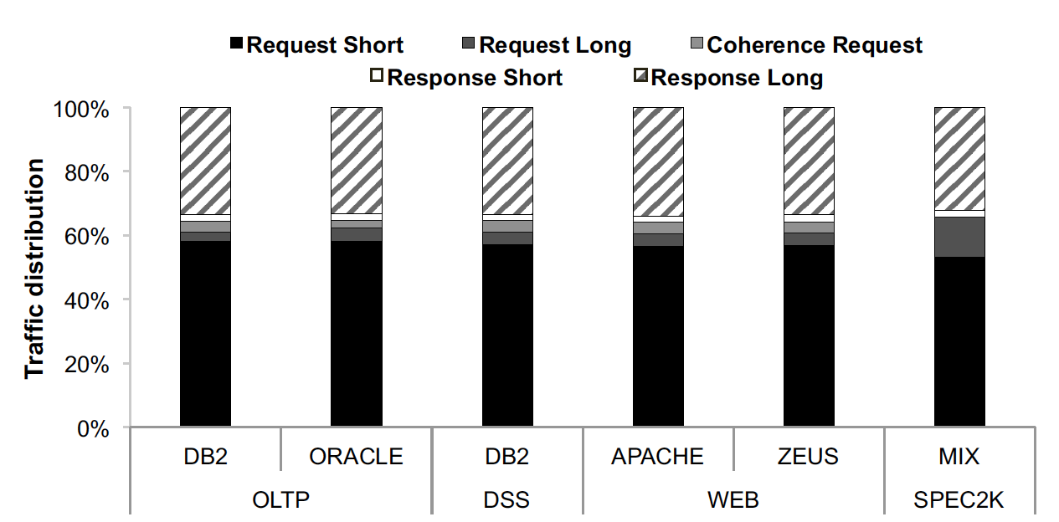
CCNoC: Cache-Coherence Network-on-Chip
Multiple networks
  Practical way to improve performance, power and area
Traffic highly skewed among short and long messages
Advocate heterogeneous dual-network architecture
  Asymmetric in datapath width and router architecture
Requests: 94% short
Responses: 95% long
Courtesy of Volos et al., NOCS 2012

Slide 183
CCNoC
Request network
  Optimized for short messages
  Multiple virtual channels
    Segregate message classes for deadlock avoidance
Response network
  No virtual channels
  Wide datapath
  Low-complexity wormhole routers
Same performance, more energy-efficient compared to a single mesh network with same bisection bandwidth
  Offers improvements over homogeneous dual-network design

Slide 184
Outline
Interconnection network introduction
Network-on-chip overview
  New challenges and opportunities
  Recent products/prototypes
Network-on-chip subtopics + Recent research trends
  System-level Overview
  Topology
  Routing Algorithms
  Flow Control
  Router Microarchitecture
  System-level Design
  Emerging Technology
Discussion of recent trends and conclusions

Slide 185
Emerging Technology and NoCs
Challenges facing electrical interconnects as technology scales
  Limited bandwidth and latency (due to RC delay)
  High power dissipation (scales with frequency)
    Heat dissipation exacerbated by increased chip power
  Crosstalk and EMI
Demand for
  Higher frequency
  Higher bandwidth
  Lower latency
  Can electrical interconnects satisfy these demands within package power budget?

Slide 186
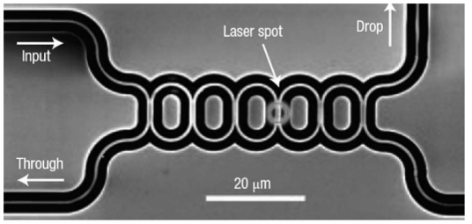
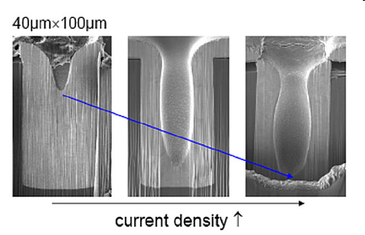
Novel Interconnect Paradigms for Many-core
Optical Interconnects
Three Dimensional
Integration
Wireless/RF
Interconnects
High Bandwidth and
Low Energy Dissipation
Slide courtesy of Ganguly, NOCS 2011

Slide 187
State-of-the-art in emerging NoCs
 |  | 3D NoC | Photonic NoC | NoC with RF-I/Wireless
Design Requirements |  | Multiple layers with active devices | Silicon photonic components | On-chip waveguide/Antennas
Performance Gains | Bandwidth | Higher connectivity & less hop count | High speed optical devices and links | High bandwidth waveguide/links
 | Lower Power | Shorter average path length | Negligible power dissipation in optical data transport | Low power dissipation in RF-I/wireless links
Reliability |  | Vertical Via Failure | Crosstalk in photonic waveguides | Signal interference in the wireless medium
Challenges |  | Heat dissipation due to higher power density | Integration of on-chip photonic components/Area overheads | Precision Transceivers and/or Antennas
Slide courtesy of Ganguly, NOCS 2011

Slide 188


Why Photonics for Many-Core NoCs?
Optics
  Modulate/receive ultra-high bandwidth data stream once per communication event
  Low power switch fabric, scalable
  Off-chip and on-chip can essentially use the same technology
Electronics
  Buffer, receive and retransmit at every switch
  Off-chip is pin-limited and power hungry

Slide 189
Photonics: Advantages and Disadvantages
Advantages
  Low power:
    Bit rate transparency: transmission/switching power independent of bandwidth
    Low propagation loss: power independent of distance (at chip-scale)
  High bandwidth
    Wavelength division multiplexing (WDM)
      Huge transmission bandwidth
  Immune to EMI, low crosstalk
  Compatible to CMOS
Drawbacks
  No buffers
  No in-flight processing
  Implementation cost

Slide 190
Photonic NoC
Challenges
  3D integration of photonic elements with standard CMOS processors
    Modulators, receivers, waveguides, switches
  Getting light onto the silicon chip
  Simplifying fabrication to lower cost
Immense bandwidth + no buffering = new architectures
  Topology, Routing and Flow Control

Slide 191
Silicon Photonic Devices
Passive elements
  Flow of light predetermined by structure design and cannot be modified once fabricated
  Dense waveguides
  Detectors
Active elements
  Change in refractive index induces change in transmission properties of device
  Switches
  Modulators
    Encode a high-speed electronic signal on constant-wave laser light
      Converting it to a stream of light pulses
  Light sources

Slide 192
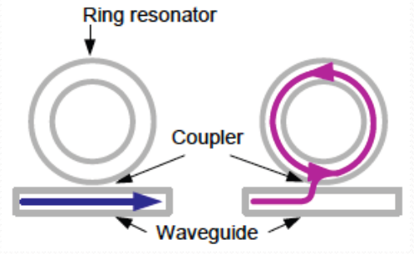
Building Blocks: Modulators
Off-resonance modulator
  Ring resonator is coupled to a waveguide through evanescent coupling
  Off-resonance wavelengths are transmitted through
On-resonance modulator
  Resonant wavelength is coupled in the ring and eventually gets attenuated by losses
  Negligible amount of light is transmitted through
By switching between on- and off-resonance state
  Achieve modulation of a continuous-wave laser

Slide 193
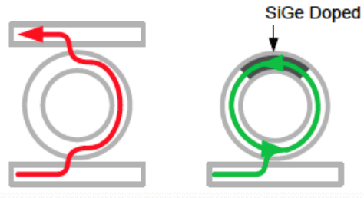
Building Blocks (cont)
Injector
  Resonant wavelength in the input waveguide coupled into right and out through output waveguide
Detector
  Resonant wavelength is coupled in ring and absorbed by SiGe detector

Slide 194
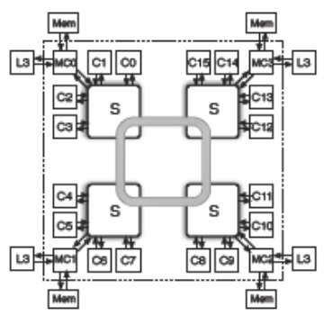
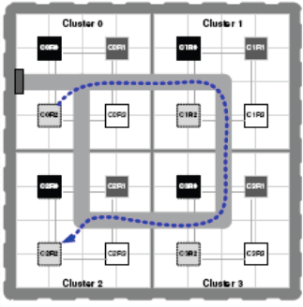
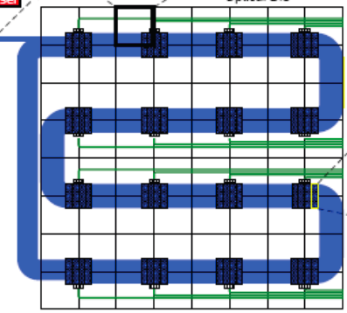
Topologies and Optics
Many examples of bus-based optical architectures
  Cornell’s hybrid electrical/optical interconnect
  Firefly: hybrid electrical/optical network
    Reservation-assisted single-writer, multiple-reader buses
  Corona
    Crossbar architecture
    Multiple-writer, single-reader buses
    Requires token-based arbitration scheme

Slide 195
Optical NoCs based on Traditional Topologies
Torus-based optical data network
  Electronic packet-switched control network
    High path-setup latency
Phastlane
  Under contention-less conditions
    Low latency optical crossbar
  In event of contention
    Electrical buffers

Slide 196
New Opportunity?
Customize topology for optical interconnects?
  Most recent optical architectures are built upon topologies originally introduced for electrical networks
Electrically-assisted optical NoCs
  High latency and power overheads for optical resource reservation
All-optical, scalable architectures

Slide 197
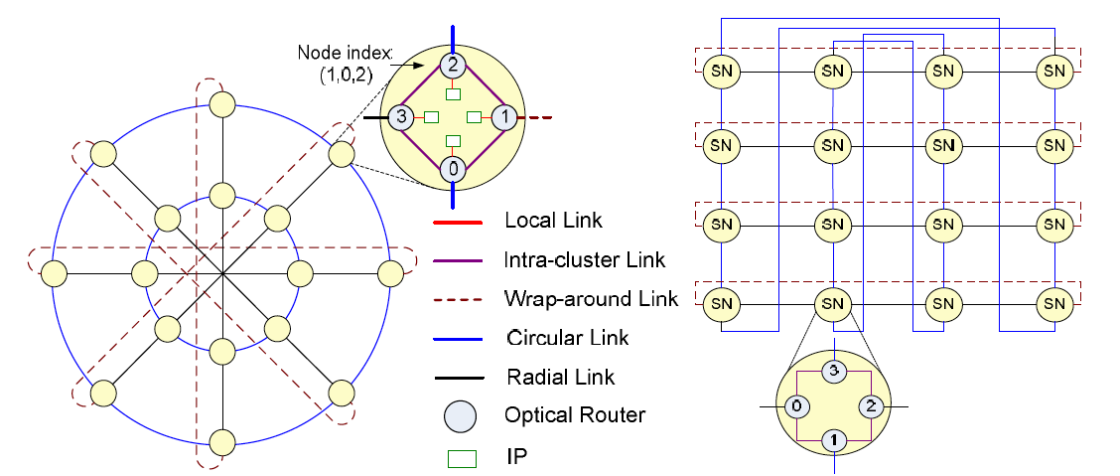
Novel Optical Network Example: 2D HERT
Small node degree
  Facilitates simpler router design and fabrication
  Maintains small diameter
Courtsey of Koohi et al., NOCS 2011

Slide 198
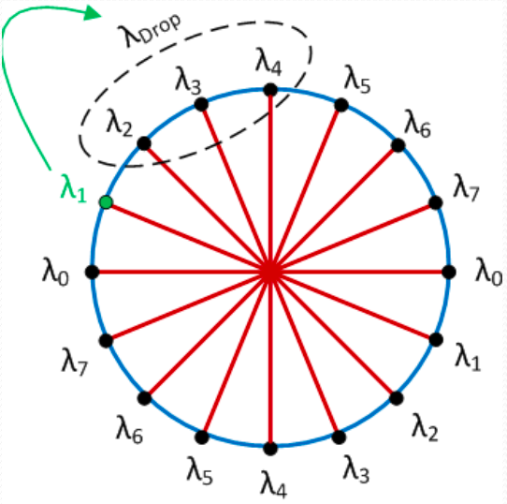
All Optical Routing
Wavelength routing
  Pre-receiver wavelengths in data network
  Per-sender wavelengths in control network
Passive optical switches
No need for electrical reservation
  Power, latency and area savings
Courtsey of Koohi et al., NOCS 2011

Slide 199
Photonic Network Summary
Leveraging photonics for novel coherence protocol implementation
  Reduce complexity of protocol without performance loss
  Enable further optimizations
Novel network designs based on photonics
  NoCs and chip-scale networks
    Reconsider design
    Opportunities beyond just converting electrical network into optical one
  High bandwidth, low power
  Buffering is challenging
  Reliability and manufacturing challenges

Slide 200
New opportunities in Networks-on-Chip
Abundant wiring
  Change in relative cost of wires and buffers
  Many short flits
Tightly integrated into system
  Not commodity – fully customized design
  Allows for optimization with uncore
    Cache coherence
Emerging technology
  Optics
  3D
Physical vs. Virtual Channels
Whole Packet Forwarding
Packet Chaining
Multicast/Reduction Routing
CCNoC
Atomic Coherence
2D Hert Optical NoC
Novel 3D topologies
Notes:
Tight area and power budgets
Ultra-low on-chip latencies
Abundant on-chip wires

Slide 201
Conclusions
Overview of each aspect of network design
  Topology, Routing, Flow Control, Microarchitecture
  Design choices are tightly coupled
Highlighted recent trends
  Focus on specific optimizations that exploit on-chip opportunities
Vibrant community
  Lots of exciting research going on
Interconnection networks
  First-class citizen of many-core era
  Even if you do not conduct research on NoCs
    Likely to touch your research in some way

Slide 202
Questions?
Submit to NOCS 2013
  Tempe, Arizona (USA), April 2013
  Abstract deadline: Nov 19, 2012
  Full paper deadline: Nov 26, 2012
  PC Chairs: Natalie Enright Jerger and John Bainbridge (Sonics)
Email:
  enright@eecg.toronto.edu

Slide 203
Additional Material
To be presented if time permits

Slide 204
Additional Multi-plane Network Example

Slide 205
Multiplane Example: Tilera iMesh
2D Mesh
  2D torus increases wire length and wiring congestion by ~2x
Bandwidth
  2Tbps bisection bandwidth
  32 Tbps interconnect bandwidth
6 separate networks
Each network
  Links consist of 2 32-bit wide unidirectional links
Each packet
  Contains a header word denoting destination location, packet length
  Up to 128 words per packet
SWITCH
MDN
TDN
UDN
IDN
STN

Slide 206
iMesh On Chip Network Architecture
Dynamic networks (5)
  Dimension order routing
  1 cycle delay for straight packets
  2 cycle delay for turning packets (route calculation)
  Message ordering preserved between 2 nodes
  Guarantee reliable delivery
Wormhole routed
  No virtual channels
  Minimal in-network buffering
  3-entry FIFO buffers (per port)
    Cover link-level flow control cost

Slide 207
Flow Control
Credit-based flow-control
  Link-level
  3 entries: minimum buffering needed to maintain full-bandwidth communication
Higher-level/end-to-end flow control
  Prevent deadlock
  Equitably share network resources
  Different for each dynamic network

Slide 208
iMesh: Network Uses
UDN: Primarily serves userland processes
  Communicate between threads without going through shared memory or OS
IDN: Used for OS and hypervisor communications, I/O
  Protect this traffic from userland code
MDN: Used to communicate with off-chip DRAM (4 controllers)
  Used for both requests and replies
TDN: tile-to-tile cache transfers
  Responses use MDN
  TDN necessary to prevent deadlock
VDN: used for cache coherence
  Invalidation messages
Static Network
  Static configuration of routing decisions at each switch
    Circuit-switched communication
  Auxiliary processor for reconfiguring routes
    Programmable
Notes:
Every tile can communicate with every DRAM controller

Slide 209
Optics and Cache Coherence

Slide 210
Optics and Cache Coherence: Atomic Coherence
Cache coherence protocols
  Represented as state machines
  Atomic transitions between stable states (e.g. M, S, I)
Early bus-based machines
  Blocking shared buses
  Once bus allocated, held until transition complete
    Bus serialized all racing requests
    Easy to accomplish atomic state transitions
  Poor performance
Higher performance interconnects
  Separate request from associated response
  Transitions between stable states no longer occur atomically

Slide 211
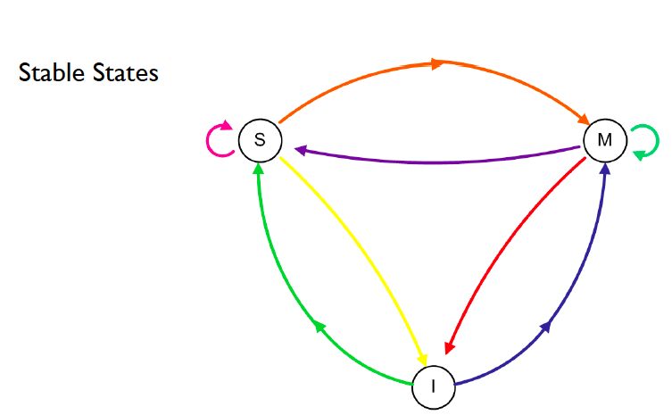
Coherence Example: MSI
Slide courtesy of Vantrease, HPCA 2011

Slide 212
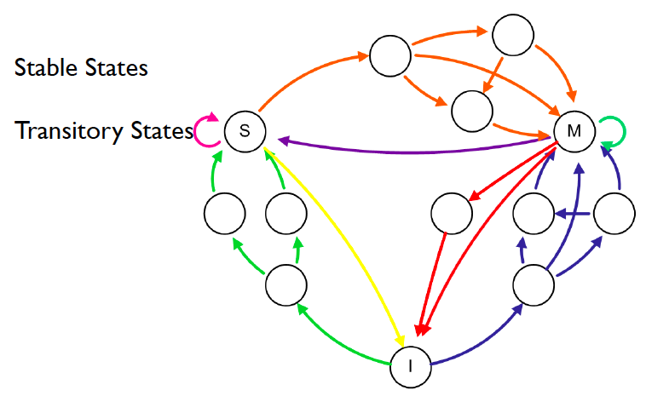
Coherence Example: MSI
Slide courtesy of Vantrease, HPCA 2011

Slide 213
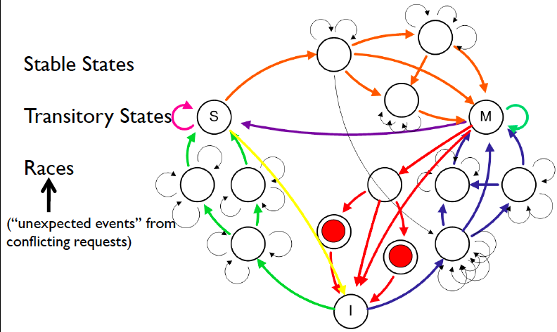
Coherence Example: MSI
Slide courtesy of Vantrease, HPCA 2011

Slide 214
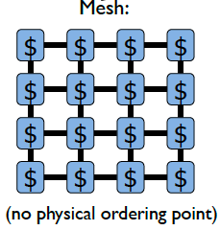
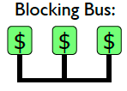
Coherence Protocol Design
Significant design complexity
  Races represent unexpected interruption
Verification challenges
  Race-induced bugs may be masked during most executions
  Formal verification: state space explosion consume large amounts of resources and time
Races were easier to detect/
resolve with simpler interconnects
vs.

Slide 215
Atomic Coherence
Argues for a return to atomic transitions
How?
  One coherence request per address active at a time
  Mutex system
Separate atomic and coherence substrates
  Decoupled, Simpler
  Longer miss path, additional resources

Slide 216
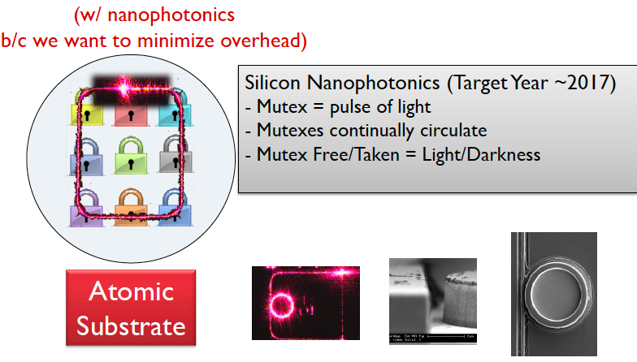
Atomic Substrate Implementation: Aggressive
Slide courtesy of Vantrease, HPCA 2011

Slide 217
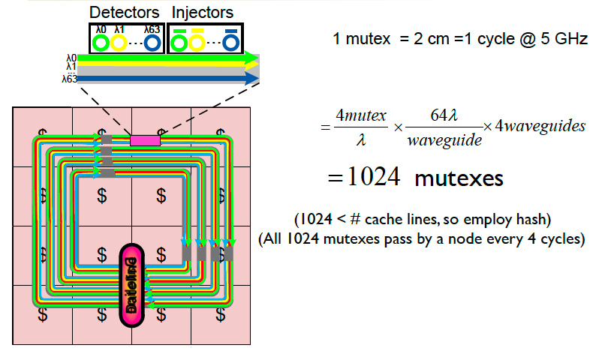
Aggressive Atomic Substrate
Slide courtesy of Vantrease, HPCA 2011

Slide 218
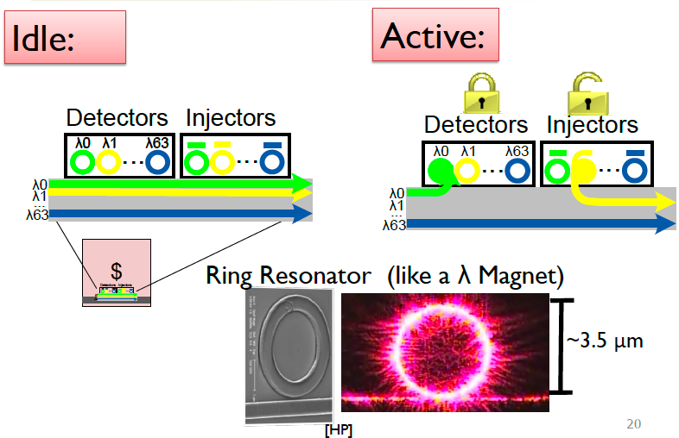
Photonic Implementation
Slide courtesy of Vantrease, HPCA 2011

Slide 219
References

Slide 220
References (* indicates reference used in presentation)
Not in anyway exhaustive
  A sample of historical and recent papers along the themes presented during the course
General
  Enright Jerger, N and Peh, L-S. On-Chip Networks. Morgan Claypool Publishers, 2009
    http://www.morganclaypool.com/doi/abs/10.2200/S00209ED1V01Y200907CAC008
  Dally, W. and Towles, B. Principles and Practices of Interconnection Networks. Morgan Kaufmann, 2004.
  Duato, J., Yalamanchili, S. and Ni, L.M. Interconnection Networks: An Engineering Approach. IEEE Computer Society, 1997.
  Pinkston, T. and Duato, J. Appendix F: Interconnection Networks in Computer Architecture: A Quantitative Approach (5th Edition). Morgan Kaufmann, 2012.
  Abts, D. and Kim, J. High Performance Datacenter Networks: Architecture, Algorithms, and Opportunities Morgan Claypool Publishers, 2011.
Topology
  Balfour, J. and Dally, W. Design Tradeoffs for Tiled CMP On-Chip Networks. In Proceedings of the International Conference on Supercomputing, 2006.
  Dally, W. Performance Analysis of k-ary n-cubes. IEEE Transactions on Computers, 1990.
  Kim, J., Balfour, J. and Dally, W. Flattened Butterfly Topology for On-Chip Networks. In Proceedings of the International Symposium on Microarchitecture, 2007.
  Li, F., et al. Design and Management of 3D Chip Multiprocessors Using Network-in-Memory. In Proceedings of the International Symposium on Computer Architecture 2006.
  Madan, N., Zhao, L., Muralimanohar, N., Udipi, A., Balasubramonian, R. Iyer, R., Makineni, S. and Newell, D. Optimizing Capacity and Communication in a 3D Stacked Reconfigurable Hierarchy. In Proceedings of the International Symposium on High Performance Computer Architecture, 2009.
*
*
Notes:
But in bold papers that I actually discuss

Slide 221
References (2)
Topology (cont).
  Park, D., et al. MIRA: A Multi-Layered On-Chip Interconnect Router Architecture. In Proceedings of the International Symposium on Computer Architecture, 2008.
  Udipi, A, Muralimanohar, N., and Balasubramoniam, R. Towards Scalable, Energy-Efficient, Bus-Based On-Chip Networks. In Proceedings of the International Symposium on High Performance Computer Architecture, 2010.
  Das, R, Eachempati, S., Mishra, A., Vijaykrishnan, N. and Das, C. Design and Evaluation of Hierarchical On-Chip Network Topologies for Next Generation CMPs. In Proceedings of the International Symposium on High Performance Computer Architecture, 2009.
Routing
  Glass, C.J. and Ni, L.M. The turn model for adaptive routing. Journal of the ACM, 1994.
  Dally, W. and Seitz, C. Deadlock-Free Message Routing in Multiprocessor Interconnection Networks. IEEE Transactions on Computers, 1987.
  Valiant, L. G. and Brebner, G.J. Universal schemes for parallel communication. In Proceedings of the ACM Symposium on the Theory of Computing, 1981.
  Enright Jerger, N., Peh, L-S., and Lipasti, M. Virtual Circuit Tree Multicasting: A Case for On-Chip Hardware Multicast Support. In Proceedings of the International Symposium on Computer Architecture, 2008.
  Krishna, T., Peh, L-S., Beckmann, B. and Reinhardt, S. Towards the Ideal On-chip Fabric for 1-to-Many and Many-to-1 Communication. In Proceedings of the International Symposium on Microarchitecture, 2011.
  Wang, L., Jin, Y., Kim, H. and Kim, E. J. Recursive Partitioning Multicast: A Bandwidth-Efficient Routing for Networks-on-Chip. In Proceedings of the International Network on Chip Symposium, 2009.
  Ma, S., Enright Jerger, N. and Wang, Z. Supporting Efficient Collective Communication in NoCs. In Proceedings of the International Symposium on High Performance Computer Architecture
  Oh, J., Prvulovic, M. and Zajic A. TLSynC: Support for Multiple Fast Barriers Using On-Chip Transmission Lines. In Proceedings of the International Symposium on Computer Architecture, 2011.
*
*
*

Slide 222
References (3)
Routing (Cont).
  Lodde, M., Flich, J. and Acacio, M. Heterogeneous NoC Design for Efficient Broadcast-based Coherence Protocol Support. In Proceedings of the International Network on Chip Symposium, 2012.
  Abad, P., Puente, V. and Gregoria, J. A. MRR: Enabling fully adaptive multicast routing for CMP interconnection networks, In Proceedings of the International Symposium on High Performance Computer Architecture, 2009.
  Rodrigo, S., Flich, J., Duato, J. and Hummel, M. Efficient unicast and multicast support for CMPs. In Proceedings of the International Symposium on Microarchitecture, 2008.
Flow Control
  Dally, W. and Seitz, C. The torus routing chip. Journal of Parallel and Distributed Computing. 1986.
  Kermani, P. and Kleinrock, L. Virtual-cut through: a new computer communications switching technique. Computer Networks, 1979.
  Dally, W. Virtual Channel Flow Control. IEEE Transactions on Parallel and Distributed Systems, 1992.
  Ma, S., Enright Jerger, N., Wang, Z. Whole Packet Forwarding: Efficient Design of Fully Adaptive Routing Algorithms for Networks-on-Chip. In Proceedings of the International Symposium on High Performance Computer Architecture, 2012.
Router Microarchitecture
  Peh, L-S. and Dally, W. A delay model and speculative architecture for pipelined routers. In Proceedings of the International Symposium on High-Performance Computer Architecture, 2001.
  Mullins, R., West, A. and Moore, S. Low-Latency Virtual-Channel Routers for On-Chip Networks. In Proceedings of the International Symposium on Computer Architecture, 2004.
  Michelogiannakis, G., Jiang, N., Becker, D. and Dally, W. Packet Chaining: Efficient Single-Cycle Allocation for On-Chip Networks. In the International Symposium on Microarchitecture, 2011.
  Yoon, Y.J., Concer, N., Petracca, M. and Carloni, L.. Virtual Channels vs. Multiple Physical Networks: a Comparative Study. In Proceedings of the Design Automation Conference, 2010.
  Hayenga, M. and Lipasti, M. The NoX Router. In Proceedings of the International Symposium on Microarchitecture, 2011.
*
*
*

Slide 223
References (4)
Systems and System-level Issues
  Wentzlaff, D., Griffin, P., Hoffmann, H., Bao, L., Edwards, B., Ramey, C., Mattina, M., Miao, C-C., Brown, J. and Agarwal, A. On-Chip Interconnection Architecture of the Tile Processor. IEEE Micro, 2007.
  Volos, S., Seiculescu, C., Grot, B., Pour, N. K., Falsafi, B. and De Micheli, G. CCNoC: Specializing On-Chip Interconnects for Energy Efficiency in Cache-Coherent Servers. In Proceedings of the International Symposium on Network-on-Chip, 2012.
  Howard, J., et al. A 48-Core IA-32 Processor in 45nm CMOS Using On-Die Message Passing and DVFS for Performance and Power Scaling. IEEE Journal of Solid-State Circuits, 2011.
  Hoskote, Y., et al. A 5-GHz Mesh Interconnect for a Teraflops Processor. IEEE Micro, 2007.
  Abts, D, et al. Achieving Predictable Performance Through Better Memory Controller Placement in Many-Core CMPs. In Proceedings of the International Symposium on Computer Architecture, 2009.
Optics
  Kirman, N., et al. Leveraging Optical Technology in Future Bus-Based Chip Multiprocessors. In Proceedings of the International Symposium on Microarchitecture, 2006.
  Pan, Y., et al. Firefly: Illuminating future network-on-chip with nanophotonics. In Proceedings of the International Symposium on Computer Architecture, 2009.
  Vantrease D., et al. Corona: System Implications of Emerging Nanophotonic Technology, In Proceedings of the International Symposium on Computer Architecture, 2008
  Shacham, A., Bergman, K., and Carloni, L. On the Design of a Photonic Network-on-Chip. In Proceedings of the International Symposium on Networks-on-Chip, 2007.
  Cianchetti, M., Kerekes, J. and Albonesi, D. Phastlane: A Rapid Transit Optical Routing Network. In Proceedings of the International Symposium on Computer Architecture, 2009.
  Koohi, S., Abdollahi, M., and Hessabi, S. All-Optical Wavelength-Routed NoC based on a Novel Hierarchical Topology. In Proceedings of the International Symposium on Networks-on-Chip, 2011.
  Vantrease, D., Lipasti, M. and Binkert, N. Atomic Coherence: Leveraging nanophotonics to build race-free cache coherence protocols. In Proceedings of the International Symposium on High Performance Computer Architecture, 2011
*
*
*

Slide 224
Related topics
Cache coherence
  Sorin, D., Hill, M. and Wood, D. A Primer on Memory Consistency and Cache Coherence. Morgan Claypool Publishers, 2011.
  Agarwal, N., Peh, L-S. and Jha, N. In-Network Snoop Ordering (INSO): Snoopy Coherence on Unordered Interconnects. In Proceedings of the International Conference on High Performance Computer Architecture, 2009.
  Agarwal, N., Peh, L-S. and Jha, N. In-Network Coherence Filtering: Snoopy Coherence Without Broadcasts. In Proceedings of the International Symposium on Microarchitecture, 2009.
  Eisley, N., Peh L-S. and Shang, Li. In-Network Cache Coherence. In Proceedings of the International Symposium on Microarchitecture, 2006.
  Bolotin, E., Guz, Z., Cidon, I., Ginosar, R. and Kolodny, A. The Power of Priority: NoC Based Distributed Cache Coherence. In Proceedings of the International Symposium on Networks-on-Chip, 2007.
Cache design
  Balasubramonian, R., Jouppi, N. and Muralimanohar, N. Multi-Core Cache Hierarchies. Morgan Claypool Publishers, 2011.
  Cho, S. and Jin L. Managing Distributed, Shared L2 Caches through OS-Level Page Allocation. In Proceedings of the International Symposium on Microarchitecture, 2006.
  Hardavellas, N., Ferdman, M., Falsafi, B. and Ailamaki, A. Reactive NUCA: Near-Optimal Block Placement and Replication in Distributed Caches. In Proceedings of the International Symposium on Computer Architecture, 2009.

