Slide 1
AirTrack: Locating Non-WiFi Interferers using Commodity WiFi Hardware
Ashish Patro, Shravan Rayanchu, Suman Banerjee
University of Wisconsin-Madison

Slide 2
Talk Outline
How non-WiFi devices affect WiFi traffic?
How to detect non-WiFi transmissions using “commodity” WiFi cards?
How to physically locate these non-WiFi devices?
Evaluation
Notes:
I’ll start off by presenting an overview of the various non-WiFi devices that co-exist with WiFi deployments and why are they an issue to the wireless deployments?

Slide 3
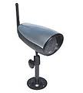
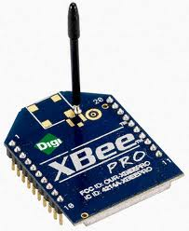
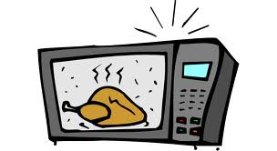
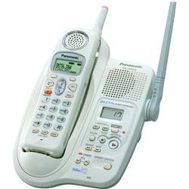
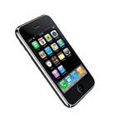
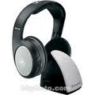
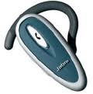
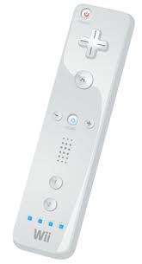
Some Non-WiFi devices
Analog Cordless Phone
Video Camera
ZigBee
Microwave Oven
Narrowband/High-duty devices
Broadband devices
FHSS Cordless Phone
Bluetooth
SCO/ACL
Game Controllers
Audio
Transmitter
Frequency-hopping devices

Slide 4
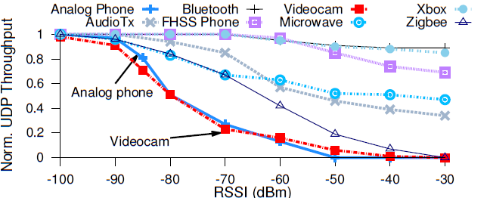
Problem
Non-WiFi devices exist in 2.4GHz/5.8GHz spectrum and impact WiFi performance

Slide 5
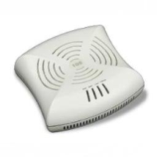
Scenario
Access Point
GOALS
How do we detect and locate these non-WiFi devices?
How to do this in real time using commodity WiFi cards?
Notes:
If we just create a software based solution, it can be easily deployed in enterprise WLANs.

Slide 6
Why use commodity WiFi cards?
Software-only solution that works on top of the cards
Can easily deploy this software solution in current WLANs
No additional expensive hardware needed
e.g. spectrum analyzers

Slide 7
What do commodity WiFi cards provide?
WiFi Packets
Packet Capture
Wireless Card
Non-WiFi devices
Sub-carrier energy samples
FFT Samples
-73, -65, -72, …

Slide 8
Challenges?
Less resolution of FFT samples compared to specialized hardware
4 us for Bandspeed AirMaestro vs 116us for Atheros
Missing FFT Samples in presence of WiFi transmissions
We can miss some non-WiFi device transmissions
Narrowband mode of operation
Atheros card scans only 20Mhz band at a time
Notes:
Not guaranteed to capture all WiFi samples. Thus, we can occasionally miss non-WiFi device transmissions.

Slide 9
Talk Outline
How non-WiFi devices affect WiFi traffic?
How to detect non-WiFi transmissions using “commodity” WiFi cards?
How to physically locate these non-WiFi devices?
Evaluation
Notes:
I’ll start off by presenting an overview of the various non-WiFi devices that co-exist with WiFi deployments and why are they an issue to the wireless deployments?

Slide 10
How to detect non-WiFi devices?
Capture energy samples
Identify ``Pulses”
Extract ``Features’’
“Classify”
Pulses
Sniffer
Duration
Power
Bandwidth
“Tagged Pulses”
e.g., Bluetooth
Frequency
Timing
Properties

Slide 11
Talk Outline
How non-WiFi devices affect WiFi traffic?
How to detect non-WiFi transmissions using “commodity” WiFi cards?
How to physically locate these non-WiFi devices?
Evaluation
Notes:
I’ll start off by presenting an overview of the various non-WiFi devices that co-exist with WiFi deployments and why are they an issue to the wireless deployments?

Slide 12
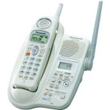
AirTrack Overview
Access Point
(with Sniffer)
Culprit Device Locations:
Analogphone @ Room 104
Analogphone @ Room 110
FHSS Phone @ Room 105
ZigBee @ Room 108

Slide 13
Device Localization
S1
S2
S1: -40db
S2: -70db
S3: -75db
Use RSSI vector to localize each device
S3

Slide 14
How to create RSSI vectors?
Same pulse caught by multiple sniffers
S1: -70db
“Merge”
Synchronize the APs
S1
S2: -60db
S1: -70db
S2: -60db
S3: -45db
FHSS Pulse
S2
Merge pulses using matching start/end times and center frequency + bandwidth
S1: -45db
S3

Slide 15
How to synchronize APs?
Reference AP
Transitive sync
+5 µs
-9 µs
Common Packets
Use Breadth First Search over clock offsets to synchronize APs
Common Packets

Slide 16
A problem…
We can’t decode non-WiFi pulses
FHSS
Device 1
FHSS
Device 2
How many devices?
Which pulse belongs to what device?
Notes:
We can’t decode pulses unlike WiFi pulses, where we can easily figure out the packet source and destination. Pulses are just time-energy blocks of transmissions….
Suppose there is one phone at one end of the room and a another phone at another end of the room… How do the controller segregate these pulses? This is a pre-requisite for localization. We need to know the number of active devices operating simultaneously, so that we can locate each one of them.

Slide 17
Some challenges need to be solved…
Airshark only identifies pulse types
FHSS Phone
Access Point (with Airshark sniffer)
Bluetooth
How can we create the RSSI vector?

Slide 18
How to segregate pulses?
Cluster using
RSSI vector
Timing properties
Algorithms
DBSCAN
EM + k-Means
FHSS Pulse Cluster 1
Clustering process segregates pulses belonging to different device instances
FHSS phone
Merged Pulses
FHSS Pulse Cluster 2
Notes:
- Timing based properties work really well…
- RSSI based properties work well unless the two devices are very to each other…

Slide 19
Each “Pulse Cluster” is a device
S1: -40db
S2: -70db
S3: -75db
FHSS Pulse Cluster 1
FHSS Device 1
Each cluster is represented by an RSSI Vector
S1: -70db
S2: -60db
S3: -45db
FHSS Device 2
FHSS Pulse Cluster 2

Slide 20
Can we perform localization now?
The answer is ‘Yes’. But, few challenges in localizing non-WiFi devices….

Slide 21
Putting it together…
AirTrack
Locate non-WiFi devices using multiple Sniffers
“Tagged
Pulses”
Synchronize access points
Merge + Cluster pulses
Localize each device
(Pulse Cluster)
Access Point (with Sniffer)

Slide 22
Putting it together…
AirTrack
Locate non-WiFi devices using multiple sniffers
“Tagged
Pulses”
Synchronize access points
Merge + Cluster pulses
Localize each device
(Pulse Cluster)
Access Point (with Sniffer)

Slide 23
Localization algorithms
AP locations are known
Tested various algorithms with different requirements
Algorithm | Input Parameters
Fingerprint | Known Fingerprints

Slide 24
Localization algorithms
AP locations are known
Tested various algorithms with different requirements
Algorithm | Input Parameters
Fingerprint | Known Fingerprints
RSS Triangulation | Device Transmit Power + Propagation Model

Slide 25
Localization algorithms
AP locations are known
Tested various algorithms with different requirements
Algorithm | Input Parameters
Fingerprint | Known Fingerprints
RSS Triangulation | Device Transmit Power + Propagation Model
Pairwise AP | Propagation Model

Slide 26
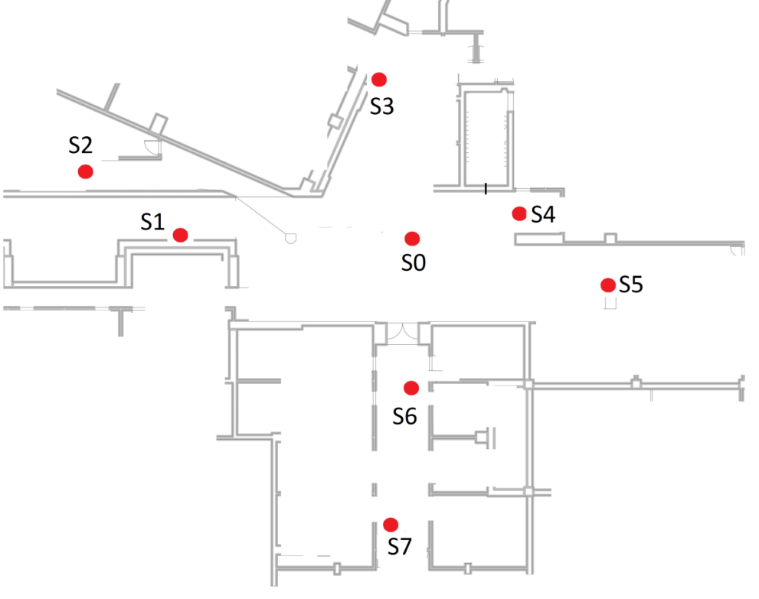
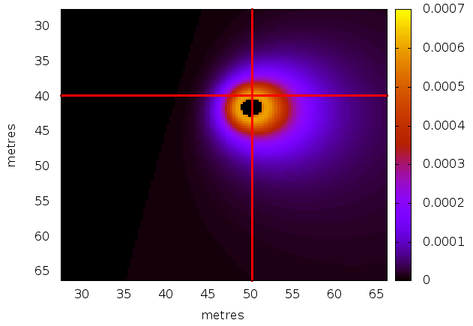
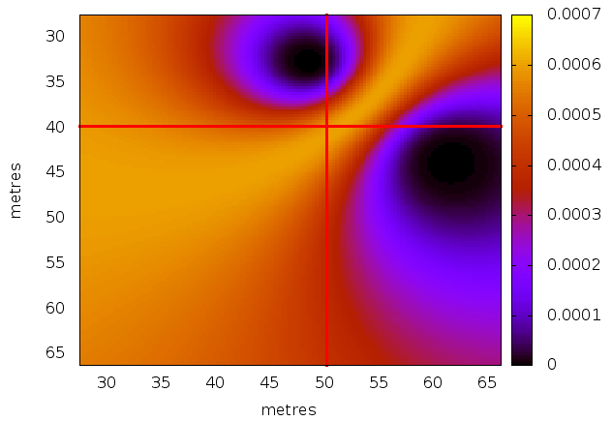
Pairwise AP algorithm
FHSS Cordless Phone
We can localize without knowing device transmit power
Pairwise AP: S0,S2
Pairwise AP: S3,S5

Slide 27
Talk Outline
How non-WiFi devices affect WiFi traffic?
How to detect non-WiFi transmissions using “commodity” WiFi cards?
How to physically locate these non-WiFi devices?
Evaluation
Notes:
I’ll start off by presenting an overview of the various non-WiFi devices that co-exist with WiFi deployments and why are they an issue to the wireless deployments?

Slide 28
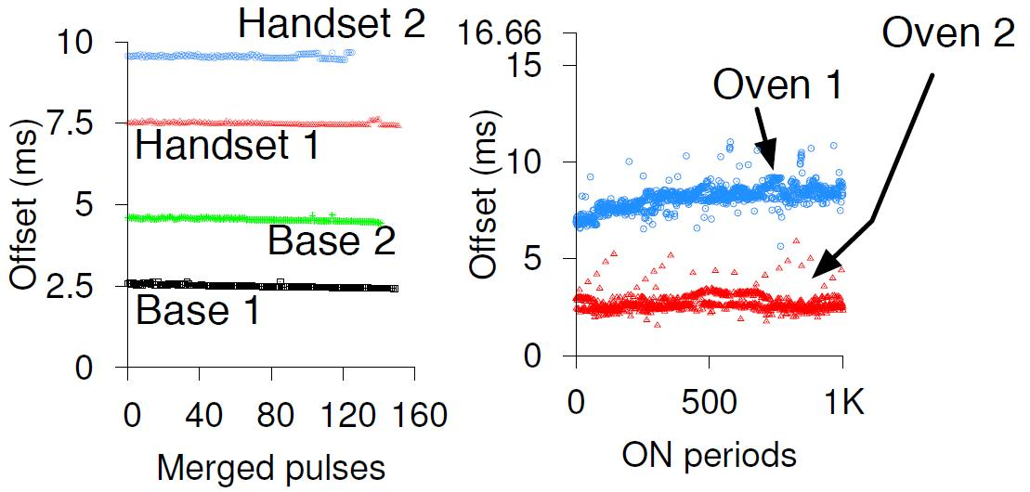
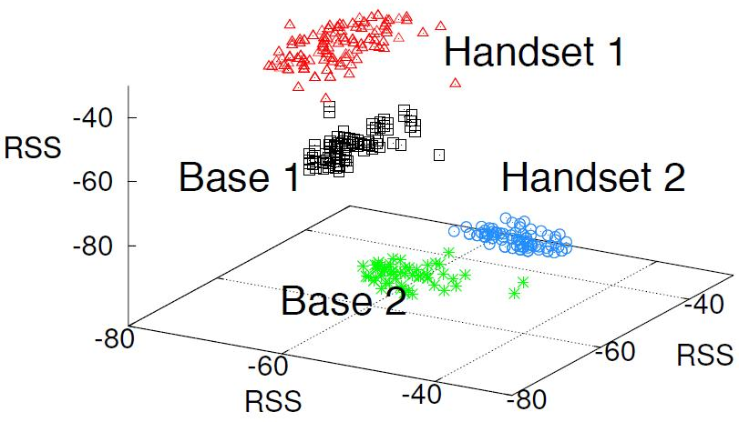
Clustering results
Each cluster is a unique active device
AirTrack can differentiate between multiple devices
FHSS Phones
Microwave Oven
FHSS Phones
Time domain clustering
RSS domain clustering

Slide 29
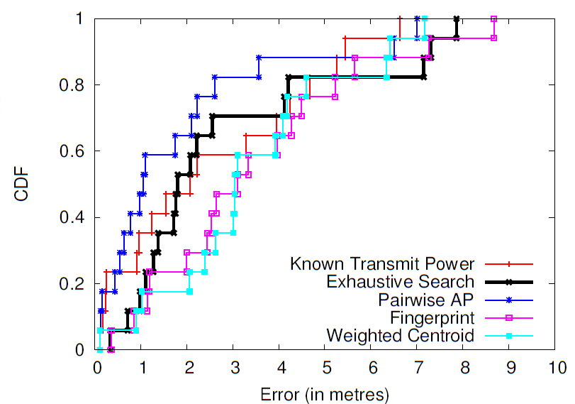
Localization Accuracy
Localization error < 6 metres for 80% of the locations

Slide 30
Summary
Presented a system for real-time localization of non-WiFi devices using commodity WiFi cards.
Localization works in the presence of multiple device instances.
Don’t require to know the device transmit power for localization.

Slide 31
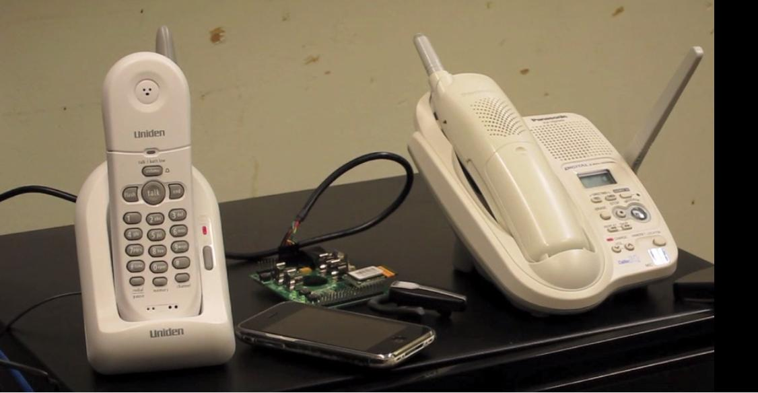
Demo

Slide 32
Thank You!!

