Slide 1
BitWarp
Energy Efficient Analytic Data Processing on Next Generation General Purpose GPUs
Jason Power || Yinan Li || Mark D. Hill || Jignesh M. Patel || David A. Wood
Computer architecture affiliates meeting 10/10/2014
Notes:
Todo:
- Put in overhead data (time per number of columns)
- Might be interesting to show seconds per column entry instead of seconds per scan
- Talk about 1 TPC-H query (Q 12?)

Slide 2
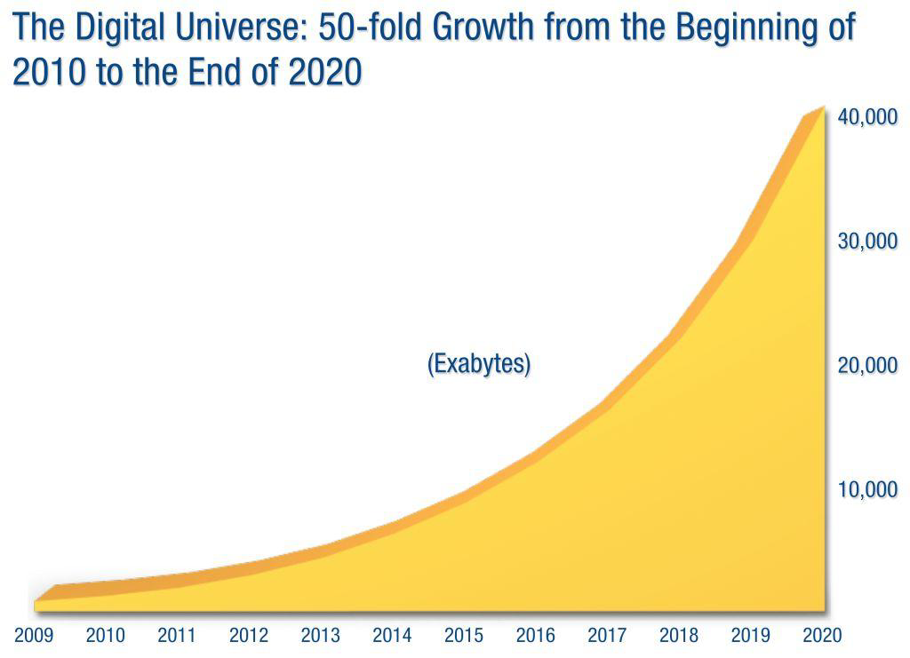
Problem
Data is growing rapidly
Analytic DBs increasingly important
Want: High performance
Need: Low energy
Notes:
High perf in terms of both low-latency (i.e. near real time) and high throughput (e.g. concurrency)
Datacenters use 1-2% of all energy, depending on how you look at it

Slide 3
GPUs to the Rescue
GPUs are becoming more general
Easier to program
Pervasive
GPUs show great promise
Higher performance than CPUs
Better energy efficiency
Analytic DBs look like GPU workloads
Notes:
Percent of all processors shipping with GPUs?

Slide 4
BitWarp
WideTable and BitWeaving [Li and Patel ‘13 & ‘14]
Denormalized and coded column-store
State of the art scan algorithm
Evaluate current and future GPGPUs
Discrete, integrated, HSA, 3D-stacked
Today: 1.4–2.9x energy savings
Future: >50x less energy

Slide 5
Outline
Motivation
GPGPU Analytic DB System
Analytic DBs
BitWeaving & BitWarp
GPGPU generations
Results
Conclusion
Notes:
Why GPGPU generations?

Slide 6
Analytic DBs
In-memory
Column-based layout
WideTable
Denormalize: Pre-join most tables
Convert queries to mostly scans
BitWeaving
Very fast scan
Sub-word parallelism
Similar to industry proposals
Notes:
I’m just going to discuss a couple of these details important to the GPU
Be clear this is on CPU

Slide 7
WideTable—Pre-join
S-ID | Type | Color
0 | Tee | Red
1 | Tee | Blue
2 | Tee | Green
3 | Tee | Yellow
4 | Sweat | Red
5 | Sweat | Green
O-ID | S-ID | Type | Color | Amt
0 | 2 | Tee | Green | 1
0 | 5 | Sweat | Green | 3
0 | 1 | Tee | Blue | 1
1 | 2 | Tee | Green | 5
1 | 3 | Tee | Yellow | 8
2 | 0 | Tee | Red | 2
2 | 3 | Tee | Yellow | 1
2 | 1 | Tee | Blue | 4
3 | 3 | Tee | Yellow | 2
NULL | 4 | Sweat | Red | NULL
⋈
O-ID | S-ID | Amt
0 | 2 | 1
0 | 5 | 3
0 | 1 | 1
1 | 2 | 5
1 | 3 | 8
2 | 0 | 2
2 | 3 | 1
2 | 1 | 4
3 | 3 | 2

Slide 8
Encoding Data
O-ID | S-ID | Type | Color | Amt
0 | 2 | Tee | Green | 1
0 | 5 | Sweat | Green | 3
0 | 1 | Tee | Blue | 1
1 | 2 | Tee | Green | 5
1 | 3 | Tee | Yellow | 8
2 | 0 | Tee | Red | 2
2 | 3 | Tee | Yellow | 1
2 | 1 | Tee | Blue | 4
3 | 3 | Tee | Yellow | 2
NULL | 4 | Sweat | Red | NULL
Type
0
1
0
0
0
0
0
0
0
1
Color
10
10
01
10
11
00
11
01
11
00
Type | Code
Tee | 0
Sweat | 1
Color | Code
Red | 00
Blue | 01
Green | 10
Yellow | 11

Slide 9
BitWeaving—Layout (Horizontal)
word |  | c0 |  | c1
w0 | X | 10 | X | 10
 |  | c2 |  | c3
w1 | X | 01 | X | 10
 |  | c4 |  | c5
w2 | X | 11 | X | 00
 |  | c6 |  | c7
w3 | X | 11 | X | 01
 |  | c8 |  | c9
w4 | X | 11 | X | 00
word |  | c0
w0 | X | 10
word |  | c0 |  | c1
w0 | X | 10 | X | 10
 | Color
c0 | 2 (10)
c1 | 2 (10)
c2 | 1 (01)
c3 | 2 (10)
c4 | 3 (11)
c5 | 0 (00)
c6 | 3 (11)
c7 | 1 (01)
c8 | 3 (11)
c9 | 0 (00)
01001000 00101000 01100000 01100100 01100000

Slide 10
Naïve Scan
Find all green shirt orders amount
Data:
10100110 11001101 1100…
Compare code:
10
10
10
Result bitvector:
1
11
110
Notes:
Find all the green shirts
Or all the time > 5 of some shirt is ordered

Slide 11
BitWeaving—Layout (Vertical)
 | Color
c0 | 10
c1 | 10
c2 | 01
c3 | 10
c4 | 11
c5 | 00
c6 | 11
c7 | 01
c8 | 11
c9 | 00
word | c0 | c1 | c2 | c3 | c4 | c5 | c6 | c7
w0 | 1 | 1 | 0 | 1 | 1 | 0 | 1 | 0
w1 | 0 | 0 | 1 | 0 | 1 | 0 | 1 | 1
 | c8 | c9
w2 | 1 | 0
w3 | 1 | 0
word | c0
w0 | 1
w1 | 0
word | c0 | c1
w0 | 1 | 1
w1 | 0 | 0

Slide 12
BitWeaving
Find all green shirt orders amount
Data:
11011010
00101011
Compare code:
1
0
Result bitvector:
11001000
Notes:
Find all the green shirts
Or all the time > 5 of some shirt is ordered

Slide 13
BitWeaving Algorithm
Compute on codes
No need to decode
Multiple codes per operation
Horizontal
Better for retrieving data
Vertical
More compact
Can use “early pruning”
See Li and Patel SIGMOD ‘13 for details

Slide 14
BitWarp
Scan: data parallel
CPU: 10’s of parallel execution units
GPUs: 1000’s of parallel execution units
Low computational intensity
Bandwidth-bound on CPU at 2+ cores
GPUs high memory bandwidth

Slide 15
BitWarp
Find all green shirt orders amount
Data:
11011010
00101011
11011010
00101011
11011010
00101011
Compare code:
1
0
Result bitvector:
11001000 0000100 11000010 …
Notes:
Find all the green shirts
Or all the time > 5 of some shirt is ordered

Slide 16
GPGPU Generations
Discrete (Gen 1)
Integrated (Gen 2)
Logically integrated (Gen 2.1)
Integrated+3D-stacked (Gen 3)
Notes:
“Now I’m going to discuss some of the characteristics of the 3 GPGPU generations we evaluated BitWarp with.”

Slide 17
Generation 1 & 2 GPGPUs
Heterogeneous
chip
Discrete (Gen 1)
High mem. B/W
Low comm. B/W
Low mem. capacity
Integrated (Gen 2)
Low mem. B/W
High comm. B/W
High mem. capacity
chip
CPU
4 cores
Memory Bus
GPU (Gen 2)
8 CUs
PCI-e
Discrete GPU (Gen 1)
32 CUs
Memory Bus

Slide 18
GPGPU Trends
Tight physical & logical integration
High memory capacity for GPU
Lower GPU overheads
Lower compute capability
Lower memory bandwidth
3D die-stacking (soon)
Increased compute capability (GPU on CPU)
Increased memory bandwidth

Slide 19
Gen 2.1 GPGPUs
HSA: Heterogeneous system architecture
Tightly logically integrated
Shared virtual address space
Cache coherent
“Pointer-is-a-pointer”
Very low communication overhead

Slide 20
Future GPGPUs
Gen 2.2
Gen 3
Increased bandwidth to DRAM
Physical and logical integration
Increased compute capability
High bandwidth to DRAM
Physical and logical integration
DRAM
CPU
DRAM
GPU
GPU
CPU
Board

Slide 21
Future GPGPUs (Gen 3)
Increased bandwidth to DRAM
Physical and logical integration
Increased compute capability
DRAM
GPU
CPU
Board

Slide 22
Outline
Motivation
Background
Results
Scan performance
Scan energy
TPC-H performance
Conclusion

Slide 23
Test System
AMD HD7970 Discrete GPU (Gen 1)
32 CU @ 1125 MHz
3 GB memory, 264 GB/s peak B/W
225 W TDP (including memory)
AMD Kaveri A10-7850K (Gen 2 and Gen 2.1)
4-Core CPU @ 3.7 GHz
8-CU GPU @ 720 MHz
16 GB memory, 21 GB/s peak B/W
95 W TDP
Energy measured with WattsUp meter

Slide 24
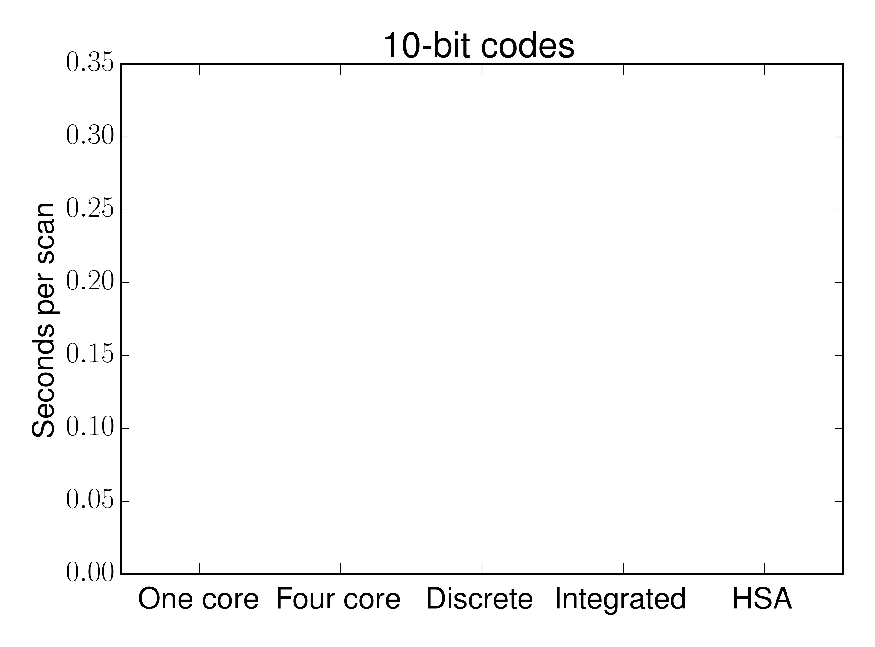
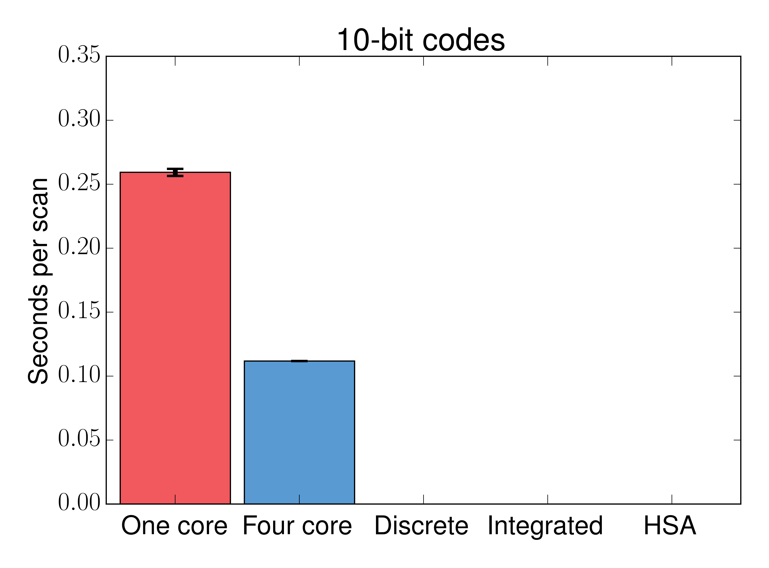
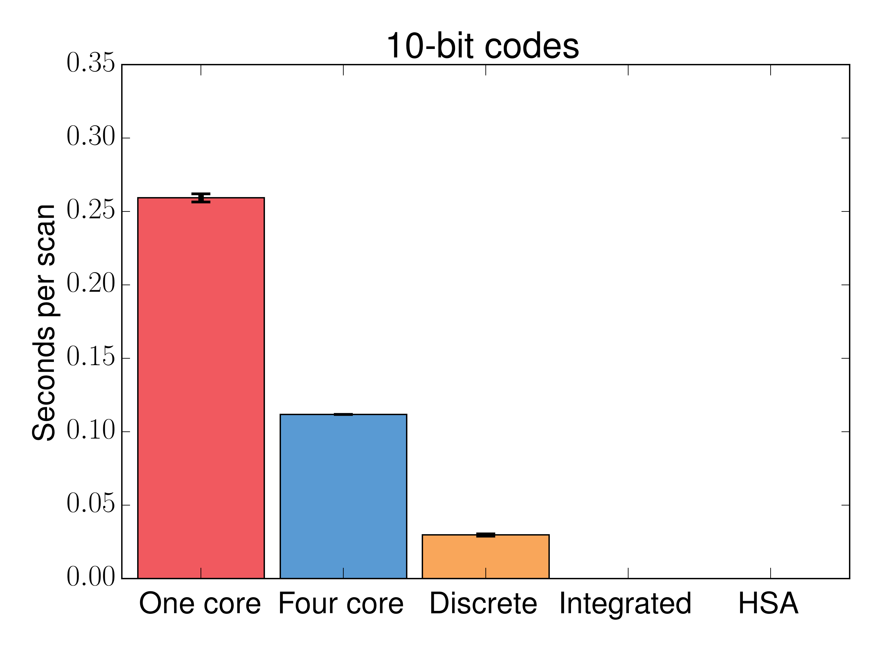
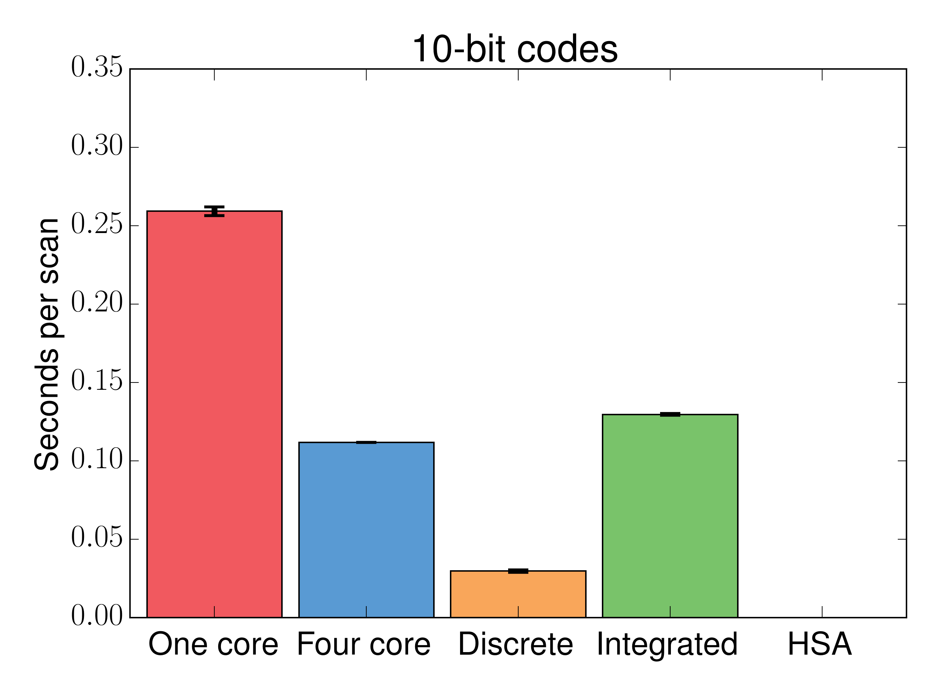
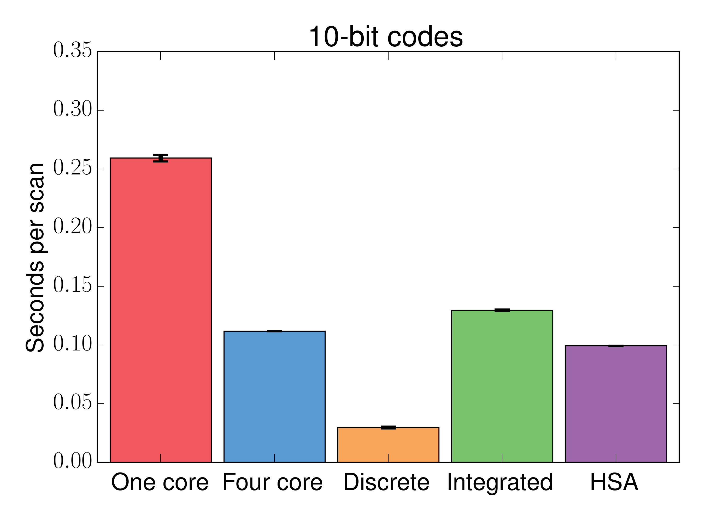
Scan Time
Notes:
1 billion codes (~ 1 GB)
Ignores the cost to migrate data to/from the GPU

Slide 25
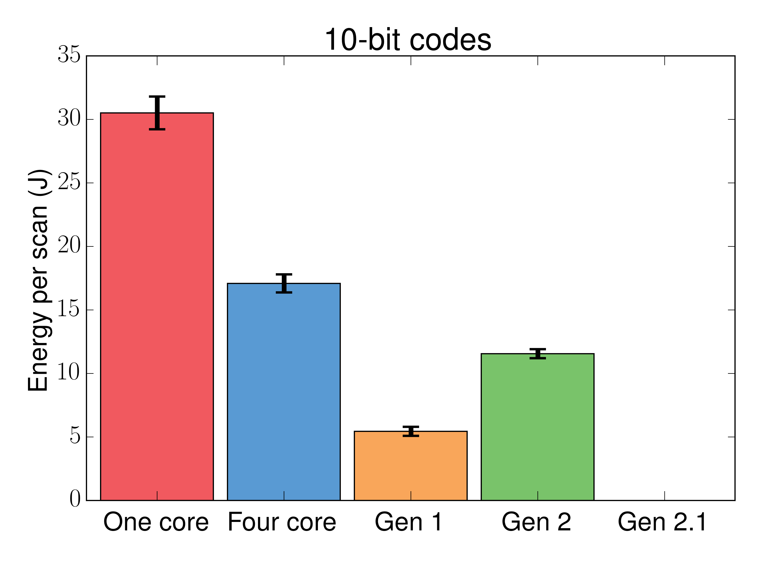
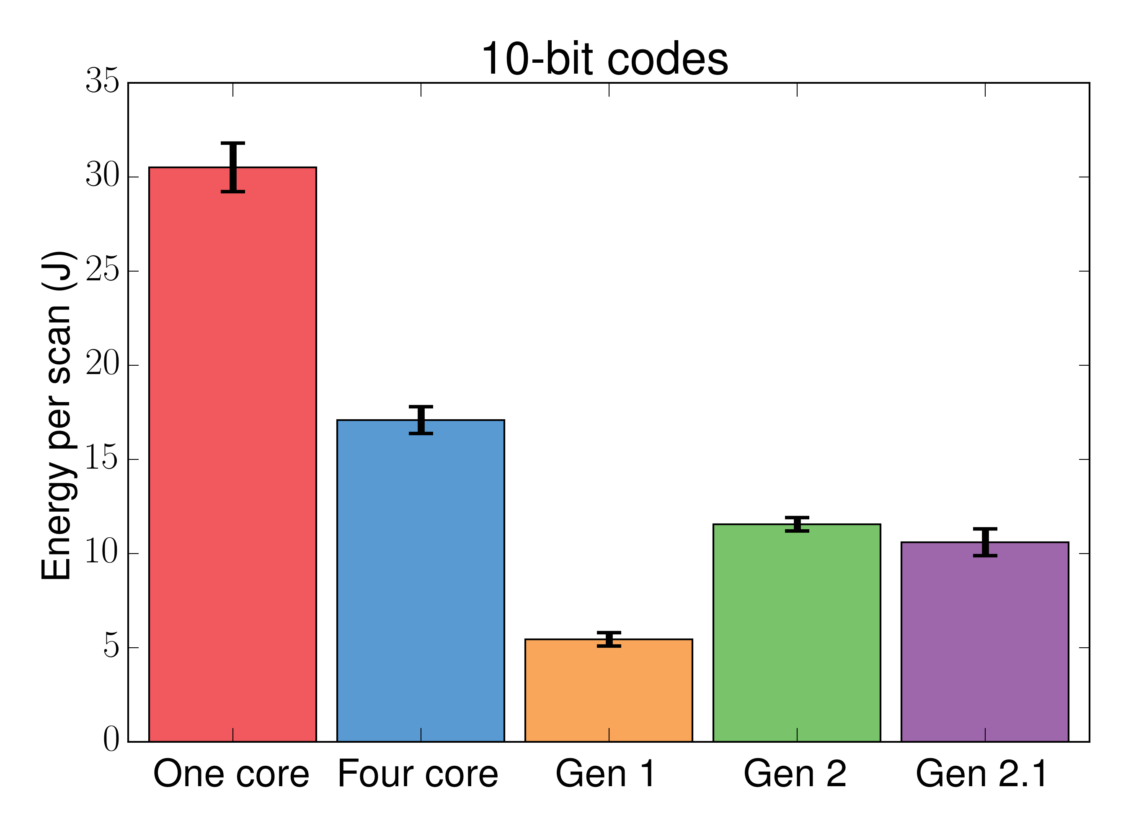
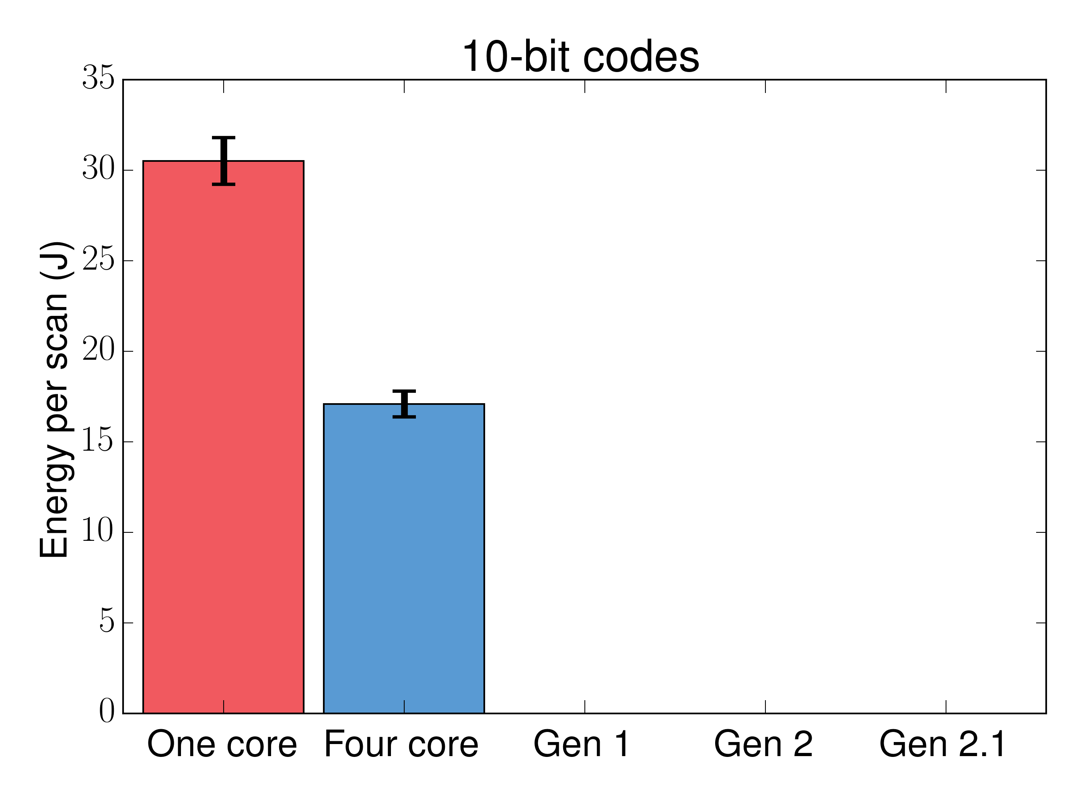
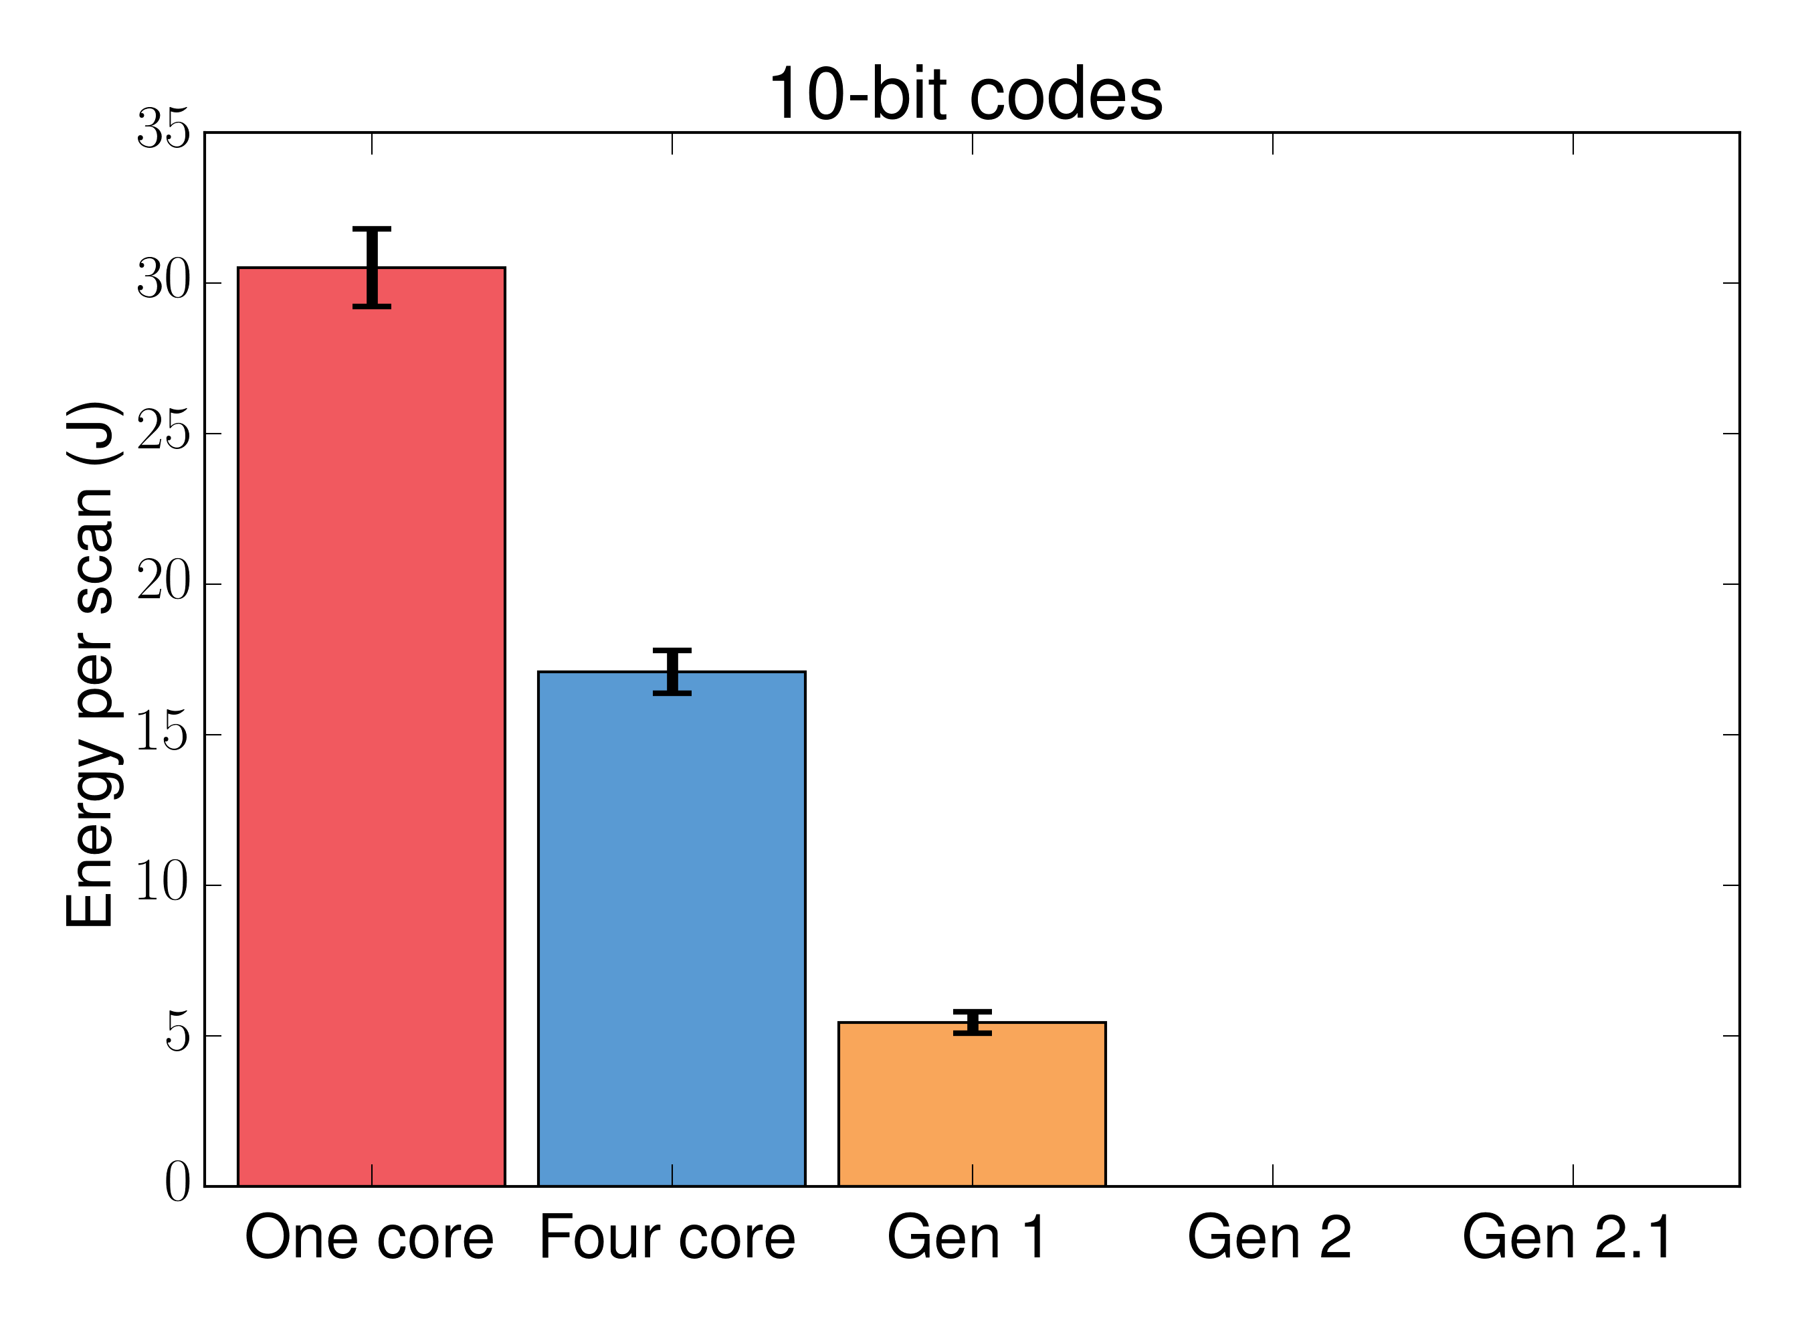
Scan Energy

Slide 26
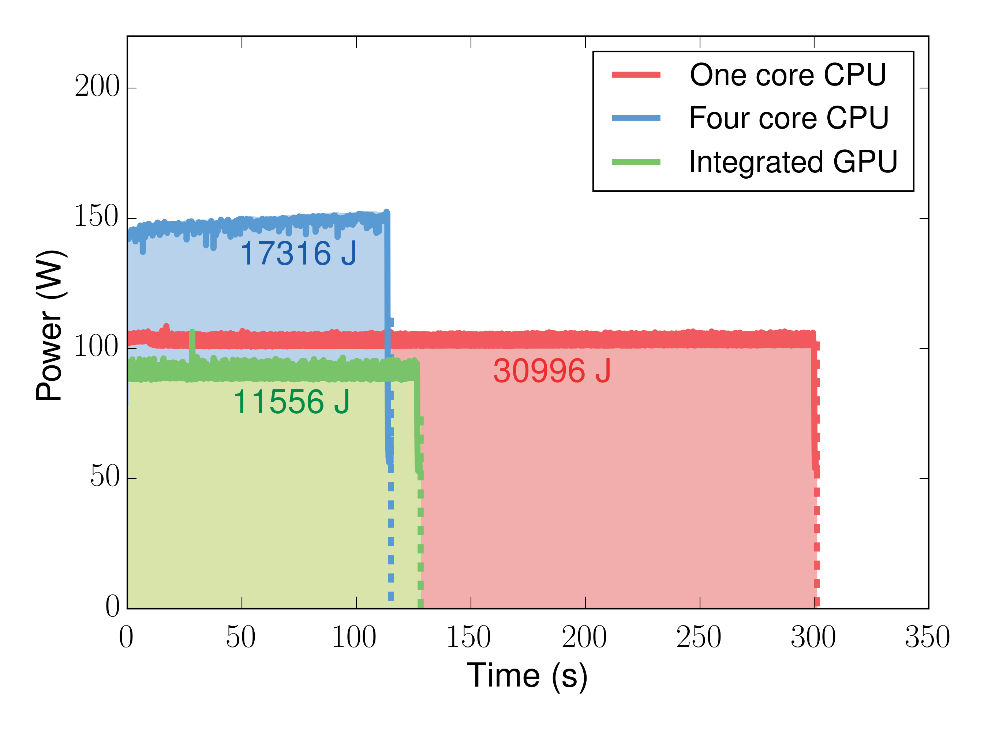
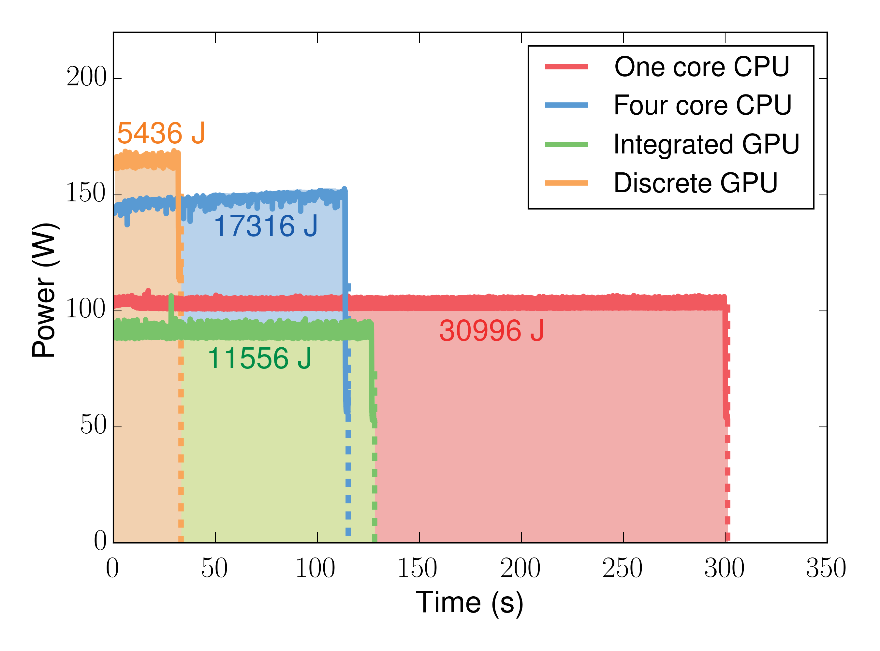
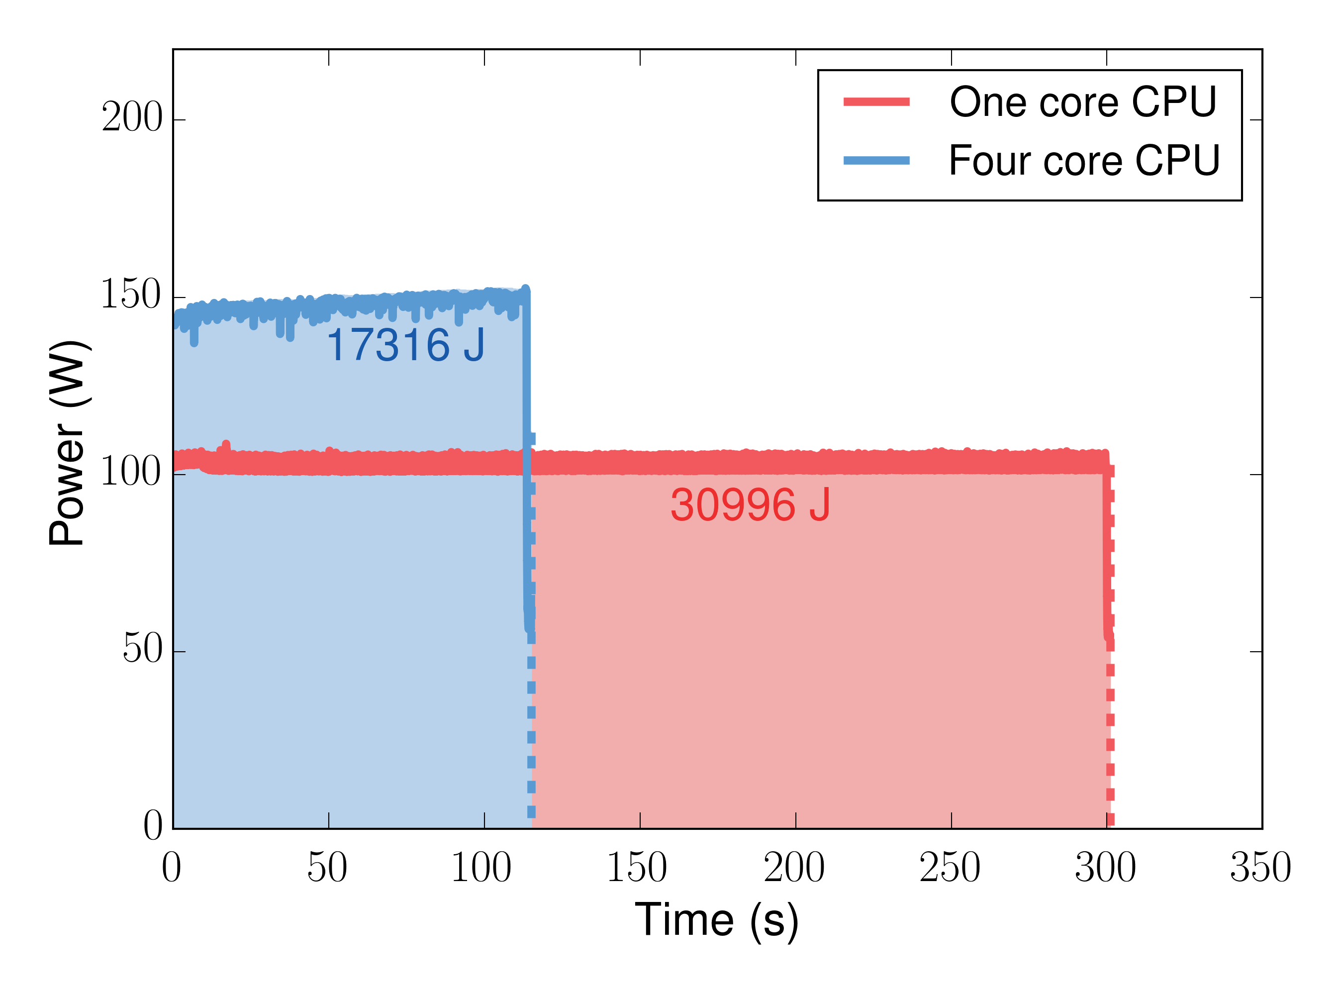
Scan Energy
Notes:
1000 scans of 10-bit codes

Slide 27
TPC-H
Analytic DB benchmark
Evaluated @ 10 GB
16/22 queries
Two main components
Scan time
Other: aggregate, group-by

Slide 28
TPC-H Performance
Query 12 (scan bottom, other top)
Query 7 (scan bottom, other top)

Slide 29
TPC-H Averages
Total query time (scan bottom, other top)
Scan-only time

Slide 30
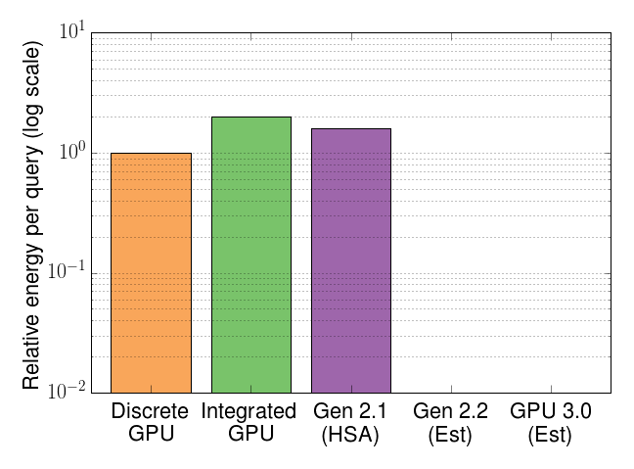
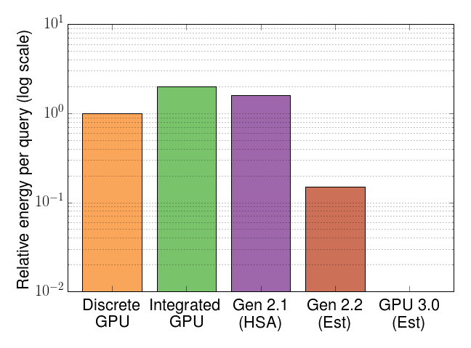
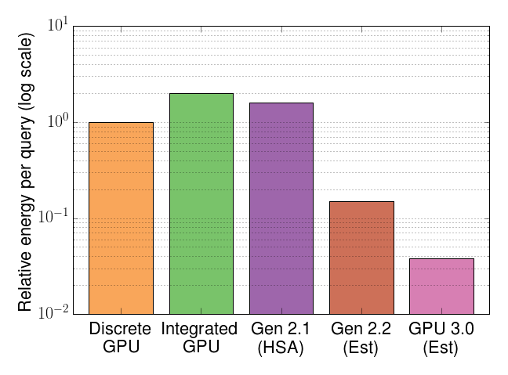
Gen 3 Energy
Memory capacity
Performance
Energy
Overheads
Compute capability
Memory bandwidth

Slide 31
Current Directions
Working with new HSA support
Quite cool
Very early software
Implementing non-scan portion of queries
GPU group-by
GPU aggregation

Slide 32
Conclusions
Analytic DBs important
High performance
Low energy
GPU good for scan-mostly workloads
Future systems make GPGPUs compelling

Slide 33
?

