Slide 1
Bandwidth Optimized DRAM Caches
Jason Lowe-Power Mark D. Hill David A. Wood

Slide 2
Problem
High bandwidth
Low capacity
More compute resources Same number of pins
Die stacking to the rescue?
Limited capacity ☹
Low bandwidth
High capacity
Notes:
For instance, knight’s landing peak FP rate: 3.46 TFLOPS
Bandwidth can’t keep up

Slide 3
Summary
Die-stacked cache: transparent high-bandwidth memory
Caches have “extra” DRAM accesses
Call this: Access Amplification. How Reduce?
Writes: Not writeback ➔ Writethrough ➔ selective writethrough
Insert: Not on miss ➔ on LLC-writeback ➔ on some LLC-writebacks
New mechanism: Laundry list
Tracks and constrains dirty blocks in the cache
Minimizes access amplification without hurting performance
Notes:
Talk about how this compares to using it as a scratchpad

Slide 4
Outline
Background
SRAM cache vs. DRAM cache
Sources of access amplification
Mitigating access amplification
Bandwidth Optimized Design
Results
Conclusion

Slide 5
SRAM Cache
DRAM Cache
Many more sub-banks for max bandwidth
Bank 0
Bank 0
DRAM
Controller
DRAM
Controller
Bank 0
Bank 1
Channel 0
Controller
Channel 1
Controller
Addr
Addr
Bank 2
Bank 3
Channel 2
Controller
Channel 3
Controller
DRAM
Controller
DRAM
Controller
Extra layer of controllers
Bank 0
Bank 0
Notes:
DRAM commands

Slide 6
SRAM Cache Bank
DRAM Cache Channel
Bank 0
Channel 0
Controller
Addr
Addr
Addr
DRAM Controller
Addr
DRAM Bank
Tag
Tag
Tag
Data
Tag
Data
Tag array higher bandwidth
Extra tag accesses interfere with demand

Slide 7
DRAM Cache Design
Reduce latency by storing tags with data [Alloy Cache: Qureshi & Loh]
Non-inclusive, memory-side cache

Slide 8
Read: Cache hit
LLC-read
DRAM-cache read
Tag check
Response
From on-chip LLC
❶
❹
❸
Cache controller
❷
Notes:
Add tag check

Slide 9
Read: Cache miss
LLC-read
DRAM-cache read
Tag check
Main-memory write (if needed)
DRAM-cache write for busy
Main-memory read
DRAM-cache write for fill
Response
From on-chip LLC
❶
❽
❹
❸
Cache controller
❻
❷
❺
❼
Access amplification
Notes:
Add pop-ups to explain each red arrow

Slide 10
Write: Cache hit or miss
LLC-write
DRAM-cache read
Tag check
DRAM-cache write
Main-memory write (if needed)
From on-chip LLC
❶
❺
❸
Cache controller
❷
❹
Must turn around bus from read to write

Slide 11
Access Amplification Effects
Traffic generation with 50-50 read-write ratio and 50% miss ratio
Notes:
Explain how I did this.
Assumes 50% reads 50% dirty and 50% misses
This baseline is like an SRAM cache. Fill on miss and writeback.
Key idea: Remove all of this extra access amplification. We can remove all but the fill requests.

Slide 12
Outline
Background
Mitigating access amplification
Writes: Not writeback ➔ Writethrough ➔ selective writethrough
Insert: Not on miss ➔ on LLC-writeback ➔ on some LLC-writebacks
Design details
Results
Conclusion
❶
❷
❸
❹

Slide 13
❶Writes: Not writeback ➔ Writethrough
LLC-write
DRAM-cache read
Tag check
DRAM-cache write
Main-memory write (if needed)
From on-chip LLC
❶
❺
❸
Cache controller
❷
❹

Slide 14
❶Write: Not writeback ➔ Writethrough
Removes “Tag read on write” and “writeback read” amplification
Traffic generation with 25-75 read-write ratio and 50% miss ratio
Notes:
Mostly writes to make the data more pronounced.
Key thing: This assumes an infinite backing store bandwidth. Not practical!

Slide 15
❷Write: Not writethrough ➔ selective writethrough
Writethrough
Reduces write amplification (no check for dirty cache data)
Pressure on main-memory bandwidth
Best of both writethrough and writeback
Track dirty cache frames in SRAM (no check for dirty data)
Proactively clean the cache when main-memory not busy
How? Laundry list

Slide 16
❸Insert: Not on miss ➔ on LLC-writeback
LLC-read
DRAM-cache read
Tag check
Main-memory write (if needed)
DRAM-cache write for busy
Main-memory read/response
DRAM-cache write for fill
Response
From on-chip LLC
❶
❽
❹
❸
Cache controller
❻
❷
❺
❼
Notes:
Targets tag write for busy and write for fill @ miss time.

Slide 17
❸Insert: Not on miss ➔ on LLC-writeback
Increases “fill write” amplification
Removes “Tag write busy” amplification
Traffic generation with 75-25 read-write ratio and 100% miss ratio

Slide 18
Fill on LLC-write problem
Most “fill writes” are clean WBs to data that is already in the cache.
Traffic generation with 75-25 read-write ratio and 10% miss ratio

Slide 19
❹Insert: Not on LLC-writebacks ➔ on some LLC-writebacks
Fill on miss -> Access amplification (Write busy state to tag)
Fill on LLC-writeback -> Useless clean writebacks
Best of both:
Fill on LLC-writeback, only if data not from cache
Track origin of data in on-chip caches
Detect “likely inclusive” data (it’s OK if we’re wrong)

Slide 20
Outline
Background
Mitigating access amplification
Bandwidth-optimized design
Fill on LLC-Write
Laundry List
Selective writeback
Results
Conclusion

Slide 21
Bandwidth optimized design
Key idea: Only read the tag when reading data Only write the tag when writing data
Fill on LLC-write with likely inclusion detection
Laundry List to track dirty frames in cache
Selective writeback to limit dirty frames in cache

Slide 22
1. Fill on LLC-write
No allocate on miss
Fill on LLC-write like a victim cache
Likely inclusion detection
When DRAM cache responds, set cached bit
Track cached bit in the LLC
On LLC eviction: only send LLC-write if dirty or no cached bit

Slide 23
2. Laundry List
Goal: Remove all tag reads on LLC-write
Store some data in SRAM
Requires: Know when it is safe to write
If the cache frame is clean
If the tag matches
Invariant: Entry in laundry list for every dirty cache frame
Naïve design 1: Dirty bits in SRAM
Area overhead (2 MB for 1 GB)
Still some access amplification
➔Assumes tag miss-match
Naïve design 2: Full Laundry list
Same as SRAM tags
Large area overhead (36 MB)

Slide 24
2. Laundry List
Laundry list design
Goal: Remove all tag reads on LLC-write
Store some data in SRAM
Requires: Know when it is safe to write
If the cache frame is clean
If the tag matches
Invariant: Entry in laundry list for every dirty cache frame
Subset of cache allowed dirty
Workloads are mostly-clean
¼ of the cache in our design
Track “super frames”
Workloads show high locality
16 KB frames in our design
Set associative structure
Any part of the cache can be dirty
930 KB area overhead (< 6% LLC)

Slide 25
3. Selective writeback
Selectively clean lines
Every time a cache frame is read or written, try to clean the frame
On dirty writeback, try writethrough
Only write through if main-memory not saturated
Reduces number of dirty lines and size of laundry list

Slide 26
Outline
Background
Mitigating access amplification
Bandwidth Optimized Design
Results
Microbenchmark
NAS Parallel benchmarks
Conclusion

Slide 27
Methodology
DRAM caches only make sense for large bandwidth-bound workloads
gem5 used for detailed memory system
1. Traffic generation microbenchmark
2. NAS parallel benchmarks (HPC)
These would take years to simulate: Sampling
System parameters: 32 core, 16 MB LLC, 128 GB/s HBM, 25 GB/s DDR3

Slide 28
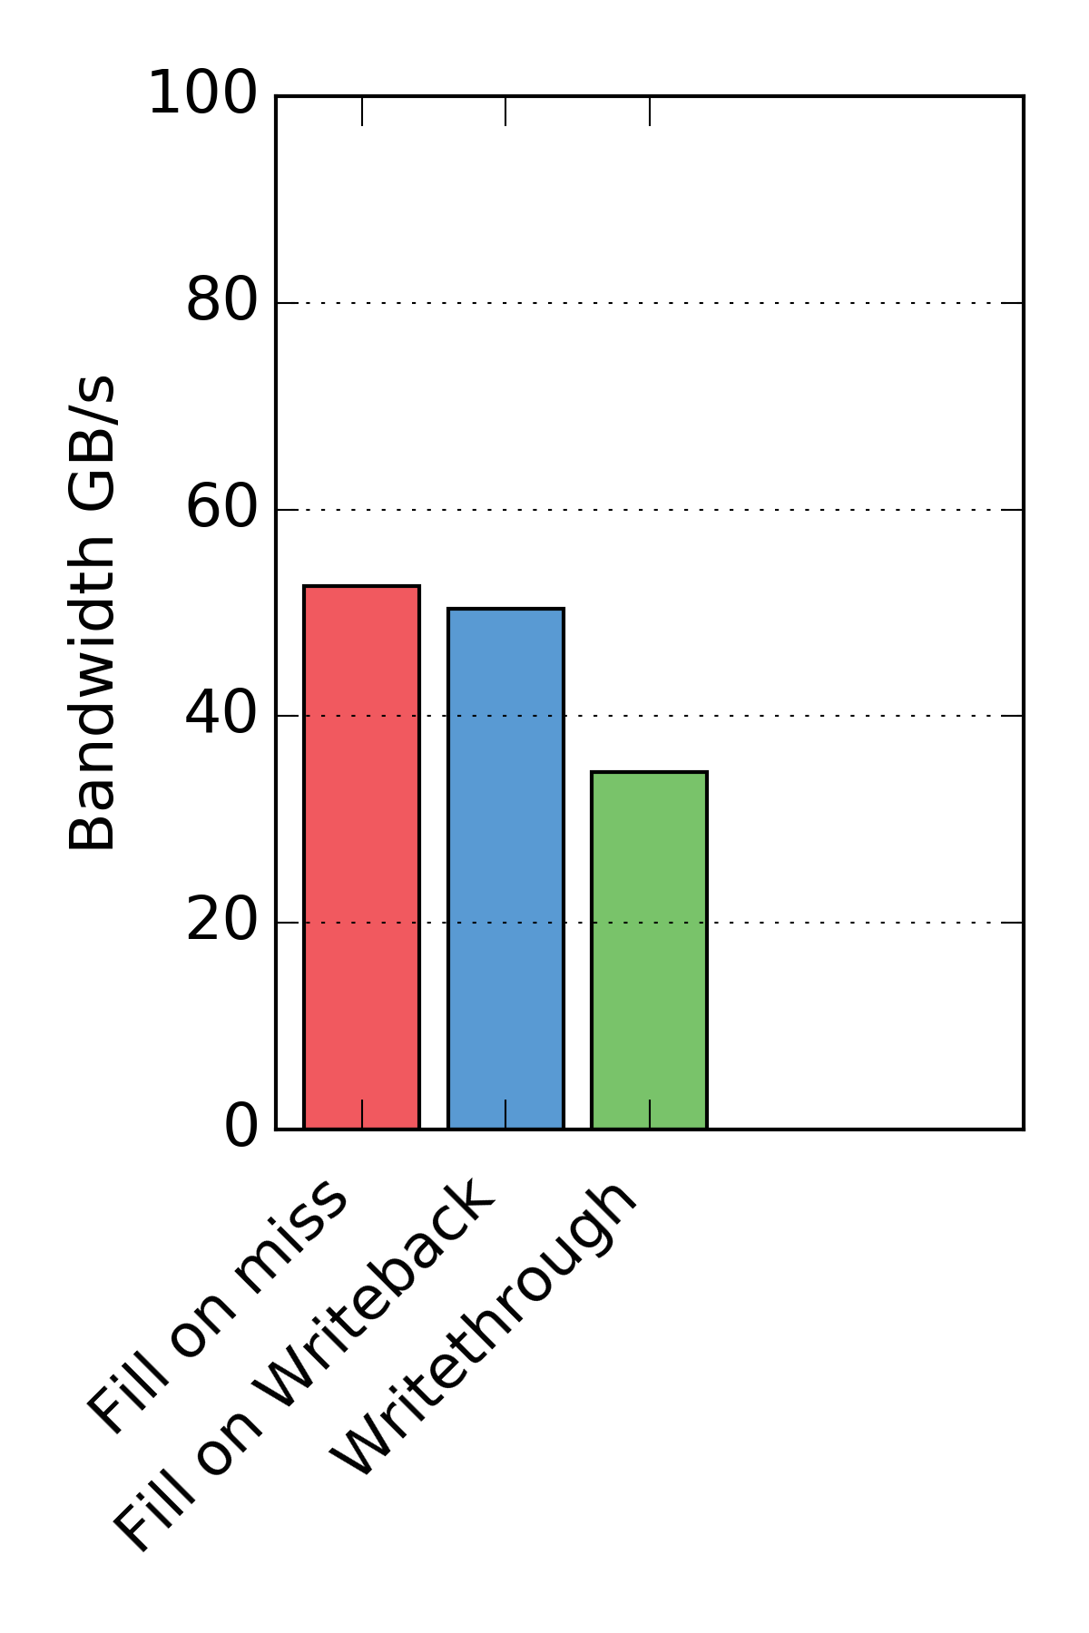
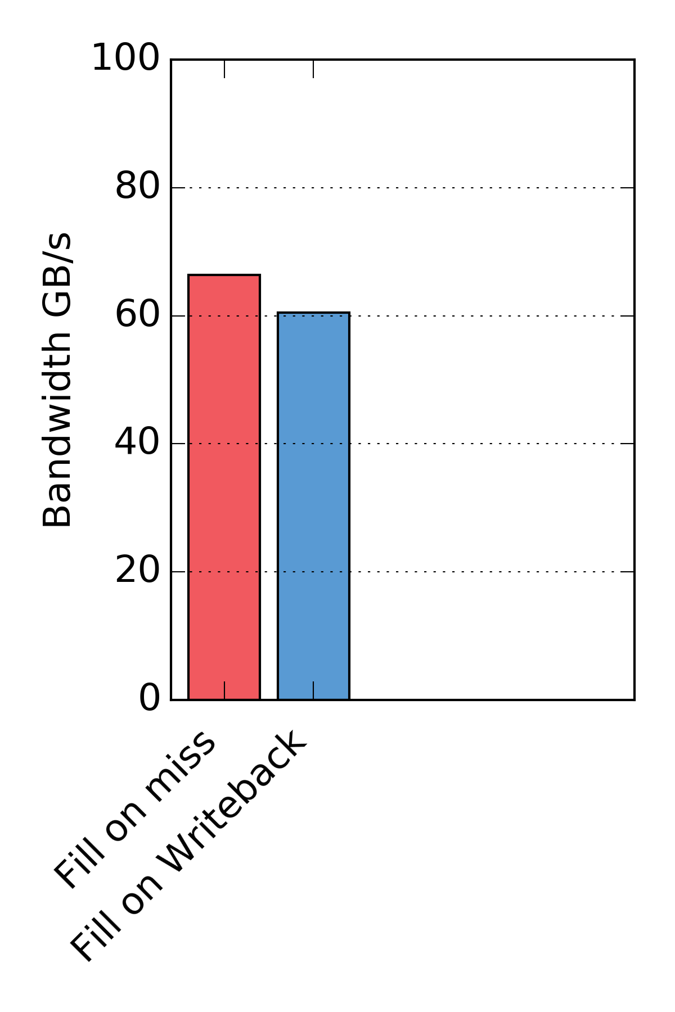
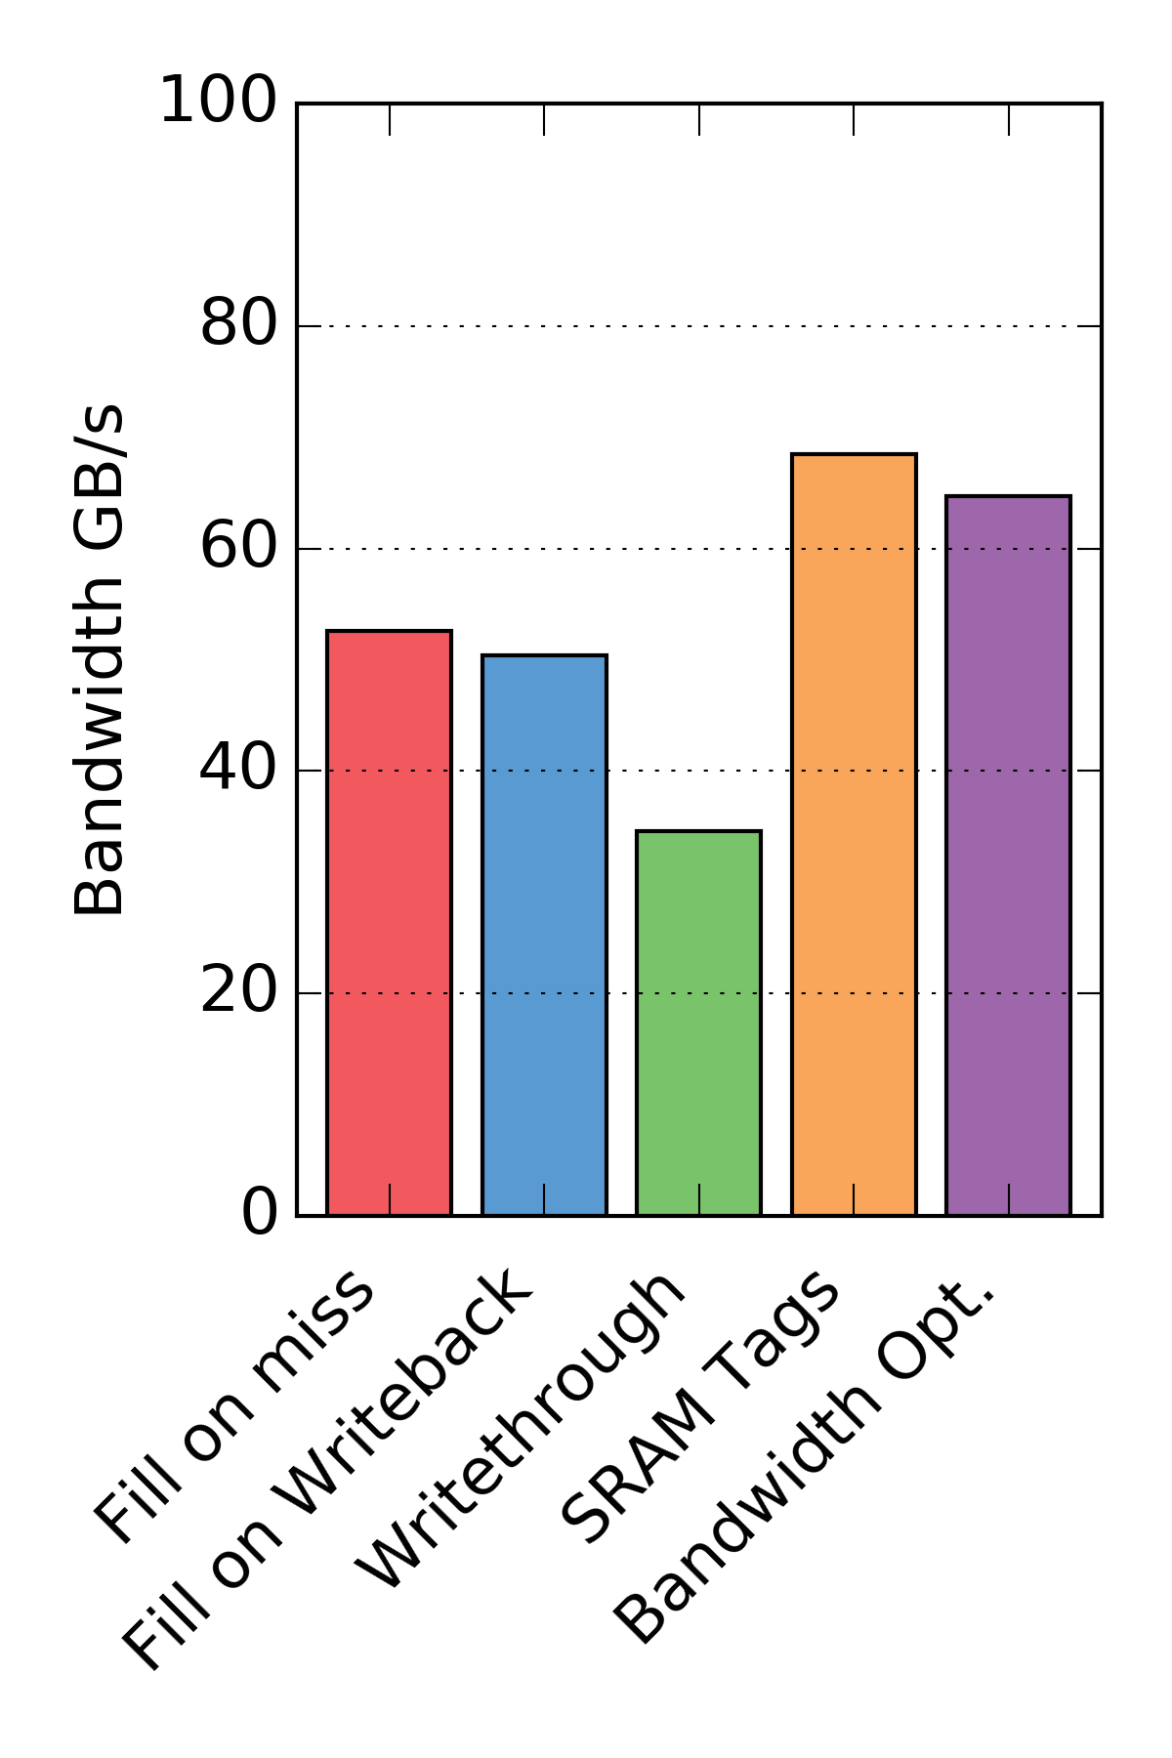
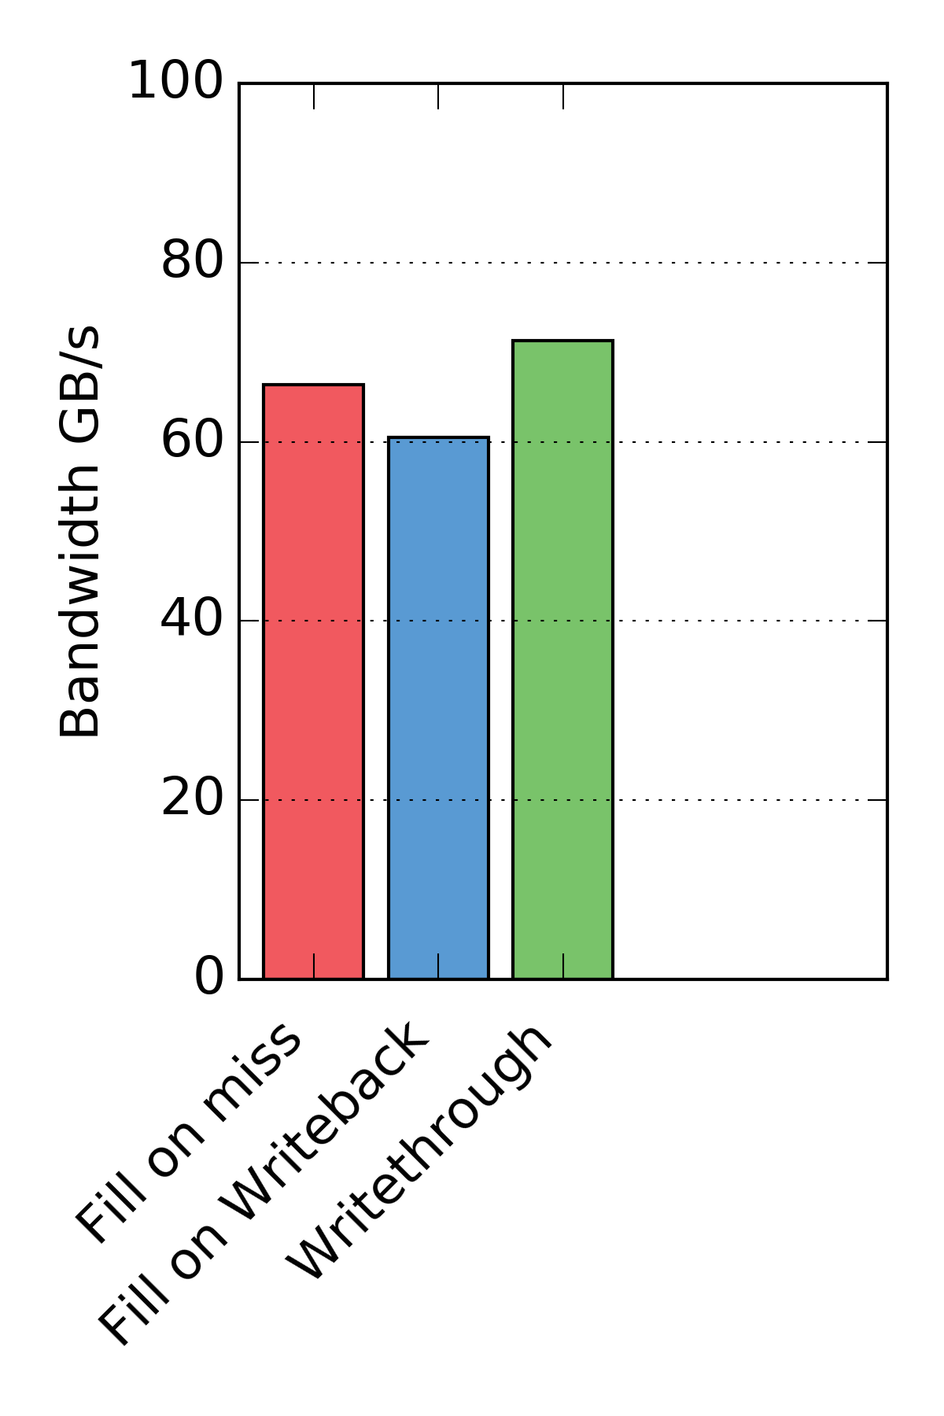
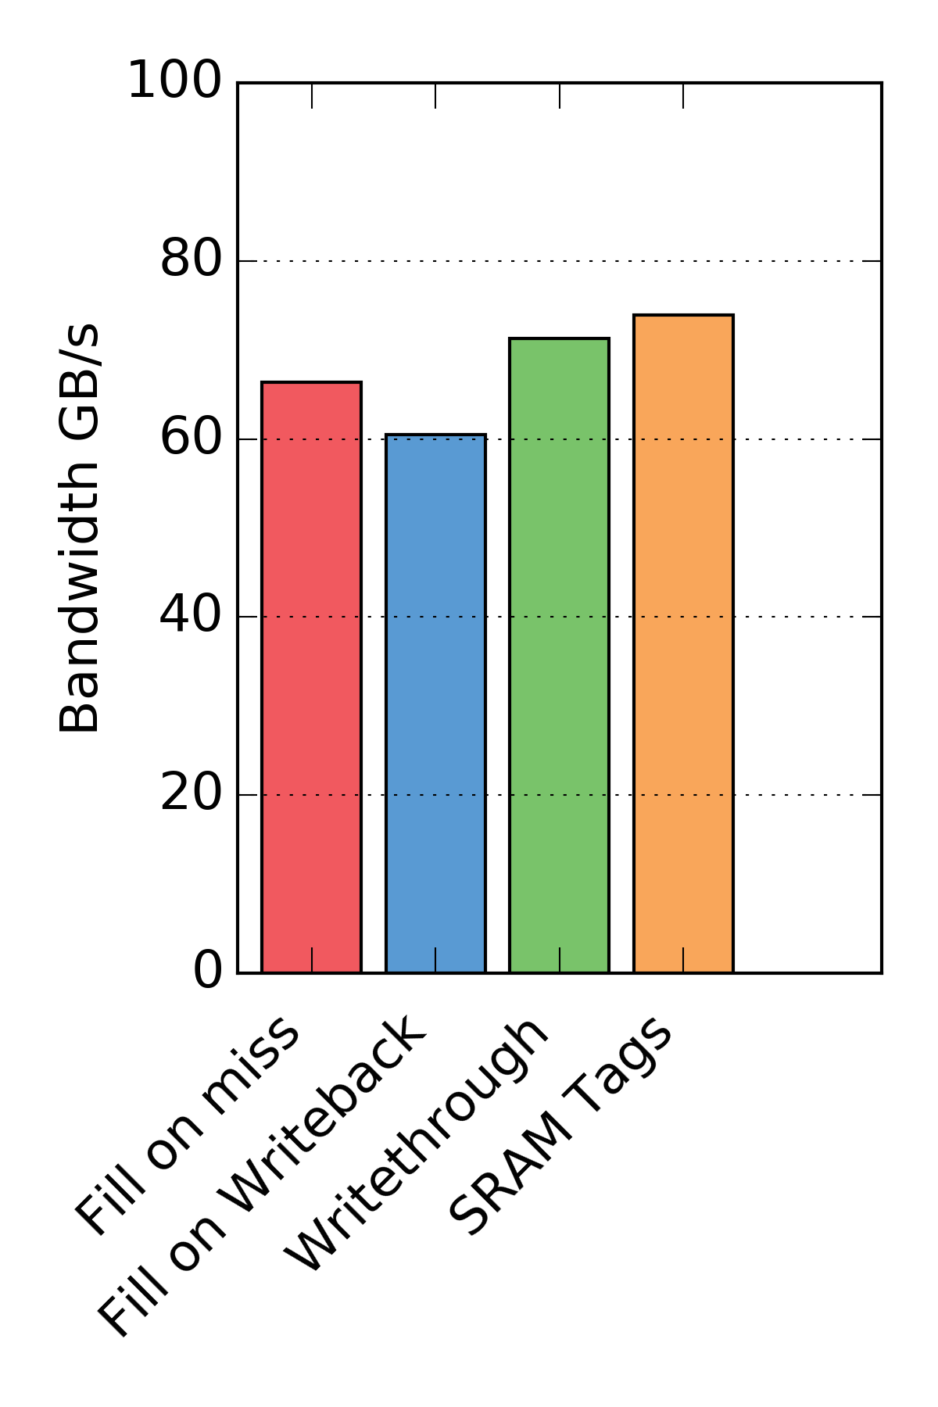
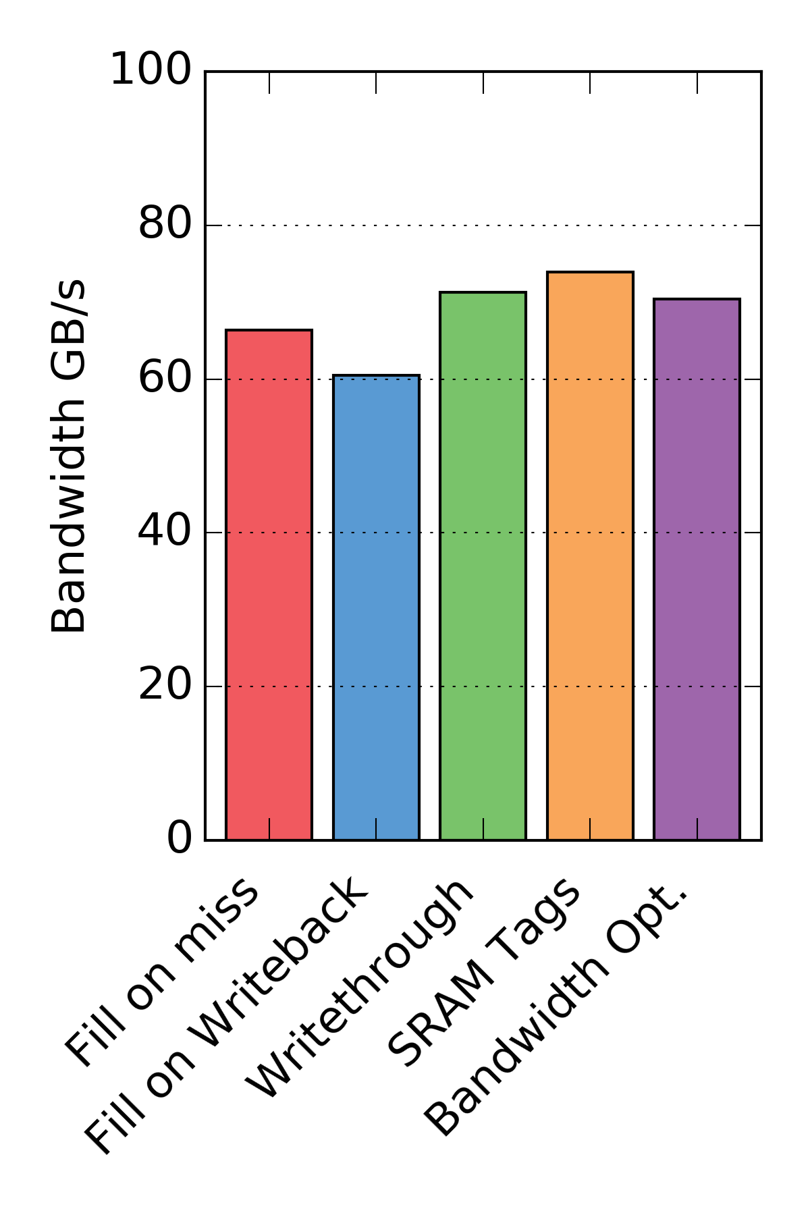
Microbenchmark results
Mostly read (90/10 split)
Many writes (50/50 split)
Writethrough hurts performance: main-memory bandwidth
Writethrough better than writeback designs
Bandwidth Opt. design equal to writethrough
Bandwidth Opt. Better than writeback and writethrough

Slide 29
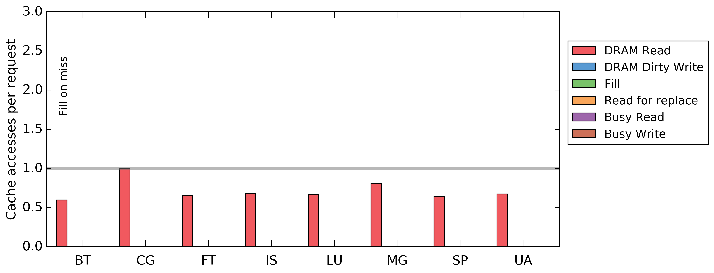
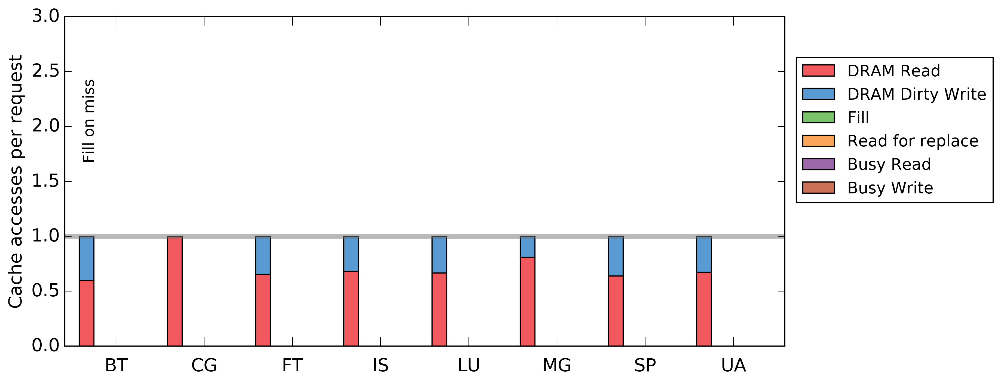
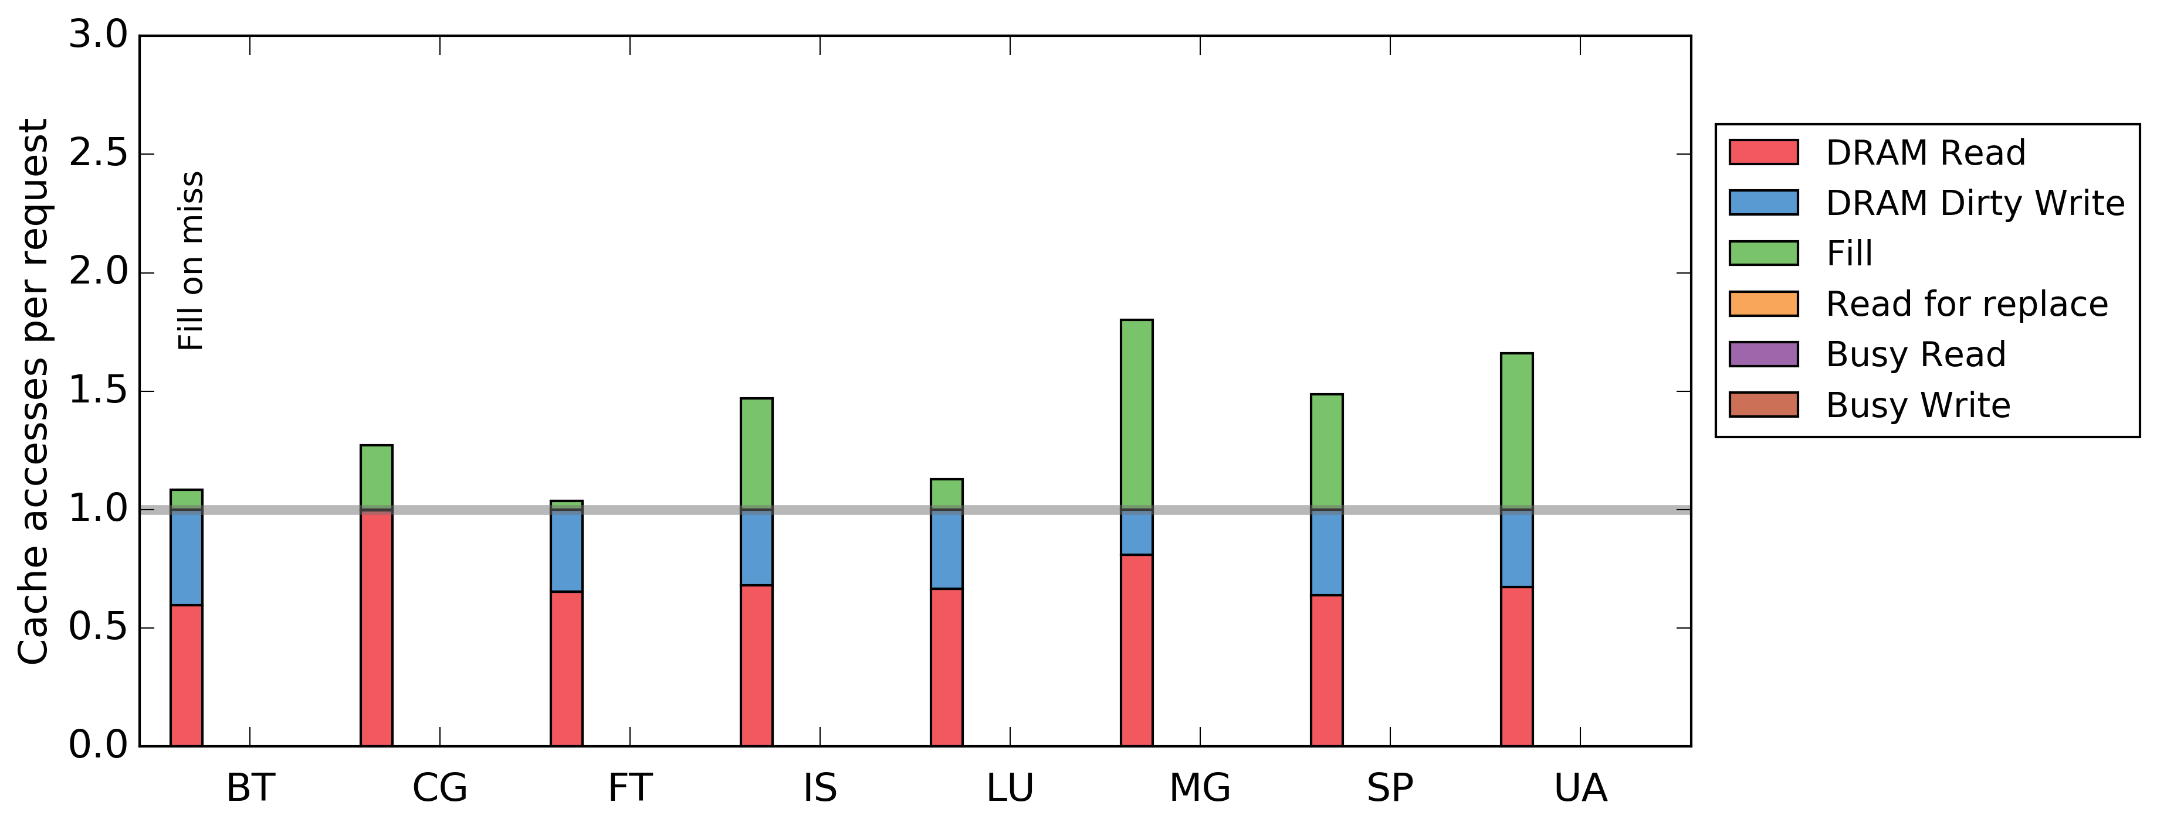
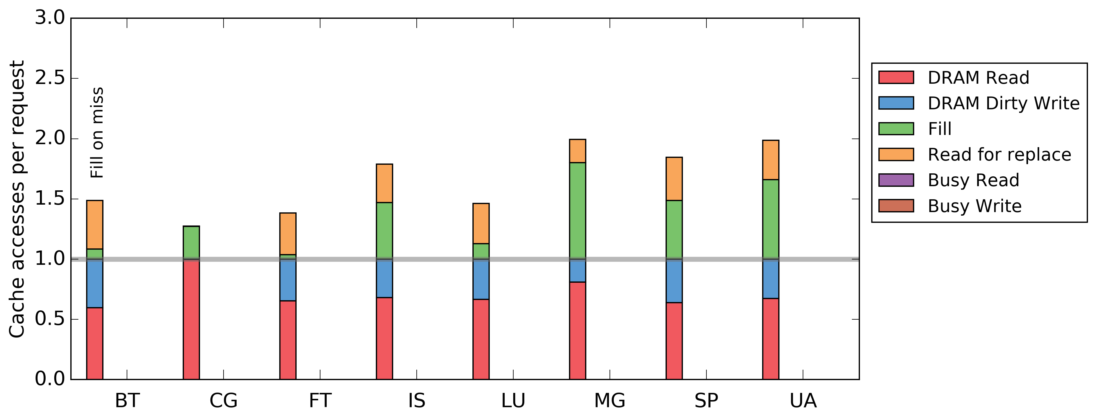
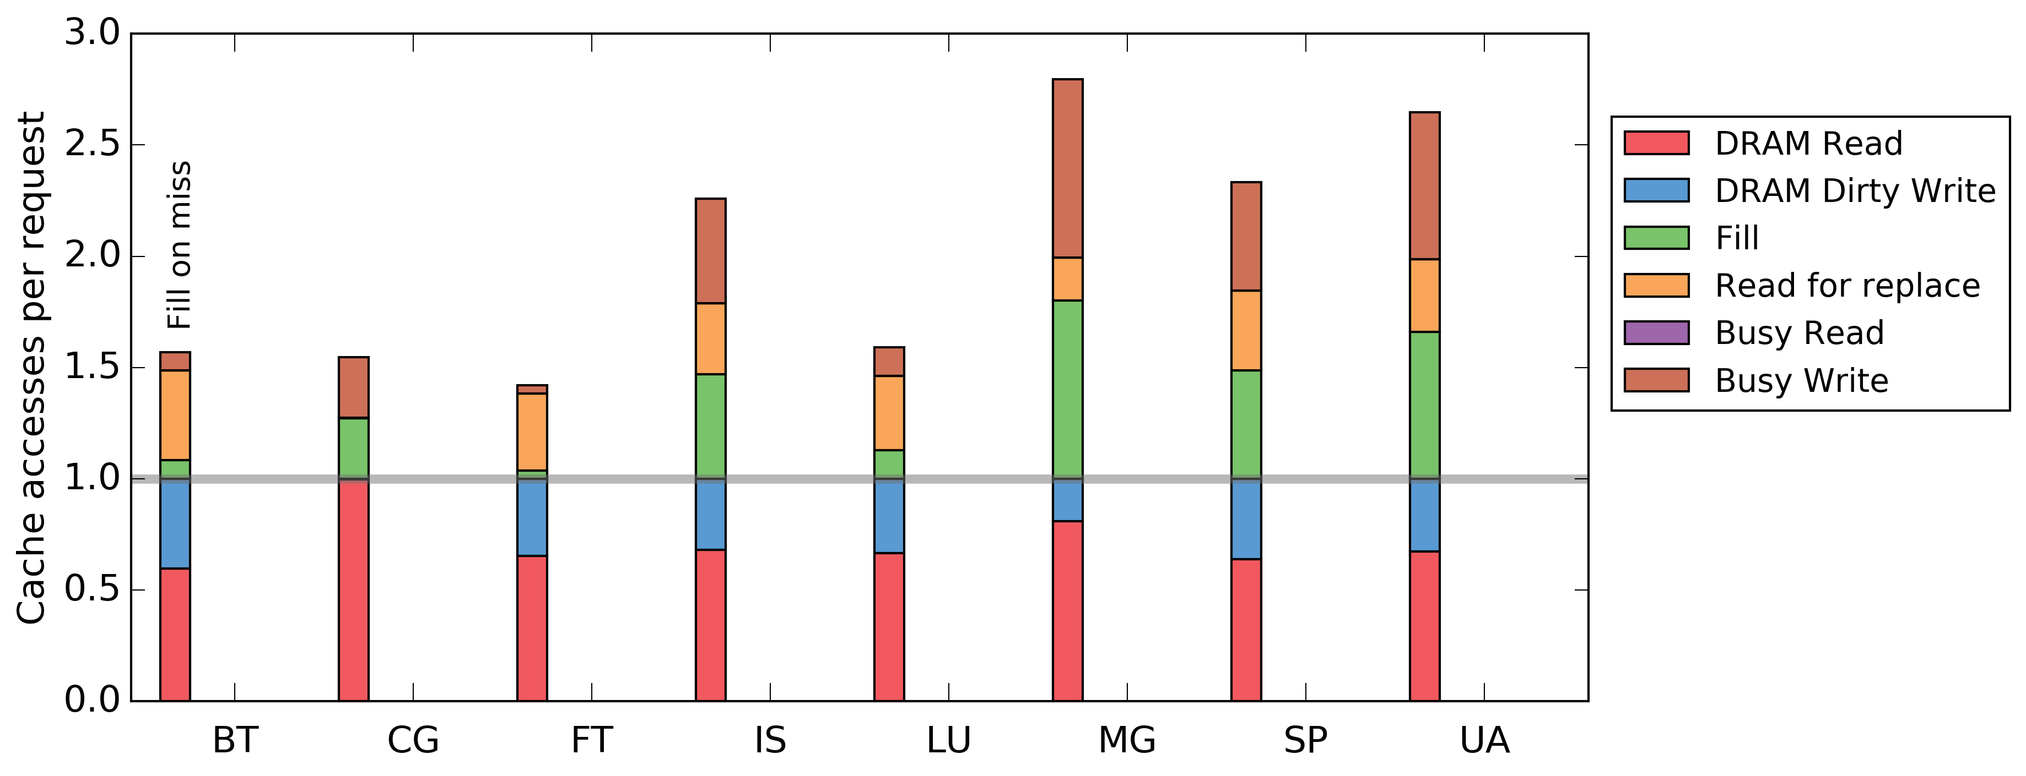
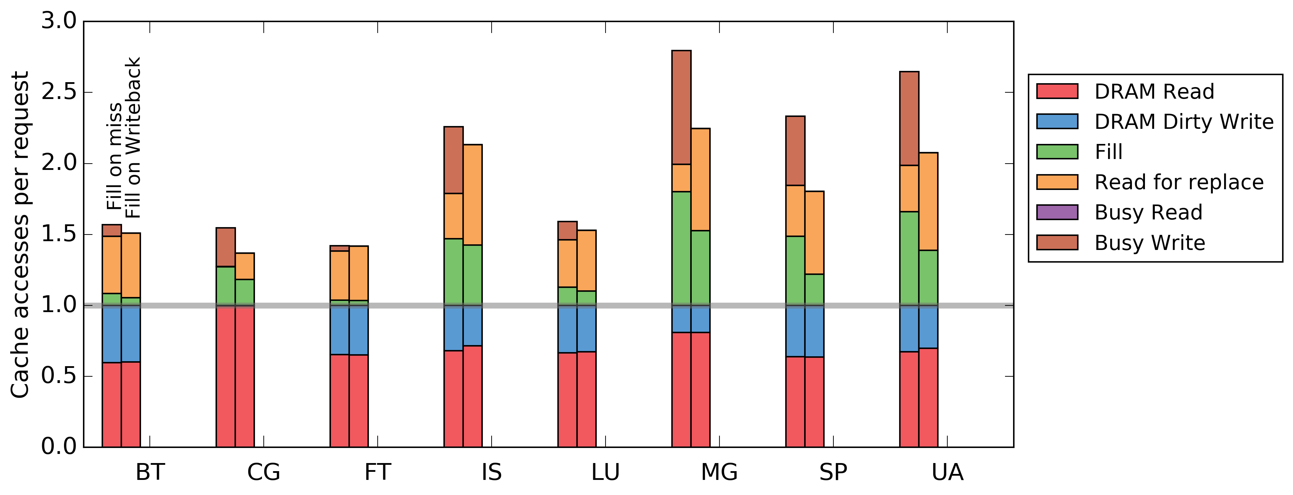
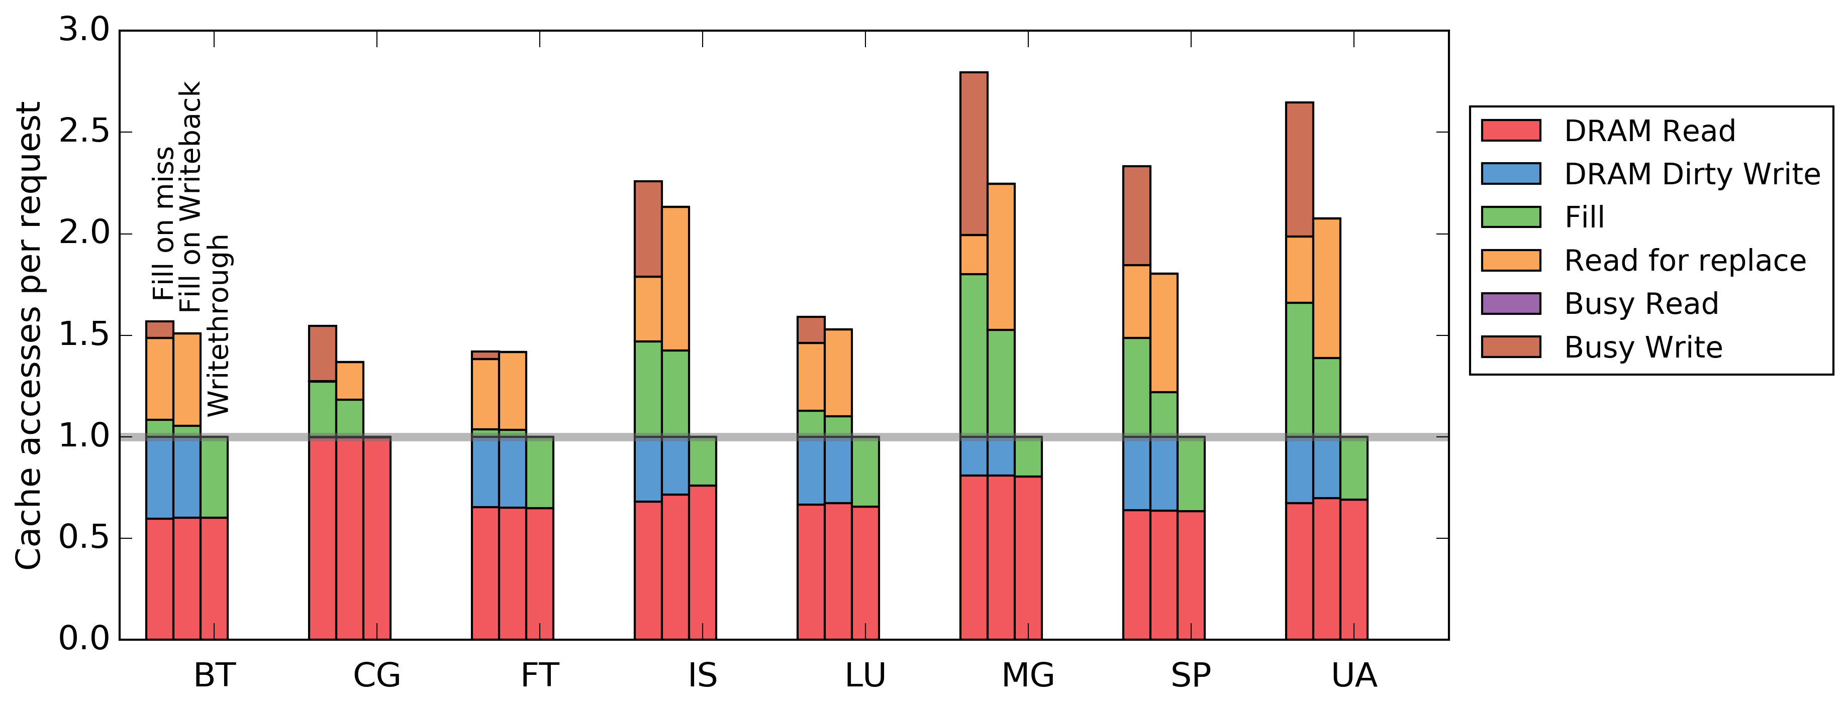
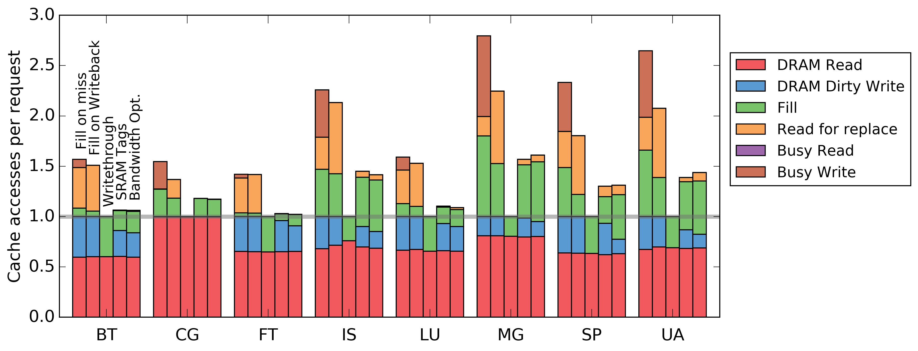
Access amplification reduction
Writethrough: No access amplification
Bandwidth Opt.: Slightly more than SRAM tags
29
Notes:
Start with just workloads. Go through each color of fill on miss, then all of fill on WB, all of WT, then the final two.

Slide 30
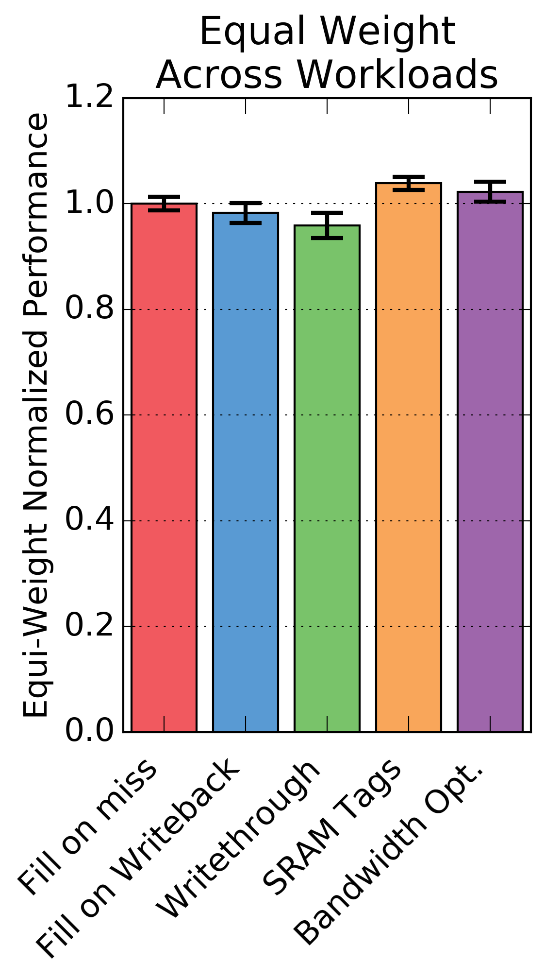
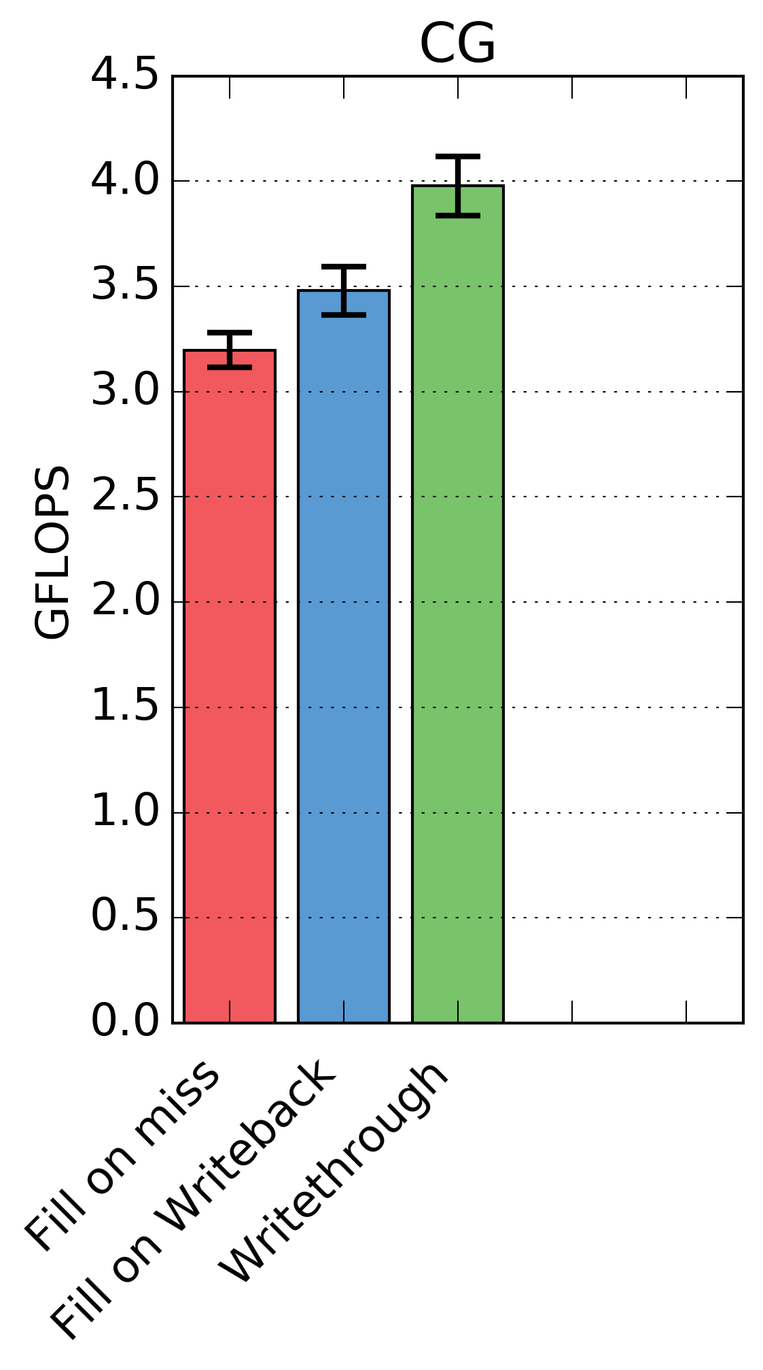
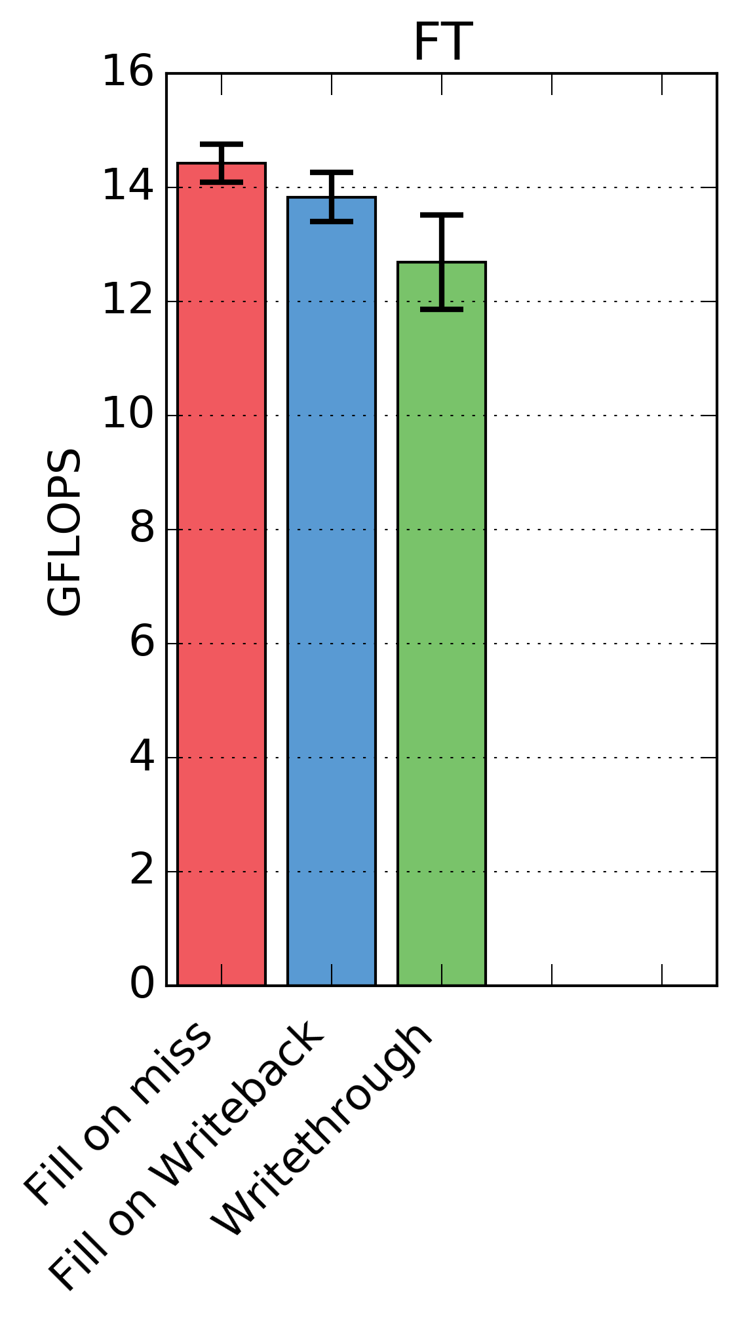
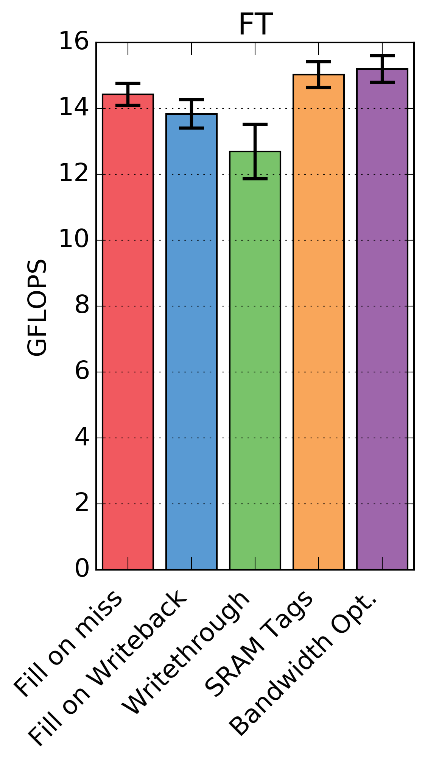
NPB Workloads
Bandwidth Opt. design reduces access amplification increasing performance
Notes:
Note: I can’t really show the average speedup. This would be some insane distribution that I couldn’t even fathom a guess at
Show first three, then BW-opt and SRAM Tags

Slide 31
Conclusions
Optimizing DRAM cache solely for latency leads to poor designs
Access amplification for fills and writebacks
Bandwidth optimized DRAM cache
Fill on write (save busy write)
Track dirty blocks (save read before write)
Adaptive writethrough (keeps cache mostly clean)
Reduces access amplification
Modest performance increase in simulation

Slide 32
Backup slides

Slide 33
2. Laundry list
Laundry List
DRAM Cache
Cache frame
Super frame
number
Super frame
¼ Laundry list 928 KB for 1 GB cache
Physical tag
Super frame tag
Dirty count

Slide 34
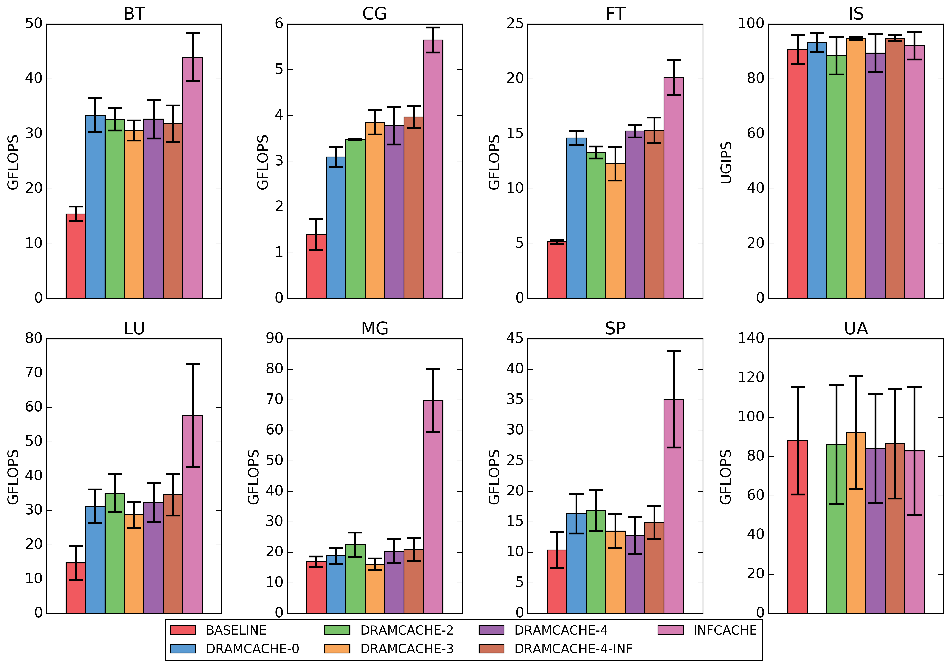
All workloads

Slide 35
Most workloads show high locality

Slide 36
Workloads mostly clean

Slide 37
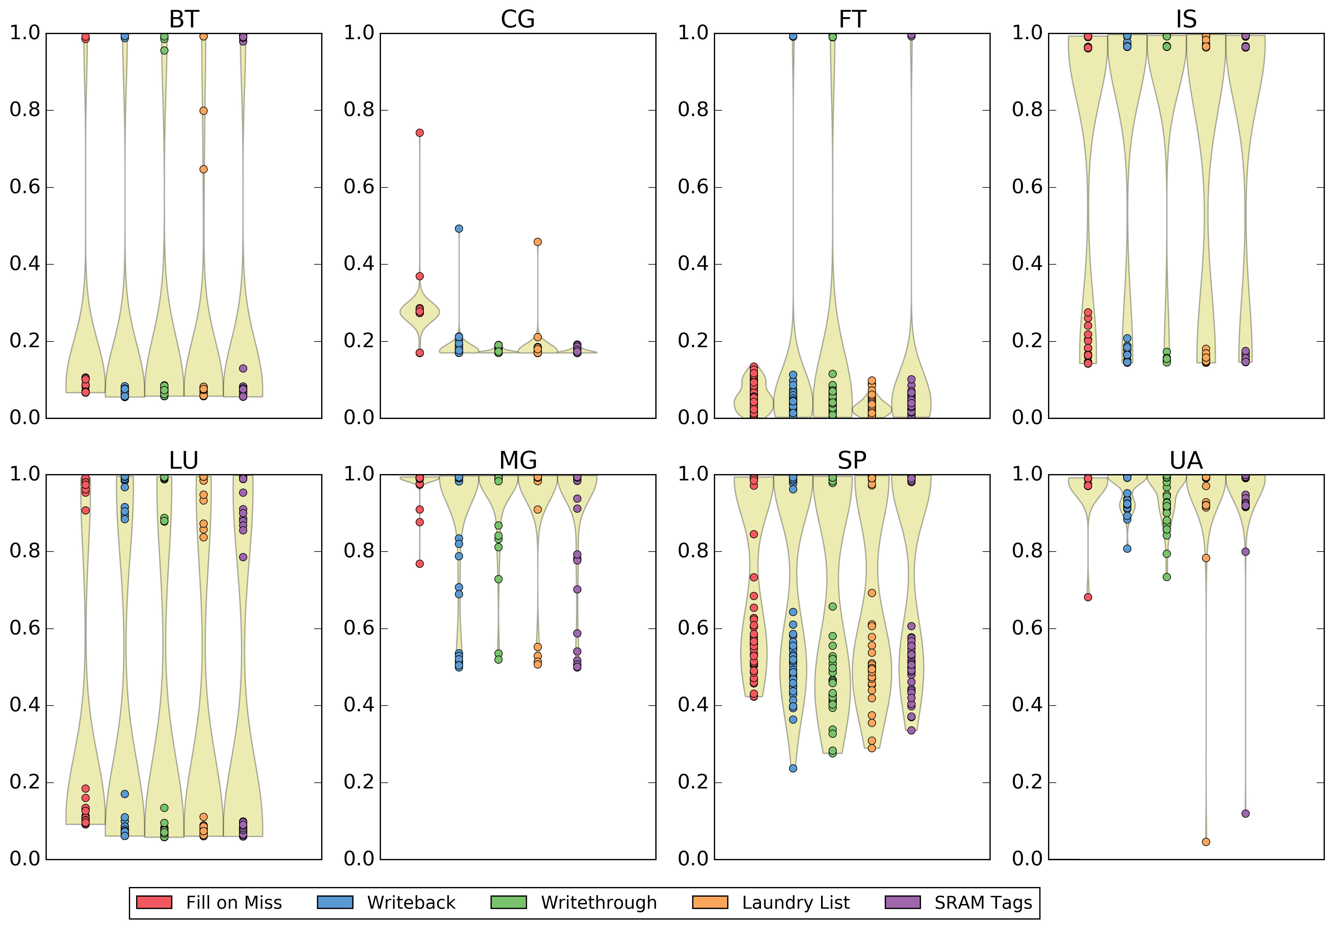
Miss ratio
Distinct phases in applications
Mixture of high and low miss ratios

Slide 38
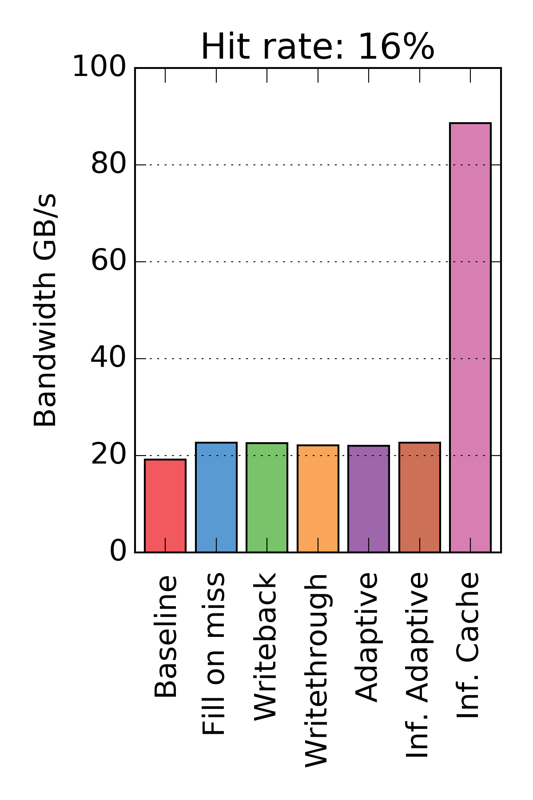
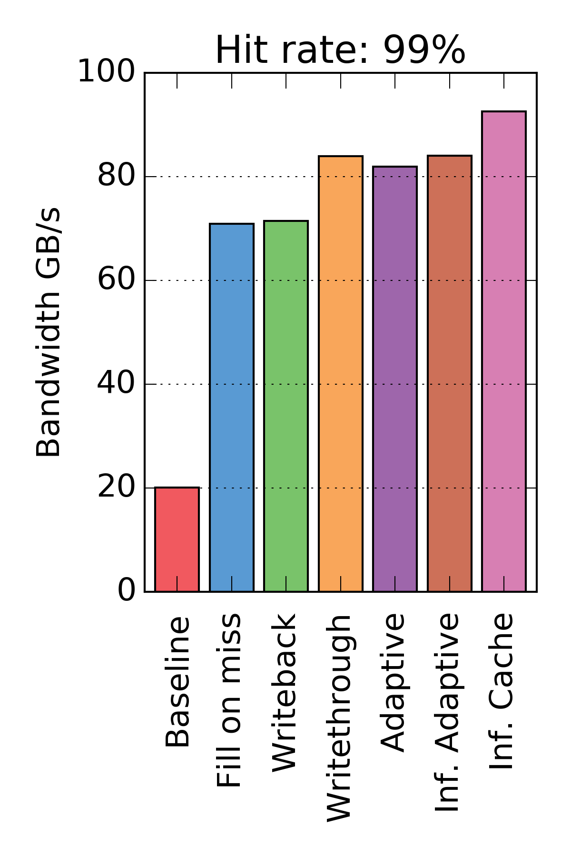
Traffic-gen results
Mostly reads (75/25 split)
All designs about the same at low hit rate
High hit rate: writethrough and adaptive best

Slide 39
DRAM Cache Operation
Shared LLC (SRAM)
LLC-read
LLC-write
Main-memory
read
DRAM-cache controller
Main-memory
write
DRAM-cache read
DRAM-cache write
Cache storage controller

Slide 40
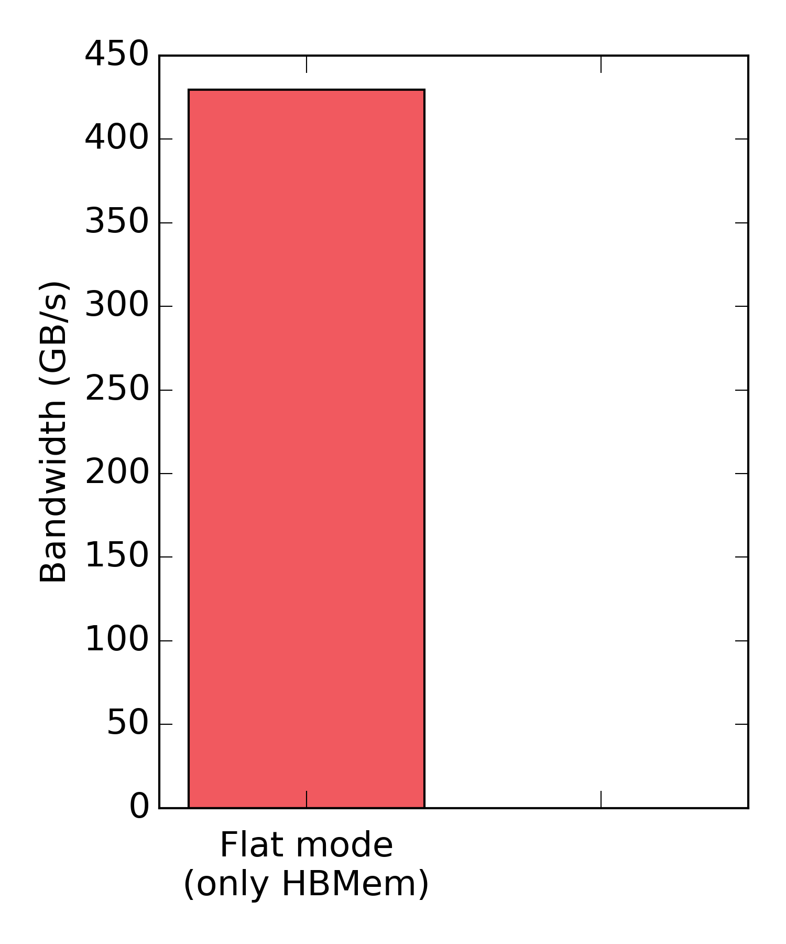
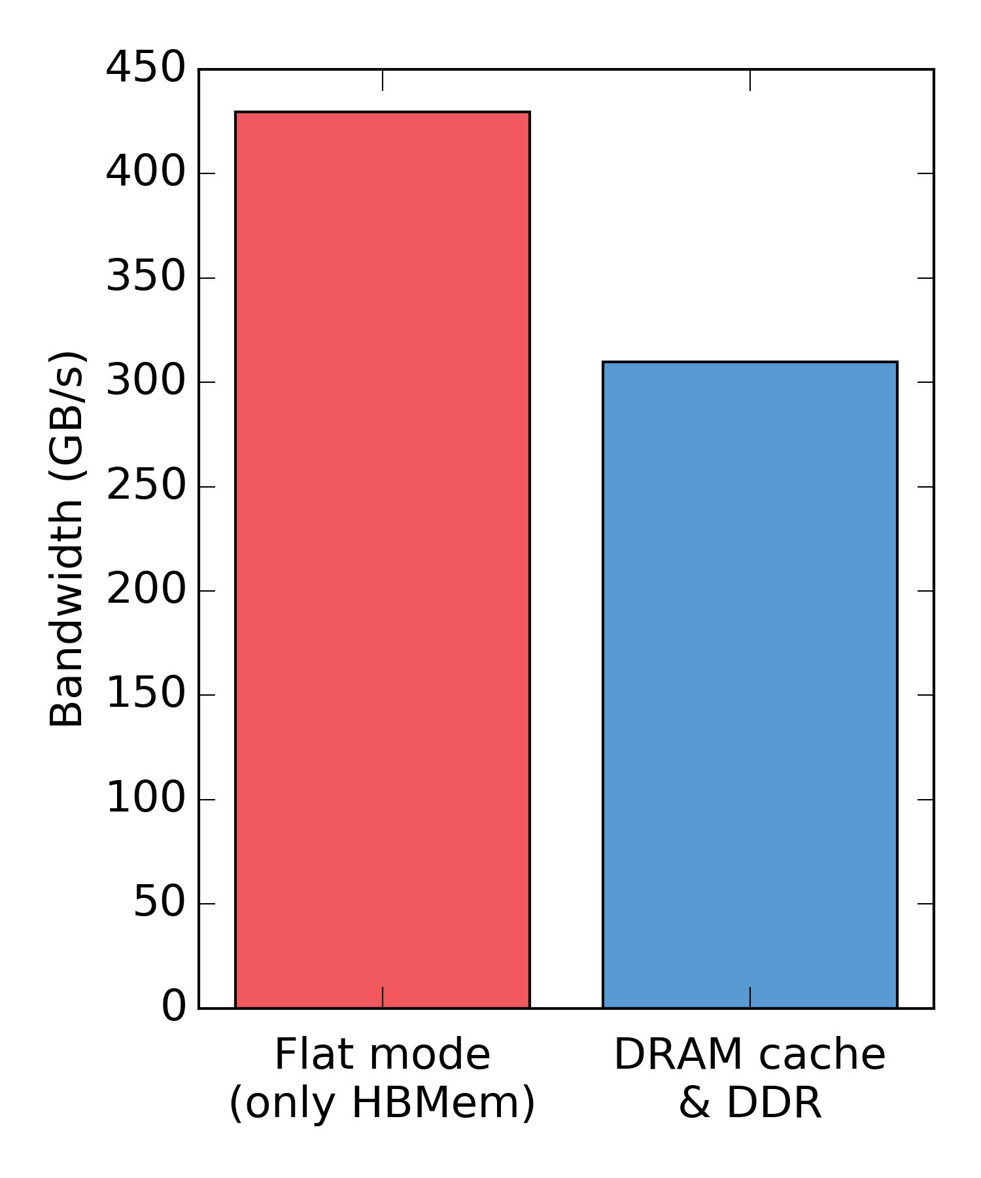
But what about bandwidth?
Let’s look at a real system!
Note: 100% hit rate!
30% reduction in peak bandwidth for transparency
Theoretical overhead of tags: 12.5%

Slide 41
DRAM vs. SRAM caches
Tags
Data

